Slide 1
Big Data Engineering Theory of Scalability
Julie Weeds
March 2020

Slide 2
Contents
Distributed Computing
Scalability
Virtualization
Multi-tenancy
Amdahl’s Law and Gustavson’s Law
Karp-Flatt Metric
Shared Nothing Architectures
CAP Theorem
Eventual Consistency

Slide 3
Fundamental problems in Distributed Computing
Efficient distribution of work
combatting serialization
Serialization is when work happens serially rather than in parallel
Consensus
combatting failure

Slide 4
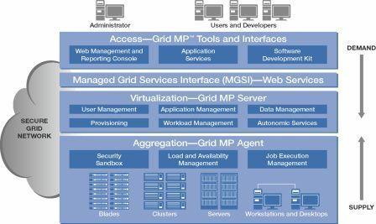
Grid Computing

Slide 5
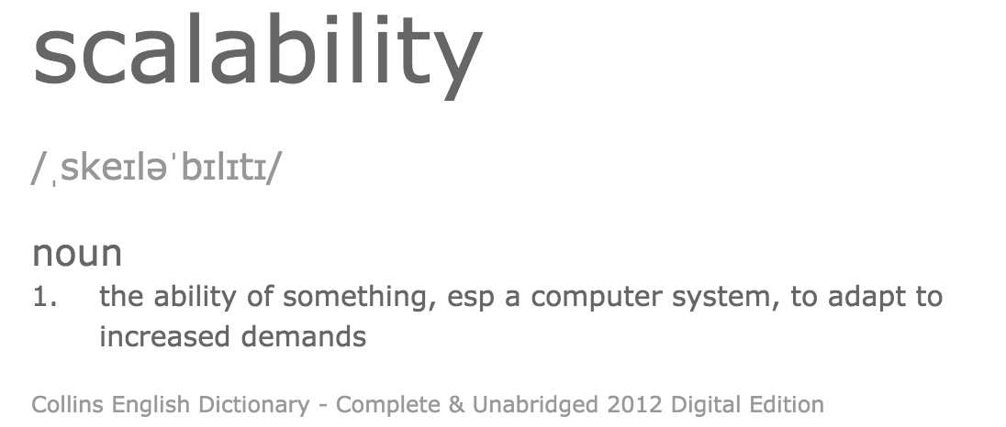

Slide 6
Speedup
The speedup is defined as the performance of new / performance of old
e.g. move from 1 -> 2 servers
New system is 1.8 x faster than the old
In terms of transactions/sec (throughput)
Speedup = 1.8

Slide 7
What inhibits speedup?
In general you can split work into
Parallelizable and
Serial parts
The serial parts stop you from scaling

Slide 8
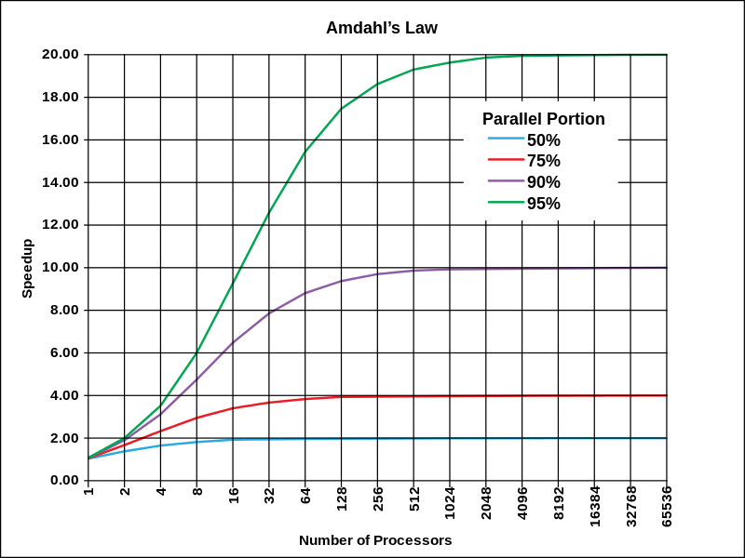
Amdahl’s Law Theoretical speedup given a fixed data size
The speedup of a program using multiple processors in parallel computing is limited by the time needed for the serial fraction of the program, given a fixed size of data

Slide 9
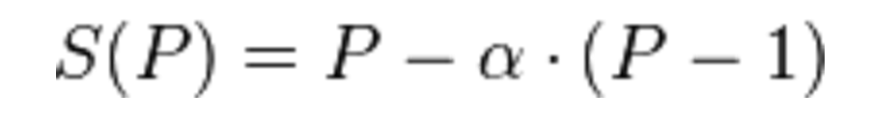
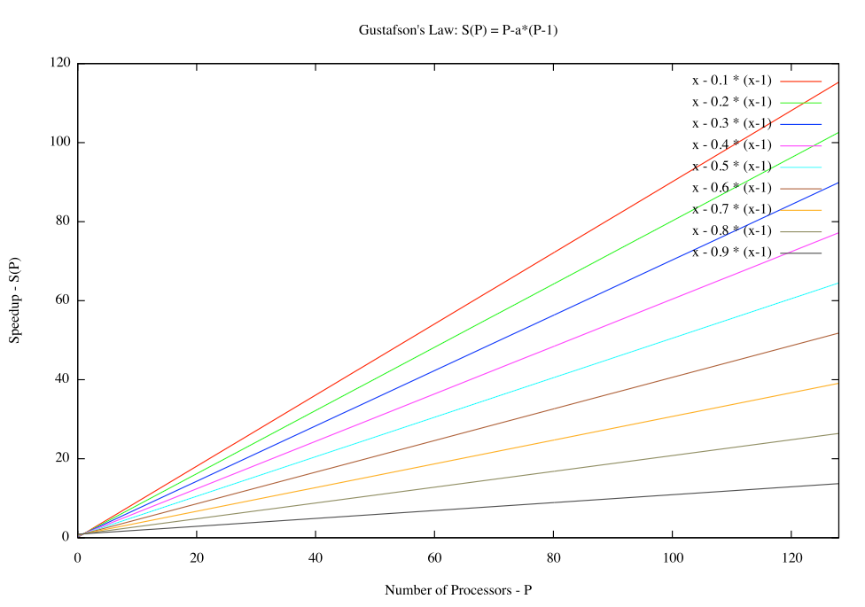
Gustafson’s Law What if the data increases too?
α is the largest
non-parallelizable fraction

Slide 10
A driving metaphor
Amdahl’s Law
You are travelling to London (60 miles)
30 miles in, you have taken one hour
You can never average > 60 mph
Gustafson’s Law
You are travelling across the US
You’ve spent an hour at 30 mph
You can achieve any average speed given enough time and distance

Slide 11
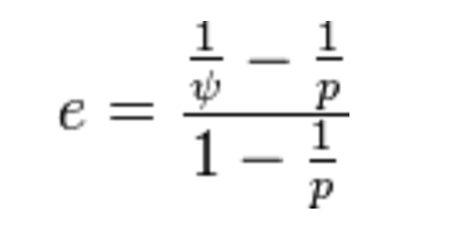
Karp-Flatt Metric
e is the Karp-Flatt Metric
ψ is the speedup
p is the number of processors
e = 0 is the best
e = 1 indicates no speedup
e > 1 indicates adding processors
slows down the system!!!
Notes:
psi = speedup

Slide 12
Karp-Flatt Metric Example
ψ =2
p = 2
e = 0
ψ =2
p = 10
e = 4/9
e = 0 is the best
e = 1 indicates no speedup
e > 1 indicates adding processors
slows down the system!!!
ψ =0.5
p = 10
e = 19/9
Notes:
psi = speedup

Slide 13
Karp-Flatt metric
e=0
e=0.3
Performance
e→1 as p increases
1 server
1 server
Number of servers

Slide 14
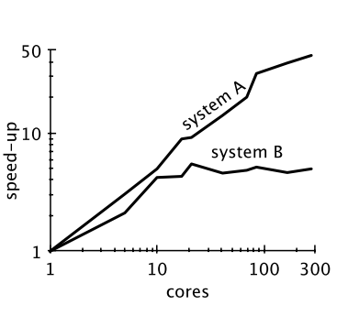
Warning
Notes:
Speed-up isn’t everything

Slide 15
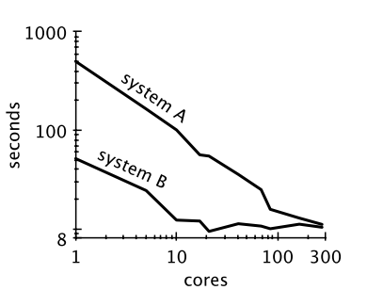
Same systems, new diagram
Notes:
System B was able to achieve same speed as system A with less cores so is actually better

Slide 16


Shared Nothing Architecture
Server
Disk
Load Balancer
Server
Disk
Server
Disk

Slide 17
Shared Nothing Architecture
Implies there is no serial part to the computation
Karp-Flatt Metric of 0
Assuming 100% efficient load balancing
In practice, this is difficult!

Slide 18
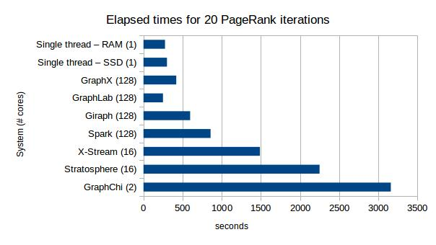
Scalability at what COST
COST = Configuration that Outperforms a Single Thread
http://www.frankmcsherry.org/assets/COST.pdf
http://www.frankmcsherry.org/graph/scalability/cost/2015/01/15/COST.html
Notes:
Parallelization can slow things down!

Slide 19
Data partitioning
Data centres scale horizontally not vertically
Partition data horizontally
different rows of a table stored on different nodes

Slide 20
Data Partitioning / Sharding
A-I
Server
Disk
J-R
Load Balancer
Server
Disk
S-Z
Server
Disk

Slide 21
Problems with Sharding
Imbalance
Fewer S-Z’s than A-I’s
Failover
what happens if one of the servers crashes?
Adding new servers requires a re-balance
Is this automatic or manual?!

Slide 22
Data Validity
What properties should database transactions have to ensure validity in the case of power failures or errors?
Transferring money from one bank account to another
what if there is a power outage mid-transaction?
How does this work at scale? In data centres?

Slide 23
ACID
atomicity
all-or-nothing
consistency
integrity-preserving: invariants satisfied
isolation
concurrent execution is the same as sequential execution
hidden intermediate results
multi-user behaviour consistent with single-user mode
durability
permanent committed results

Slide 24
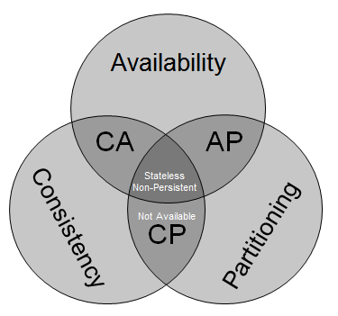
CAP Theorem
Originally proposed by Eric Brewer
Proved in 2002 by Gilbert and Lynch
You can have 2 out of three:
Consistent
every read receives the most recent write or an error
Available
every request gets a (non-error) response
Partition tolerance
system continues to operate despite an arbitrary number of messages dropped (or delayed) between nodes
http://blog.mccrory.me/2010/11/03/cap-theorem-and-the-clouds/

Slide 25
Imagine two nodes
Update
Node 1
Node 2
Propagate
Potential Network Partition
Network partition occurs if the network switch device between two subnets fails.

Slide 26
Imagine two nodes
Update
Node 1
Node 2
Propagate
Potential Network Partition
If there is a partition, then you can either update one node (give up on Consistencey), or make one node unavailable (give up on Availability). If you want C and A you can’t allow a Partition.

Slide 27
CAP options
CA
Traditional databases
Cannot be scaled multi-datacentre or work in cases of high-latency
AP
Multi-master NoSQL databases
Dynamo, Cassandra, CouchDB
Not consistent but work across datacentres in a highly available model
CP
Not a good idea, as not available!
Notes:
latency = delay times
high-latency = long delays

Slide 28
CAP Theorem
The proof requires some complex definitions of C, A and P
I recommend reading Brewer’s update:
http://www.infoq.com/articles/cap-twelve-years-later-how-the-rules-have-changed
“The 2 of 3 formulation was always misleading”
“CAP prohibits only a tiny part of the design space”

Slide 29
In real life
Network partitions are rare
So we can implement a strategy:
Detect a partition
Enter “partition mode”
Carry on with inconsistency
Recover when partition vanishes
Known as “eventually consistent”

Slide 30
What does recovery mean?
Depends on your database and requirements
E.g. Amazon’s shopping cart is made consistent by creating the union of the inconsistent carts
Deleted items may re-appear
Another option is to forbid certain operations during partition mode
To make it easier to recover consistency
A simplistic approach would be to go read-only

Slide 31
What does that mean in real-life?
Databases like Cassandra let you “tune” consistency and availability
Define the quorum you need for a response
Trades off latency vs consistency
Choose an “easy quorum” for guaranteed low latency / high availability (but low consistency)
Choose a “hard quorum” for high consistency but higher potential latency / lower availability
Notes:
hard quorum e.g., all --> write must be made to all nodes → high consistency, low availability (higher potential latency)
easy quorum e.g., any → write must be made to any node -> low consistency, high availability (guaranteed low latency)

Slide 32
PACELC (pr. pass-elk)
Partition: Availability vs Consistency, Else Latency vs Consistency
“For data replication over a WAN, there is no way around the consistency/latency tradeoff”
Usually a combination of sync/async
Synchronous writes to n systems followed by asynchronous writes to m systems
http://cs-www.cs.yale.edu/homes/dna/papers/abadi-pacelc.pdf

Slide 33
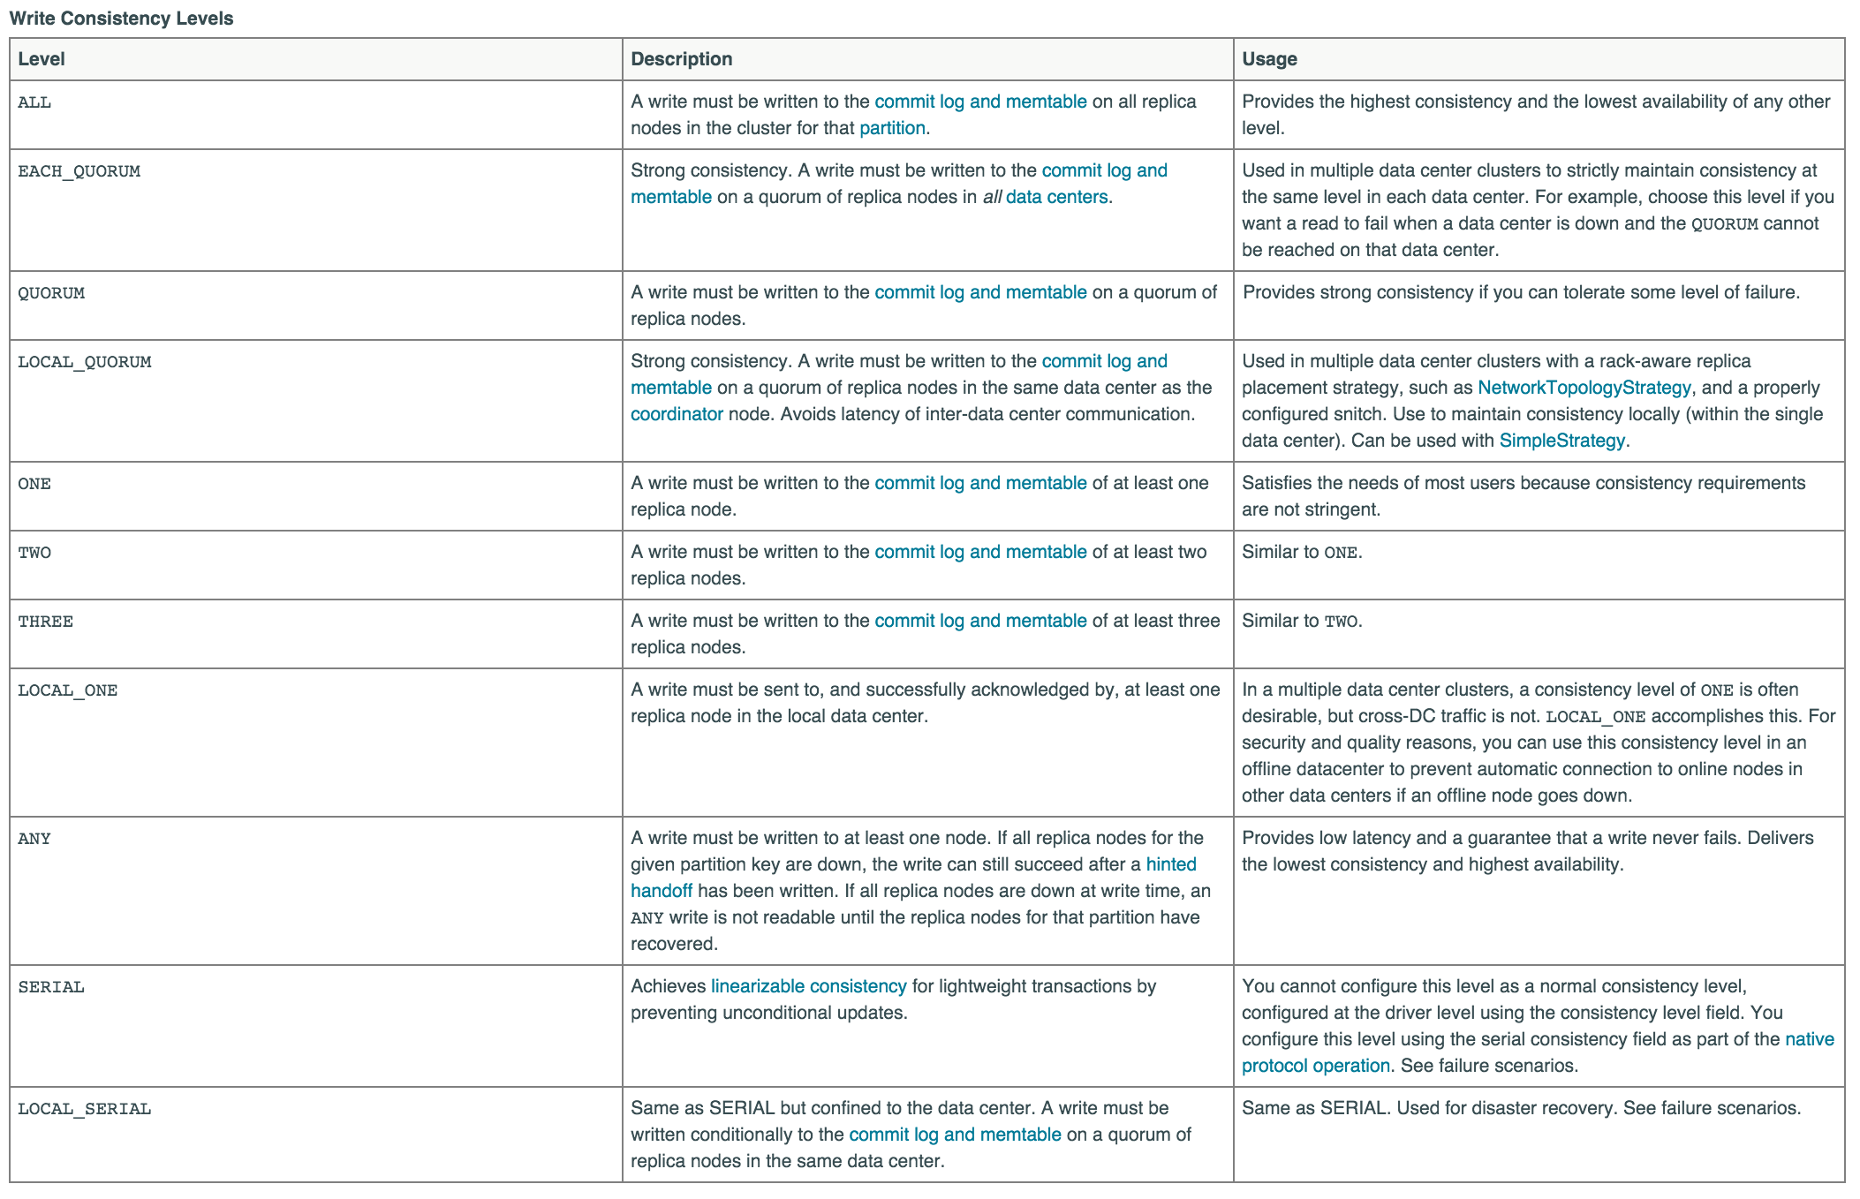
Cassandra Quorum Levels (Write)

Slide 34
Summary
We have looked at the challenges to scaling on multiple servers
Serial vs Parallel
Fixed data vs growing
CAP
Eventually Consistent

Slide 35
Questions?

