Slide 1
Big Data Engineering Other Tools and Libraries
Julie Weeds
March 2020

Slide 2
HDFS in a nutshell
Client
NameNode
Secondary
NameNode
metadata
checkpoint
Data access
DataNode
DataNode
DataNode
DataNode
Notes:
HDFS – hadoop distributed filesystem

Slide 3
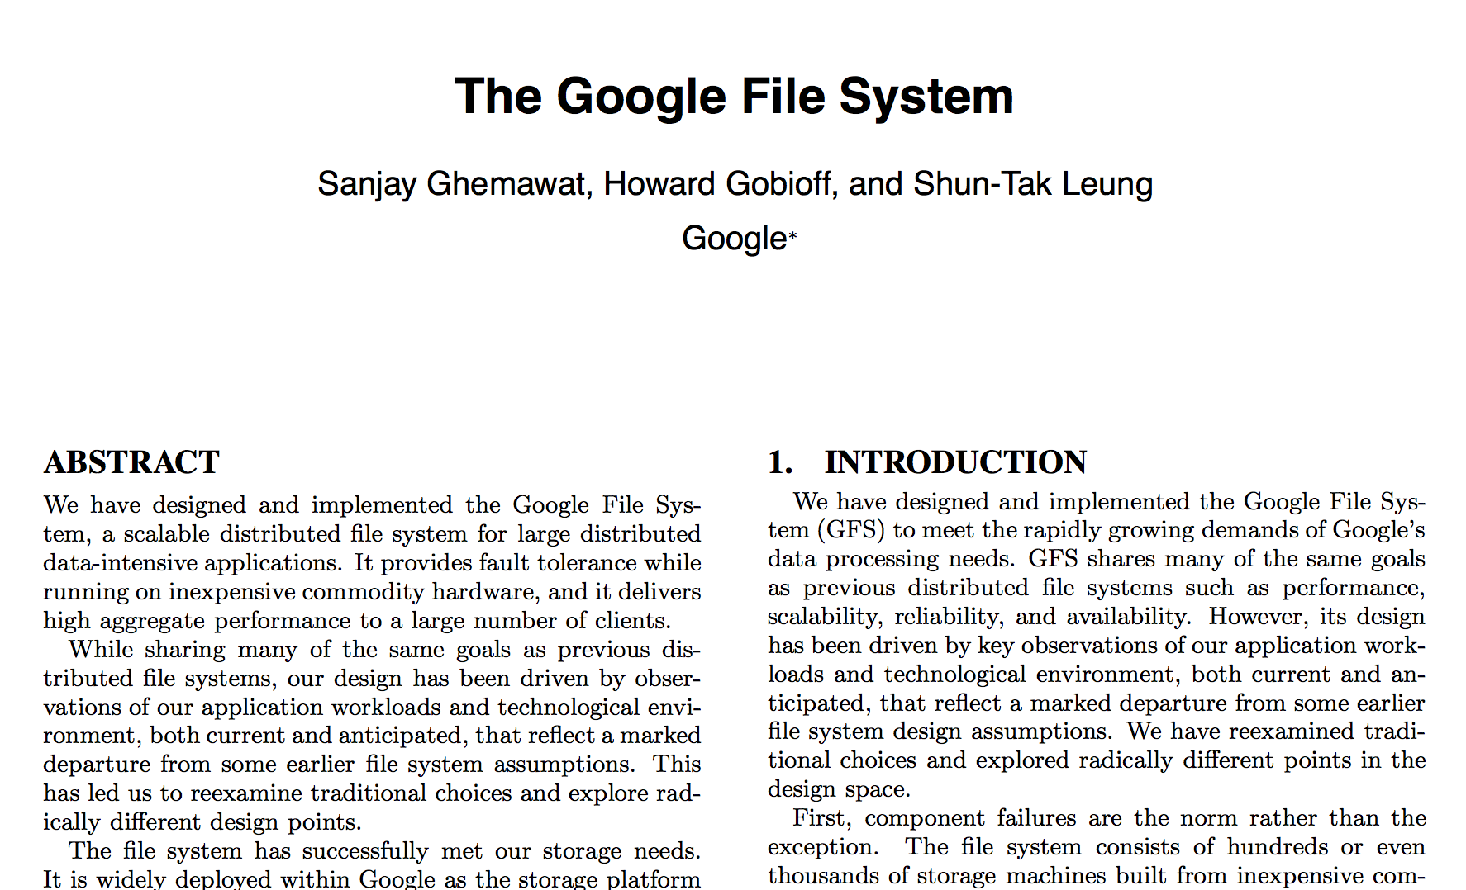
HDFS inspiration
Google File System
Sanjay Ghemawat, Howard Gobioff, and Shun-Tak Leung. 2003. The Google file system. In Proceedings of the nineteenth ACM symposium on Operating systems principles (SOSP '03). ACM, New York, NY, USA, 29-43.

Slide 4
HDFS overview
Good for streaming access to large files, reliability, scale
Not good for random access, small files
Blocks of data 64Mb in size (configurable)
Each block can be replicated across multiple data nodes for High Availability (HA)

Slide 5
HDFS Usage
Spotify has 1600+ nodes, storing 60+ petabytes of data
https://www.usenix.org/system/files/conference/fast17/fast17-niazi.pdf
One of Facebook's largest clusters (based on HDFS) holds more than 100 PB of data, processing more than 60,000 Hive queries a day
https://www.facebook.com/notes/facebook-engineering/under-the-hood-scheduling-mapreduce-jobs-more-efficiently-with-corona/

Slide 6
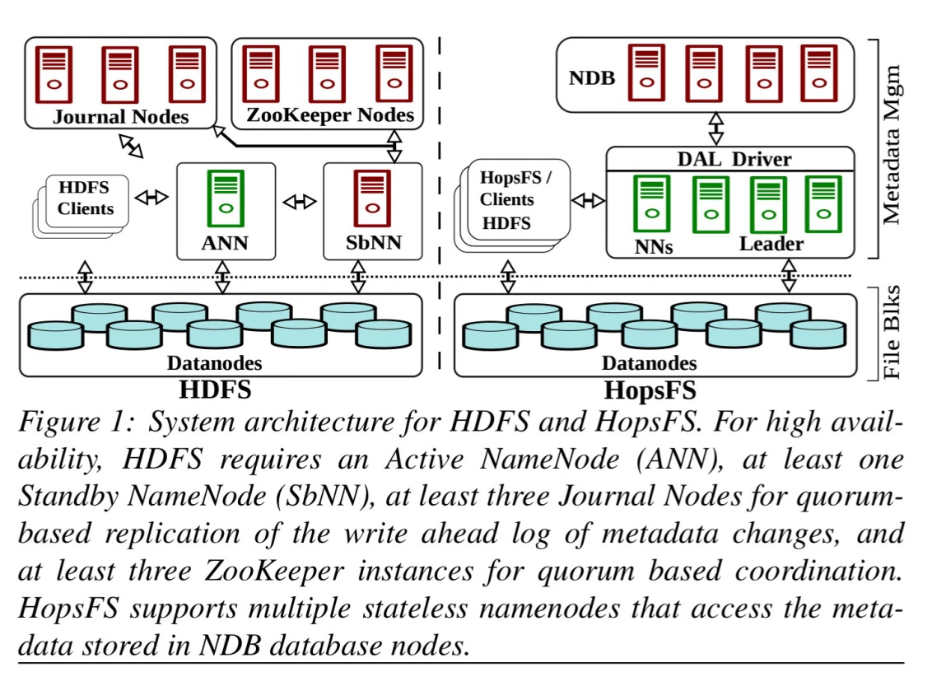
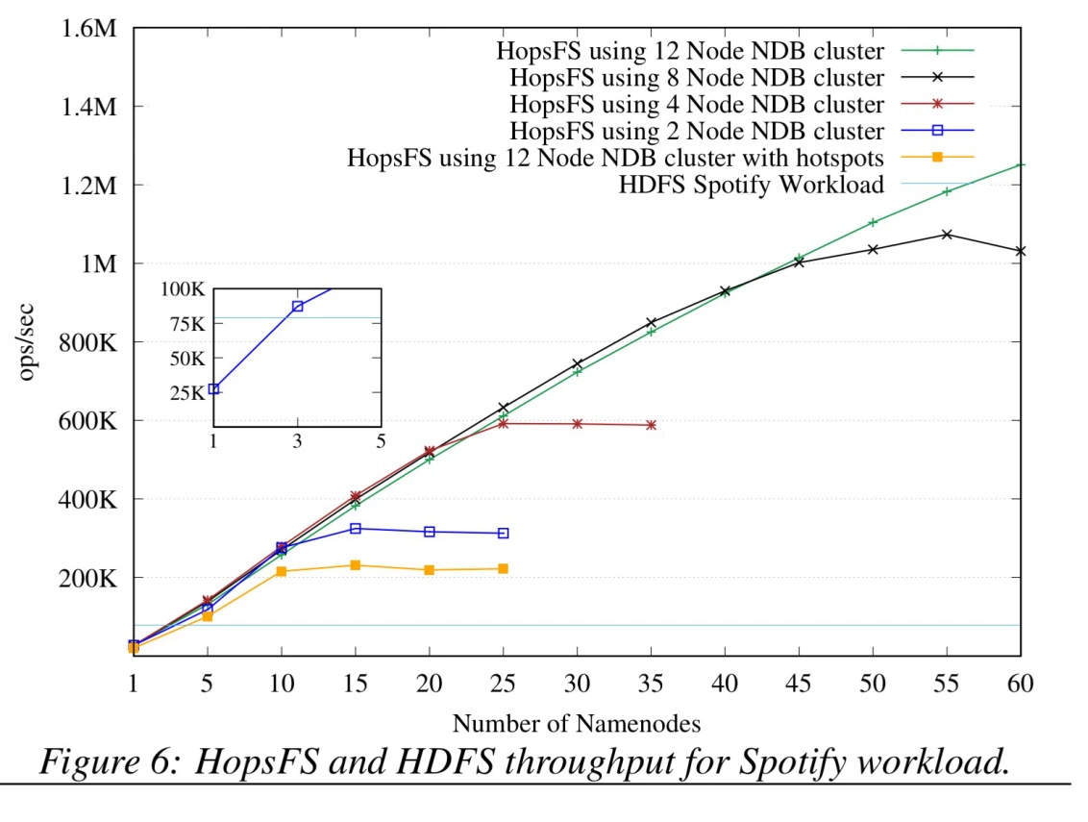
HopFS
HopFS is a drop-in replacement for HDFS, based on HDFS v2.0.4.

Slide 7
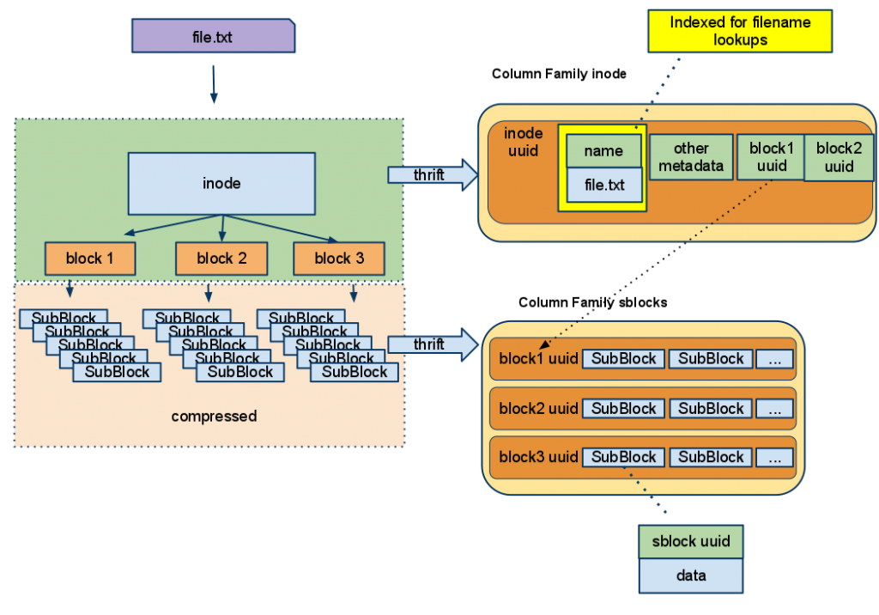
CassandraFS (not open source)
Notes:
compatible with HDFS. Simplify operation overhead of Hadoop by removing the single points of failure in the Hadoop Namenode

Slide 8
Amazon S3
Simple Storage Service
Unlimited storage of files
Up to 5 terabytes each
Stored in named “buckets”
Accessible via AWS APIs or HTTP
Authenticated or Public

Slide 9
Spark packages
A wide set of plugins
Currently 148 community donated plugins
Data connectors
Cassandra, Couchbase, Mongo, CSV, etc
Machine Learning, Neural networks
Streaming
etc

Slide 10
Using Spark Packages
Automatic download from the web:
bin/spark-shell
--packages com.databricks:spark-csv_2.11:1.2.0

Slide 11
Locality
Spark understands the locality of data:
Already in memory
HDFS location
Cassandra location

Slide 12
Spark Extras
Spark
SQL
Spark Streaming
Spark
MLlib
SparkR
GraphX
Spark Core

Slide 13
Spark Extras
Spark Streaming
Realtime analysis in Spark
Spark MLLib
Like Mahout – Machine learning in Spark
GraphX
Graph processing in Spark
SparkR
R statistical analysis on Spark

Slide 14
Spark MLlib
Simple stats and correlation testing
Classification and regression
Collaborative Filtering
Alternating Least Squares
Clustering
k-means, etc
Frequent Pattern Mining
Plus more

Slide 15
MLlib example
from pyspark.mllib.fpm import FPGrowth
data = sc.textFile("data/mllib/sample_fpgrowth.txt")
transactions = data.map(lambda line: line.strip().split(' '))
model = FPGrowth.train(transactions, minSupport=0.2, numPartitions=10)
result = model.freqItemsets().collect()
for fi in result:
print(fi)

Slide 16
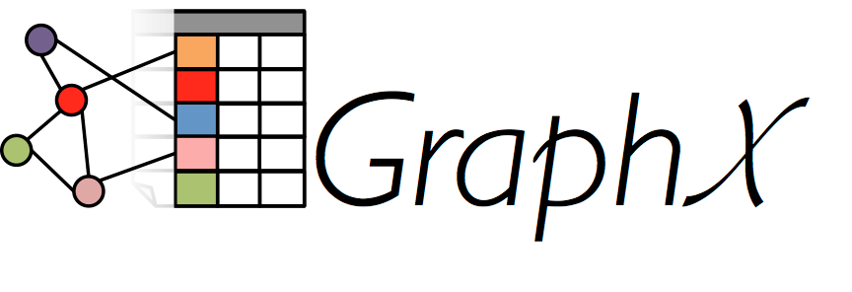
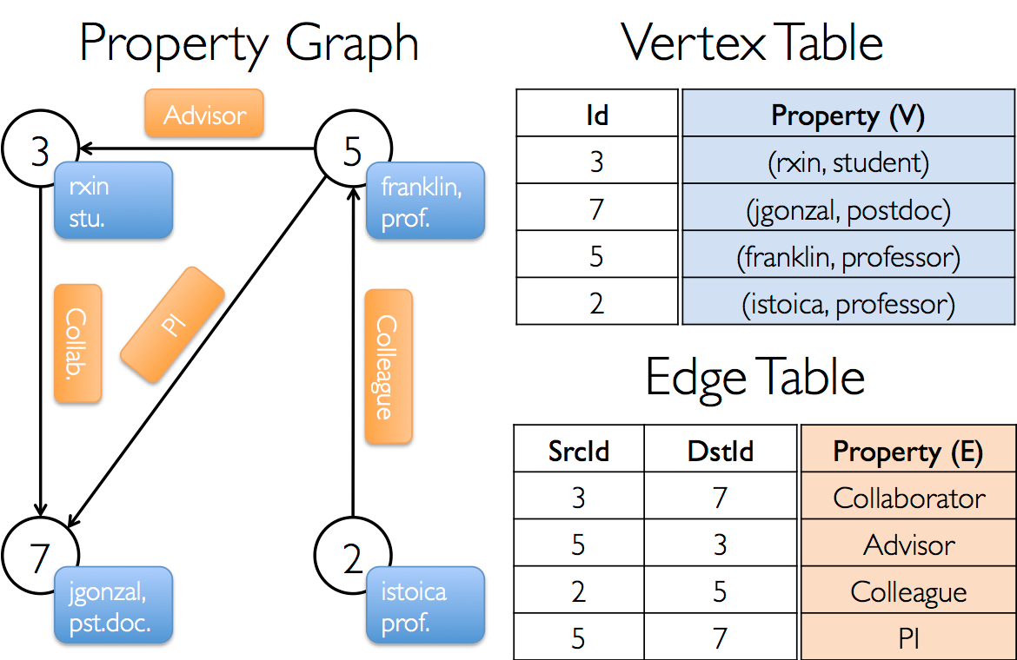
GraphX

Slide 17

R
R is an open source system for statistics and graphics
Based on the S language from AT&T Bell Labs
Supports a wide variety of statistical techniques and graphing tools
An extensible set of packages that provide extra functions via CRAN
The Comprehensive R Archive Network

Slide 18
SparkR
A lightweight approach to use Spark from within R
Also works with MLlib for machine learning
Allows complex statistical analysis to be done on a Spark cluster

Slide 19
Apache Avro
A compact data storage and transmission system
Uses schemas of data to ensure it can be read by the receiver
Supports dynamic typing
Used by RPC or data collection systems
Fast binary protocols
Also supports storage
Hence used by many Big Data apps including Hadoop and Spark

Slide 20
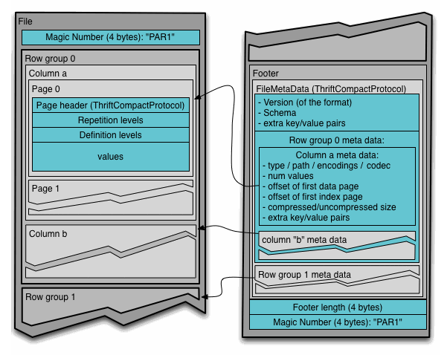
Apache Parquet
Apache Parquet is a columnar data storage model
Works with Hadoop, Spark and many others
Efficient storage of data
Based on another Google system called Dremel

Slide 21
Cluster management systems for Big Data
YARN
Part of Hadoop but significantly rebuilt since Hadoop 1
Mesos
Popular Apache project
Built to be a resource manager for a complete datacenter
Supports many workloads (e.g. Docker as well as Spark)

Slide 22
What is YARN?
YARN is the system that runs your code on multiple nodes
Hadoop 2.0 replacement for the cluster manager
Basically a model to distribute and manage workloads
Not just MapReduce but supports other workloads

Slide 23
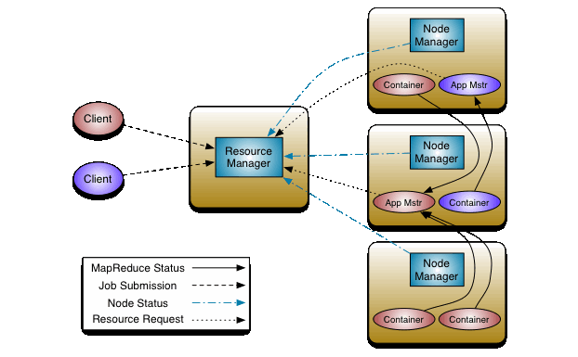
YARN architecture

Slide 24
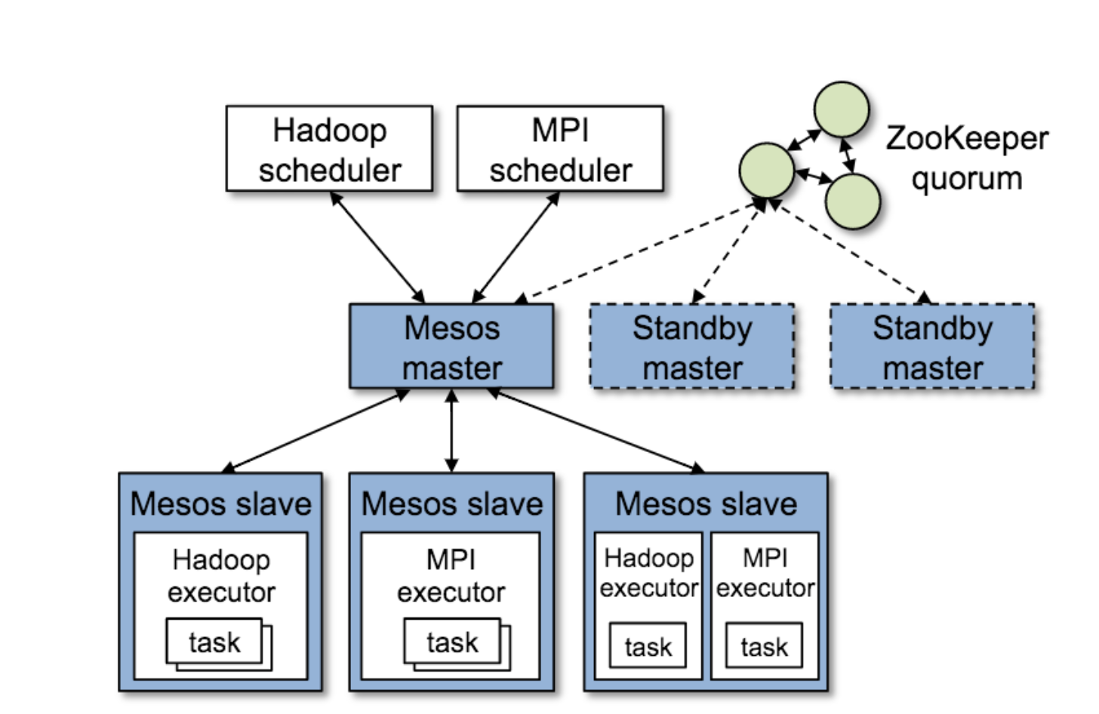
Apache Mesos

Slide 25
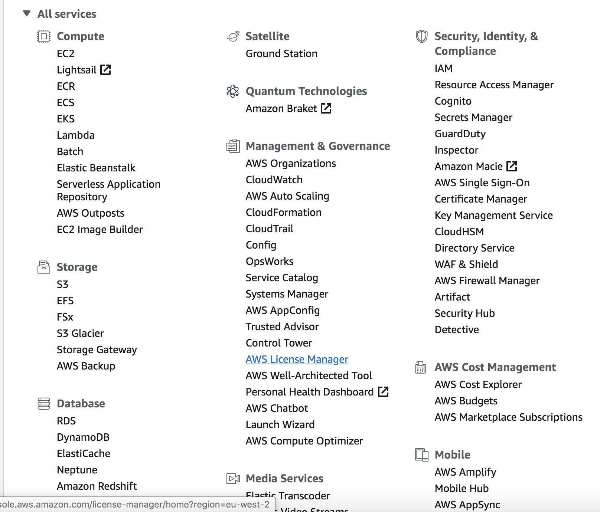
AWS: Infrastructure-as-a-Service
Notes:
update with current screen shot? Showing EMR

Slide 26
EC2 / AWS main functions
EC2 (Elastic Compute Cloud)
Instances
Servers of various sizes
AMIs (Amazon Machine Images)
Server images
Elastic Block Storage (EBS)
Virtualized Hard drives
VPC (Virtual Private Cloud)
Secure network space
S3 (Simple Storage Solution)
“Buckets” of data
Longer term storage of data

Slide 27
AWS - EMR
EMR (Elastic Map Reduce)
runs on top of EC2
provides straightforward interface for launching clusters and running Spark
lab will go through the process of starting a cluster with Spark and other python packages installed, running Jupyter notebooks on the cluster, and introduce SSH connection for more intensive python scripts

Slide 28
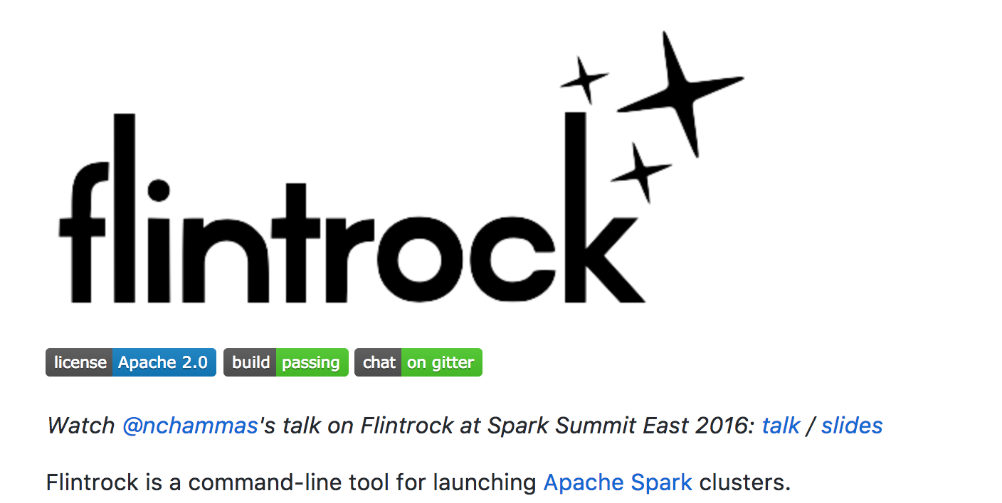
Flintrock

Slide 29
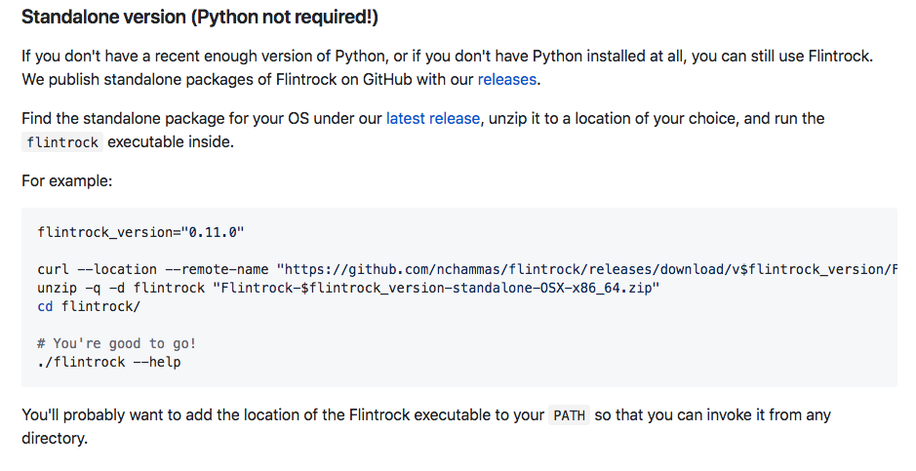
Installing standalone version

Slide 30
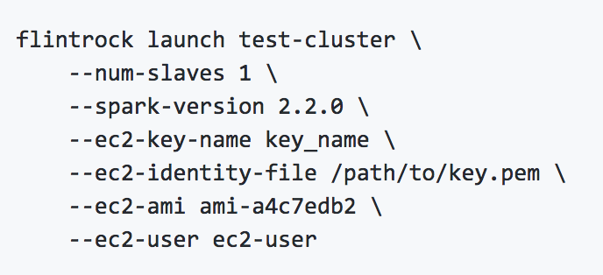
Flintrock Launching a cluster

Slide 31
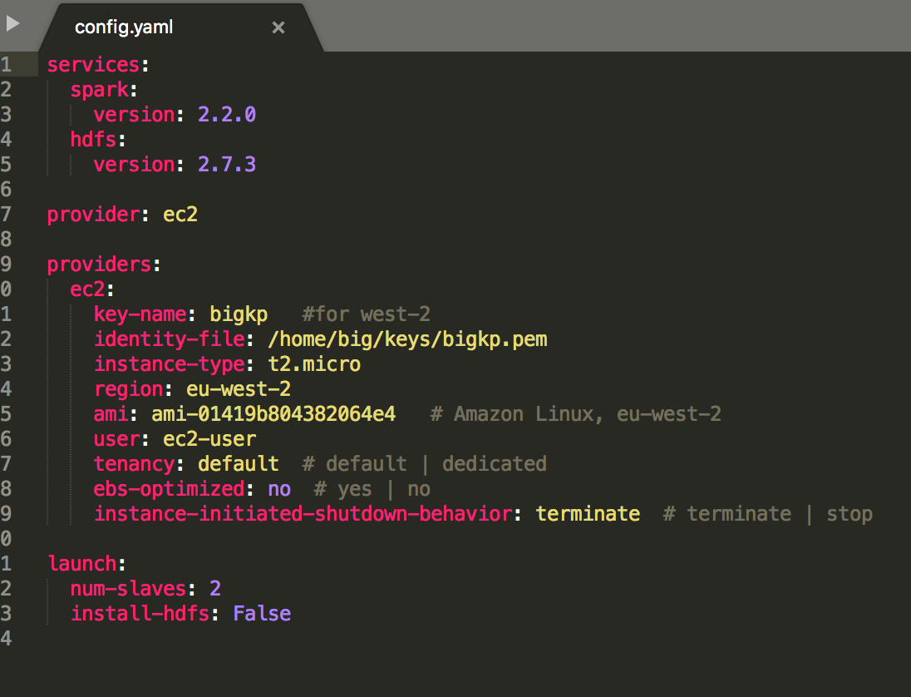
Flintrock configure

Slide 32
Other things you can do
flintrock destroy test-cluster
flintrock login test-cluster
flintrock describe test-cluster
flintrock add-slaves test-cluster
--num-slaves 2
flintrock remove-slaves test-cluster
--num-slaves 1
flintrock run-command test-cluster 'sudo yum install -y package'
flintrock copy-file test-cluster
/local/path /remote/path

Slide 33
Questions?

