Slide 1
Big Data Engineering NoSQL databases
Julie Weeds
March 2020

Slide 2
Contents
Why NoSQL (Not only SQL)?
A summary of a few NoSQL databases
MongoDB, Cassandra,
NewSQL

Slide 3
NoSQL history
Not just a recent thing ☺
IBM IMS (Information Management System)
Launched in 1968
Used to store the bill of materials for the Saturn V rocket
Hierarchical model
Still in widespread use today

Slide 4
Relational databases and SQL
Structured Query Language.
Originally pronounced “Sequel”, now usually ``EssQueEll’’
Invented by the English computer scientist Edgar F. Codd whilst working at IBM in the 1970s
Dominant for many years and still incredibly popular / pervasive.
In a relational database management system the data is perceived by the user as tables (and nothing but tables).
Tables are referred to as relations
Each row or record is referred to as a tuple.
The number of tuples is referred to as the cardinality of the relation.
STUD# | SURNAME | COURSE# | DOB
S1 | Smith | C2 | 31/10/1982
S2 | Jones | C1 | 6/6/1995
S3 | Smith | C1 | 11/10/1990
COURSE# | NAME | SCHOOL#
C1 | Computer Science | S1
C2 | Artificial Intelligence | S1
Each column or field is referred to as an attribute. The number of attributes is referred to as the degree of the relation.

Slide 5
Limitations of Relational Approach
In the 1970s databases were conceived to store “operational data” for large enterprises (banks, universities, businesses, ....)
This data largely fit into the relational model – that the data should be perceived by the user as tables and nothing but tables.
The schema for such a database (i.e., how the database is divided into tables) could be designed once and then fixed.
Acceptable performance on cross-table joins and transactions could be achieved by hosting the database on a single, very large and powerful server.
Does this approach work for “big” data?

Slide 6
Big data database requirements
Support for massive volumes of data ... without placing it all on a single expensive server.
Support for variety in data forms:-
temporal data, spatial data, multimedia data, unstructured data, document libraries
Support for agility in database design – want to be able to quickly and cheaply integrate a new data source
Support for complex/structured data types
Support for generalization and inheritance
May only require access via primary key

Slide 7
Why NoSQL?
better handling of large volumes of rapidly changing structured, semi-structured and unstructured data
dynamic schemas which allow agile development
use of object-oriented programming paradigm
Horizontal scaling – increase capacity by adding more servers rather than increasing the size of a single server
Servers can be geographically distributed, i.e., in the cloud.
Databases automatically replicated to maintain availability in the event of localised outages or downtime.
More appropriate balance between read/write performance

Slide 8
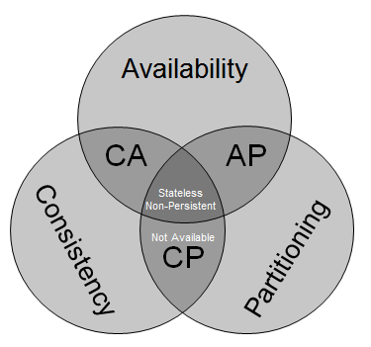
ReCAP
You can have 2 out of three:
Consistent
ACID
Available
HA / Accessible 24x7
Partitioned
Able to split into different datacentres
Survive network down
http://blog.mccrory.me/2010/11/03/cap-theorem-and-the-clouds/
Notes:
Traditonal databases provide consistency at the cost of availability. In order to ensure consistent (all nodes have the same data), have to make non-available whilst replicating data

Slide 9
NoSQL parents
Amazon Dynamo
Eventually consistent
Google BigTable
Supporting very large rows
LDM
Graph database

Slide 10
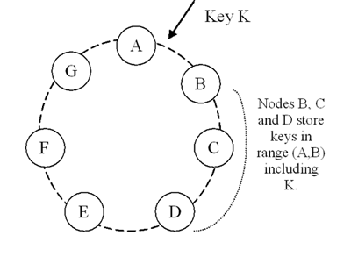
Dynamo Partitioning and Replication Model
http://www.allthingsdistributed.com/2007/10/amazons_dynamo.html

Slide 11
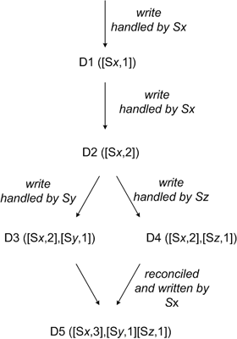
Reconciliation / Eventual Consistency
http://www.allthingsdistributed.com/2007/10/amazons_dynamo.html

Slide 12
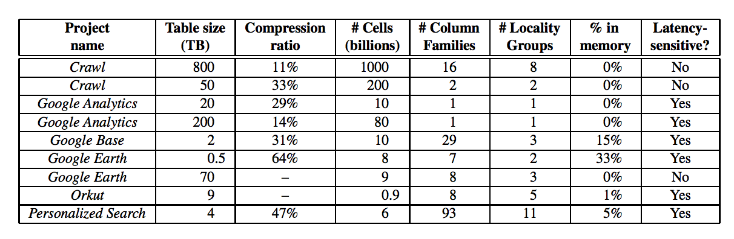
Google BigTable
Optimized to support very large data
Not just many rows, but rows that cannot fit into the memory of a single server
Column Families allow each row to live across servers
This table dates back to 2005

Slide 13
Current NoSQL Databases
Too many to list!
Popular databases include:
MongoDB
Couchbase
Apache Cassandra
Apache HBase
Voldemort
Redis
Riak
Etc, etc

Slide 14
Types of NoSQL databases
Type | Description | Examples
Key-value stores | every single item in the database is stored as an attribute name (or key) together with its value | Berkeley DB Riak
Graph stores | used to store information about graphs/networks of data (e.g., social connections) | Neo4J Giraph
Document databases | pair each key with a complex data structure known as a document. Documents can contain many different key-value pairs, key-array pairs or nested documents. | MongoDB
Wide-column stores | optimised for queries over large datasets and store columns of data together, instead of rows. | Cassandra HBase

Slide 15
MongoDB
Uses a document data model
Each record and its associated data is thought of as a “document”
Documents encoded in a JSON-like format called BSON (essentially a binary encoding of JSON)
Advantages include
documents are independent units, related data is stored contiguously, making it easier to distribute data across multiple servers and maintain performance
application logic is written in any language which supports object-oriented programming. The object model in your application can be turned directly into a document.
Unstructured data is stored easily
Database does not need to know the schema in advance

Slide 16
Key Value databases
A persistent associative array or dictionary
Simple access and fits well with programming models (especially MapReduce)
Indexing on other data is not often possible and can be slow

Slide 17
Column-oriented DBMS
Data tables stored as columns rather than rows
Practical use is very similar to a row-oriented DBMS
Can use SQL to interact with data
Row-oriented systems perform well at row-based queries – e.g., returning all information about a particular object
Column-oriented systems perform well at column-based queries – e.g., find all record with a particular attribute value
001:10, Smith, Joe, 40000
002:12, Jones, Mary, 50000
003:11, Johnson, Cathy, 44000
004:22, Jones, Bob, 55000
10:001; 12:002; 11:003; 22:004;
Smith:001; Jones:002,004; Johnson: 003;
Joe:001; Mary: 002; Cathy: 003; Bob: 004;
40000:001; 50000:002; 44000:004; 55000: 004

Slide 18
Apache Cassandra
Hybrid between key-value and column-oriented DBMS
Uses Cassandra Query Language (CQL) as an alternative to SQL
Developed by Facebook and released as open-source project in 2008
Main features:
Data is distributed across a cluster (no single point of failure)
Supports replication, fault-tolerant
Horizontal scaling
Tunable consistency
Hadoop integration with MapReduce support (+Apache Pig and Apache Hive)
Notes:
How It Works
The architectural details of Cassandra lie beyond the scope of this article but a brief overview is warranted. At level comparable with the high of Mt. Everest, a Cassandra cluster consists of a decentralized network of autonomous nodes (commodity servers) with a ring-like network typology. A client connects to the Cassandra cluster by connecting with any particular node present in the ring and interfaces with that node via CQL. The node the client connects to is called the coordinator and it assumes the responsibility of satisfying the client’s request.
Cassandra is a distributed database system and relies on data partitioning to equally distribute the data amongst the nodes in the cluster. To avoid the problem of single-point-of-failure associated with shared nothing architectures, Cassandra employs data replication to store replicas (data copies) on participating nodes. This contributes to the high availability of the database system.
The coordinator will inform the client of a successful read or write operation in accordance with the established consistency level. This parameter allows users to configure the number of replicas that must acknowledge a read or write operation before the client is informed of a successful operation. Alternatively, this parameter describes the number of nodes which must complete the operation before the client is informed of a success.
What is interesting here is that an operation can be considered successful before data has been propagated to every node in the cluster. This is very important for increasing network performance. Nodes in the Cassandra cluster rely on the Gossip Protocol to exchange information with each other.
This protocol allows nodes to obtain state information about other nodes by exchanging information a node has about itself and other nodes. A particular node does not directly exchange information with every other node in the cluster; data is exchanged with a few nodes and with the passage of time data propagates throughout the cluster in a manner similar with which a virus would spread through a population.

Slide 19
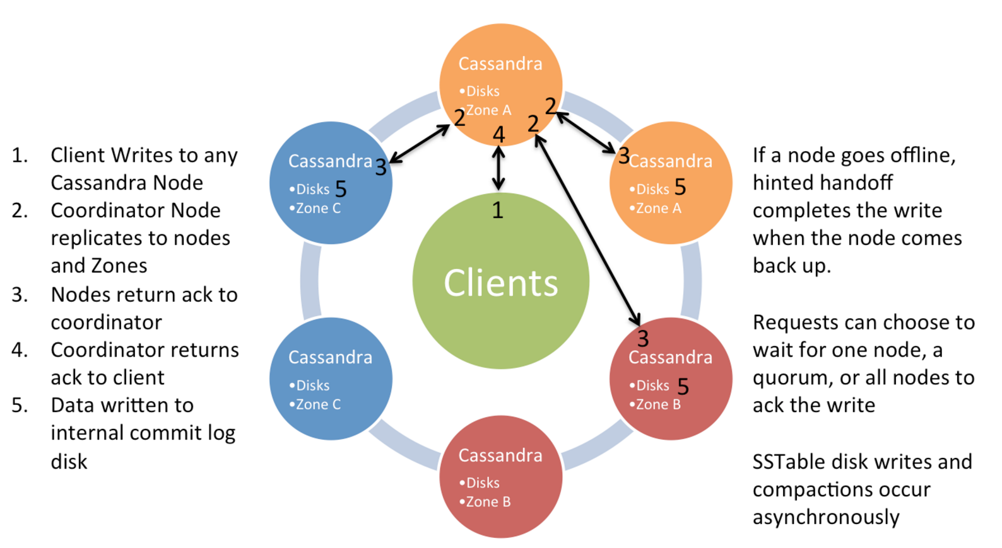
Cassandra Write Model Single Datacentre
Source: Netflix

Slide 20
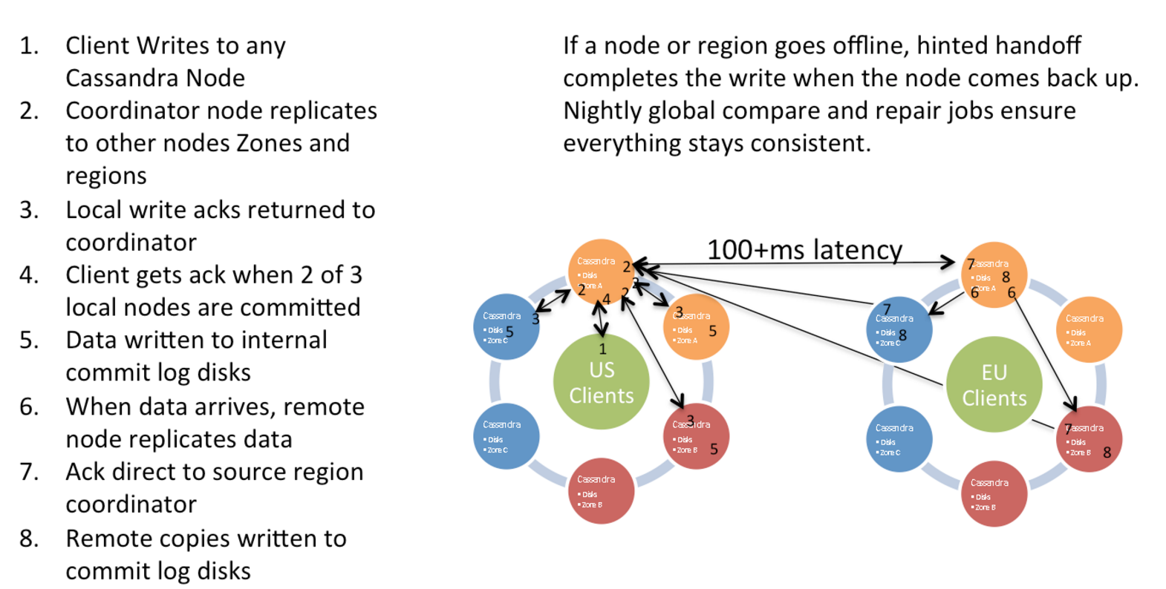
Multi Datacentre Writes
Source: Netflix

Slide 21
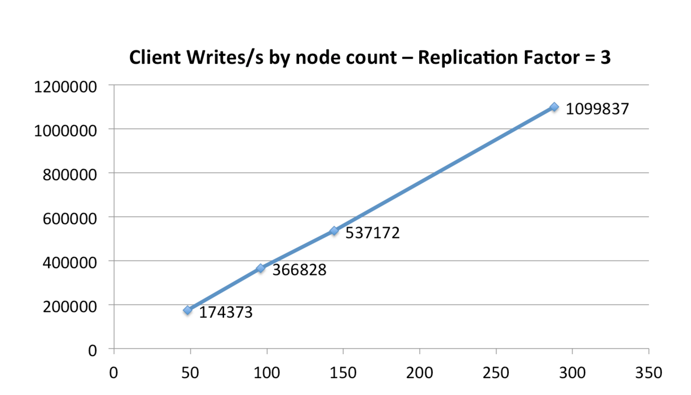
Cassandra Scale Up In Amazon EC2
https://netflixtechblog.com/benchmarking-cassandra-scalability-on-aws-over-a-million-writes-per-second-39f45f066c9e
Source: Netflix

Slide 22
Cassandra Model
Keyspaces are roughly equivalent to SQL Databases
Encapsulate replication strategies
Column Families roughly equivalent to SQL tables
Generally a different approach vs SQL
Writes are cheap
Indexes are expensive
Normalization is not the goal

Slide 23
Cassandra Model cont.
Inserts are the same as updates
No read first
Data can be marked with a Time to Live (TTL)
Automatically deleted
Deletes are not instant
Deleted rows are marked with a tombstone
Eventually cleaned up
Can re-appear if you do not run node repair after a node failure

Slide 24
CQL
A variant of SQL written specifically for Cassandra
The preferred model of access
Replaces the old “Thrift” API
Attempts to have some compatibility with normal SQL
e.g. you can use either KEYSPACE or TABLE interchangeably

Slide 25
CQL examples
SELECT name, occupation FROM users WHERE userid IN (199, 200, 207);
However, some queries are not permitted:
SELECT firstname, lastname FROM users WHERE birth_year = 1981 AND country = 'FR';
Requires a large scan of the database and cannot give a predictable time response:
ALLOW FILTERING will make this run anyway

Slide 26
INSERT / UPDATE
INSERT INTO NerdMovies (movie, director, main_actor, year)
VALUES ('Serenity', 'Joss Whedon', 'Nathan Fillion', 2005)
USING TTL 86400;
Every row can have a specified expiry time
Inserts work even if the data is already there, unless you specify:
INSERT INTO NerdMovies (movie, director, main_actor, year)
VALUES ('Serenity', 'Joss Whedon', 'Nathan Fillion', 2005) IF NOT EXISTS
USING TTL 86400;
This can have unpredictable timing because it requires read-before-write

Slide 27
Non-SQL data types
Sets
CREATE TABLE cycling.cyclist_career_teams ( id UUID PRIMARY KEY, lastname text, teams set<text> );
Lists
CREATE TABLE cycling.upcoming_calendar ( year int, month int, events list<text>, PRIMARY KEY ( year, month) );
Maps
CREATE TABLE cycling.cyclist_teams ( id UUID PRIMARY KEY, lastname text, firstname text, teams map<int,text> );
Tuples
CREATE TABLE cycling.popular (rank int PRIMARY KEY, cinfo tuple<text,text,int> );

Slide 28
Direct support for JSON
INSERT INTO cycling.cyclist_category JSON '{
"category" : "GC",
"points" : 780,
"id" : "829aa84a-4bba-411f-a4fb-38167a987cda",
"lastname" : "SUTHERLAND" }';

Slide 29
cassandra.yaml
Configuration of the major parts of the system
Datacentres, Racks, Cluster name
Authentication and Authorization
Partitioner
Data Storage location
Cacheing
Network topology and ports
Etc, etc

Slide 30
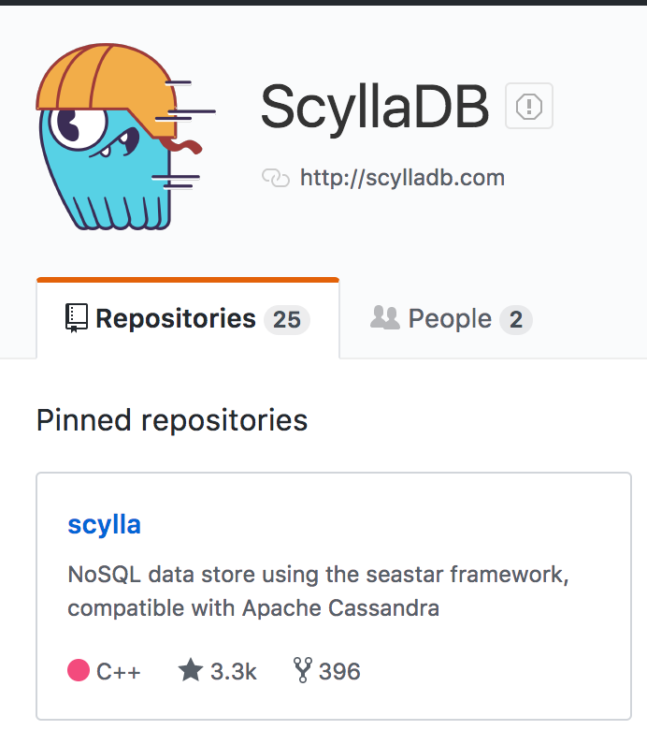
ScyllaDB
A C++ “clone” of Cassandra
Also Open Source
Claims to be significantly faster

Slide 31
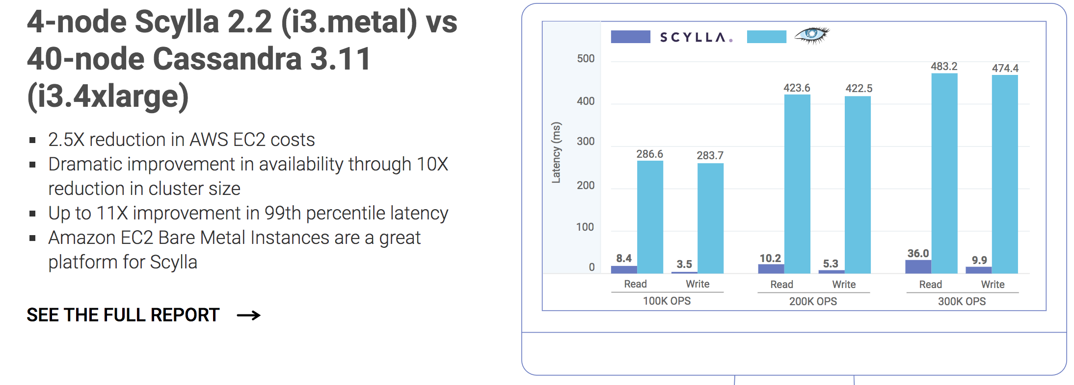
Scylla vs Cassandra

Slide 32
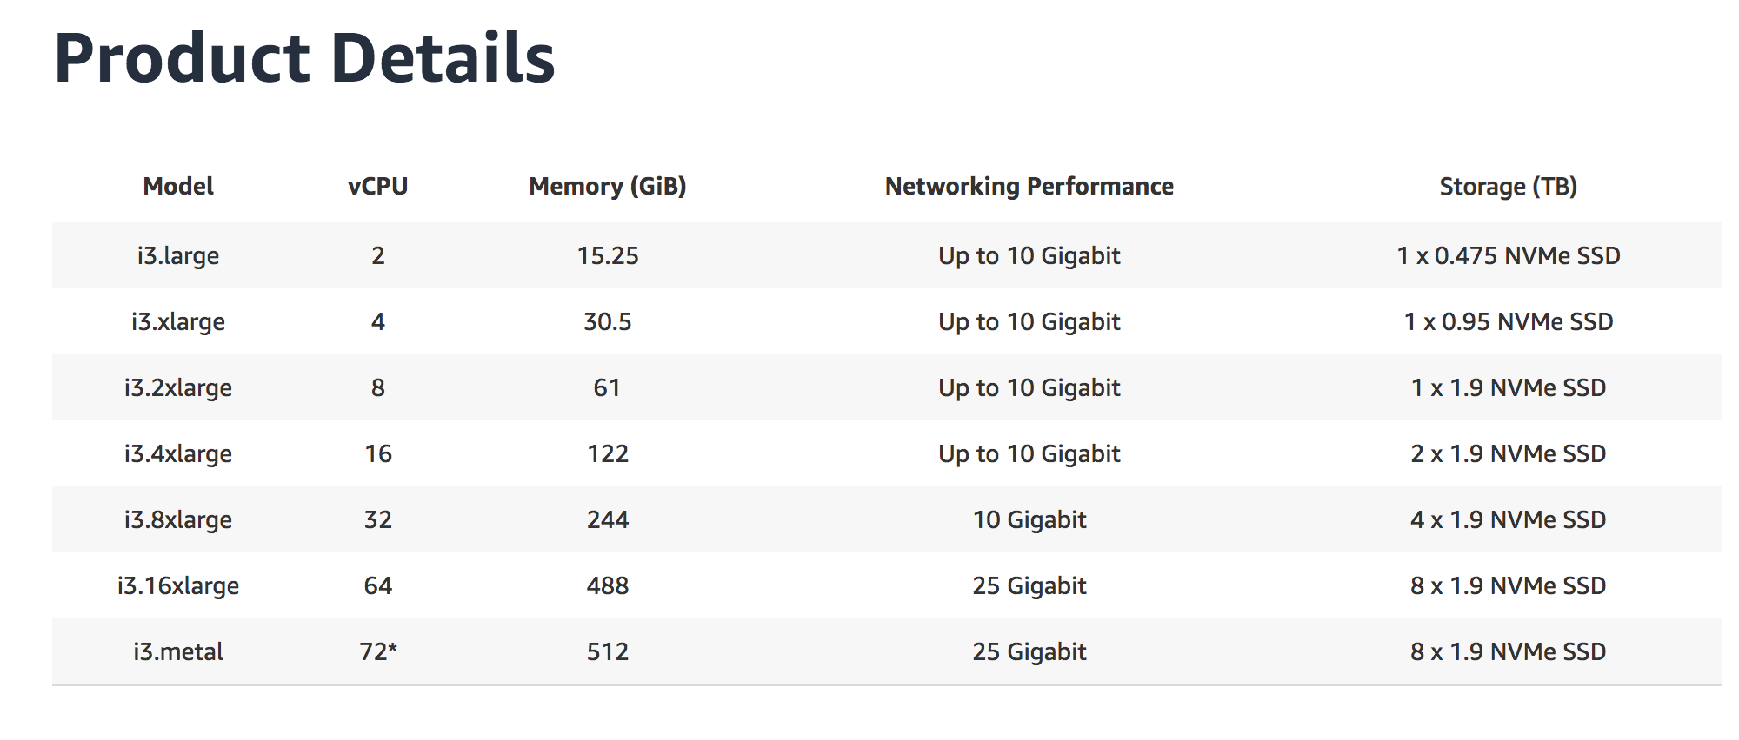
Amazon EC2 I3 Instances
Storage optimised for high transaction workloads

Slide 33
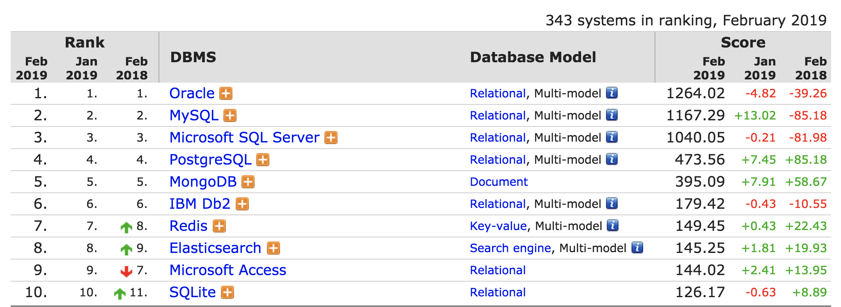
Top ten databases 2019
ranked by popularity:
number of results in web searches
Stack Overflow & DBA Stack Exchange
Google Trends
job advertisements
professional networks
social networks
http://db-engines.com/en/ranking

Slide 34
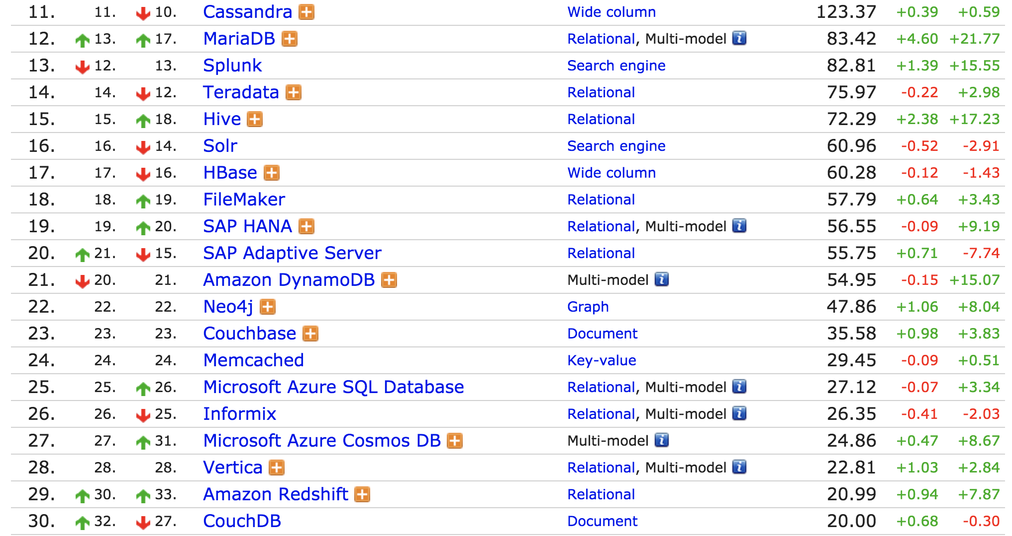
Next 20

Slide 35
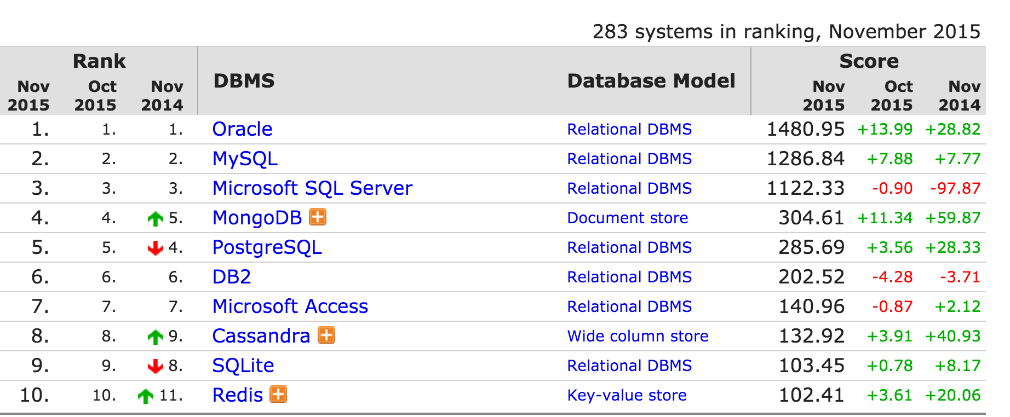
Top ten databases 2015
http://db-engines.com/en/ranking

Slide 36
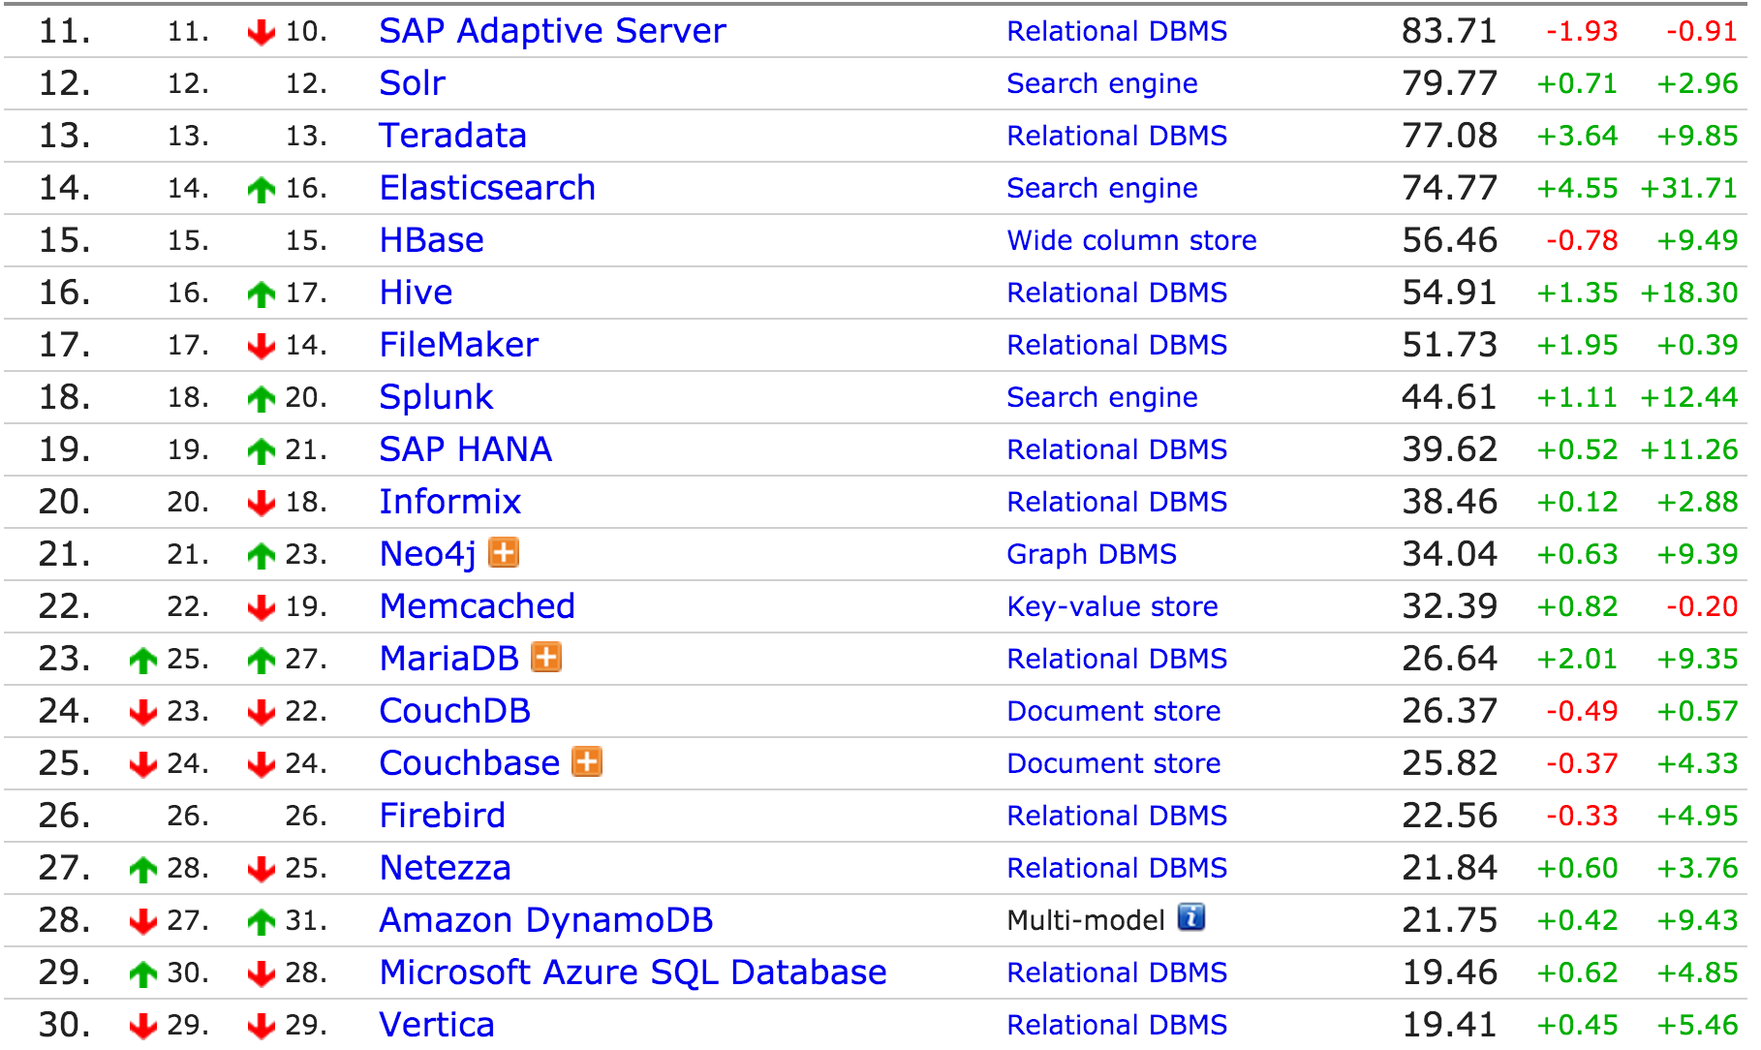
Next 20

Slide 37
2015 → 2019
Gaining popularity
Losing popularity
Redis
Elasticsearch
Splunk
key-value
Cassandra
Hbase
wide column stores
search engine
Relational databases (e.g., SQL) still seem dominant

Slide 38
“NewSQL”
ACID databases that aim to provide high availability and scalabilility
VoltDB
NuoDB
Google Spanner
MemSQL
Generally assume
online transaction processing (rather than analysis)
individual transactions touch on a small portion of the database
transactions are repetitive (with different values)

Slide 39
In Memory Databases
Memory is relatively much cheaper than it used to be
Uses snapshots or transaction logs to ensure durability
Some NoSQL, some NewSQL
SAP Hana
Redis
VoltDB
MemSQL
Apache Geode

Slide 40
Questions?

