Slide 1
Map-Reduce and Scaling Big Data Processing
Big Data Engineering
Julie Weeds
March 2020

Slide 2
Contents
Understanding Map Reduce
Functional programming patterns applied for scalability
Hadoop
Map-reduce in Hadoop
Python
Java
Hadoop Distributed File System (HDFS)
Further reading
Notes:
The Hadoop Distributed File System (HDFS) is a distributed file system designed to run on commodity hardware. It has many similarities with existing distributed file systems. However, the differences from other distributed file systems are significant. HDFS is highly fault-tolerant and is designed to be deployed on low-cost hardware. HDFS provides high throughput access to application data and is suitable for applications that have large data sets.

Slide 3
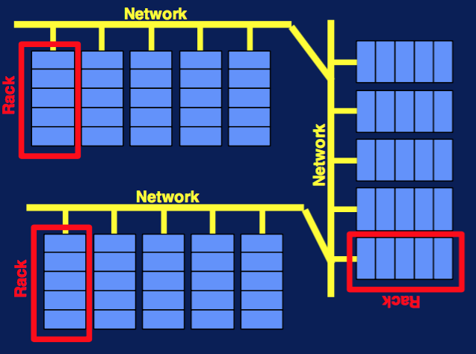
Data centres
Big Data analysis can be greatly speeded up through parallel and distributed computation.
Data centres provide parallelism through computing clusters – large collections of commodity hardware, including conventional processors (“compute nodes”) connected by Ethernet cables or inexpensive switches
Compute nodes are stored on racks – maybe 8-64 on a rack (5 per rack shown in the diagram).

Slide 4
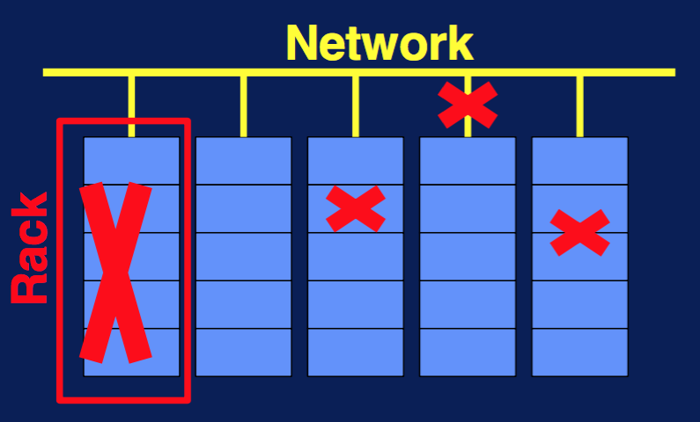
Fault tolerance
To avoid having to abort and restart an entire computation every time a component fails, systems should be fault tolerant. This involves:
file replication at different nodes (e.g., x3 in HDFS)
division of computation into tasks, such that if one fails to complete it can be restarted without affecting other tasks (e.g., MapReduce)
Components (including individual nodes, entire racks and network connections) can fail. The more components a system has, the more likely it is for one to fail.

Slide 5
Distributed file systems
A DFS may be suitable when
Files are enormous (maybe a TB or more)
Files are rarely updated. They are appended or read sequentially (read or write random access not required)
Files are divided into chunks.
Typically (e.g., HDFS), chunks are 64MB and are replicated 3 times at 3 different compute nodes (on 3 different racks).
The name node (or master node) for a file stores where the chunks are to be found.
The name node is replicated and the directory for the file system knows where to find the copies
The directory itself can be replicated and all users know where the directory copies are.

Slide 6
MapReduce
a computing paradigm
developed by Google for indexing web pages and published in 2004
open-source implementation Hadoop first made available by Yahoo in 2005
All you write are two functions Map() and Reduce()
The system manages the parallel execution and coordination of the tasks that execute Map and Reduce, as well as dealing with the possibility that one of these tasks might fail.

Slide 7
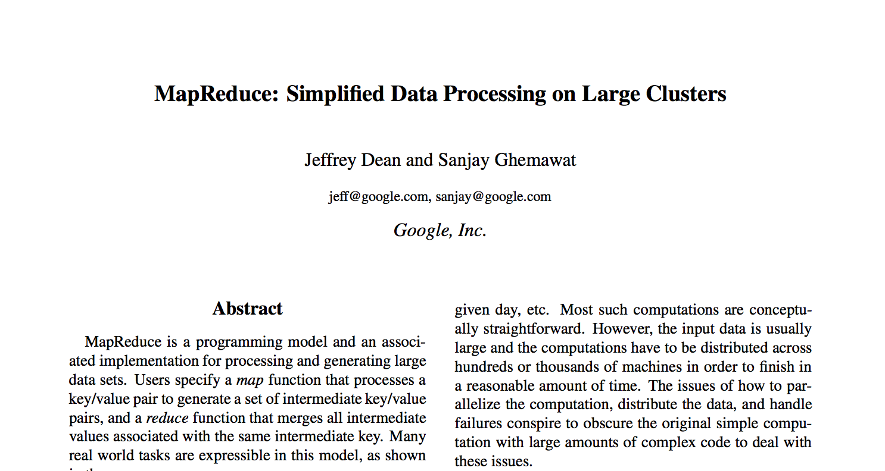
Original 2004 Google Paper

Slide 8
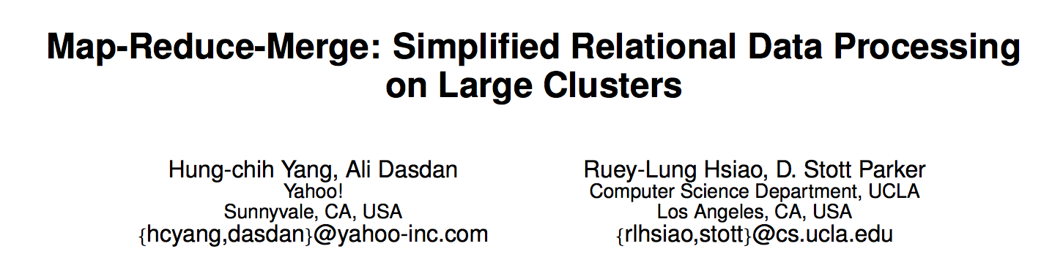
Yahoo 2007

Slide 9
Class Exercise
Find a small piece of paper and write your university and number of siblings on it.
Sussex 3
Notes:
How to … find the total / average number of siblings per university
Map: each data item (person) to a key:value pair
Reduce: for each key, accumulate all of the values using a reduce operation (e.g., add)

Slide 10
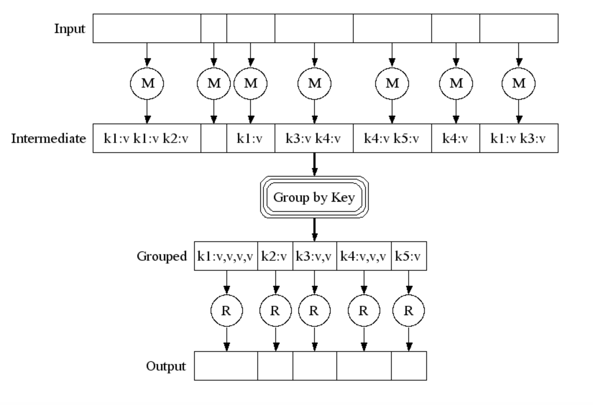
Pictorially

Slide 11
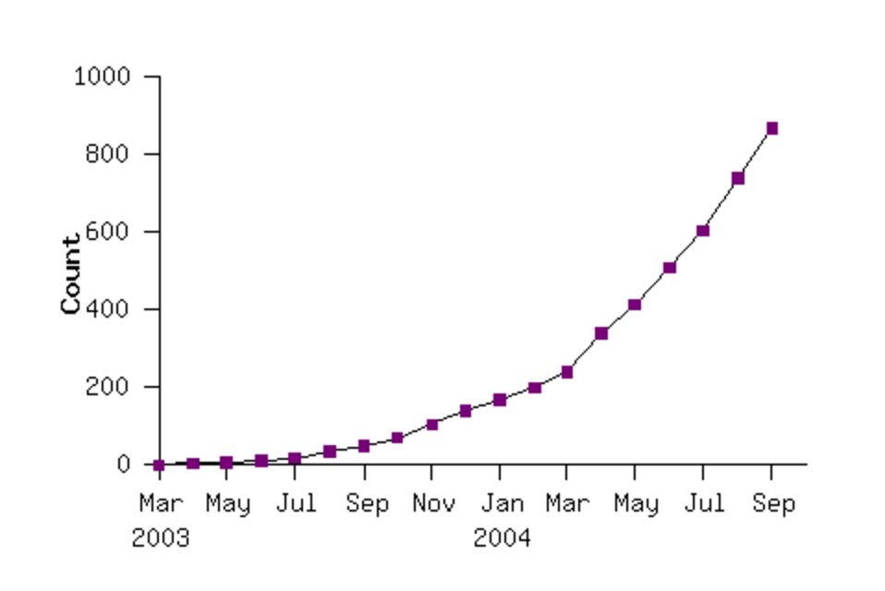
Google’s early use of MR Map Reduce programs in their code repository

Slide 12
A first MapReduce algorithm ...
... typically involves counting words
I want to know the frequency of occurrence of the all of the words in a number of texts.
How shall we go about computing that distribution efficiently?

Slide 13
Notes:
Map>> word:1
Reduce>> sort by key and add

Slide 14
Counting words with MapReduce
Distribute
Chunks of the input (individual texts) are distributed to different nodes.
A worker at each node works out the frequency of each word in its chunk
Key-value pairs are stored in an intermediate file according to some hash function (the first letter of the word)
Intermediate files transferred to the node responsible for those key-values pairs
A worker at that node adds up the associated key-value pairs and produces a single file with the output.
Map
GroupBy
Reduce

Slide 15
Map Reduce example in words
Count how many times each word occurs in 1000 books:
First count each book (map wc onto book)
Then reduce the outputs to a global wordcount across all books

Slide 16
Efficiency
Reduce phase:
We can theoretically process each word in parallel
How?
Shuffle / Sort the results from the map phase by key (word)
Partition by keys
Parallelize the reduce phase

Slide 17
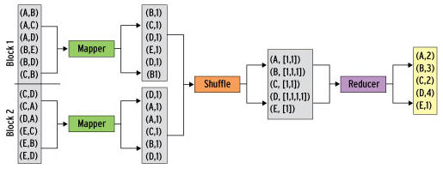
Map/Shuffle/Reduce

Slide 18
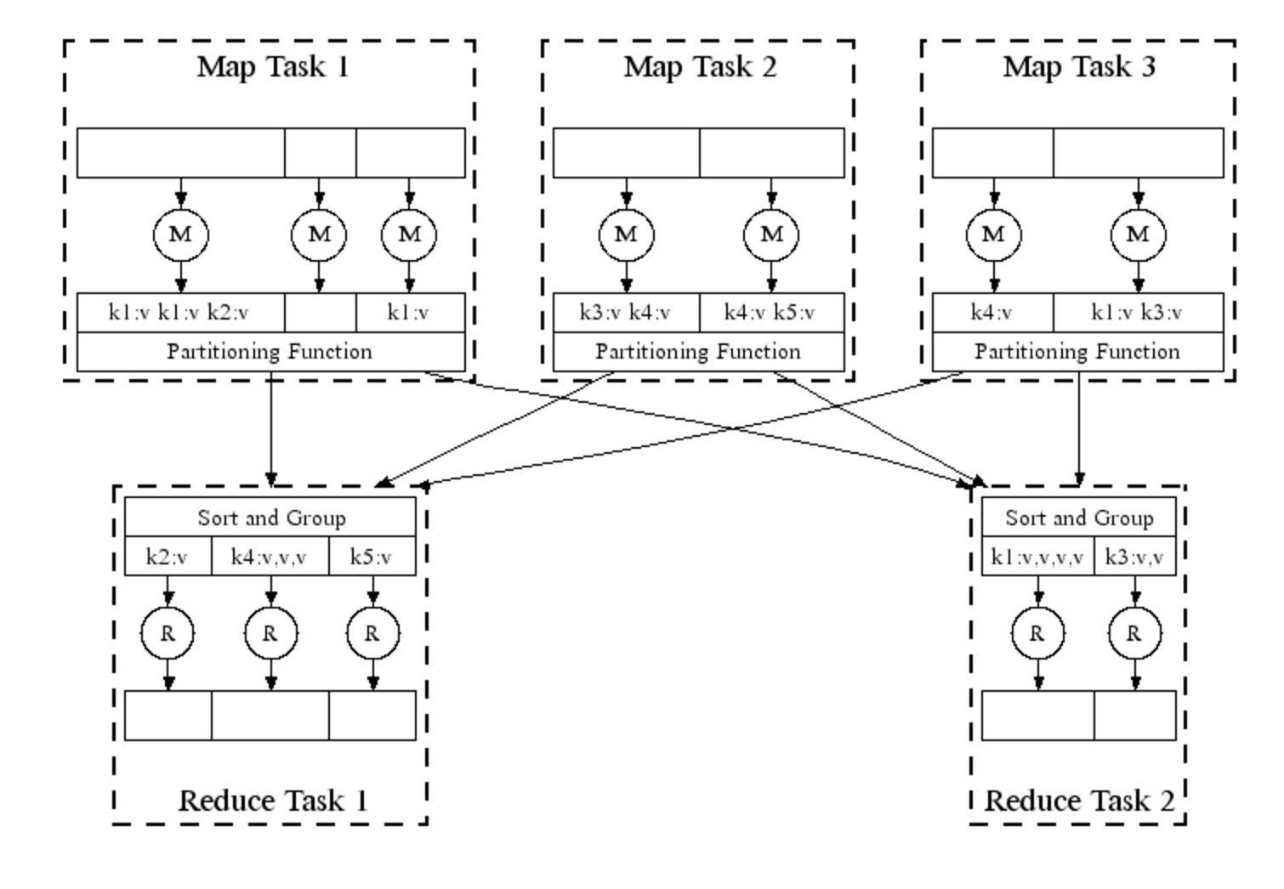

Slide 19
Map Reduce in Real Life
Analysing web logs
Summarise by user / cookie
Then aggregate to identify who did what
Analysing twitter data
Who retweeted
Who was retweeted the most
Almost all big data problems can be re-factored into Map Reduce
Some more efficiently than others

Slide 20
Tuning
Fault tolerance
Simply re-execute work that fails
Performance:
Partitioning the data
Moving the work to near the data

Slide 21
Overview of the Execution of a MapReduce Program
User program
fork
fork
master
fork
assign Map
assign Reduce
Map Task
Reduce Task
Map Task
Map Task
Reduce Task
intermediate files
input
output

Slide 22
Coping with Node Failures
If the compute node at which the Master is executing fails, the entire MapReduce job must be restarted.
Other failures managed by the Master.
Master periodically pings Worker processes to check they are still alive.
If a Map worker fails, all of the Map tasks assigned to this worker must be redone. The Master reschedules them for a new worker and informs the Reduce tasks where to look for the location of its input
If a Reduce worker fails, the Master simply reschedules its currently executing Reduce tasks on another reduce worker.

Slide 23
When NOT to use MapReduce
Don’t use MapReduce for processes which involve relatively little calculation and/or which change the database e.g., interacting with a product data-base
MapReduce is good for data-parallelism i.e., when the same task needs to be done repeatedly to lots of data
It is not good for task-parallelism i.e., when lots of different tasks need to be done to the same data

Slide 24
Apache Hadoop
The most famous and popular Map Reduce framework
Open Source
Written in Java, but supports other languages
Runs Map Reduce workloads across a cloud or cluster of machines
Supports a distributed filesystem to store data for these jobs
Provides reliability when servers in the cluster fail

Slide 25
Components of Hadoop
Map Reduce or Other Workloads
Java, Scala, Python, Apache Pig, Apache Hive, etc
YARN (Yet Another Resource Negotiator)
Cluster Resource Management
Hadoop Distributed File System (HDFS)
Redundant Reliable Distributed File System

Slide 26
Summary
Understanding the Map Reduce Model
How is it implemented in Hadoop
Notes:
see 06-additional tools

Slide 27
Questions?

