Slide 1
Big Data Engineering Apache Spark
Julie Weeds
March 2020

Slide 2
Contents
What is wrong with Hadoop?
Apache Spark
PySpark / Python

Slide 3
Issues with Hadoop
Hadoop is fundamentally all about Map Reduce
Though v2 did allow for other approaches
Based on cheap commodity hardware
But….
Not based on cheap commodity hardware with lots of memory!

Slide 4
Hadoop Model
Map
Reduce
Map
Reduce
Map
Reduce
HDFS
Notes:
HDFS = hadoop distributed file system

Slide 5
Hadoop and Disk
Hadoop does everything via replicated disk images
Intermediate results are stored on disk
Slow for many operations
Including Machine Learning
No support for interactive processing

Slide 6
Improved Approach
A new model based on memory
Based on Directed Acyclic Graphs (DAGs)
And partitions
What about reliability?

Slide 7
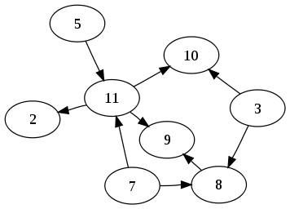
DAG Directed Acyclic Graph No Loops!

Slide 8
Apache Spark
Started in 2009 at UC Berkeley
Donated to Apache in 2013
Written on top of JVM mainly in Scala
10x-100x faster than Hadoop
Supports coding in:
Scala
Java
Python
R
Supports an interactive shell
More details in this paper:
http://www.cs.berkeley.edu/~matei/papers/2012/nsdi_spark.pdf

Slide 9
Resilient Distributed Datasets
A logical collection of data
Partitioned across multiple machines
Logs the lineage of the current data
If there is a failure, recreate the data
Solves the reliability problem
Developers can specify the persistence and partitioning of RDDs
Notes:
lineage = graph (DAG) of all of the parent RDDs of an RDD

Slide 10
RDD Lineage (aka RDD operator graph and RDD dependency graph)
Which RDDs depend on which other RDDs?
Why is it important that it is a DAG?

Slide 11
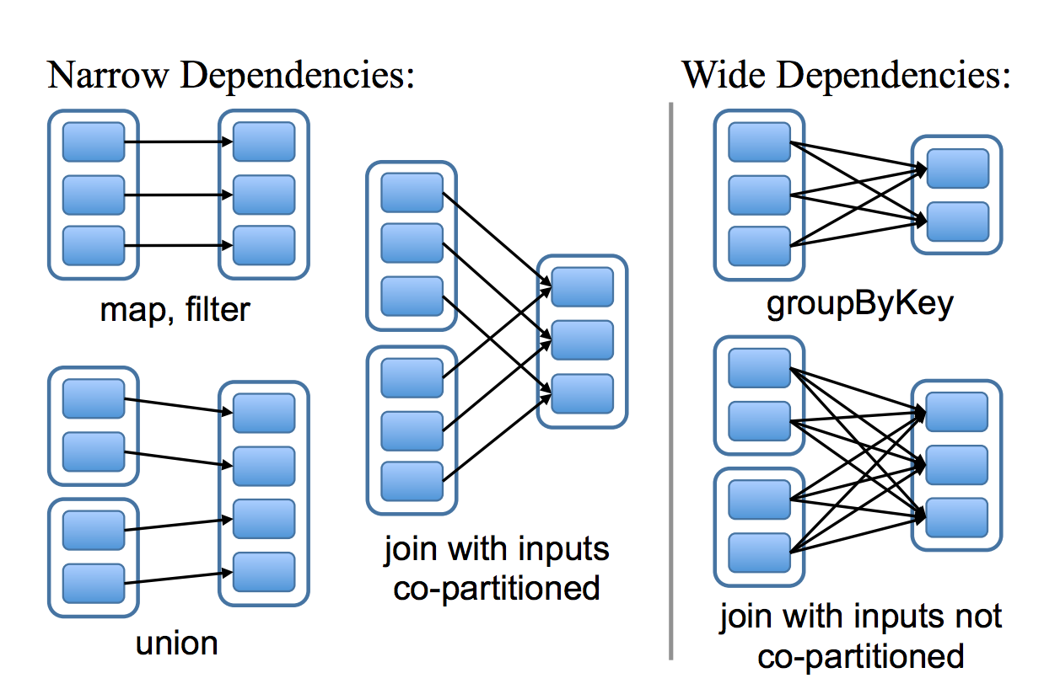
Narrow and Wide dependencies
Narrow dependencies: Each partition of the parent is used by one child partition
Wide Dependencies: multiple child dependencies depend upon it
Source: http://www.cs.berkeley.edu/~matei/papers/2012/nsdi_spark.pdf

Slide 12
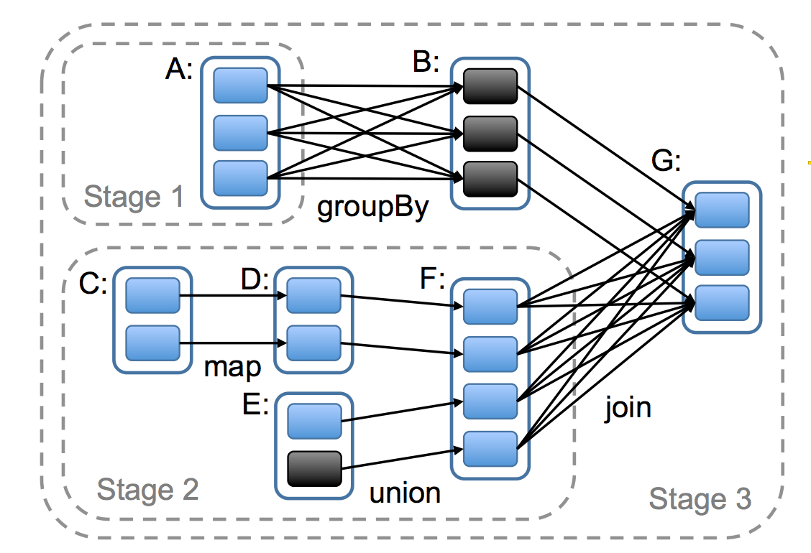
How Spark computes jobs
Boxes with solid outlines are RDDs. Partitions are shaded rectangles, in black if they are already in memory.
To run an action on RDD
G, build stages at wide dependencies and pipeline narrow transformations inside each stage. In this case, stage 1’s
output RDD is already in RAM, so we run stage 2 and then 3.
Source: http://www.cs.berkeley.edu/~matei/papers/2012/nsdi_spark.pdf

Slide 13
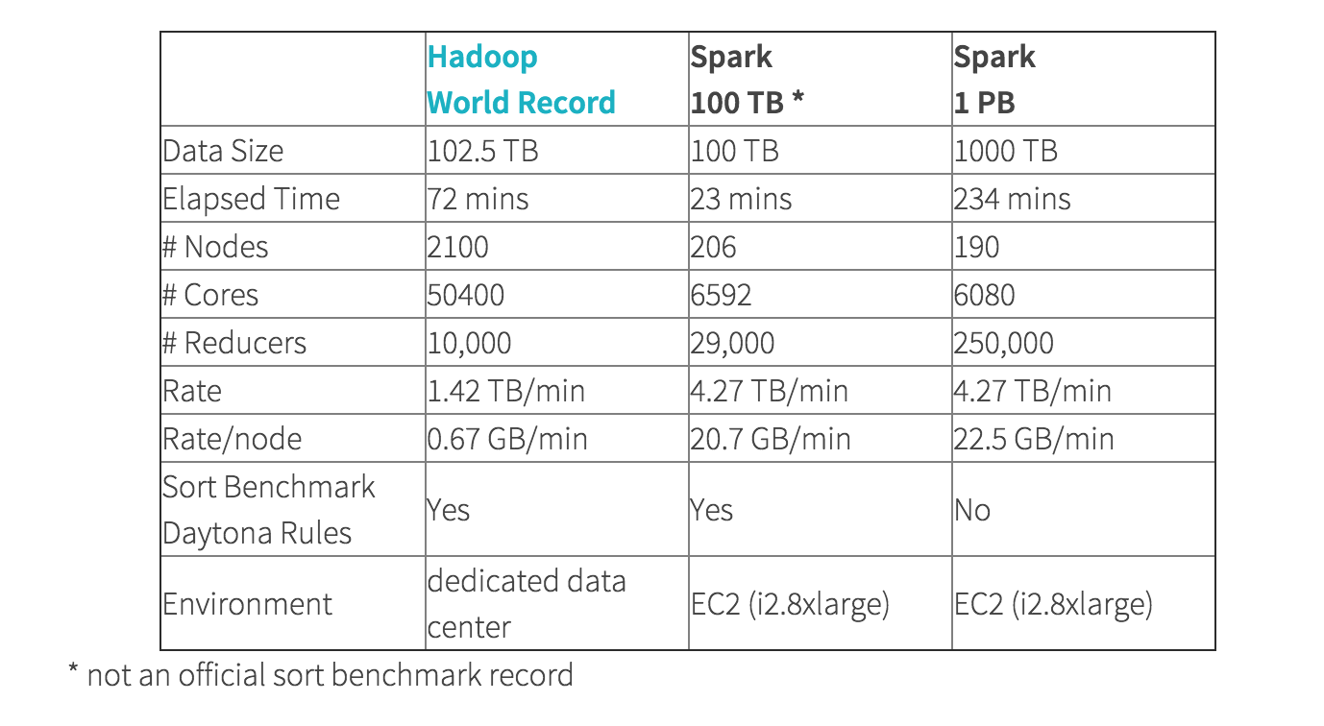
Hadoop vs Spark sorting

Slide 14

Apache Spark cluster model

Slide 15
Spark Coding
You can code in:
Scala
Java
Python
R
SQL
We will be using Python and SQL in the class
After you leave here you can use anything you like
Including “Not Spark”

Slide 16
Spark Key Objects
RDD
Think of it like an array
You can do map/reduce operations on it
And others
But you can’t assume everything is run on one machine
Unless you explicitly force that using forEach() or collect()
DataFrame
Just like a Pandas DataFrame except distributed across machines and threads
You can convert from DF <-> RDD

Slide 17
Apache Spark RDD objects
Typical operations include
map: apply a function to each line/element
flatMap: can return a sequence not just an element
filter: return element if func(element) is true
reduceByKey: reduces a set of [K,V] key/value pairs
reduce: apply a reducer function
collect: get all the results back to the master (driver) server in the cluster
foreach: apply a function across each element
Operations on RDDs will happen across machines
Be careful!

Slide 18
Most common
RDD.map(lambda x: …)
Applies the lambda function to each element in the RDD
RDD.flatMap(lambda x: ...)
The lambda produces a sequence of items that are then flattened into a single RDD
RDD.reduce(lambda x,y: …)
Applies the function iteratively across all the elements in the RDD

Slide 19
reduceByKey
Function (V,V) -> V
Takes pairs (K,V)
It will apply the function within the Key K
[(hello, 1), (hello, 1), (hello, 1), (world,1), (world, 1)] lambda x,y: x+y
What is the result?

Slide 20
Getting results
You often need to bring the results back to a single thread to display them:
collect()
Alternatively you can save the results (which can happen in parallel)
RDD.saveAsTextFile()
DataFrame.save()

Slide 21
Other useful things
first()
Returns the first member of an RDD
take(10)
Returns the first 10 elements
sample(..)/takeSample(..)
Samples the RDD
Very useful for reducing a massive dataset to something workable while you are testing
count()
Counts the RDD
countByKey()
Counts by key
Might have been useful in our word count example ☺
forEach()
Allows you to do operations with side-effects (accumulators)

Slide 22
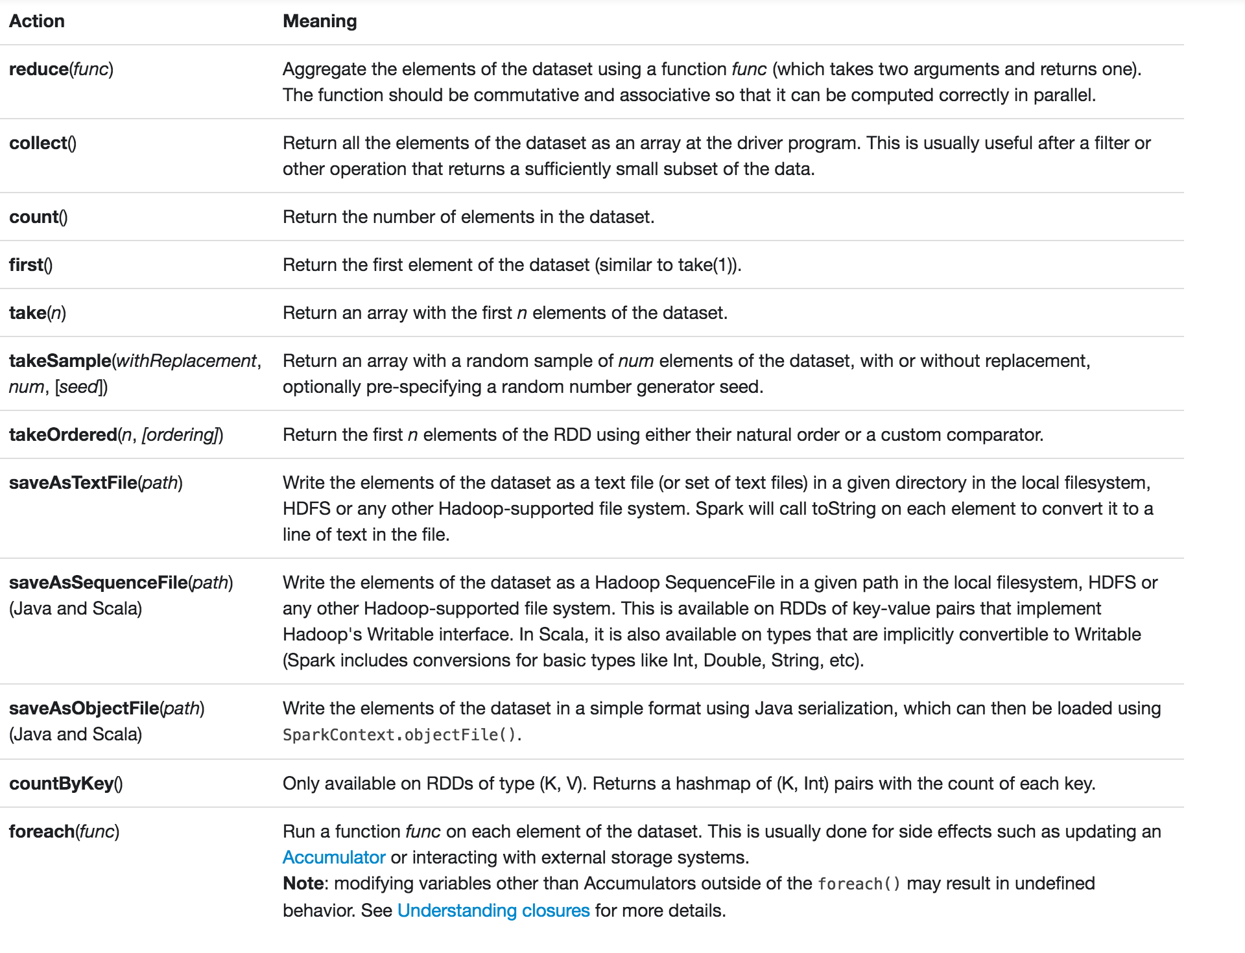
Notes:
Concentrate on
reduce()
collect()

Slide 23
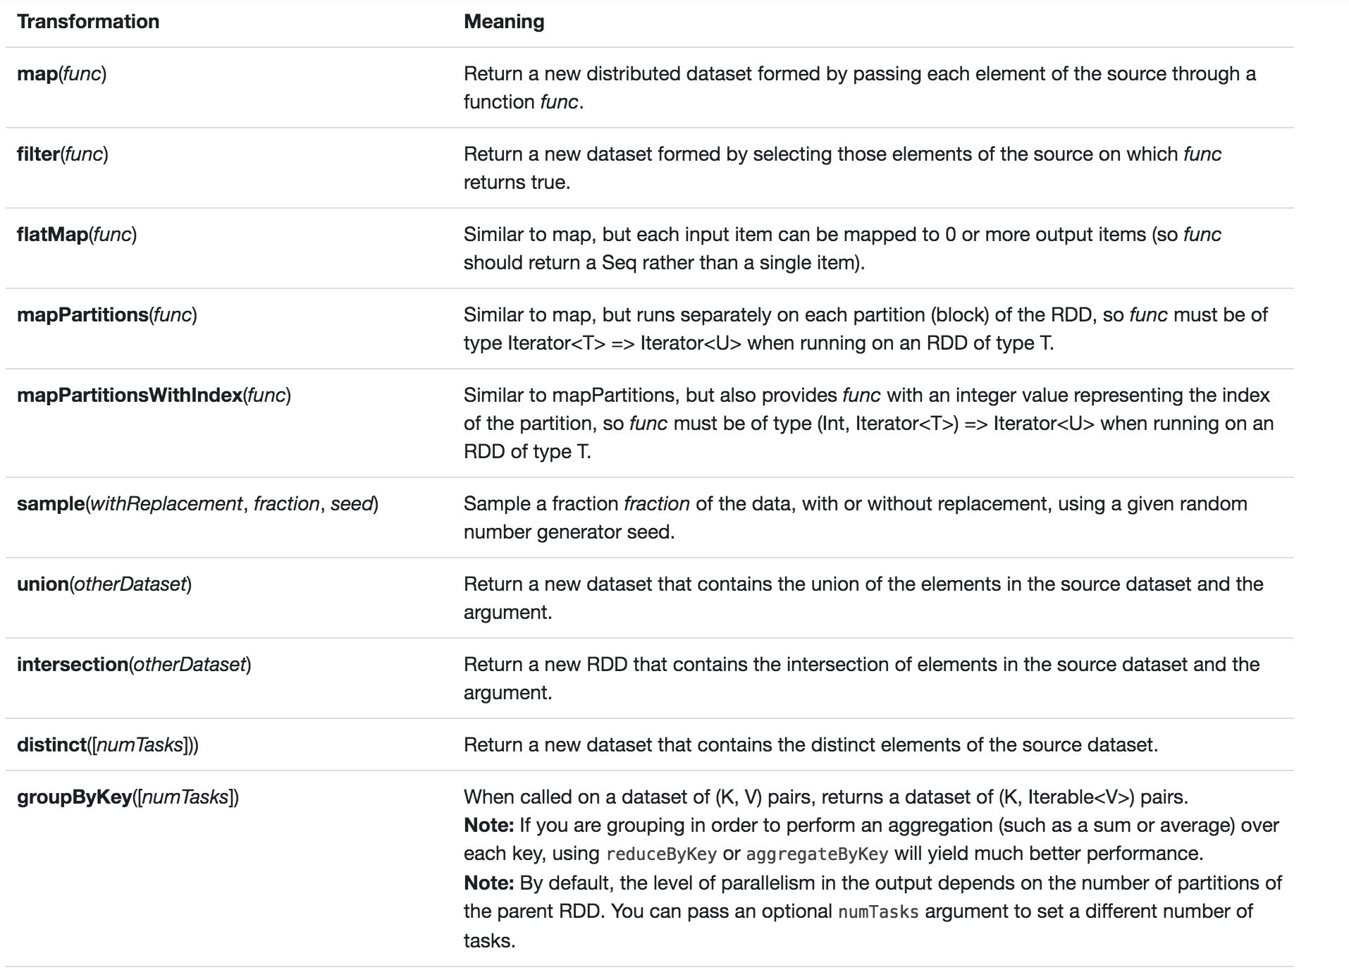

Slide 24
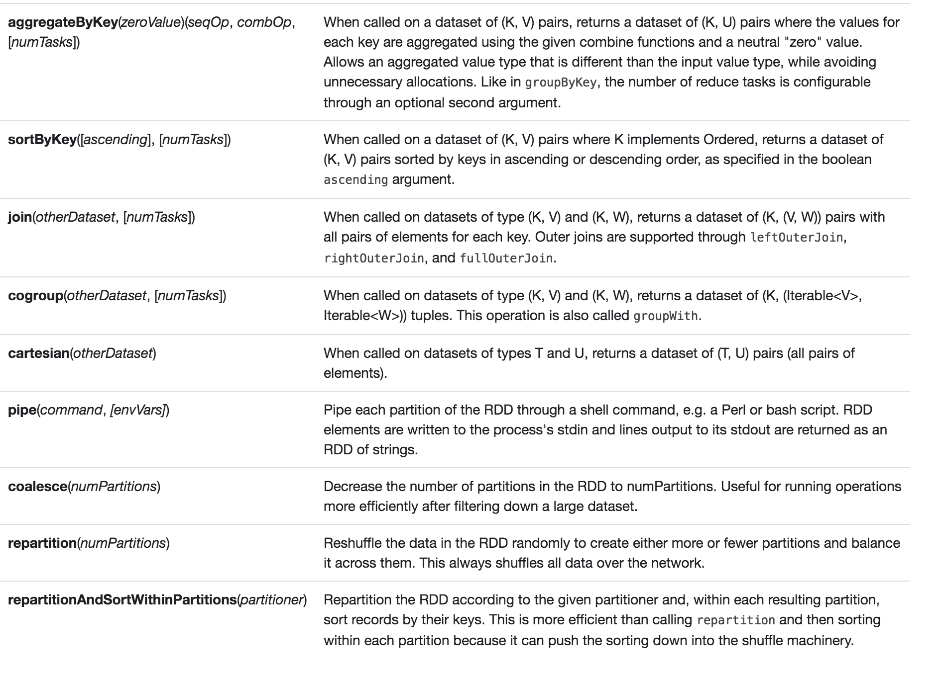
Notes:
Talk about sortByKey
Is this faster than sorting the results in serial?

Slide 25
Transformations and Actions
Transformations: create a new RDD from an existing one
Actions: return a value to the driver program after carrying out a computation
What are map(), reduce() and reduceByKey()?
All transformations in Spark are lazy: only carried out when needed by an action
Notes:
map and reduceByKey are transformations whereas reduce is an action

Slide 26
Serialization and Deserialization
serialization = converting an object into a sequence of bytes which can be persisted to a disk or database or can be sent through streams.
deserialization = creating object from sequence of bytes.
may be necessary for persistence of data
but avoid unnecessary serializations and deserializations (e.g., RDD → DF → RDD)
why?

Slide 27
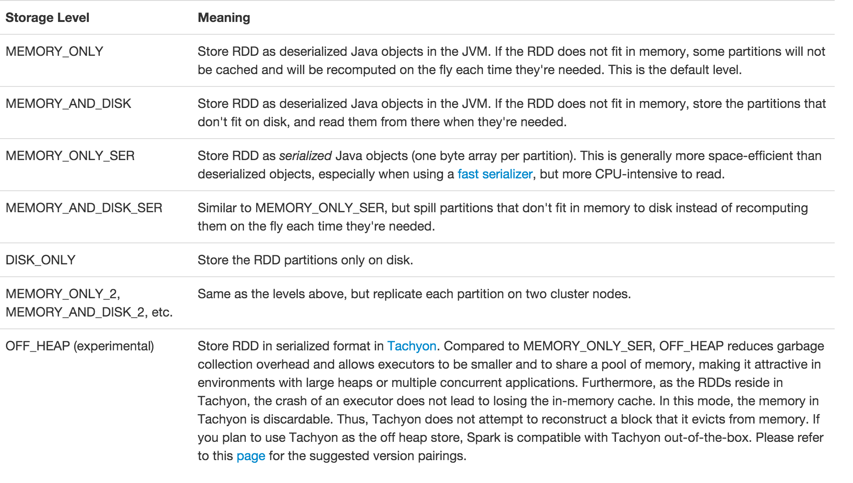
Serialization

Slide 28
Lambda syntax
Lambda’s are unnamed functions
From Alonzo Church’s 1930s work on the Lambda Calculus
In Python, simply:
f = lambda x: x.split()
g = lambda x,y: x+y

Slide 29
Tuples Clever pattern matching
A tuple in Python is just (x,y) or (x,y,z)
You can have tuples in tuples:
(x, (y,w), z)
What parameters do the following functions take and return?
lambda x,y: x+y lambda (x,y): x+y lambda (w,v),(x,y): ((w+x), (v+y)) lambda (x,(y,z)): (x,y+z)

Slide 30
Example
sc = SparkContext()
books = sc.textFile(“books/*”)
mysplit = books.flatMap(lambda line: line.split())
numbered = mysplit.map(lambda word: (word, 1))
wordcount = numbered.reduceByKey(lambda a,b: a+b)
for k,v in wordcount.collect():
print (k,v)
sc.stop()

Slide 31
What doesn’t work in a cluster
counter = 0
rdd = sc.parallelize(data)
# Wrong: Don't do this!!
rdd.foreach(lambda x: counter += 1)
print("Counter value: " + counter)

Slide 32
Apache Spark cluster model

Slide 33
How to count across a cluster?
Accumulators
acc = sc.accumulator(0)
rdd = sc.parallelize(data) rdd.foreach(lambda x: acc.add(1))

Slide 34
What also doesn’t work
rdd.forEach(println)
Of course this will work when you test in local mode

Slide 35
Questions?

