Slide 1
Rockbuster Stealth Analysis
David Byl
1/26/2023

Slide 2
What we are trying to find
Key Questions:
Which movies contributed the most/least to revenue gain?
What was the average rental duration for all videos?
Which countries are Rockbuster customers based in?
Where are customers with a high lifetime value based?
Do sales figures vary between geographic regions?
Initial Question
What is the is the best strategy for Rockbuster to launch its online video service and stay competitive?
This analysis will provide an insight on how best to launch this new streaming service

Slide 3
Data Overview
Number of films: 1000
Number of customers: 599
Rental rate avg: $2.98
Average replacement cost: $19.98
Rental rate max: $4.99
Rental rate min: $0.99
Countries: 109
Average Rental Duration: 4.9 days
Release year for all films: 2006
While there is a lot of insightful data within Rockbuster’s data base including staff information, actors' names, and inventory, shown below is the main insights from the film and customer tables of data
* All this data comes from 2006 only which is a limitation of this database
Answer to Key Question #2

Slide 4
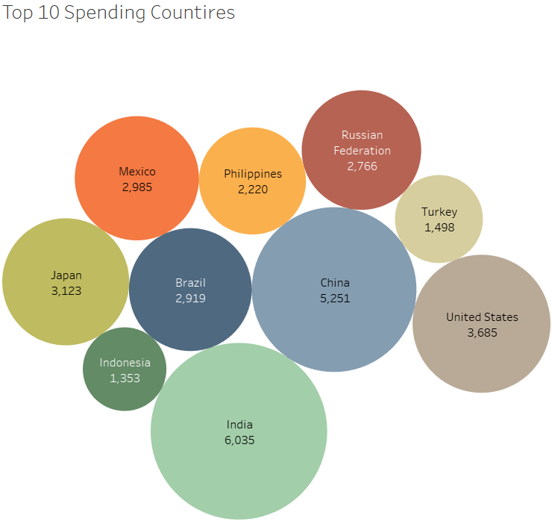
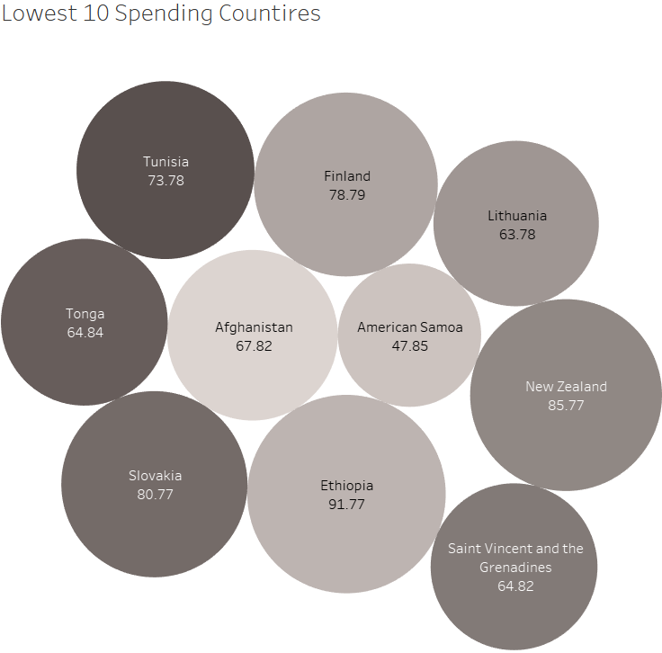
Analysis
Here we can see the top and bottom 10 countries in terms of their overall spending (in 2006). India and China are at the top and American Samoa and Lithuania are at the bottom.

Slide 5
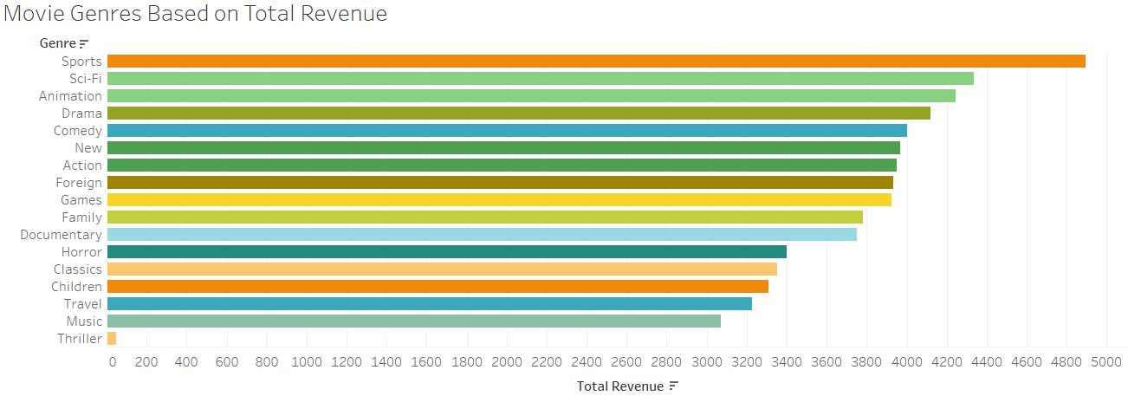
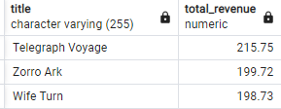
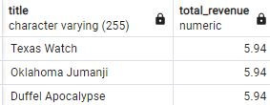
Analysis
Here we can see a summary of the best and worst movie genres based off revenue. At the top there is sports, sci-fi, and animation while travel, music, and thrillers make up the bottom.
On the left, we have a list of the top and bottom 3 preforming movies based again off total revenue.

Slide 6
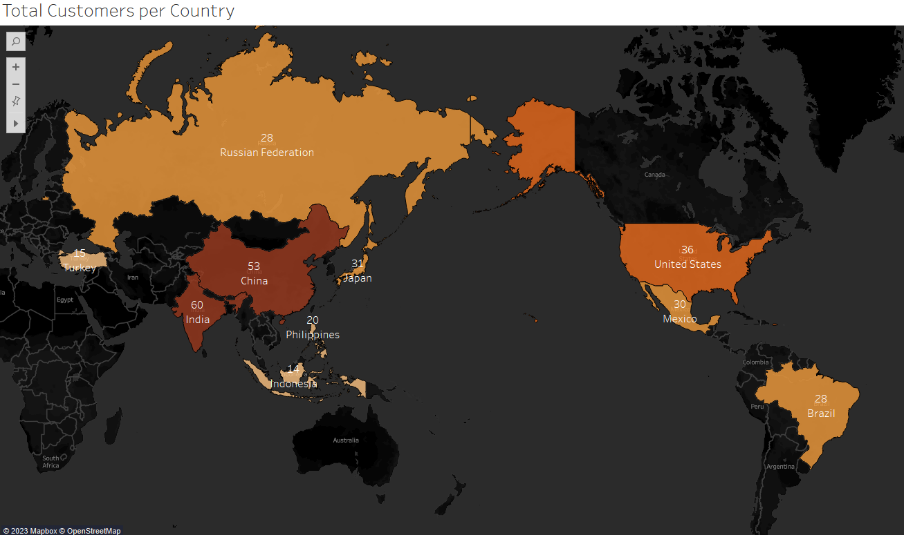
Analysis
This map is showing the top 10 countries with the most Rockbuster customers. We can see that India, China, and the United States are the top 3 countries in terms of customer count and going back to our top 10 spending countries, the order to the top is the exact same.

Slide 7
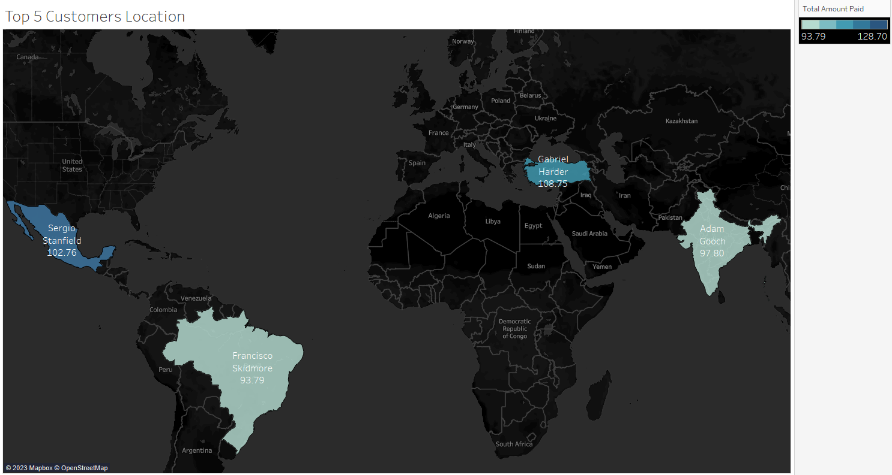
Analysis
The customers on the map below are the top 4 spenders on Rockbuster movie rentals. These customers specifically have the highest lifetime value, and their total spending can also be seen.

Slide 8
Conclusions and recommendations
With our analysis we can recommend the following strategies:
Invest in the top countries like India, China, and the United States
If the goal is to grow, start a marketing campaign in the lower revenue countries such as American Samoa and Lithuania
People love the sports, sci-fi, and animation genre. When launching make sure to have an abundance of those genres on the platform
Show branding with movies like Telegraphic Voyage, Zorro Ark, and Wife turn, aka, our top 3 selling movies.
The top 4 customers have loved our platform. Giving them a reward of some kind, (1 year half off streaming service), will help keep loyalty and will spread from word of mouth to grow our customer base

Slide 9
Questions?
Links to visualization: https://public.tableau.com/app/profile/david.byl

