Slide 1
Binary Analysis using BERT
Explainability of the Input Space
Roman Rankl, Julian Geißinger

Slide 2
Motivation
Measure the importance of certain model inputs for learning about binary function similarity
Recent Research[1] highlights the importance of instructions containing specific opcodes (like „call“ ) within a function
Our approach tries to extend the understanding about the relevance of certain inputs
Instead of measuring the importance between different instructions, we compare the parts of an instruction ( opcode vs. operands )
[1]:Dannehl, M., Valenzuela, S. & Kinder, J. Which Instructions Matter the Most: A Saliency Analysis of Binary Function Embedding Models (2025)

Slide 3
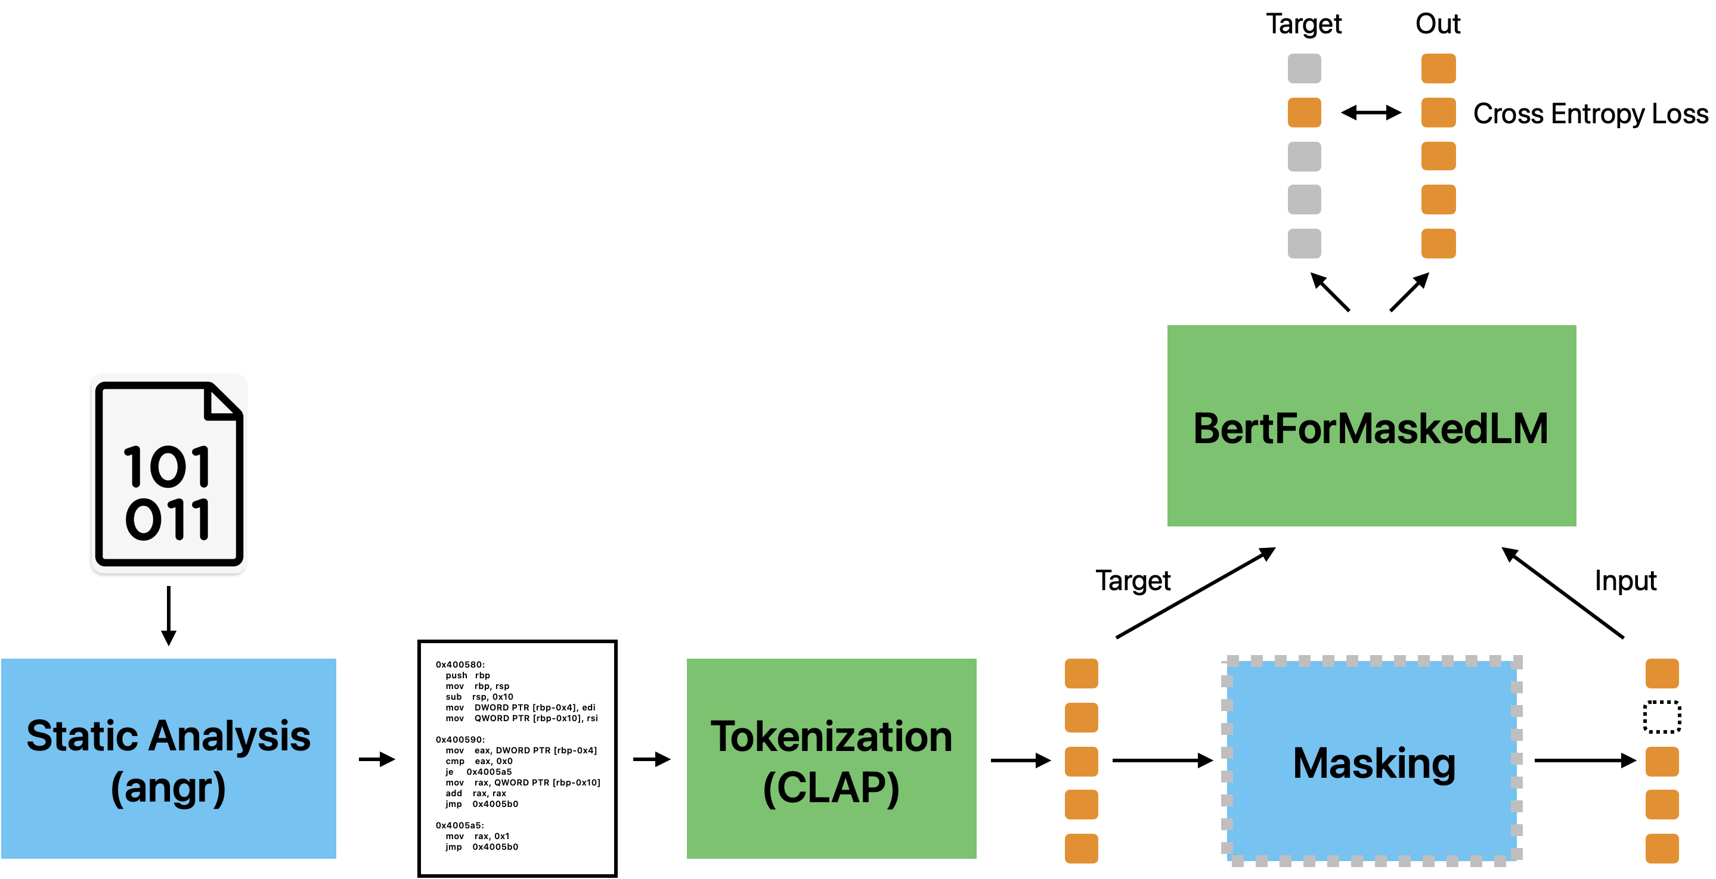
Training Pipeline
Opcode Masking
Operand Masking
[1]
[1] Hao Wang, Zeyu Gao, Chao Zhang, Zihan Sha, Mingyang Sun, Yuchen Zhou, Wenyu Zhu, Wenju Sun, Han Qiu, & Xi Xiao. (2024).
CLAP: Learning Transferable Binary Code Representations with Natural Language Supervision.

Slide 4
Opcode vs. Operand Statistic Masking
Shift the models focus on either opcodes or operands
To train our BERT model we base on traditional Masked Language Modeling
We measure the importance of each category by setting a statistic focus on opcodes and operands

Slide 5
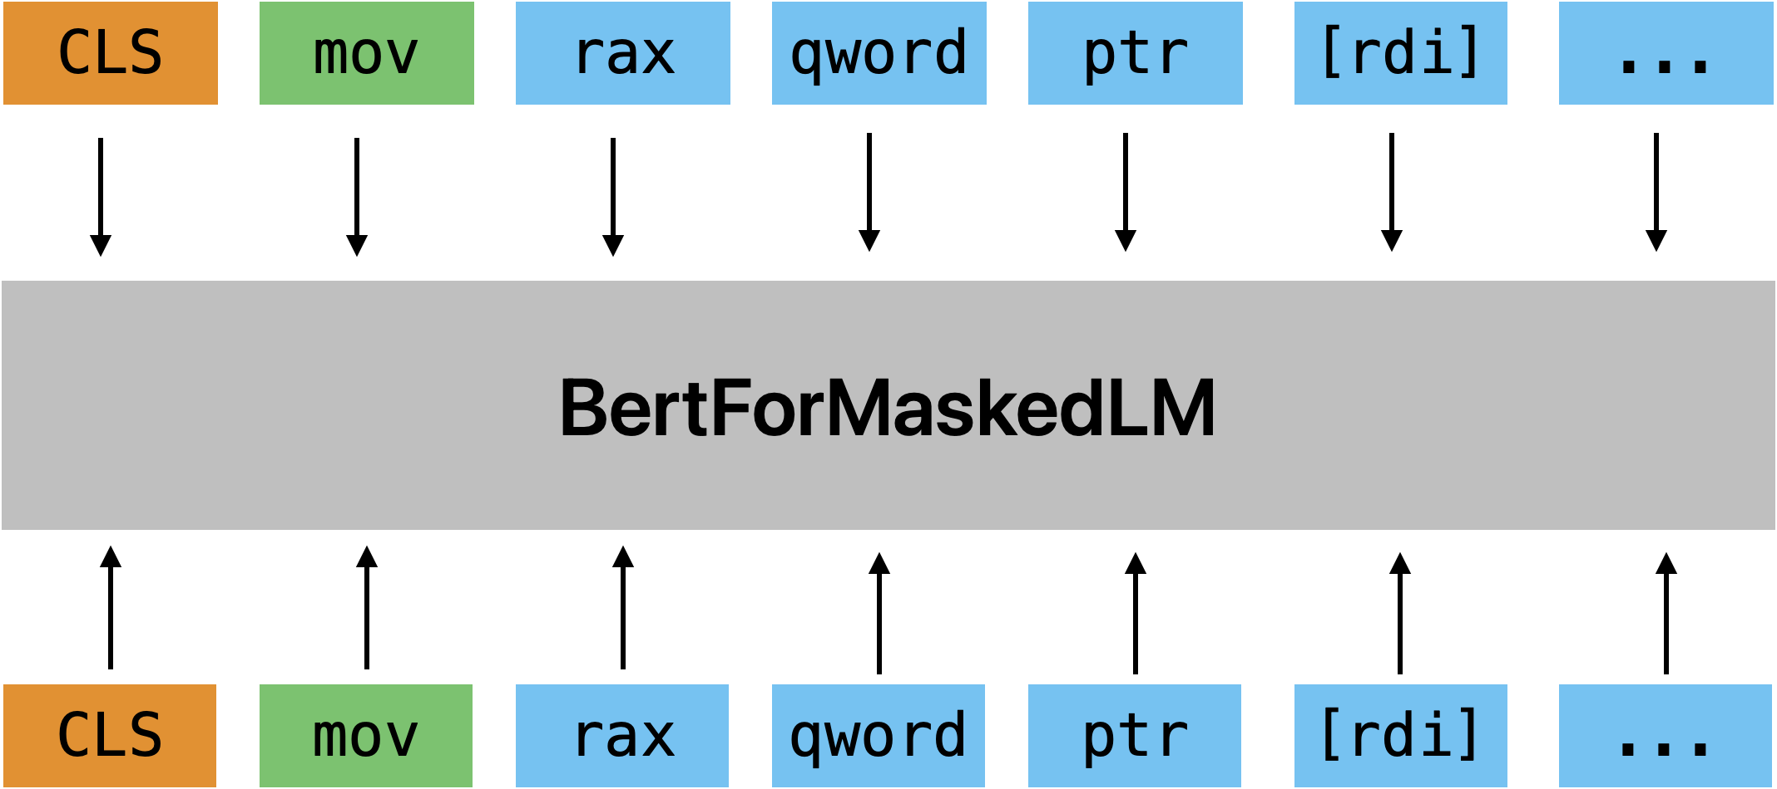
Opcode vs. Operand Statistic Masking
Standard MLM
<mask>
lea

Slide 6
Opcode vs. Operand Statistic Masking
Statistic Opcode / Operand Split MLM
<mask>
lea
Choose the tokens not uniform, but with split_propability*MLM
p = 0.8*0.15
p = 0.2*0.15

Slide 7
Inference
Cosine Similarity
Precompute the output embeddings of the anchor functions of all pools and store them for lookup
Batch process candidates of each pool and compute cosine similarity between anchor & candidates
Take measurements based on the cosine similarities (MRR, Top_K, nDCG)

Slide 8
Inference
Function Pools
Each function pool follows the same structure:
1 Anchor Function, N-Positive Samples, 200 Negative Samples, where N > 7 to only include pools with sufficient function variants
N-Positive Samples:
      N = number of all positive samples across each test project
      Samples that have the same f_name and same file origin are filtered out (duplicates)
      Filter out function variants which contain the exact same assembly instructions, but differ in file origin (prevent spoiling the measurements)

Slide 9
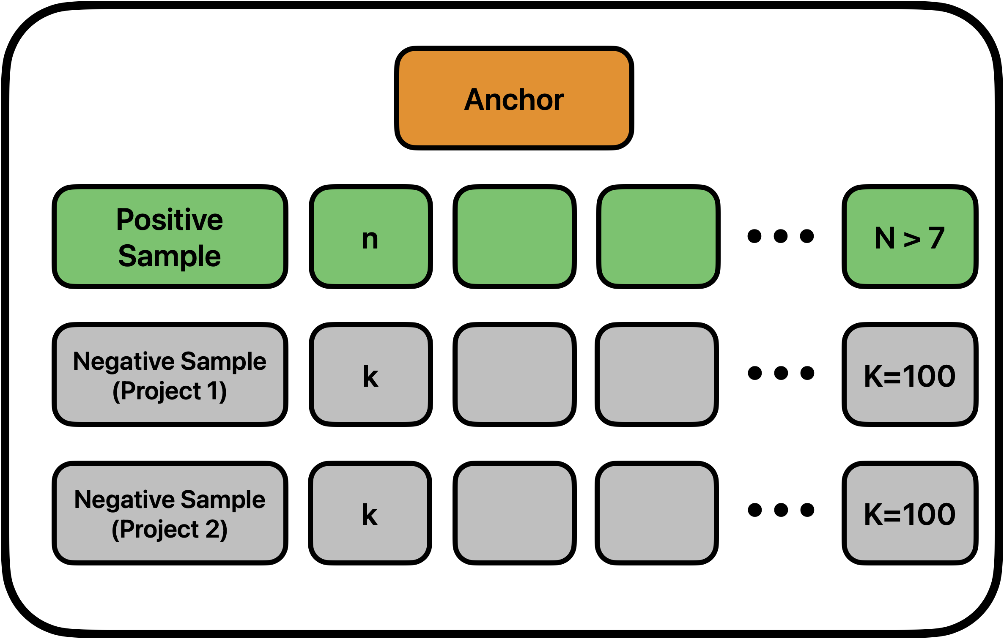
Inference
Function Pool Setup
    Anchor = arbitrary function variant
    N = number of all positive samples across the anchors’ project (mininum 7)
K = number of negative samples per test project

Slide 10
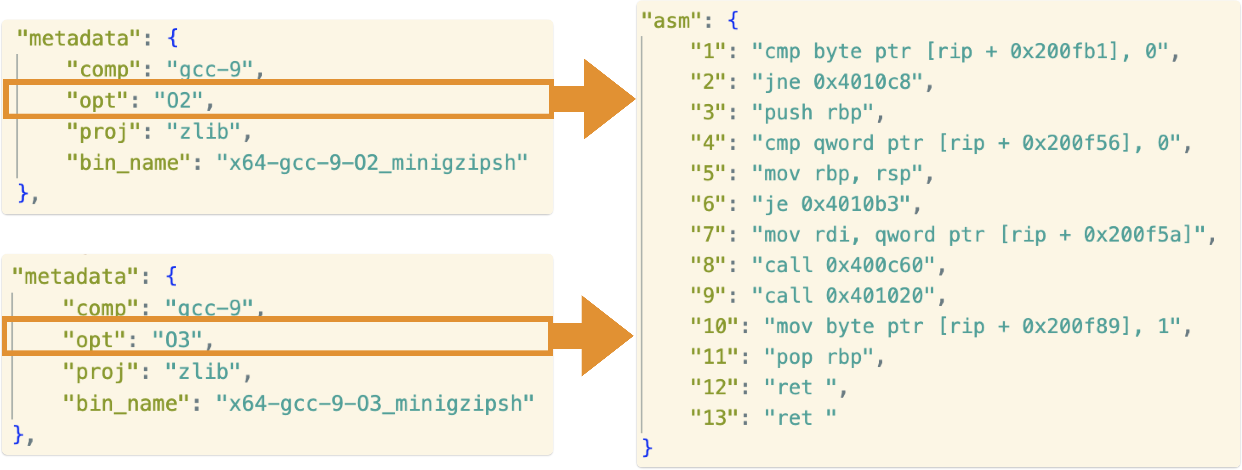
Positive Samples Filtering
Duplicated Assembly
Very Similar Embedding:
—> spoiled measurements

Slide 11
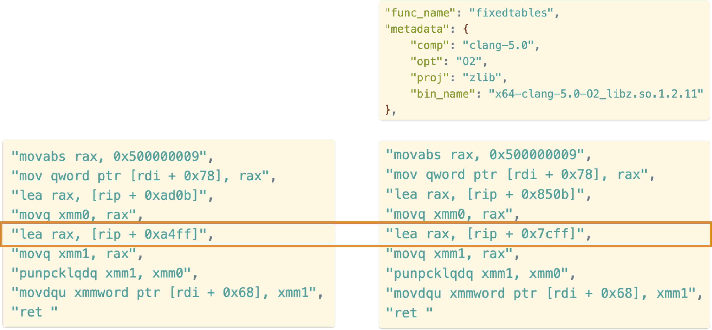
Positive Samples Filtering
same Name, same File
Slight differences in assembly

Slide 12
Inference
Function Pools 2
200 Negative Samples:
    Randomly pick 100 samples from each of the two test projects
    Ensure each sample has a different name than the anchor
Anchor Function:
      Pick an arbitrary variant of similar named functions

Slide 13
Training Configuration
Batch Size | 96
Learning Rate | 0,0001
Epochs | 10
Number of Attention Heads | 4
Number of Hidden Layers | 4
Train Data | clamav, nmap, openssl ( ~ 1GB )
Validation Data | curl ( ~ 40MB )
Test Data | zlib, unrar ( ~ 400MB )
Binary Data Architecture | X64

Slide 14
Results
MLM Split Opcodes/Operands | MRR | nDCG | Prec@10 (top_K)
Random (baseline) | 0.1305 | 0.8339 | 0.8870
90/10 | 0.1316 | 0.8585 | 0.8886
80/20 | 0.1316 | 0.8493 | 0.8893
70/30 | 0.1285 | 0.8226 | 0.8769
60/40
20/80 | 0.1328 | 0.8499 | 0.8936

