Slide 1
Linux Programming
Pthread
www.rt-ics.com
v13958190992@163.com

Slide 2
Topics
Threads
Pthread
Pthread Mutex
Pthread Condition variables
Pthread Main API

Slide 3
Linux Programming
Threads

Slide 4
Threads
Overview
Multithreading Models
Threading Issues
Pthreads
Windows XP Threads
Linux Threads
Java Threads

Slide 5

Single vs. Multithreaded Processes
Process: everything we’ve seen up to now
Thread: like a process, only shares memory, global variables, files, PID
with other threads within the same process

Slide 6
use threads or processes?
Why use threads instead of processes?
  Faster context switch
  Easier to share data
  Uses less memory and resources
  Thread creation faster than process creation
  Less things to set-up
Why use processes instead of threads?
  Different code
  Running on different machines
  Different owners
  Little communication
  Sharing memory can lead to obscure bugs

Slide 7
User-level threads
Threads can be provided at the user or kernel level
User level: kernel knows nothing about threads
Implemented in a library by somebody without touching the kernel
User library handles
  Thread creation
  Thread deletion
  Thread scheduling
Benefits:
  Faster creation and scheduling
Drawbacks:
  One thread blocking during I/O blocks all threads in process (even ready-to-run threads)

Slide 8
User-level threads (cont’d)
Three primary thread libraries:
  POSIX Pthreads
  Win32 threads
  Java threads

Slide 9
Kernel-level threads
Kernel knows about threads
Kernel handles thread creation, deletion, scheduling
Benefits:
  Kernel can schedule another thread if current one does blocking I/O
  Kernel can schedule multiple threads on different CPUs on SMP multiprocessor
Drawbacks:
  Slower to schedule, create, delete than user-level
Most modern OSes support kernel-level threads
  Windows XP/2000
  Solaris
  Linux
  Tru64 UNIX
  Mac OS X

Slide 10
Multithreading Models
How to map kernel-level threads to user-level threads?
  Many-to-One
  One-to-One
  Many-to-Many

Slide 11

Many-to-One Model

Slide 12
Many-to-One
Many user-level threads mapped to single kernel thread
Examples:
  Solaris Green Threads
  GNU Portable Threads
Any disadvantages?
  All block when one blocks
  All run on 1 CPU

Slide 13

One-to-one Model

Slide 14
One-to-One
Each user-level thread maps to a kernel thread
Examples:
  Windows NT/XP/2000
  Linux
  Solaris 9 and later
Any disadvantages?
  Overhead for creating threads
  Many operating systems limit number of threads

Slide 15

Many-to-Many Model

Slide 16
Many-to-Many Model
Allows many user level threads to be mapped to smaller or equal number of kernel threads
Allows the flexibility of choosing the number of kernel threads allocated to a process
“Best of both worlds”
Solaris prior to version 9

Slide 17

Two-level Model

Slide 18
Two-level Model
Similar to many-to-many, but allows a user thread to be bound to kernel thread
Examples
  IRIX
  HP-UX
  Tru64 UNIX
  Solaris 8 and earlier

Slide 19
Threading Issues
Semantics of fork() and exec() system calls
Thread cancellation
Signal handling
Thread pools
Thread-specific data

Slide 20
Semantics of fork() and exec()
Does fork() duplicate only the calling thread or all threads?
Some UNIX systems have two versions of fork()
exec() usually replaces all threads with new program
fork1()
fork2()

Slide 21
Thread Cancellation
Terminating a thread before it has finished
E.g., two cooperating threads, one discovers an error
Two general approaches:
  Asynchronous cancellation terminates the target thread immediately
  Deferred cancellation allows the target thread to periodically check if it should be cancelled
Why is this an issue?
  What if a thread is in the middle of
    Allocating resources
    Performing I/O
    Updating a shared data structure

Slide 22
Thread Cancellation (cont’d)
Essentially, deferred cancellation = “target, please cancel yourself”
  Occurs when target checks for cancellation signal
Allows cancellation at “safe” points
  Called cancellation points in Pthreads

Slide 23
Signal Handling
Signals are used in UNIX to notify a process that a particular event has occurred
A signal handler is used to process signals
  Signal is generated by a particular event
  Signal is delivered to a process
  Signal is handled (or ignored/blocked)
Options:
  Deliver the signal to the thread to which the signal applies
    Applicable with synchronous signals e.g., illegal memory access
  Deliver the signal to every thread in the process
  Deliver the signal to certain threads in the process
  Assign a specific threat to receive all signals for the process

Slide 24
Thread Pooling
When design situations arise that could benefit by using many short-lived threads, thread pooling is a useful technique.
Rather than create a brand new thread for each task, you can have one of the threads from the thread pool pulled out of the pool and assigned to the task.
When the thread is finished with task, it adds itself back to the pool and waits for another assignment

Slide 25
Benefits of Thread Pooling
You can reduce response time because a thread is already constructed and started and is simply waiting for its next task. In the case of an HTTP server, an available thread in the pool can deliver each new file requested
Threads are fixed in size at the time of construction. All the threads are started, and then each goes into a wait state until a task is assigned to it. If all the threads are currently assigned a task, new service requests will put into a wait state until one of the threads finishes its task and returns itself to the pool.

Slide 26
Thread Pools
Motivating example: a web server running on an SMP machine
To handle each connection:
  Create a new process to handle it
    too slow, inefficient
  Create a new thread to handle it
Option 2 better but still has some problems:
  Some overhead for thread creation/deletion
  Thread will only be used for this connection
  Unbounded number of threads might crash web server
Better solution: use a thread pool of (usually) fixed size

Slide 27
Thread Pools (cont’d)
Threads in pool sit idle
Request comes in:
  Wake up a thread in pool
  Assign it the request
  When it completes, return it to pool
  If no threads in pool available, wait
Advantages:
  Usually slightly faster to wake up an existing thread than create a new one
  Allows the number of threads in the application to be limited by the size of the pool
  More sophisticated systems dynamically adjust pool size

Slide 28
Thread-specific Data
Allows each thread to have its own copy of data
Useful for implementing protection
  For example, user connects to bank’s database server
  Server process responds, has access to all accounts
  Multiple people may be accessing their accounts at the same time
  Thread assigned to manipulate or view user’s bank account
  Using thread-specific data limits (unintentional or erroneous) access by other threads

Slide 29
Pthreads
A POSIX standard (IEEE 1003.1c) API for thread creation and synchronization
  NOT an implementation
  Implementation in different OSes may be using user or kernel threads
Common in UNIX operating systems (Solaris, Linux, Mac OS X)
Fairly portable
Available on pyrite
Has man pages on Linux (check “man pthread_create”)
To use:
  #include <pthread.h>
  Link with pthread library: g++ prog.cc -lpthread

Slide 30
Windows XP Threads
Implements the one-to-one mapping
Each thread contains
  A thread id
  Register set
  Separate user and kernel stacks
  Private data storage area
The register set, stacks, and private storage area are known as the context of the threads

Slide 31
Linux Threads
Linux refers to them as tasks rather than threads
Thread creation is done through the clone() system call
clone() allows a child task to share different things with the parent task such as:
  the address space
  the table of open files
  the signal handlers
If nothing is shared: same as fork(), creates essentially a process
If everything is shared: creates a thread as we know it

Slide 32
Linux Threads (cont’d)
int clone(int (*fn)(void *), void *child_stack, int flags, void *arg);
clone() is used to create kernel-level threads
PCB1
PCB2 (cloned from PCB1)
open files
files
open files
address space
memory space
address space
To the user: PCB1 and PBC2 are
“kernel-level threads within the same process”
To the kernel: PCB1 and PCB 2 are processes (tasks)

Slide 33
Java Threads
Java threads are managed by the JVM
Java threads may be created by:
  Extending Thread class
  Implementing the Runnable interface
Details in textbook

Slide 34
Linux Programming
Pthread

Slide 35
Thread Basic
Thread operations include thread creation, termination, synchronization, data management
Threads in the same process share:
Process address space, instructions and most data
Opened files
Signals and signal handles
Each thread has a unique:
Thread ID
A register set
Stack
Local variables and return address

Slide 36
Pthreads: POSIX Threads
Pthreads is a standard set of C library functions for multithreaded programming
  IEEE Portable Operating System Interface, POSIX, section 1003.1 standard, 1995
Pthread Library (60+ functions)
  Thread management: create, exit, detach, join, . . .
  Thread cancellation
  Mutex locks: init, destroy, lock, unlock, . . .
  Condition variables: init, destroy, wait, timed wait, . . .
  . . .
Programs must include the file pthread.h
Programs must be linked with the pthread library (-lpthread)

Slide 37
Pthreads Naming Convention
Types: pthread[_object]_t
Functions: pthread[_object]_action
Constants/Macros: PTHREAD_PURPOSE
Examples:
  pthread_t: the type of a thread
  pthread_create(): creates a thread
  pthread_mutex_t: the type of a mutex lock
  pthread_mutex_lock(): lock a mutex
  PTHREAD_CREATE_DETACHED

Slide 38
Pthread – POSIX thread
Include pthread header file
# include <pthread.h>
Compile and execution
C compiler: gcc –o foo foo.c -lpthread
C++ compiler: g++ -o foo foo.c –lpthread
Execution: ./foo

Slide 39
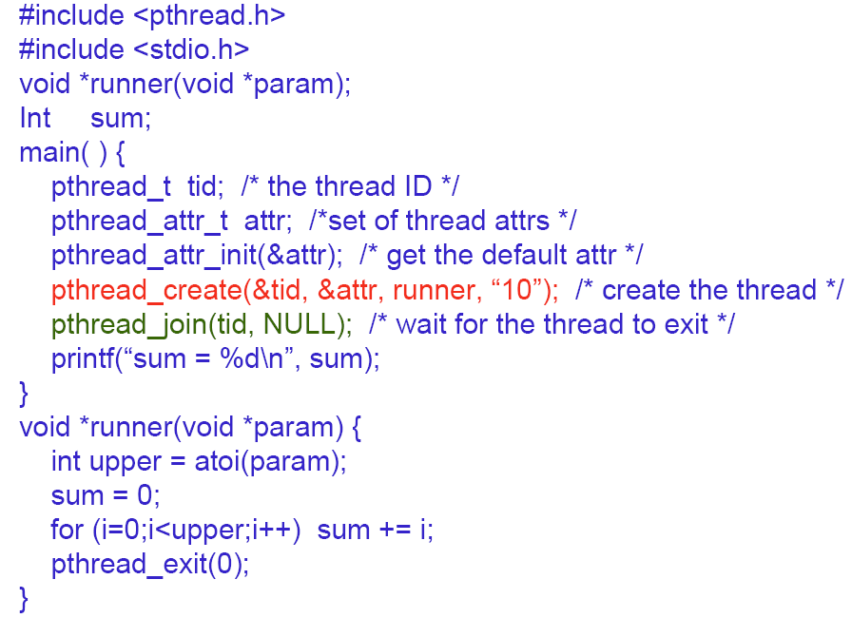
Example

Slide 40
Pthread – POSIX thread
Basic pthread functions
  pthread_create – create child thread
  pthread_exit – thread termination
  pthread_join – wait for thread termination
  phtread_mutex_lock – lock critical section
  pthread_mutex_unlock – unlock critical section
  pthread_cond_wait – wait for a condition signal
  phtread_cond_signal – wake up one waiting thread
  pthread_cond_broadcast – wake up all waiting threads

Slide 41
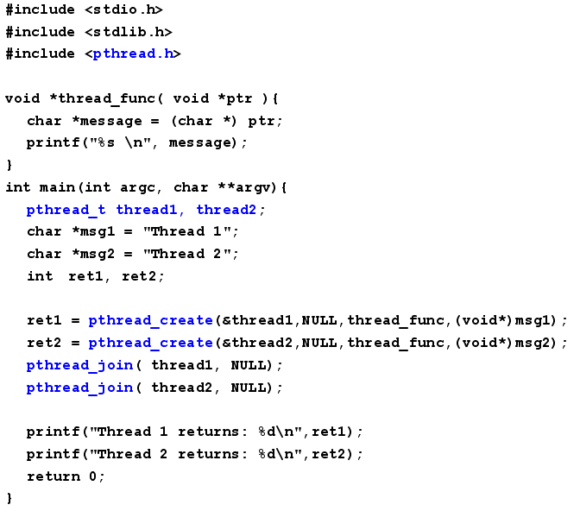

Slide 42
pthread_self()
Returns the thread identifier for the calling thread
  At any point in its instruction stream a thread can figure out which thread it is
  Convenient to be able to write code that says: “If you’re thread 1 do this, otherwise do that”
  However, the thread identifier is an opaque object (just a pthread_t value)
  you must use pthread_equal() to test equality
pthread_t pthread_self(void);
int pthread_equal(pthread_t id1, pthread_t id2);

Slide 43
pthread_create()
Creates a new thread
  int pthread_create (
  pthread_t *thread,
  pthread_attr_t *attr,
  void * (*start_routine) (void *),
  void *arg);
  Returns 0 to indicate success, otherwise returns error code
  thread: output argument for the id of the new thread
  attr: input argument that specifies the attributes of the thread to be created (NULL = default attributes)
  start_routine: function to use as the start of the new thread
    must have prototype: void * foo(void*)
  arg: argument to pass to the new thread routine
    If the thread routine requires multiple arguments, they must be passed bundled up in an array or a structure

Slide 44
pthread_create() example
Want to create a thread to compute the sum of the elements of an array
void *do_work(void *arg);
Needs three arguments
  the array, its size, where to store the sum
  we need to bundle them in a structure
struct arguments {
double *array;
int size;
double *sum;
}

Slide 45
pthread_create() example
int main(int argc, char *argv) {
double array[100];
double sum;
pthread_t worker_thread;
struct arguments *arg;
arg = (struct arguments *)calloc(1,
sizeof(struct arguments));
arg->array = array;
arg->size=100;
arg->sum = &sum;
if (pthread_create(&worker_thread, NULL,
do_work, (void *)arg)) {
fprintf(stderr,”Error while creating thread\n”);
exit(1);
}
...
}

Slide 46
pthread_create() example
void *do_work(void *arg) {
struct arguments *argument;
int i, size;
double *array;
double *sum;
argument = (struct arguments*)arg;
size = argument->size;
array = argument->array;
sum = argument->sum;
*sum = 0;
for (i=0;i<size;i++)
*sum += array[i];
return NULL;
}

Slide 47
Comments about the example
The “main thread” continues its normal execution after creating the “child thread”
IMPORTANT: If the main thread terminates, then all threads are killed!
  We will see that there is a join() function
Of course, memory is shared by the parent and the child (the array, the location of the sum)
  nothing prevents the parent from doing something to it while the child is still executing
  which may lead to a wrong computation
  we will see that Pthreads provide locking mechanisms
The bundling and unbundling of arguments is a bit tedious

Slide 48
Memory Management of Args
The parent thread allocates memory for the arguments
Warning #1: you don’t want to free that memory before the child thread has a chance to read it
  That would be a race condition
  Better to let the child do the freeing
Warning #2: if you create multiple threads you want to be careful there is no sharing of arguments, or that the sharing is safe
  For instance, if you reuse the same data structure for all threads and modify its fields before each call to pthread_create(), some threads may not be able to read the arguments destined to them
  Safest way: have a separate arg structure for each thread

Slide 49
pthread_exit()
Terminates the calling thread
void pthread_exit(void *retval);
  The return value is made available to another thread calling a pthread_join() (see next slide)
  My previous example had the thread just return from function do_work()
    In this case the call to pthread_exit() is implicit
    The return value of the function serves as the argument to the (implicitly called) pthread_exit().

Slide 50
pthread_join()
Causes the calling thread to wait for another thread to terminate
int pthread_join(
pthread_t thread,
void **value_ptr);
  thread: input parameter, id of the thread to wait on
  value_ptr: output parameter, value given to pthread_exit() by the terminating thread (which happens to always be a void *)
  returns 0 to indicate success, error code otherwise
  multiple simultaneous calls for the same thread are not allowed

Slide 51
pthread_kill()
Causes the termination of a thread
int pthread_kill(
pthread_t thread,
int sig);
  thread: input parameter, id of the thread to terminate
  sig: signal number
  returns 0 to indicate success, error code otherwise

Slide 52
pthread_join() example
int main(int argc, char *argv) {
double array[100];
double sum;
pthread_t worker_thread;
struct arguments *arg;
void *return_value;
arg = (struct arguments *)calloc(1,sizeof(struct arguments));
arg->array = array;
arg->size=100;
arg->sum = &sum;
if (pthread_create(&worker_thread, NULL,
do_work, (void *)arg)) {
fprintf(stderr,”Error while creating thread\n”);
exit(1);
}
...
if (pthread_join(worker_thread, &return_value)) {
fprintf(stderr,”Error while waiting for thread\n”);
exit(1);
}
}

Slide 53
pthread_join() Warning
This is a common “bug” that first-time pthread programmers encounter
Without the call to pthread_join() the previous program may end immediately, with the main thread reaching the end of main() and exiting, thus killing all other threads perhaps even before they have had a chance to execute

Slide 54
pthread_join() Warning
When creating multiple threads be careful to store the handle of each thread in a separate variable
  Typically one has an array of thread handles
That way you’ll be able to call pthread_join() for each thread
Also, note that the following code is sequential!
  for (i=0; i < num_threads; i++) {
  pthread_create(&(threads[i]),...)
  pthread_join(threads[i],...)
  }

Slide 55
Thread Attributes
One of the parameters to pthread_create() is a thread attribute
In all our previous examples we have set it to NULL
But it can be very useful and provides a simple way to set options:
  Initialize an attribute
  Set its value with some Pthread API call
  Pass it to Pthread API functions like pthread_create()

Slide 56
pthread_attr_init()
Initialized the thread attribute object to the default values
int pthread_attr_init(
pthread_attr_t *attr);
  Return 0 to indicate success, error code otherwise
  attr: pointer to a thread attribute

Slide 57
Detached Thread
One option when creating a thread is whether it is joinable or detached
  Joinable: another thread can call join on it
    By default a thread is joinable
  Detached: no thread can call join on it
Let’s look at the function that allows to set the “detached state”

Slide 58
pthread_attr_setdetachstate()
Sets the detach state attribute
int pthread_attr_setdetachstate(
pthread_attr_t *attr,
int detachstate);
  returns 0 to indicate success, error code otherwise
  attr: input parameter, thread attribute
  detachstate: can be either
    PTHREAD_CREATE_DETACHED
    PTHREAD_CREATE_JOINABLE (default)

Slide 59
Detach State
Detached threads have all resources freed when they terminate
Joinable threads have state information about the thread kept even after they finish
  To allow for a thread to join a finished thread
  So-called “no rush to join”
So, if you know that you will not need to join a thread, create it in a detached state so that you save resources
This is lean-and-mean C, as opposed to hand-holding Java, and every little saving is important

Slide 60
Creating a Detached Thread
#include <pthread.h>
#define NUM_THREAD 25
void *thread_routine (void *arg) {
printf(“Thread %d, my TID is %u\n”,
(int)arg, pthread_self());
pthread_exit(0);
}

Slide 61
Creating a Detached Thread
int main() {
pthread_attr_t attr;
pthread_t tids[NUM_THREADS];
int x;
pthread_attr_init(&attr);
pthread_attr_setdetachstate(&attr,PTHREAD_CREATE_DETACHED);
phthread_create(&(tids[x]),
&attr,
thread_routine,
(void *)x);
. . . // should take a while otherwise
. . . // the child may not have time to run
}

Slide 62
Mutual Exclusion and Pthreads
Pthreads provide a simple mutual exclusion lock
Lock creation
int pthread_mutex_init(
pthread_mutex_t *mutex, const pthread_mutexattr_t *attr);
  returns 0 on success, an error code otherwise
  mutex: output parameter, lock
  attr: input, lock attributes
    NULL: default
    There are functions to set the attribute (look at the man pages if you’re interested)

Slide 63
Linux Programming pthread mutex

Slide 64
Pthread: Locking
Locking a lock
  If the lock is already locked, then the calling thread is blocked
  If the lock is not locked, then the calling thread acquires it
int pthread_mutex_lock(
pthread_mutex_t *mutex);
  returns 0 on success, an error code otherwise
  mutex: input parameter, lock

Slide 65
Pthread: Locking
Just checking
  Returns instead of locking
int pthread_mutex_trylock(
pthread_mutex_t *mutex);
  returns 0 on success, EBUSY if the lock is locked, an error code otherwise
  mutex: input parameter, lock

Slide 66
Synchronizing pthreads
Releasing a lock
int pthread_mutex_unlock(
pthread_mutex_t *mutex);
  returns 0 on success, an error code otherwise
  mutex: input parameter, lock
Pthreads implement exactly the concept of locks as it was described in the previous lecture notes

Slide 67
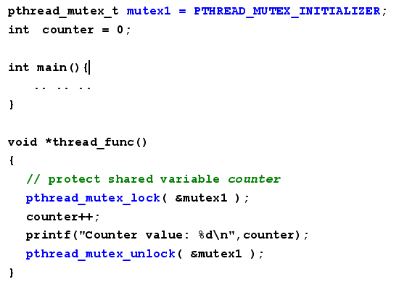
Mutex example

Slide 68
Cleaning up memory
Releasing memory for a mutex attribute
int pthread_mutex_destroy(
pthread_mutex_t *mutex);
Releasing memory for a mutex
int pthread_mutexattr_destroy(
pthread_mutexattr_t *mutex);

Slide 69
Linux Programming pthread Condition variables

Slide 70
Pthread Synchronization
Condition variables –
Condition variable is used with the appropriate functions for waiting and later continuation
Creating/Destroying:
pthread_cond_init()
pthread_cond_t cond = PTHREAD_COND_INITIALIZER;
Pthread_cond_destroy()
Waiting on condition:
pthread_cond_wait()
pthread_cond_timewait(timeout)
Waking thread based on condition:
pthread_cond_signal() – wake any one thread
phread_cond_broadcast() - wake up all threads blocked

Slide 71
Condition Variables
Pthreads also provide condition variables as they were described in the previous lecture notes
Condition variables are of the type pthread_cond_t
They are used in conjunction with mutex locks
Let’s look at the API’s functions

Slide 72
pthread_cond_init()
Creating a condition variable
int pthread_cond_init(
pthread_cond_t *cond,
const pthread_condattr_t *attr);
  returns 0 on success, an error code otherwise
  cond: output parameter, condition
  attr: input parameter, attributes (default = NULL)

Slide 73
pthread_cond_wait()
Waiting on a condition variable
int pthread_cond_wait(
pthread_cond_t *cond,
pthread_mutex_t *mutex);
  returns 0 on success, an error code otherwise
  cond: input parameter, condition
  mutex: input parameter, associated mutex

Slide 74
pthread_cond_signal()
Signaling a condition variable
int pthread_cond_signal(
pthread_cond_t *cond;
  returns 0 on success, an error code otherwise
  cond: input parameter, condition
“Wakes up” one thread out of the possibly many threads waiting for the condition
  The thread is chosen non-deterministically

Slide 75
pthread_cond_broadcast()
Signaling a condition variable
int pthread_cond_broadcast(
pthread_cond_t *cond;
  returns 0 on success, an error code otherwise
  cond: input parameter, condition
“Wakes up” ALL threads waiting for the condition
  May be useful in some applications

Slide 76
Condition Variable: example
Say I want to have multiple threads wait until a counter reaches a maximum value and be awakened when it happens
  pthread_mutex_lock(&lock);
  while (count < MAX_COUNT) {
  pthread_cond_wait(&cond,&lock);
  }
  pthread_mutex_unlock(&lock)
  Locking the lock so that we can read the value of count without the possibility of a race condition
  Calling pthread_cond_wait() in a while loop to avoid “spurious wakes ups”
  When going to sleep the pthread_cond_wait() function implicitly releases the lock
  When waking up the pthread_cond_wait() function implicitly acquires the lock
  The lock is unlocked after exiting from the loop

Slide 77
pthread_cond_timed_wait()
Waiting on a condition variable with a timeout
int pthread_cond_timedwait(
pthread_cond_t *cond,
pthread_mutex_t *mutex,
const struct timespec *delay);
  returns 0 on success, an error code otherwise
  cond: input parameter, condition
  mutex: input parameter, associated mutex
  delay: input parameter, timeout (same fields as the one used for gettimeofday)

Slide 78
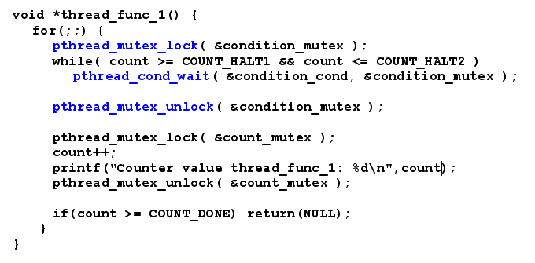
Synchronization – Condition example

Slide 79
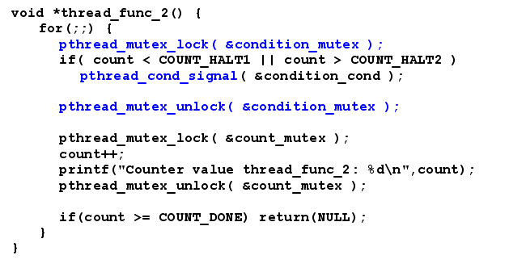
Synchronization – Condition example(con’t)

Slide 80
Putting a Pthread to Sleep
To make a Pthread thread sleep you should use the usleep() function
#include <unistd.h>
int usleep(usecond_t microseconds);
Do not use the sleep() function as it may not be safe to use it in a multi-threaded program

Slide 81
PThreads: Conclusion
Pthreads implement everything we talked about in the previous set of lecture notes almost directly
There are many other useful functions, some which you may even need for your programming assignment
  e.g., Read/Write locks

Slide 82
Beyond Locks and Cond. Vars
At this point, we have everything we need to write concurrent programs
  Locks for efficient mutual exclusion
  Condition variables for non-wasteful thread synchronization and/or communication
In the next lecture we’ll see another abstraction for thread synchronization and mutual exclusion: Semaphores

Slide 83
Pthread Basic
The same function is used in each thread, but the arguments of each thread are different
Thread termination
  thread itself calls pthread_exit() explictly
  main process exits and all threads are terminated
Be careful to the order of mutex posted or it may cause deadlock

Slide 84
Linux Programming pthread main api

Slide 85
Main API
pthread_atfork - register handlers to be called at fork(2) time
pthread_attr_destroy [pthread_attr_init] - thread creation attributes
pthread_attr_getdetachstate [pthread_attr_init] - thread creation attributes
pthread_attr_getinheritsched [pthread_attr_init] - thread creation attributes
pthread_attr_getschedparam [pthread_attr_init] - thread creation attributes
pthread_attr_getschedpolicy [pthread_attr_init] - thread creation attributes
pthread_attr_getscope [pthread_attr_init] - thread creation attributes

Slide 86
Main API
pthread_attr_init - thread creation attributes
pthread_attr_setdetachstate [pthread_attr_init] - thread creation attributes
pthread_attr_setinheritsched [pthread_attr_init] - thread creation attributes
pthread_attr_setschedparam [pthread_attr_init] - thread creation attributes
pthread_attr_setschedpolicy [pthread_attr_init] - thread creation attributes
pthread_attr_setscope [pthread_attr_init] - thread creation attributes
pthread_cancel - thread cancellation

Slide 87
Main API
pthread_cleanup_pop [pthread_cleanup_push] - install and remove cleanup handlers
pthread_cleanup_pop_restore_np [pthread_cleanup_push] - install and remove cleanup handlers
pthread_cleanup_push - install and remove cleanup handlers
pthread_cleanup_push_defer_np [pthread_cleanup_push] - install and remove cleanup handlers

Slide 88
Main API
pthread_condattr_destroy [pthread_condattr_init] - condition creation attributes
pthread_condattr_init - condition creation attributes
pthread_cond_broadcast [pthread_cond_init] - operations on conditions
pthread_cond_destroy [pthread_cond_init] - operations on conditions
pthread_cond_init - operations on conditions
pthread_cond_signal [pthread_cond_init] - operations on conditions
pthread_cond_timedwait [pthread_cond_init] - operations on conditions
pthread_cond_wait [pthread_cond_init] - operations on conditions

Slide 89
Main API
pthread_create - create a new thread
pthread_detach - put a running thread in the detached state
pthread_equal - compare two thread identifiers
pthread_exit - terminate the calling thread

Slide 90
Main API
pthread_getschedparam [pthread_setschedparam] - control thread scheduling parameters
pthread_getspecific [pthread_key_create] - management of thread-specific data
pthread_join - wait for termination of another thread
pthread_key_create - management of thread-specific data
pthread_key_delete [pthread_key_create] - management of thread-specific data
pthread_kill_other_threads_np - terminate all threads in program except calling thread
pthread_kill [pthread_sigmask] - handling of signals in threads

Slide 91
Main API
pthread_mutexattr_destroy [pthread_mutexattr_init] - mutex creation attributes
pthread_mutexattr_getkind_np [pthread_mutexattr_init] - mutex creation attributes
pthread_mutexattr_init - mutex creation attributes
pthread_mutexattr_setkind_np [pthread_mutexattr_init] - mutex creation attributes
pthread_mutex_destroy [pthread_mutex_init] - operations on mutexes
pthread_mutex_init - operations on mutexes
pthread_mutex_lock [pthread_mutex_init] - operations on mutexes
pthread_mutex_trylock [pthread_mutex_init] - operations on mutexes
pthread_mutex_unlock [pthread_mutex_init] - operations on mutexes

Slide 92
Main API
pthread_once - once-only initialization
pthread_self - return identifier of current thread
pthread_setcancelstate [pthread_cancel] - thread cancellation
pthread_setcanceltype [pthread_cancel] - thread cancellation
pthread_setschedparam - control thread scheduling parameters
pthread_setspecific [pthread_key_create] - management of thread-specific data
pthread_sigmask - handling of signals in threads
pthread_testcancel [pthread_cancel] - thread cancellation

Slide 93
Reference
PThread Tutorial: https://computing.llnl.gov/tutorials/pthreads/
http://www.humanfactor.com/pthreads/
http://www.yolinux.com/TUTORIALS/LinuxTutorialPosixThreads.html
QNX 632 Help.chm

Slide 94
THANKS

