Slide 1
VBA Project Walkthrough

Slide 2
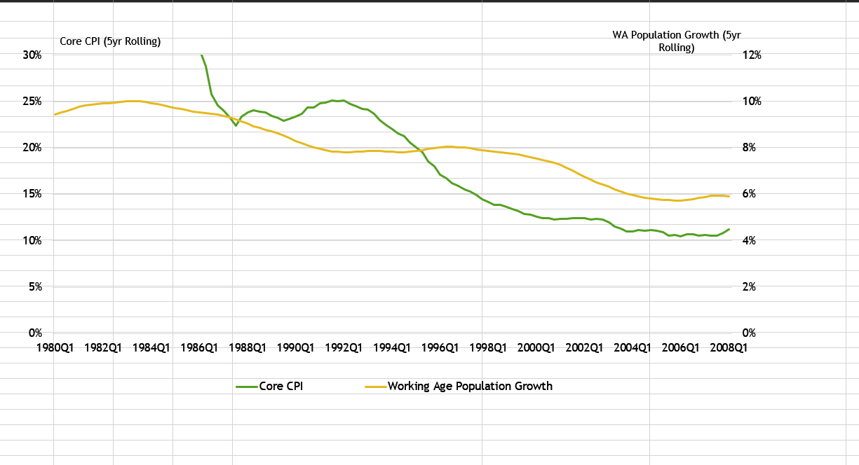
Original Chart

Slide 3
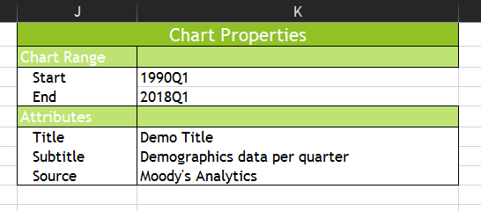
CHANGING CHART PROPERTIES…

Slide 4
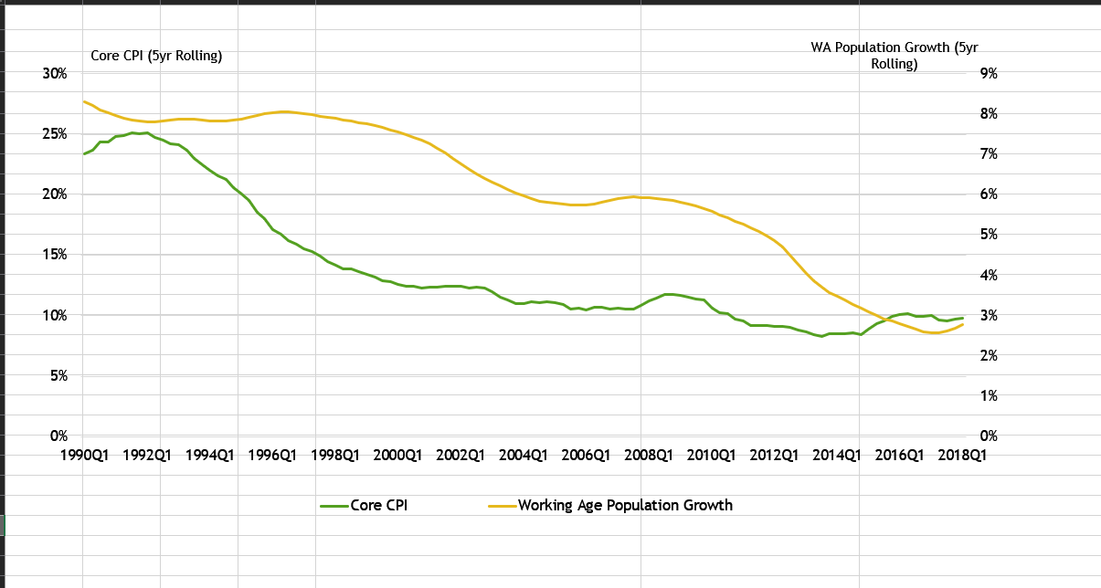
NEW Chart

Slide 5
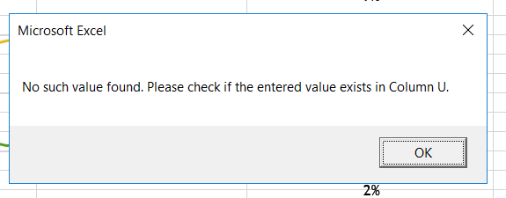
IF THE VALUE ENTERED In CHART PROPERTIES Doesn't EXIST …

Slide 6
WHEN YOU RUN the ‘CREATE PPT’ MACRO…

Slide 7
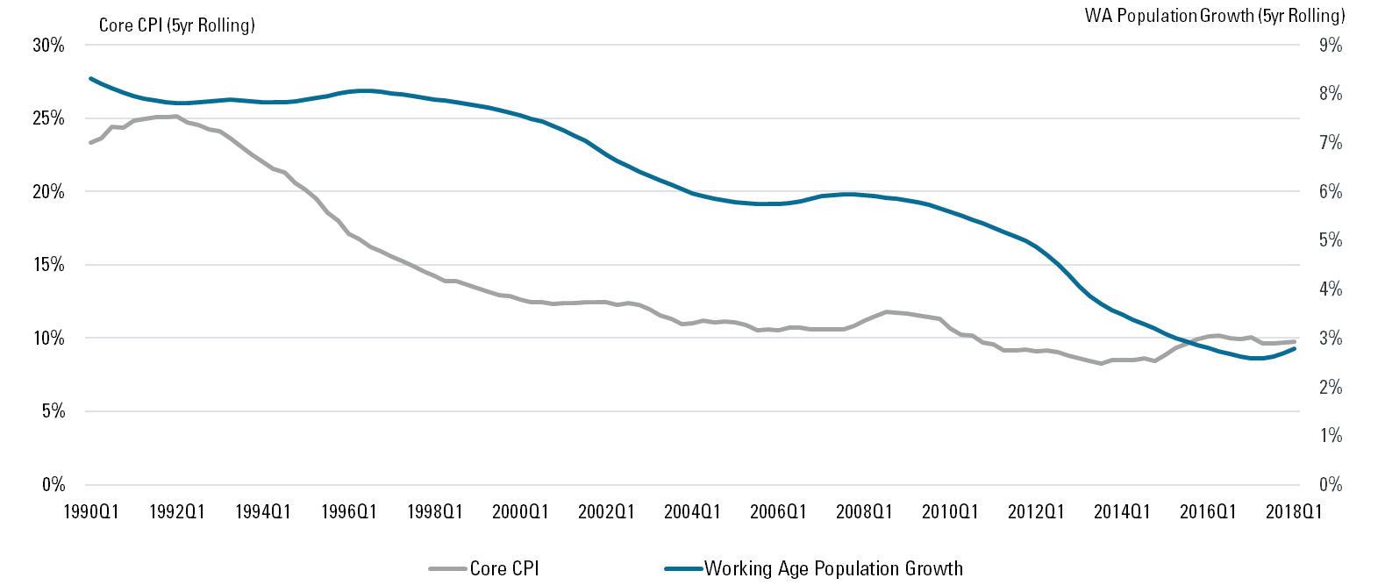
Demo Title
Demographics data per quarter
Moody's Analytics

Slide 8
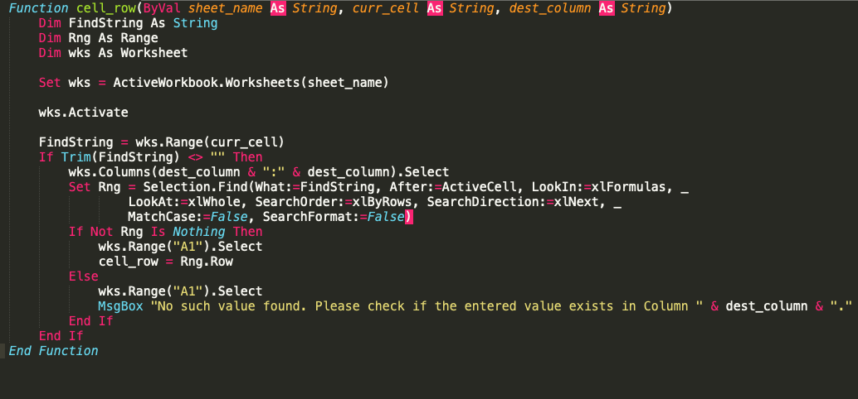
VBA CODE SNIPPETS

Slide 9
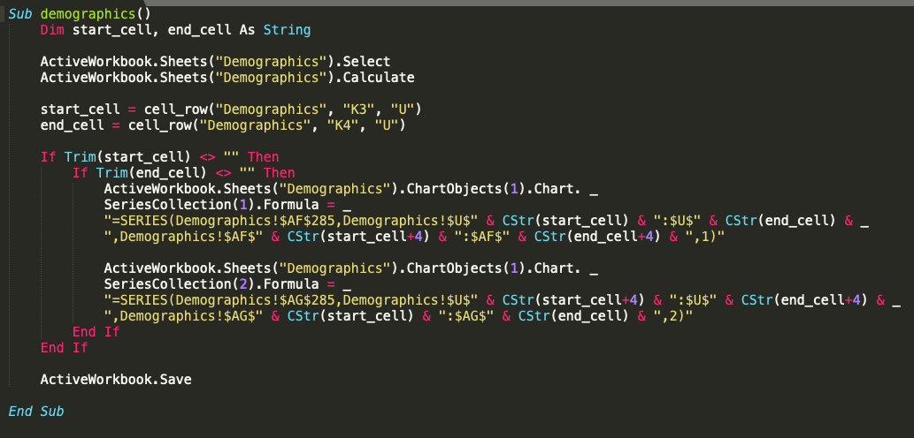
VBA CODE SNIPPETS

Slide 10
THANK YOU

