Slide 1

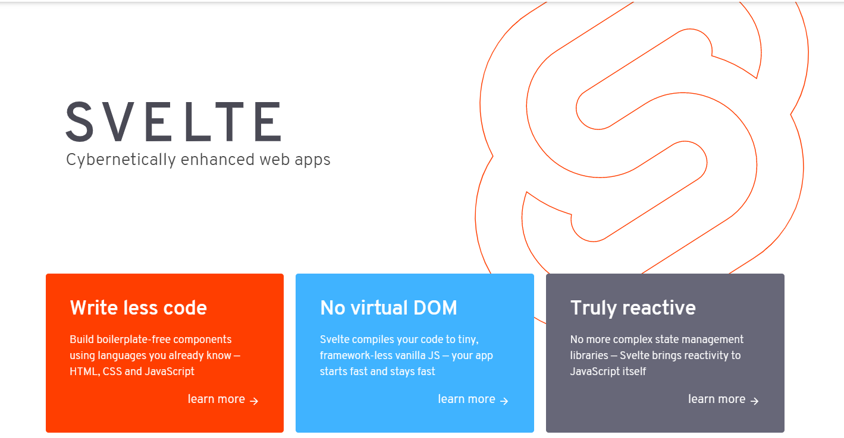
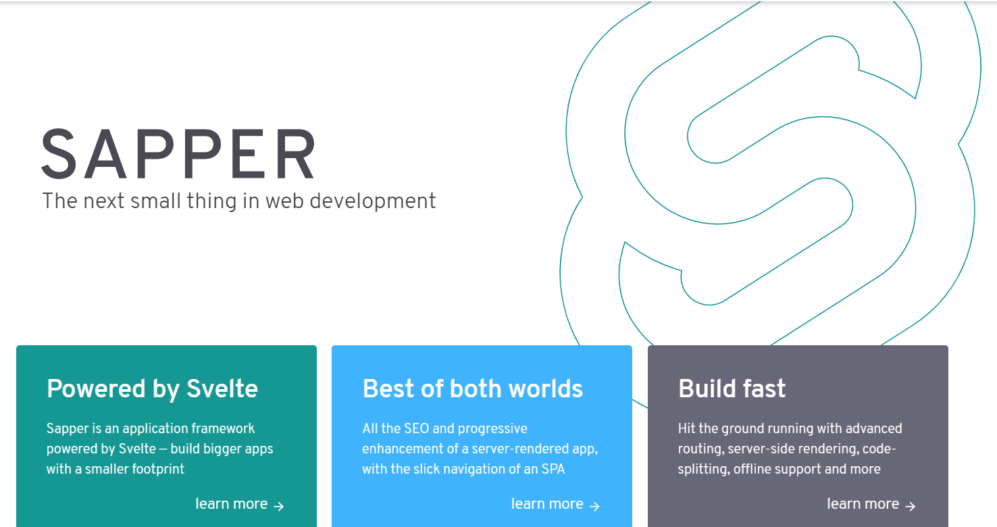
Intro to Svelte 3 & Sapper The return of ‘Write Less, Do More’
By
Julio ZINGA
(02/21/2020)

Slide 2
Svelte & Sapper-intro
History
Developer : Rich Harris (11/2016)
Current version:
Svelte 3.18.2 (02/2020)
Sapper v0.27.9 (09/2019)
Svelte -> Compiler and framework JS to create optimized, efficient and reactive apps (React, Vue & Angular)
Sapper -> Framework JS (SPA routing, SSR, PWA, SEO…) based on Polka (express), Svelte & Rust (GatsbyJS, Next.js, Nuxt.js)
Backends (+svelte in Frontend)
ASP.net (C#, .net core) -> https://github.com/NetCoreTemplates/svelte-spa
Laravel (PHP) -> https://dev.to/shuv1824/using-svelte-js-with-laravel-part-1-setting-up-laravel-application-with-svelte-36p4
Ruby on rails (Ruby) -> https://blog.usejournal.com/getting-started-with-svelte-and-rails-6-d8384c80ad6c
Django (Python) -> https://github.com/cdrappi/django-svelte/tree/master
Flask (Python) -> https://medium.com/@cabreraalex/svelte-js-flask-combining-svelte-with-a-simple-backend-server-d1bc46190ab9
Mobile (native project): Svelte native (Svelte + NativeScript) https://svelte-native.technology/ (iOS & Android apps)
Desktop apps (project) : Svelectron (Svelte + Electron) https://github.com/maxatwork/svelte-electron-template

Slide 3
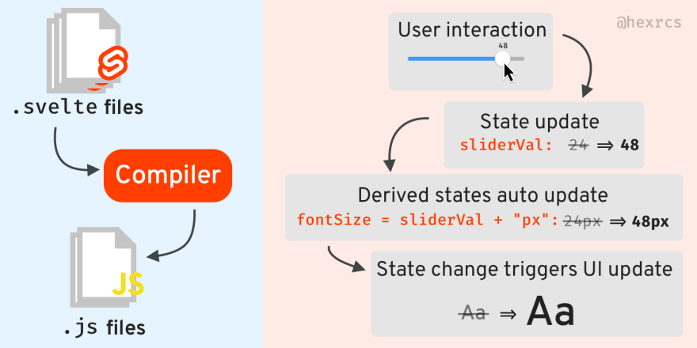
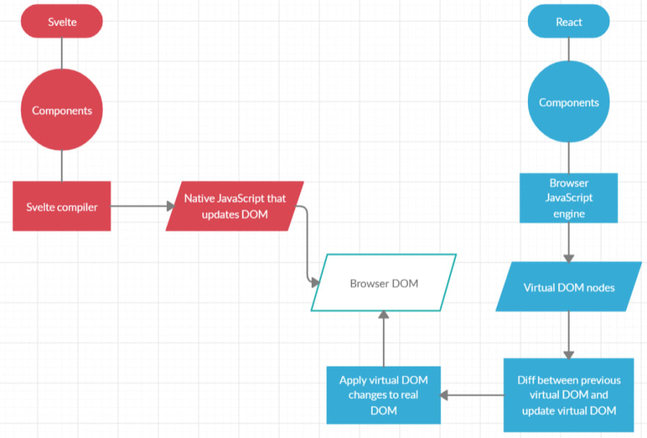
Svelte-compiler
Compiler
Rollup (JS bundler-loaders)
Optimization & performance (wearable, IoT, smart TV/homes, control screens cars…)
Use of modern JS (es6+, no babel)
No virtual DOM required
Compiles your components (.svelte) into native JS modules during the building stage
Apps needs no dependencies to start
Component = f(state1, state2,…)
Linter (good practices, accessibility…)
CSS Preprocessor (Sass, postCSS) + TypeScript
SUPER small bundle size (bundle.css & bundle.js ~ ko)
LESS lines of code (40% less than React) &TRULY reactive

Slide 4
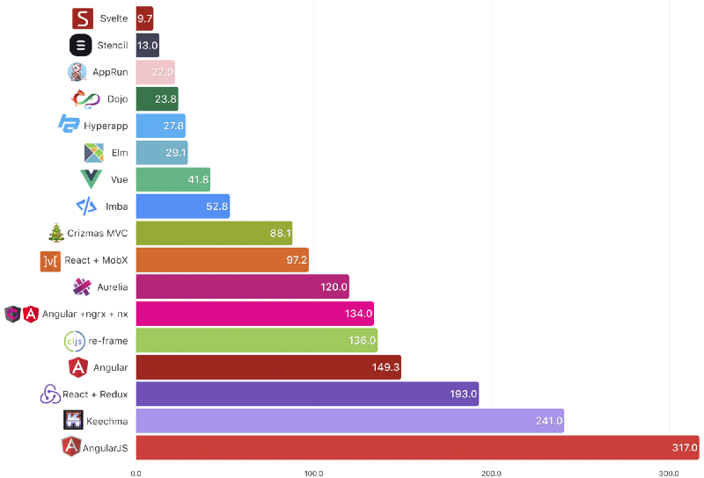
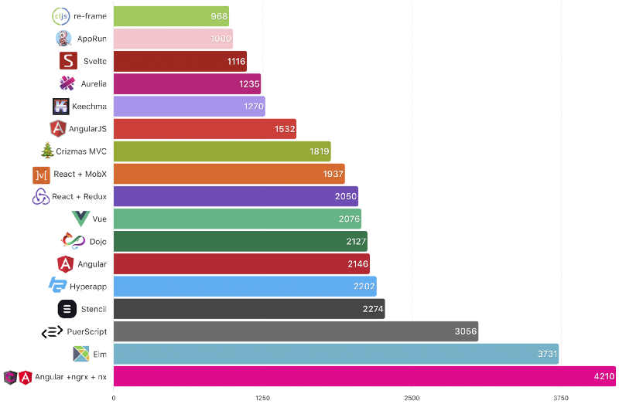
Svelte-tests
Tests
18 libraries/frameworks JS
Conduit (light medium clone) https://demo.realworld.io/#/
Size (build) in KB
Lines of code

Slide 5
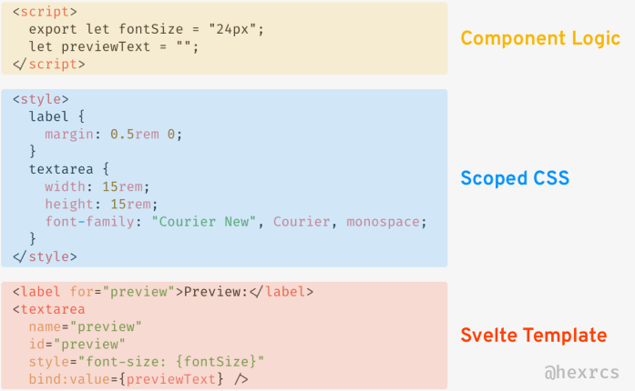
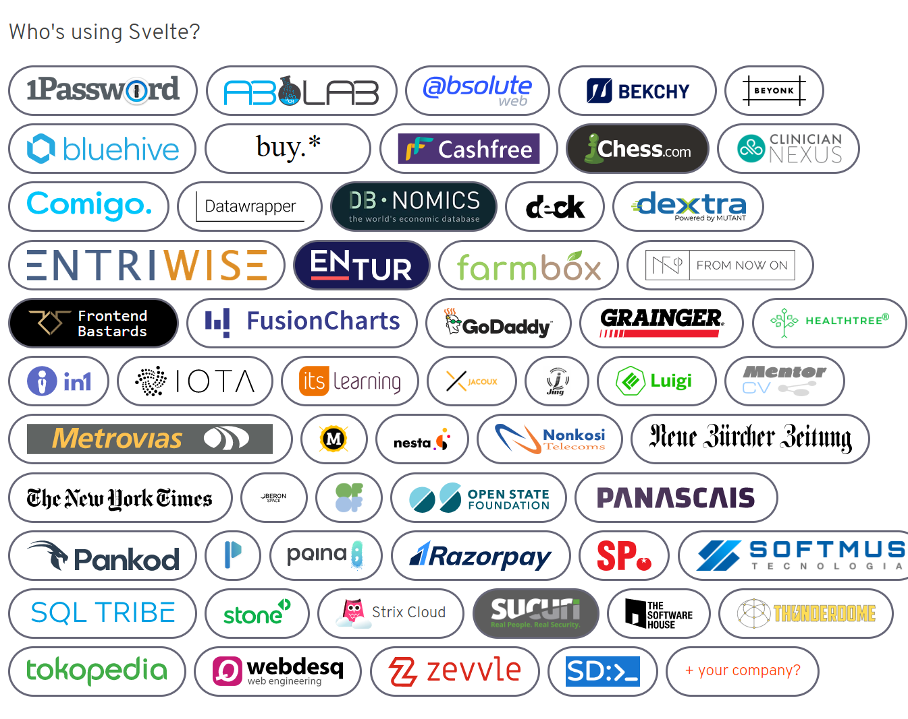
Svelte-framework
Framework
Young but gaining in popularity
Dan Abramov (redux), Mike Bostock (d3.js)
Component driven architecture (React) : props, state, HOC…
Very light framework (3 Ko)
Hello word apps (1.16 Ko Svelte VS React 37.6 Ko)
Code mainly in Vanilla JavaScript
Very few features (svelte language)
Anatomy of a Svelte Component
<script /> (component logic)
<script lang="typescript"> (yarn add typescript --dev)
<style /> (scoped CSS)
<style lang="scss"> (yarn add svelte-preprocess node-sass --dev)
HTML (svelte template) -> JS in HTML + handlebars

Slide 6
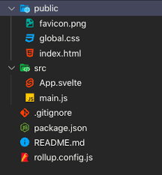
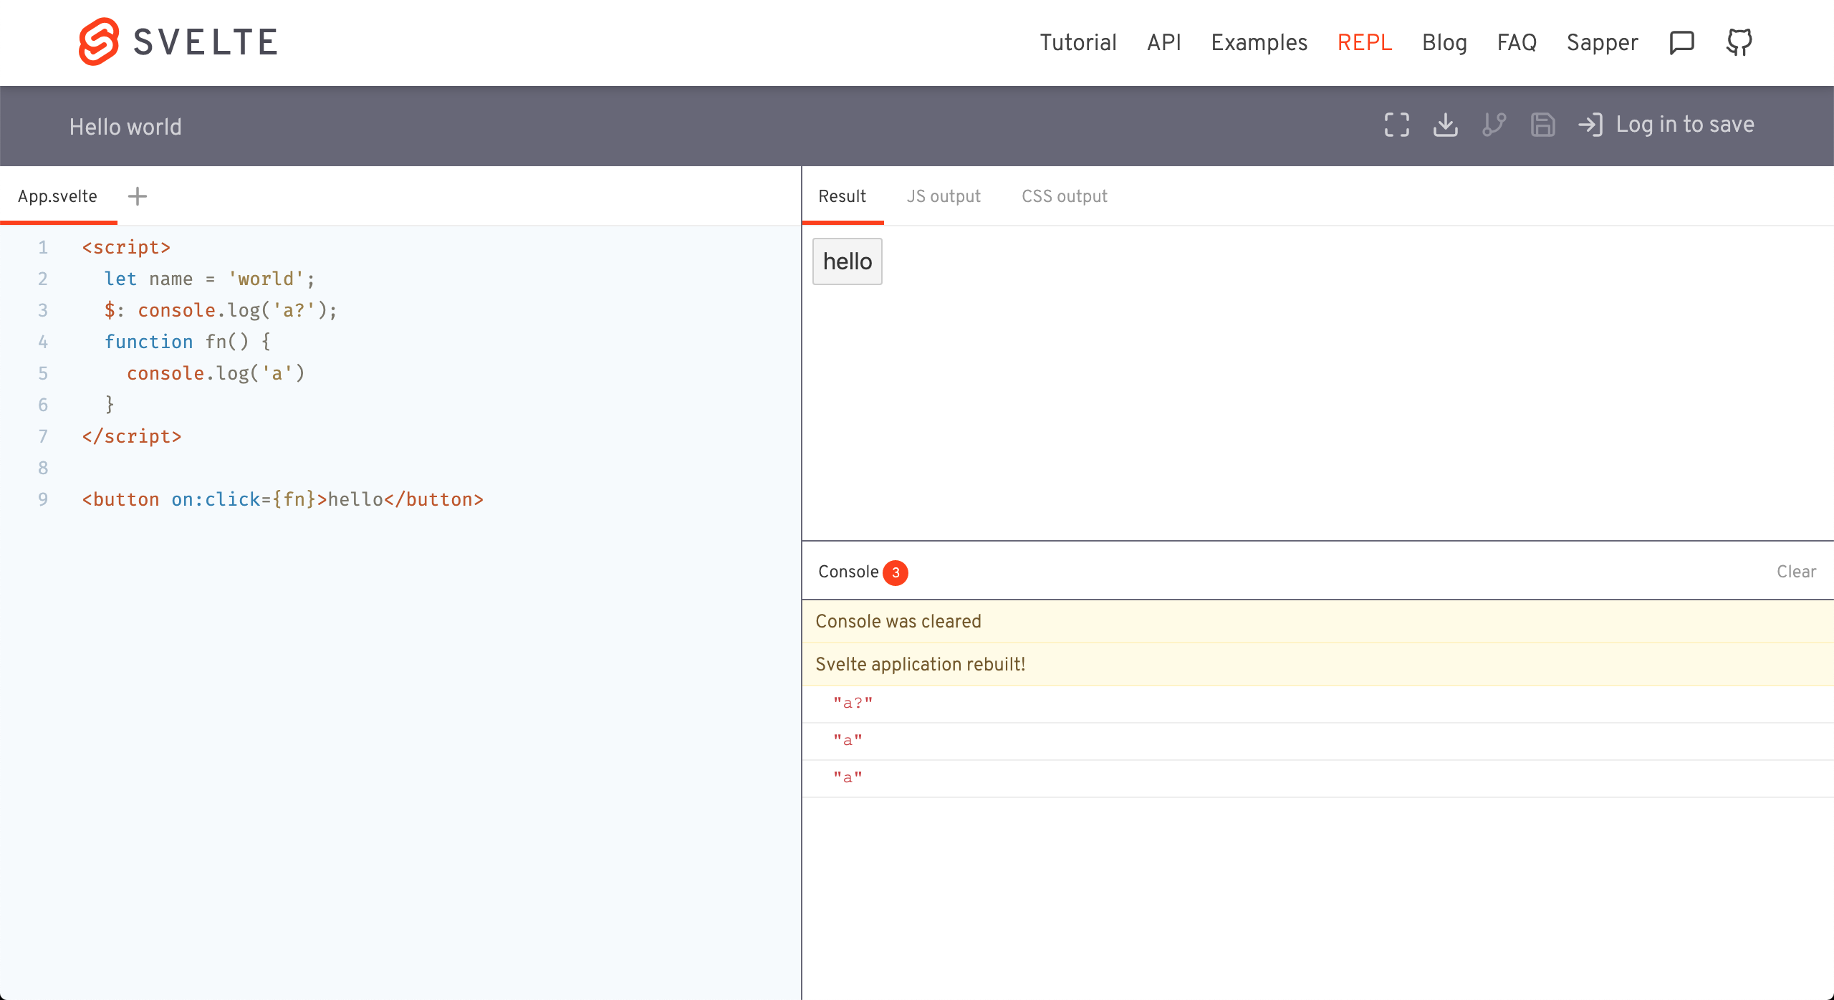
Svelte-setup
Local (dev) setup
Template : npx degit sveltejs/template firstapp (https://github.com/sveltejs/template)
Svelte extension for VS code
Setup for SCSS (SASS) :
yarn add svelte-preprocess node-sass --dev
File rollup.config.js
import autoPreprocess from "svelte-preprocess";
plugins: [
preprocess: autoPreprocess(),
css: css => { css.write("public/build/bundle.css" }
]
Create file svelte.config.js
module.exports = { preprocess: autoPreprocess() };
Execution:
run (dev) -> yarn run dev & run (build) -> yarn run build
App starts on localhost (port 5000 by default)
Online editor
(Interpreter) REPL (Read–eval–print loop)
https://svelte.dev/repl/hello-world?version=3.18.2
Github info (sign up)

Slide 7
Svelte-features (1)
Features (1)
State no hooks (useState) no setState (class component) let declaration reassignment (=) Components Svelte files (.svelte) Import create hierarchical relationship (parent -> child) Passing data Parent -> child (props) (export let propsName) Parent -> descendants (API context) setContext(key, val) & getContext(key) HTML/CSS features Boolean attribute (flag=true/false) <button disabled="{flag}"> Conditionnal class : <input class:alert="{flag}" /> Expression in template (like JSX) : <div>{expression}</div> | Template syntax If-template (conditionnal logic) {#if expr1} HTML content 1 {:else if expr2} HTML content 2 {:else} HTML content 3 {/if} Loop-template Arrays {#each fruits as fruit, index (index)} <li>{fruit}</li> {/each} Arrays of objects {#each fruits as fruit, index (fruit.id)} <li>{fruit.name}: {fruit.price}</li> {/each} Promises template

Slide 8
Svelte-features (2)
Features (2)
Two-way binding Value (forms, media, sizes, files…) bind:value={val} bind:checked={val} bind:group={val} bind:currentTime={val} bind:duration={val} bind:paused={val} bind:played={val} bind:volume={val} bind:offsetWidth={val} (read-only) bind:offsetHeight={val} bind:clientWidth={val} bind:clientHeight={val} bind:files={files} Props DOM: bind:this={val}) Component | Reactivity operator $ (like MobX & RxJS) Listen for changes in the component state Update other variables $: double = count * 2 $: console.log('The count is', count) $: if (expr) double = count * 2 $: { console.log('the count is', count) double = count * 2 console.log('double the count is', double) } Events DOM events (on:click, on:change…) Events modifiers (once, preventDefault…) Custom events DOM event forwarding Slots Slots & default slots Named slots Slots props

Slide 9
Svelte-features (3)
Features (3)
Lifecycle onMount onDestroy beforeUpdate afterUpdate tick Call it any time Returns a promise that resolves ASAP any pending state changes have been applied to the DOM (or immediately, if there are no pending state changes). Motions Tweened Configure delay, duration, easing function… https://svelte.dev/tutorial/tweened Animations Transitions and animations CSS | Promises-template <script> const fetchImage = (async () => { const response = await fetch('https://dog.ceo/api/breeds/image/random’) if (response.ok) throw new Error(An error occurred!) return await response.json() })() </script> {#await fetchImage} <Loading /> {:then data} <img src={data.message} alt="Dog image" /> {:catch error} <p>An error occurred!</p> {/await}

Slide 10
Svelte-features (4)
Features (4) – Store
A store is any object that allows reactive access to a value via a simple store contract https://svelte.dev/docs#svelte_store
Has get() for get the value of the store variable once
Has subscribe() method, or prefix stores with $ for auto-unsubscribes, prevents memory leaks!
Types of stores
Readable stores (readable())
Can't be updated from the outside (no set() & update() methods)
Fetch a resource from the network, API call, get data from the filesystem (using local Node.js server), Timer…
Writable stores (writable())
Has set(newValue), update(currentValue => f(currentValue)) methods
Derived Stores
A derived store allows you to create a new store value that depends on the value of an existing store.
Custom stores
Add custom functions based on set(), update(CRUD, reset()…)

Slide 11

Questions

