Slide 1
DAVI CA2
Name: Julio Ho Sheng Yang
&
AdminNo: P2317384

Slide 2
Section 1.2: Seaborn
The objective of this analysis is to investigate the impact of students' highest qualifications on their academic performance and financial investment in courses.

Slide 3
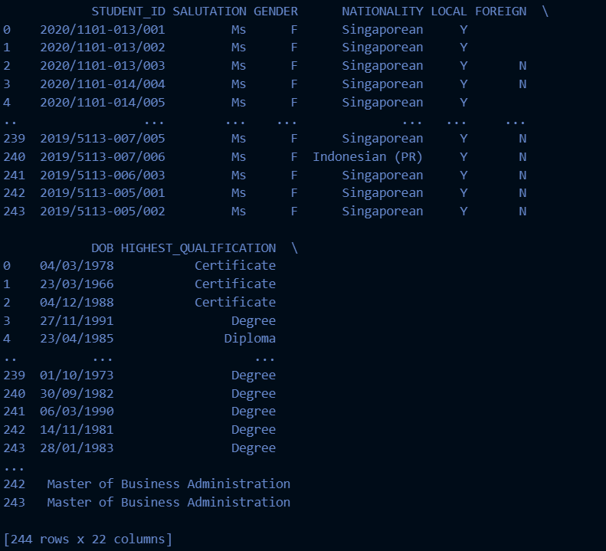
Dataset
2 datasets were used, coursecode_df (7 rows x 2 columns) and studentprofile_df(244 rows x 20 columns).
Need to data wraggling and clean before merging
Steps done to clean data:
Standardize columns
Drop NA values
Standardize qualification names
Merge dataframes
Final Dataframe - merged_df 244 x 22 columns

Slide 4
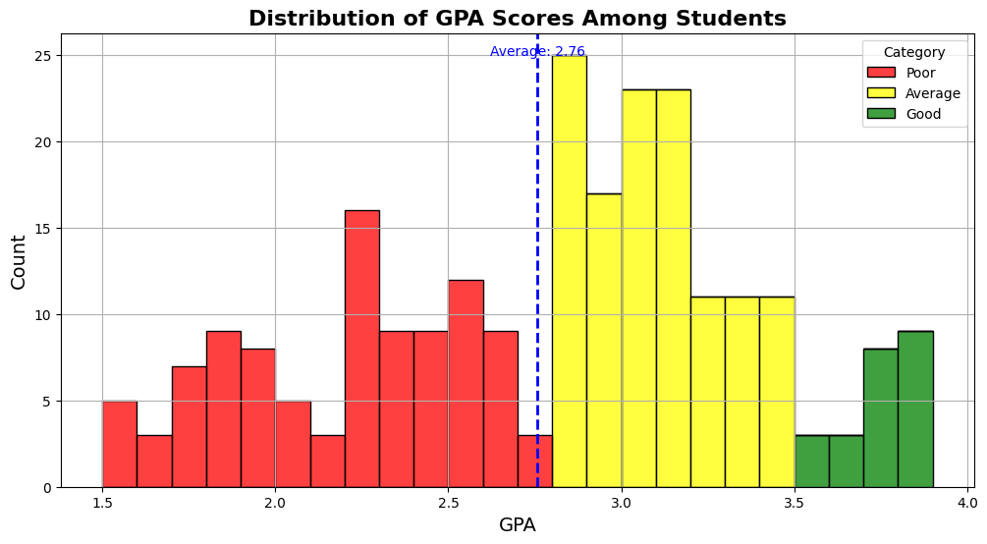
Univariate analysis: Distribution of gpa scores among students
Overall, the distribution suggests a healthy academic environment where students are achieving average to good grades with smaller portion falling below average.
The GPA score ranges average of 2.76 , range of 1.5 to 4.0
This suggests that while there are students performing at all levels, the overall average falls into the ‘Average’ category.

Slide 5
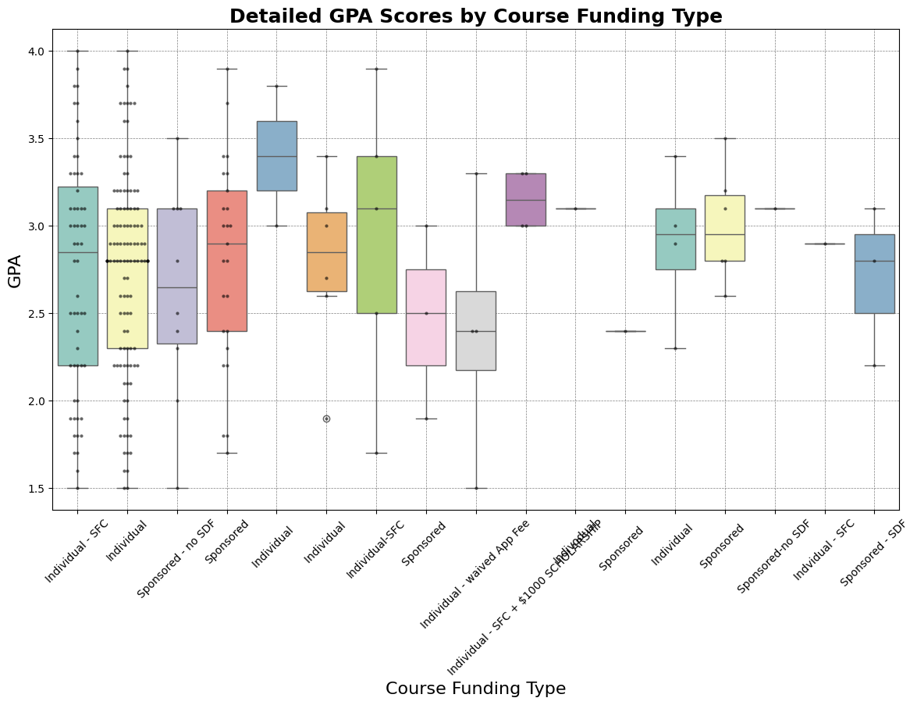
Chart 2: Bivirate Analysis GPA VS Course funding
The median GPA is around 2.5 with a wide range from 1.5 to 4.0.
Institutional State, Local, Federal, Private:
These categories represent students funded by various institutional sources. The medians for these groups are consistently higher than the individual-funded groups, hovering around 3.0 or slightly above.
The interquartile ranges are also narrower, indicating a more consistent GPA among institutionally funded students.
Sponsor E, S, & C:
The median GPAs here vary, with some being comparable to institutional funding and others being lower.
Overall, It suggests that institutional funding is associated with higher median GPAs, while individual funding shows more variability and generally lower median GPAs. The presence of outliers in all categories indicates that there are always exceptions to the general trends.

Slide 6
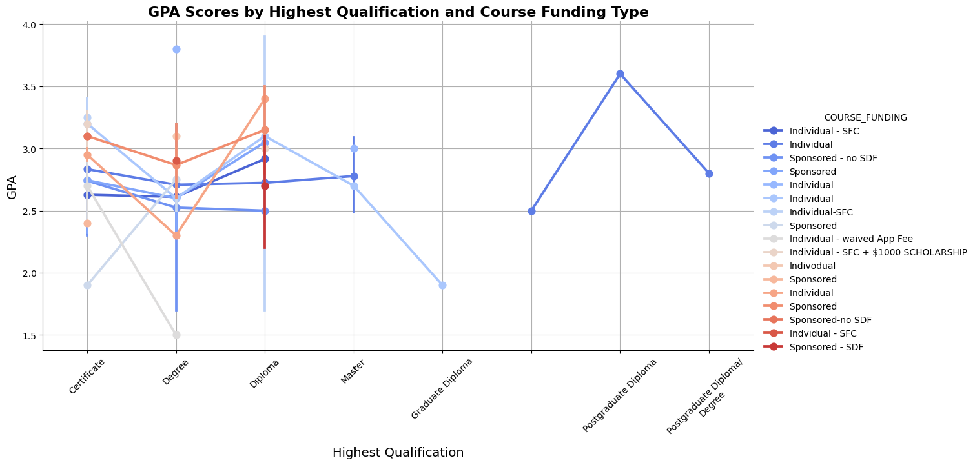
Chart 3: Multivariate Analysis : GPA vs. Highest Qualification and Course Funding Type
Individual Funding:
Students with individual funding show a range of GPA scores across all qualification levels.
The GPA tends to increase with higher qualifications.
Sponsored - SDF:
This line indicates that students with Skills Development Fund sponsorship generally have higher GPAs than individually funded students, especially at the Diploma and Bachelor’s Degree levels.
Individual + $1000 Scholarship:
Students who receive an individual funding plus a $1000 scholarship seem to have the highest GPAs across all qualification levels, particularly at the Postgraduate level.
Overall, Those with additional scholarships or sponsorships tend to have higher GPAs, suggesting that financial support could be linked to better academic performance.

Slide 7
ReccomMendations
Enhance Academic Support for Sponsored Students:
Educational institutions could consider implementing or enhancing academic support programs specifically tailored for sponsored students. This could include tutoring, mentoring, study workshops, or other resources aimed at maximizing the potential of these students to achieve better academic outcomes.
Comprehensive Academic Advising:
Establish a robust academic advising system where students can receive personalized guidance on course selection, career planning, and academic strategies tailored to their individual goals and challenges.
Collaborative Learning Opportunities:
Encourage collaborative learning by creating study groups and peer-led sessions. This fosters a supportive community where students can learn from each other and build a network of academic peers.

Slide 8
Part 2: Analyzing the Impact of Professional Designation on Course Completion and Academic Performance
Investigate the relationship between students' designations and their course completion rates, with a focus on understanding how different professional roles influence academic success and program engagement.

Slide 9
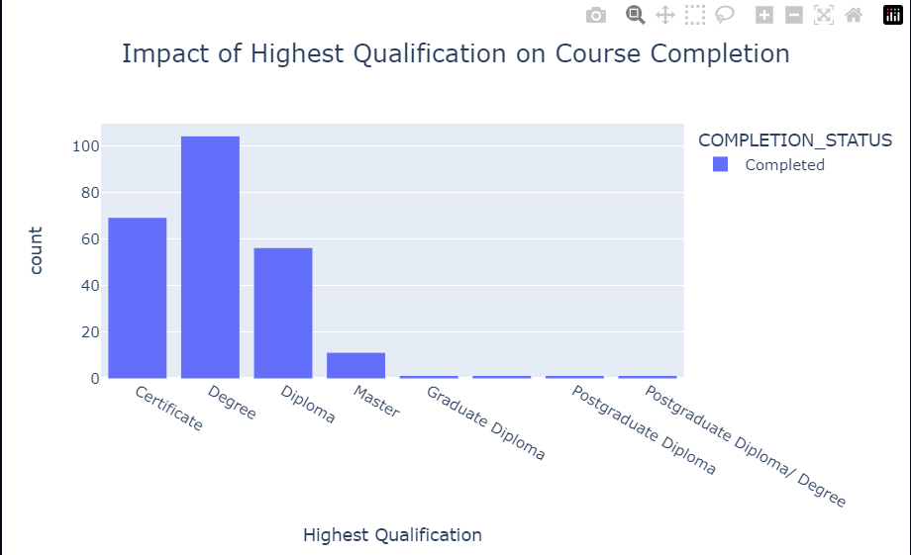
Distribution of Course Completion by Designation Objective: Visualize the distribution of course completion rates across different professional designations.
The chart indicates that students with a degree have the highest completion rates among all qualification levels.
This suggests that students with a higher level of prior education are more likely to complete the courses they enroll in.
Recommendations
Targeted Support Programs: Develop targeted support programs for students with lower initial qualifications, such as those holding certificates, to improve their completion rates. This can include tutoring, mentorship programs, and additional resources.

Slide 10
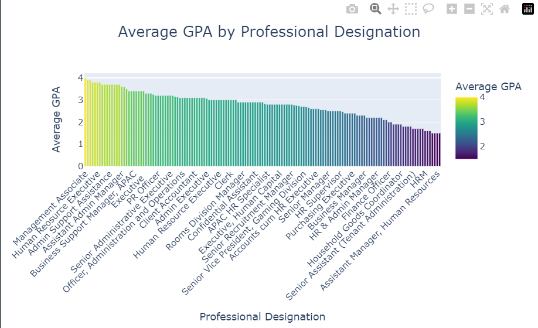
Chart 2: Average GPA by Designation Objective: Examine the relationship between students' professional designations and their academic performance as measured by GPA.
Top Performers: Designations such as "Finance Officer" and "Assistant Director, Human Resources" appear to have higher average GPAs. This might suggest that individuals in higher managerial or specialized roles tend to perform better academically.
Room for Improvement: Some designations show lower average GPAs. Identifying these roles can help the institute provide targeted academic support and resources to improve their performance.
Recommendations
Tailored Support Programs: Create tailored academic support programs for designations with lower average GPAs. This could include additional tutoring, workshops, and study groups focused on the specific needs of these students.

Slide 11

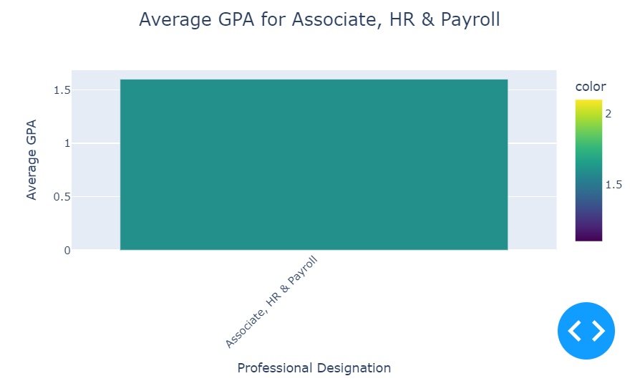
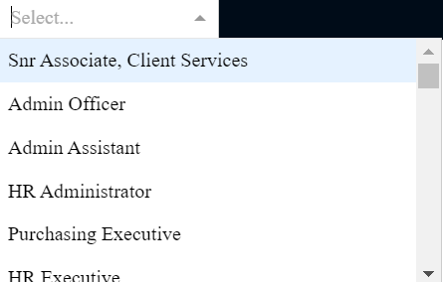
Plotly Dash: an interactive dashboard to explore course completion rates and GPA trends by professional designation.
This dashboard allows us to navigate dropbar menu finding GPAs of different professional designation.
Generally higher positions such as HR admistration , Senior HR Officer has a higher GPA compared to lower positions.
Policy Recommendations: Based on the analysis, educational institutions might consider tailoring their financial aid programs to target students who could benefit the most, potentially leading to improved academic performance.

Slide 12
Conclusions
Key Takeaways
Targeted Support:
Designations with lower completion rates and GPAs may benefit from targeted support programs such as additional tutoring, mentorship, and resources tailored to their specific needs.
Recognition of High Performers:
Identifying and recognizing high-performing designations can help in understanding best practices and replicating successful strategies across other roles.
Leverage Data for Decision-Making:
Utilize the insights gained from the dashboard to inform policy decisions, curriculum development, and resource allocation, ensuring that educational interventions are data-driven and effectively address the needs of all students.
By leveraging these insights and recommendations, educational institutions can enhance the overall learning experience, improve course completion rates, and foster higher academic performance across diverse professional designations.

Slide 13
References
ERIC (Education Resources Information Center) - Provides a detailed report on how various factors, including professional qualifications, impact educational outcomes and completion rates. Link to Report
Harvard Graduate School of Education - Discusses factors influencing college completion rates, emphasizing the role of grade inflation and institutional support. Link to Article
This supports our general findings which generally supports our insights and recommendations

