Slide 1
Data@ANZ Program Exploratory Data Analysis
Julio Pimentel
Email: julio.pimentela@gmail.com
Linkedin: https://www.linkedin.com/in/juliopimentel/

Slide 2
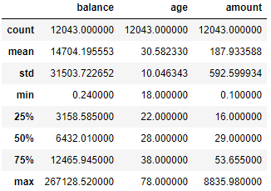
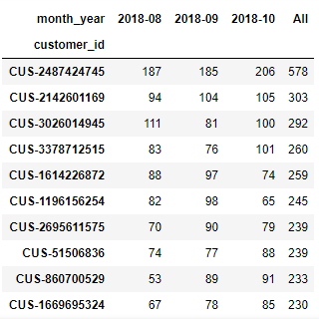
Insights - transactions
The average transaction amount in the dataset is AUD 187.93.
Top 10 clients with most transaction did more than 230 transactions in 3 months.

Slide 3
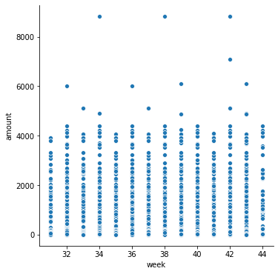
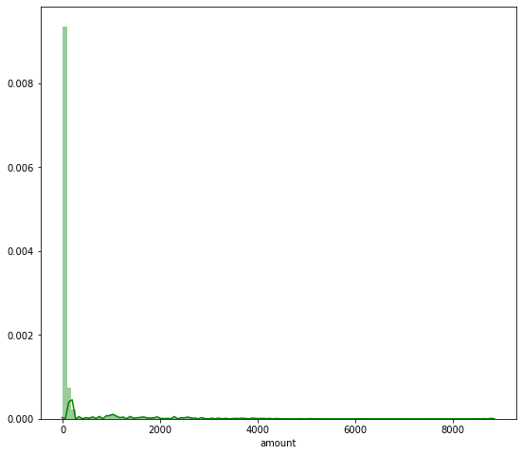
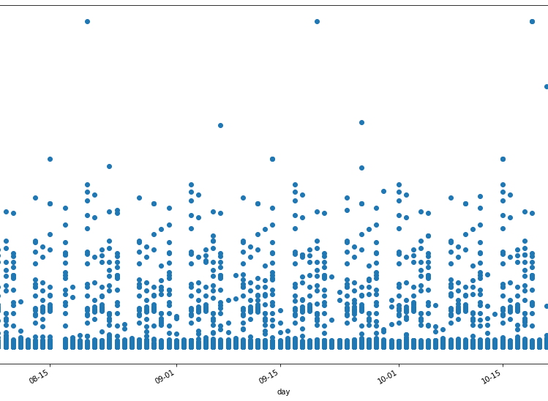
Insights - spending
The data have significant outliners above the upper quartile.
These outliers distort the analysis made with the variable “amount”.

Slide 4
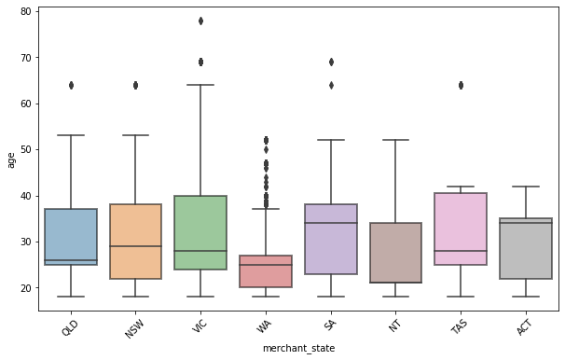
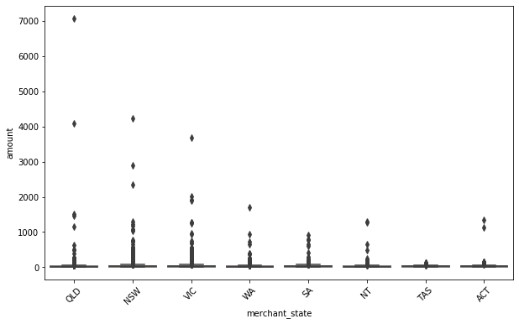
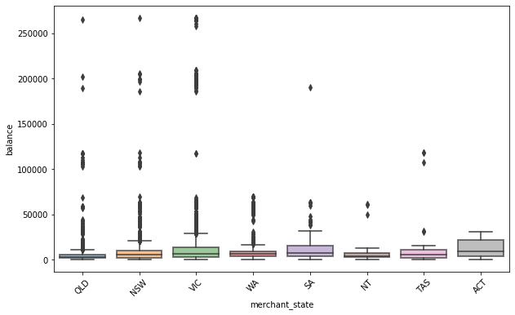
Insights - location
All states, except for TAS, have significant outliers above the upper quartile.
WA has the youngest clients.
VIC has the most extended difference of age between the youngest and oldest clients.
QLD, NSW, VIC, and TAS have clients with a balance higher than AUD 10,000.

