Slide 1
Data@ANZ Program Exploratory Data Analysis
Julio Pimentel
Email: julio.pimentela@gmail.com
Linkedin: https://www.linkedin.com/in/juliopimentel/

Slide 2
Exploratory data analysis
The dataset has 12,043 rows.
Transaction period is from 01/08/2018 to 31/10/2018 with a missing value in 16/08/2018.
The customers are in Australia except for the customer ID CUS-1617121891.

Slide 3
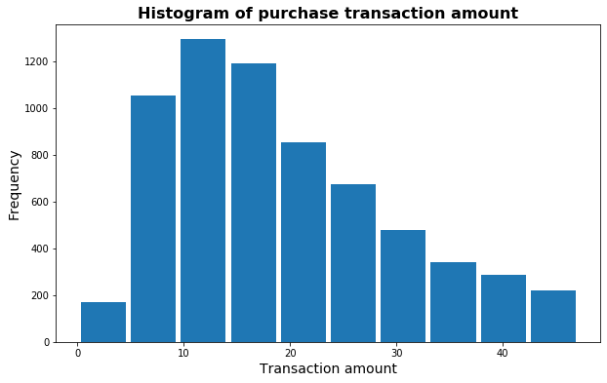
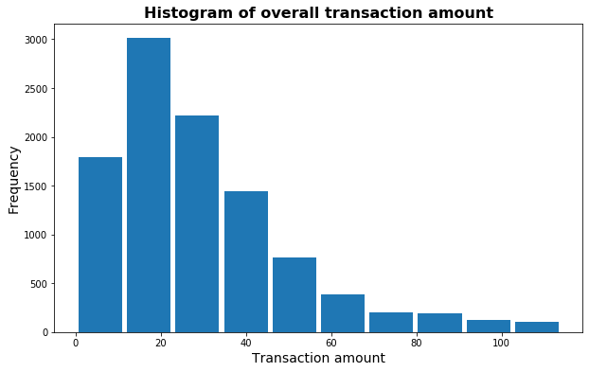
Insights - transactions
The purchase transaction values represented 7,717 values of the 12,043 values from the dataset.
The purchase transaction frequency is concentrated between AU$5 and AU$30.
The purchase transaction values have 1,158 outliers (above 85% of the sub-data distribution) between AU$47 and AU$7,081.
The overall transaction frequency is concentrated between AU$0 and AU$40.
The overall transaction values have 1,807 outliers (above 85% of the-sub data distribution) between AU$114 and AU$8,835.

Slide 4
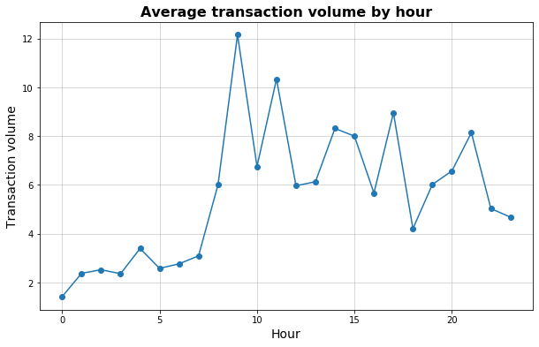
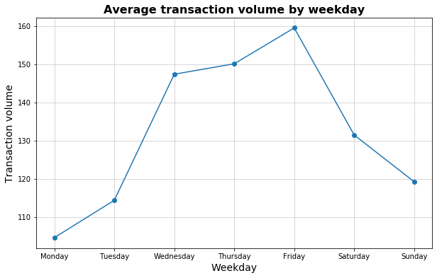
Insights - spending
The transaction volume was analyzed by the hour and weekday.
Wednesday, Thursday, and Friday are the days with more transaction volume.
Monday and Tuesday are the days with less transaction volume.
The hours 9:00, 11:00, 17:00 are the highest peak of transaction volume.
Between 0:00 and 8:00 is the lowest peak of transaction volume.

