Slide 1
Data@ANZ Program Predictive Analytics
Julio Pimentel
Email: julio.pimentela@gmail.com
Linkedin: https://www.linkedin.com/in/juliopimentel/

Slide 2
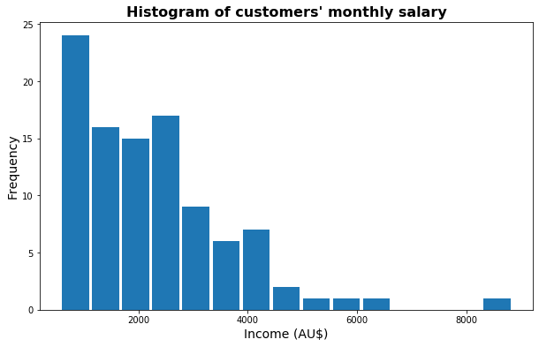
Insights – monthly salary
The customer's monthly salary was calculated by filtering the attribute “PAY/SALARY” from the columns “txn_description”.
It was assumed that the monthly salary did not change in the interval of the dataset.
75% of the customers' salary is between AU$576 and AU$2,886.

Slide 3
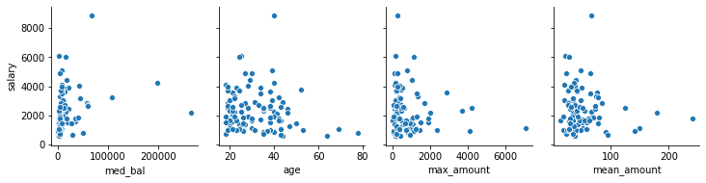
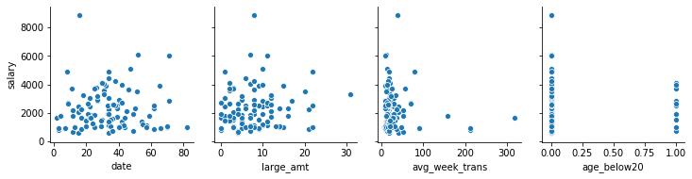
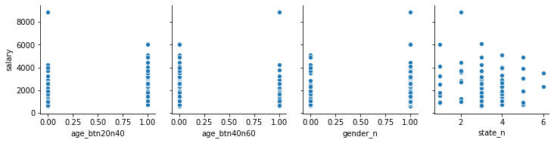
Insights – variables
The original variables of the dataset “age”, and “state” were selected.
New attributes were created from the original variables:
(1) balance’s median, (2) amount’s maximum, (3) amount’s mean, (4) number of dates with a transaction, (5) number of the large transaction amount, (6) average week transactions, (7) age intervals (below 20, between 20 and 40, between 40 and 60).
Each variable was plotted against the customers’ monthly salary.

Slide 4
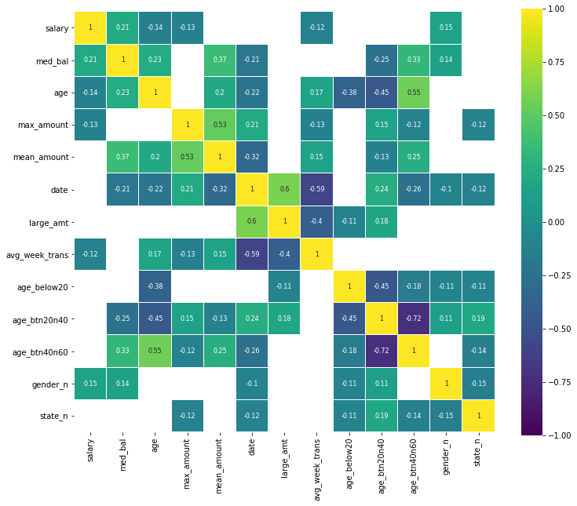
Insights – variables
The selected variables do not have a significant correlation above 0.50, which is not better than making a guess.
The first linear regression model using all variables has an R² of 0.155 and MSE of 1,634,256.
Second model using the variables “age”, “amount’s maximum”, “average week transactions”, “gender” and “balance’s medium” has a R² of 0.129 MSE of 1,684,761.

