Slide 1
FINAL PROJECT REPORT
Instructor guide: Mr. Pham Thai Ky Trung

Slide 2
Members of group
Huỳnh Tuấn Anh - 521H0003
Nguyễn Cảnh Tùng - 519H0360

Slide 3
1
2
3
INTRODUCTION
4
ARCHITECTURE
PROJECT MANAGERMENT PLAN
5
DESIGN
REQUIREMENT SPECIFICATIONS
DEMO
6

Slide 4
01
INTRODUCTION
Enter a subtitle here if you need it

Slide 5
INTRODUCTION
Purpose and scope: A software solution is being developed for a mobile phone distributor to manage interactions with authorized resellers and agents. It will cover inventory management, order and payment processing, reporting, and a B2C e-commerce platform.

Slide 6
INTRODUCTION
Product overview: The software will cater to the needs of both the distributor's staff and authorized resellers/agents through Windows Forms, Web Forms, and a B2C e-commerce platform. It will integrate with VNPay for agent payments and use Zalo or Email for order confirmations, as well as support multiple payment methods.

Slide 7
INTRODUCTION
Structure of the document: Includes introduction, project management plan, requirements specification, architecture, design, test plan to ensure the software works properly and finally the Demo is the result of the product including the basic database, source code and test

Slide 8
02
PROJECT MANAGERMENT PLAN

Slide 9
PROJECT MANAGERMENT PLAN
Project organization: My team will divide the work for 2 people including: analyzing project requirements, drawing diagrams, designing databases, creating main functional code interfaces, testing errors and finally running product demos.

Slide 10
PROJECT MANAGERMENT PLAN
Lifecycle model used: The project will follow an Agile development methodology, with iterative and incremental development cycles.

Slide 11
Project organization
Risk Analysis: Potential risks include insufficient hardware or software resources, lack of familiarity with technology, and challenges in integration with third-party services.

Slide 12
Project organization
Hardware and Software Resource Requirements: The project will require a development environment with C#, Windows Forms, Web Forms, and MSSQL.

Slide 13
Project organization
Monitoring, Reporting, and Controlling Mechanisms: Project progress will be monitored through regular team meetings, progress reports, and status updates on GitHub.

Slide 14
Project organization
Professional Standards: The project will adhere to best practices in software development, including proper documentation, code reviews, and testing.

Slide 15
Project organization
Evidence all the artifacts have been placed under configuration management: The project artifacts, including source code and documentation, will be stored and managed using a GitHub repository.

Slide 16
PROJECT MANAGERMENT PLAN
Impact of the project on individuals and organizations: For organizations, it will be easier to manage employees, have a reward and punishment policy, and spend less time. As for individuals, the work will be easier, less stressful, more professional, and less time wasted on cumbersome manipulations to work more efficiently.

Slide 17
Project organization
Impact of the project on individuals and organizations: The software will streamline the distributor's operations and improve the efficiency of interactions between the distributor, resellers, and agents. This will lead to improved customer satisfaction, increased sales, and enhanced profitability.

Slide 18
03
REQUIREMENT SPECIFICATIONS
Stakeholders for the system: Distributor,Accountant,Reseller/Agent

Slide 19
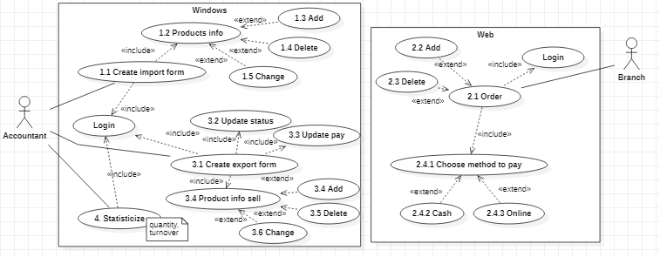
Use case model

Slide 20
REQUIREMENT SPECIFICATIONS
Functional requirements
- Goods received note creation
- Viewing incoming/outgoing stock report
- Viewing best-selling products report
- Viewing monthly revenue report
- Goods delivery note creation
- Placing orders
- Choosing payment method
- Making online payments
- Viewing order status
- Browsing products
- Adding products to cart
- Checkout process
- Making payments

Slide 21
REQUIREMENT SPECIFICATIONS
Non-functional requirements
NFR1: Performance
The system should be able to handle a high volume of transactions.
The system should provide quick response times for user actions.
NFR2: Scalability
The system should be able to handle an increasing number of users and transactions as the business grows.
NFR3: Security
The system should protect sensitive user and transaction data.
The system should provide role-based access control for staff members.
NFR4: Usability
The system should have an intuitive user interface for all user types (accountants, resellers/agents, and B2C customers).
NFR5: Availability
The system should be available 24/7 with minimal downtime.
NFR6: Integration
The system should integrate with VNPay for payment processing.
The system should integrate with Zalo or email for order confirmation notifications.

Slide 22
ARCHITECTURE
04

Slide 23
ARCHITECTURE
Architecture style used
The project will use a layered architectural style, with separate presentation, business logic, and data access layers. This style provides separation of concerns, allowing for easier maintenance and scalability of the system.

Slide 24
ARCHITECTURE
Technology, software, and hardware used
Hardware and software resource requirements: About hardware: Intel Core i7-11800H CPU @ 2.30GHz Ram 16GB Win 11 About software: SQL server management studio, Visual studio.

Slide 25
ARCHITECTURE
Rationale for your architectural style and model
The layered architecture is chosen for its separation of concerns, modularity, and maintainability. This approach allows for easy updates and extensions, as well as improved testing capabilities.

Slide 26
DESIGN
05

Slide 27
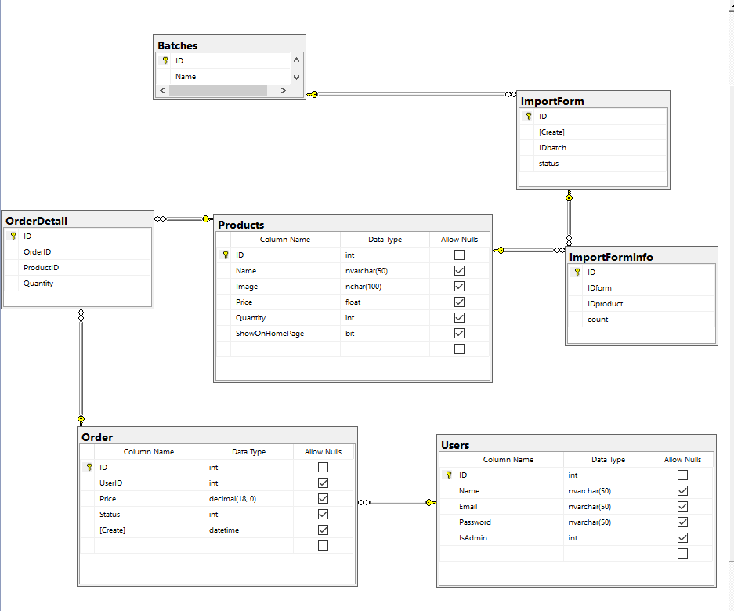
DESIGN
Database design

Slide 28
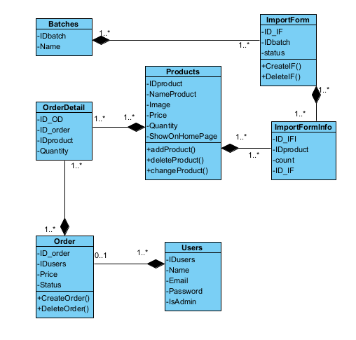
DESIGN
Class diagrams

Slide 29
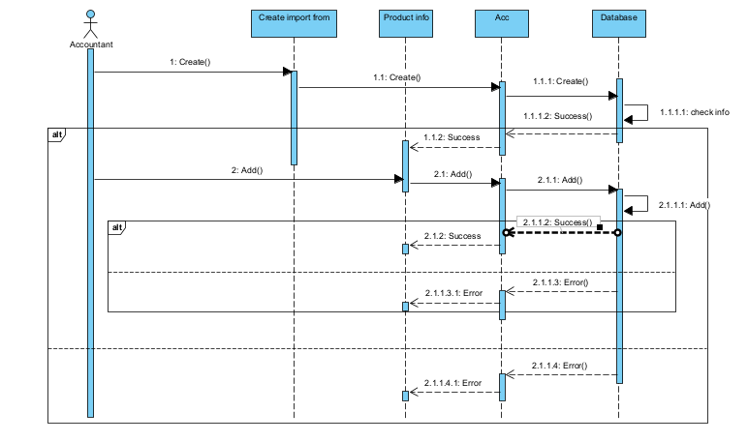
DESIGN
Sequence diagrams

Slide 30
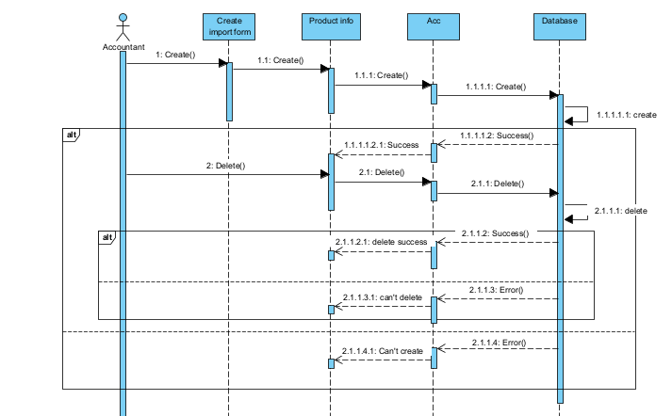
DESIGN
Sequence diagrams

Slide 31
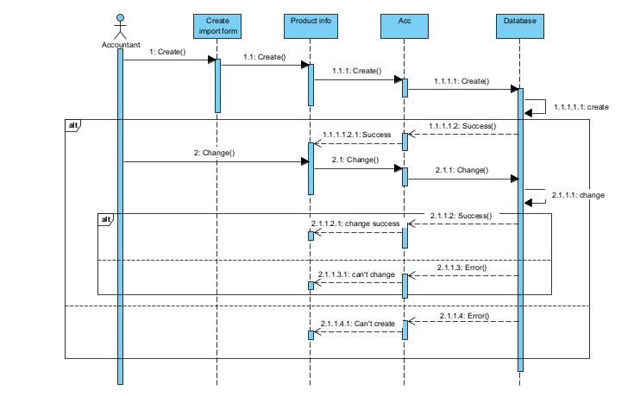
DESIGN
Sequence diagrams

Slide 32
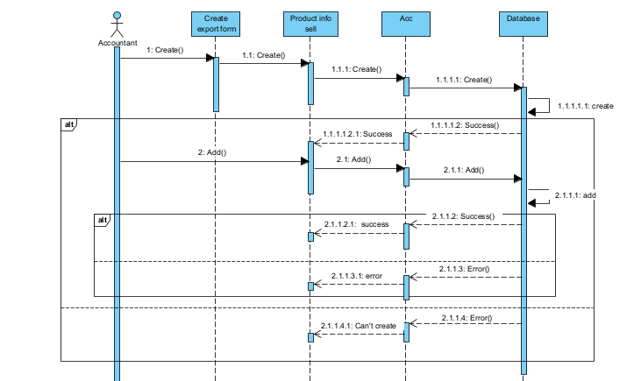
DESIGN
Sequence diagrams

Slide 33
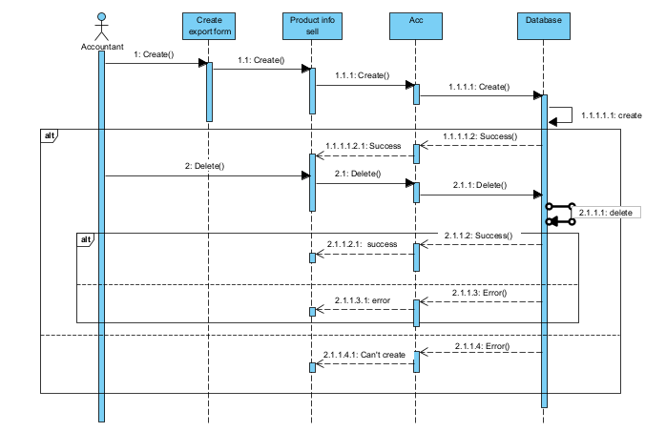
DESIGN
Sequence diagrams

Slide 34
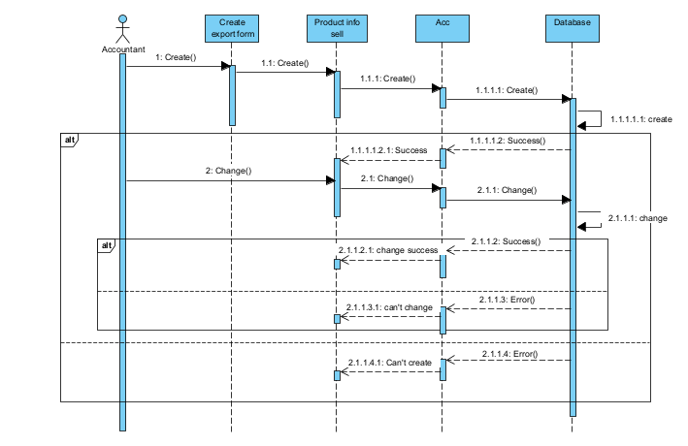
DESIGN
Sequence diagrams

Slide 35
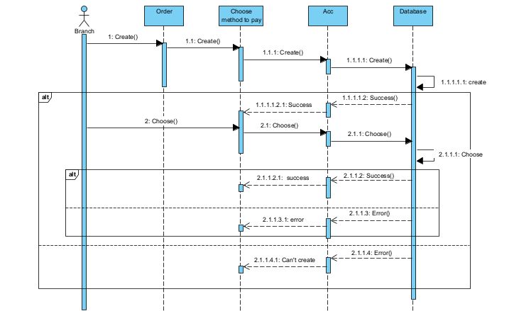
DESIGN
Sequence diagrams

Slide 36
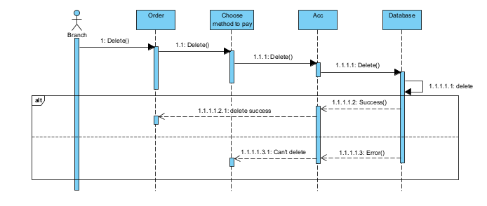
DESIGN
Sequence diagrams

Slide 37
DEMO
06

Slide 38
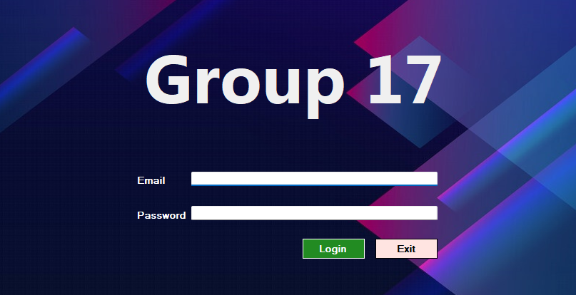
Winform
Login

Slide 39

Winform
Home

Slide 40
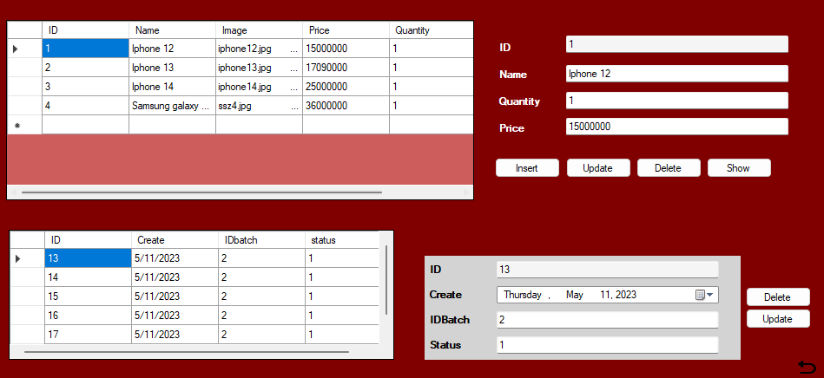
Winform
Edit products

Slide 41
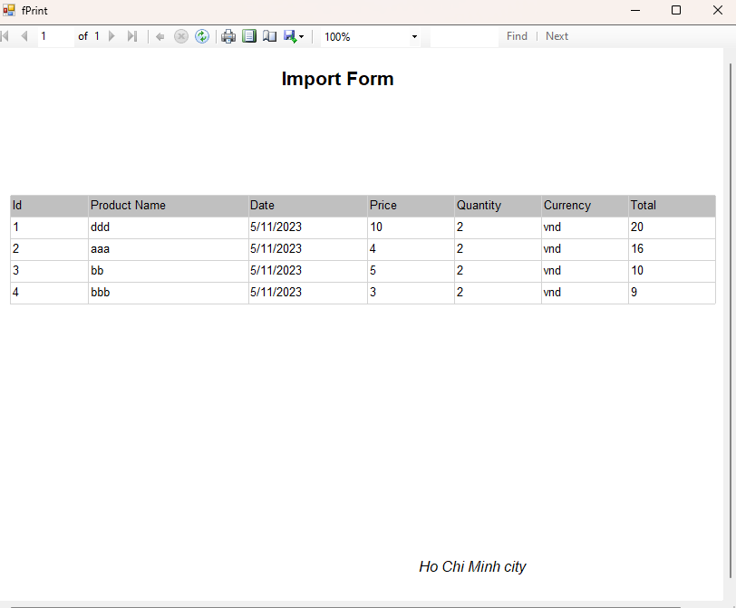
Winform
print the delivery note

Slide 42
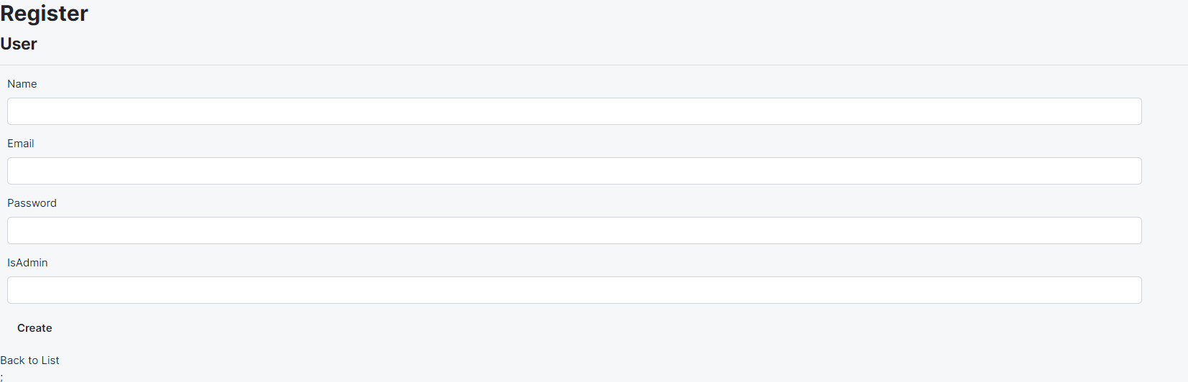
Webform
Register

Slide 43
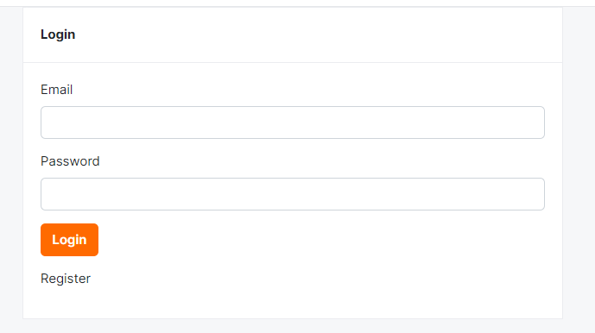
Webform
Login

Slide 44
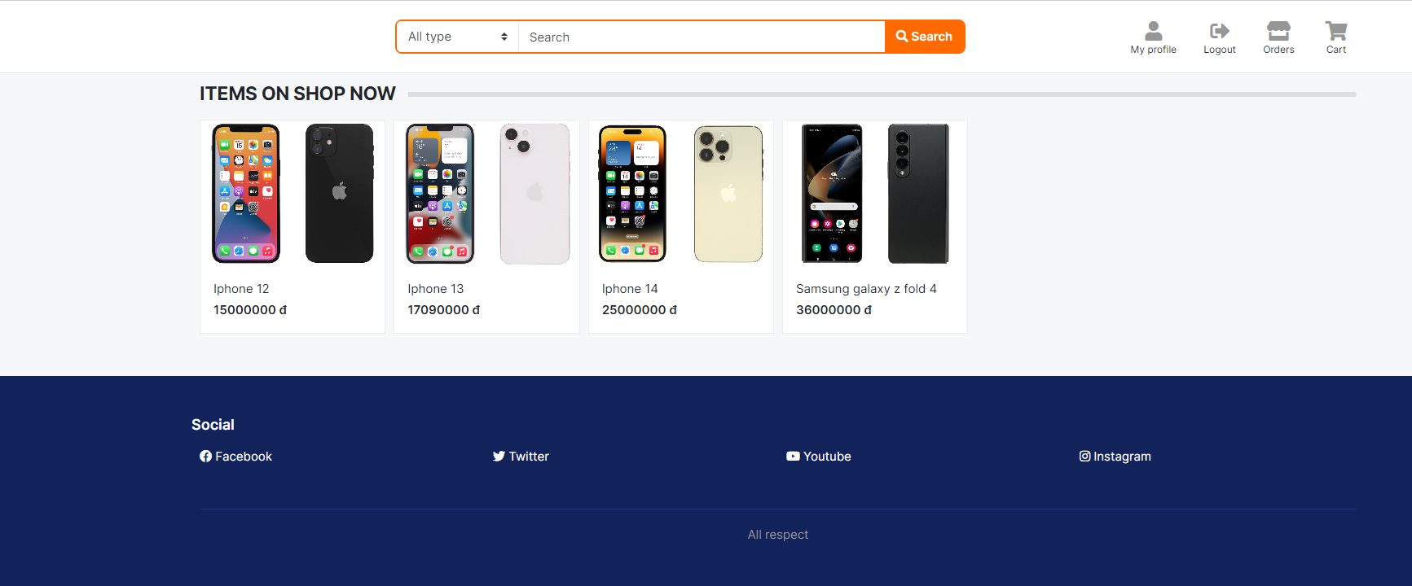
Webform
Display products info

Slide 45
Thanks for watching!

