Slide 1
Project Report iCT Multi-platform Flashcard software for learning English
COURSE: SOFTWARE ENGINEERING
GROUP X:
- Bùi Thị Phương Anh
- Nguyễn Việt Anh
- Trần Vũ Hải
- Trần Thị Thoa
- Phạm Nguyên Khánh Phong
Notes:
1

Slide 2
OUTLINE
1. Overview
2. Analysis and Design
3. Software Implementation/Coding
4. Testing & Document
5. Teamwork
6. Final result
Notes:
1

Slide 3
1.OVERVIEW
Flashcard => METHOD TO LEARN FOREIGN LANGUAGE
=> COMBINE IMAGES WITH WORD
-------> EASIER TO REMEMBER
iCT Flashcard => PROVIDE VISUAL FLASHCARDS
=> LEARN EVERYWHERE
=> DON’T HAVE TO BUY PAPER FLASHCARD
Notes:
1

Slide 4
2.ANALYSIS AND DESIGN
PROGRESS:
→ Requirement definition (in design document)
→ Diagrams (in design document)
→ System architecture design
→ Technologies in use
Notes:
1

Slide 5

2.ANALYSIS AND DESIGN
SYSTEM ARCHITECTURE
WEB SERVER
CLIENT DESKTOP APP
Services
Server: MVC model
Models
Controllers
Database
JAVA SWING
View (json) – REST. API
Web client:
JAVASCRIPT / JQUERY / AJAX
HTML / BOOTSTRAP
Notes:
1

Slide 6
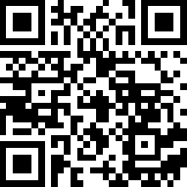
3.SOFTWARE IMPLEMENTATION / CODING
SOURCE VERSION CONTROL : GIT
Github Address: https://github.com/vietanhdev/iCT-Flashcard
Notes:
1

Slide 7
4. TESTING & DOCUMENTS
TESTING: USE POSTMAN TEST FOR WEB APIs
Notes:
1

Slide 8
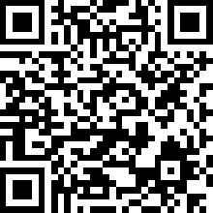
4. TESTING & DOCUMENTS
DOCUMENTS
- DESIGN DOCUMENT:
https://github.com/vietanhdev/iCT-Flashcard/blob/master/docs/DesignDoc.pdf
- DOCUMENT PAGE FOR DEVELOPER:
< Phong làm >
Notes:
<number>

Slide 9
5.TEAMWORK
Collaboration is done using github.
WEB SERVER
DESKTOP APP
TESTING & DOCUMENT
Thoa:
- Design the base structure
- Design database
- MVC model
- Manage images
VietAnh:
- Implement Restful APIs
- Create dictionary database
PhuongAnh:
- Design the desktop app
- Implement in JavaSwing
Hai:
- Create initial layouting for desktop app
- Flashcard displaying
Hai:
- Write test script using Postman script
All team:
- Design general structure and UMLs
VietAnh:
- Create DesignDocument from available diagrams.
- Create slides for presentation.
Phong:
- Make document page for developer.
Thoa:
- Webpage testing
PhuongAnh
- Desktop app testing
CLIENT DESKTOP APP
WEB - CLIENT SIDE
Phong:
- HTML layouting
- About pages
VietAnh:
- Webpage design / Logic code for client
Thoa:
- Implement multiple-language.
Notes:
<number>

Slide 10
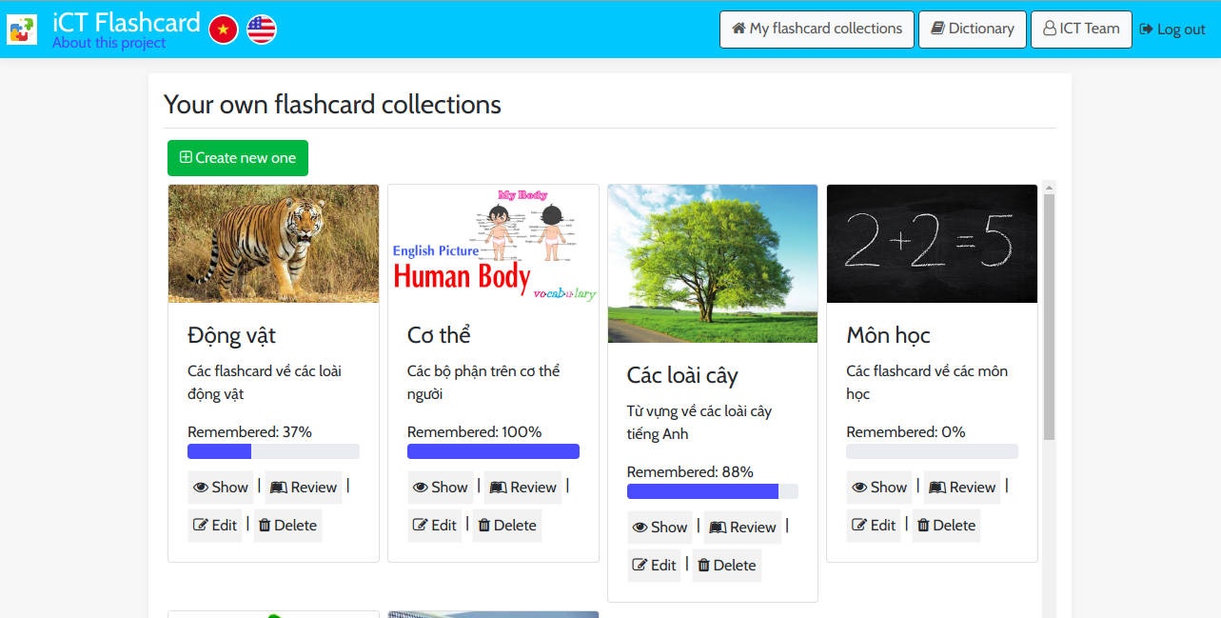
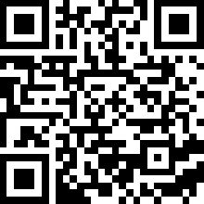
6.FINAL RESULT
Webpage: https://ict-flashcard-server.herokuapp.com/
PC App:
< Phuong Anh adds later>
Notes:
<number>

Slide 11
Q&A
Notes:
<number>

Slide 12
THANK YOU YOUR ATTENTION!
Notes:
<number>

