Slide 1
Class syllabus and introductions
Lecture 00

Slide 2

Instructor
Julio Marco B. Pineda
Senior in Bioengineering and Math
Peer advisor for the Bioengineering Dept.
Undergraduate researcher in the Pun lab
Cancer therapeutics
Hobbies!
Photography, video games, anime, literature
Watching YouTube!

Slide 3
Contact Information
Email: juliomp@uw.edu
No formal office hours:
Feel free to send me emails if you have any questions!
Study sessions: Tutors and counselors
Github repository for all files in this class:
https://github.com/juliomarcopineda/ClassRepository
Save!

Slide 4
Before we begin…
Introduce yourself to the class!

Slide 5
What is our class?
Introductory Python programming course
Syntax and style
Control flow, functions, some data structures
Basic algorithms
A taste of applied math/programming course
Homework, for the most part, will address a real-world problem
Final project will tackle a challenging problem

Slide 6
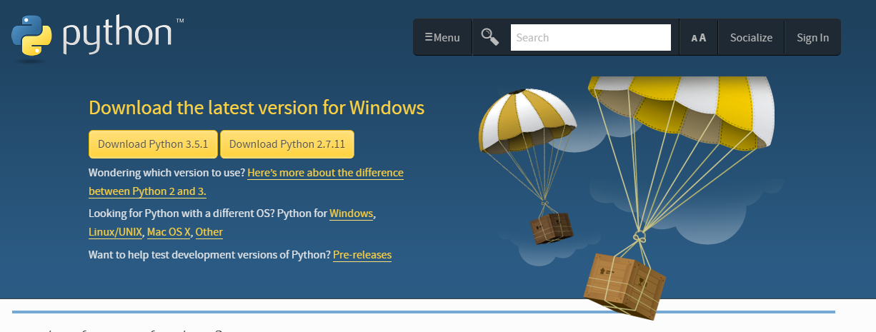
Setup time!
Installing Python essentials:
https://www.python.org/downloads/

Slide 7
Command prompt (optional)
Use any text editing software you have:
Notepad, Sublime Text 3, etc.
Use command line (cmd) to run python code

Slide 8
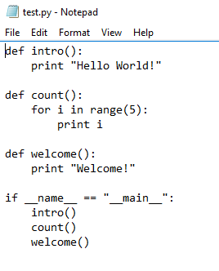
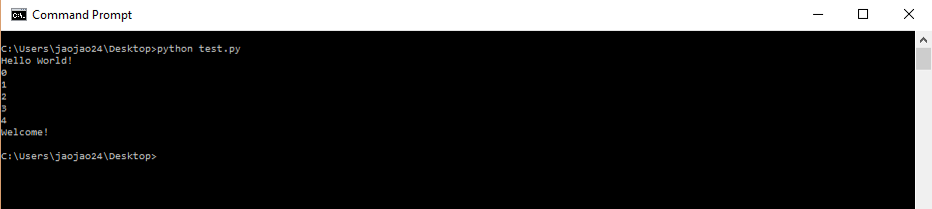
Command prompt (optional)

Slide 9
Integrated development environment (IDE)
Recommended for this class because it’s simple.
Many IDE’s exist out there many have their unique strengths and weaknesses.
Some basic features to look for:
Code coloring
Debugging
Interface

Slide 10
Suggested IDE: Spyder
I have used this in my bioengineering course
Simple to follow and has the essential features
Feel free to use any other one if you have preferences:
PyCharm, PyDev, etc.

Slide 11
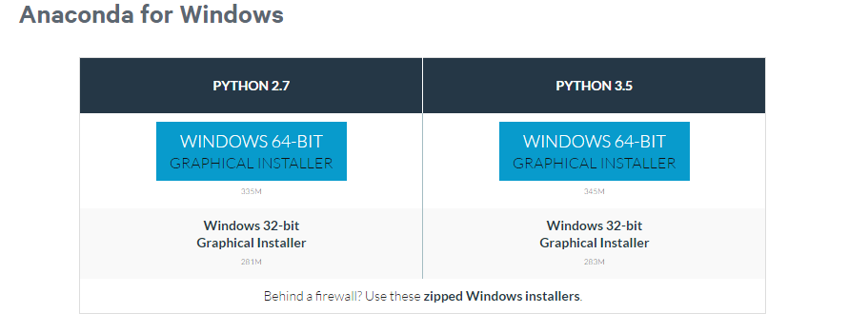
Installation Instructions
https://www.continuum.io/downloads

Slide 12
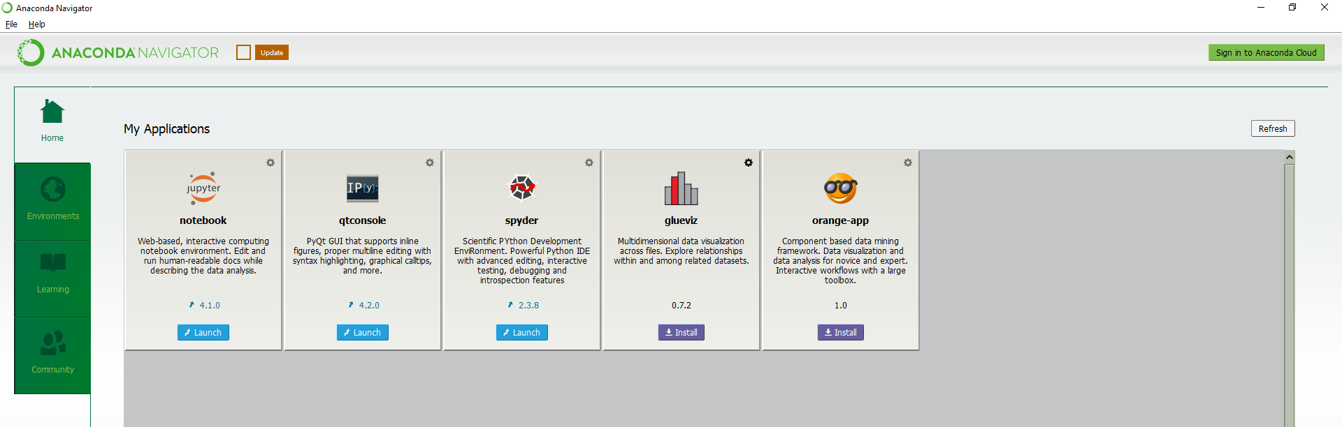
Installation Instructions
After installing by clicking the .exe file:

Slide 13
Spyder Demo

Slide 14
Some book resources
Think Python: How to Think Like a Computer Scientist by Allen Downey
Free! http://www.greenteapress.com/thinkpython/thinkpython.pdf
Introduction to Computation and Programming Using Python: Revised and Expanded Edition by John V. Guttag
Not so free ☹
Will contact Lisa/Greg to get you copies if possible
I will not heavily rely on this book.

Slide 15
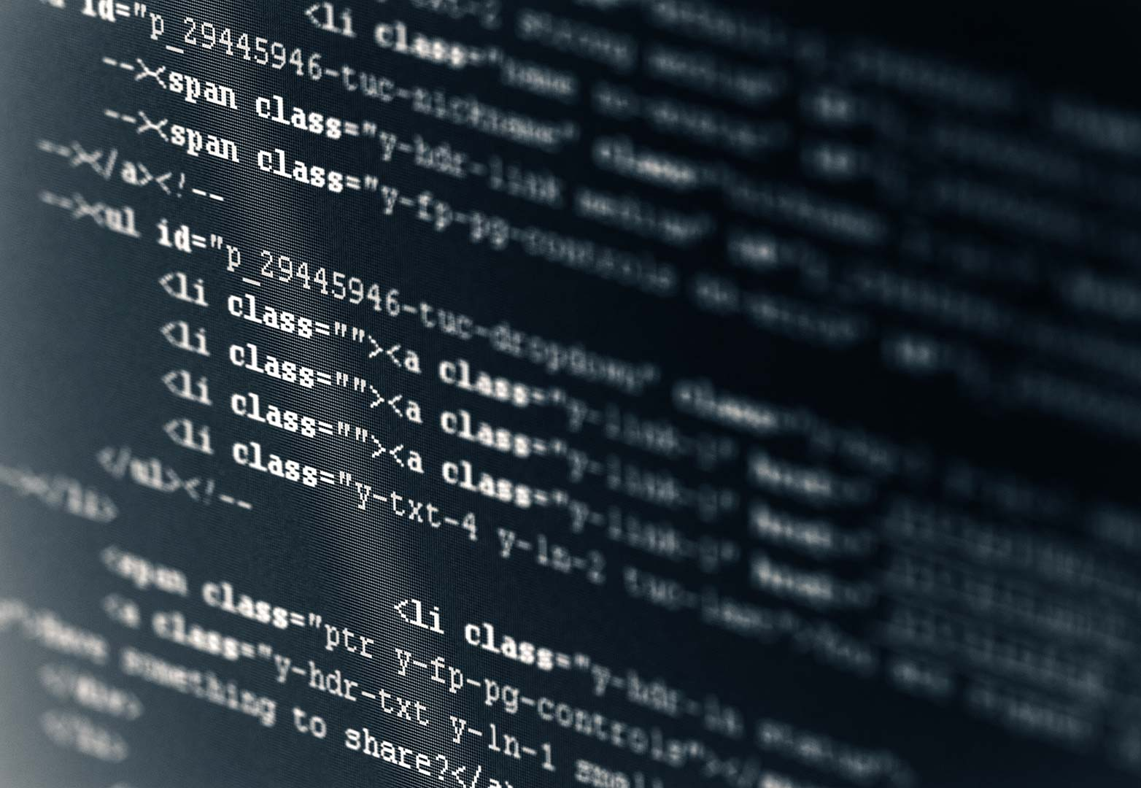

What is programming?
A program is a sequence of instructions that specifies how to perform a computation.
How is this different from recipes? Algorithms? Checklist?

Slide 16
Basic properties of all programs
Input: Get data from the keyboard, file, other source
Output: Display data on screen
Math: Perform basic math operations
Conditional Execution: Check if conditions are met, then execute code
Repetition: Perform some action repeatedly, with some variations
Break a large, complex task into smaller and smaller subtasks that are simple enough to be performed by these basic instructions!

Slide 17
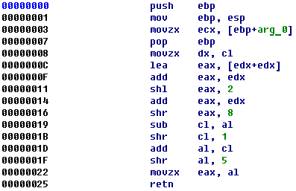
High vs Low level languages
Low level languages: “Machine languages” or “assembly languages”
Computers can only run programs written in low-level languages
Not all computers are created equal! Need to re-write for different types.

Slide 18
High vs Low level languages
High level language
Easier to understand
Takes less time to write
Can be run by different types of computers
Is Python high or low level?

Slide 19
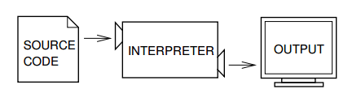
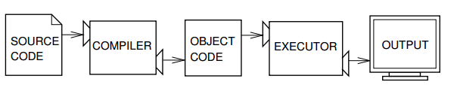
How are programs executed
Interpreter:
Compiler

Slide 20
Why do we use Python?
Great first programming language
Syntax is similar to everyday English
You do not want to re-invent the wheel when dealing with large projects
Vast resources for libraries (will explain later) to use other people’s code to perform basic instructions
Widely used by industry!
Personal opinion: The language really does not matter. As long as you understand the programming concepts! You can easily switch to any high level programming language.

