Slide 1
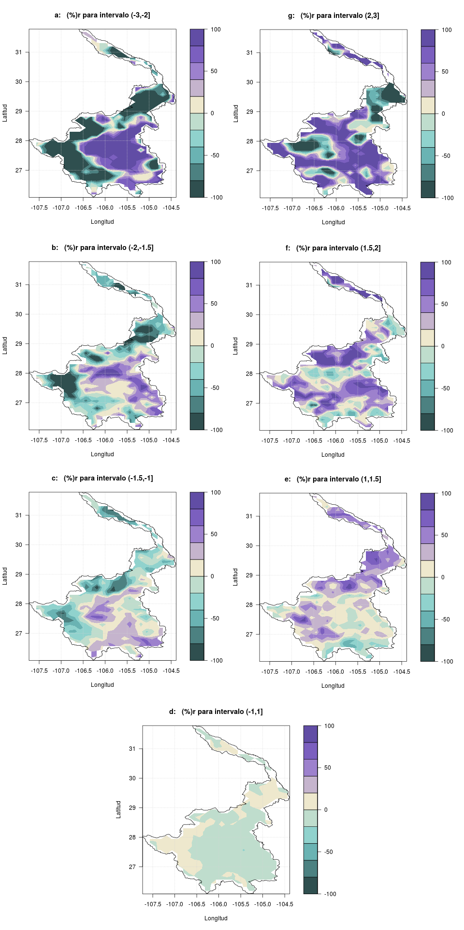
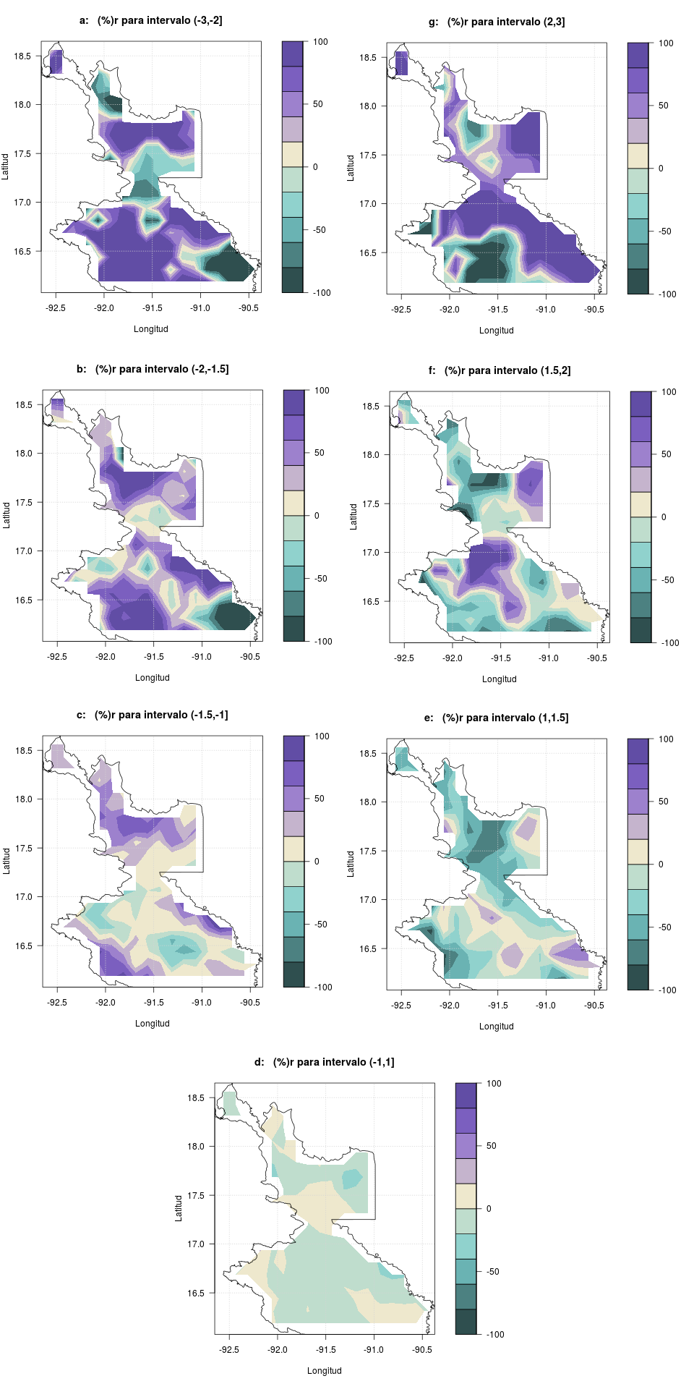
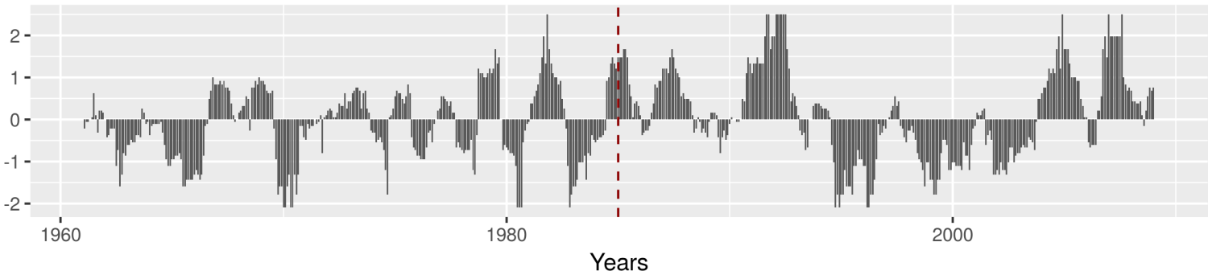

SPI-12 Analysis Comparison
Conchos
Usumacinta
ed
ew
ed
ew
SPI | Category | Probability
≥ 2.0 | extremely wet (ew) | 0.023
1.5 to 1.99 | severely wet (sw) | 0.044
1.0 to 1.49 | moderately wet (mw) | 0.092
-0.99 to 0.99 | approx normal (an) | 0.682
-1.0 to -1.49 | moderately dry (md) | 0.092
-1.5 to -1.99 | severely dry (sd) | 0.044
≤ -2 | extremely dry (ed) | 0.023
sd
100
sw
sd
100
sw
0
0
-100
-100
$$\%r=\frac{h1−h0}{h1+h0}×100$$
md
mw
md
mw
%r > 0 (purple) → recent period dominates
(1985-2008)
%r < 0 (emerald) → old period dominates
(1961-1984)
old
recent
Conchos basin
Avg SPI-12
1961-2008
1985

