Slide 1
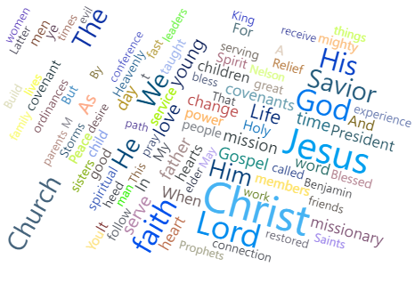
General Conference Word Count

Slide 2
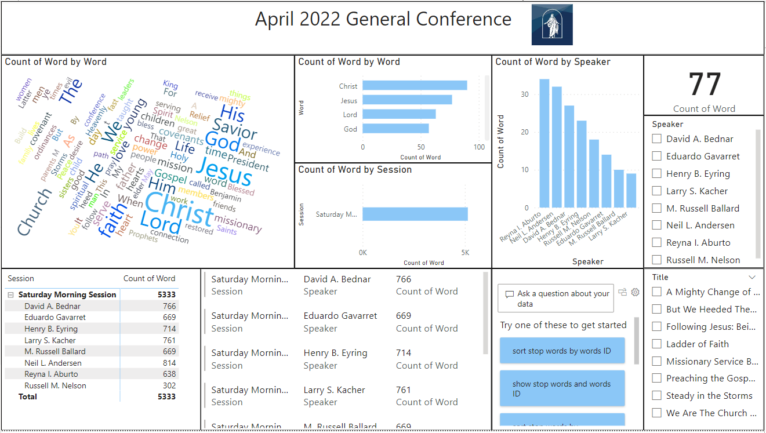
What did you build and how does it work?

Slide 3

What is the purpose and objective of your dashboard?
Count the most used words during the first session of general conference
Understand by looking at the most common words what lessons we should pay more attention to

Slide 4
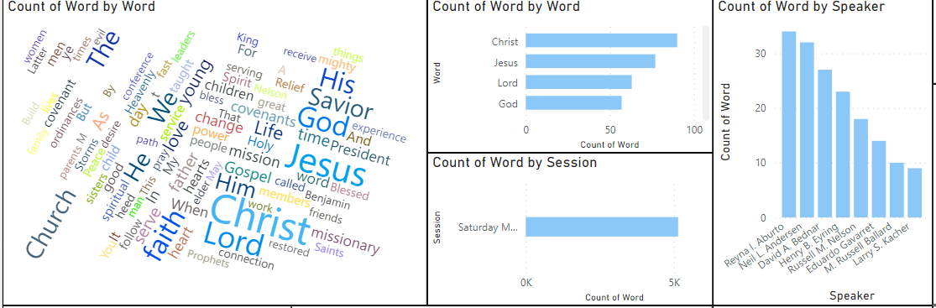
What does this dashboard teach us about your data source?
The name of Jesus Christ is the most common word
Sister Aburto had the most Christ focused talk
Out of the apostles that spoke, Elder Andersen is the one who spoke the most about Christ.

Slide 5
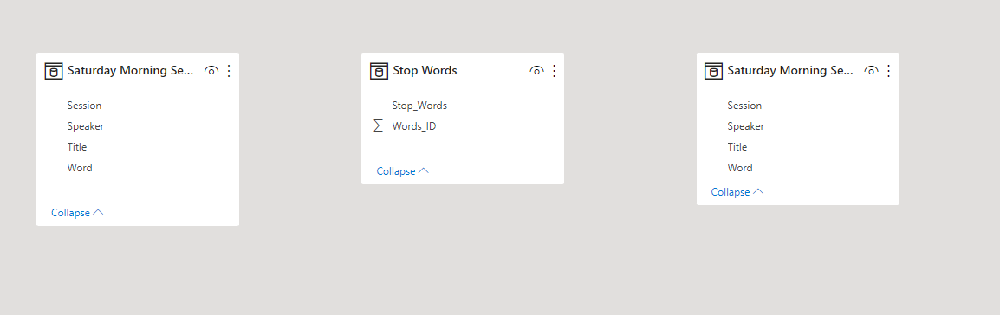
Challenges

