Slide 1
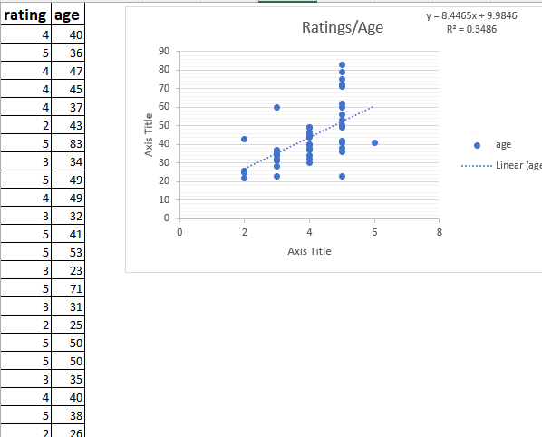
What did you build and how does it work?
Amazon women rating by age.

Slide 2

What is the purpose and objective of your project?
1 ) Understand if there is any correlation between age and ratings
2) Understand if it is possible to predict a woman’s rating based on her age.

Slide 3
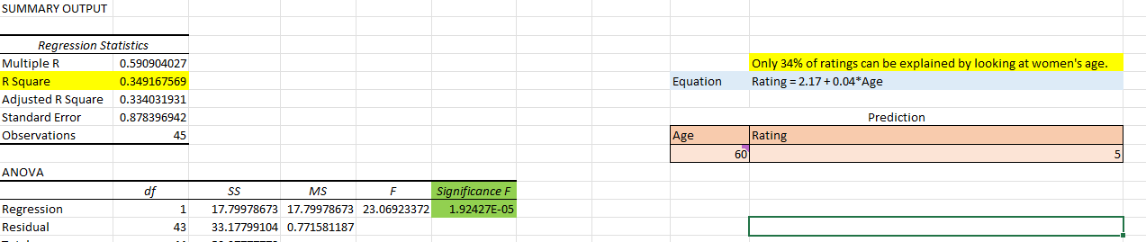
What does your solution teach us about predicting your dependent variable (for example house prices)?

