Slide 1
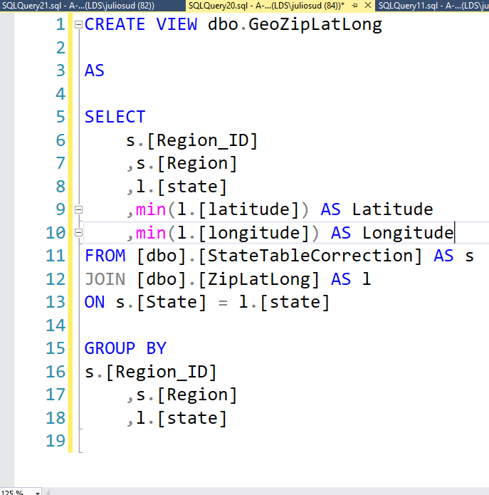
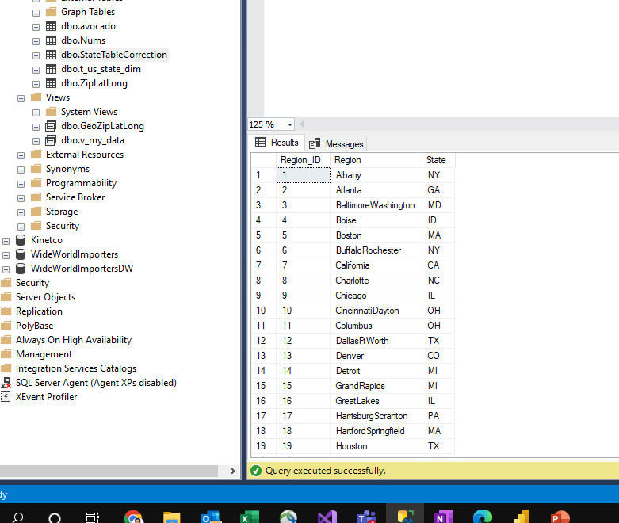
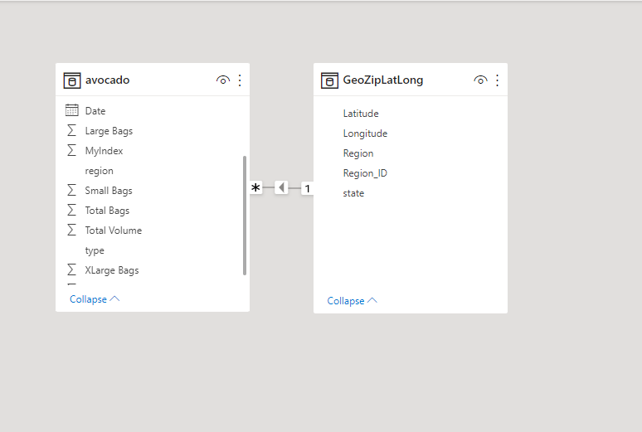
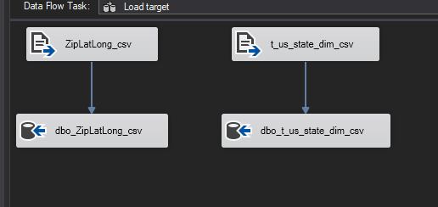
Data Prep
Used SSIS to import data to SSMS
Used SSMS to model the data and create views
Used Power BI to relate the data and create the visual report

Slide 2
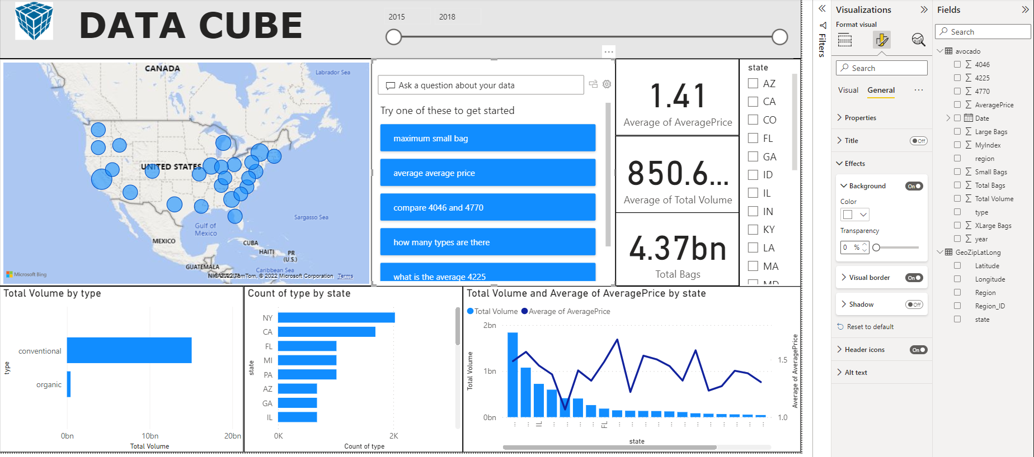
This dashboard is designed to measure sales perspective over the country.

