Slide 1
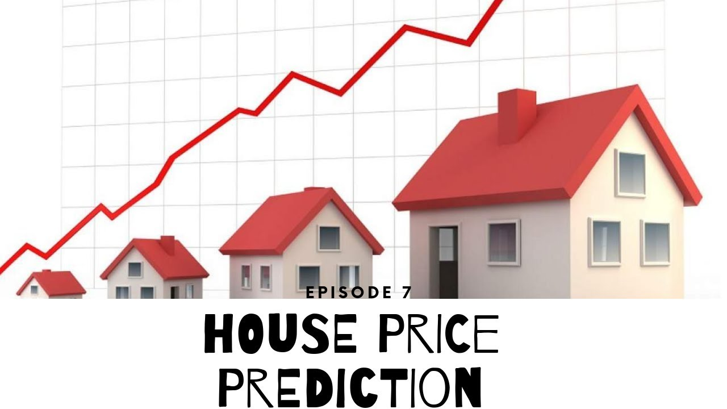
House Price Prediction

Slide 2
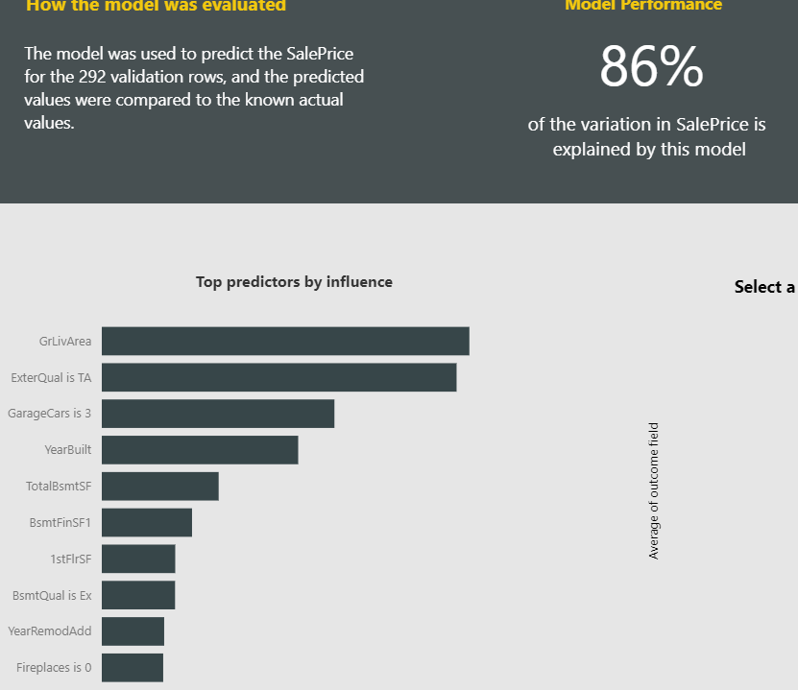
What did you build and how does it work?
I used PowerBI service ML and AI tools to help me analyze in Excel and PowerBI desktop the house price prediction in US.

Slide 3

What is the purpose and objective of your project?
This report is designed to give us insights about house pricing prediction in US. Also, this dashboard helps us understand the main factors that can lead a house to be priced the way it is.

Slide 4
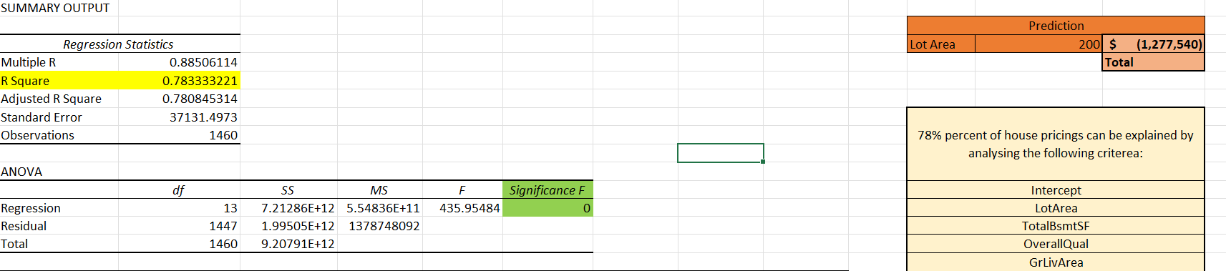
What does your solution teach us about predicting your dependent variable (for example house prices)?
There are main factors that can influence the price of a house. Based on our analysis, 78% of house prices in US can be explained by this report.

Slide 5
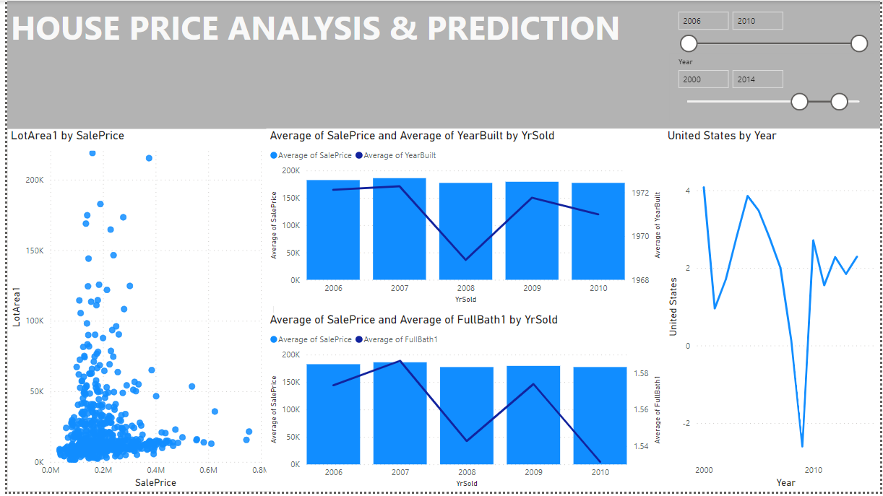
Power BI Dashboard
House price by Area
House price over the years
Number of bathrooms by over the years

