Slide 1
Multiple Windows

Slide 2
Using multiple windows
What is it?
  More than one window for the same app
Why use it?
  Separate windows for separate tasks
Where else?
  Run routines in background (running total, graph, etc.)

Slide 3

How to use multiple windows
One main window, several subwindows
public class MainWindow extends JFrame {
private Subwindow sub;
private JFrame subFrame;
subFrame.add(sub);
subFrame.setVisible(true);
}
public class Subwindow extends JPanel {
...
}

Slide 4
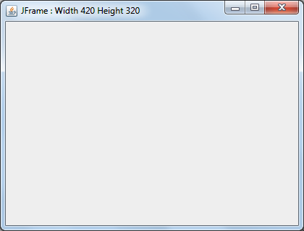
How to use multiple panels
One main window, several embedded panels
public class MainWindow extends JFrame {
private Subwindow sub1;
private AnotherSub sub2;
this.add(sub1);
sub1.setVisible(true);
this.add(sub2);
sub2.setVisible(false);
}
public class Subwindow extends JPanel {
...
}
public class Subwindow extends JPanel {
...
}

Slide 5
Model View Controller
Model
Observer
Manages properties
Represents info
View
Facade
User interface
Manages user actions
do not update directly from view
should not send directly to model
Controller
Mediates
Writes and Reads
Does the dirty work
manages updates to view or model

Slide 6
Application Deployment

Slide 7
Class library
Use NetBeans to create a Java Class Library Project
Use Refactor to move your code into library
  package names are important!
  Only one class should have a main() method!
Compile the library
  Produces a JAR file
To use the library
  Add the JAR to another project

Slide 8
Executable packages
Create a JAR file
JAR file also includes the manifest
  Manifest.mf -> Make File
  Manifest includes name of class with main()
  Only one class should have a main()!
Folders
  dist: distribution assets
  src: source code
  lib: any JAR files used in the library

Slide 9
Other things to consider
Add any extra files to your JAR
  Images, data files, text files, etc.
Zip the distribution contents
  Just the contents, not the folder
  Include subfolders
Test it!
  Ideally, test on another machine
  You must have a JRE installed
  Use: java my_zip_file

