Slide 1
Practical Application Development with Spring DATA
Module 9: JPA

Slide 2

Agenda
Revisão do Spring Essentials
Spring BooT - Overview
Spring BooT – Introduction;
Spring BooT – Components;
Spring BooT – Features;
Funcionamento;
Construção de aplicação;

Slide 3
Spring JPA
Aplicação
Corrida JPA

Slide 4
Spring JPA
CRUD (acrónimo do inglês Create, Read, Update e Delete) são as quatro operações básicas (criação, consulta, atualização e destruição de dados) utilizadas em bases de dados relacionais (RDBMS) fornecidas aos utilizadores do sistema;

Slide 5
Spring JPA
Criaremos um banco de dados MYSQL (free);
Iremos utilizar o JPA para persistência dos dados;
Vamos configurar o intialzr para criar o projeto no STS;
Criar 9 classes com código;

Slide 6
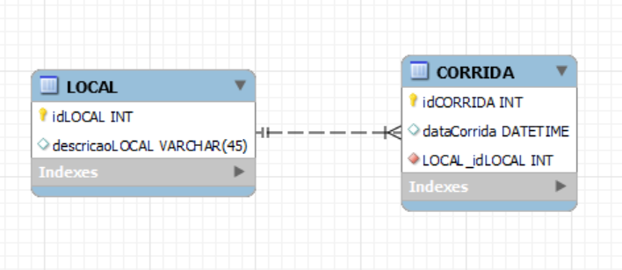
Spring JPA
Criar as classes

Slide 7
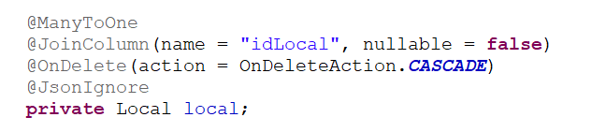
Spring JPA
Criar as classes

Slide 8
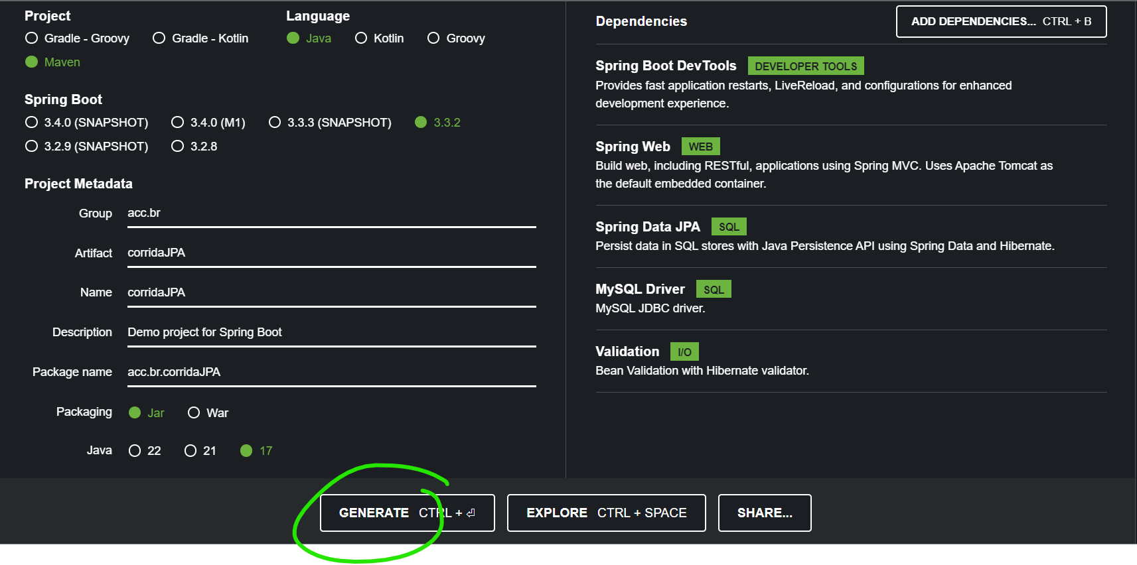
Spring JPA
Starters;

Slide 9
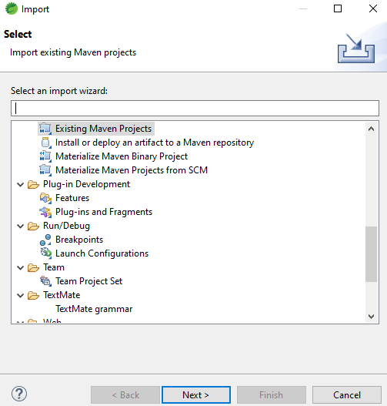
Spring JPA
FILE ->Import;

Slide 10
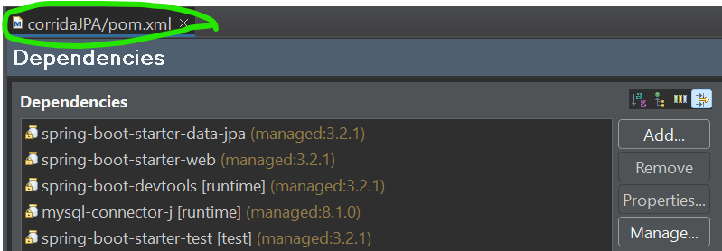
Spring JPA
Estrutura dos pacotes e dependências;
POM.XML (código no slide)
Notes:
<?xml version="1.0" encoding="UTF-8"?>
<project xmlns="http://maven.apache.org/POM/4.0.0" xmlns:xsi="http://www.w3.org/2001/XMLSchema-instance"
xsi:schemaLocation="http://maven.apache.org/POM/4.0.0 https://maven.apache.org/xsd/maven-4.0.0.xsd">
<modelVersion>4.0.0</modelVersion>
<parent>
<groupId>org.springframework.boot</groupId>
<artifactId>spring-boot-starter-parent</artifactId>
<version>2.7.15</version>
<relativePath/> <!-- lookup parent from repository -->
</parent>
<groupId>acc.br</groupId>
<artifactId>coridaJPA</artifactId>
<version>0.0.1-SNAPSHOT</version>
<name>coridaJPA</name>
<description>Demo project for Spring Boot</description>
<properties>
<java.version>17</java.version>
</properties>
<dependencies>
<dependency>
<groupId>org.springframework.boot</groupId>
<artifactId>spring-boot-starter-data-jpa</artifactId>
</dependency>
<dependency>
<groupId>org.springframework.boot</groupId>
<artifactId>spring-boot-starter-web</artifactId>
</dependency>
<dependency>
<groupId>org.springframework.boot</groupId>
<artifactId>spring-boot-devtools</artifactId>
<scope>runtime</scope>
<optional>true</optional>
</dependency>
<dependency>
<groupId>com.mysql</groupId>
<artifactId>mysql-connector-j</artifactId>
<scope>runtime</scope>
</dependency>
<dependency>
<groupId>org.springframework.boot</groupId>
<artifactId>spring-boot-starter-test</artifactId>
<scope>test</scope>
</dependency>
</dependencies>
<build>
<plugins>
<plugin>
<groupId>org.springframework.boot</groupId>
<artifactId>spring-boot-maven-plugin</artifactId>
</plugin>
</plugins>
</build>
</project>

Slide 11
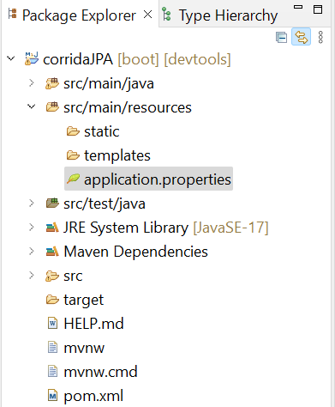
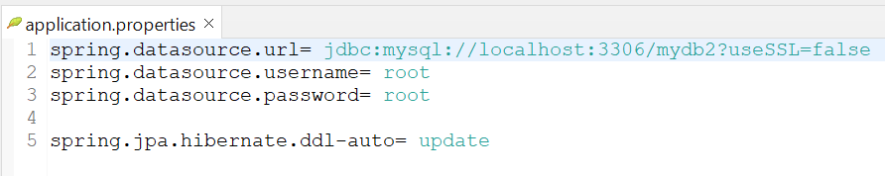
Spring JPA
application.properties
Configuração do MYSQL
Schema: mydb2
Notes:
spring.datasource.url= jdbc:mysql://localhost:3306/mydb2?useSSL=false
spring.datasource.username= root
spring.datasource.password= root
spring.jpa.hibernate.ddl-auto= update

Slide 12
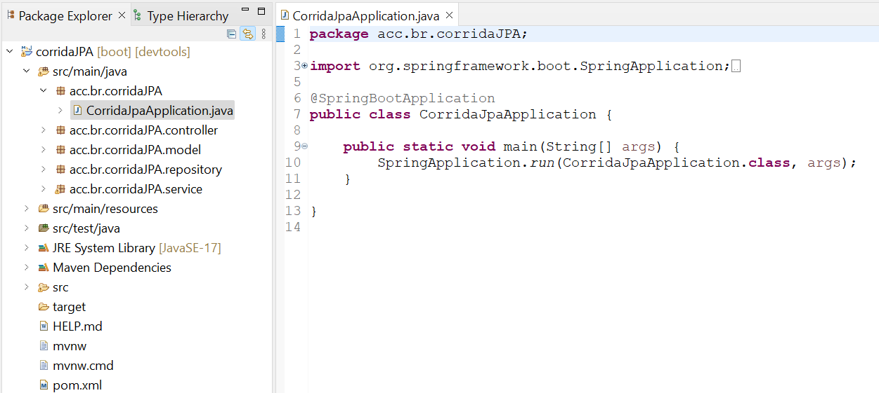
Spring JPA
A classe principal
Sistema no pacote com.example.jpa
Notes:
package acc.br.corridaJPA;
import org.springframework.boot.SpringApplication;
import org.springframework.boot.autoconfigure.SpringBootApplication;
@SpringBootApplication
public class CorridaJpaApplication {
public static void main(String[] args) {
SpringApplication.run(CorridaJpaApplication.class, args);
}
}

Slide 13
Spring JPA
EndPoints do Projeto(menu).
LOCAL
CORRIDA
@Get("/local")
@Get("/corrida")
@Get("/local/{id}")
@Get("/corrida/{id}")
@Delete("/local/{id}")
@Delete("/corrida/{id}")
@Post("/local")
@Post("/corrida")
@Post("/local/{id}/corrida")
@Get("/local/{id}/corrida")
@Delete("/local/{id}/corrida")

Slide 14
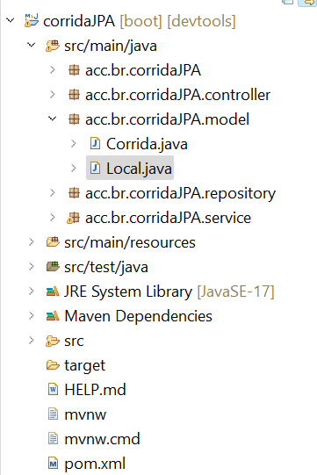
Spring JPA
Criar a camada MODEL
No pacote acc.br.corridaJPA.model:
Criar a classe Local.java (código no slide)
Notes:
package acc.br.corridaJPA.model;
import java.io.Serializable;
import jakarta.persistence.Column;
import jakarta.persistence.Entity;
import jakarta.persistence.GeneratedValue;
import jakarta.persistence.GenerationType;
import jakarta.persistence.Id;
@Entity
public class Local implements Serializable {
/**
*
*/
private static final long serialVersionUID = 1L;
@Id
@GeneratedValue(strategy = GenerationType.IDENTITY)
private Long id;
@Column(unique = true, nullable = false, length = 45)
private String descricao;
public Long getId() {
return id;
}
public void setId(Long id) {
this.id = id;
}
public String getDescricao() {
return descricao;
}
public void setDescricao(String descricao) {
this.descricao = descricao;
}
}

Slide 15
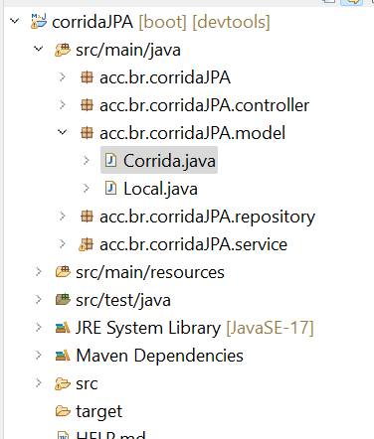
Spring JPA
Criar a camada MODEL
No pacote acc.br.corridaJPA.model:
Criar a classe Corrida.java (código no slide)
Notes:
package acc.br.corridaJPA.model;
import java.io.Serializable;
import java.time.LocalDateTime;
import org.hibernate.annotations.OnDelete;
import org.hibernate.annotations.OnDeleteAction;
import com.fasterxml.jackson.annotation.JsonFormat;
import com.fasterxml.jackson.annotation.JsonIgnore;
import jakarta.persistence.Column;
import jakarta.persistence.Entity;
import jakarta.persistence.GeneratedValue;
import jakarta.persistence.GenerationType;
import jakarta.persistence.Id;
import jakarta.persistence.JoinColumn;
import jakarta.persistence.ManyToOne;
@Entity
public class Corrida implements Serializable {
/**
*
*/
private static final long serialVersionUID = 1L;
@Id
@GeneratedValue(strategy = GenerationType.IDENTITY)
private Long idCorrida;
@Column(nullable = false)
@JsonFormat(shape = JsonFormat.Shape.STRING, pattern = "dd/MM/yyyy HH:mm:ss", timezone = "GMT-3")
private LocalDateTime dataCorrida;
@ManyToOne
@JoinColumn(name = "idLocal", nullable = false)
@OnDelete(action = OnDeleteAction.CASCADE)
@JsonIgnore
private Local local;
public Long getIdCorrida() {
return idCorrida;
}
public void setIdCorrida(Long idCorrida) {
this.idCorrida = idCorrida;
}
public LocalDateTime getDataCorrida() {
return dataCorrida;
}
public void setDataCorrida(LocalDateTime dataCorrida) {
this.dataCorrida = dataCorrida;
}
public Local getLocal() {
return local;
}
public void setLocal(Local local) {
this.local = local;
}
}

Slide 16
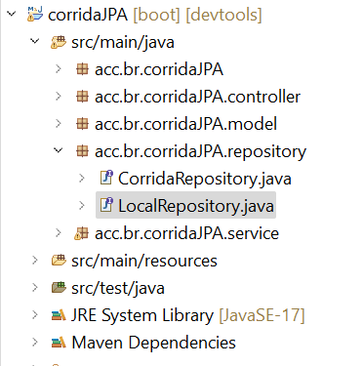
Spring JPA
Criar a camada REPOSITORY
No pacote acc.br.corridaJPA.repository:
Criar a classe LocalRepository.java (código no slide)
Notes:
package acc.br.corridaJPA.repository;
import org.springframework.data.jpa.repository.JpaRepository;
import org.springframework.stereotype.Repository;
import acc.br.corridaJPA.model.Local;
@Repository
public interface LocalRepository extends JpaRepository<Local, Long>
{
}

Slide 17
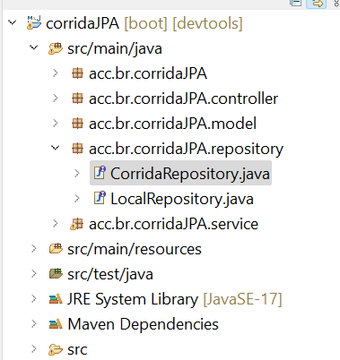
Spring JPA
Criar a camada REPOSITORY
No pacote acc.br.corridaJPA.repository:
Criar a classe CorridaRepository.java (código no slide)
Notes:
package acc.br.corridaJPA.repository;
import java.util.List;
import org.springframework.data.jpa.repository.JpaRepository;
import org.springframework.stereotype.Repository;
import acc.br.corridaJPA.model.Corrida;
import jakarta.transaction.Transactional;
@Repository
public interface CorridaRepository extends JpaRepository<Corrida, Long>
{
List<Corrida> findByLocalId(Long localId);
@Transactional
void deleteByLocalId(Long localId);
}

Slide 18
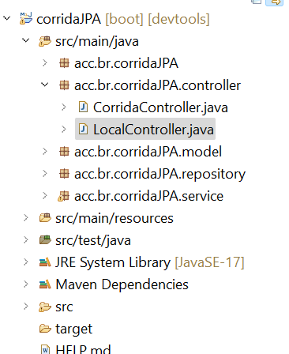
Spring JPA
Criar a camada CONTROLLER
No pacote acc.br.corridaJPA.controller:
Criar a classe LocalController.java (código no slide)
Notes:
package acc.br.corridaJPA.controller;
import java.util.List;
import org.springframework.beans.factory.annotation.Autowired;
import org.springframework.web.bind.annotation.DeleteMapping;
import org.springframework.web.bind.annotation.GetMapping;
import org.springframework.web.bind.annotation.PathVariable;
import org.springframework.web.bind.annotation.PostMapping;
import org.springframework.web.bind.annotation.RequestBody;
import org.springframework.web.bind.annotation.RestController;
import acc.br.corridaJPA.model.Local;
import acc.br.corridaJPA.service.LocalService;
//creating RestController
@RestController
public class LocalController
{
//autowired the localService class
@Autowired
LocalService localService;
//creating a get mapping that retrieves all the Local detail from the database
@GetMapping("/local")
private List<Local> getAllLocal()
{
return localService.getAllLocal();
}
//creating a get mapping that retrieves the detail of a specific student
@GetMapping("/local/{id}")
private Local getLocal(@PathVariable("id") int id)
{
return localService.getLocalById(id);
}
//creating a delete mapping that deletes a specific student
@DeleteMapping("/local/{id}")
private void deleteLocal(@PathVariable("id") int id)
{
localService.delete(id);
}
//creating post mapping that post the student detail in the database
@PostMapping("/local")
private long saveLocal(@RequestBody Local local)
{
localService.saveOrUpdate(local);
return local.getId();
//return 123;
}
}
//http://localhost:8080/swagger-ui/index.html#/

Slide 19
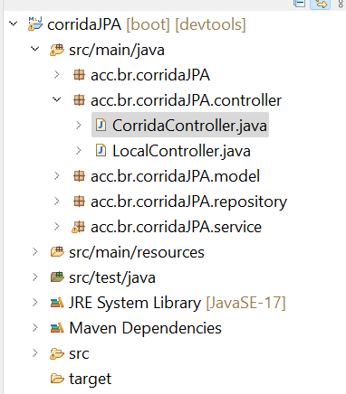
Spring JPA
Criar a camada CONTROLLER
No pacote acc.br.corridaJPA.controller:
Criar a classe CorridaController.java (código no slide)
Notes:
package acc.br.corridaJPA.controller;
import java.util.List;
import org.springframework.beans.factory.annotation.Autowired;
import org.springframework.http.HttpStatus;
import org.springframework.http.ResponseEntity;
import org.springframework.web.bind.annotation.DeleteMapping;
import org.springframework.web.bind.annotation.GetMapping;
import org.springframework.web.bind.annotation.PathVariable;
import org.springframework.web.bind.annotation.PostMapping;
import org.springframework.web.bind.annotation.RequestBody;
import org.springframework.web.bind.annotation.RestController;
import acc.br.corridaJPA.model.Corrida;
import acc.br.corridaJPA.service.CorridaService;
import acc.br.corridaJPA.service.LocalService;
//creating RestController
@RestController
public class CorridaController
{
//autowired the StudentService class
@Autowired
CorridaService corridaService;
@Autowired
LocalService localService;
@GetMapping("/corrida")
private List<Corrida> getAllCorrida()
{
return corridaService.getAllCorrida();
}
//creating a get mapping that retrieves the detail of a specific student
@GetMapping("/corrida/{id}")
private Corrida getCorrida(@PathVariable("id") int id)
{
return corridaService.getCorridaById(id);
}
//creating a delete mapping that deletes a specific student
@DeleteMapping("/corrida/{id}")
private void deleteCorrida(@PathVariable("id") int id)
{
corridaService.delete(id);
}
//creating post mapping that post the student detail in the database
@PostMapping("/corrida")
private long saveCorrida(@RequestBody Corrida corrida)
{
corridaService.saveOrUpdate(corrida);
return corrida.getIdCorrida();
}
//Adicionar uma corrida a um Local
@PostMapping("/local/{localId}/corrida")
public ResponseEntity<Corrida> criarCorrida(@PathVariable(value = "localId") Long localId, @RequestBody Corrida corridaRequest) {
corridaService.criarCorrida(localId, corridaRequest);
return new ResponseEntity<>(corridaRequest, HttpStatus.CREATED);
}
//Consulta todas as corridas de um local
@GetMapping("/local/{localId}/corrida")
public ResponseEntity<List<Corrida>> consultaCorridasPorLocalId(@PathVariable(value = "localId") Long localId) {
return corridaService.consultaCorridasPorLocalId(localId);
}
@DeleteMapping("/local/{localId}/corrida")
public ResponseEntity<List<Corrida>> deletaCorridasPorLocalId(@PathVariable(value = "localId") Long localId) {
corridaService.deletaCorridasPorLocalId(localId);
return new ResponseEntity<>(HttpStatus.NO_CONTENT);
}
}

Slide 20
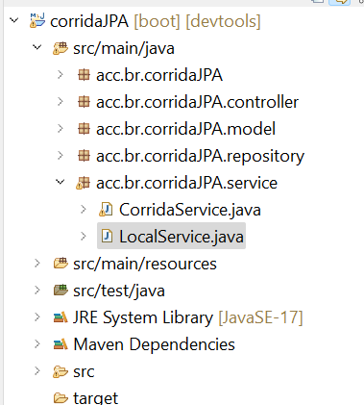
Spring JPA
Criar a camada SERVIÇO
No pacote acc.br.corridaJPA.service:
Criar a classe LocalService.java (código no slide)
Notes:
package acc.br.corridaJPA.service;
import java.util.ArrayList;
import java.util.List;
import org.springframework.beans.factory.annotation.Autowired;
import org.springframework.stereotype.Service;
import acc.br.corridaJPA.model.Local;
import acc.br.corridaJPA.repository.LocalRepository;
//Define a lógica de negócio
@Service
public class LocalService
{
@Autowired
LocalRepository localRepository;
//Pega todos os registros da tabela students
public List<Local> getAllLocal()
{
List<Local> locais = new ArrayList<Local>();
localRepository.findAll().forEach(local -> locais.add(local));
return locais;
}
//Recupera um registro especifico
public Local getLocalById(long id)
{
return localRepository.findById(id).get();
}
public void saveOrUpdate(Local local)
{
localRepository.save(local);
}
//Deleta um registro especifico
public void delete(long id)
{
localRepository.deleteById(id);
}
}

Slide 21
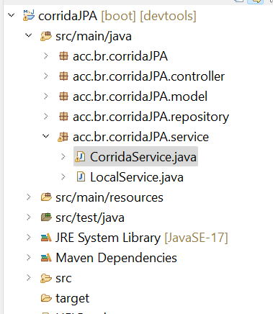
Spring JPA
Criar a camada SERVIÇO
No pacote acc.br.corridaJPA.service:
Criar a classe CorridaService.java (código no slide)
Notes:
package acc.br.corridaJPA.service;
import java.util.ArrayList;
import java.util.List;
import org.springframework.beans.factory.annotation.Autowired;
import org.springframework.http.HttpStatus;
import org.springframework.http.ResponseEntity;
import org.springframework.stereotype.Service;
import org.springframework.web.bind.annotation.PathVariable;
import org.springframework.web.bind.annotation.RequestBody;
import acc.br.corridaJPA.model.Corrida;
import acc.br.corridaJPA.repository.CorridaRepository;
import acc.br.corridaJPA.repository.LocalRepository;
//Define a lógica de negócio
@Service
public class CorridaService
{
@Autowired
CorridaRepository corridaRepository;
@Autowired
LocalRepository localRepository;
//Pega todos os registros da tabela students
public List<Corrida> getAllCorrida()
{
List<Corrida> corridas = new ArrayList<Corrida>();
corridaRepository.findAll().forEach(corrida -> corridas.add(corrida));
return corridas;
}
//Recupera um registro especifico
public Corrida getCorridaById(long id)
{
return corridaRepository.findById(id).get();
}
public void saveOrUpdate(Corrida corrida)
{
corridaRepository.save(corrida);
}
//Deleta um registro especifico
public void delete(long id)
{
corridaRepository.deleteById(id);
}
//POST Adicionar uma corrida a um Local
public void criarCorrida(@PathVariable(value = "localId") Long localId, @RequestBody Corrida corridaRequest) {
// public ResponseEntity<Corrida> createCorrida(@PathVariable(value = "localId") Long localId, @RequestBody Corrida corridaRequest) {
Corrida corrida = localRepository
.findById(localId)
.map(local -> {
corridaRequest.setLocal(local);
return corridaRepository.save(corridaRequest);})
.orElse(corridaRequest);
// .orElseThrow(() -> new ResourceNotFoundException("Não encontrado o Local com id = " + localId));
// return new ResponseEntity<>(corrida, HttpStatus.CREATED);
}
//GET Consulta corridas por local
public ResponseEntity<List<Corrida>> consultaCorridasPorLocalId(@PathVariable(value = "localId") Long localId) {
if (!localRepository.existsById(localId)) {
// throw new ResourceNotFoundException("Não encontrado o Local com id = \" + localId));
}
List<Corrida> corridas = corridaRepository.findByLocalId(localId);
return new ResponseEntity<>(corridas, HttpStatus.OK);
}
//DELETE Coridas por Local
public ResponseEntity<List<Corrida>> deletaCorridasPorLocalId(@PathVariable(value = "localId") Long localId) {
if (!localRepository.existsById(localId)) {
// throw new ResourceNotFoundException("Not found Tutorial with id = " + localId);
}
corridaRepository.deleteByLocalId(localId);
return new ResponseEntity<>(HttpStatus.NO_CONTENT);
}
}

Slide 22
Spring JPA
TESTE A API
Notes:
http://localhost:8080/swagger-ui/index.html#/

Slide 23
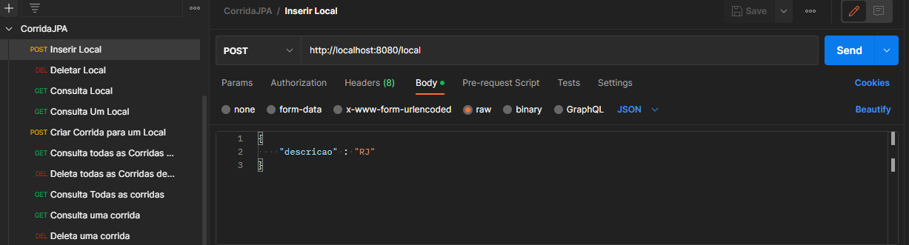
Spring JPA
Testando com o POSTMAN
Inserindo um Local de corrida
POST => http:/localhost:8080/local
Notes:
http:/localhost:8080/local
{
"descricao" : "RJ"
}

Slide 24
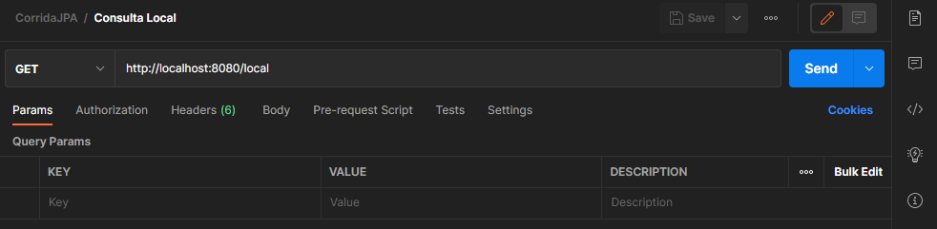
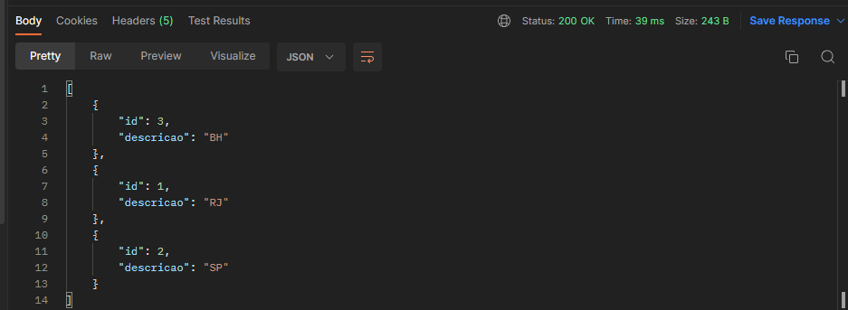
Spring JPA
Consulta todos os locais de corrida.
GET => http://localhost:8080/local
Notes:
http://localhost:8080/local

Slide 25
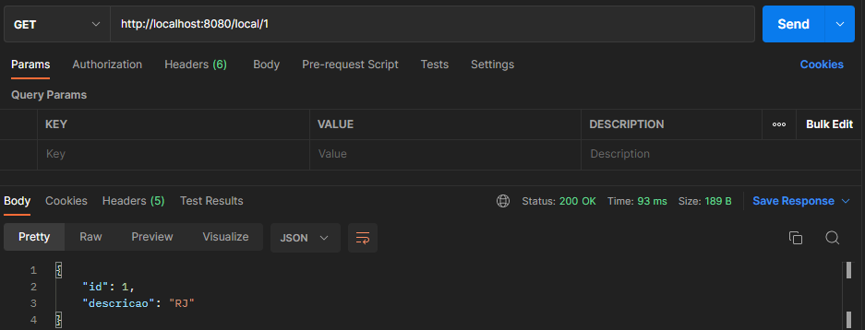
Spring JPA
Consulta um local de corrida.
GET => http://localhost:8080/local/1
Notes:
http://localhost:8080/local/1

Slide 26
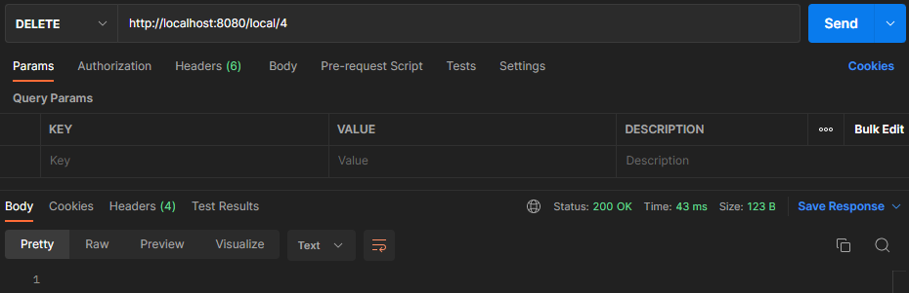
Spring JPA
Deleta um local de corrida.
DELETE => http://localhost:8080/local/3
Notes:
http://localhost:8080/local/3

Slide 27
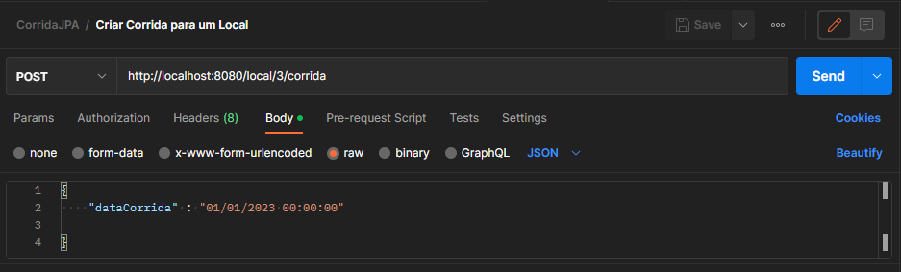
Spring JPA
Criar uma corrida para um local
POST => http://localhost:8080/local/3/corrida
Notes:
http://localhost:8080/local/3/corrida

Slide 28
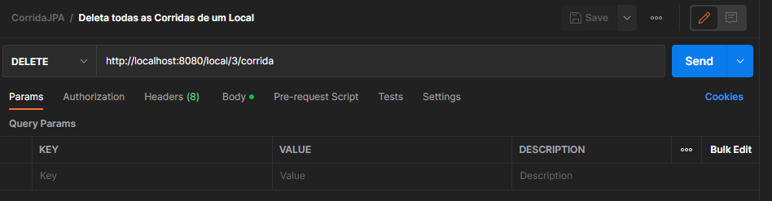
Spring JPA
Deleta todas as corridas de um local
DELETE => http://localhost:8080/local/3/corrida
Notes:
http://localhost:8080/local/3/corrida

Slide 29
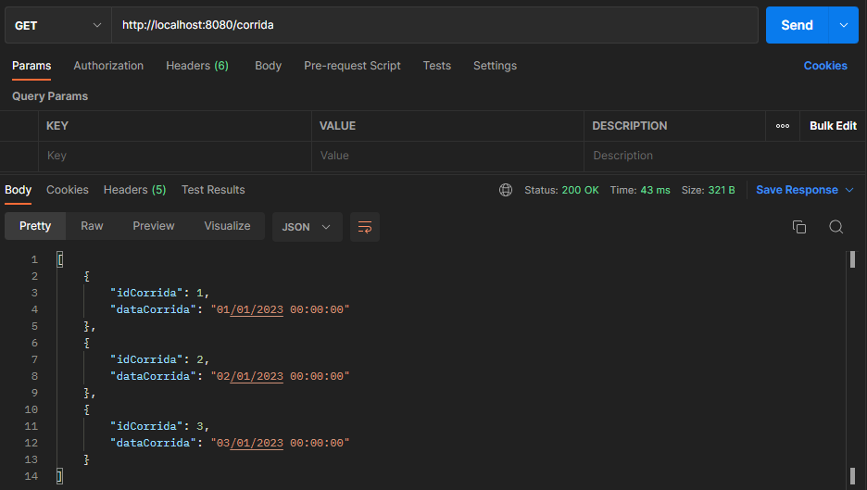
Spring JPA
Consulta todas as corridas
GET => http://localhost:8080/corrida
Notes:
http://localhost:8080/corrida

Slide 30
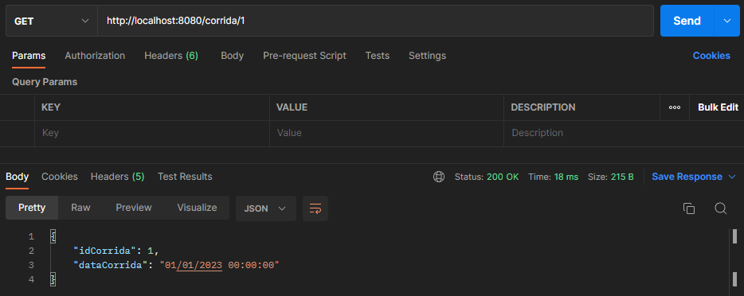
Spring JPA
Consulta uma corrida
GET => http://localhost:8080/corrida/1
Notes:
http://localhost:8080/corrida/1

Slide 31
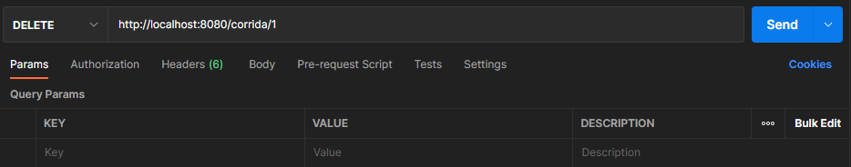
Spring JPA
Deleta uma corrida
DELETE => http://localhost:8080/corrida/1
Notes:
http://localhost:8080/corrida/1

Slide 32
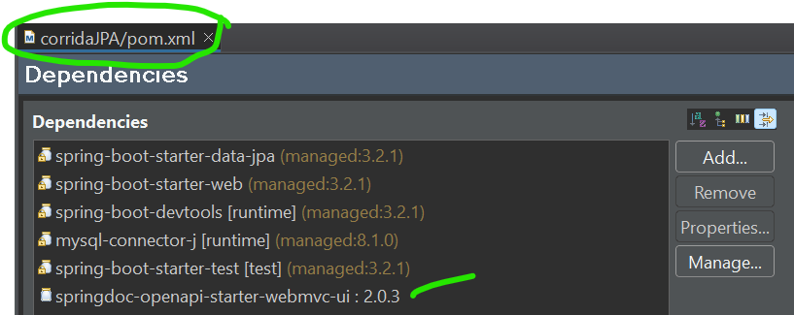
Spring JPA
DESAFIO
Adicionar o Swagger
http://localhost:8080/swagger-ui/index.html#/
Notes:
http://localhost:8080/corrida/1

Slide 33


Questions and Comments
What questions or comments do you have?

