Slide 1
Spring Boot
Aplicação
CRUD Students
Notes:
Aqui abrir uma aplicação juntamente com os alunos;

Slide 2
Projeto CRUD Student
CRUD (acrónimo do inglês Create, Read, Update e Delete) são as quatro operações básicas (criação, consulta, atualização e destruição de dados) utilizadas em bases de dados relacionais (RDBMS) fornecidas aos utilizadores do sistema;
Notes:
Content: N/A
Notes to Instructor:

Slide 3
Projeto CRUD Student
Iremos criar uma página de CRUD, para listar a tabela de students;
Utilizaremos o SpringInitializer;
Criaremos um banco de dados H2 (free);
Iremos utilizar o Hibernate para persistência dos dados;
Vamos configurar o Maven para criar o projeto no STS;
Criar o código;
Notes:
Content: N/A
Notes to Instructor:

Slide 4
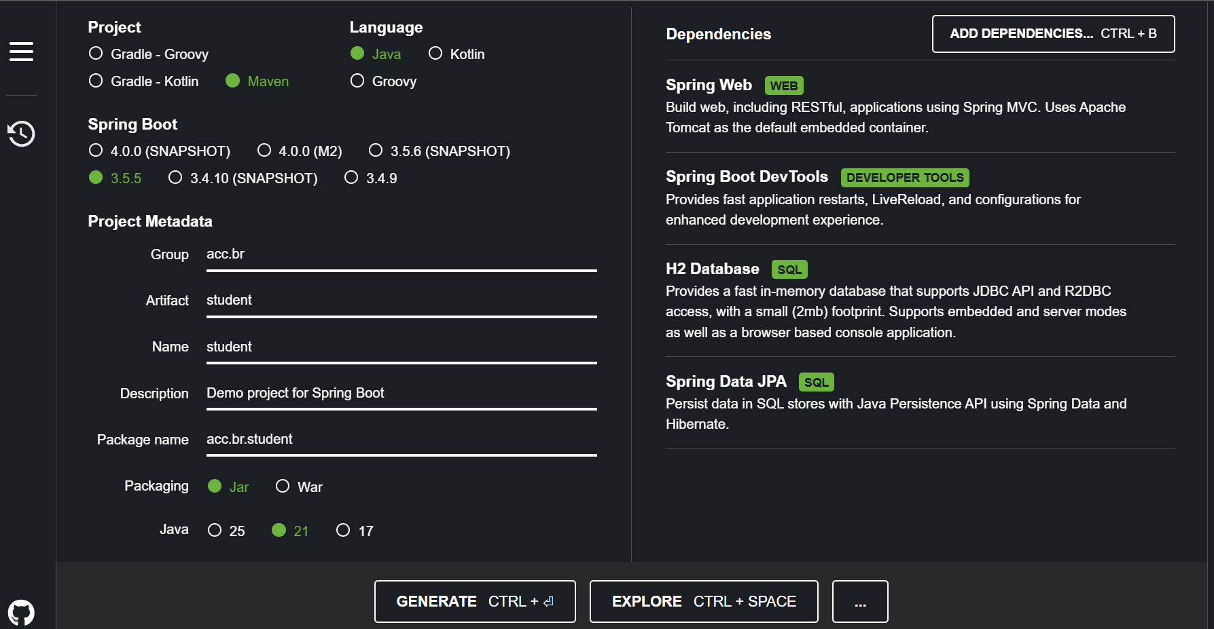
Projeto CRUD Student
Notes:
<?xml version="1.0" encoding="UTF-8"?>
<project xmlns="http://maven.apache.org/POM/4.0.0" xmlns:xsi="http://www.w3.org/2001/XMLSchema-instance"
xsi:schemaLocation="http://maven.apache.org/POM/4.0.0 https://maven.apache.org/xsd/maven-4.0.0.xsd">
<modelVersion>4.0.0</modelVersion>
<parent>
<groupId>org.springframework.boot</groupId>
<artifactId>spring-boot-starter-parent</artifactId>
<version>2.3.0.M1</version>
<relativePath/> <!-- lookup parent from repository -->
</parent>
<groupId>com.javatpoint</groupId>
<artifactId>spring-boot-h2-database-example</artifactId>
<version>0.0.1-SNAPSHOT</version>
<name>spring-boot-h2-database-example</name>
<description>Demo project for Spring Boot</description>
<properties>
<java.version>1.8</java.version>
</properties>
<dependencies>
<dependency>
<groupId>org.springframework.boot</groupId>
<artifactId>spring-boot-starter-data-jpa</artifactId>
</dependency>
<dependency>
<groupId>org.springframework.boot</groupId>
<artifactId>spring-boot-starter-web</artifactId>
</dependency>
<dependency>
<groupId>com.h2database</groupId>
<artifactId>h2</artifactId>
<scope>runtime</scope>
</dependency>
<dependency>
<groupId>org.springframework.boot</groupId>
<artifactId>spring-boot-starter-test</artifactId>
<scope>test</scope>
<exclusions>
<exclusion>
<groupId>org.junit.vintage</groupId>
<artifactId>junit-vintage-engine</artifactId>
</exclusion>
</exclusions>
</dependency>
</dependencies>
<build>
<plugins>
<plugin>
<groupId>org.springframework.boot</groupId>
<artifactId>spring-boot-maven-plugin</artifactId>
</plugin>
</plugins>
</build>
<repositories>
<repository>
<id>spring-milestones</id>
<name>Spring Milestones</name>
<url>https://repo.spring.io/milestone</url>
</repository>
</repositories>
<pluginRepositories>
<pluginRepository>
<id>spring-milestones</id>
<name>Spring Milestones</name>
<url>https://repo.spring.io/milestone</url>
</pluginRepository>
</pluginRepositories>
</project>

Slide 5
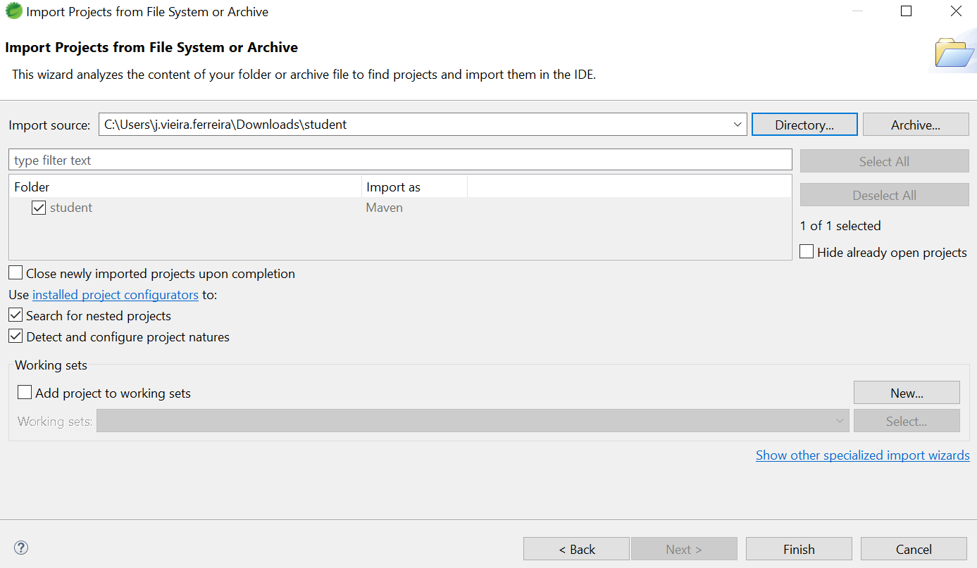
Projeto CRUD Student
FILE ... IMPORT....PROJECTS FROM FOLDER OR...
Notes:
<?xml version="1.0" encoding="UTF-8"?>
<project xmlns="http://maven.apache.org/POM/4.0.0" xmlns:xsi="http://www.w3.org/2001/XMLSchema-instance"
xsi:schemaLocation="http://maven.apache.org/POM/4.0.0 https://maven.apache.org/xsd/maven-4.0.0.xsd">
<modelVersion>4.0.0</modelVersion>
<parent>
<groupId>org.springframework.boot</groupId>
<artifactId>spring-boot-starter-parent</artifactId>
<version>2.3.0.M1</version>
<relativePath/> <!-- lookup parent from repository -->
</parent>
<groupId>com.javatpoint</groupId>
<artifactId>spring-boot-h2-database-example</artifactId>
<version>0.0.1-SNAPSHOT</version>
<name>spring-boot-h2-database-example</name>
<description>Demo project for Spring Boot</description>
<properties>
<java.version>1.8</java.version>
</properties>
<dependencies>
<dependency>
<groupId>org.springframework.boot</groupId>
<artifactId>spring-boot-starter-data-jpa</artifactId>
</dependency>
<dependency>
<groupId>org.springframework.boot</groupId>
<artifactId>spring-boot-starter-web</artifactId>
</dependency>
<dependency>
<groupId>com.h2database</groupId>
<artifactId>h2</artifactId>
<scope>runtime</scope>
</dependency>
<dependency>
<groupId>org.springframework.boot</groupId>
<artifactId>spring-boot-starter-test</artifactId>
<scope>test</scope>
<exclusions>
<exclusion>
<groupId>org.junit.vintage</groupId>
<artifactId>junit-vintage-engine</artifactId>
</exclusion>
</exclusions>
</dependency>
</dependencies>
<build>
<plugins>
<plugin>
<groupId>org.springframework.boot</groupId>
<artifactId>spring-boot-maven-plugin</artifactId>
</plugin>
</plugins>
</build>
<repositories>
<repository>
<id>spring-milestones</id>
<name>Spring Milestones</name>
<url>https://repo.spring.io/milestone</url>
</repository>
</repositories>
<pluginRepositories>
<pluginRepository>
<id>spring-milestones</id>
<name>Spring Milestones</name>
<url>https://repo.spring.io/milestone</url>
</pluginRepository>
</pluginRepositories>
</project>

Slide 6
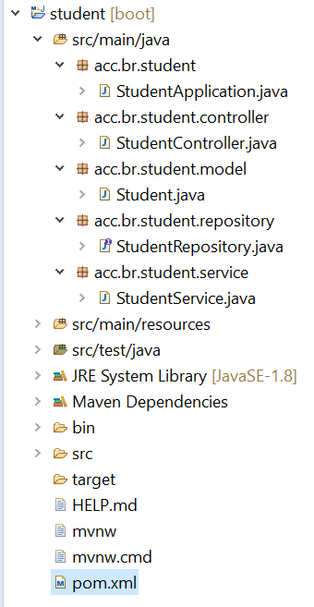
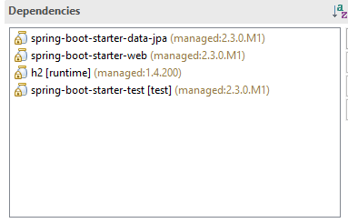
Projeto CRUD Student
Estrutura dos pacotes e dependências;
Notes:
<?xml version="1.0" encoding="UTF-8"?>
<project xmlns="http://maven.apache.org/POM/4.0.0" xmlns:xsi="http://www.w3.org/2001/XMLSchema-instance"
xsi:schemaLocation="http://maven.apache.org/POM/4.0.0 https://maven.apache.org/xsd/maven-4.0.0.xsd">
<modelVersion>4.0.0</modelVersion>
<parent>
<groupId>org.springframework.boot</groupId>
<artifactId>spring-boot-starter-parent</artifactId>
<version>2.3.0.M1</version>
<relativePath/> <!-- lookup parent from repository -->
</parent>
<groupId>com.javatpoint</groupId>
<artifactId>spring-boot-h2-database-example</artifactId>
<version>0.0.1-SNAPSHOT</version>
<name>spring-boot-h2-database-example</name>
<description>Demo project for Spring Boot</description>
<properties>
<java.version>1.8</java.version>
</properties>
<dependencies>
<dependency>
<groupId>org.springframework.boot</groupId>
<artifactId>spring-boot-starter-data-jpa</artifactId>
</dependency>
<dependency>
<groupId>org.springframework.boot</groupId>
<artifactId>spring-boot-starter-web</artifactId>
</dependency>
<dependency>
<groupId>com.h2database</groupId>
<artifactId>h2</artifactId>
<scope>runtime</scope>
</dependency>
<dependency>
<groupId>org.springframework.boot</groupId>
<artifactId>spring-boot-starter-test</artifactId>
<scope>test</scope>
<exclusions>
<exclusion>
<groupId>org.junit.vintage</groupId>
<artifactId>junit-vintage-engine</artifactId>
</exclusion>
</exclusions>
</dependency>
</dependencies>
<build>
<plugins>
<plugin>
<groupId>org.springframework.boot</groupId>
<artifactId>spring-boot-maven-plugin</artifactId>
</plugin>
</plugins>
</build>
<repositories>
<repository>
<id>spring-milestones</id>
<name>Spring Milestones</name>
<url>https://repo.spring.io/milestone</url>
</repository>
</repositories>
<pluginRepositories>
<pluginRepository>
<id>spring-milestones</id>
<name>Spring Milestones</name>
<url>https://repo.spring.io/milestone</url>
</pluginRepository>
</pluginRepositories>
</project>

Slide 7
Projeto CRUD de Produtos
Starters
O spring-boot-starter-web permite aplicativos da web, clássicos e RESTFul.
O spring-boot-starter-data-jpa é um iniciador para usar Spring Data JPA com Hibernate
O H2 (runtime) fornece conectividade para o H2 database.
O spring-boot-starter-test é a principal dependência do teste, ele contém os elementos necessários para nossos testes.
Notes:
Content: N/A
Notes to Instructor:

Slide 8
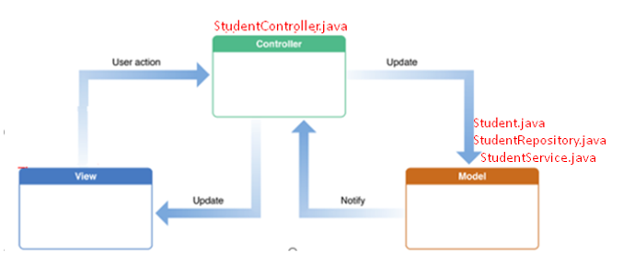
Projeto CRUD Student
Estrutura

Slide 9
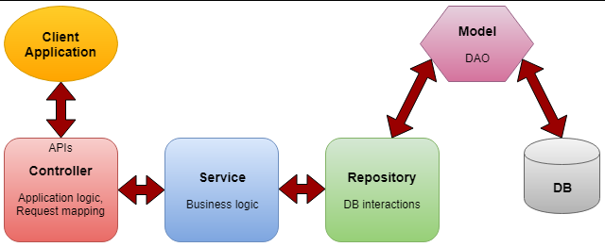
Projeto CRUD Student
Estrutura:
@controller @service @repository
Notes:
Controlador- A camada do controlador contém a * lógica do aplicativo, mapeando a solicitação do usuário para funções específicas e passando a entrada do usuário para a camada de serviço para aplicar a lógica de negócios.
Serviço- Esta é a camada entre o controlador e o repositório que executa a * lógica de negócios e a lógica de validação. O controlador passa a entrada do usuário para a camada de serviço e, após aplicar a lógica de negócios, é passada para a camada de repositório.
Repositório- A camada que interage com as operações CRUD do banco de dados por meio dos DAOs (objetos de acesso a dados).
Modelo - São as classes POJO simples que atuam como DTO (Interagir com a transferência de dados no nível do aplicativo) ou DAO (Interação com operações de banco de dados)

Slide 10
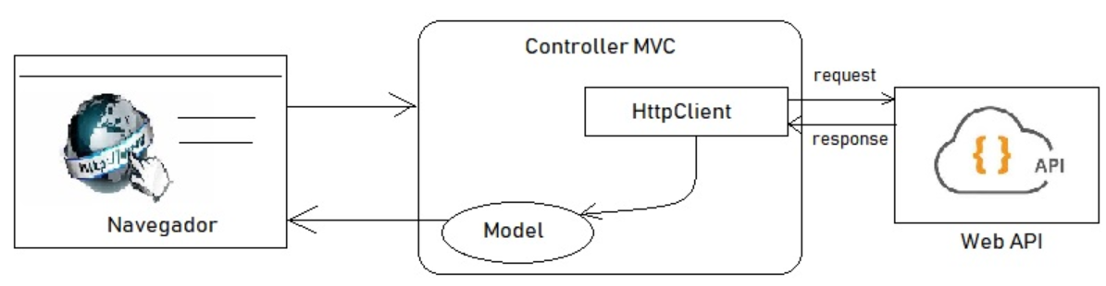
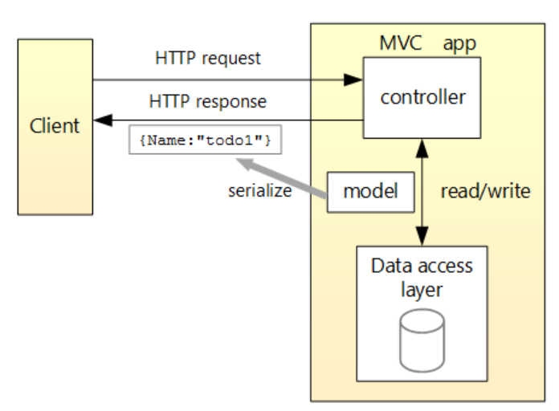
Projeto CRUD Student
Estrutura;
Notes:
Controlador- A camada do controlador contém a * lógica do aplicativo, mapeando a solicitação do usuário para funções específicas e passando a entrada do usuário para a camada de serviço para aplicar a lógica de negócios.
Serviço- Esta é a camada entre o controlador e o repositório que executa a * lógica de negócios e a lógica de validação. O controlador passa a entrada do usuário para a camada de serviço e, após aplicar a lógica de negócios, é passada para a camada de repositório.
Repositório- A camada que interage com as operações CRUD do banco de dados por meio dos DAOs (objetos de acesso a dados).
Modelo - São as classes POJO simples que atuam como DTO (Interagir com a transferência de dados no nível do aplicativo) ou DAO (Interação com operações de banco de dados)

Slide 11
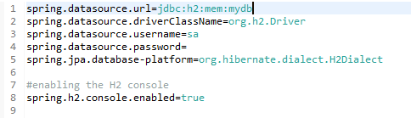

Projeto CRUD Student
Application Properties
http://localhost:8080/h2-console/
Notes:
spring.datasource.url=jdbc:h2:mem:mydb
#spring.datasource.driverClassName=org.h2.Driver
spring.datasource.username=sa
spring.datasource.password=
#spring.jpa.database-platform=org.hibernate.dialect.H2Dialect
#enabling the H2 console
spring.h2.console.enabled=true
#persist the data
#spring.datasource.url=jdbc:h2:file:/data/sampledata
#spring.datasource.url=jdbc:h2:C:/data/sampledata

Slide 12
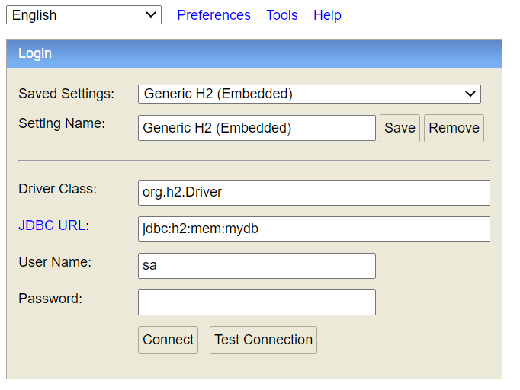
Projeto CRUD Student
H2;
Notes:
Content: N/A
Notes to Instructor:

Slide 13
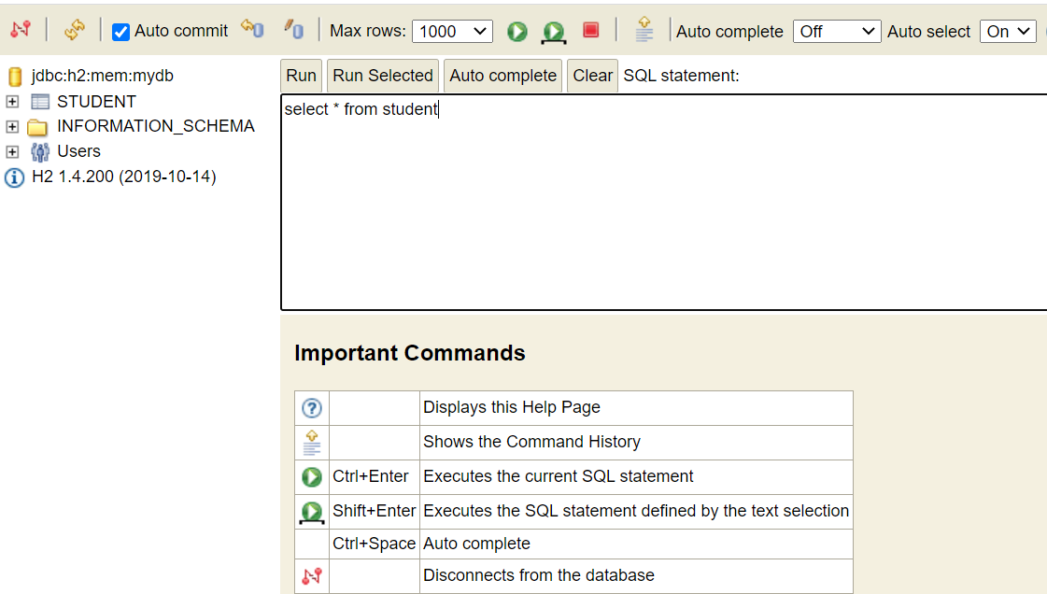
Projeto CRUD Student
H2;
Notes:
Content: N/A
Notes to Instructor:

Slide 14
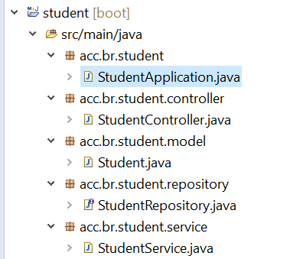
Projeto CRUD Student
Criar a classe principal
StudentApplication no pacote acc.br.student
Notes:
package acc.br.student;
import org.springframework.boot.SpringApplication;
import org.springframework.boot.autoconfigure.SpringBootApplication;
@SpringBootApplication
public class StudentApplication {
public static void main(String[] args) {
SpringApplication.run(StudentApplication.class, args);
}
}

Slide 15
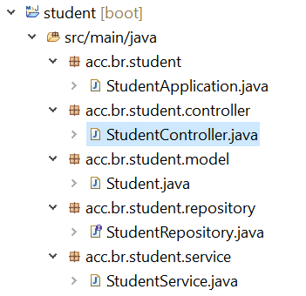
Projeto CRUD Student
Criar a classe controller
Vamos definir o repositório StudentController.java no pacote acc.br.student.controller
Notes:
package acc.br.student.controller;
import java.util.List;
import org.springframework.beans.factory.annotation.Autowired;
import org.springframework.web.bind.annotation.DeleteMapping;
import org.springframework.web.bind.annotation.GetMapping;
import org.springframework.web.bind.annotation.PathVariable;
import org.springframework.web.bind.annotation.PostMapping;
import org.springframework.web.bind.annotation.RequestBody;
import org.springframework.web.bind.annotation.RestController;
import acc.br.student.model.Student;
import acc.br.student.service.StudentService;
//creating RestController
@RestController
public class StudentController
{
//autowired the StudentService class
@Autowired
StudentService studentService;
//creating a get mapping that retrieves all the students detail from the database
@GetMapping("/student")
private List<Student> getAllStudent()
{
return studentService.getAllStudent();
}
//creating a get mapping that retrieves the detail of a specific student
@GetMapping("/student/{id}")
private Student getStudent(@PathVariable("id") int id)
{
return studentService.getStudentById(id);
}
//creating a delete mapping that deletes a specific student
@DeleteMapping("/student/{id}")
private void deleteStudent(@PathVariable("id") int id)
{
studentService.delete(id);
}
//creating post mapping that post the student detail in the database
@PostMapping("/student")
private int saveStudent(@RequestBody Student student)
{
studentService.saveOrUpdate(student);
return student.getId();
}
}

Slide 16
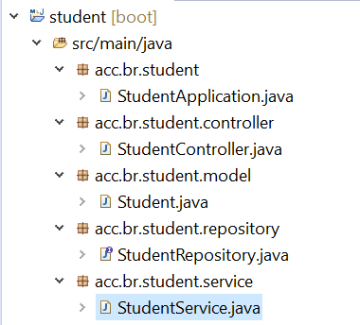
Projeto CRUD Student
Criar a classe service
Vamos definir o repositório StudentService.java no pacote acc.br.student.service
Notes:
package acc.br.student.service;
import java.util.ArrayList;
import java.util.List;
import org.springframework.beans.factory.annotation.Autowired;
import org.springframework.stereotype.Service;
import acc.br.student.model.Student;
import acc.br.student.repository.StudentRepository;
//defining the business logic
@Service
public class StudentService
{
@Autowired
StudentRepository studentRepository;
//getting all student records
public List<Student> getAllStudent()
{
List<Student> students = new ArrayList<Student>();
studentRepository.findAll().forEach(student -> students.add(student));
return students;
}
//getting a specific record
public Student getStudentById(int id)
{
return studentRepository.findById(id).get();
}
public void saveOrUpdate(Student student)
{
studentRepository.save(student);
}
//deleting a specific record
public void delete(int id)
{
studentRepository.deleteById(id);
}
}

Slide 17
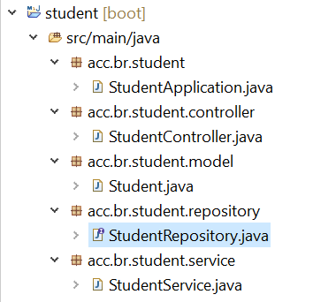
Projeto CRUD Student
Criar a classe repository
Vamos definir o repositório StudentRepository.java no pacote acc.br.student.repository
Notes:
package acc.br.student.repository;
import org.springframework.data.repository.CrudRepository;
import acc.br.student.model.Student;
public interface StudentRepository extends CrudRepository<Student, Integer>
{
}

Slide 18
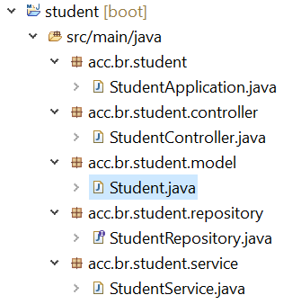
Projeto CRUD Student
Criar a classe model
Vamos definir o repositório Student.java no pacote acc.br.student.model
Notes:
package acc.br.student.model;
import jakarta.persistence.Column;
import jakarta.persistence.Entity;
import jakarta.persistence.Id;
import jakarta.persistence.Table;
//mark class as an Entity
@Entity
//defining class name as Table name
@Table
public class Student
{
//mark id as primary key
@Id
//defining id as column name
@Column
private int id;
//defining name as column name
@Column
private String name;
//defining age as column name
@Column
private int age;
//defining email as column name
@Column
private String email;
public int getId()
{
return id;
}
public void setId(int id)
{
this.id = id;
}
public String getName()
{
return name;
}
public void setName(String name)
{
this.name = name;
}
public int getAge()
{
return age;
}
public void setAge(int age)
{
this.age = age;
}
public String getEmail()
{
return email;
}
public void setEmail(String email)
{
this.email = email;
}
}

Slide 19
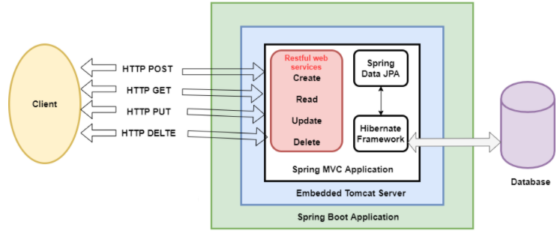
Projeto CRUD Student
POSTMAN
Notes:
Content: N/A
Notes to Instructor:
{
"id": "001",
"age": "23",
"name": "Amit",
"email": "amit@yahoo.co.in"
}

Slide 20
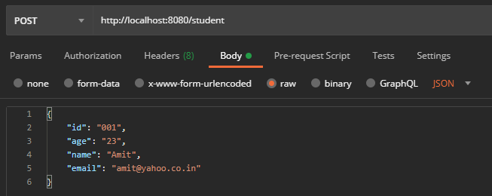
Projeto CRUD Student
POST
Para testar os endpoints, vamos utilizar o Postman:
Notes:
{
"id": "001",
"age": "23",
"name": "Amit",
"email": "amit@yahoo.co.in"
}

Slide 21
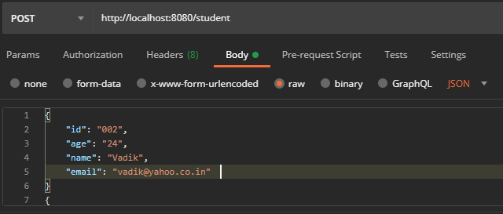
Projeto CRUD Student
POST
Para testar os endpoints, vamos utilizar o Postman:
Notes:
{
"id": "002",
"age": "24",
"name": "Vadik",
"email": "vadik@yahoo.co.in"
}
{
"id": "003",
"age": "21",
"name": "Prateek",
"email": "prateek@yahoo.co.in"
}
{
"id": "004",
"age": "25",
"name": "Harsh",
"email": "harsh@yahoo.co.in"
}
{
"id": "005",
"age": "24",
"name": "Swarit",
"email": "Swarit@yahoo.co.in"
}

Slide 22
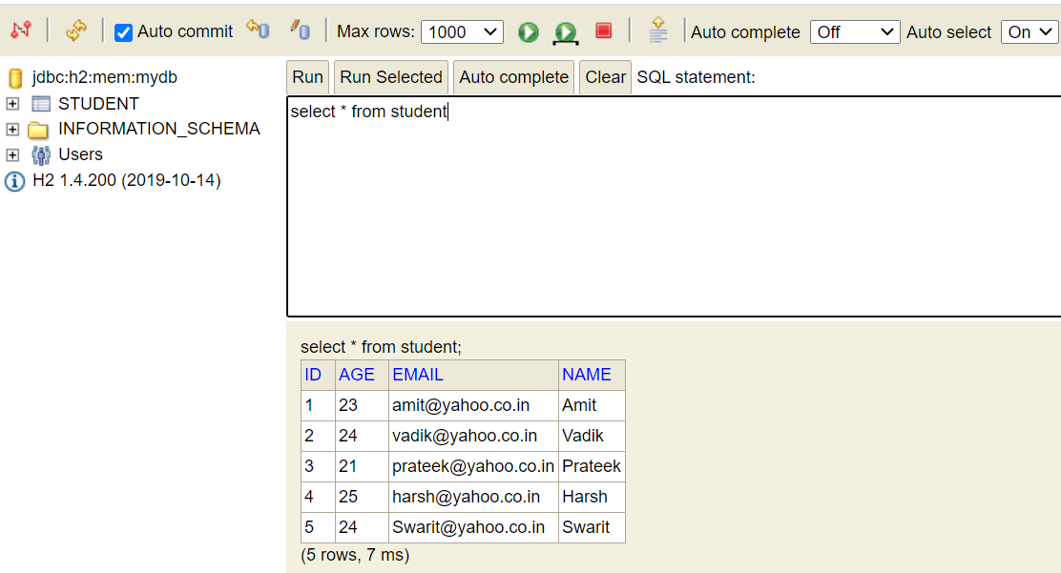
Projeto CRUD Student
http://localhost:8080/h2-console/
Notes:
Content: N/A
Notes to Instructor:

Slide 23
Projeto CRUD Student
Para testar os endpoints,
GET id
DELETE
PUT
Notes:
Content: N/A
Notes to Instructor:

Slide 24
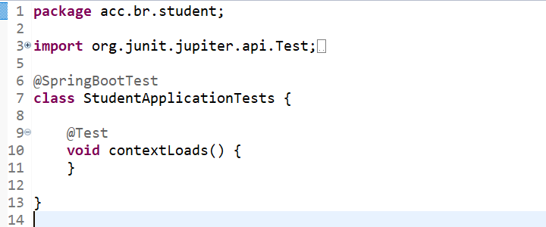
Projeto CRUD de Produtos
Anotation
@SpringBootTest faz a varredura e carrega todo o contexto do aplicativo e todas as configurações automáticas relacionadas ao Spring Boot.
Notes:
package acc.br.student;
import org.junit.jupiter.api.Test;
import org.springframework.boot.test.context.SpringBootTest;
@SpringBootTest
class StudentApplicationTests {
@Test
void contextLoads() {
}
}

Slide 25


Questions and Comments
What questions or comments do you have?

