Slide 1
Spring Boot
Aplicação
GEN AI com Spring AI
Notes:
Aqui abrir uma aplicação juntamente com os alunos;

Slide 2
Projeto CRUD Student
Utilizaremos o SpringInitializer;
Iremos utilizar o Spring Ai para fala com a LLM;
Vamos configurar o Maven;
Criar o código;
Notes:
Content: N/A
Notes to Instructor:

Slide 3
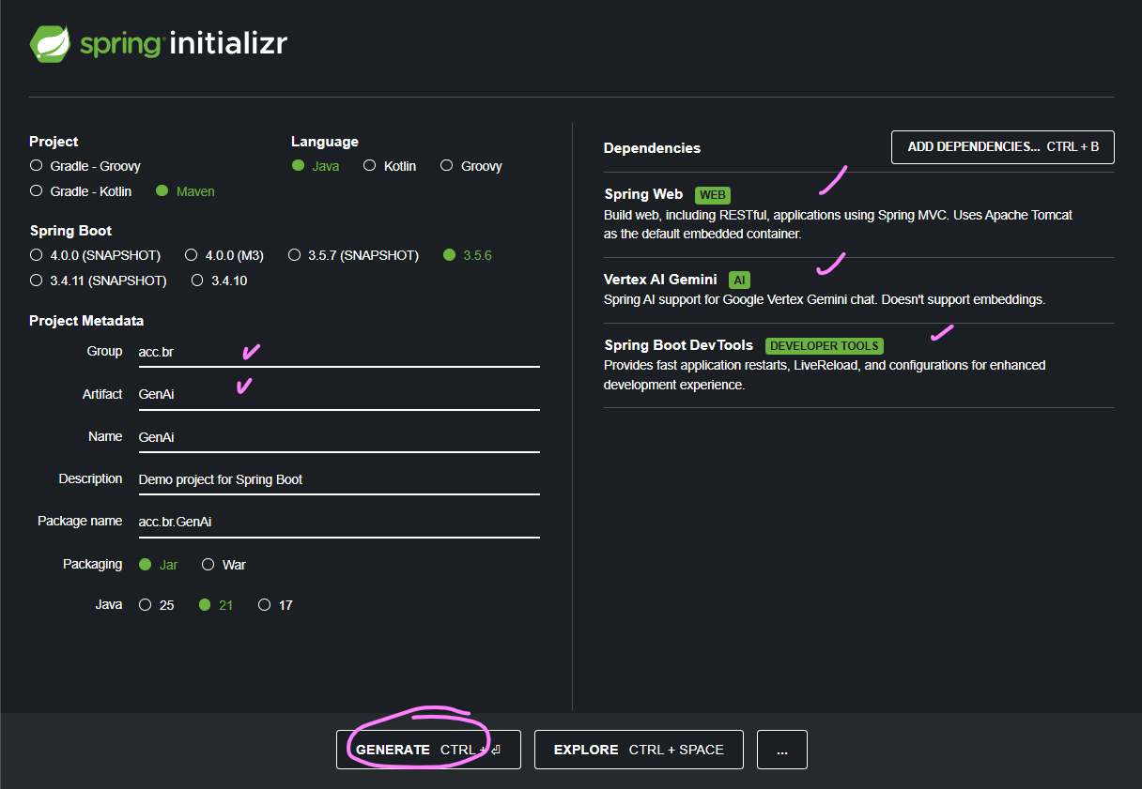
Projeto GenAi
Notes:
<?xml version="1.0" encoding="UTF-8"?>
<project xmlns="http://maven.apache.org/POM/4.0.0" xmlns:xsi="http://www.w3.org/2001/XMLSchema-instance"
xsi:schemaLocation="http://maven.apache.org/POM/4.0.0 https://maven.apache.org/xsd/maven-4.0.0.xsd">
<modelVersion>4.0.0</modelVersion>
<parent>
<groupId>org.springframework.boot</groupId>
<artifactId>spring-boot-starter-parent</artifactId>
<version>2.3.0.M1</version>
<relativePath/> <!-- lookup parent from repository -->
</parent>
<groupId>com.javatpoint</groupId>
<artifactId>spring-boot-h2-database-example</artifactId>
<version>0.0.1-SNAPSHOT</version>
<name>spring-boot-h2-database-example</name>
<description>Demo project for Spring Boot</description>
<properties>
<java.version>1.8</java.version>
</properties>
<dependencies>
<dependency>
<groupId>org.springframework.boot</groupId>
<artifactId>spring-boot-starter-data-jpa</artifactId>
</dependency>
<dependency>
<groupId>org.springframework.boot</groupId>
<artifactId>spring-boot-starter-web</artifactId>
</dependency>
<dependency>
<groupId>com.h2database</groupId>
<artifactId>h2</artifactId>
<scope>runtime</scope>
</dependency>
<dependency>
<groupId>org.springframework.boot</groupId>
<artifactId>spring-boot-starter-test</artifactId>
<scope>test</scope>
<exclusions>
<exclusion>
<groupId>org.junit.vintage</groupId>
<artifactId>junit-vintage-engine</artifactId>
</exclusion>
</exclusions>
</dependency>
</dependencies>
<build>
<plugins>
<plugin>
<groupId>org.springframework.boot</groupId>
<artifactId>spring-boot-maven-plugin</artifactId>
</plugin>
</plugins>
</build>
<repositories>
<repository>
<id>spring-milestones</id>
<name>Spring Milestones</name>
<url>https://repo.spring.io/milestone</url>
</repository>
</repositories>
<pluginRepositories>
<pluginRepository>
<id>spring-milestones</id>
<name>Spring Milestones</name>
<url>https://repo.spring.io/milestone</url>
</pluginRepository>
</pluginRepositories>
</project>

Slide 4
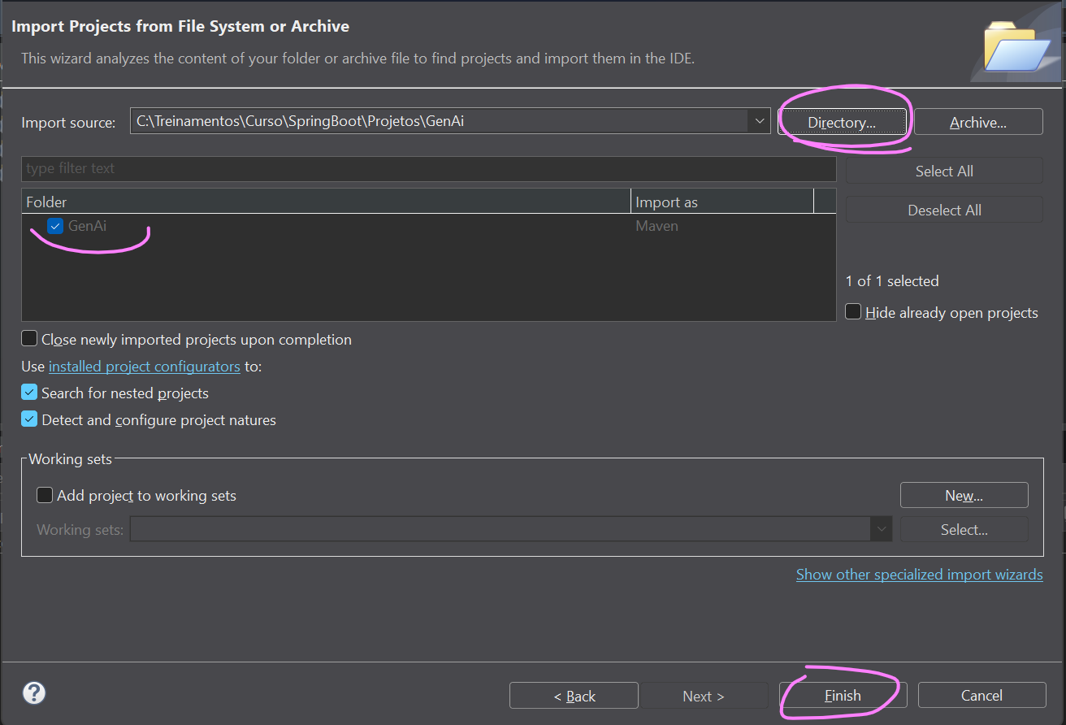
Projeto GenAi
FILE ... IMPORT....PROJECTS FROM FOLDER OR...
Notes:
<?xml version="1.0" encoding="UTF-8"?>
<project xmlns="http://maven.apache.org/POM/4.0.0" xmlns:xsi="http://www.w3.org/2001/XMLSchema-instance"
xsi:schemaLocation="http://maven.apache.org/POM/4.0.0 https://maven.apache.org/xsd/maven-4.0.0.xsd">
<modelVersion>4.0.0</modelVersion>
<parent>
<groupId>org.springframework.boot</groupId>
<artifactId>spring-boot-starter-parent</artifactId>
<version>2.3.0.M1</version>
<relativePath/> <!-- lookup parent from repository -->
</parent>
<groupId>com.javatpoint</groupId>
<artifactId>spring-boot-h2-database-example</artifactId>
<version>0.0.1-SNAPSHOT</version>
<name>spring-boot-h2-database-example</name>
<description>Demo project for Spring Boot</description>
<properties>
<java.version>1.8</java.version>
</properties>
<dependencies>
<dependency>
<groupId>org.springframework.boot</groupId>
<artifactId>spring-boot-starter-data-jpa</artifactId>
</dependency>
<dependency>
<groupId>org.springframework.boot</groupId>
<artifactId>spring-boot-starter-web</artifactId>
</dependency>
<dependency>
<groupId>com.h2database</groupId>
<artifactId>h2</artifactId>
<scope>runtime</scope>
</dependency>
<dependency>
<groupId>org.springframework.boot</groupId>
<artifactId>spring-boot-starter-test</artifactId>
<scope>test</scope>
<exclusions>
<exclusion>
<groupId>org.junit.vintage</groupId>
<artifactId>junit-vintage-engine</artifactId>
</exclusion>
</exclusions>
</dependency>
</dependencies>
<build>
<plugins>
<plugin>
<groupId>org.springframework.boot</groupId>
<artifactId>spring-boot-maven-plugin</artifactId>
</plugin>
</plugins>
</build>
<repositories>
<repository>
<id>spring-milestones</id>
<name>Spring Milestones</name>
<url>https://repo.spring.io/milestone</url>
</repository>
</repositories>
<pluginRepositories>
<pluginRepository>
<id>spring-milestones</id>
<name>Spring Milestones</name>
<url>https://repo.spring.io/milestone</url>
</pluginRepository>
</pluginRepositories>
</project>

Slide 5
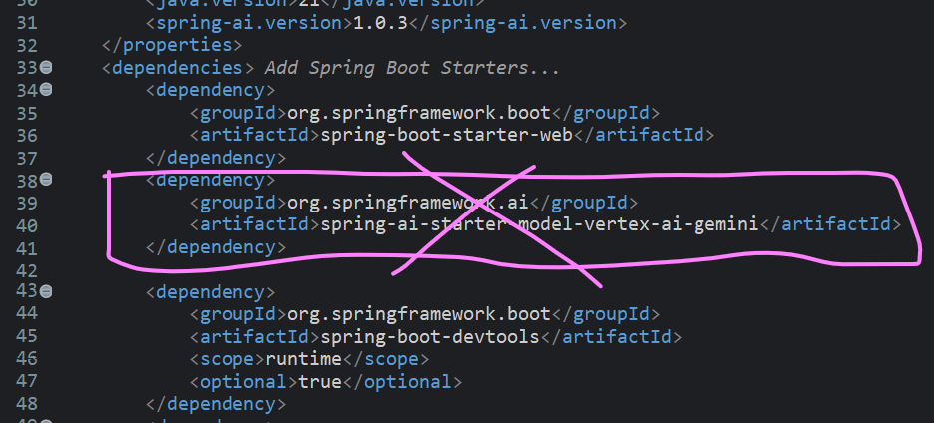
Projeto GenAi
Edite o arquivo POM.XML.
Exclua o código indicado.
Em seguida coloque o código deste slide.
Notes:
<dependency>
<groupId>org.springframework.ai</groupId>
<artifactId>spring-ai-starter-model-google-genai</artifactId>
<version>1.1.0-M3</version>
</dependency>

Slide 6
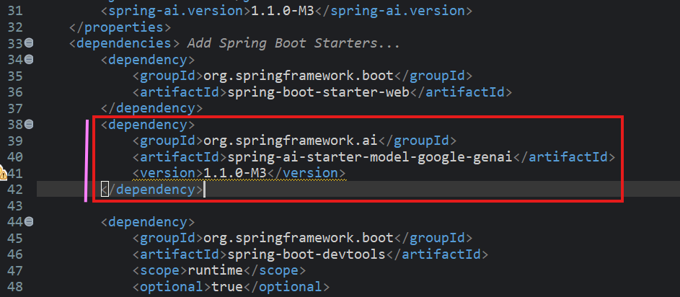
Projeto GenAi
Ficou assim.
Salve o arquivo para que as atualizações aconteçam.
Notes:
<dependency>
<groupId>org.springframework.ai</groupId>
<artifactId>spring-ai-starter-model-google-genai</artifactId>
<version>1.1.0-M3</version>
</dependency>

Slide 7
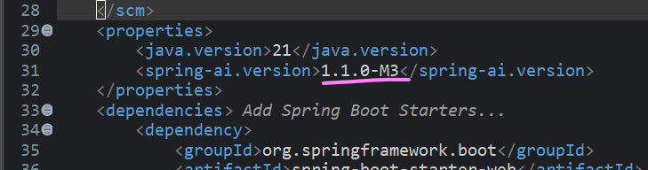
Projeto GenAi
Em seguida altere conforme indicado nas figuras.
Salve o arquivo.
Notes:
<dependency>
<groupId>org.springframework.ai</groupId>
<artifactId>spring-ai-starter-model-google-genai</artifactId>
<version>1.1.0-M3</version>
</dependency>

Slide 8
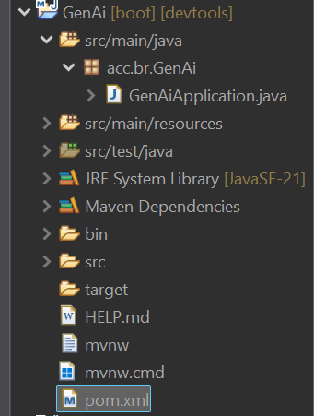
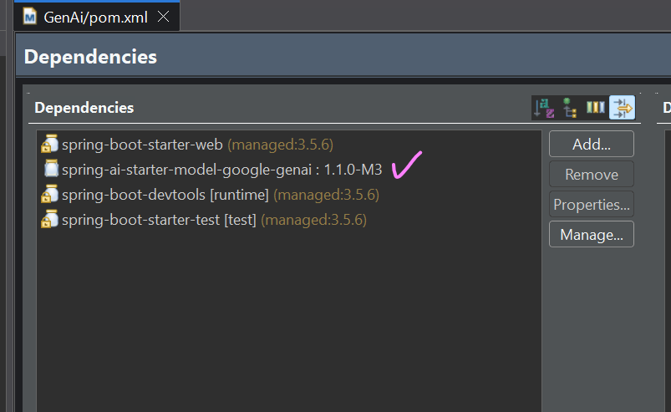
Projeto GenAi
Estrutura dos pacotes e dependências;
Notes:
<?xml version="1.0" encoding="UTF-8"?>
<project xmlns="http://maven.apache.org/POM/4.0.0" xmlns:xsi="http://www.w3.org/2001/XMLSchema-instance"
xsi:schemaLocation="http://maven.apache.org/POM/4.0.0 https://maven.apache.org/xsd/maven-4.0.0.xsd">
<modelVersion>4.0.0</modelVersion>
<parent>
<groupId>org.springframework.boot</groupId>
<artifactId>spring-boot-starter-parent</artifactId>
<version>2.3.0.M1</version>
<relativePath/> <!-- lookup parent from repository -->
</parent>
<groupId>com.javatpoint</groupId>
<artifactId>spring-boot-h2-database-example</artifactId>
<version>0.0.1-SNAPSHOT</version>
<name>spring-boot-h2-database-example</name>
<description>Demo project for Spring Boot</description>
<properties>
<java.version>1.8</java.version>
</properties>
<dependencies>
<dependency>
<groupId>org.springframework.boot</groupId>
<artifactId>spring-boot-starter-data-jpa</artifactId>
</dependency>
<dependency>
<groupId>org.springframework.boot</groupId>
<artifactId>spring-boot-starter-web</artifactId>
</dependency>
<dependency>
<groupId>com.h2database</groupId>
<artifactId>h2</artifactId>
<scope>runtime</scope>
</dependency>
<dependency>
<groupId>org.springframework.boot</groupId>
<artifactId>spring-boot-starter-test</artifactId>
<scope>test</scope>
<exclusions>
<exclusion>
<groupId>org.junit.vintage</groupId>
<artifactId>junit-vintage-engine</artifactId>
</exclusion>
</exclusions>
</dependency>
</dependencies>
<build>
<plugins>
<plugin>
<groupId>org.springframework.boot</groupId>
<artifactId>spring-boot-maven-plugin</artifactId>
</plugin>
</plugins>
</build>
<repositories>
<repository>
<id>spring-milestones</id>
<name>Spring Milestones</name>
<url>https://repo.spring.io/milestone</url>
</repository>
</repositories>
<pluginRepositories>
<pluginRepository>
<id>spring-milestones</id>
<name>Spring Milestones</name>
<url>https://repo.spring.io/milestone</url>
</pluginRepository>
</pluginRepositories>
</project>

Slide 9
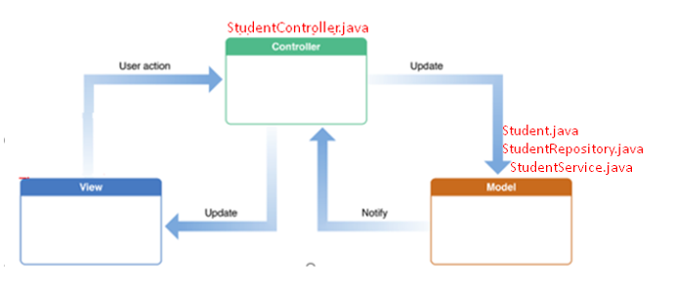
Projeto GenAi
Estrutura

Slide 10

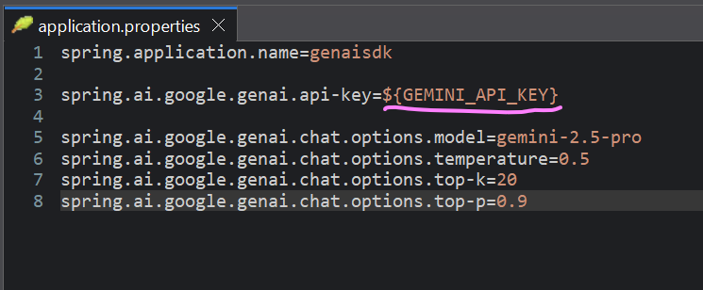
Projeto GenAi
Application Properties
Notes:
spring.application.name=genaisdk
spring.ai.google.genai.api-key=${GEMINI_API_KEY}
spring.ai.google.genai.chat.options.model=gemini-2.5-pro
spring.ai.google.genai.chat.options.temperature=0.5
spring.ai.google.genai.chat.options.top-k=20
spring.ai.google.genai.chat.options.top-p=0.9

Slide 11
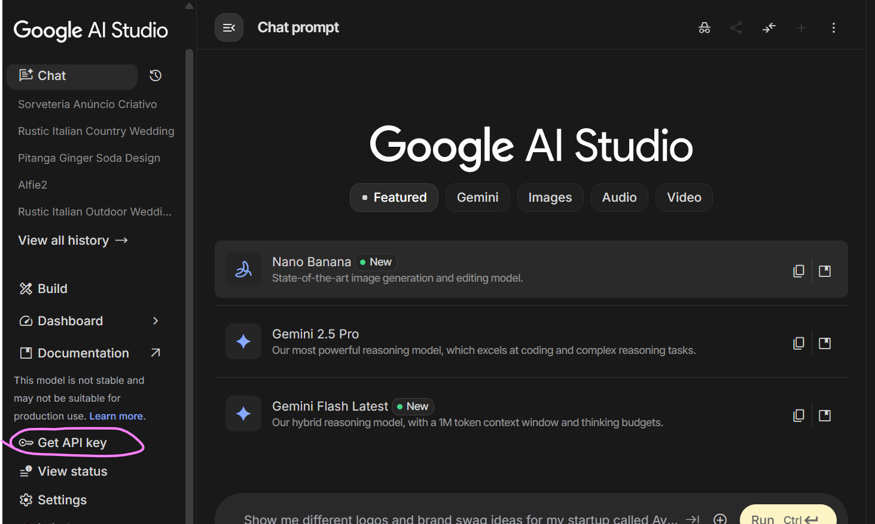
Projeto GenAi
Obtendo a API Key
https://aistudio.google.com/

Slide 12
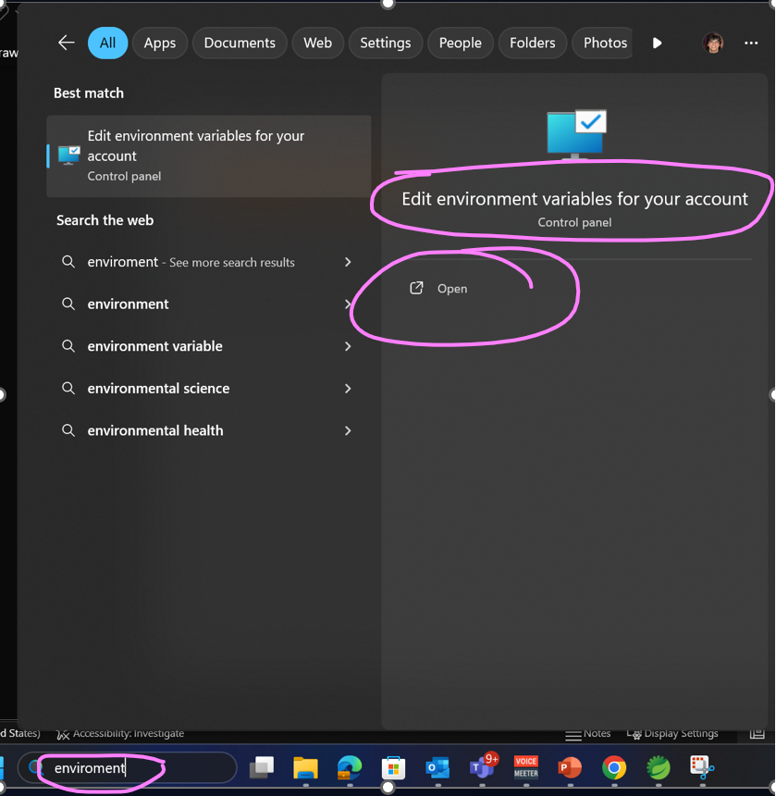
Projeto GenAi
Criando a variável de ambiente que vai guardar a API Key

Slide 13
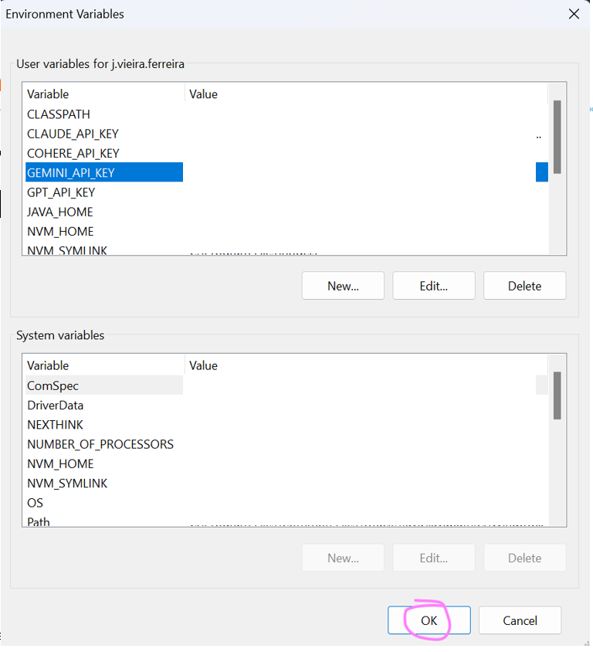
Projeto GenAi
Criando a variável de ambiente que vai guardar a API Key

Slide 14
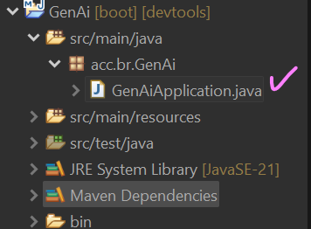
Projeto GenAi
A classe principal
GenAiApplication no pacote acc.br.GenAi
Notes:
package acc.br.student;
import org.springframework.boot.SpringApplication;
import org.springframework.boot.autoconfigure.SpringBootApplication;
@SpringBootApplication
public class StudentApplication {
public static void main(String[] args) {
SpringApplication.run(StudentApplication.class, args);
}
}

Slide 15
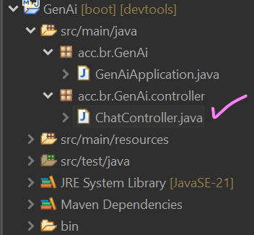
Projeto GenAi
Criar a classe controller
GenAiController.java no pacote acc.br.GenAi.controller
Notes:
package acc.br.GenAi.controller;
import org.springframework.ai.chat.client.ChatClient;
import org.springframework.ai.chat.model.ChatResponse;
import org.springframework.web.bind.annotation.GetMapping;
import org.springframework.web.bind.annotation.RestController;
@RestController
public class ChatController {
private final ChatClient chatClient;
public ChatController(ChatClient.Builder builder) {
this.chatClient = builder.build();
}
@GetMapping("/")
public ChatResponse chat() {
return chatClient.prompt()
.user("Qual a capital do japão?")
.call()
.chatResponse();
}
@GetMapping("/q")
public String chat2() {
return chatClient.prompt()
.user("Qual a capital do japão?")
.call()
.content();
}
}

Slide 16
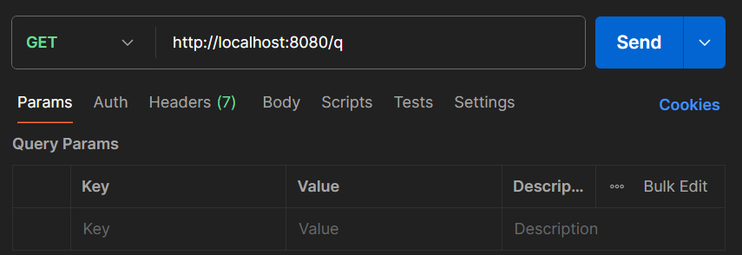
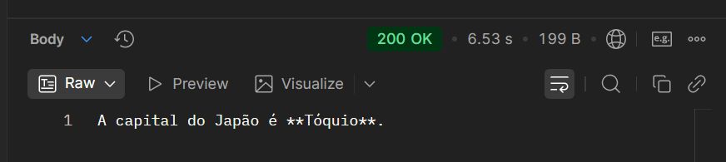
Projeto GenAi
GET

Slide 17
Projeto GenAi
DESAFIOS
Ao receber de volta a respota a mensagem da IA, grave a mesma no banco de dados.Grave o prompt e a resposta.
Altera a aplicação inclua JoptionPane de forma a obter o prompt do teclado e
Notes:
Content: N/A
Notes to Instructor:

Slide 18


Questions and Comments
What questions or comments do you have?

