Slide 1
Practical Application Development with Spring BOOT
Module 12: JWT

Slide 2
Spring Boot
Aplicação
Pessoa_JWT
Notes:
Aqui abrir uma aplicação juntamente com os alunos;

Slide 3
Projeto CRUD Pessoa_JWT
Iremos criar uma página de CRUD, para listar a tabela de students;
Utilizaremos o SpringInitializer;
Criaremos um banco de dados MYSQL (free);
Iremos utilizar o Hibernate para persistência dos dados;
Vamos configurar o Maven para criar o projeto no STS;
Criar o código;
Notes:
Content: N/A
Notes to Instructor:

Slide 4
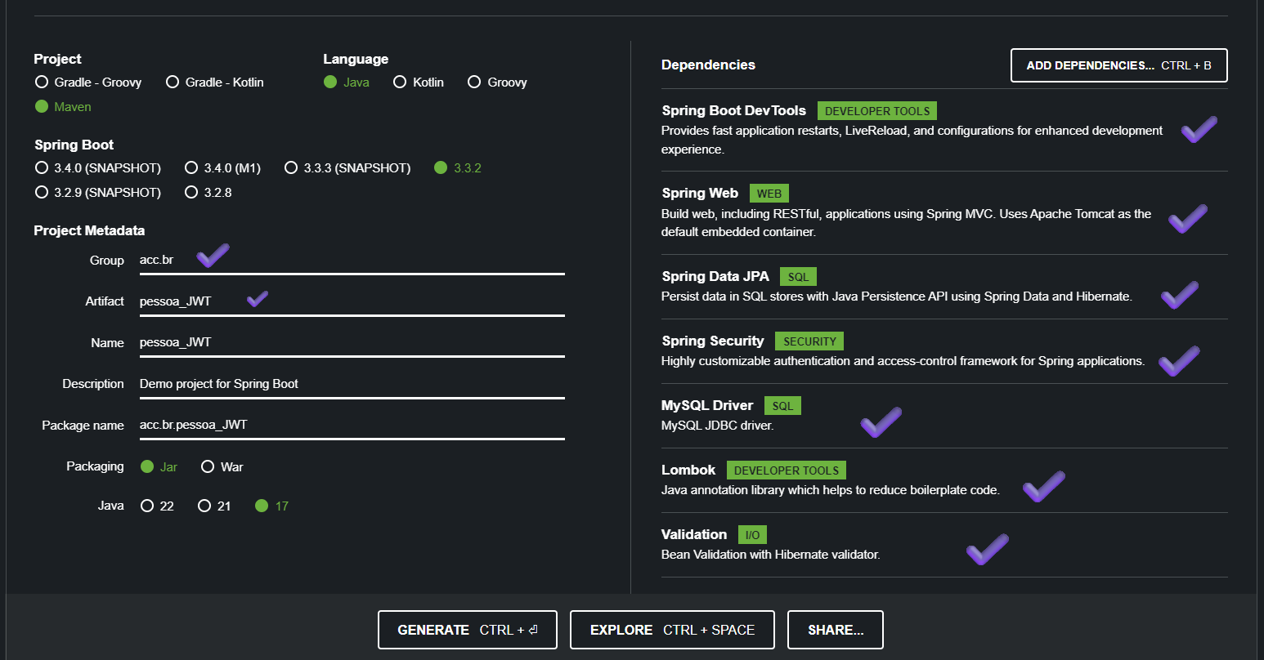
Projeto CRUD Pessoa_JWT
Utilizaremos o SpringInitializer;
Notes:
Content: N/A
Notes to Instructor:

Slide 5
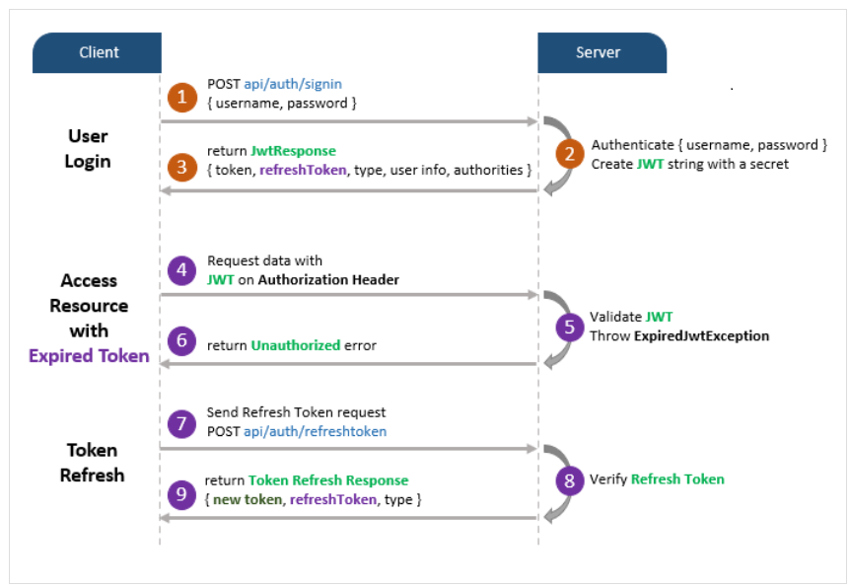
Projeto CRUD Pessoa_JWT
Processo de autorização
Notes:
Content: N/A
Notes to Instructor:

Slide 6
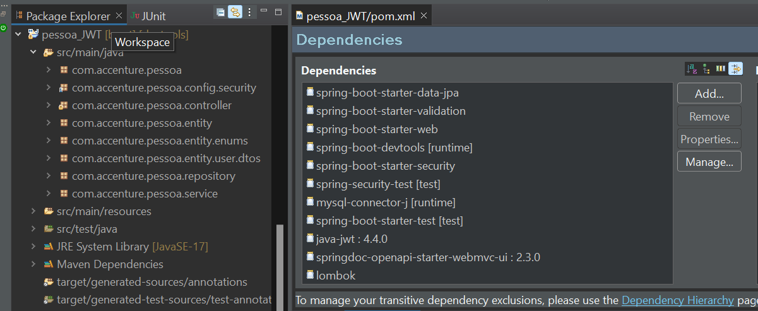
Projeto CRUD Pessoa_JWT
Estrutura dos pacotes e dependências;
Notes:
<?xml version="1.0" encoding="UTF-8"?>
<project xmlns="http://maven.apache.org/POM/4.0.0"
xmlns:xsi="http://www.w3.org/2001/XMLSchema-instance"
xsi:schemaLocation="http://maven.apache.org/POM/4.0.0 https://maven.apache.org/xsd/maven-4.0.0.xsd">
<modelVersion>4.0.0</modelVersion>
<parent>
<groupId>org.springframework.boot</groupId>
<artifactId>spring-boot-starter-parent</artifactId>
<version>3.3.2</version>
<relativePath /> <!-- lookup parent from repository -->
</parent>
<groupId>com.accenture</groupId>
<artifactId>pessoa</artifactId>
<version>0.0.1-SNAPSHOT</version>
<name>pessoa</name>
<description>Demo project for Spring Boot</description>
<url />
<licenses>
<license />
</licenses>
<developers>
<developer />
</developers>
<scm>
<connection />
<developerConnection />
<tag />
<url />
</scm>
<properties>
<java.version>17</java.version>
</properties>
<dependencies>
<dependency>
<groupId>org.springframework.boot</groupId>
<artifactId>spring-boot-starter-data-jpa</artifactId>
</dependency>
<dependency>
<groupId>org.springframework.boot</groupId>
<artifactId>spring-boot-starter-validation</artifactId>
</dependency>
<dependency>
<groupId>org.springframework.boot</groupId>
<artifactId>spring-boot-starter-web</artifactId>
</dependency>
<dependency>
<groupId>org.springframework.boot</groupId>
<artifactId>spring-boot-devtools</artifactId>
<scope>runtime</scope>
<optional>true</optional>
</dependency>
<dependency>
<groupId>org.springframework.boot</groupId>
<artifactId>spring-boot-starter-security</artifactId>
</dependency>
<dependency>
<groupId>org.springframework.security</groupId>
<artifactId>spring-security-test</artifactId>
<scope>test</scope>
</dependency>
<dependency>
<groupId>com.mysql</groupId>
<artifactId>mysql-connector-j</artifactId>
<scope>runtime</scope>
</dependency>
<dependency>
<groupId>org.springframework.boot</groupId>
<artifactId>spring-boot-starter-test</artifactId>
<scope>test</scope>
</dependency>
<dependency>
<groupId>com.auth0</groupId>
<artifactId>java-jwt</artifactId>
<version>4.4.0</version>
</dependency>
<dependency>
<groupId>org.springdoc</groupId>
<artifactId>springdoc-openapi-starter-webmvc-ui</artifactId>
<version>2.3.0</version>
</dependency>
<dependency>
<groupId>org.projectlombok</groupId>
<artifactId>lombok</artifactId>
<optional>true</optional>
</dependency>
</dependencies>
<build>
<plugins>
<plugin>
<groupId>org.apache.maven.plugins</groupId>
<artifactId>maven-resources-plugin</artifactId>
<!--$NO-MVN-MAN-VER$ -->
</plugin>
<plugin>
<groupId>org.springframework.boot</groupId>
<artifactId>spring-boot-maven-plugin</artifactId>
</plugin>
</plugins>
</build>
</project>

Slide 7
Projeto CRUD Pessoa_Swagger
Starters
O spring-boot-starter-web permite aplicativos da web, clássicos e RESTFul.
O spring-boot-starter-data-jpa é um iniciador para usar Spring Data JPA com Hibernate
O MYSQL (runtime) fornece conectividade para o database.
O spring-boot-starter-test é a principal dependência do teste, ele contém os elementos necessários para nossos testes.
O spring-boot-starter-validation é uma especificação para tratar validações de dados de forma centralizada, pois as validações são inseridas no próprio modelo através de anotações.
http://localhost:8080/swagger-ui/index.html#/
Notes:
Content: N/A
Notes to Instructor:

Slide 8

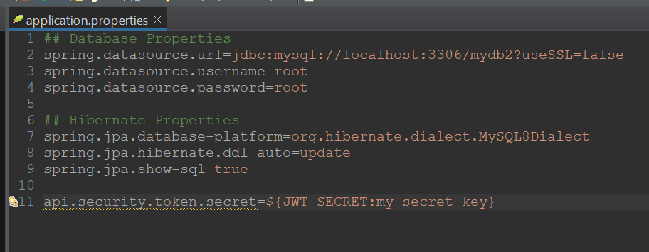
Projeto CRUD Pessoa_JWT
Application Properties
Notes:
## Database Properties
spring.datasource.url=jdbc:mysql://localhost:3306/mydb2?useSSL=false
spring.datasource.username=root
spring.datasource.password=root
## Hibernate Properties
spring.jpa.properties.hibernate.dialect =org.hibernate.dialect.MySQL8Dialect
spring.jpa.hibernate.ddl-auto=update
spring.jpa.show-sql=true
api.security.token.secret=${JWT_SECRET:my-secret-key}

Slide 9
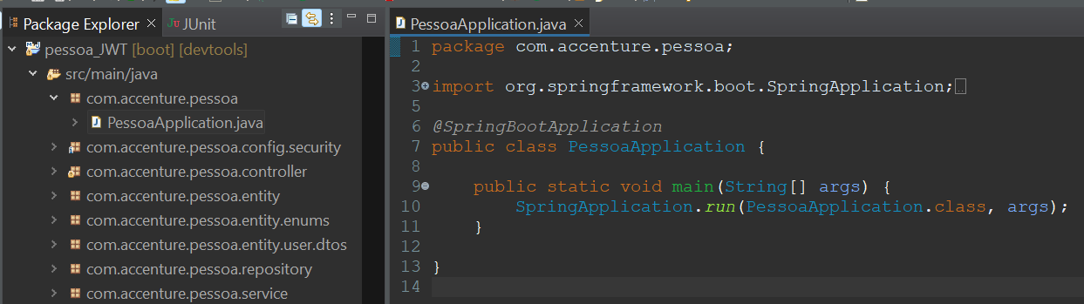
Projeto CRUD Pessoa_JWT
Criar a classe principal
PessoaApplication no pacote com.accenture.pessoa
Notes:
package com.accenture.pessoa;
import org.springframework.boot.SpringApplication;
import org.springframework.boot.autoconfigure.SpringBootApplication;
@SpringBootApplication
public class PessoaApplication {
public static void main(String[] args) {
SpringApplication.run(PessoaApplication.class, args);
}
}

Slide 10
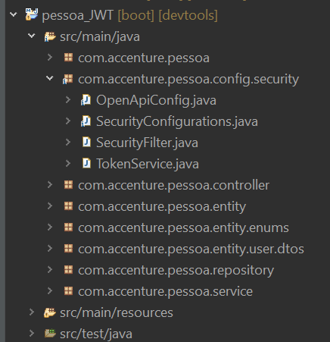
Projeto CRUD Pessoa_JWT
Security
Vamos definir a classe OpenApiConfig.java no pacote com.accenture.pessoa.config.security
Notes:
package com.accenture.pessoa.config.security;
import io.swagger.v3.oas.models.Components;
import io.swagger.v3.oas.models.OpenAPI;
import io.swagger.v3.oas.models.info.Info;
import io.swagger.v3.oas.models.security.SecurityRequirement;
import io.swagger.v3.oas.models.security.SecurityScheme;
import org.springframework.context.annotation.Bean;
import org.springframework.context.annotation.Configuration;
@Configuration
public class OpenApiConfig {
@Bean
public OpenAPI customOpenAPI() {
return new OpenAPI()
.components(new Components()
.addSecuritySchemes("bearer-key",
new SecurityScheme().type(SecurityScheme.Type.HTTP).scheme("bearer").bearerFormat("JWT")))
.info(new Info().title("Minha API").version("1.0"))
.addSecurityItem(new SecurityRequirement().addList("bearer-key"));
}
}

Slide 11
Projeto CRUD Pessoa_JWT
Security
Vamos definir a classe SecurityConfigurations.java no pacote com.accenture.pessoa.config.security
Notes:
package com.accenture.pessoa.config.security;
import org.springframework.beans.factory.annotation.Autowired;
import org.springframework.context.annotation.Bean;
import org.springframework.context.annotation.Configuration;
import org.springframework.http.HttpMethod;
import org.springframework.security.authentication.AuthenticationManager;
import org.springframework.security.config.annotation.authentication.configuration.AuthenticationConfiguration;
import org.springframework.security.config.annotation.web.builders.HttpSecurity;
import org.springframework.security.config.annotation.web.configuration.EnableWebSecurity;
import org.springframework.security.config.http.SessionCreationPolicy;
import org.springframework.security.crypto.bcrypt.BCryptPasswordEncoder;
import org.springframework.security.crypto.password.PasswordEncoder;
import org.springframework.security.web.SecurityFilterChain;
import org.springframework.security.web.authentication.UsernamePasswordAuthenticationFilter;
@Configuration
@EnableWebSecurity
public class SecurityConfigurations {
@Autowired
SecurityFilter securityFilter;
@Bean
public SecurityFilterChain securityFilterChain(HttpSecurity httpSecurity) throws Exception {
return httpSecurity
.csrf(csrf -> csrf.disable())
.sessionManagement(session -> session.sessionCreationPolicy(SessionCreationPolicy.STATELESS))
.authorizeHttpRequests(authorize -> authorize
.requestMatchers(HttpMethod.POST, "/auth/login").permitAll()
.requestMatchers(HttpMethod.POST, "/auth/register").permitAll()
//.requestMatchers(HttpMethod.POST, "/auth/register").hasRole("ADMIN")
.requestMatchers(HttpMethod.POST, "/pessoas").hasRole("ADMIN")
.requestMatchers("/swagger-ui/**").permitAll()
.requestMatchers("/v3/api-docs/**").permitAll()
.anyRequest().authenticated()
)
.addFilterBefore(securityFilter, UsernamePasswordAuthenticationFilter.class)
.build();
}
@Bean
public AuthenticationManager authenticationManager(AuthenticationConfiguration authenticationConfiguration) throws Exception {
return authenticationConfiguration.getAuthenticationManager();
}
@Bean
public PasswordEncoder passwordEncoder(){
return new BCryptPasswordEncoder();
}
}

Slide 12
Projeto CRUD Pessoa_JWT
Security
Vamos definir a classe SecurityFilter.java no pacote com.accenture.pessoa.config.security
Notes:
package com.accenture.pessoa.config.security;
import java.io.IOException;
import org.springframework.beans.factory.annotation.Autowired;
import org.springframework.security.authentication.UsernamePasswordAuthenticationToken;
import org.springframework.security.core.context.SecurityContextHolder;
import org.springframework.security.core.userdetails.UserDetails;
import org.springframework.stereotype.Component;
import org.springframework.web.filter.OncePerRequestFilter;
import com.accenture.pessoa.repository.UserRepository;
import jakarta.servlet.FilterChain;
import jakarta.servlet.ServletException;
import jakarta.servlet.http.HttpServletRequest;
import jakarta.servlet.http.HttpServletResponse;
@Component
public class SecurityFilter extends OncePerRequestFilter {
@Autowired
TokenService tokenService;
@Autowired
UserRepository userRepository;
@Override
protected void doFilterInternal(HttpServletRequest request, HttpServletResponse response, FilterChain filterChain) throws ServletException, IOException {
var token = this.recoverToken(request);
if(token != null){
var login = tokenService.validateToken(token);
UserDetails user = userRepository.findByLogin(login);
var authentication = new UsernamePasswordAuthenticationToken(user, null, user.getAuthorities());
SecurityContextHolder.getContext().setAuthentication(authentication);
}
filterChain.doFilter(request, response);
}
private String recoverToken(HttpServletRequest request){
var authHeader = request.getHeader("Authorization");
if(authHeader == null) return null;
return authHeader.replace("Bearer ", "");
}
}

Slide 13
Projeto CRUD Pessoa_JWT
Security
Vamos definir a classe TokenService.java no pacote com.accenture.pessoa.config.security
Notes:
package com.accenture.pessoa.config.security;
import java.time.Instant;
import java.time.LocalDateTime;
import java.time.ZoneOffset;
import org.springframework.beans.factory.annotation.Value;
import org.springframework.stereotype.Service;
import com.accenture.pessoa.entity.User;
import com.auth0.jwt.JWT;
import com.auth0.jwt.algorithms.Algorithm;
import com.auth0.jwt.exceptions.JWTCreationException;
import com.auth0.jwt.exceptions.JWTVerificationException;
@Service
public class TokenService {
@Value("${api.security.token.secret}")
private String secret;
public String generateToken(User user){
try{
Algorithm algorithm = Algorithm.HMAC256(secret);
String token = JWT.create()
.withIssuer("auth-api")
.withSubject(user.getLogin())
.withExpiresAt(genExpirationDate())
.sign(algorithm);
return token;
} catch (JWTCreationException exception) {
throw new RuntimeException("Error while generating token", exception);
}
}
public String validateToken(String token){
try {
Algorithm algorithm = Algorithm.HMAC256(secret);
return JWT.require(algorithm)
.withIssuer("auth-api")
.build()
.verify(token)
.getSubject();
} catch (JWTVerificationException exception){
return "";
}
}
private Instant genExpirationDate(){
return LocalDateTime.now().plusHours(2).toInstant(ZoneOffset.of("-03:00"));
}
}

Slide 14
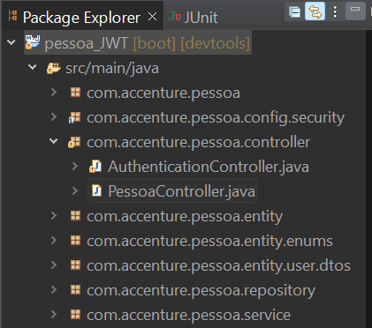
Projeto CRUD Pessoa_JWT
Criar a classe controller
Vamos definir a classe PessoaController.java no pacote com.accenture.pessoa.controller
Notes:
package com.accenture.pessoa.controller;
import java.util.List;
import java.util.Optional;
import org.springframework.beans.factory.annotation.Autowired;
import org.springframework.http.ResponseEntity;
import org.springframework.web.bind.annotation.DeleteMapping;
import org.springframework.web.bind.annotation.GetMapping;
import org.springframework.web.bind.annotation.PathVariable;
import org.springframework.web.bind.annotation.PostMapping;
import org.springframework.web.bind.annotation.PutMapping;
import org.springframework.web.bind.annotation.RequestBody;
import org.springframework.web.bind.annotation.RequestMapping;
import org.springframework.web.bind.annotation.RestController;
import com.accenture.pessoa.entity.Pessoa;
import com.accenture.pessoa.service.PessoaService;
@RestController
@RequestMapping(value = "/pessoas")
public class PessoaController {
@Autowired
private PessoaService service;
@GetMapping
public List<Pessoa>getAllPessoas(){
return service.findAll();
}
@GetMapping("/{id}")
public ResponseEntity<Pessoa> getPessoaById(@PathVariable Long id) {
Optional<Pessoa> p = service.getPessoaById(id);
return p.map(ResponseEntity::ok).orElseGet(() -> ResponseEntity.notFound().build());
}
@PostMapping
public Pessoa createPessoa(@RequestBody Pessoa pessoa) {
return service.save(pessoa);
}
@PutMapping("/{id}")
public ResponseEntity<Pessoa> updateContato(@PathVariable Long id, @RequestBody Pessoa pessoaDetails) {
Optional<Pessoa> updatePessoa = service.update(id, pessoaDetails);
return updatePessoa.map(ResponseEntity::ok).orElseGet(() -> ResponseEntity.notFound().build());
}
@DeleteMapping("/{id}")
public ResponseEntity<Void>delete(@PathVariable Long id){
service.delete(id);
return ResponseEntity.noContent().build();
}
}

Slide 15
Projeto CRUD Pessoa_JWT
Criar a classe controller
Vamos definir a classe AuthenticationController.java no pacote com.accenture.pessoa.controller
Notes:
package com.accenture.pessoa.controller;
import org.springframework.beans.factory.annotation.Autowired;
import org.springframework.http.ResponseEntity;
import org.springframework.security.authentication.AuthenticationManager;
import org.springframework.security.authentication.UsernamePasswordAuthenticationToken;
import org.springframework.security.crypto.bcrypt.BCryptPasswordEncoder;
import org.springframework.web.bind.annotation.PostMapping;
import org.springframework.web.bind.annotation.RequestBody;
import org.springframework.web.bind.annotation.RequestMapping;
import org.springframework.web.bind.annotation.RestController;
import com.accenture.pessoa.config.security.TokenService;
import com.accenture.pessoa.entity.User;
import com.accenture.pessoa.entity.user.dtos.AuthenticationDTO;
import com.accenture.pessoa.entity.user.dtos.LoginResponseDTO;
import com.accenture.pessoa.entity.user.dtos.RegisterDTO;
import com.accenture.pessoa.repository.UserRepository;
import jakarta.validation.Valid;
@RestController
@RequestMapping("auth")
public class AuthenticationController {
@Autowired
private AuthenticationManager authenticationManager;
@Autowired
private UserRepository repository;
@Autowired
private TokenService tokenService;
@PostMapping("/login")
public ResponseEntity login(@RequestBody @Valid AuthenticationDTO data){
var usernamePassword = new UsernamePasswordAuthenticationToken(data.login(), data.password());
var auth = this.authenticationManager.authenticate(usernamePassword);
var token = tokenService.generateToken((User) auth.getPrincipal());
return ResponseEntity.ok(new LoginResponseDTO(token));
}
@PostMapping("/register")
public ResponseEntity register(@RequestBody @Valid RegisterDTO data){
if(this.repository.findByLogin(data.login()) != null) return ResponseEntity.badRequest().build();
String encryptedPassword = new BCryptPasswordEncoder().encode(data.password());
User newUser = new User(data.login(), encryptedPassword, data.role());
this.repository.save(newUser);
return ResponseEntity.ok().build();
}
}

Slide 16
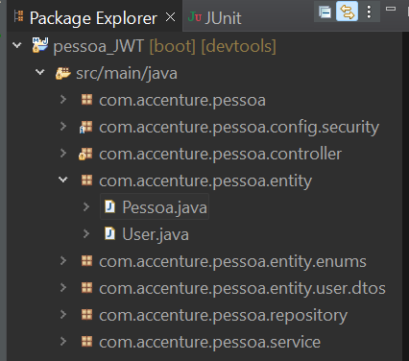
Projeto CRUD Pessoa_JWT
Criar a classe entity
Vamos definir a classe Pessoa.java no pacote com.accenture.pessoa.entity
Notes:
package com.accenture.pessoa.entity;
import jakarta.persistence.Column;
import jakarta.persistence.Entity;
import jakarta.persistence.GeneratedValue;
import jakarta.persistence.GenerationType;
import jakarta.persistence.Id;
@Entity
public class Pessoa
{
@Id
@GeneratedValue(strategy = GenerationType.AUTO)
private Long id;
@Column(nullable = false)
private String nome;
public Pessoa() {
}
public Pessoa(Long id, String nome) {
this.id = id;
this.nome = nome;
}
public Long getId() {
return id;
}
public String getNome() {
return nome;
}
public void setNome(String nome) {
this.nome = nome;
}
public void setId(Long id) {
this.id = id;
}
}

Slide 17
Projeto CRUD Pessoa_JWT
Criar a classe entity
Vamos definir a classe User.java no pacote com.accenture.pessoa.entity
Notes:
package com.accenture.pessoa.entity;
import java.util.Collection;
import java.util.List;
import org.springframework.security.core.GrantedAuthority;
import org.springframework.security.core.authority.SimpleGrantedAuthority;
import org.springframework.security.core.userdetails.UserDetails;
import com.accenture.pessoa.entity.enums.UserRoles;
import jakarta.persistence.Entity;
import jakarta.persistence.GeneratedValue;
import jakarta.persistence.GenerationType;
import jakarta.persistence.Id;
import jakarta.persistence.Table;
import lombok.AllArgsConstructor;
import lombok.EqualsAndHashCode;
import lombok.Getter;
import lombok.NoArgsConstructor;
@SuppressWarnings("serial")
@Entity
@Table(name = "tb_users")
@Getter
@NoArgsConstructor
@AllArgsConstructor
@EqualsAndHashCode(of = "id")
public class User implements UserDetails {
@Id
@GeneratedValue(strategy = GenerationType.IDENTITY)
private Long id;
private String login;
private String password;
private UserRoles role;
public User(String login, String password, UserRoles role) {
this.login = login;
this.password = password;
this.role = role;
}
@Override
public Collection<? extends GrantedAuthority> getAuthorities() {
// TODO Auto-generated method stub
// Retorna as Roles do usuario
if(this.role == UserRoles.ADMIN) return List.of(new SimpleGrantedAuthority("ROLE_ADMIN"), new SimpleGrantedAuthority("ROLE_USER"));
else return List.of(new SimpleGrantedAuthority("ROLE_USER"));
}
@Override
public String getUsername() {
// TODO Auto-generated method stub
//aqui coloca o que vai ser usado para logar
return login;
}
public String getPassword() {
return password;
}
@Override
public boolean isAccountNonExpired() {
return true;
}
@Override
public boolean isAccountNonLocked() {
return true;
}
@Override
public boolean isCredentialsNonExpired() {
return true;
}
@Override
public boolean isEnabled() {
return true;
}
}

Slide 18
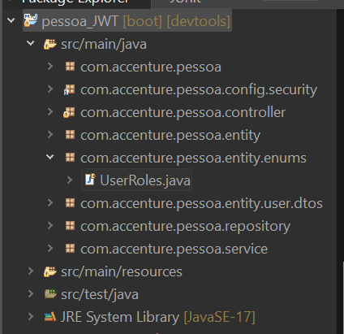
Projeto CRUD Pessoa_JWT
Criar a classe entity
Vamos definir a classe UserRoles.java no pacote com.accenture.pessoa.Entity.enums
Notes:
package com.accenture.pessoa.entity.enums;
public enum UserRoles {
ADMIN("admin"), USER("user");
private String role;
UserRoles(String role) {
this.role = role;
}
public String getRole() {
return role;
}
}

Slide 19
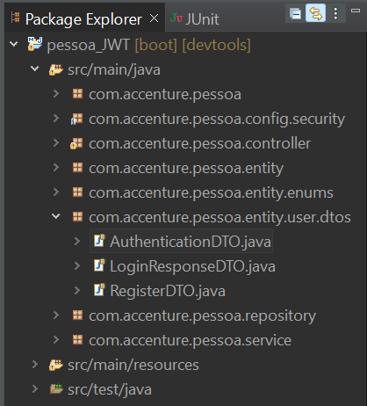
Projeto CRUD Pessoa_JWT
Criar a classe entity
Vamos definir a classe AuthenticationDTO.java no pacote com.accenture.pessoa.user.dtos
Notes:
package com.accenture.pessoa.entity.user.dtos;
public record AuthenticationDTO(String login, String password) {
}

Slide 20
Projeto CRUD Pessoa_JWT
Criar a classe entity
Vamos definir a classe LoginResponseDTO.java no pacote com.accenture.pessoa.user.dtos
Notes:
package com.accenture.pessoa.entity.user.dtos;
public record LoginResponseDTO(String token) {
}

Slide 21
Projeto CRUD Pessoa_JWT
Criar a classe entity
Vamos definir a classe RegisterDTO.java no pacote com.accenture.pessoa.user.dtos
Notes:
package com.accenture.pessoa.entity.user.dtos;
import com.accenture.pessoa.entity.enums.UserRoles;
public record RegisterDTO(String login, String password, UserRoles role) {
}

Slide 22
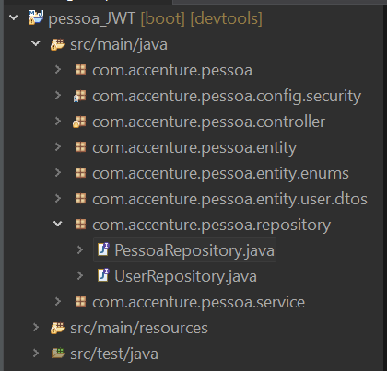
Projeto CRUD Pessoa_JWT
Criar a classe repository
Vamos definir a classe PessoaRepository.java no pacote com.accenture.pessoa.repository
Notes:
package com.accenture.pessoa.repository;
import org.springframework.data.jpa.repository.JpaRepository;
import com.accenture.pessoa.entity.Pessoa;
public interface PessoaRepository extends JpaRepository<Pessoa, Long>{
}

Slide 23
Projeto CRUD Pessoa_JWT
Criar a classe repository
Vamos definir a classe UserRepository.java no pacote com.accenture.pessoa.repository
Notes:
package com.accenture.pessoa.repository;
import org.springframework.data.jpa.repository.JpaRepository;
import org.springframework.security.core.userdetails.UserDetails;
import com.accenture.pessoa.entity.User;
public interface UserRepository extends JpaRepository<User, Long>{
//consulta usuario pelo login
UserDetails findByLogin(String login);
}

Slide 24
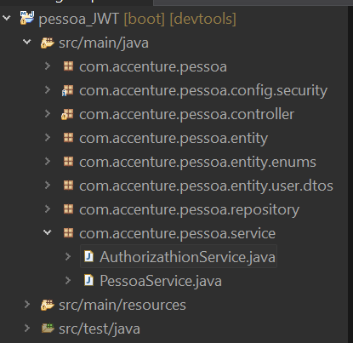
Projeto CRUD Pessoa_JWT
Criar a classe repository
Vamos definir a classe AuthorizationService.java no pacote com.accenture.pessoa.service
Notes:
package com.accenture.pessoa.service;
import org.springframework.beans.factory.annotation.Autowired;
import org.springframework.security.core.userdetails.UserDetails;
import org.springframework.security.core.userdetails.UserDetailsService;
import org.springframework.security.core.userdetails.UsernameNotFoundException;
import org.springframework.stereotype.Service;
import com.accenture.pessoa.repository.UserRepository;
@Service
public class AuthorizathionService implements UserDetailsService{
@Autowired
UserRepository repository;
@Override
public UserDetails loadUserByUsername(String username) throws UsernameNotFoundException {
return repository.findByLogin(username);
}
}

Slide 25
Projeto CRUD Pessoa_JWT
Criar a classe repository
Vamos definir a classe PessoaService.java no pacote com.accenture.pessoa.service
Notes:
package com.accenture.pessoa.service;
import java.util.List;
import java.util.Optional;
import org.springframework.beans.factory.annotation.Autowired;
import org.springframework.stereotype.Service;
import org.springframework.transaction.annotation.Transactional;
import com.accenture.pessoa.entity.Pessoa;
import com.accenture.pessoa.repository.PessoaRepository;
@Service
public class PessoaService {
@Autowired
private PessoaRepository repository;
@Transactional(readOnly = true)
public List<Pessoa> findAll() {
return repository.findAll();
}
@Transactional(readOnly = true)
public Optional<Pessoa> getPessoaById(Long id) {
return repository.findById(id);
}
@Transactional
public Pessoa save(Pessoa pessoa) {
return repository.save(pessoa);
}
@Transactional
public Optional<Pessoa> update(Long id, Pessoa pessoaDetails) {
return repository.findById(id).map(pessoa -> {
pessoa.setNome(pessoaDetails.getNome());
return repository.save(pessoa);
});
}
@Transactional
public void delete(Long id) {
repository.deleteById(id);
}
}

Slide 26
Projeto CRUD Pessoa_JWT
Execute a aplicação.
Abra o Swagger no browser
http://localhost:8080/swagger-ui/index.html#/
Teste a aplicação.
Altere as permissões e volte a testar a aplicação.
Notes:
Content: N/A
Notes to Instructor:

Slide 27
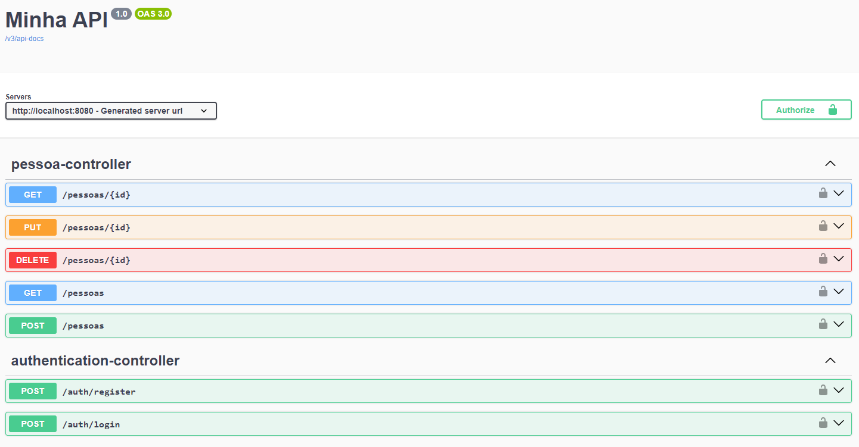
Projeto CRUD Pessoa_Swagger
SWAGGER
http://localhost:8080/swagger-ui/index.html#/
Notes:
Content: N/A
Notes to Instructor:
{
"id": "002",
"age": "24",
"name": "Vadik",
"email": "vadik@yahoo.co.in"
}
{
"id": "003",
"age": "21",
"name": "Prateek",
"email": "prateek@yahoo.co.in"
}
{
"id": "004",
"age": "25",
"name": "Harsh",
"email": "harsh@yahoo.co.in"
}
{
"id": "005",
"age": "24",
"name": "Swarit",
"email": "Swarit@yahoo.co.in"
}

Slide 28


Questions and Comments
What questions or comments do you have?

