Slide 1
JULIO QUEVEDO
Aspiring Web Developer

Slide 2
.
Unlike most of you
(I assume)
this is the first web page
I’ve ever created

Slide 3
.
It is not a complex
piece of coding

Slide 4
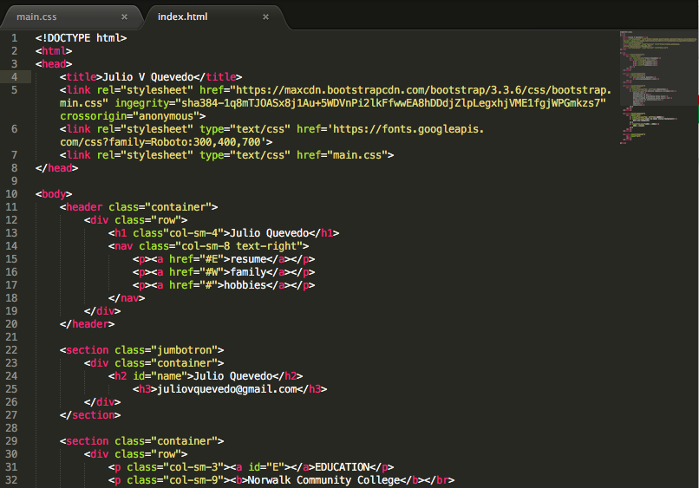

Slide 5
.
But I am very proud of it.
especially since up to
about 3 weeks ago
I didn’t know what CSS was

Slide 6
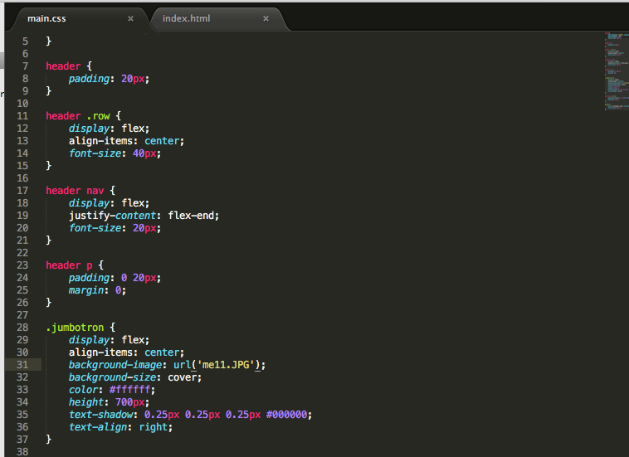
.

Slide 7
.
I want to tell you
a little bit about
my background

Slide 8
Many years ago
when I first went
to college

Slide 9
I learned
Basic
Pascal
C

Slide 10
I taught myself
C++
Java
GUI

Slide 11
More recently
JavaScript
HTML
CSS

