Slide 1
Título de tesis de maestría
Instituto Nacional de Astrofísica, Óptica y Electrónica (INAOE)
Maestría en Ciencias en Electrónica
Autor: Julisa Verdejo Palacios
Asesor: Dr. Mario Moreno Moreno (INAOE)
Coasesor: Dr. José de Jesús Rangel Magdaleno (INAOE)
25 de Septiembre de 2024

Slide 2
Índice
Introducción
Objetivos
Antecedentes
Máquinas de estado finito
ADCs y DACs
Diseño de firmware
Diseño de PCB
Resultados
Conclusiones

Slide 3
Introducción

Slide 4
¿Qué son los microbolómetros?
Alguna introducción

Slide 5
Objetivos

Slide 6
Antecedentes

Slide 7
Máquinas de estado finito

Slide 8
DACs y ADCs

Slide 9
Diseño de firmware

Slide 10
Diseño de PCB

Slide 11
Resultados

Slide 12
Conclusiones

Slide 13
Courses and training activities
Courses | Credits | Professor | Hours | Year
Front-end electronics DAQ systems for radiation detection (HE5) | 1.5 | Adriano Di Giovanni | 20 | 1st
Design of readout integrated circuits for particle detectors | 2.5 | Flavio Loddo | 20 | 2nd
Programmable System on Chip (SoC) for data acquisition and processing | 2.5 | Domizia Orestano | 20 | 2nd
Electronic systems in high energy physics | 6 | Adriano Lai | 48 | 2nd
Training activities | Dates | Place | Year
Verification with UVM for HEP Workshop | (27/02/2024 – 01/03/2024) | CERN | 1st
Training Framework PixESL for simulation of pixel chip | (07/04/2024 – 12/04/2024) | CERN | 1st
Cadence, System Verilog for design and verification | (07/02/2024 – 07/04/2024) | Online | 1st
Synopsys, Language: System Verilog Testbench | (06/02/2024 – 06/04/2024) | Online | 1st
Synopsys, Language: System Verilog Verification using UVM | (12/04/2024 – 12/06/2024) | Online | 1st
Cadence, SystemC language Fundamentals | To be defined | Online | 2nd
Cadence, SystemC Transaction-Level Modeling TLM2.0 | To be defined | Online | 2nd

Slide 14
Research topic and objectives

Slide 15

Research topic and objectives
The research focuses on the development of a UVM verification framework to prove the correctness of pixel chip design to be used in future projects in the field of High Energy Physics (HEP). Moreover, the modelling of pixel-based detectors, from front-end to back-end, at a high level of abstraction to perform architectural studies will be implemented. This will provide metrics to compare different solutions to satisfy functional and non-functional requirements, both at detector and readout chip level.

Slide 16
Verification and HEP

Slide 17
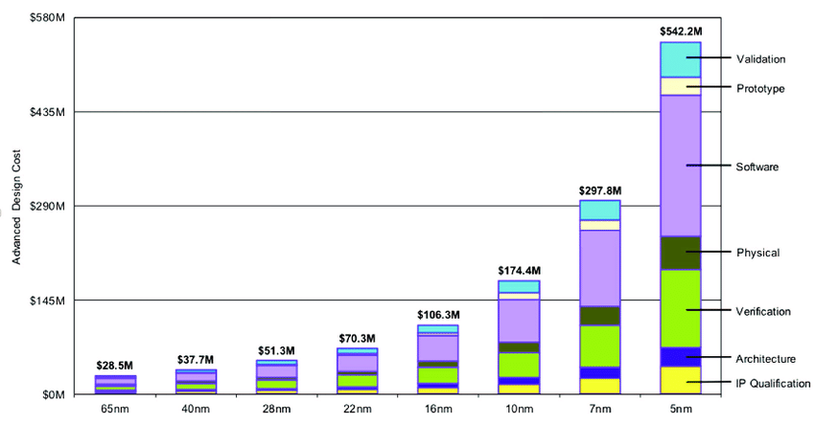
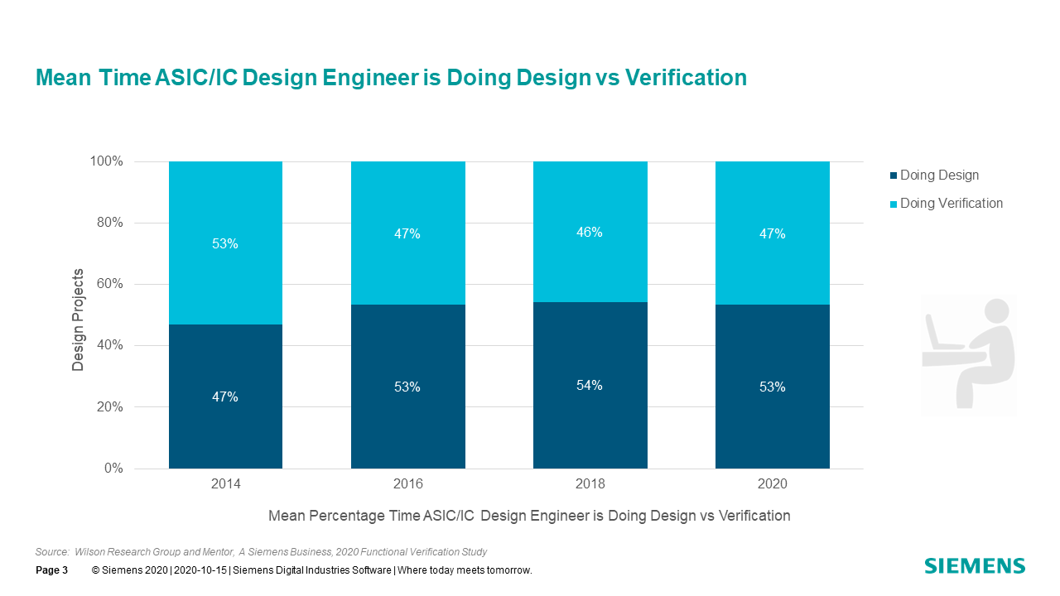
What is Verification
Design activity to prone correctness
Verification is a resource limited quest to find as many bugs as possible before shipping.
Hard problem
How to prove absence of bugs?
Bottleneck
ASIC verification is more complex and time consuming than design
Verification is resource intensive
New skill in HEP community
Chip Design and Manufacturing Cost under Different Process Nodes: Data Source from IBS

Slide 18
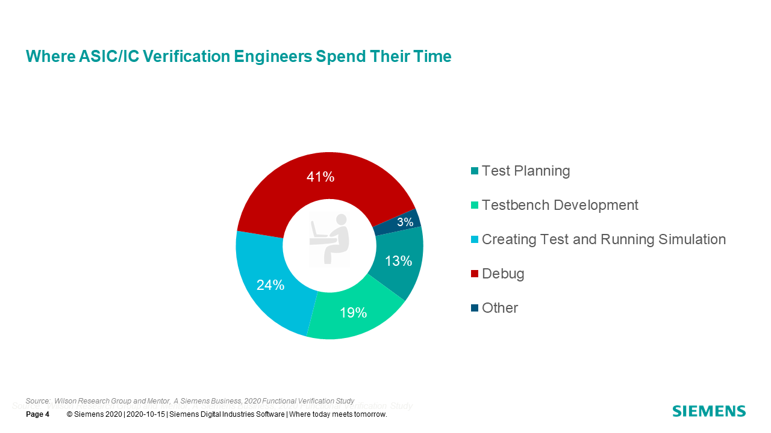
Verification for HEP ASICs
Extreme Radiation Tolerance
Fault injection campaigns
Single Event Transient
TID (Total Ionizing Dose) aware designs
High data-rate
High-Luminosity Large Hadron Collider (HL-LHC), hit rate of 3.5 GHz/cm2
Trigger-based architectures (RD53)
Data-driven architectures (Velopix)

Slide 19
Verification Methodology

Slide 20
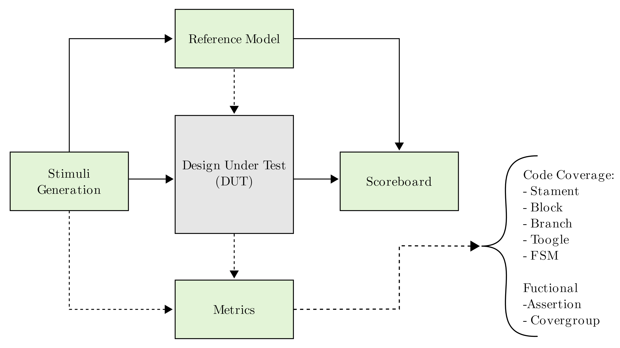
Anatomy of a Verification Environment

Slide 21
Reference Model
Receive the same stimuli as the DUT
Predict DUT output
Based on specifications
Implements the transfer function(s)
Tightly tied to DUT specification
Using C++ / SystemC

Slide 22
Research activities carried out so far 1st year

Slide 23





Tools
Improvement knowledge of the following tools:
Verilog / SystemVerilog
UVM
C/C++
SystemC
Python
Jinja2
PyYAML
Bash
Synopsys

Slide 24





Activities carried out
Development of Verification Utility Tools and Script to facilitate workflow.
UVC Code Generator
Linting and Formatting utility scripts
Resource Guide
UVM UVC Tutorial
Development of general purpose UVM Verification IPs (VIP) to be use in different projects
GPIO UVC
Clock Generator UVC
I2C UVC

Slide 25
Plan for 2nd and 3rd years

Slide 26
Plan for 2nd and 3rd years
2nd Year
Start using UVM expertise in real ASIC - IGNITE chip
UVCs connection
Create basic coverage
Directed tests
Create new UVCs specific for the chip
Create SystemC model studies
FIFO connections
Datapath possibilities
Based on CERN PixESL framework
3rd Year
Continue working in the development of the verification framework
Writing the thesis
Put information about IGNITE some pictures and description, specify technology of 28nm

Slide 27
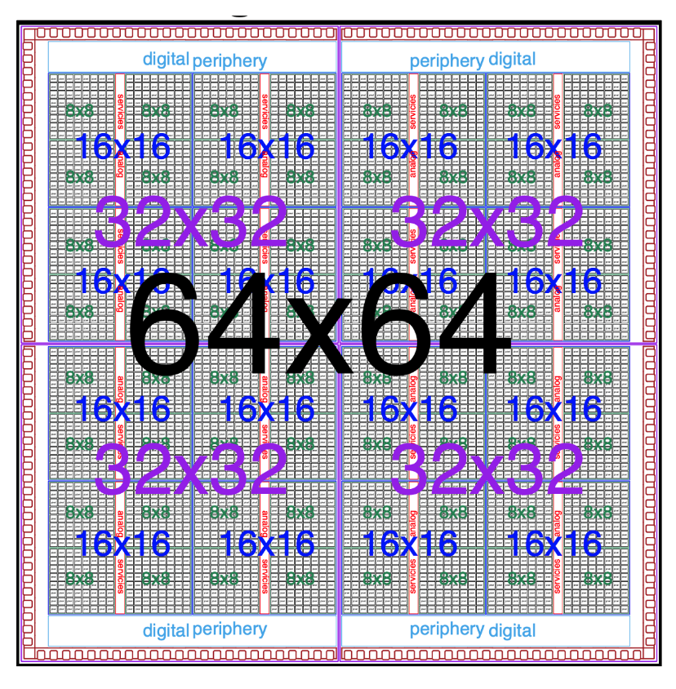
IGNITE64 ASIC
The IGNITE project aims at developing read-out and processing solutions for high intensity 4D-tracking
Concurrent high time less than 50 ps and space resolution of 10 μm
Power density as low as possible around 1 W cm⁻²
Operate at large fluences (> 1x 10¹⁶ 1 MeV neutron per cm²)
High total ionizing dose (TID > 1 Grad)
28 nm CMOS technology

Slide 29
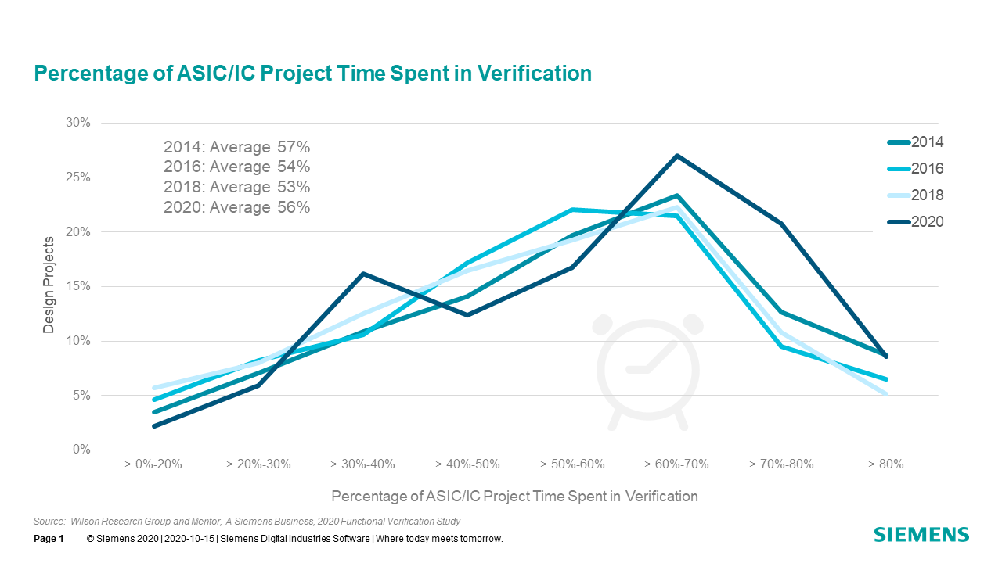
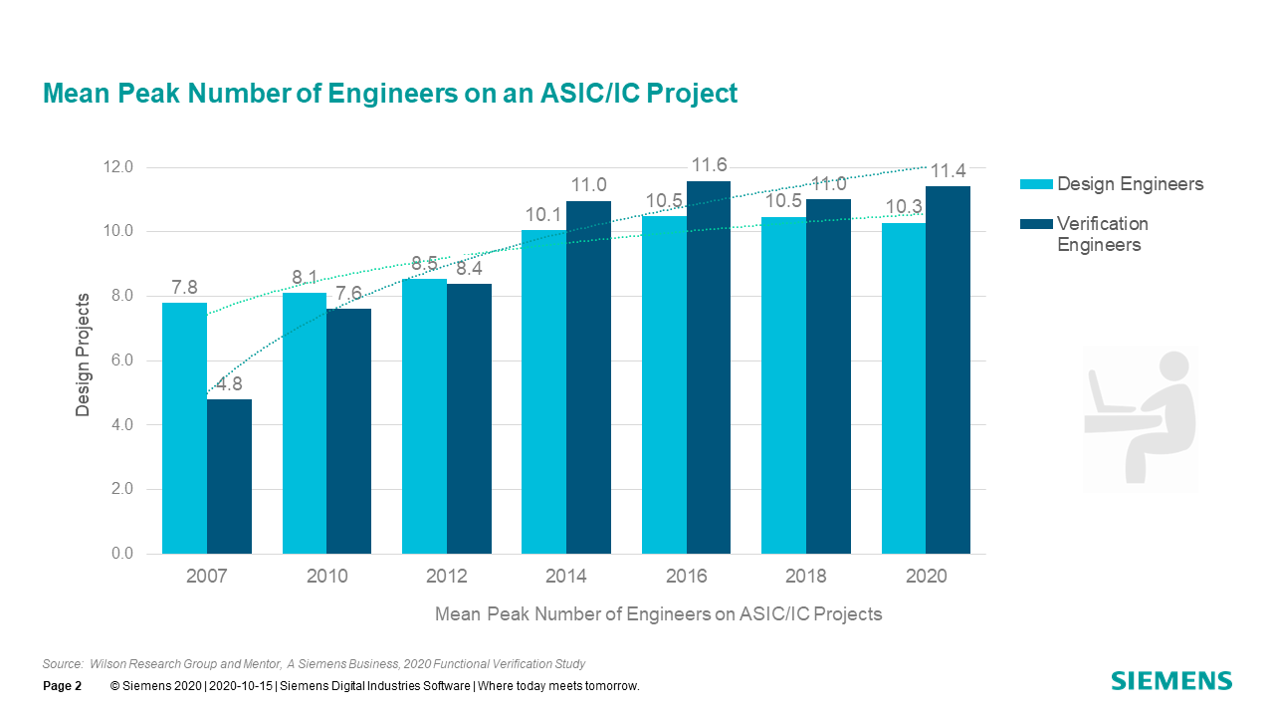
Verification: a bottleneck
ASIC verification is more complex and time consuming than design
Verification is resource intensive
New skill in HEP community

Slide 30
Details of VIPs
GPIO UVC
Support single pin or arrays of pins, synchronous and asynchronous change in levels
Use cases: driving/monitoring GPIO, reset pins
Clock Generator UVC
Generates a set of related clock, each clock can have independent jitter and phase difference
Use cases: generate related clocks base on one single source as in real experiments
I2C UVC
Control a I2C bus in a master configuration
Use cases: DUT configuration, registers operation

