Slide 1
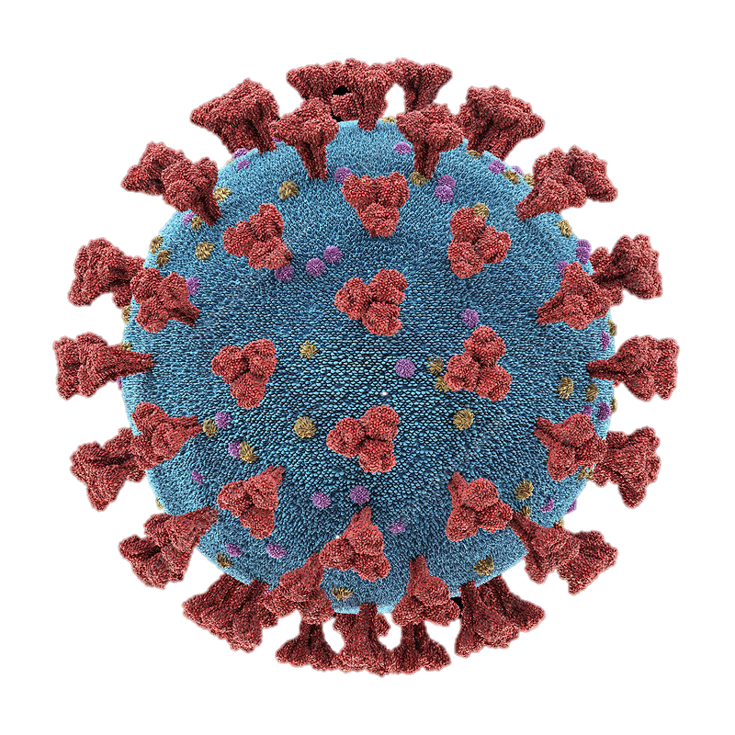
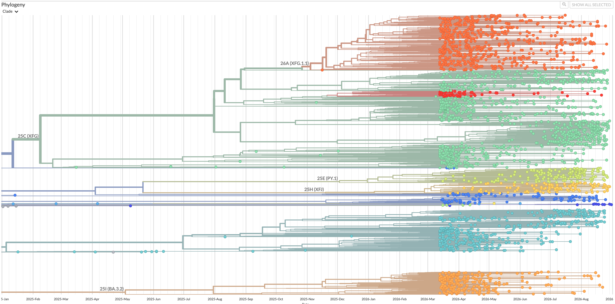

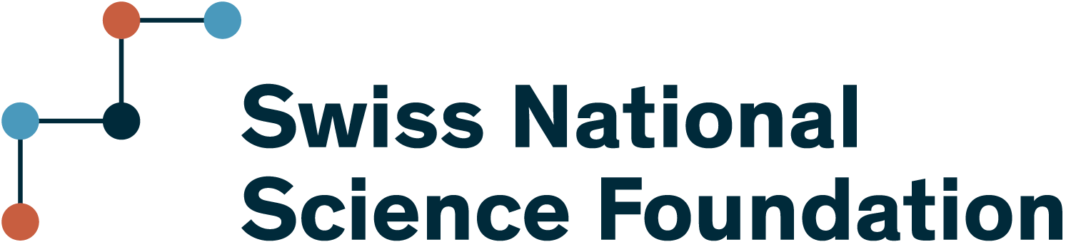

Chasing the coronavirus
a global, collaborative effort to identify the next variant
Julius Winter
Clinical bioinformatics, SIB

Slide 2
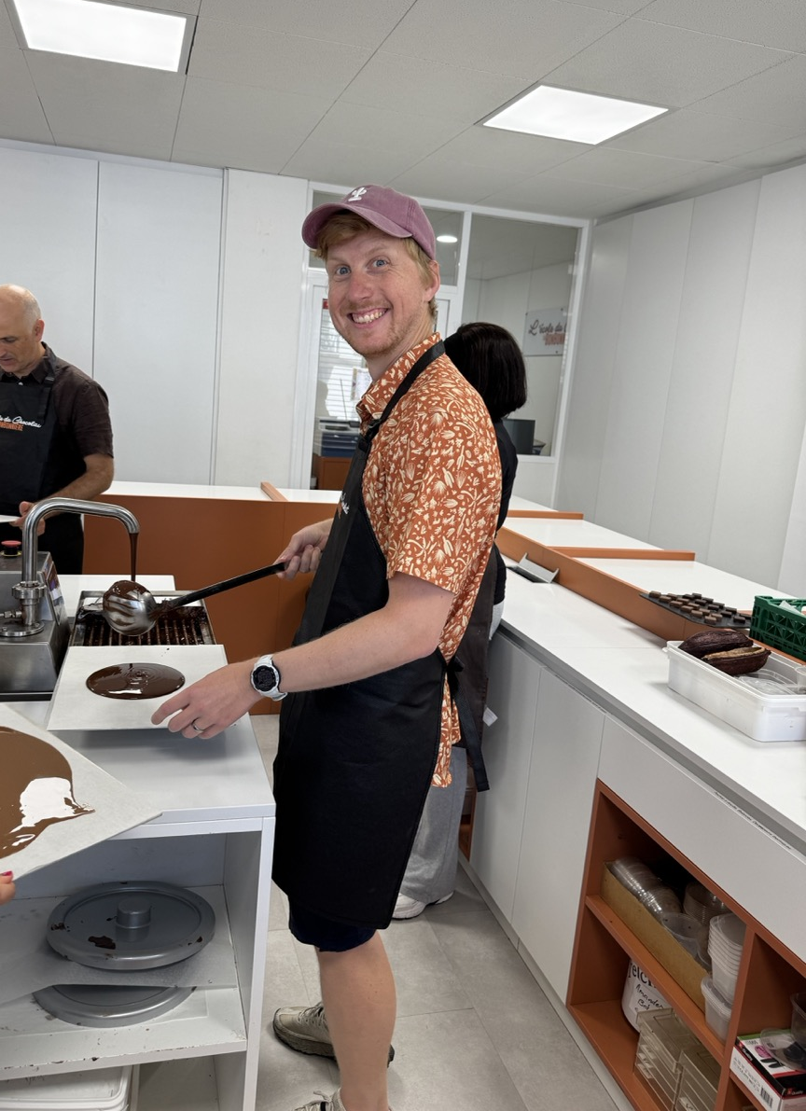
Wer bin ich?
Julius Winter
Matura 2012 – Gymnasium Leonhard (Schwerpunkt Spanisch)
Bachelor Nanowissenschaften Uni Basel
Master Nanowissenschaften Uni Basel
PhD Bioengineering ETH Lausanne
Seit 2024 Computational Biologist beim SIB in Genf

Slide 3

From nose to database

Slide 4
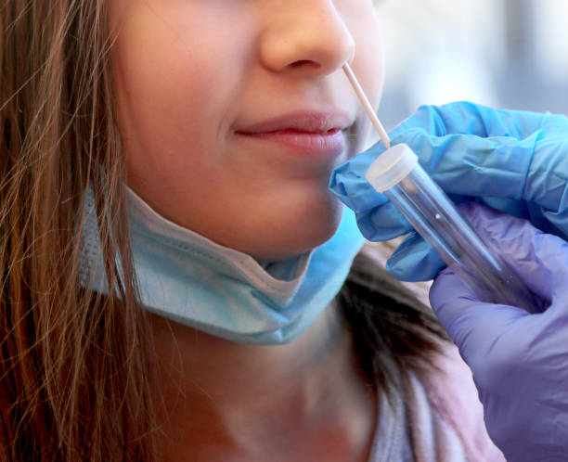
From nose to database

Slide 5
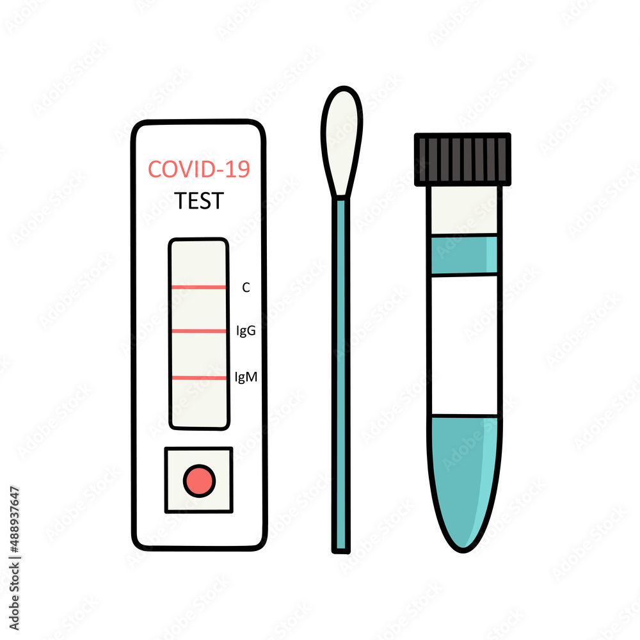
From nose to database

Slide 6
From nose to database
sequencing lab

Slide 7

From nose to database
sequencing lab

Slide 8
From nose to database
cttgtccctggtttcaacgagaaaac...
sequencing lab
New variant!

Slide 9
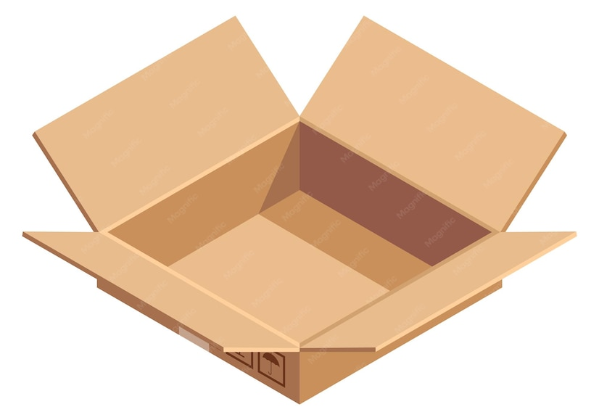
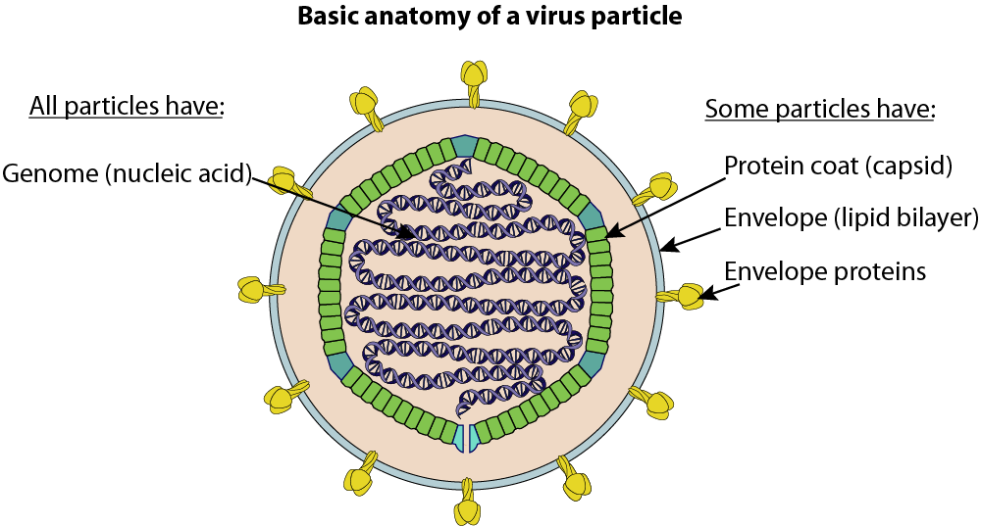
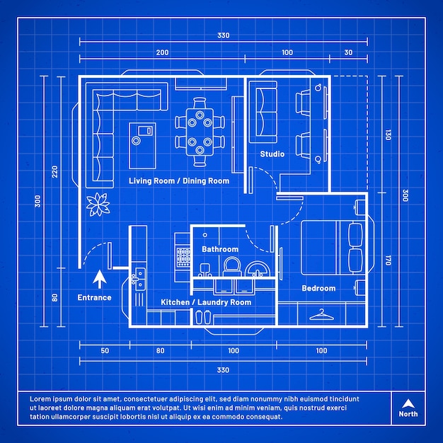
Let’s take a step back – what even is a virus?
building instructions → genetic material (DNA or RNA)
protective box, address label, etc. → protein shell, surface proteins

Slide 10
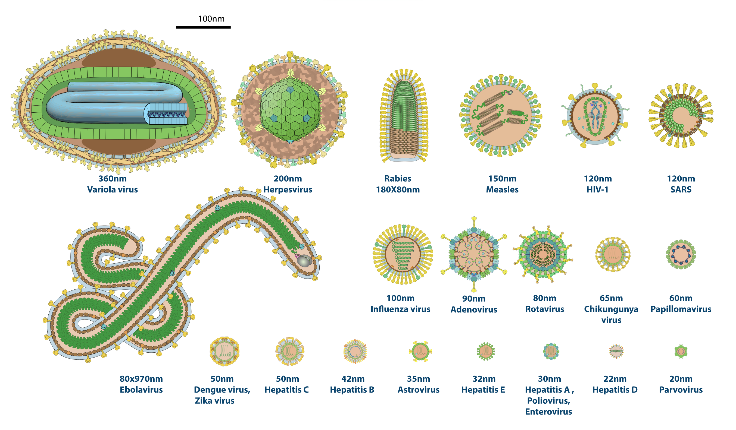
They come in all shapes and sizes
Eradicated since 1980 thanks to the variola vaccine*
https://viralzone.expasy.org/5216
*https://iris.who.int/items/ba4ab312-1c43-4304-8235-969979499717

Slide 11
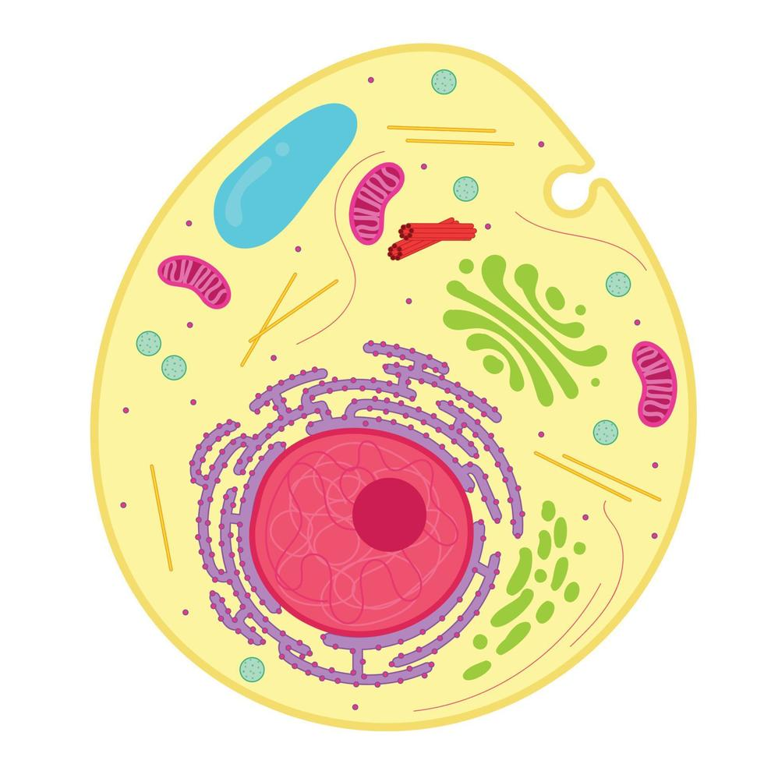

What makes a virus dangerous?
Only about ~200 virus types lead to infectious diseases in humans https://viralzone.expasy.org/678
genetic material
Animal cell
Virus particle

Slide 12
What makes a virus dangerous?
Only about ~200 virus types lead to infectious diseases in humans https://viralzone.expasy.org/678
genetic material
organelles allowing the cell to grow and replicate
Animal cell
Virus particle

Slide 13
What makes a virus dangerous?
Only about ~200 virus types lead to infectious diseases in humans https://viralzone.expasy.org/678
~200-300x smaller
Animal cell
Virus particle

Slide 14
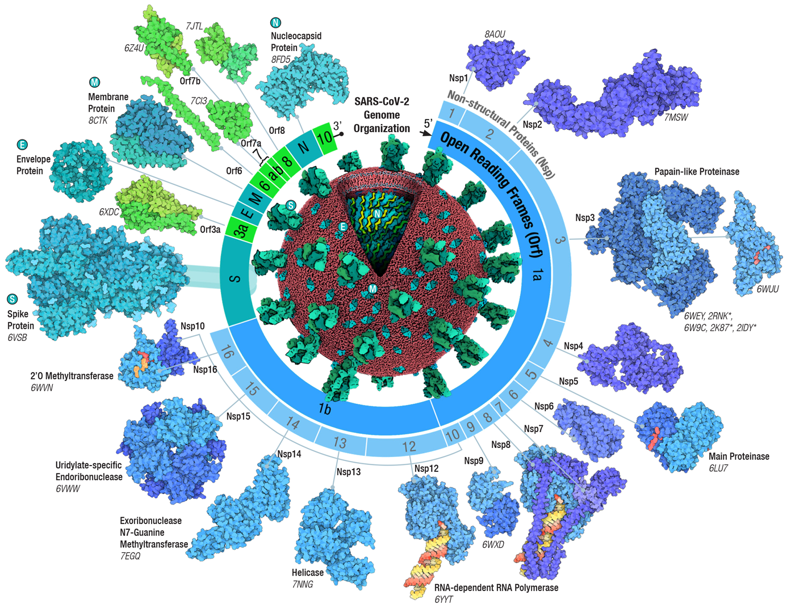
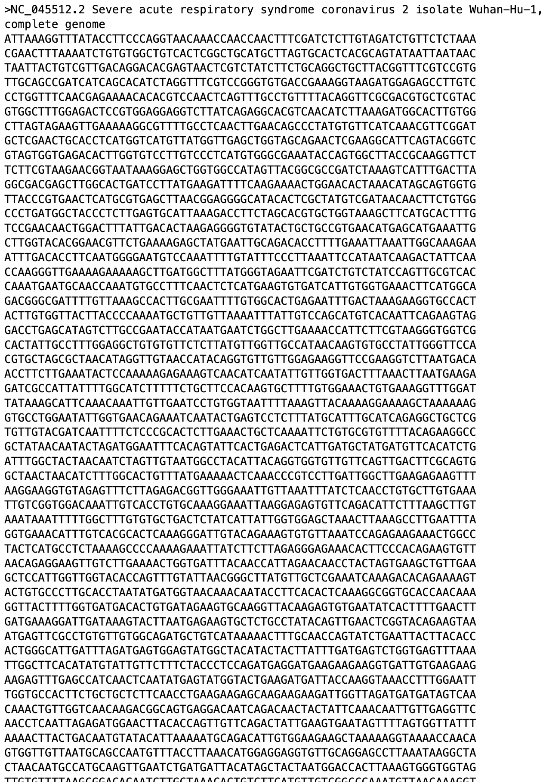
Just a few genes to make it all work
~29’000 bases long
Notes:
Humans about 19’000-20’000 protein coding genes

Slide 15
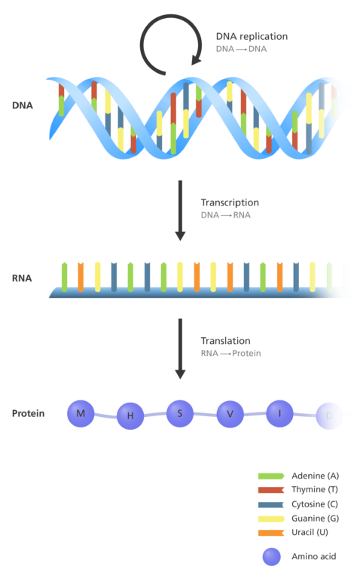
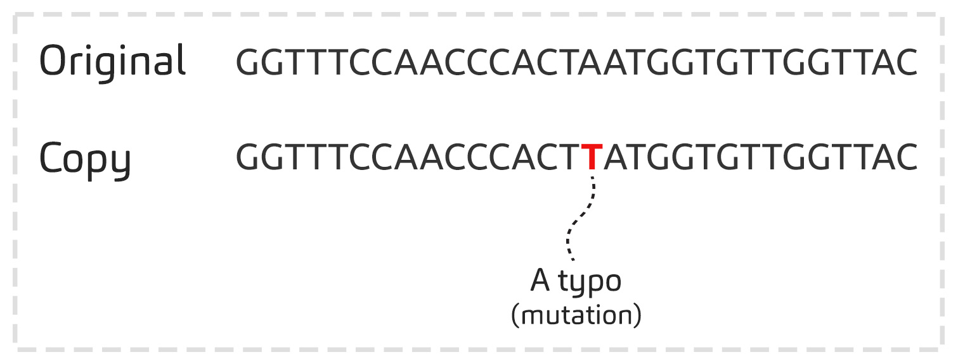
Mistakes can happen during replication

Slide 16
Mutations change the behavior of the encoded protein
Notes:
With a certain amount of mutations, a virus can gain an evolutionary advantage over others. This is when we speak of a variant

Slide 17
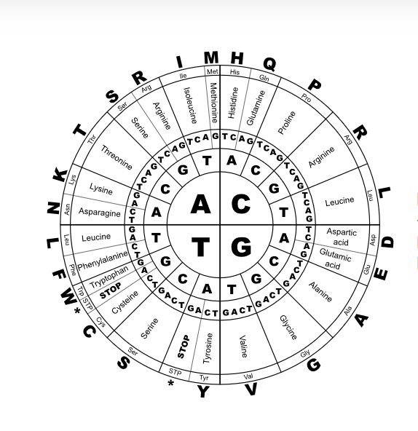
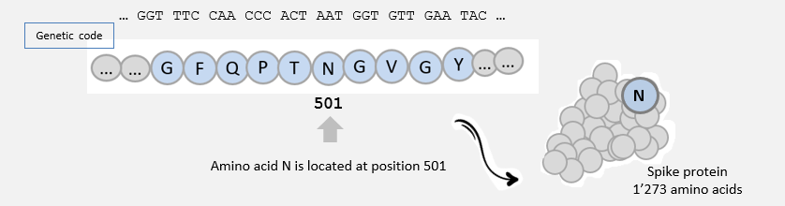
Mutations change the behavior of the encoded protein
Notes:
With a certain amount of mutations, a virus can gain an evolutionary advantage over others. This is when we speak of a variant

Slide 18
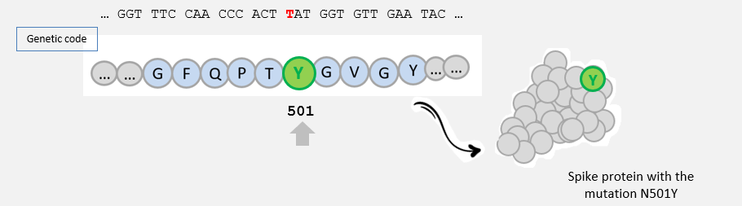
Mutations change the behavior of the encoded protein
Notes:
With a certain amount of mutations, a virus can gain an evolutionary advantage over others. This is when we speak of a variant

Slide 19
One protein stands out

Slide 20
One protein stands out

Slide 21
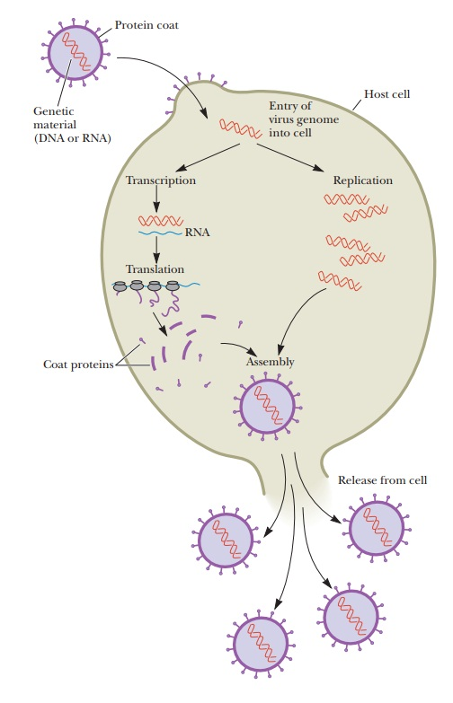
What makes a virus dangerous?
virus enters host cell an hijacks it

Slide 22
What makes a virus dangerous?
one of the most important steps
virus enters host cell an hijacks it

Slide 23
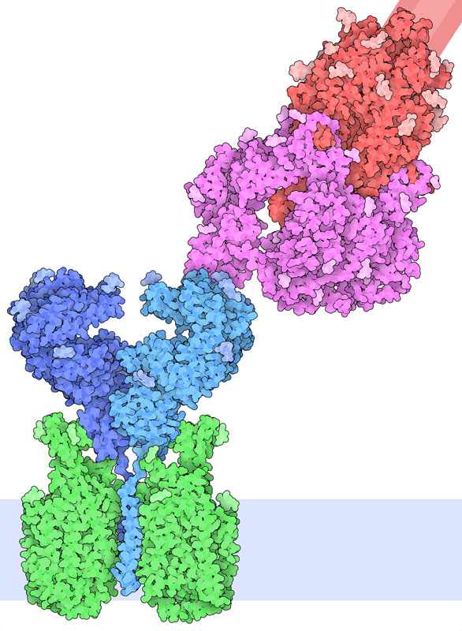
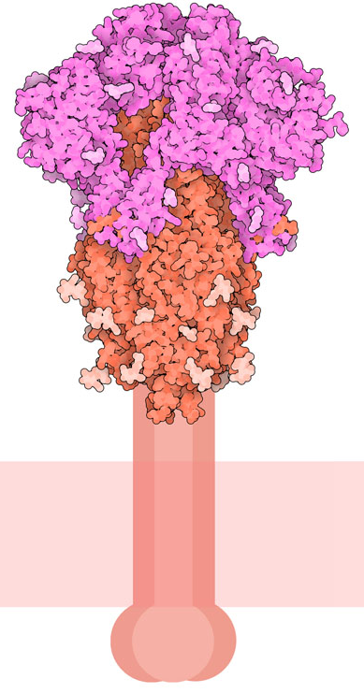
The spike protein is the key into the cell
SARS-CoV-2 Spike
SARS-CoV-2 Spike
human ACE2 protein
ACE2 is a cell surface protein involved in the control of blood pressure.
It is found on lung, heart, kidney, and intestinal cells
virus shell
cell membrane

Slide 24
Spike mutations change how well the virus infects cells
SARS-CoV-2 Spike

Slide 25
Spike mutations change how well the virus infects cells
SARS-CoV-2 Spike

Slide 26
Spike mutations change how well the virus infects cells
SARS-CoV-2 Spike

Slide 27
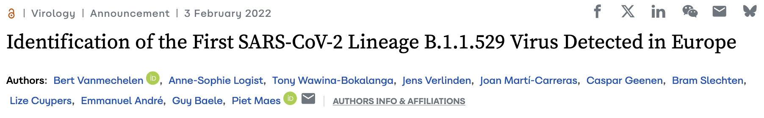

Slide 28
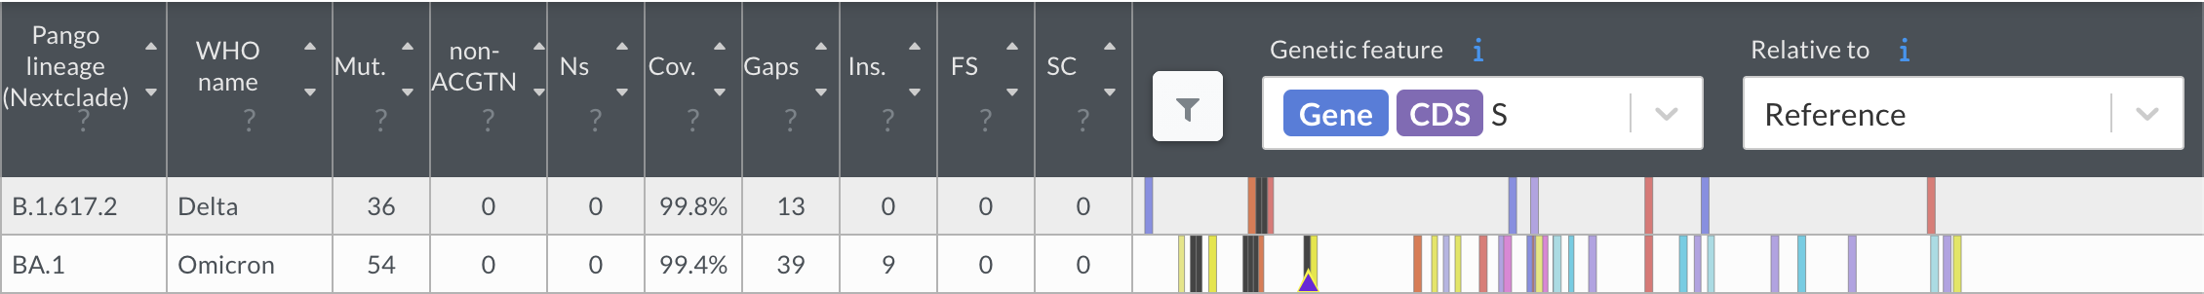
*variant comparison using nextclade

Slide 29
*variant comparison using nextclade
Positive test for Covid-19
BUT
Negative for SARS-CoV-2 Spike

Slide 30
*variant comparison using nextclade
Positive test for Covid-19
BUT
Negative for SARS-CoV-2 Spike
Further investigation and identification of novel variant!

Slide 31
Quickly responding and adapting to ongoing epidemics
is only possible with open knowledge and data
Pathoplexus

Slide 32
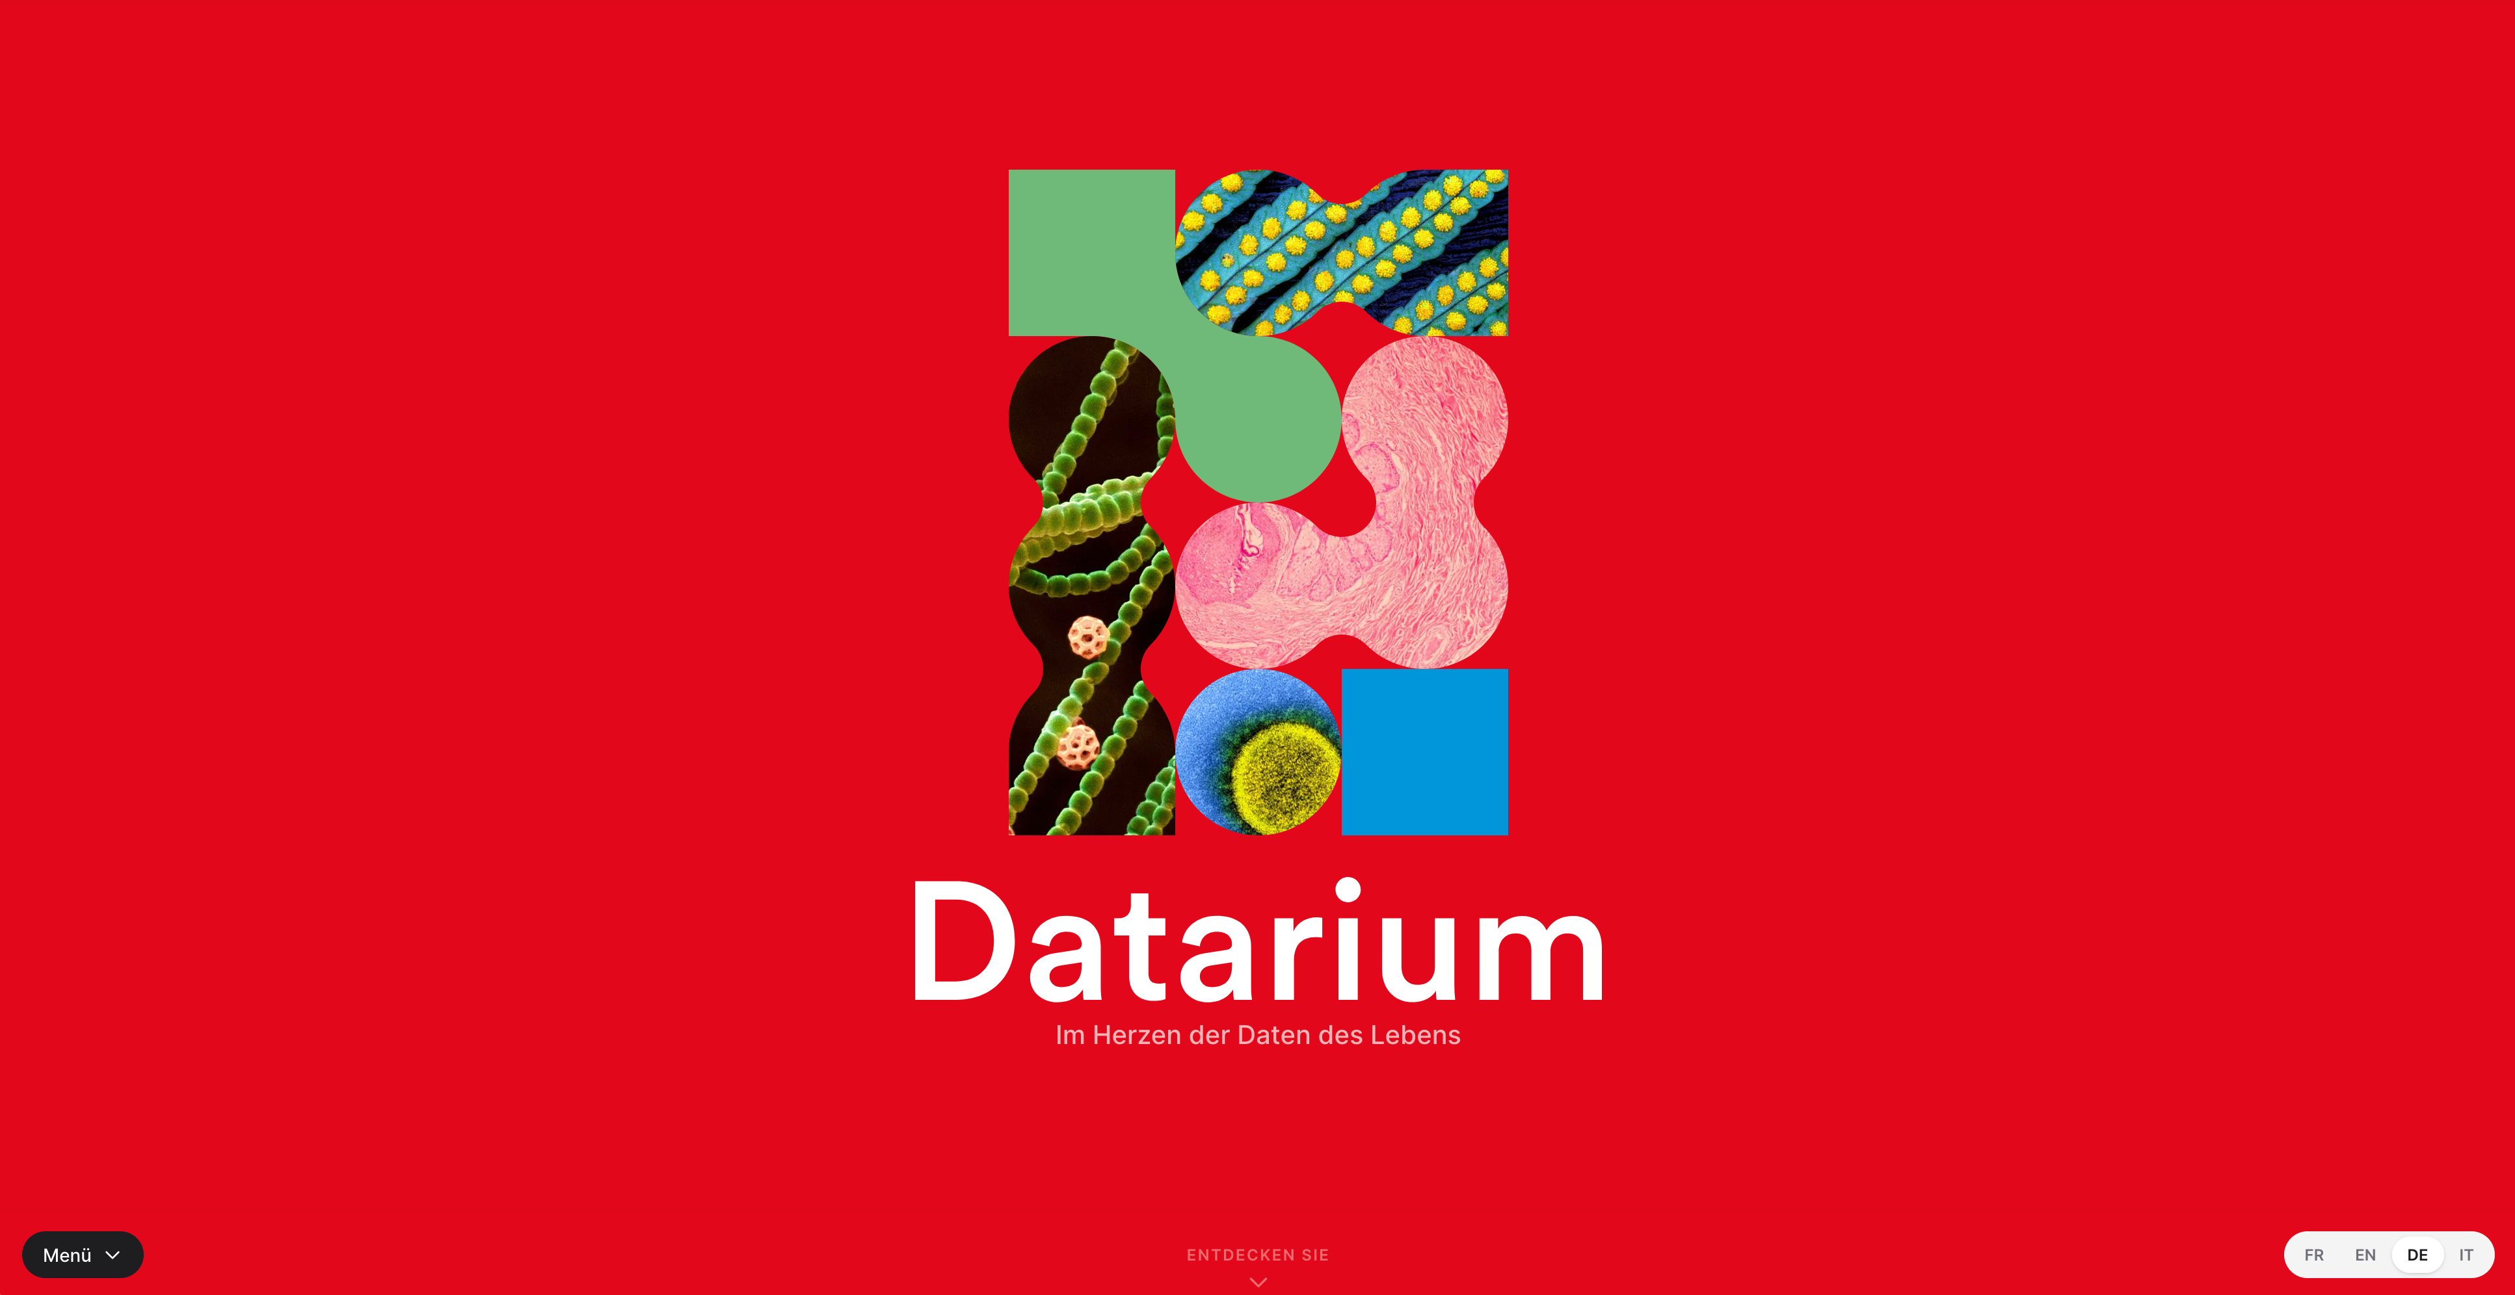
SIB Datarium
datarium.ch/de

Slide 33
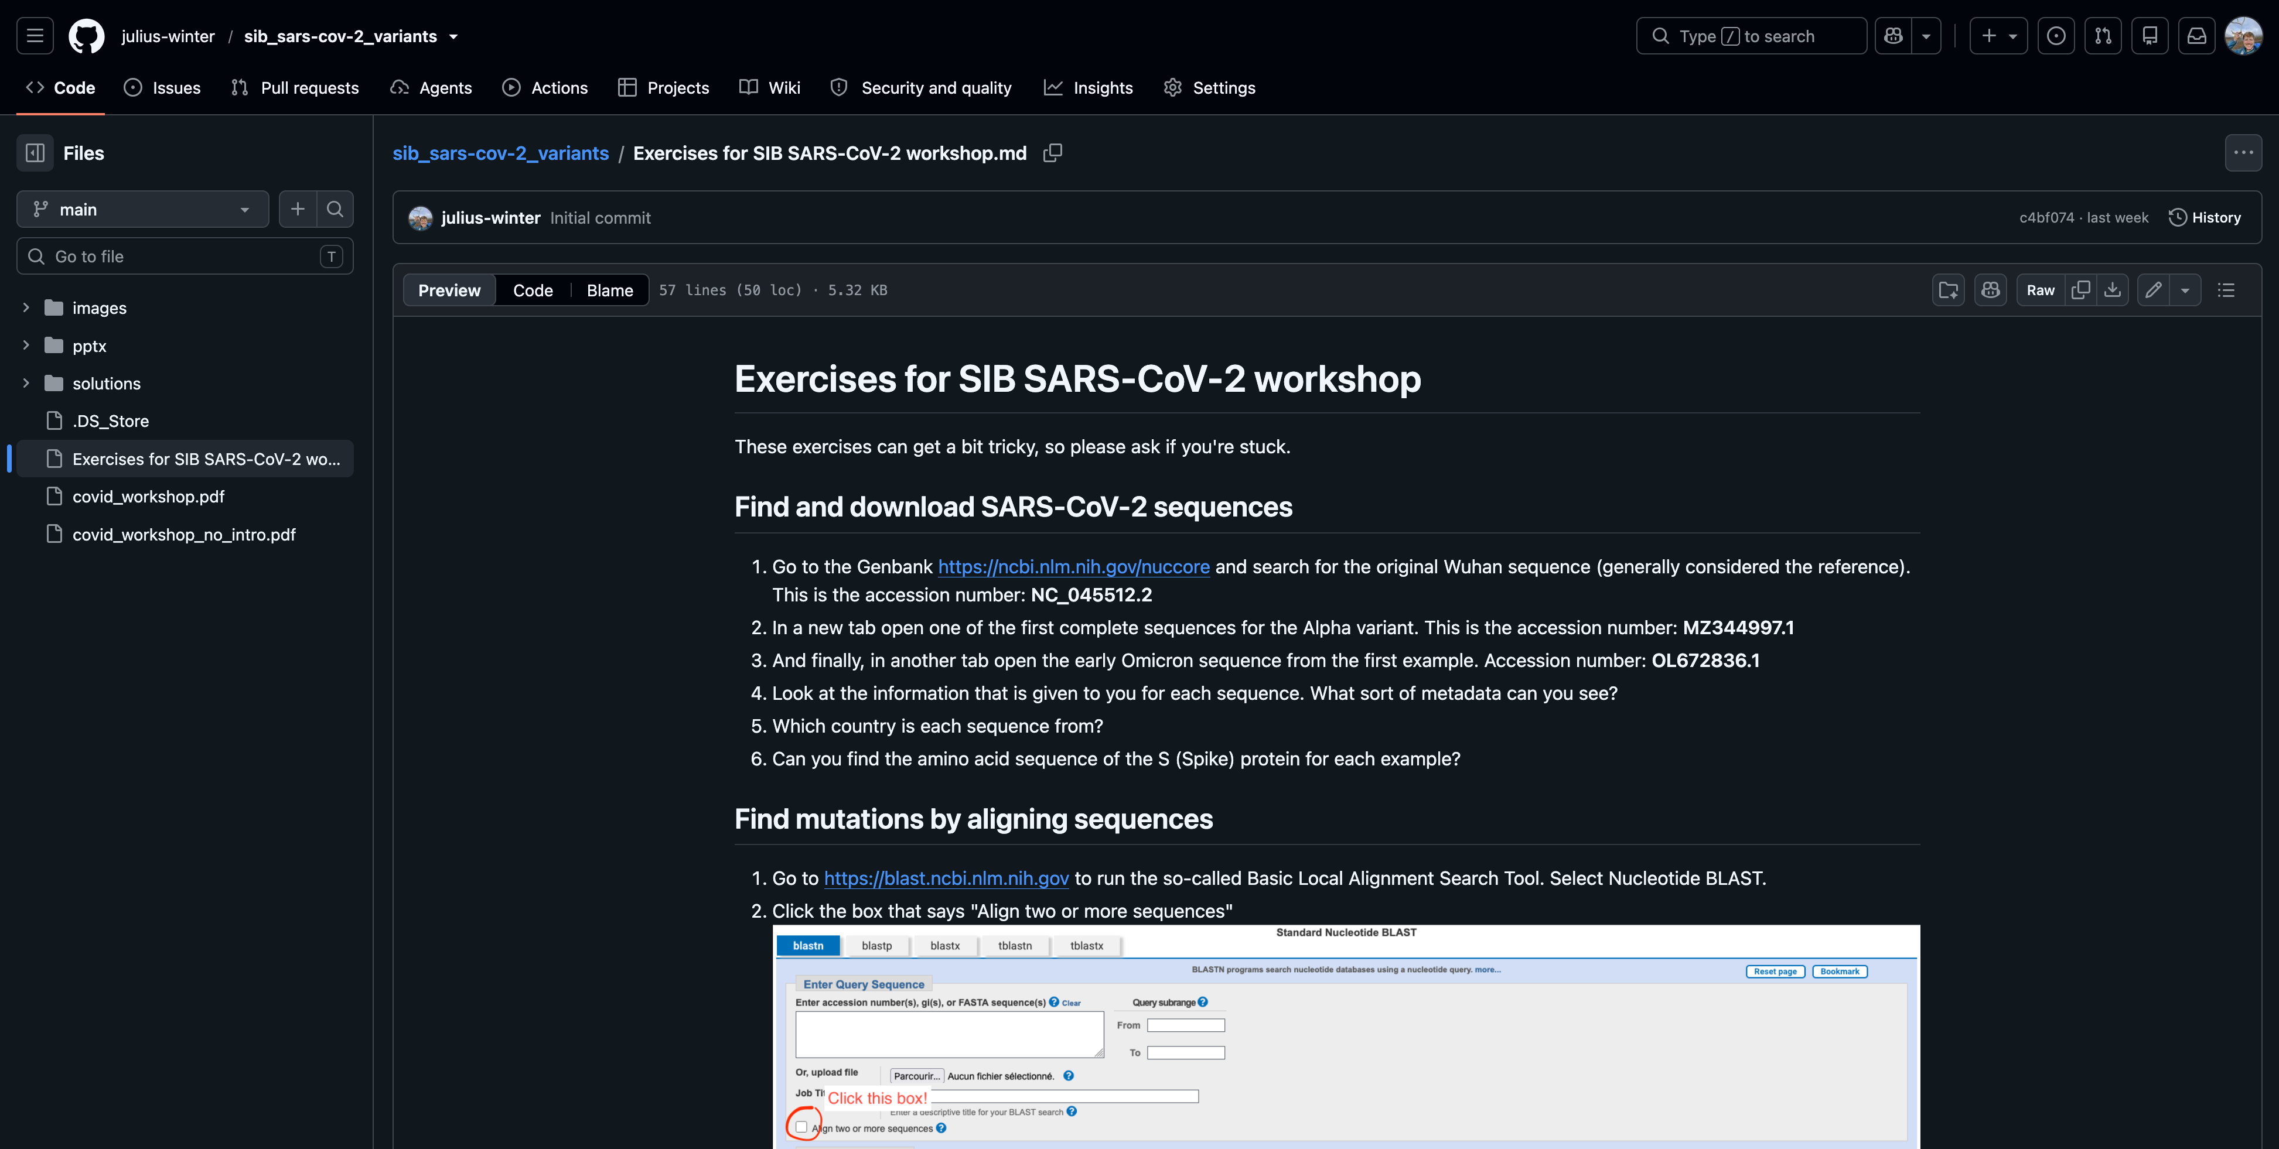
Time for you to do some bioinformatics!
https://kurzlink.ch/scov2

