Slide 1

Final Presentation Marketing Analytics
Marketing Analytics
Group 2:
Constantin Cimpoes, Julius Voss

Slide 2
Introduction & Problem Setup
Context
The Problem
Vibrent: Norwegian fashion rental platform (high-frequency, high-churn business), 7,400 customers, 15,649 garments
CLV in rental ≠ discrete purchases. It's driven by rental frequency, category preference, and duration
Conventional models use only transactions, they ignore what customers rent
Research gap: Does product-level intelligence improve customer-level revenue predictions and churn predictions?
Objectives
Fashion rental needs a smarter CLV model because if you don't know which customers are coming back, you can't decide what to buy or who to target
Product Segmentation → Build a semantically meaningful product segmentation
Revenue Prediction → Predict 12-month customer revenue
Churn Identification → Identify churners before they go silent

Slide 3
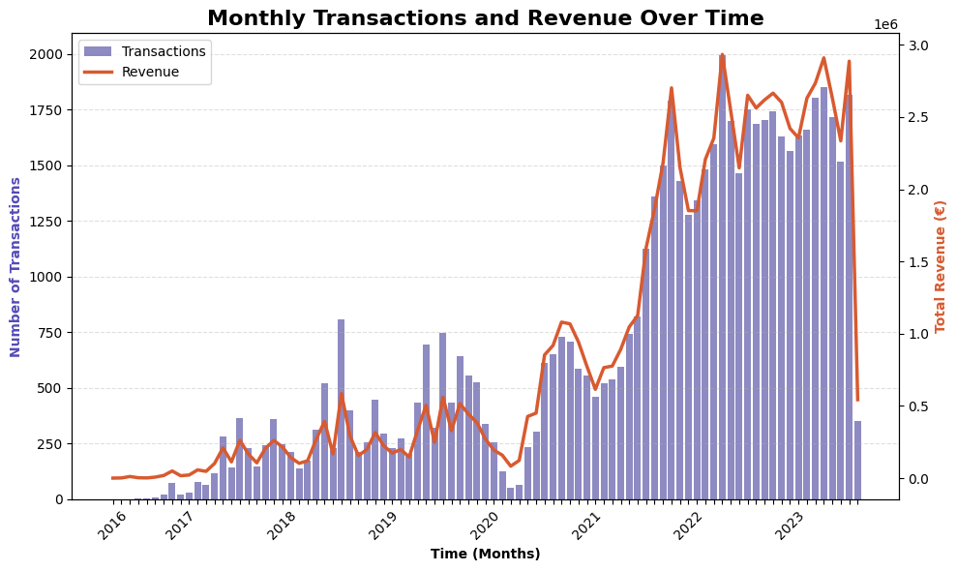
Data & The April 2020 Structural Break
Why it matters: A model trained on pre-2020 data learns the wrong business. Labels and model evaluation must use only post-2020 dynamics
?
March 2016 – September 2023
77,100 rental events | 7,400 customers
Problem: throwing away pre-2020 data entirely loses deep behavioral context (tenure, early loyalty signals)
Solution: features engineered on full history 2016–2023, labels strictly from post-2020 periods
Results: using full history reduces MAE by 74% vs. post-2020 data alone (12,674 → 3,296 NOK)
April 2020 structural break: spot-rental → subscription model
Median duration: 4 days → 30 days
Monthly transactions: ~100 → ~2,000
Temporal validation
Train: features up to Sep 2021 → labels Sep 2021–2022 (n = 5,943)
Test: features up to Sep 2022 → labels Sep 2022–2023 (n = 6,809)
Submission: features up to Sep 2023 → predict Sep 2023–2024
Window expands forward in time, thus the model never sees the future it is predicting

Slide 4
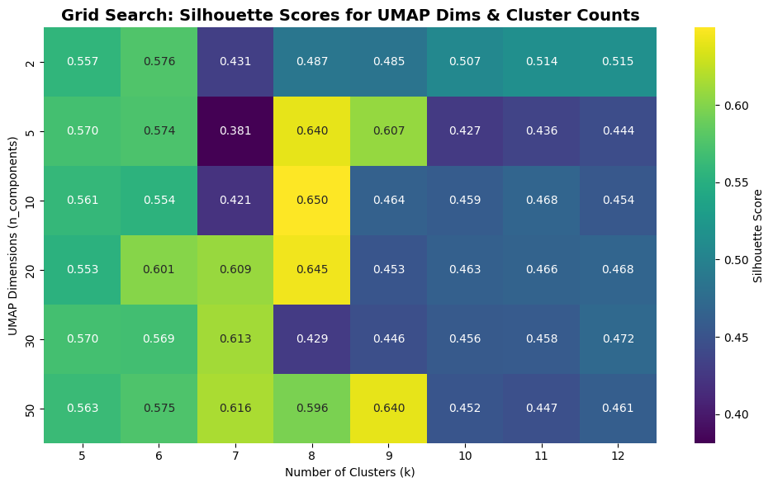
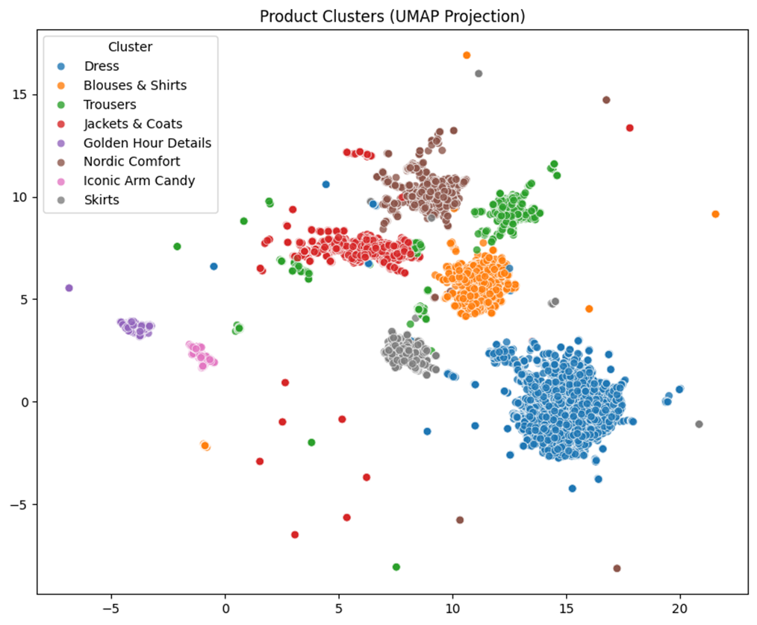
The Clustering Pipeline
Product images + descriptions
A metadata tag says "dress“, an embedding captures what kind of dress (the silhouette, color palette, occasion, vibe)
Voyage 3.5 (2048-dim)
Why Voyage Multimodal 3.5: integrates both image and text in a single interleaved vector → one representation per garment, no modality mismatch
Why not cluster on raw 2,048-dim embeddings? Curse of dimensionality, HDBSCAN collapsed 84% of items into one cluster. K-Means Silhouette scores near zero. Distance metrics break in high dimensions.
UMAP (20-dim)
Why UMAP first? Non-linear dimensionality reduction that preserves both local and global structure. Reduces to 20 dimensions where distance is meaningful again
K-Means (k=8)
Why K-Means over GMM? After UMAP, over 99% of items had >99% probability of belonging to a single cluster, probabilistic modeling adds no value. K-Means is simpler, more stable, fully interpretable
Why k=8? Grid search across k=5/13 and UMAP dims 2/50. k=8 achieved the global Silhouette peak of 0.645 and mean ARI of 0.85 across 100 random initializations
8 coherent segments
RESULT:

Slide 5
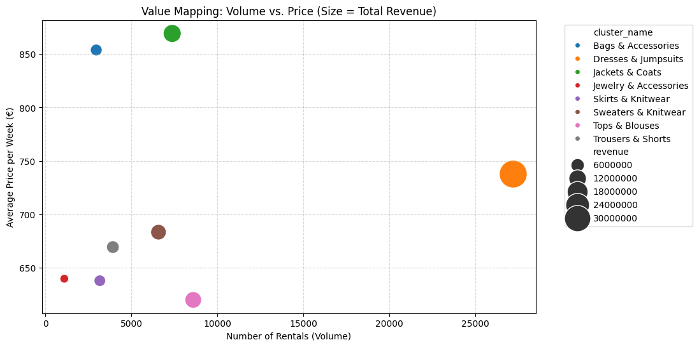
Business Profiling: four strategic roles
Hidden White Space
Bags & Accessories: utilization rate 7.05 (71% above avg), revenue-per-item 10,139 NOK
Lowest ROI (1.98): high acquisition cost makes this a capital-intensive growth lever, not an efficiency play
Only 20% dead inventory: supply is the binding constraint, not demand
Jackets & Coats: The Premium Anchor commanding the highest median monthly price (1,800 NOK)
Dead Inventory: never-rented rates as high as 36.7%
Revenue Engine
Dresses & Jumpsuits:
Outlier in absolute volume (~27,000 rentals
41.9% of revenue
42.3% of inventory
ROI 2.76
Perfectly balanced
Capital Workhorses
Tops & Blouses (ROI 3.79) and Sweaters & Knitwear (ROI 3.59)
low cost-base and high turnover allow these to recover their cost nearly 4x over.
Structural underperformers
Trousers & Skirts:16% of inventory, 11% of revenue, never-rented rates up to 35.8%

Slide 6
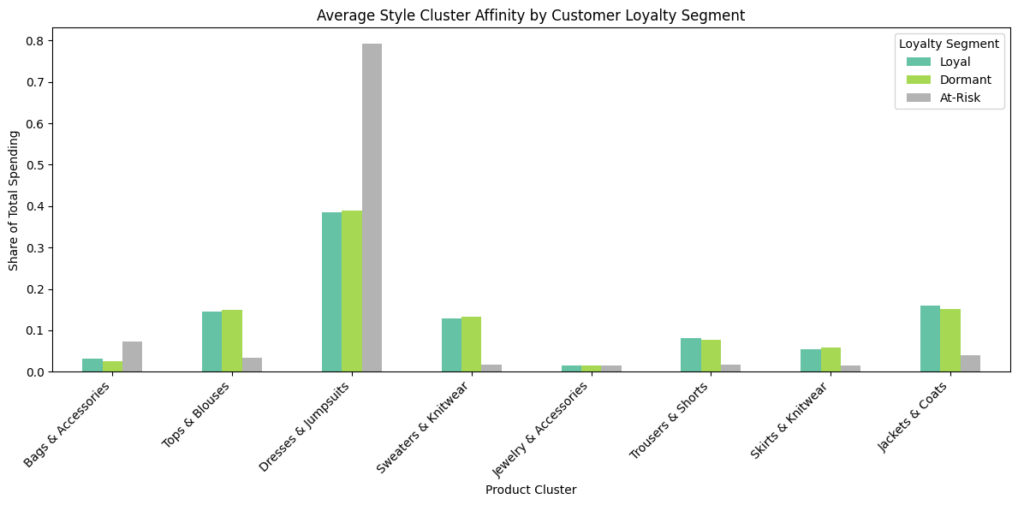
Customer Affinity: style diversity predicts loyalty
Loyal and Dormant customers look nearly identical in style preference: ~39% Dresses, ~16% Jackets, ~15% Tops, ~13% Knitwear. Overall a broad engagement across 5+ categories
At-Risk customers: 79% of spending concentrated in a single category (Dresses)
Interpretation: At-Risk users come to Vibrent for a one-time occasion (a wedding, a gala), solve that need, then churn
Why this matters for modeling
This behavioral insight motivated the use of Style Entropy and Cluster Affinity features: Style Entropy to capture overall diversity, individual Cluster Affinities to capture engagement with specific product categories
SFS eliminated Style Entropy as redundant
Once specific Cluster Affinities were included, the diversity signal was already captured. Not all affinities were needed either: only the economic anchors identified in the business profiling (Bags, Tops, Dresses, Jackets)
The model derived the full behavioral pattern from just a few targeted features, confirming that engagement with specific catalog anchors, more than just broad diversity metrics, is the decisive predictor of retention

Slide 7
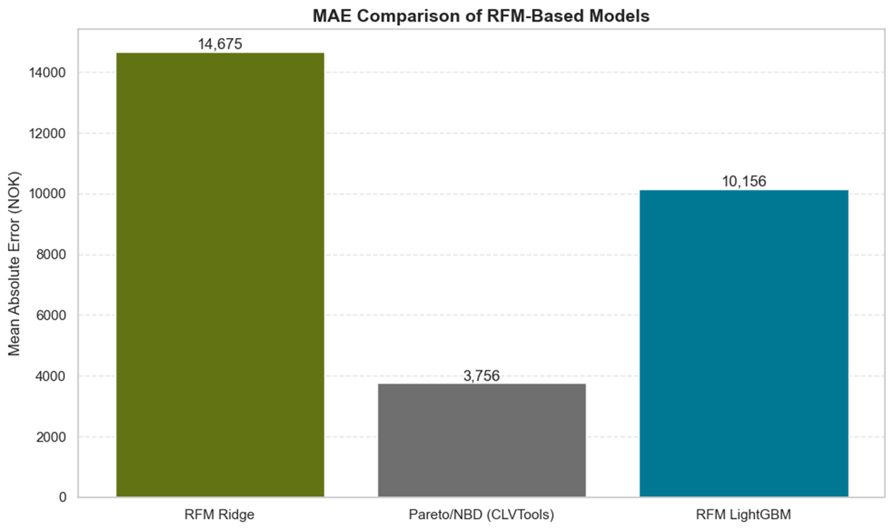
The Baseline - Comparing RFM-based Models
CLVTools‘ Pareto/NBD model outperforms simple RFM-based models
Good starting point to compare CLVTools baseline against more advanced models with more features
Problem: 2 different datasets used
RFM Ridge & LightGBM trained on post-2020 data
CLVTools on whole dataset

Slide 8
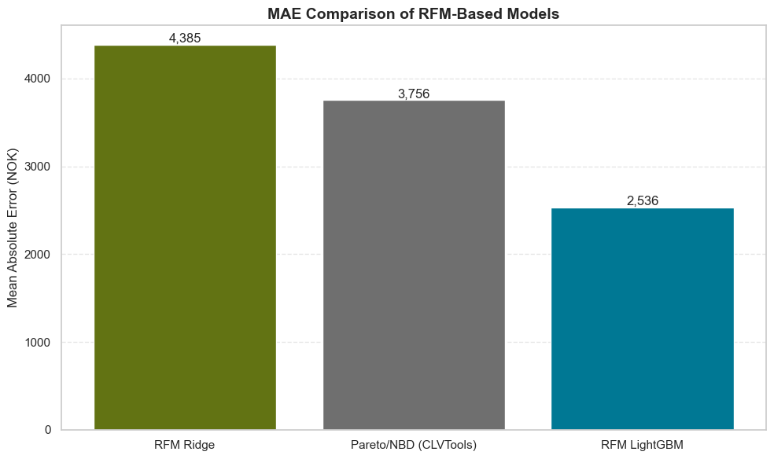
The Baseline - LightGBM Already Beats the Industry Benchmark on RFM-Features
Ridge (4,385): Wrong assumptions, linearity can't capture churn
Example:
Recency: 245 days
Frequency: 33 rentals
Monetary: 55,451.33 NOK
Actual Revenue: 0 NOK
Predicted: 23,884.28 NOK
Pareto/NBD (3,756): Industry benchmark, built for this problem, but constrained by fixed statistical assumptions
LightGBM (2,536): Learns churn from data directly → no assumptions needed
−16.7%
−32,5%

Slide 9
The Modeling Journey – Four Problems, Four Solutions, Three Improvements
Problem Identified
Solution Applied
MAE Impact
Baseline soley relies on 3 features
Feature engineering of additional 33 features
2,536 → 3,296 NOK
93% of customers generate zero revenue
Tweedie distribution objective
3,296 → 2,595 NOK
Redundant & noisy features
Sequential Forward Selection (18 features)
2,595 → 2,408 NOK
Latent churners inflate predictions
Hybrid Two-Stage Model
2,408 → 2,387 NOK

Slide 10
Hybrid Two-Stage Model
LightGBM Classifier scores churn prediction
Start
All customers
Hybrid prediction combination if churned → CLV = 0
If active → CLV prediction of regressor
Final CLV prediction
End
LightGBM Regressor
predicts clv for all
Why not a pure two-stage model?
Why not a single-stage model alone?
Stage 2 trained on only 439 active customers → too sparse to learn high-value behavior
Can't explicitly zero out latent churners → over-predicts dormant high-spenders

Slide 11
Hybrid Two-Stage Model
LightGBM Regressor
Predict CLV of all customers
NO
Start
LightGBM Classifier
Churned?
Set CLV = 0
Combine predictions
YES
Why not a pure two-stage model?
Why not a single-stage model alone?
Stage 2 trained on only 439 active customers → too sparse to learn high-value behavior
Can't explicitly zero out latent churners → over-predicts dormant high-spenders
Architecture provides a final MAE of 2387 NOK – improvement by 6% compared to the single-stage model

Slide 12
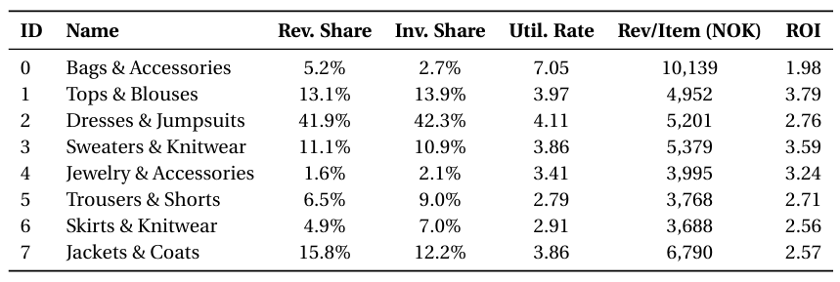
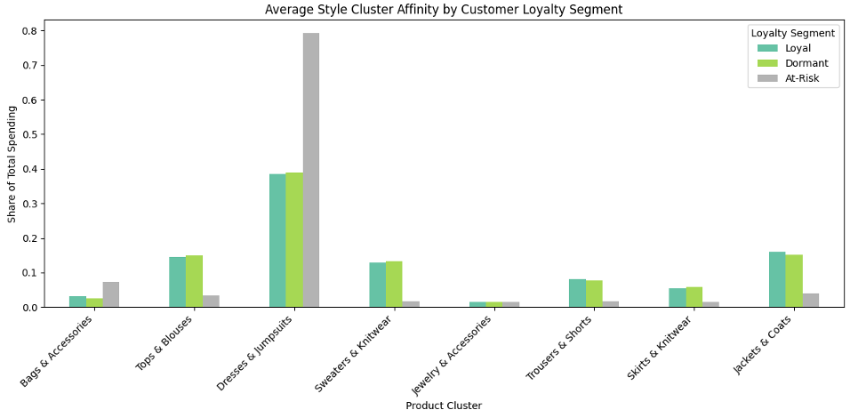
Single-Stage LightGBM rediscovered the Segmentation
SFS Selected Features (grouped)
Segmentation Findings
Recency, Monetary, Monetary x Frequency (RFM core)
Weighted revenue, avg revenue, revenue trend, tenure_days, max_retail_price, avg_price_per_week (behavioral depth)
Revenue per day, rentals per day, pct_weekly_rentals (velocity)
Summer rentals, active months (seasonality)
cluster_affinity_0 (Bags), cluster_affinity_1 (Tops), cluster_affinity_2 (Dresses), cluster_affinity_7 (Jackets)
Notes:
The model didn't need all 8 clusters — just the ones that matter economically
I want to flag something that connects directly back to Constantin's segmentation work. When Sequential Forward Selection chose which features to keep, it didn't retain all eight cluster affinities — it kept exactly four. And those four are Bags, Tops, Dresses, and Jackets — the precise clusters that the business profiling identified as the economic anchors of the platform

Slide 13
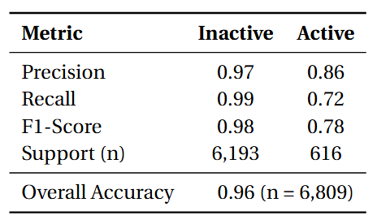
The Churn Model Confirms the Story
Churn Classifier Performance
SFS Selected Features
Recency
Monetary x Frequency
Pct_weekly_rentals
cluster_affinity_6 (Skirts) → everyday fashion –could be a loyalty signal
Assignment Evaluation Metrics:
Total Hit Ratio (Accuracy): 96%
Recall (Inactive customers): 99%
Notes:
The churn classifier was built separately from the revenue model, using its own feature selection process. So it independently chose its own set of four predictors. And again you can see it uses RFM which seem to be strong predictors for churn too and one of them is Cluster 6 - Skirts
Here's why that matters: customers who engage with everyday fashion staples are less likely to churn. Customers who concentrate on Dresses or Bags — occasion wear — are the ones solving a one-time need and leaving. The classifier found that signal on its own, without being told anything about the affinity analysis. Two completely separate methods, same conclusion."

Slide 14
Recommendations to Vibrent
Expand Bags & Accessoires
Highest revenue-per-item in the catalog (10,139 NOK), utilization 71% above average but lowest ROI due to acquisition cost. Growth lever, not efficiency play.
Reallocate away from Trousers & Skirts
16% of inventory, 11% of revenue. Never-rented rates up to 35.8%. Shift budget toward Tops & Sweaters with an ROI exceeding 3.5x.
Trigger a second-category nudge after the first Dress rental
At-risk customers spend 79% in a single category. One cross-category interaction changes the behavioral profile from occasion renter to subscriber.
Notes:
So would should Vibrent do with those information
Bags: high utilization – maybe increase price sligthly, buy similar bags to does rented often – they have higher utiliasation and better ROI
Shift away from trousers and skirts – since high share of never rented items – shift towards tops and sweaters with higher roi
Dress rental seems to be a good churn predictor – so goal should be to get customers to rent from everyday clothes categories to get them away from the special occasion rents

Slide 15
Thank You! Group 2 Constantin Cimpoes • Julius Voss
Notes:
So would should Vibrent do with those information
Bags: high utilization – maybe increase price sligthly, buy similar bags to does rented often – they have higher utiliasation and better ROI
Shift away from trousers and skirts – since high share of never rented items – shift towards tops and sweaters with higher roi
Dress rental seems to be a good churn predictor – so goal should be to get customers to rent from everyday clothes categories to get them away from the special occasion rents

