Slide 1
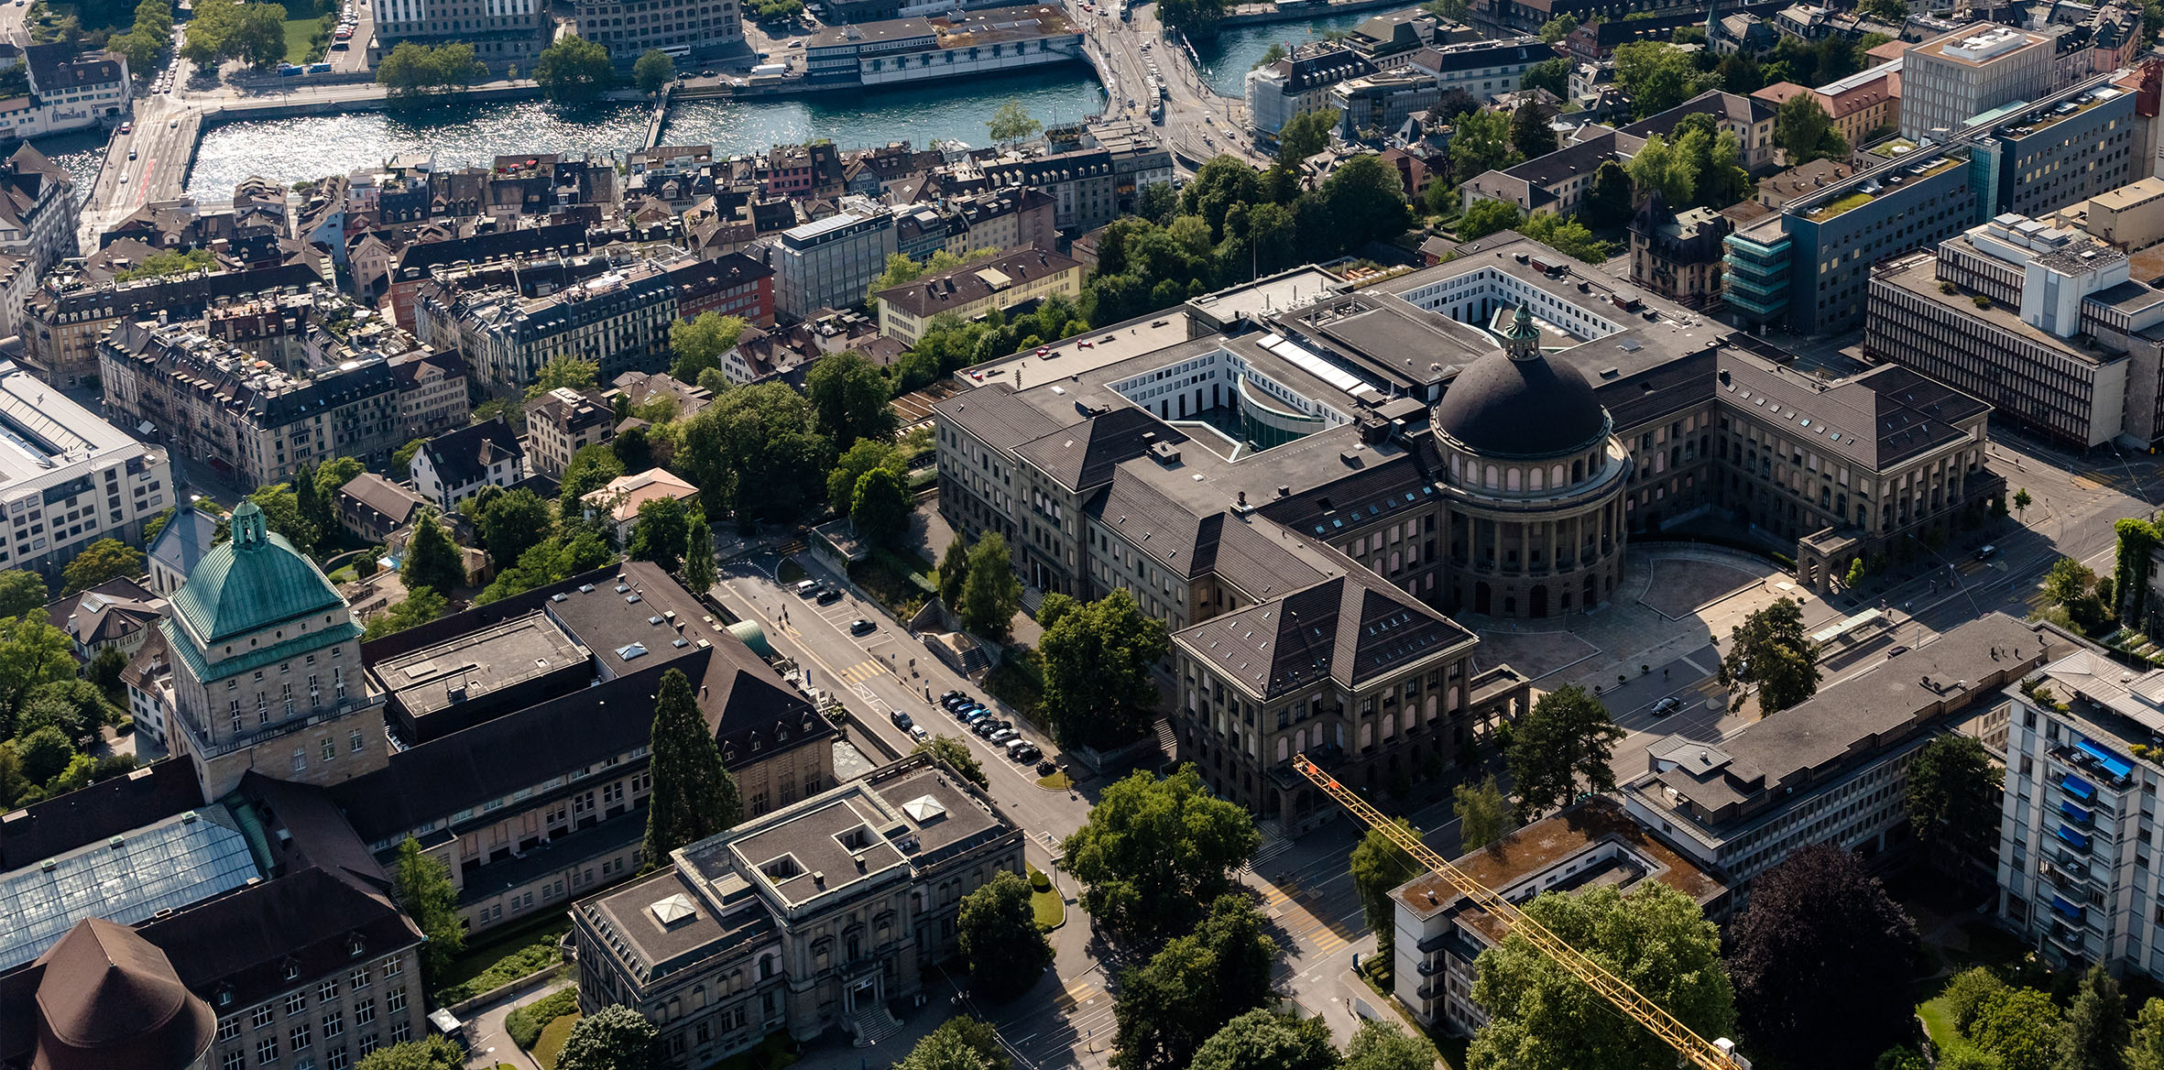
Assignment 1: Embedding Challenge
Julius Voss

Slide 2
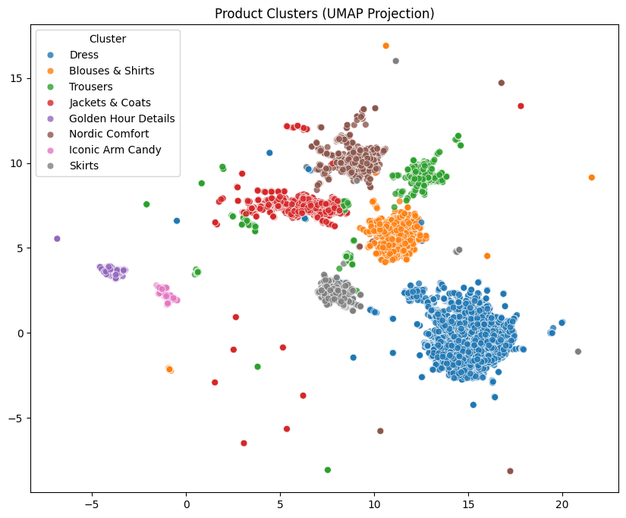



Setup & Model Selection a Reducing high-dimensional image-text data (Voyage AI) using UMAP, enabled a robust identification of 8 fashion product clusters.
Multi-modal Embeddings (Voyage)
Combination of image and text data (2048 dimensions) for a comprehensive understanding of the product.
Dimensionality Reduction (UMAP)
Compression from 2048 to 20 dimensions to sharpen the structures (curse of dimensionality).
Clustering with KMeans
KMeans delivers 8 stable, business-relevant, product segments
Notes:
Voyage Multimodal embeddings - Visual and textual features – hope that with both information there is a better differentiation possible between the products
Dimensionality reduction because i did not get good and robust results with 2048 dimensions probably because of the curse of dimensionality
Tried HDBSCAN and Kmeans for clustering but kmeans seemed to be better since HDBSCAN was struggeling to differentiate between trousers and jackets – i gues because on the picture there is sometimes trousers visible
To get the number of clusters for kmeans i used the elbow method which did not give clear results on how many clusters to pick → Silhouette score was a lot more clear so i decided on using 8 clusters

Slide 3
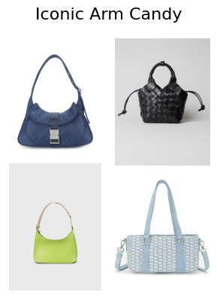
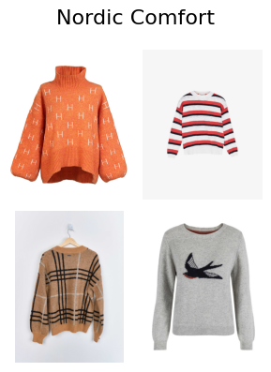
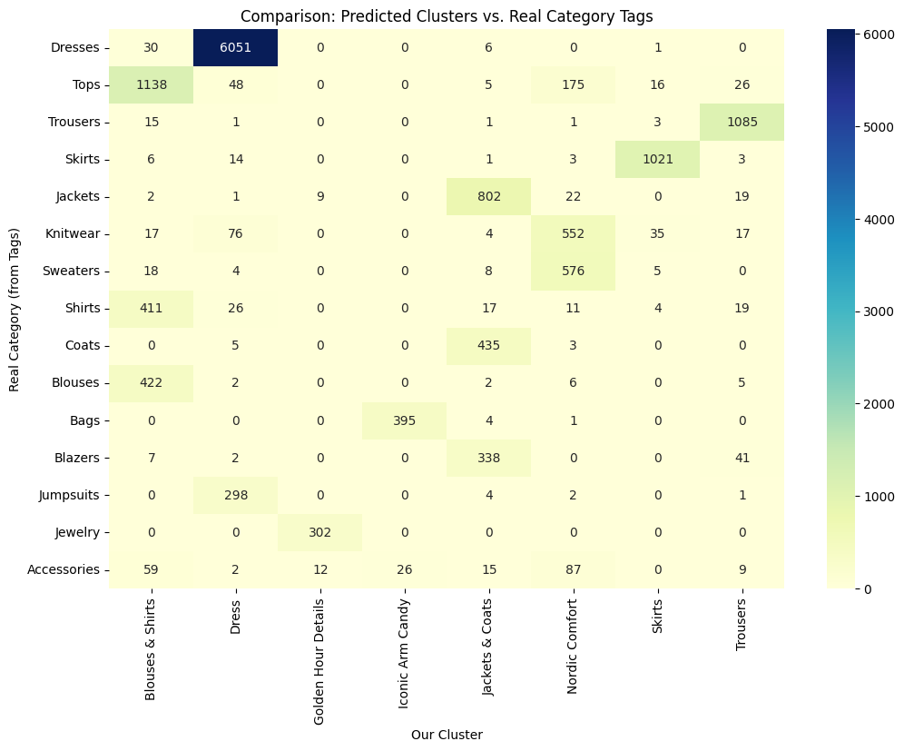
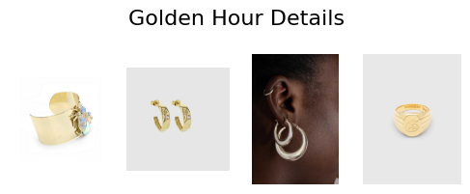
Cluster Interpretation a Cross-referencing predicted clusters with manual category tags validates the model's high semantic accuracy.

