Slide 1

Assignment 2: Baseline Challenge
Marketing Analytics
Group 2:
Constantin Cimpoes, Julius Voss

Slide 2
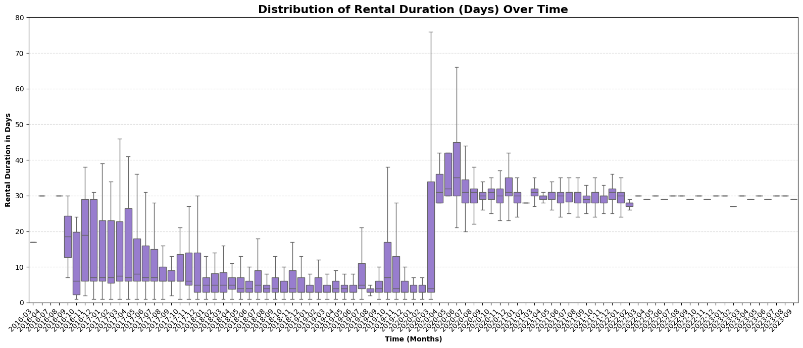
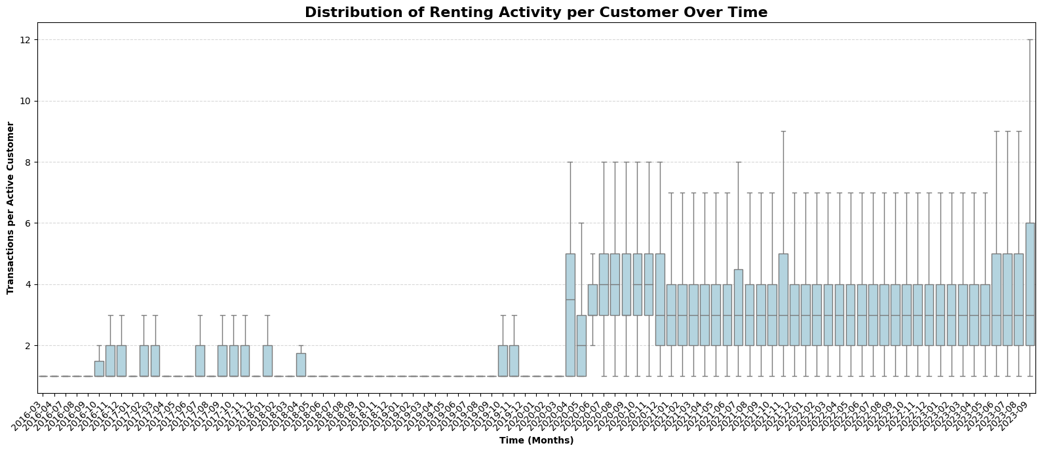
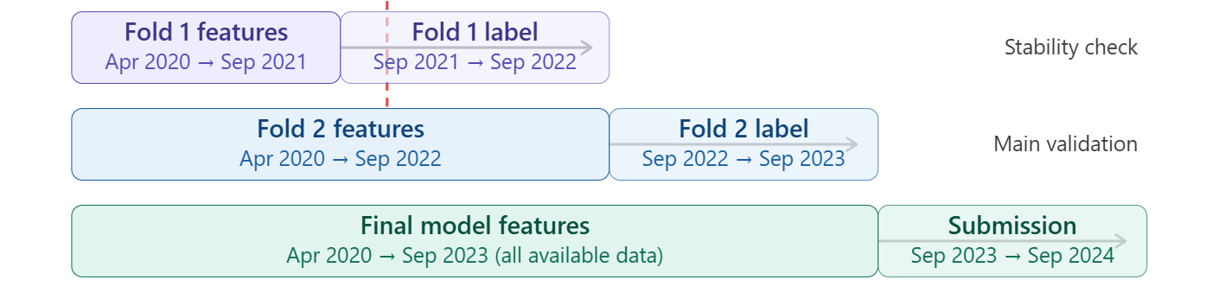
Time-Based Validation Strategy for CLV Prediction
Data Analysis
Train-test split
Focus on post-behavioral shift period (Apr 2020 onward) to ensure consistent customer dynamics
Forward-chaining validation (2 folds) tests model stability across time
Fold 1 (consistency check): Can the model generalize to unseen data before the final period?
Fold 2 (main validation): Does the model work in the most recent, most relevant period?
Consistent performance across folds → reliable generalization to unseen period
With expanded historical data, Fold 2 is expected to match or exceed baseline performance
Plots reveal a structural break in consumer behavior starting April 2020
Final model predicts CLV for Sep 2023 – Sep 2024 using all available stable data
Notes:
Structural break in consumer behavior or renting behavior → maybe iniatied by a change in the renting business model
Because before 2020 most rentals were around a week long and after it basically stabilized to 30 day rentals
That’s why we are just going to focus on the data after the shift
We tought about doing a two fold test train approach
We use Fold 1 to establish a baseline. If Fold 1 performs well, and Fold 2 performs just as well or better, it proves our model is stable and ready to predict
But what could also be a point is to check if the first couple of months have too much “variance” in them before the data distribution settles. If the first fold is a lot worse that could be a hind to this and then we would crop the data even further

Slide 3
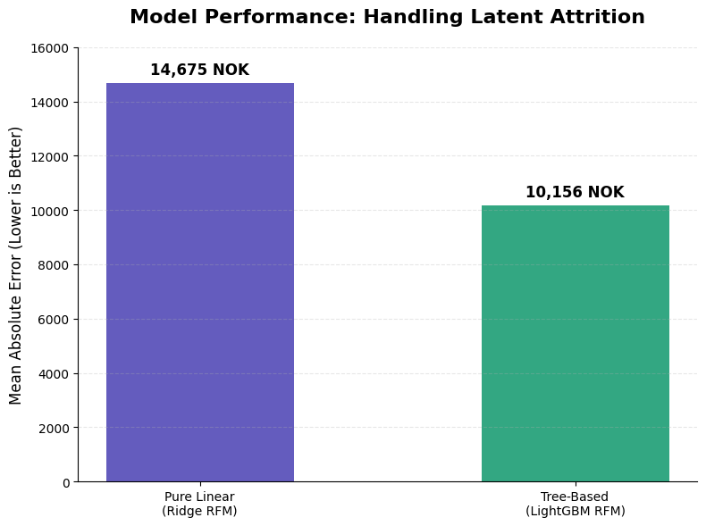
RFM Baseline for CLV Prediction
Ridge Regression: The simple linear ridge model cannot handle customers who spent a lot in 2021 but stopped completely in 2023. It hallucinates high revenue for dead accounts
Feature
Description
Recency
Days since last rental before cutoff
Frequency
Total rental count in feature window
Monetary
Total revenue generated (NOK)
--- LATENT ATTRITION EXAMPLES ---
Customer ID: 3
- Recency: 245 days
- Frequency: 33 rentals
- Monetary: 55,451.33 NOK
=> ACTUAL Future Revenue (Target): 0.00 NOK
=> RIDGE Predicted Revenue: 24,355.41 NOK
Customer ID: 9
- Recency: 3 days
- Frequency: 3 rentals
- Monetary: 3,402.67 NOK
=> ACTUAL Future Revenue (Target): 6,700.00 NOK
=> RIDGE Predicted Revenue: 14,653.23 NOK
Feature Importance
Recency -7793
Frequency -9150
Monetary 21982
Coefficients
−31%
LightGBM: We implement a tree-based model that can implicitly learn to ignore these churned customers. Upgrading to a tree-based model cuts the MAE by 31%:
Feature Importance Monetary 556 Recency 451 Frequency 337
While this is a solid improvement, our conclusion is that pure RFM features are still not enough for a highly accurate prediction. Our next step for the final model is to enrich this LightGBM with behavioral features (e.g., Style Entropy and Cluster Affinity) to precisely predict who is churning and reduce the error gap even further
Splits
Marketing Analytics
Notes:
[Transition - Take the floor from your colleague]
"Following up on the temporal split my colleague just explained, I'll walk you through our baseline models and a critical issue we discovered in the data: Latent Attrition."
[Point to the Bar Chart on the left]
"We started with a standard RFM approach using a simple Ridge Regression. As you can see on the chart, this resulted in a massive Mean Absolute Error of nearly 14,700 NOK."
[Point to the Table on the top right]
"To understand why it failed, look at the actual data in the table. Customer number 3 is a 'churned whale'. They spent over 55,000 NOK historically, but haven't rented anything in 245 days. Their actual future revenue is zero.
But because a linear model heavily weights historical spend, it doesn't understand this latent attrition. It hallucinates over 24,000 NOK in future revenue for a completely dead account."
[Point back to the LightGBM Bar on the chart]
"To fix this, we upgraded to a tree-based model: LightGBM. Because trees can learn non-linear rules, LightGBM implicitly learned that once 'Recency' crosses a certain threshold, the predicted revenue must drop to zero. This cut our error by 30%."
[Look at the audience / Point to the Takeaways]
"However, the main takeaway here is that even an optimized pure-RFM baseline is insufficient. To close the error gap further, our next step is to enrich this tree model with the behavioral features we engineered earlier — like Style Entropy — to precisely predict who is churning.
Thank you."

