Slide 1
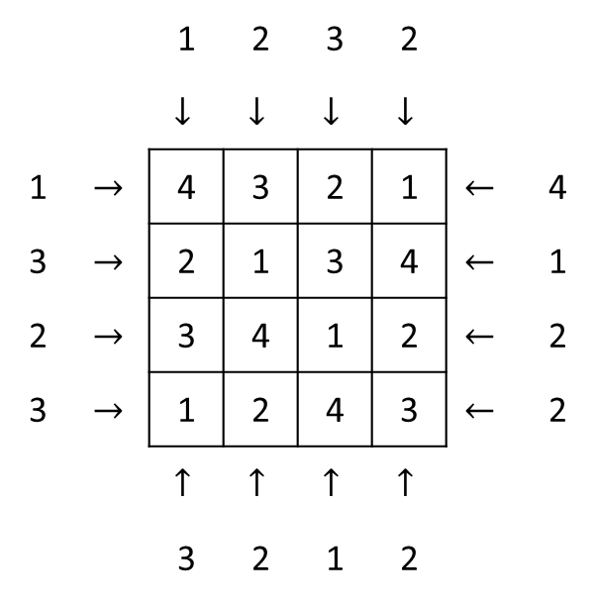
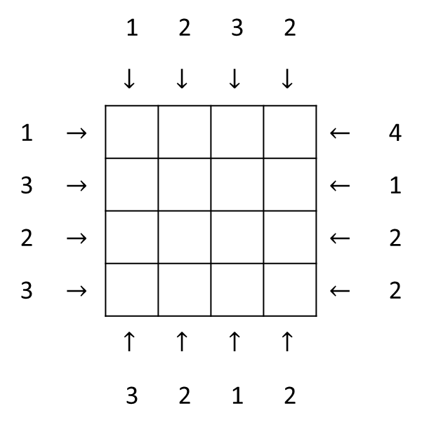
 |  | 1 | 2 | 3 | 2
 |  | $$↓$$ | $$↓$$ | $$↓$$ | $$↓$$
1 | $$→$$ |  |  |  |  | $$←$$ | 4
3 | $$→$$ |  |  |  |  | $$←$$ | 1
2 | $$→$$ |  |  |  |  | $$←$$ | 2
3 | $$→$$ |  |  |  |  | $$←$$ | 2
 |  | $$↑$$ | $$↑$$ | $$↑$$ | $$↑$$
 |  | 3 | 2 | 1 | 2
 |  | 1 | 2 | 3 | 2
 |  | $$↓$$ | $$↓$$ | $$↓$$ | $$↓$$
1 | $$→$$ | 4 | 3 | 2 | 1 | $$←$$ | 4
3 | $$→$$ | 2 | 1 | 3 | 4 | $$←$$ | 1
2 | $$→$$ | 3 | 4 | 1 | 2 | $$←$$ | 2
3 | $$→$$ | 1 | 2 | 4 | 3 | $$←$$ | 2
 |  | $$↑$$ | $$↑$$ | $$↑$$ | $$↑$$
 |  | 3 | 2 | 1 | 2

Slide 2
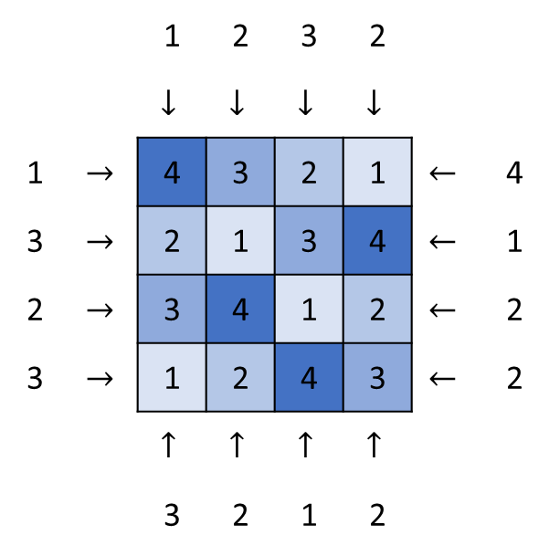
 |  | 1 | 2 | 3 | 2
 |  | $$↓$$ | $$↓$$ | $$↓$$ | $$↓$$
1 | $$→$$ | 4 | 3 | 2 | 1 | $$←$$ | 4
3 | $$→$$ | 2 | 1 | 3 | 4 | $$←$$ | 1
2 | $$→$$ | 3 | 4 | 1 | 2 | $$←$$ | 2
3 | $$→$$ | 1 | 2 | 4 | 3 | $$←$$ | 2
 |  | $$↑$$ | $$↑$$ | $$↑$$ | $$↑$$
 |  | 3 | 2 | 1 | 2

Slide 3
2
2

