Slide 1
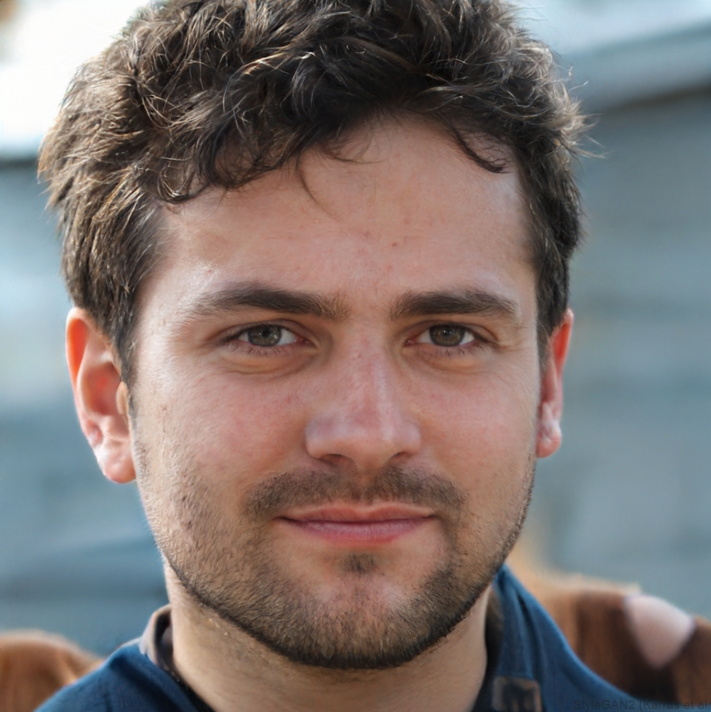
Robust AI Image Generation in the Wild

Slide 2
Evolution of Image Generation
1950s – 1980s: Symbolic AI & Algorithmic Art
  The Logic: Researchers used explicit human-defined rules (If-Then statements) to create 2D animations and simple patterns.
  Key Concept: "Non-learning" AI. The machine didn't understand the image; it just followed a geometric recipe.
1990s: Statistical Texture Synthesis
  Used mathematical models to replicate patterns (like brick walls or grass) by analyzing the probability of pixel distributions.
2006: The “Wake-Sleep” Philosophy
  Geoffrey Hinton introduced the idea that to recognize shapes, a system should first learn to generate them. He proposed using "top-down" generative connections to produce reconstructions of data (Hinton, 2007).

Slide 3
Evolution of Image Generation (contd.)
2014: The Dual Path (GANs vs. VAEs)
  Generative Adversarial Networks (GANs): A "Minimax" game where a Generator creates images and a Discriminator tries to spot fakes. Result: Sharp, high-fidelity images but unstable to train.
  Variational Autoencoders (VAEs): Uses an Encoder to map images to a probabilistic "Latent Space" and a Decoder to reconstruct them. Result: Stable training and diverse outputs, but notoriously blurry.
2021: The Semantic Breakthrough (DALL-E 1 & CLIP)
  OpenAI’s DALL-E (v1) combined Transformers with VAEs.
  It proved that AI could "understand" and blend concepts (e.g., "An armchair in the shape of an avocado") rather than just mimicking textures.
2022 – Present: Diffusion Models
  The Mechanism: Models like Stable Diffusion and Midjourney work by gradually removing "Gaussian noise" from a static-filled image until a coherent picture emerges.
  Why it won: Unlike GANs, Diffusion is highly stable to train and offers far more creative control through natural language prompting.

Slide 4
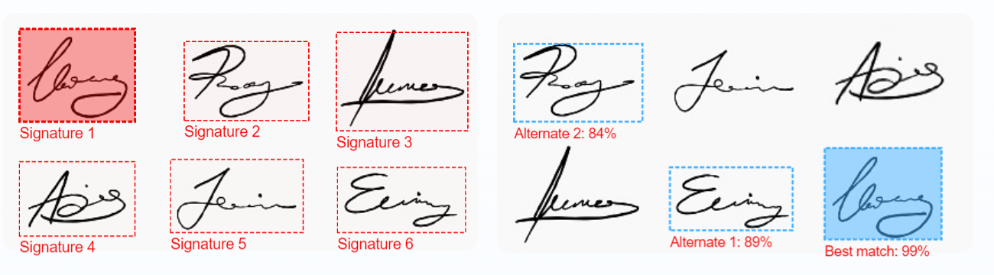
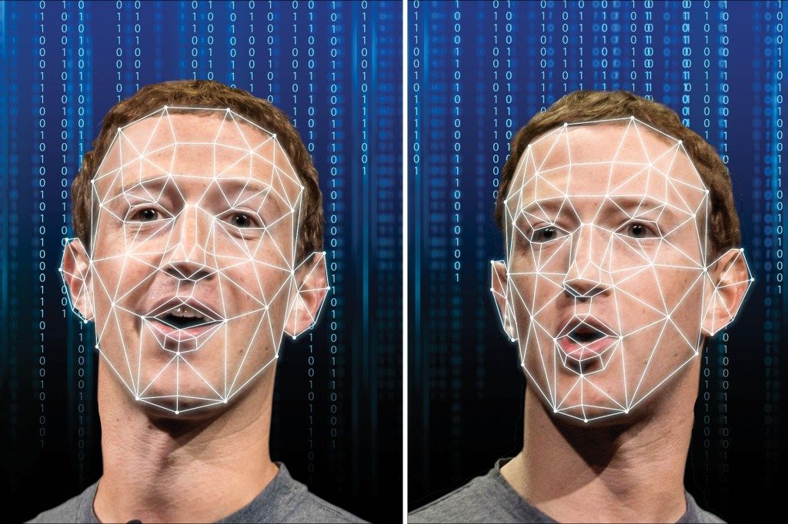
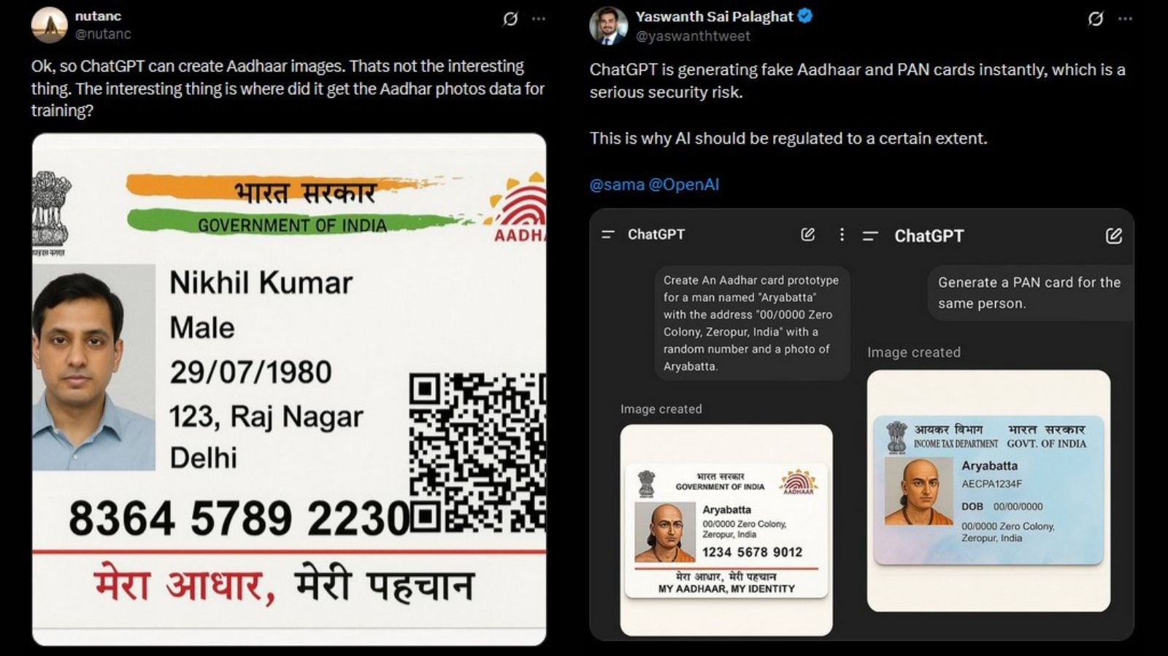
Risks and Societal Impact

Slide 5
Problem Statement – NTIRE 2026
  Text-to-image (T2I) models have made synthetic images nearly indistinguishable from real photos in many cases, which creates serious challenges for trust, authenticity, forensics, and content safety. At the same time, real-world images are routinely transformed (cropped, resized, compressed, blurred), and detectors must remain reliable under such post-processing and distribution shifts.
  In this challenge, we introduce a dataset of real and AI-generated images, with additional “in-the-wild” style transformations, to benchmark detection methods that are accurate, robust, and generalize to unseen generators.

Slide 6
Problems with AI Detection
Real-World Transformations
  Compression: JPEG/WebP discard high frequency data save space. This smooths-out specific noise patterns which will be crucial in detecting the validity of an image
  Resampling (Resizing or Cropping): Posting photos to different social media apps like Instagram or Facebook often involves changing the actual size or removing some of the photo. This will lead to loss of information that will be helpful in finding an AI generated image
  Blurring: Taking a photo with shaky hands, capturing a moving subject, or simple autofocus failure. Since many detectors rely on sharp pixel transitions or specific edge artifacts to spot AI, a blurred AI image can easily pass as a poorly taken real photo.
  Noise: Photos taken at night or indoors force cameras to boost sensitivity, creating "grain" or speckles. Users intentionally adding "film grain" filters (VSCO, Instagram) to make images look vintage.

Slide 7
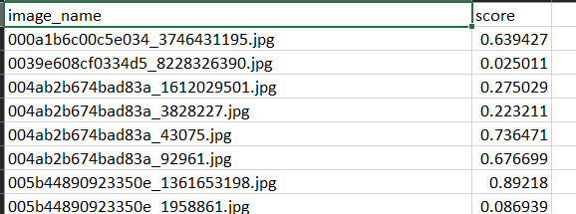
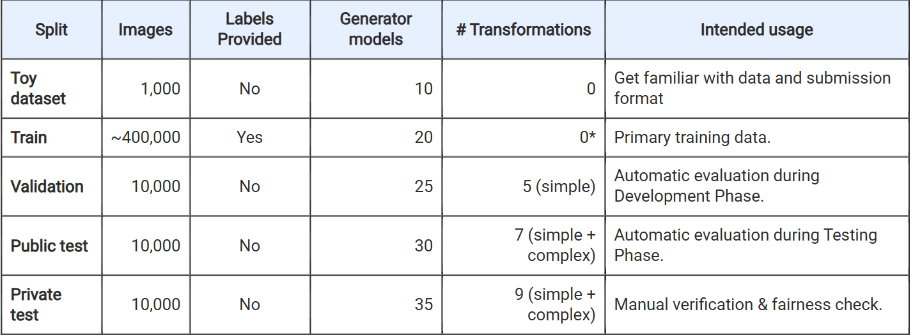
Dataset
Type of Data
Image classification dataset
Natural images labeled as:
  Real
  AI-generated
Images may undergo real-world transformations (compression, blur, resize, etc.)
Labels & What They Represent
0 → Real image
1 → AI-generated image
Model output is a probability score, not a hard label.
Potential Preprocessing Steps
Image resizing & normalization
Strong data augmentation:
  compression
  Gaussian blur
  Random resize / crop
  Noise injection
Ensure robustness to distribution shifts
Potential Challenges with the dataset
Class Imbalance
Generator Bias

Slide 8
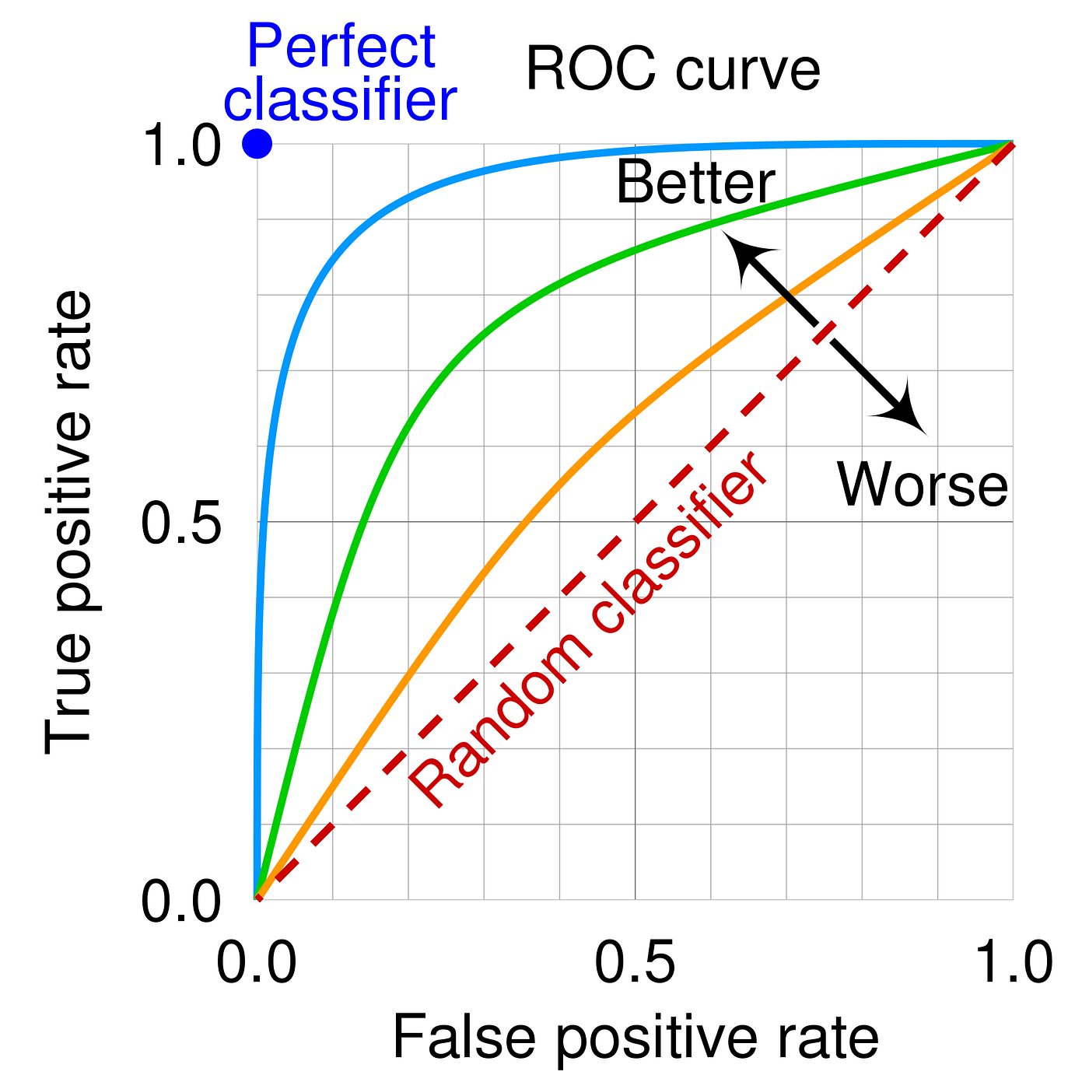
Evaluation Metrics
ROC – Receiver Operating Characteristic
  It’s a graph that plots True Positive Rate (TPR) vs. False Positive Rate (FPR)
  We want a high TPR (detection) and a low FPR (false alarm)
AUC – Area Under the Curve
  A single score [0,1] – summarizes the ROC curve
  Interpretation:
    1 – Perfect Classifier
    0.5 – Random Classification
    <0.5 – Worse than Random Classification

Slide 9
Literature Review
Diffusion Reconstruction Error (DIRE)
1.Hypothesis: “ Synthetic images are more easily reconstructed by a pre-trained diffusion models than real world photos.”
2.Noise -> Denoise -> calculate reconstruction error
3.Real Images -> High amplitude error map
Frequency Guided Reconstruction Error (FIRE)
1.AI models fail to perfectly recreate the ‘middle’ details of a real photo- mid frequency information
2.Uses Frequency Mask Refinement (FMRE) to filter out the easy parts of image and focus only on mid-frequency information.
3.Superior robustness against JPEG compressions, blurring etc

Slide 10
Literature Review - Cont’d
G-Channel Removed Reconstruction Error (GRRE)
1.Digital cameras use filters that consist of 50% green pixels, 25%red pixels and 25% blue pixels.
2.Hence, green pixels carry majority information about luminance, texture and structural details.
3.During reconstruction, AI models find it difficult to reconstruct those authentic, physical details.
4.However, green channel removed in the AI generated images can be easily filled back using it’s mathematical formulation.
Hybrid Spectral and Semantic Cues
1.Spectral Features: Uses FFT to notice the subtle, repetitive mathematical fingerprints in frequency domain normal cameras don’t make.
2.Semantic Features: AI models still make semantic mistakes, even if it has the ability to hide the technical fingerprints.

Slide 11

Thank You

