Slide 1

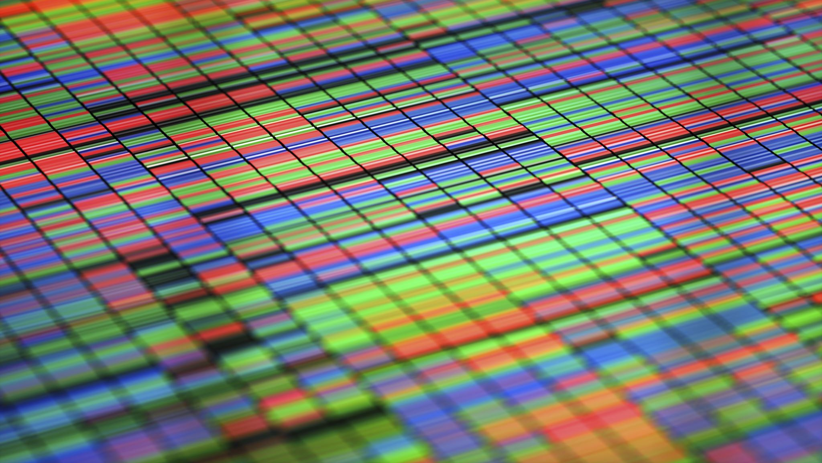
DLOR Project Report
Julius Chan

Slide 2
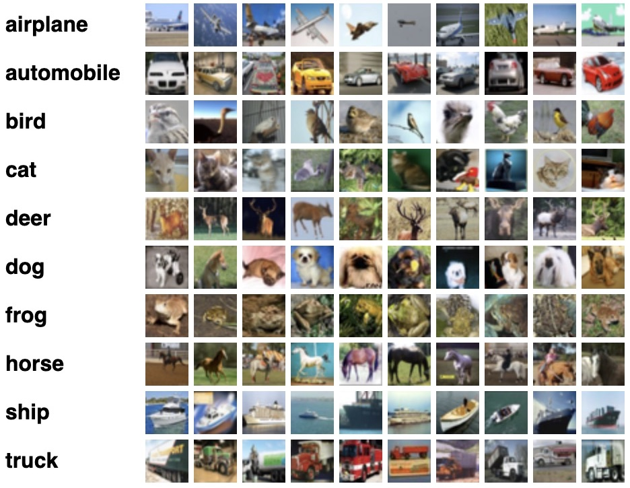
Introduction
The CIFAR-10 dataset (Canadian Institute For Advanced Research) is a set of photographs used to train machine learning and computer vision algorithms.
The CIFAR-10 dataset comprises 60,000 32 × 32-pixel color pictures organized into 10 classifications in three channels. There are 6,000 photos in each class. There are 50,000 photos in the training set and 10,000 images in the test set. This is a ten-class categorization issue (muti-label classification).
This specific neural network model was chosen for the project because it is one of the most used datasets for deep learning studies and for evaluating computer vision algorithms in the field of machine learning.
The goal is to identify previously unseen images and classify them into one of ten categories.
Image from https://www.cs.toronto.edu/~kriz/cifar.html

Slide 3
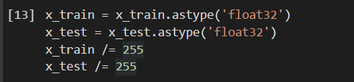

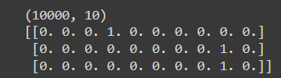
Data Pre-Processing
Normalization It is beneficial in the optimization process to keep our input data within a common range.
Normalization is applied to the data. For computation, the data type of x_train & x_test is converted to float.
There are ten different values for the output variable. It's possible that this is a multiclass categorization issue. These labels are then encoded into a single hot vector.
One hot encoding is applied to y_train & y_test to convert class vectors to binary class matrices.
Normalization
One-Hot Encoding Results

Slide 4
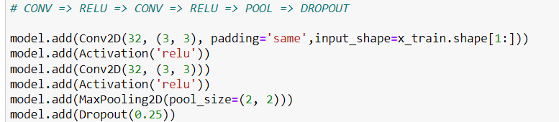
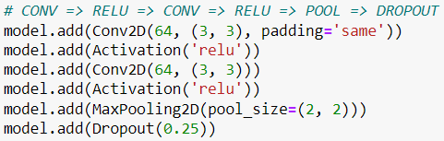
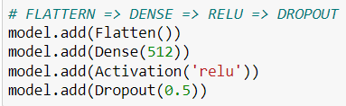
Model Architectures (ConvNets)
First Stage : The neural network will learn 32 convolutional filters, each having a 3 × 3 size. The output dimension is the same as the input shape, so it will be 32 × 32, with relu activation, which is a technique that introduce non-linearity. Then there are additional 32 convolutional filters, each with a 3 x 3 size and relu activation. Following that, there will be a max-pooling operation with a pool size of 2 × 2 and a 25% dropout.
Second Stage : In the second stage. The neural network will learn 64 convolutional filters, each with a size of 3 x 3. The output dimension is the same as the input shape, with relu activation. This is followed by additional 64 convolutional filters, each with a 3 x 3 size and relu activation. Following that, there will be a max-pooling operation with a pool size of 2 × 2 and a 25% dropout.
Third Stage : A dense network with 512 units and relu activation is used, which is followed by a dropout at 50% and a SoftMax layer with 10 classes as output, one for each category which then completes the activation function of the classifier.
First Stage
Second Stage
Third Stage

Slide 5


Model Training
Before Model Training, setting the hyperparameters is required. The batch size is set to 32, the number of classes is set to 10, and the number of epochs to run is set to 100.
The root mean square prop(RMSprop) as the optimizer and the loss function as category cross entropy are used to train the neural network.
The loss function is used to determine the quality of a model. As new data comes in, the optimizer updates the network, decreasing the loss value. The metrics are used to assess the network's accuracy.
Hyperparameters Setting
Starting RMSprop

Slide 6
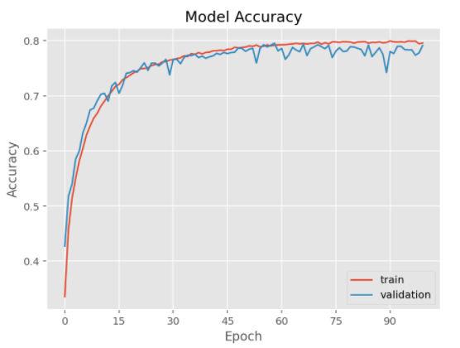
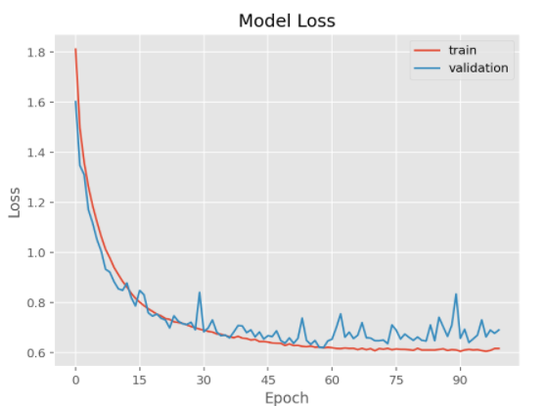
Results & Analysis
Data augmentation is used in the model to avoid overfitting. To avoid overfitting, the dataset is expanded. Cropping, Rotating, Scaling, Translating, Flipping, and Adding Noise are just a few of the picture augmentation techniques that were used to the training data.
The model's accuracy does not increase significantly after 60 epochs, as seen in the Model Log History visualization. There is no overfitting present on the model as well.
Model Accuracy
Model Accuracy Scores
Test Accuracy | Test Loss
0.7738999724388123 | 0.7150523066520691
Model Loss

Slide 7
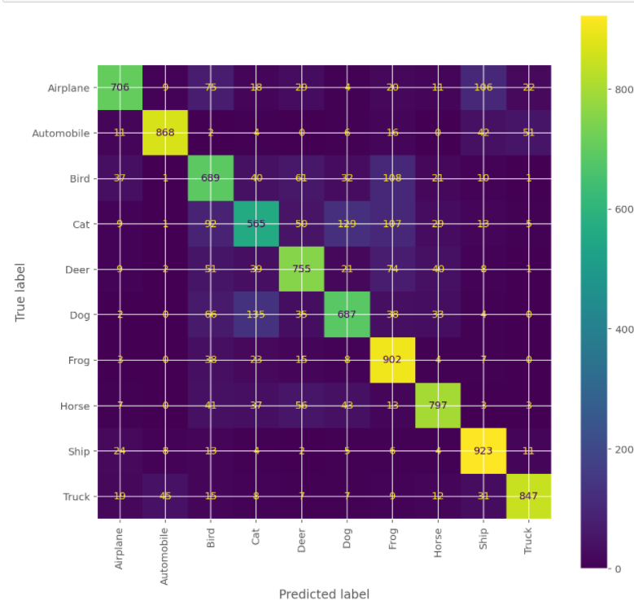
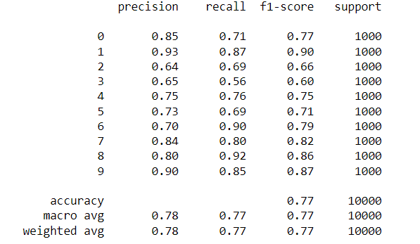
Classification Report
The confusion matrix shows that the classes are highly correlated with their corresponding Predicted labels, implying that the Image Classification Accuracy is high.
The classification report reveals that each class performed well in terms of precision, recall, and f1 score, indicating good accuracy.
Classification Report of each class
Confusion Matrix of Predicted & True Labels

Slide 8
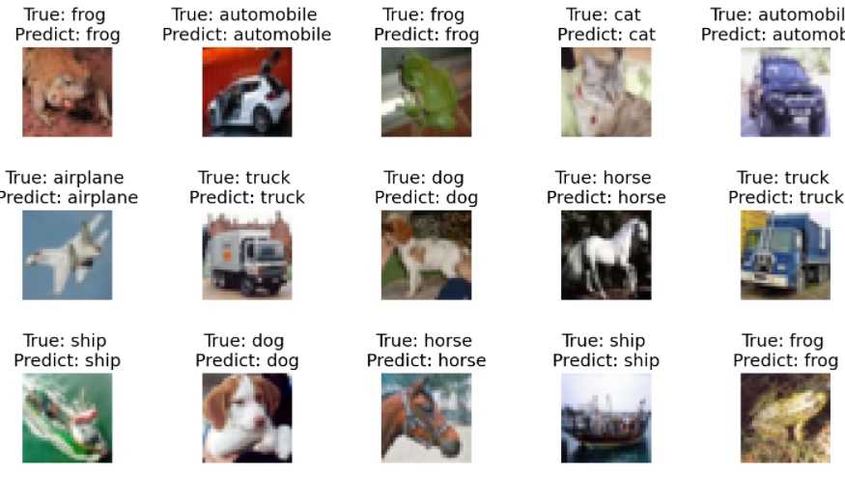
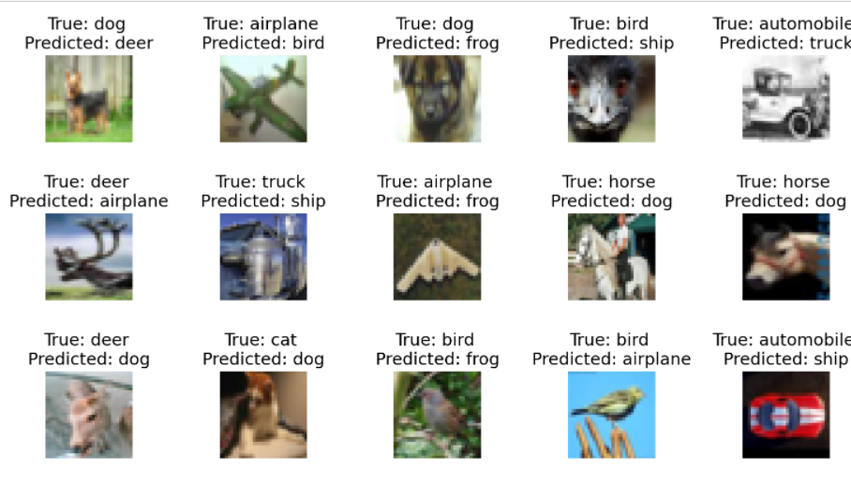
Image Classification
Correct Predictions of Images
Wrong Predictions of Images

Slide 9
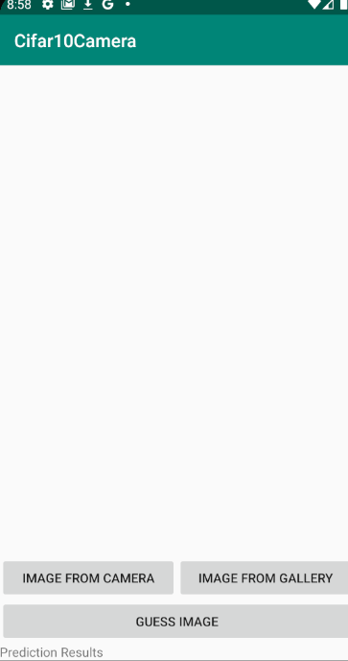
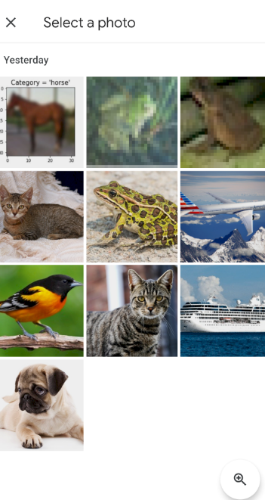
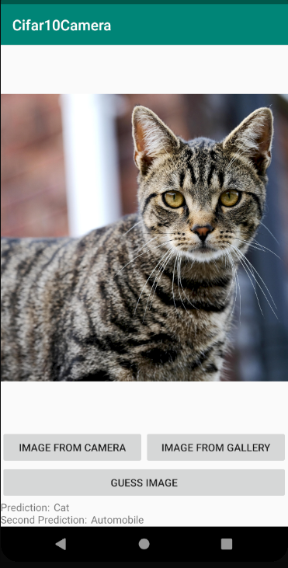
Android Deployment

Slide 10
Conclusion
During Model Training, I would reduce the number of epochs as it helps to reduce the training time. The model accuracy didn’t increase after 60 epochs and does not overfit at that point which might help to lower the test loss as well.
Certain classes are categorized incorrectly. Cats are mistakenly classified as dogs because they have similar body features, while birds are mistakenly classified as airplanes because they both have wings.
Due to its similarities, the confusion matrix revealed that several of the incorrect Predicted & True labels had a correlation. Identifying areas where the model fails can help to improve it by collecting more training data and changing the hyperparameters would reduce the model’s bias.
The suggestions would not be applicable as today. Android Deployment shows poor prediction due to the high-quality image. CIFAR-10 images are very small (32x32 pixels) and there are more datasets with high quality images available now, such as ImageNet and OpenImage, that make predictions more accurate but would requires more neurals in the neural network & takes a long time to train due to its size.

Slide 11
References
https://www.kaggle.com/pankrzysiu/cifar10-python
https://scikit-learn.org/stable/modules/neural_networks_supervised.html
https://machinelearningmastery.com/how-to-develop-a-cnn-from-scratch-for-cifar-10-photo-classification/
https://www.tensorflow.org/api_docs/python/tf/keras/preprocessing/image/ImageDataGenerator
https://keras.io/api/preprocessing/image/
https://github.com/Vikramank/CIFAR-Android-TF/blob/master/cifar_export.py

