Slide 1
複合Key資料處理

Slide 2
大綱
情境說明: 資料攤平轉換巢狀
程式說明: 物件 equals 使用
程式說明: collection groupby
資料攤平轉換巢狀-程式說明

Slide 3
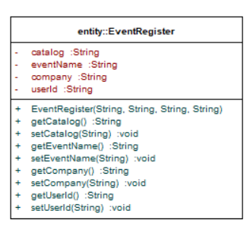
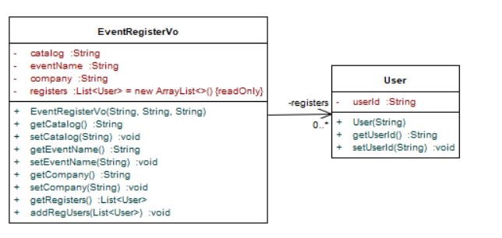
情境說明: 資料攤平轉換巢狀
catalog | eventName | company | userId
BigData | Hadoop | Chipbond | 1
BigData | Hadoop | Chipbond | 3
BigData | Hadoop | TSMC | 2
BigData | Hadoop | TSMC | 4
ML | Classification | Chipbond | 1
ML | Classification | Chipbond | 3
ML | Classification | TSMC | 2
ML | Classification | TSMC | 4
catalog | eventName | company | registers__userId
BigData | Hadoop | Chipbond | 1
 |  |  | 3
BigData | Hadoop | TSMC | 2
 |  |  | 4
ML | Classification | Chipbond | 1
 |  |  | 3
ML | Classification | TSMC | 2
 |  |  | 4

Slide 4
程式說明: 物件 equals 使用 – Set, Map

Slide 5
程式說明: collection groupby

Slide 6
資料攤平轉換巢狀-程式說明

Slide 7
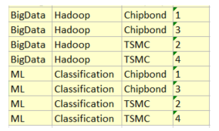
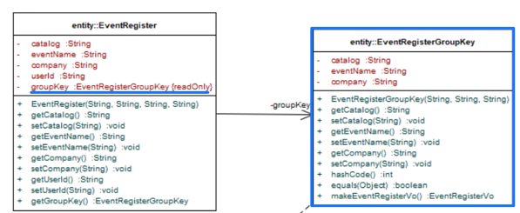
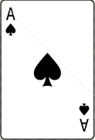

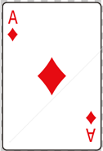
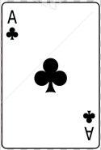





Group By 示意圖
:EventRegister
:EventRegister
:EventRegister
:EventRegister
Big Data/
Hadoop/
Chipbond
Big Data/
Hadoop/
TSMC
ML/
Classification/
Chipbond
ML/
Classification/
TSMC
:EventRegisterGroupKey
:EventRegisterGroupKey
:EventRegisterGroupKey
:EventRegisterGroupKey

Slide 8
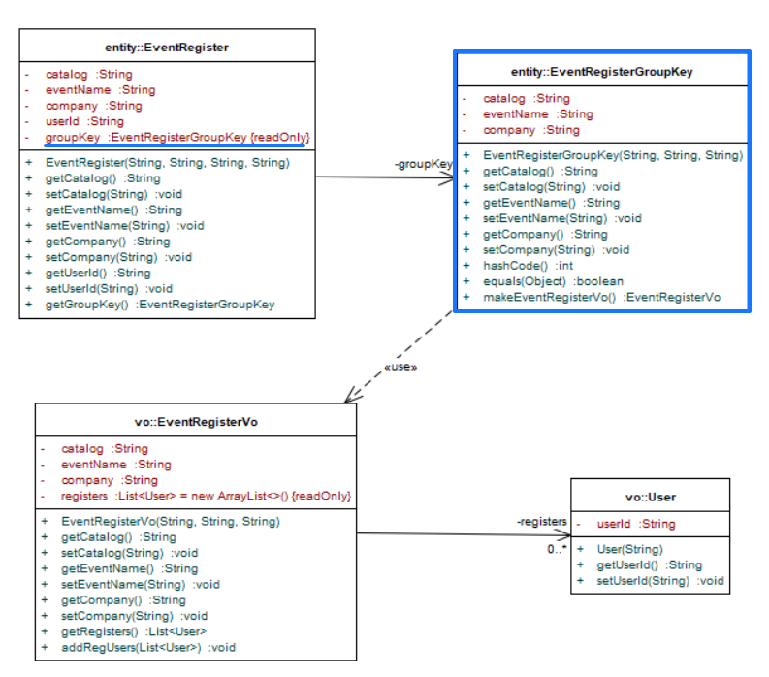
資料攤平轉換巢狀- Class Diagram

Slide 9
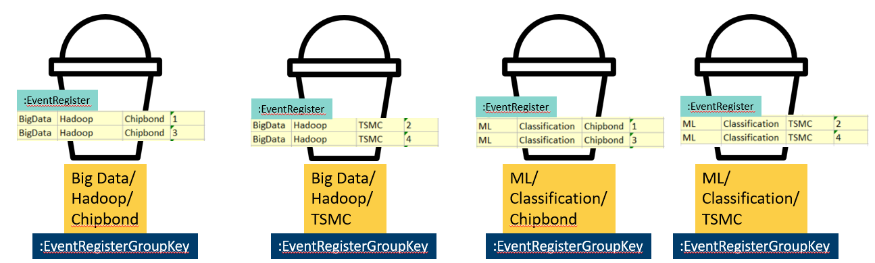
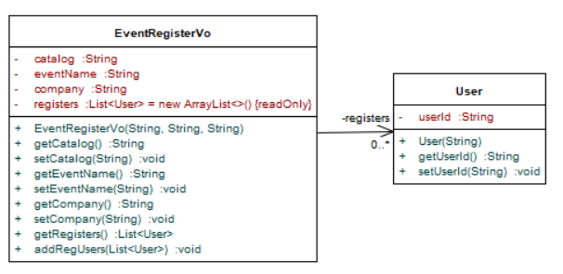
產生符合前端資料結構
catalog | eventName | company | registers__userId
BigData | Hadoop | Chipbond | 1
 |  |  | 3
BigData | Hadoop | TSMC | 2
 |  |  | 4
ML | Classification | Chipbond | 1
 |  |  | 3
ML | Classification | TSMC | 2
 |  |  | 4

Slide 10
End

