Slide 1
Smarter Food Forecasting at Walmart CA_3
Using Machine Learning to Improve Daily Demand Accuracy
and Reduce Inventory Risk in the FOODS Category
Executive Presentation | For Business Stakeholders
Store Scope
Category
Departments
FOODS_1 | FOODS_2 |
FOODS_3
CA_3
FOODS
Forecast Horizon
Period
28 Days Daily
Apr 25 – May 22, 2016
Julius Lauren Marasigan | Post-Graduate Diploma in Artificial Intelligence and Machine Learning | April 2026

Slide 2
1. The Business Problem — Why Getting Food Forecasts Right Matters
The Cost of Getting Wrong
Over-forecast: Perishable food spoils. Every unsold unit is a write-off — there is no markdown recovery for expired food.
Under-forecast: Empty shelves cannot be restocked within the same sales window. The customer's need is immediate and the sale is gone permanently.
Service Equity — SNAP Customers
SNAP benefit customers shop on fixed calendar dates each month. If CA_3 shelves are under-stocked on those days, the store fails the most price-sensitive and time-constrained shoppers — precisely when they are most likely to visit. This is not just a business problem — it is a service equity issue.
2 - Direction
Cost of Error
Both over AND under-forecasting cost money – waste from spoilage OR lost of sales from empty shelves.
Why Food Demand Is Hard to Predict
Four demand signals fire simultaneously — and a single rule cannot capture all of them at once:
SNAP benefit days— predictable monthly spikes tied to benefit issuance dates
Day-of-week patterns— weekends consistently differ from mid-week
Seasonal events— holidays and sporting events shift demand by department
Price sensitivity— demand reacts to markdowns with a delayed effect
5+ Years
of daily history used
1,829 days per department — the model learned from every weekday, SNAP day, event day, and seasonal cycle in the data
From History to Forecast | Julius Lauren Marasigan | April 2026
2-Direction Cost of Error
Both over AND under-forecasting cost money — waste from spoilage OR lost sales from empty shelves

Slide 3
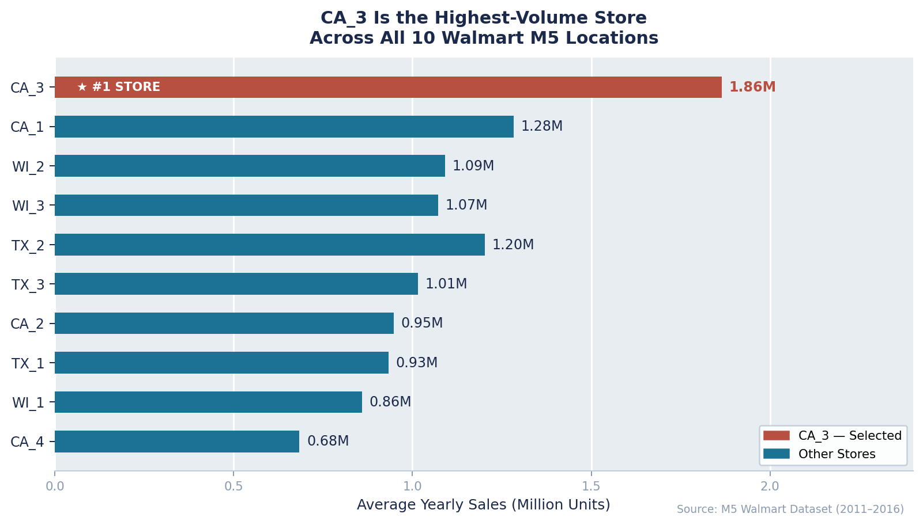
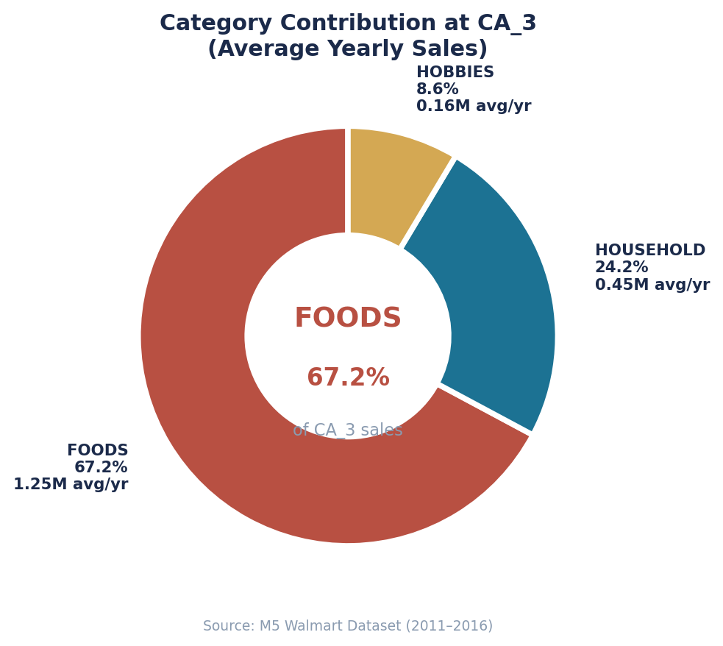
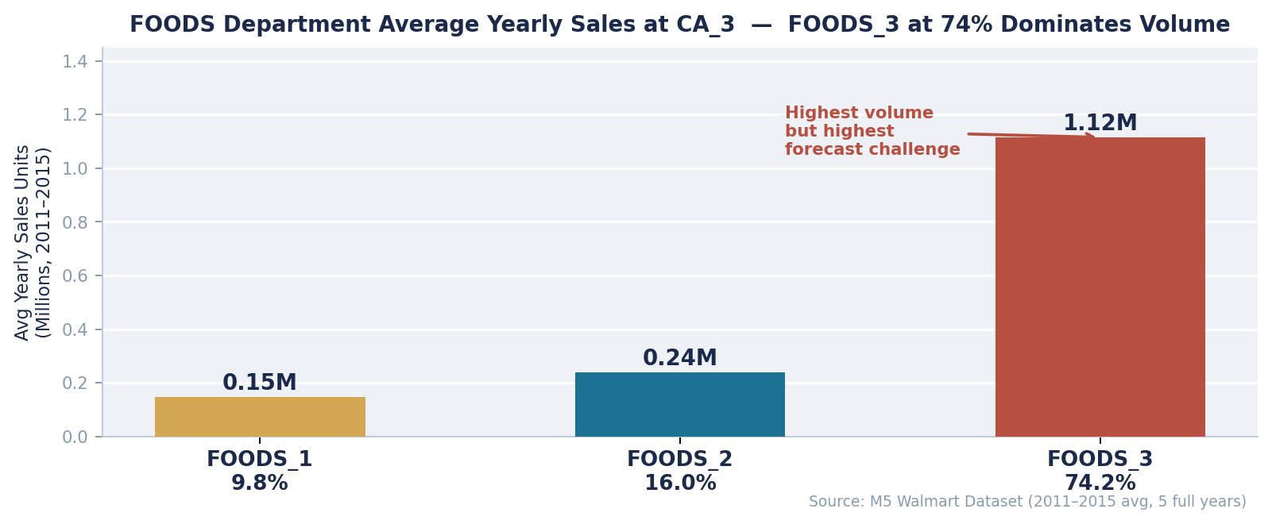
2. Why CA_3? Why FOODS? — The Data Makes the Case
FOODS_3 dominates department volume (74%) — making it the highest-priority forecasting challenge at CA_3.
From History to Forecast | Julius Lauren Marasigan | April 2026

Slide 4
3. Our Approach — Training the Model and Testing It Rigorously
1 - Scope to Highest Impact
CA_3 is the #1 revenue store.
FOODS is the #1 category.
Three departments modeled separately — FOODS_1, FOODS_2, and FOODS_3 — because each has a different demand structure and scale.
2 - Train on 5 Years of Daily History
1,829 days of department-level sales per department. 15 forecasting approaches tested — from simple rules (Naive, Seasonal Naive) to advanced machine learning (XGBoost, LightGBM). Winner selected through rigorous out-of-sample testing on the most recent 20% of data.
3 – Validate for Accuracy and Fairness
Results checked across SNAP days, event days, each day of the week, and high vs low demand periods. Bias formally audited before any recommendation was made. Model explainability confirmed — planners can see exactly why every forecast was produced.
Output: A 28-day daily demand signal per department — used as reference for supply plan cross-checking against current on-hand inventory and in-transit stock.
From History to Forecast | Julius Lauren Marasigan | April 2026

Slide 5
4. Key Findings — What the Data Revealed
Day of Week Is the Biggest Driver
For FOODS_1 and FOODS_3, which day of the week it is matters more than any other signal — more than price, events, or even recent sales. Weekend demand is structurally higher and must be planned for.
SNAP Days Are Accurately Captured ✓
The model handles SNAP benefit days correctly for all three departments. FOODS_2 is actually more accurate on SNAP days (8.4% error) than on regular days (9.0%).
FOODS_3 Event Days Are a Critical Gap ⚠
On event days, FOODS_3 average error reached 673%. The model cannot be trusted for FOODS_3 on event weeks — demand planner must review and override before any supply plan is prepared.
FOODS_1 Saturdays Consistently Short
The model under-estimates every Saturday for FOODS_1 by 8.1%. Weekend demand plans for FOODS_1 need a fixed Saturday uplift.
FOODS_3 Is Accurate on Peak Days
Despite high overall error, FOODS_3 achieves only 6.8% error on its typical high-volume days. Forecast failures are concentrated on specific event days and Fridays — not general planning days.
Monthly Cycle Anchors FOODS_3
Last month's equivalent day is the strongest predictor for FOODS_3. Monthly purchasing and benefit cycles create a repeatable pattern that the model captures effectively for normal trading days.
From History to Forecast | Julius Lauren Marasigan | April 2026
2-Direction Cost of Error
Both over AND under-forecasting cost money — waste from spoilage OR lost sales from empty shelves

Slide 6
5. Results — Machine Learning vs Simple Rule-Based Methods
Comparison against the two simplest baselines any business currently uses:
Department | Naive (repeat last day) | Seasonal Naive (repeat last week) | ML Model (XGBoost tuned) | Improvement vs Naive & Seasonal Naive
FOODS_1 | 106.3 RMSE 16.5MAPE | 130.3 RMSE 23.1 MAPE | 76.7 RMSE ▼ 12.4 MAPE ▼ | Significant improvement
FOODS_2 | 221.8 RMSE 25.4 MAPE | 125.5 RMSE 14.2 MAPE | 74.5 RMSE ▼ 8.8 MAPE ▼ | Significant improvement
FOODS_3 | 659.8 RMSE 183.2 MAPE | 482.1 RMSE 179.8 MAPE | 282.3 RMSE ▼ 57.8 MAPE ▼ | Significant improvement
MAPE = Mean Absolute Percentage Error. Lower is better. RMSE = Root Mean Squared Error (daily units).
FOODS_2 — Deployment Ready
8.8% average daily error. Accurate on regular, event, and SNAP days alike.
FOODS_1 — Solid and Minor Fixes
12.4% MAPE. Apply +9 units/day bias correction and Saturday uplift before supply planning.
FOODS_3 — Improves Significantly
From unworkable baseline error down to 57.8%. Event days and Fridays still need planner override.
From History to Forecast | Julius Lauren Marasigan | April 2026
2-Direction Cost of Error
Both over AND under-forecasting cost money — waste from spoilage OR lost sales from empty shelves

Slide 7
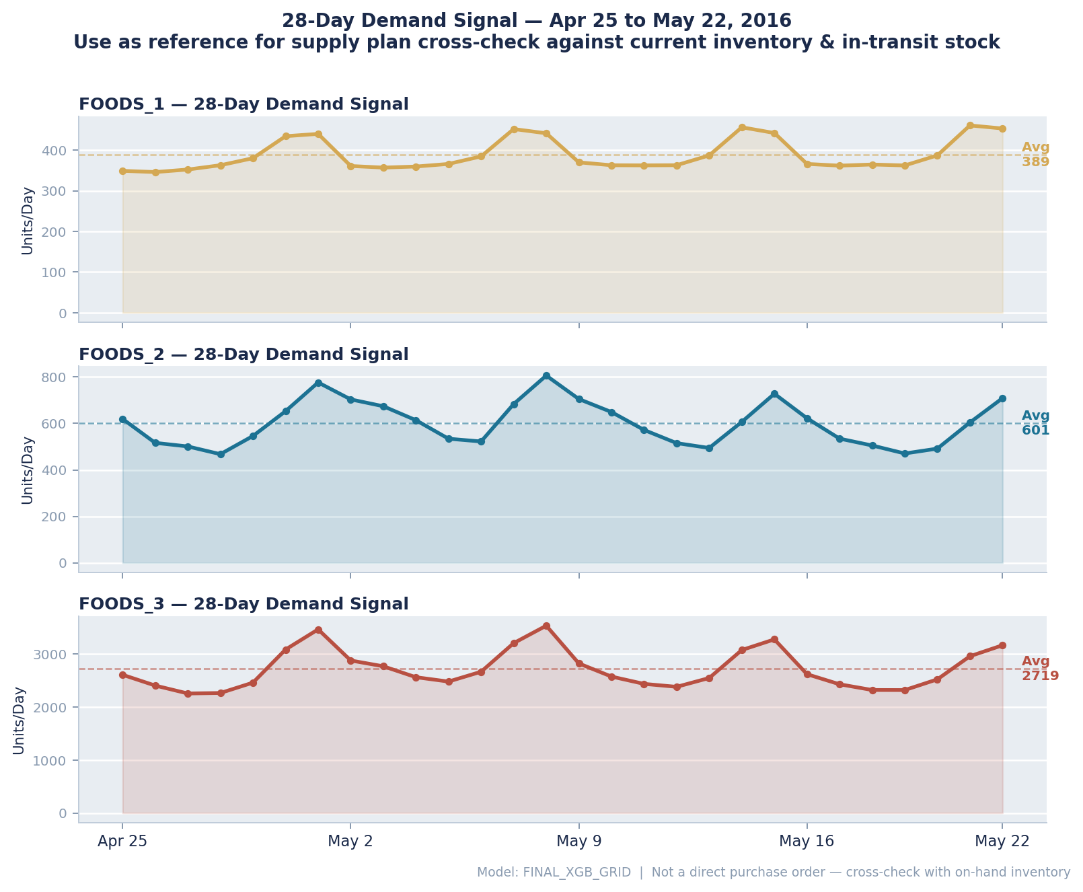
6. The 28-Day Demand Signal — Apr 25 to May 22, 2016
Important: This demand signal is a reference input for supply planning — not a direct purchase quantity. The supply team must cross-check against current on-hand inventory at CA_3 and incoming in-transit stock before finalizing any order. Net demand = Forecast signal − On-hand − In-transit.
From History to Forecast | Julius Lauren Marasigan | April 2026
2-Direction Cost of Error
Both over AND under-forecasting cost money — waste from spoilage OR lost sales from empty shelves

Slide 8
7. Recommendations — Five Actions Before Handover to Supply Planning
1
Apply Bias Corrections — FOODS_1 and FOODS_2
Both departments consistently under-estimate demand. Add +9 units/day to FOODS_1 and +14 units/day to FOODS_2 demand signals before using them as supply plan input. These are systematic gaps, not noise.
Apply Saturday Uplift — FOODS_1
The model under-estimates every Saturday for FOODS_1 by 8.1%. Apply a fixed weekend uplift factor to the Saturday demand signal before cross-checking with inventory.
Override FOODS_3 Event Day Forecasts Before Supply Planning
Event day demand signal for FOODS_3 is unreliable (673% average error). On any week containing a confirmed event, the FOODS_3 signal must be manually reviewed and adjusted by the demand planner before use in supply planning.
Flag FOODS_3 Friday Demand Signals
Friday demand signal for FOODS_3 shows 363% average error. Flag for mandatory planner sign-off before any Friday-driven supply plan is released.
Design SKU-Level Demand Split for Ordering
The signal covers department totals. Before translating to a purchase order, split using each item's daily contribution % (3–6 months rolling). Phase-in items inherit the outgoing item's contribution. New items use analogue from a similar active product.
QUICK WIN
2
QUICK WIN
3
HIGH PRIORITY
4
CRITICAL
5
NEXT STEPS
From History to Forecast | Julius Lauren Marasigan | April 2026
2-Direction Cost of Error
Both over AND under-forecasting cost money — waste from spoilage OR lost sales from empty shelves

Slide 9
8. Risks and Considerations
This is a demand signal — not an automatic purchase order
The forecast output feeds into supply planning as a reference. Demand planners must cross-check against current on-hand stock and in-transit inventory before releasing any purchase order. The net quantity after netting is what gets ordered.
Process Risk
FOODS_3 requires the closest scrutiny
FOODS_3's higher error rate reflects genuine demand volatility driven by a small number of extreme days. Treat its demand signal as directional — always subject to planner sign-off on event days and Fridays.
Operational Risk
Forecast errors compound over 28 days
Day 1 of the 28-day signal is the most reliable. For production use, the model should be refit weekly with the latest actual sales data to maintain accuracy over the full planning horizon.
Model Risk
Poor item-level split causes shelf gaps
A department signal that looks accurate can still produce stockouts if the SKU contribution percentages are wrong. Item fill rate must be monitored independently — aggregate department accuracy will not catch this.
Supply Chain Risk
SNAP equity — monitor after SKU split
The model signals SNAP benefit days accurately at department level. Equity risk shifts to the item split step — if SNAP-basket staples are under-allocated, benefit customers will face stockouts on their primary shopping days.
Equity Risk
From History to Forecast | Julius Lauren Marasigan | April 2026

Slide 10
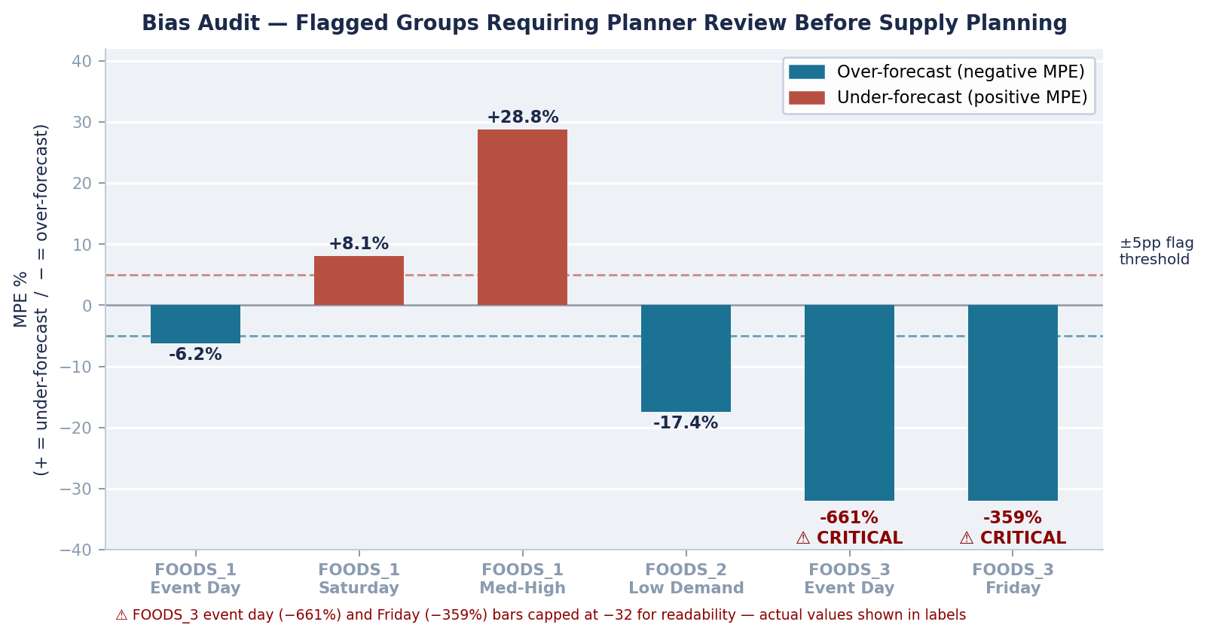
9. Bias Audit Results & Next Steps — ROI
Week 1-2
Saturday uplift for FOODS_1
Flag FOODS_3 event/Friday for override
Month 1-2
Apply Bias corrections
Design SKU daily contribution
Item fill rate monitoring dashboard
Document phase-in / phase-out rules
Month 2-4
Weekly model refitting cadence
Event override rule library
Extend to other Walmart stores
Deployment Roadmap
ROI
Reduce Waste
Fewer over-orders on perishable items – direct write-off cost reduction.
Planner Efficiency
Statistical signal replaces manual tracking — planners focus on exceptions.
Fewer Stockouts
Accurate Saturday and SNAP signals prevent shelf gaps on peak days.
SNAP Service
Accurate SNAP day signals confirmed — equity maintained at dept level.
From History to Forecast | Julius Lauren Marasigan | April 2026

Slide 11
The Bottom Line
✓
Machine learning significantly outperforms every traditional method across all three departments at CA_3.
✓
FOODS_2 at 8.8% error is the most reliable — its demand signal can feed directly into supply planning with light planner review.
✓
FOODS_1 and FOODS_3 issues are known, flagged, and correctable with specific planner interventions before supply planning.
!
The output is a demand signal — supply planners must cross-check against on-hand stock and in-transit inventory before any order is placed.
→
SKU-level demand split is the immediate next step to make the signal actionable at the individual item ordering level.
github.com/juliuslauren13/walmarts-foods-forecasting | M5 Capstone | April 2026

