Slide 1
From History to Forecast
A Machine Learning Approach to Daily Food Demand Forecasting
at Walmart CA_3 Using the M5 Dataset
Technical Presentation | For Peers and Other Data Professionals
Store Scope
Category
Departments
FOODS_1 | FOODS_2 |
FOODS_3
CA_3
FOODS
Forecast Horizon
Period
28 Days Daily
Apr 25 – May 22, 2016
Julius Lauren Marasigan | Post-Graduate Diploma in Artificial Intelligence and Machine Learning | April 2026

Slide 2
1. Problem & Data Overview
Problem Statement
ML Task: Time Series Regression Target: Daily sales_qty per department Scope: CA_3 · FOODS_1, FOODS_2, FOODS_3 Horizon: 28 days ahead
Challenge: Food demand is driven by multiple overlapping signals — SNAP benefit dates, weekly shopping cycles, seasonal events, and price — that a single rule cannot capture simultaneously. Over-forecasting causes waste. Under-forecasting causes unrecoverable stockouts.
Success criteria: ● Beat Naive and Seasonal Naive on RMSE and MAPE ● SNAP day accuracy ≥ non-SNAP day accuracy ● No group exceeds 5pp MPE gap in bias audit
M5 Dataset Facts
Source | Walmart / Kaggle M5 Competition
Raw Files | calendar.csv ・sales_train_validation.csv・sell_prices.csv
Full Dataset | 30,490 items ・10 stores ・3 states
After Filtering | CA_3 + FOODS → 3 Departments
Date Range | 2011-01-29 to 2016-04-24 (5+ years)
After Aggregation | 5,739 rows x 14 columns (dept. level)
After Feature Engineering | 5,487 rows x 53 columns (1,829/dept)
Train / Test Split | 80% training / 20% holdout (time-based)
Forecast Period | 2016-04-25 to 2016-05-22 (28 days)
From History to Forecast | Julius Lauren Marasigan | April 2026
2-Direction Cost of Error
Both over AND under-forecasting cost money — waste from spoilage OR lost sales from empty shelves

Slide 3
1. EDA Key Findings
CA_3 #1
Top store by average yearly
sales — ₱1.86M/year
FOODS #1
Top category at CA_3
— 67% of total sales
FOODS_3
Dominates with 5.58M total units (74%)
0 nulls
No missing values after sell_price forward-fill
Weekly Seasonal Confirmed
STL decomposition shows clear period-7 cycles across all three departments. Saturday and Sunday consistently show the highest demand. day_of_week is the top SHAP feature for FOODS_1 and FOODS_3.
SNAP Demand Lift Detected
snap_CA is the #1 raw feature importance for FOODS_2 (0.144). FOODS_2 is more accurate on SNAP days (MAPE 8.41%) than non-SNAP days (8.95%).
FOODS_3 Scale Difference
FOODS_3 daily avg = 2,915 units vs FOODS_1 at 385. Monthly cycle (lag_28) dominates with importance 0.41. Each dept requires a separate model.
Stationary (ADF) & Seasonal Strength (STL)
Department | Avg Daily | ADF p-val | Stationary | Seasonal Str
FOODS_1 | 385 | 0.014 | Yes | 0.42
FOODS-2 | 629 | 0.001 | Yes | 0.58
FOODS_3 | 2,915 | 0.107 | Borderline | 0.64
From History to Forecast | Julius Lauren Marasigan | April 2026
2-Direction Cost of Error
Both over AND under-forecasting cost money — waste from spoilage OR lost sales from empty shelves

Slide 4
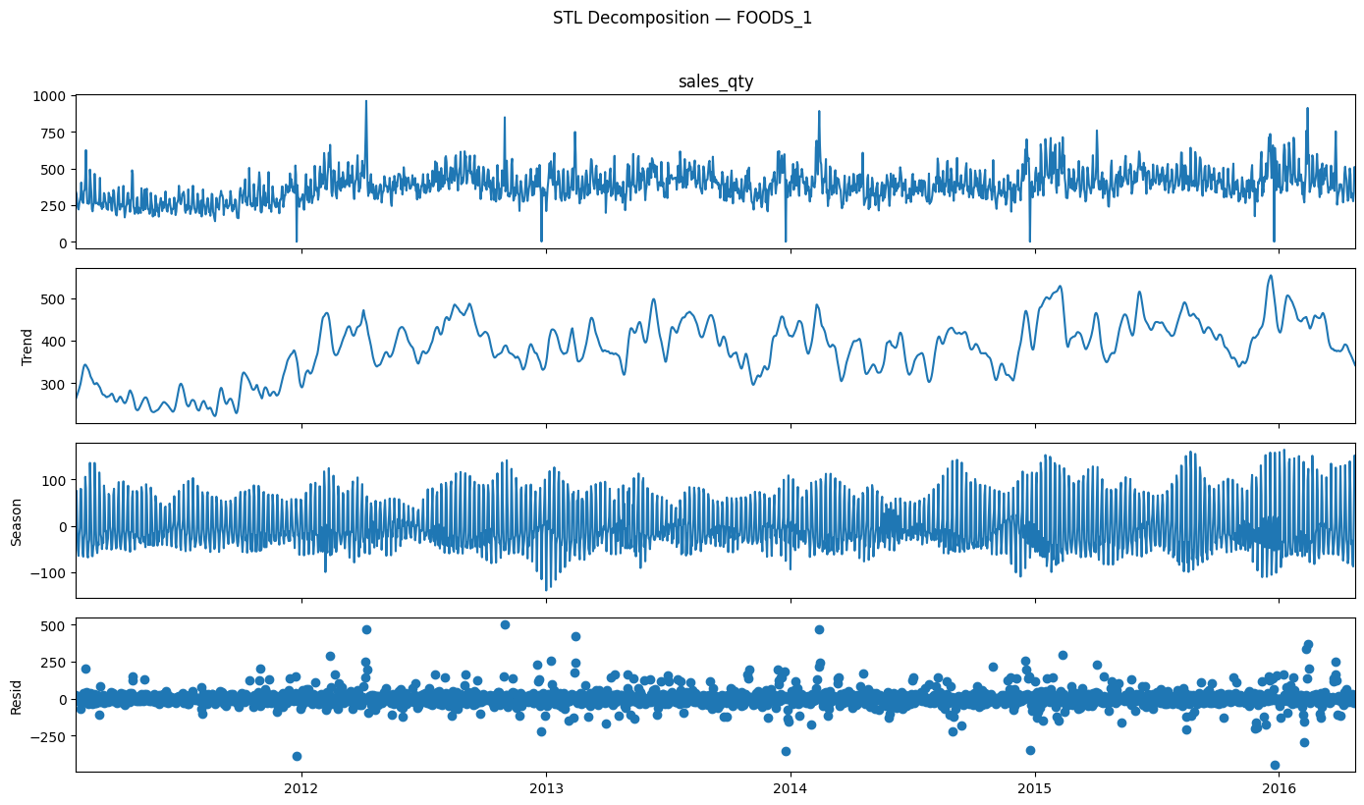
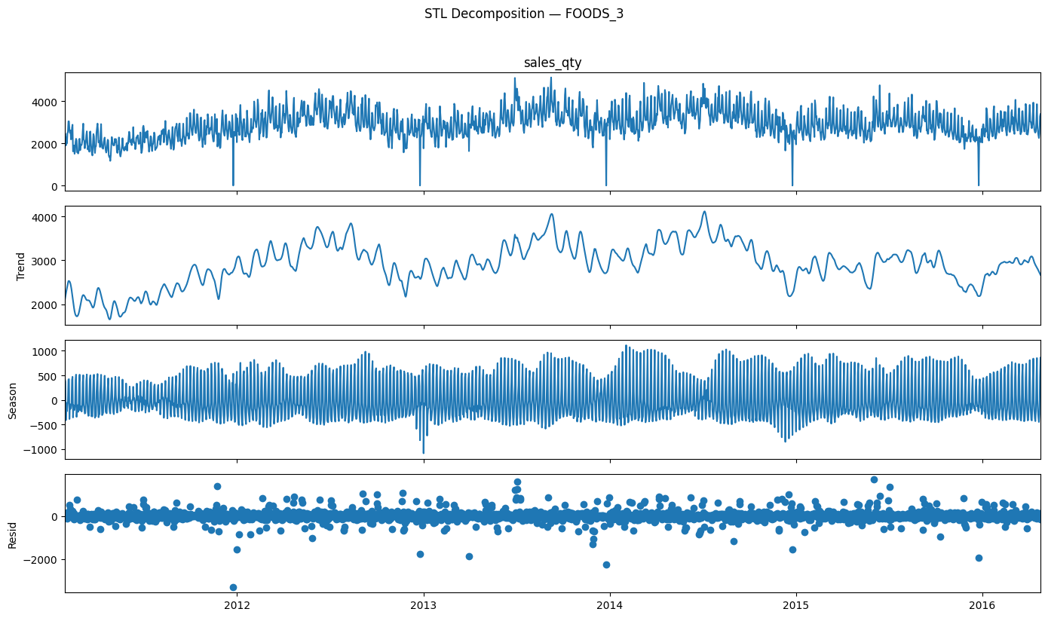
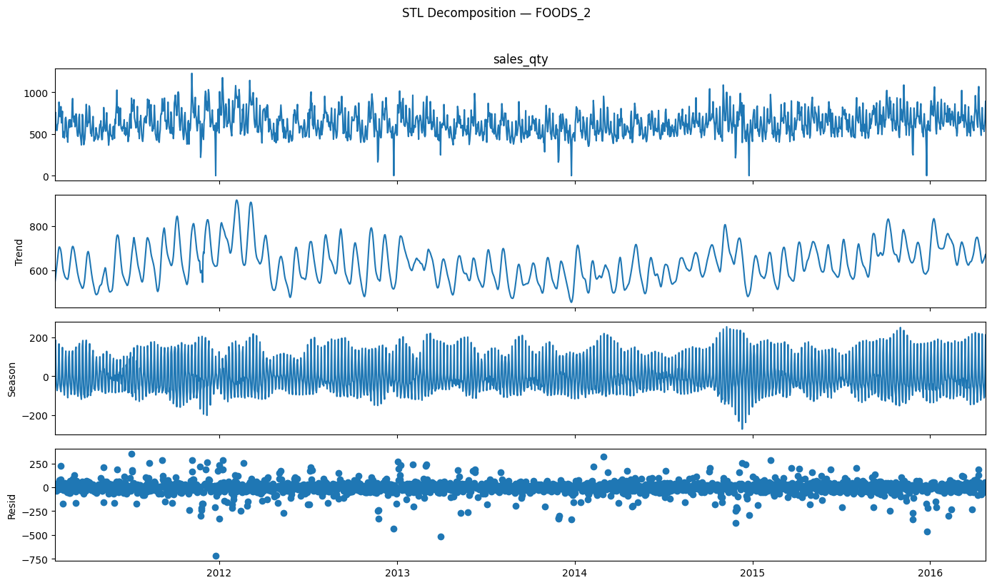
STL Decomposition & Stationary
ADF Stationary Test
FOODS_1 p = 0.014
FOODS_2 p = 0.001
FOODS_3 p = 0.107
FOODS_1 and FOODS_2 are stationary (p<0.05). FOODS_3 is borderline — justifying d=1 differencing in ARIMA/SARIMA. Clear weekly seasonality confirmed across all three departments.
From History to Forecast | Julius Lauren Marasigan | April 2026
2-Direction Cost of Error
Both over AND under-forecasting cost money — waste from spoilage OR lost sales from empty shelves

Slide 5
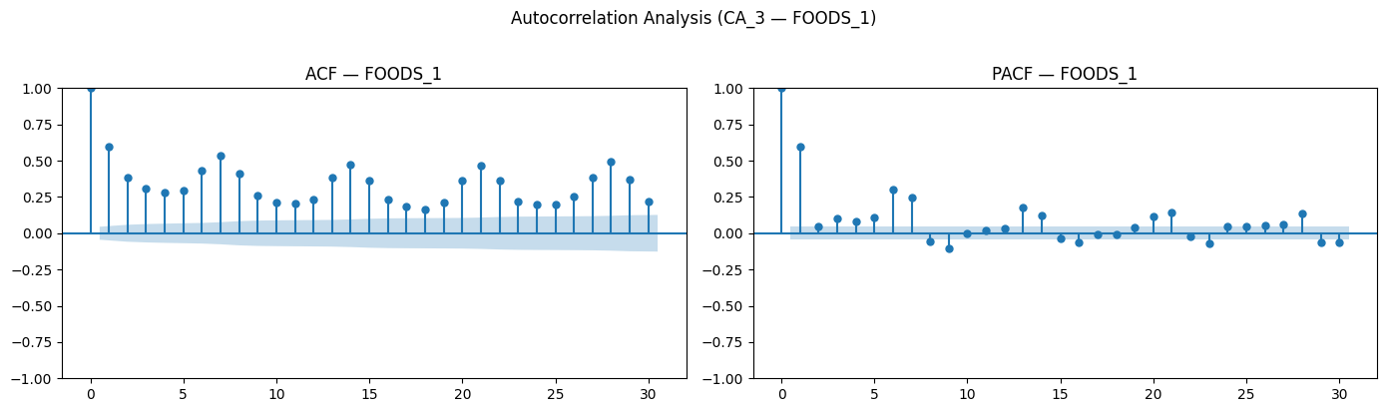
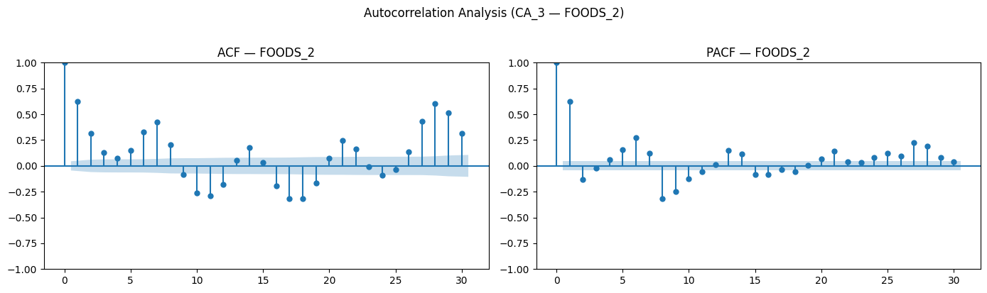
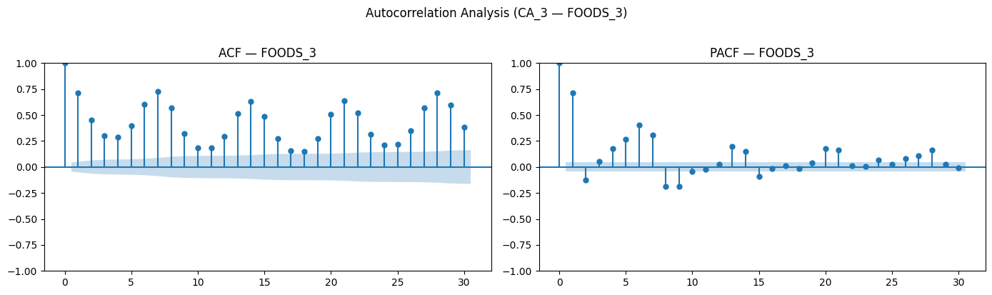
ACF & PACF Autocorrelation Analysis
ACF / PACF — Lags 1 and 7 dominate, confirming daily and weekly demand cycles
FOODS_1
FOODS_2
FOODS_3
Strong autocorrelation at lag 1 (yesterday) and lag 7 (same weekday last week) confirmed across all departments — directly justifying the lag feature engineering approach in Notebook 03.
From History to Forecast | Julius Lauren Marasigan | April 2026
2-Direction Cost of Error
Both over AND under-forecasting cost money — waste from spoilage OR lost sales from empty shelves

Slide 6
3. Feature Engineering - 39 Features across 8 Groups
Lag (10)
lag_1/2/3/7/14/21
lag_28/42/56/84
Rolling Mean (5)
7/14/42/56-days
Smoothed demand level
Rolling Std (5)
7/14/28/42/56-day
Demand volatility
EWMA (3)
Exponential Weighted Moving Average
span 7/14/28-days
⍺ = 0.25/0.133/0.067
Rolling Max/Min (4)
7-day & 28-day
Peak and Floor signal
Calendar (6)
day_of_week・week_of_year・is_weekend・day_of_month
Price (4)
price_change 7/28-day
sell_price_lag 7/28-day
Trend + Interaction
trend_index
snap_event_inter
Leakage prevention: .shift(1) before all rolling computations | PCA not applied: lag/rolling features already capture principal variance; PCA removes interpretability needed for demand planning | weekday (text) dropped — numeric day_of_week used
From History to Forecast | Julius Lauren Marasigan | April 2026
2-Direction Cost of Error
Both over AND under-forecasting cost money — waste from spoilage OR lost sales from empty shelves

Slide 7
4. Model Selection - Stage 1 Results (15 Candidates per Department)
 | dept_id | model_family | model_name | mae | rmse | mape
0 | FOODS_1 | ML | XGB_200_0.05_5 ★ | 52.81 | 73.94 | 12.26
1 | FOODS_1 | ML | XGB_100_0.1_3 | 52.83 | 74.26 | 12.09
2 | FOODS_1 | ML | LGB_300_0.03_8_63 | 54.44 | 76.87 | 12.38
3 | FOODS_1 | ML | LGB_200_0.05_6_31 | 54.72 | 77.50 | 12.36
4 | FOODS_1 | ML | RF_100_5 | 56.26 | 79.20 | 12.84
5 | FOODS_1 | ML | RF_200_10 | 56.47 | 79.97 | 12.95
6 | FOODS_1 | Traditional | SARIMA(1, 1, 2)(1,1,1,7) | 62.05 | 85.70 | 14.27
7 | FOODS_1 | Traditional | SARIMA(2, 1, 1)(1,1,1,7) | 63.87 | 88.14 | 14.25
8 | FOODS_1 | Traditional | SARIMA(1, 1, 1)(1,1,1,7) | 68.55 | 93.70 | 14.84
9 | FOODS_1 | Traditional | ARIMA(1, 1, 1) | 75.79 | 104.67 | 16.41
10 | FOODS_1 | Baseline | Naive | 76.89 | 106.25 | 16.51
11 | FOODS_1 | Traditional | ARIMA(1, 1, 2) | 77.29 | 106.79 | 16.56
12 | FOODS_1 | Traditional | ARIMA(2, 1, 1) | 78.14 | 107.93 | 16.66
13 | FOODS_1 | Traditional | ES_add_add | 86.06 | 111.89 | 18.16
14 | FOODS_1 | Baseline | Seasonal_Naive | 104.81 | 130.33 | 23.10
 | dept_id | model_family | model_name | mae | rmse | mape
0 | FOODS_2 | ML | XGB_200_0.05_5 ★ | 56.98 | 73.26 | 8.82
1 | FOODS_2 | ML | LGB_200_0.05_6_31 | 58.45 | 74.13 | 8.85
2 | FOODS_2 | ML | LGB_300_0.03_8_63 | 59.62 | 75.29 | 8.96
3 | FOODS_2 | ML | XGB_100_0.1_3 | 60.25 | 77.16 | 9.34
4 | FOODS_2 | ML | RF_200_10 | 59.68 | 77.31 | 8.95
5 | FOODS_2 | ML | RF_100_5 | 63.21 | 81.37 | 9.44
6 | FOODS_2 | Traditional | SARIMA(2, 1, 1)(1,1,1,7) | 92.03 | 119.08 | 13.25
7 | FOODS_2 | Traditional | SARIMA(1, 1, 2)(1,1,1,7) | 93.27 | 120.51 | 13.39
8 | FOODS_2 | Traditional | SARIMA(1, 1, 1)(1,1,1,7) | 96.28 | 124.33 | 13.69
9 | FOODS_2 | Baseline | Seasonal_Naive | 98.02 | 125.54 | 14.20
10 | FOODS_2 | Traditional | ES_add_add | 98.84 | 127.08 | 14.00
11 | FOODS_2 | Traditional | ARIMA(2, 1, 1) | 110.73 | 144.88 | 16.03
12 | FOODS_2 | Traditional | ARIMA(1, 1, 2) | 110.88 | 145.08 | 16.04
13 | FOODS_2 | Traditional | ARIMA(1, 1, 1) | 111.28 | 145.64 | 16.06
14 | FOODS_2 | Baseline | Naive | 185.27 | 221.76 | 25.37
 | dept_id | model_family | model_name | mae | rmse | mape
0 | FOODS_3 | ML | XGB_200_0.05_5 ★ | 200.80 | 275.66 | 77.04
1 | FOODS_3 | ML | XGB_100_0.1_3 | 198.78 | 276.31 | 34.79
2 | FOODS_3 | ML | LGB_200_0.05_6_31 | 205.17 | 281.10 | 86.46
3 | FOODS_3 | ML | LGB_300_0.03_8_63 | 208.91 | 284.16 | 75.35
4 | FOODS_3 | ML | RF_200_10 | 204.50 | 287.30 | 84.26
5 | FOODS_3 | ML | RF_100_5 | 218.82 | 305.78 | 83.74
6 | FOODS_3 | Traditional | ES_add_add | 308.22 | 421.57 | 196.18
7 | FOODS_3 | Traditional | SARIMA(2, 1, 1)(1,1,1,7) | 378.31 | 476.17 | 173.09
8 | FOODS_3 | Traditional | SARIMA(1, 1, 1)(1,1,1,7) | 380.64 | 478.45 | 173.21
9 | FOODS_3 | Baseline | Seasonal_Naive | 368.80 | 482.06 | 179.79
10 | FOODS_3 | Traditional | SARIMA(1, 1, 2)(1,1,1,7) | 363.30 | 483.28 | 212.96
11 | FOODS_3 | Traditional | ARIMA(1, 1, 1) | 412.20 | 536.63 | 203.89
12 | FOODS_3 | Traditional | ARIMA(1, 1, 2) | 412.28 | 537.48 | 203.36
13 | FOODS_3 | Traditional | ARIMA(2, 1, 1) | 412.83 | 540.40 | 201.89
14 | FOODS_3 | Baseline | Naive | 499.20 | 659.81 | 183.18
★ Winner across all three departments — ranked by RMSE on 20% holdout test set
From History to Forecast | Julius Lauren Marasigan | April 2026
2-Direction Cost of Error
Both over AND under-forecasting cost money — waste from spoilage OR lost sales from empty shelves

Slide 8
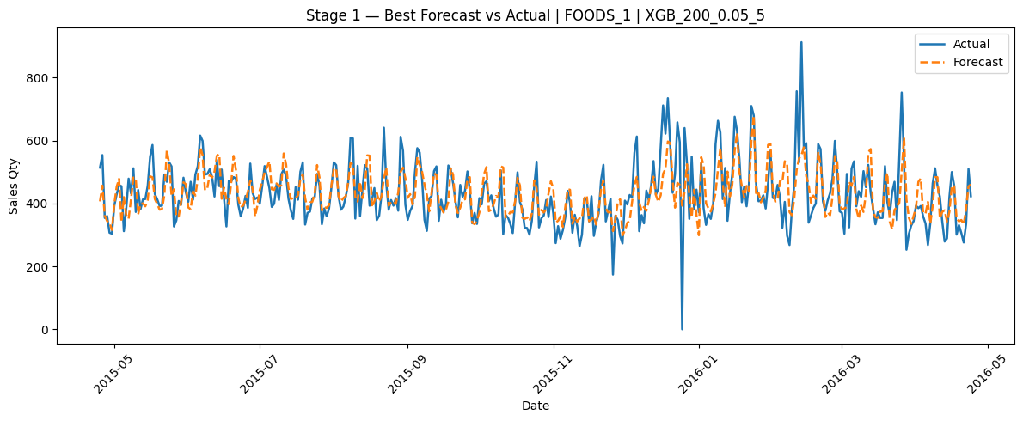
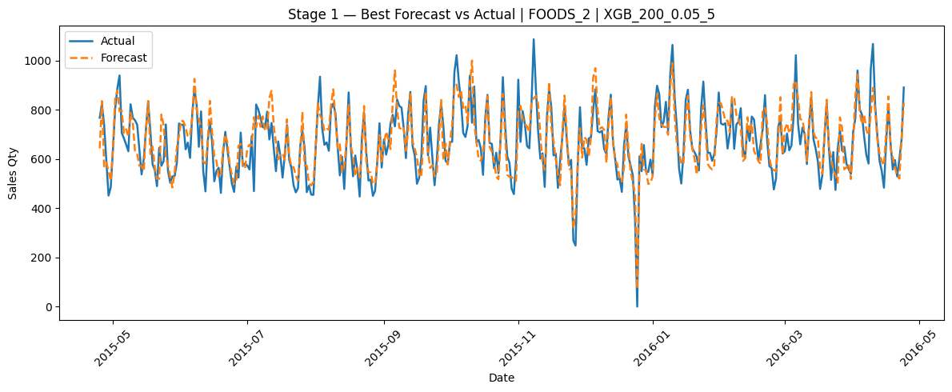
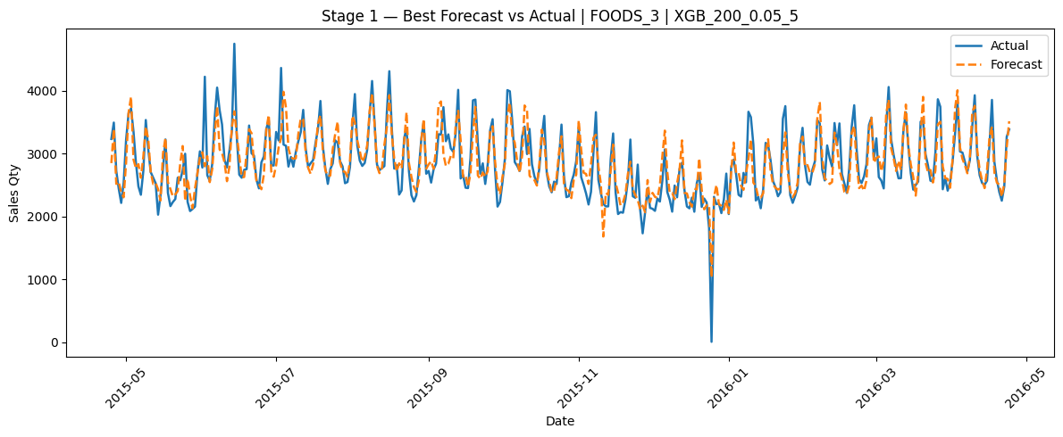
Stage 1 Winner - Actual vs Predicted on est Period:
From History to Forecast | Julius Lauren Marasigan | April 2026
2-Direction Cost of Error
Both over AND under-forecasting cost money — waste from spoilage OR lost sales from empty shelves

Slide 9
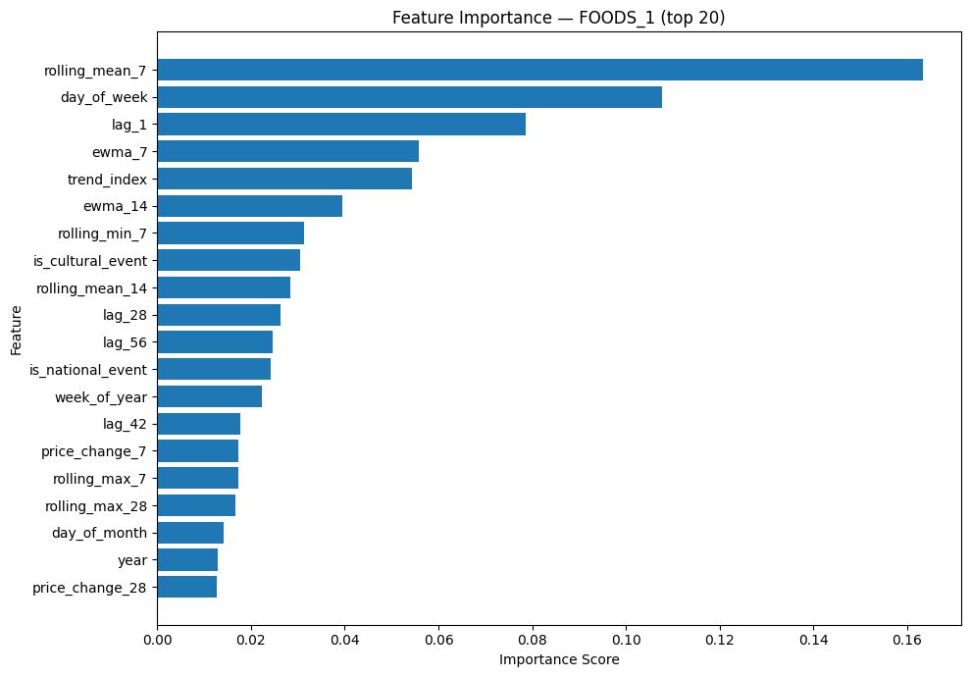
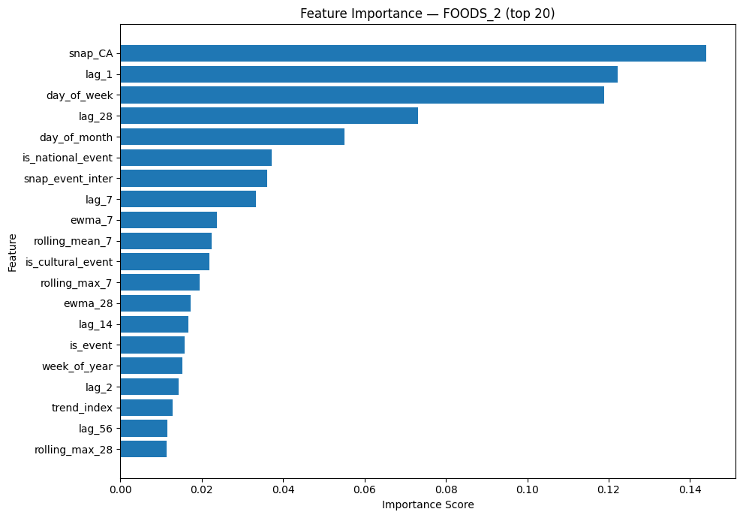
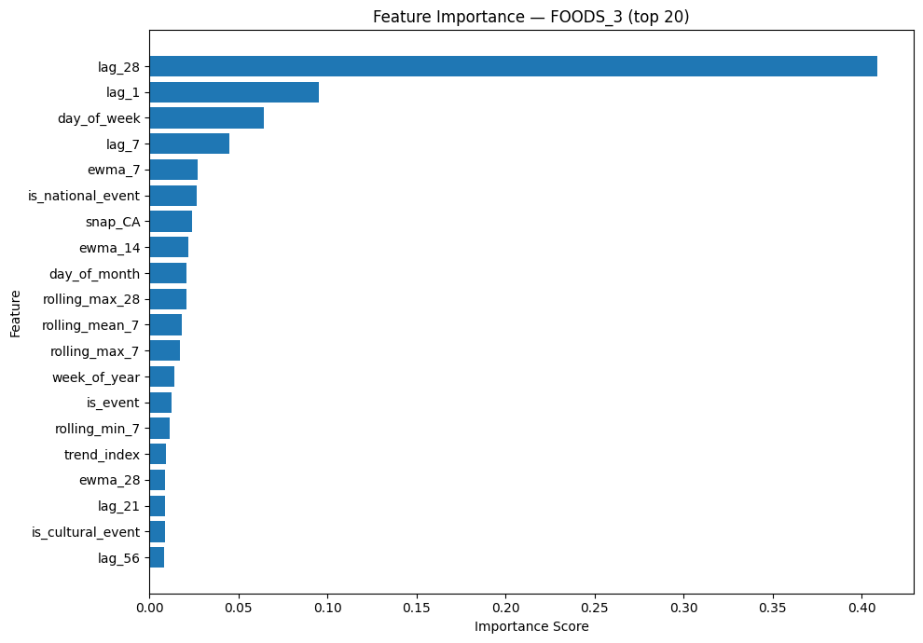
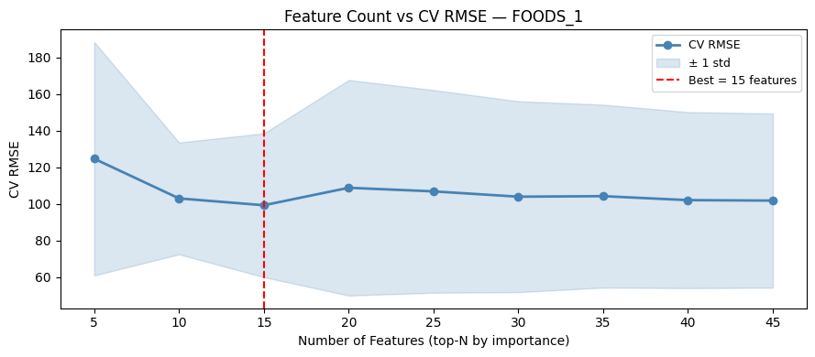
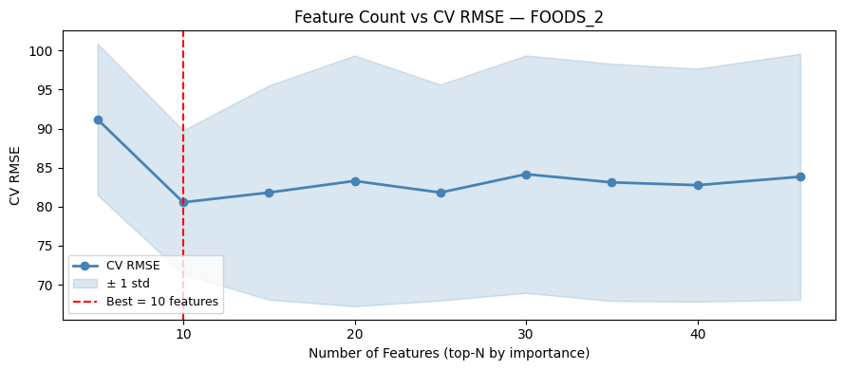
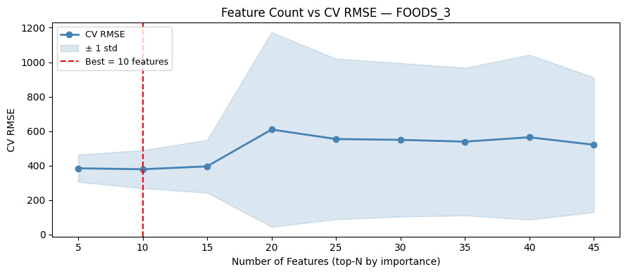
Stage 1 Feature Importance & CV Feature Count Search
Raw XGBoost Feature Importance — Top 20 per Department (Stage 1 Winner):
CV Feature Count Search (TimeSeriesSplit 5-fold) — Optimal N Selected Before Stage 2:
Best N by dept: FOODS_1 = 15 features (CV RMSE 99.32) · FOODS_2 = 10 features (CV RMSE 80.55) · FOODS_3 = 10 features (CV RMSE 378.81)
· Testing 5→45 features, dashed red line = optimal
From History to Forecast | Julius Lauren Marasigan | April 2026
2-Direction Cost of Error
Both over AND under-forecasting cost money — waste from spoilage OR lost sales from empty shelves

Slide 10
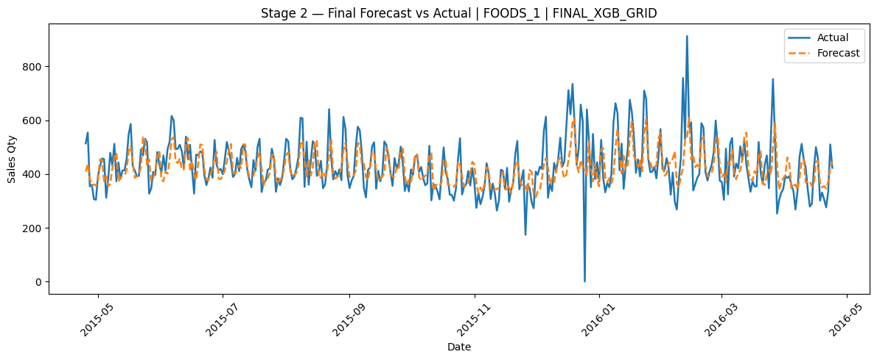
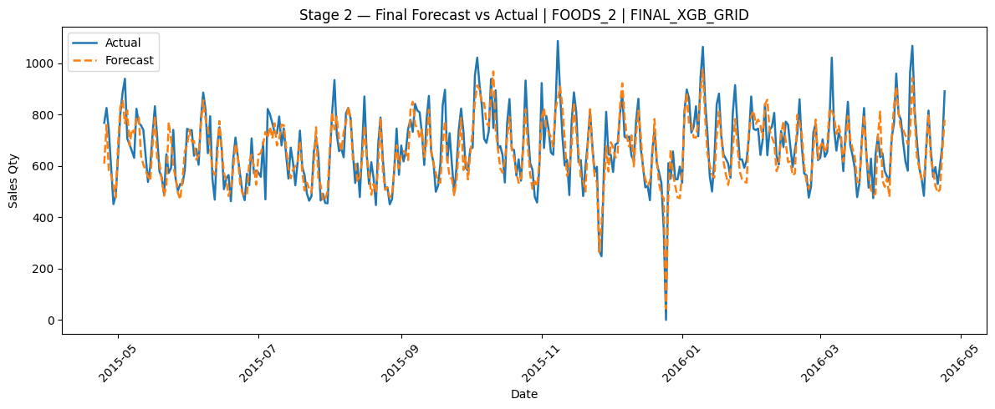
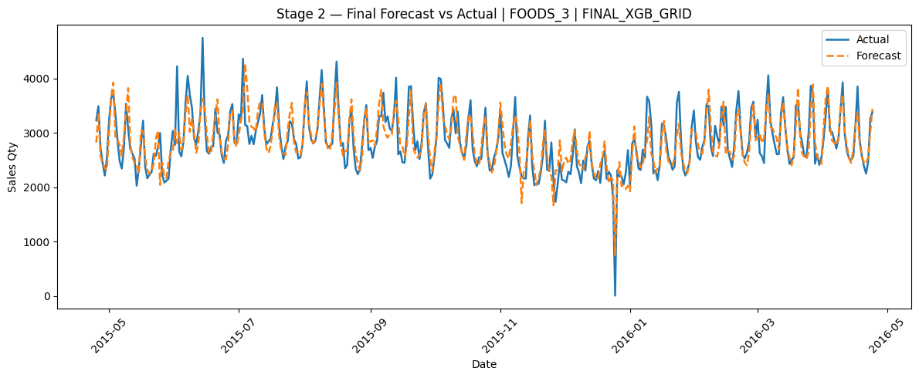
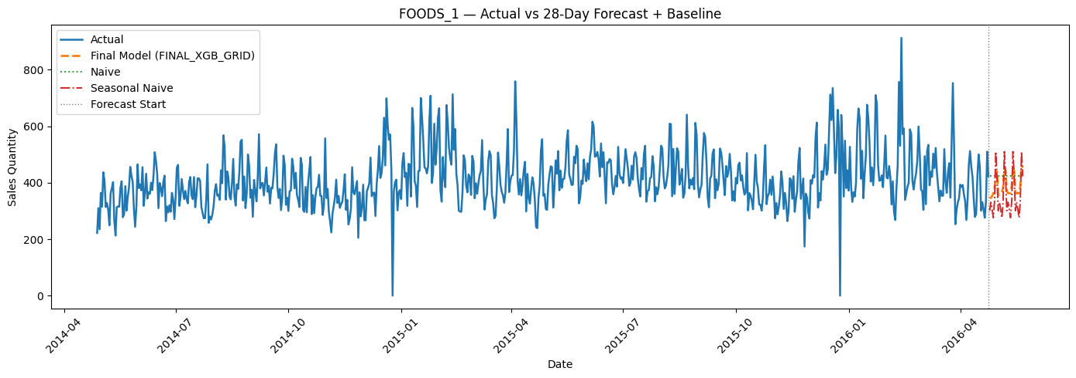
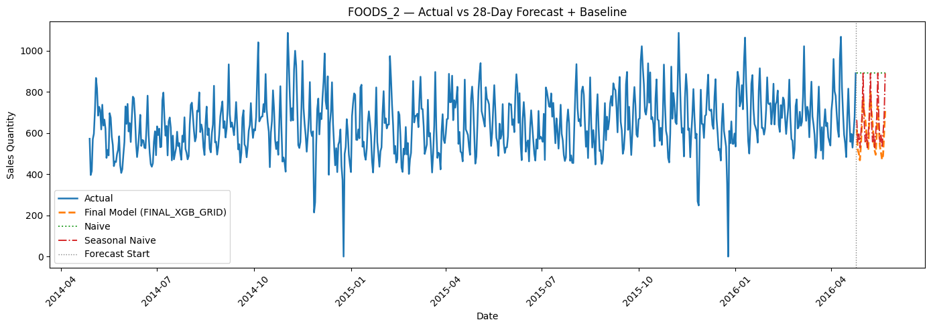
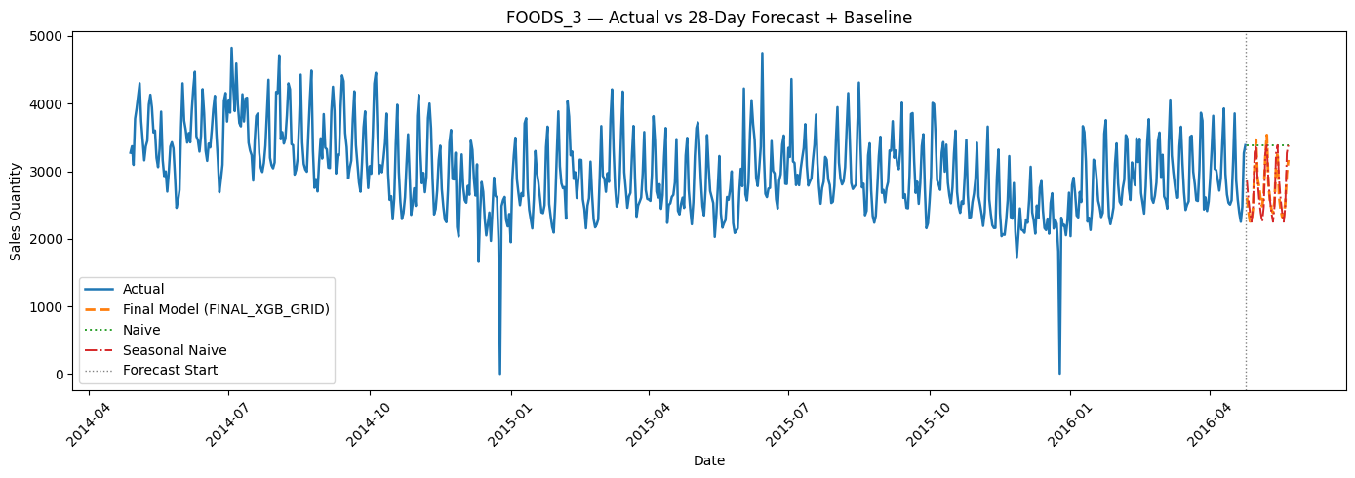
5. Results — Stage 2 (GridSearchCV) vs Stage 1 Comparison
Dept | S1 Model | S1 RMSE | S1 MAPE | S2 Model | S2 RMSE | S2 MAPE | Features | Best Params
FOODS_1 | XGB_200_0.05_5 | 73.94 | 12.26% | FINAL_XGB_GRID | 76.70 | 12.41% | 15 | col_tree=0.8, lr=0.05
FOODS_2 | XGB_200_0.05_5 | 73.26 | 8.82% | FINAL_XGB_GRID | 74.53 | 8.77% ▲ | 10 | col_tree=1.0, lr=0.05
FOODS_3 | XGB_200_0.05_5 | 275.66 | 77.04% | FINAL_XGB_GRID | 282.31 | 57.80% ▲ | 10 | col_tree=0.8, lr=0.05
▲ improved vs Stage 1 | Stage 2 RMSE slightly higher but MAPE improved — tuned model is more regularized and consistently accurate on typical demand days. MAPE is the operationally relevant metric.
Stage 2 Final Model — Actual vs Predicted on Test Period:
28-Day Forecast (Apr 25 – May 22, 2016) vs Baselines:
From History to Forecast | Julius Lauren Marasigan | April 2026
2-Direction Cost of Error
Both over AND under-forecasting cost money — waste from spoilage OR lost sales from empty shelves

Slide 11
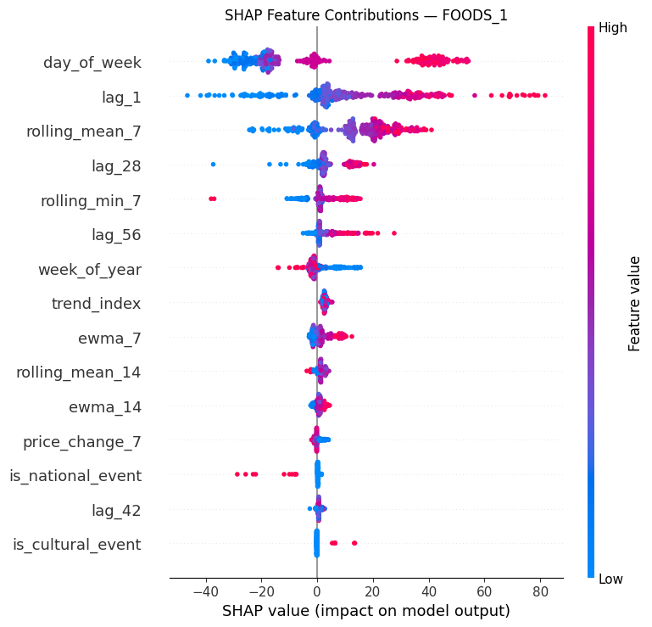
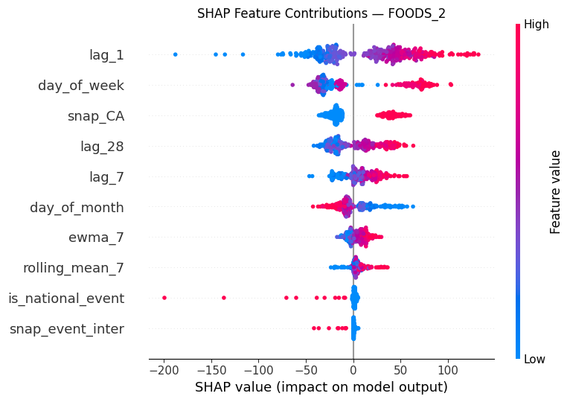
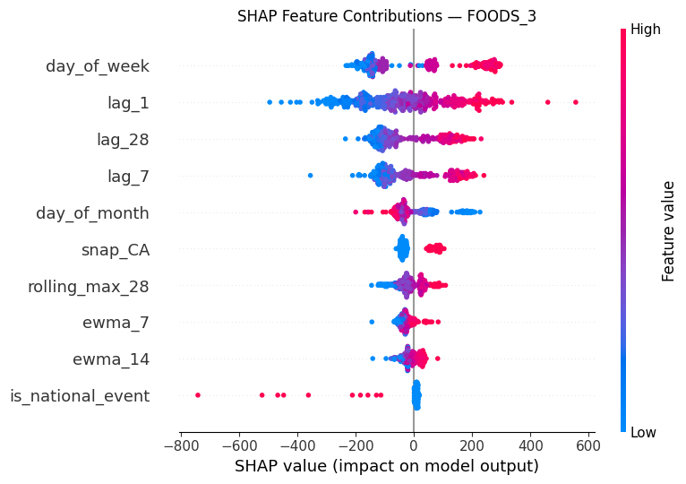
6. Feature Importance & Explainability
SHAP summary plot ranks features by mean |SHAP value| across all test predictions. Dot color = feature value (red=high, blue=low). Horizontal spread = magnitude of impact on individual predictions.
SHAP Summary Rankings (Test Set) — Top 5 by department:
Rank | FOODS_1 | FOODS_2 | FOODS_3
1 | day_of_week | lag_1 | day_of_week
2 | lag_1 | day_of_week | lag_1
3 | rolling_mean_7 | snap_CA | lag_28
4 | lag_28 | lag_28 | lag_7
5 | rolling_min_7 | lag_7 | day_of_month
Raw XGBoost importance ≠ SHAP ranking. Raw importance = tree split frequency (snap_CA tops FOODS_2 raw at 0.144). SHAP = actual contribution magnitude on test predictions (lag_1 tops FOODS_2 SHAP). Both are valid and complementary views.
From History to Forecast | Julius Lauren Marasigan | April 2026
2-Direction Cost of Error
Both over AND under-forecasting cost money — waste from spoilage OR lost sales from empty shelves

Slide 12
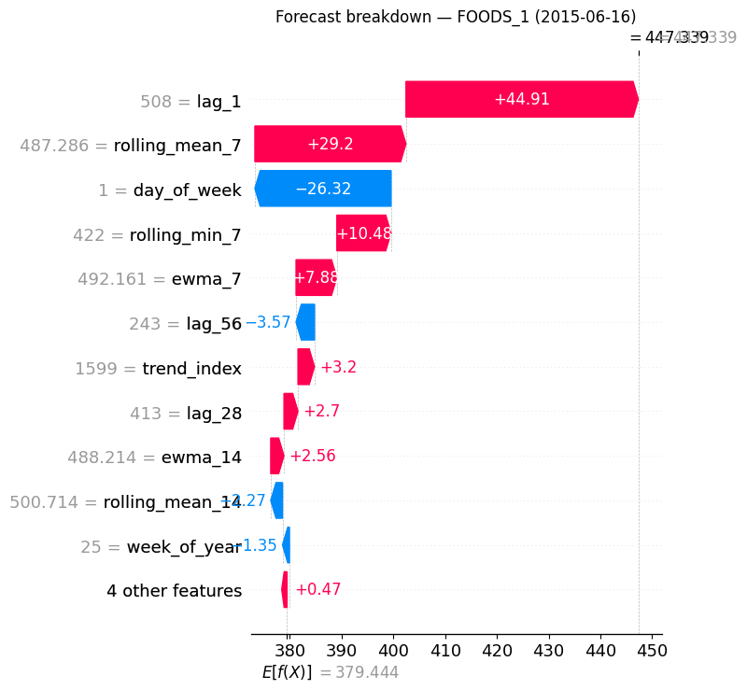
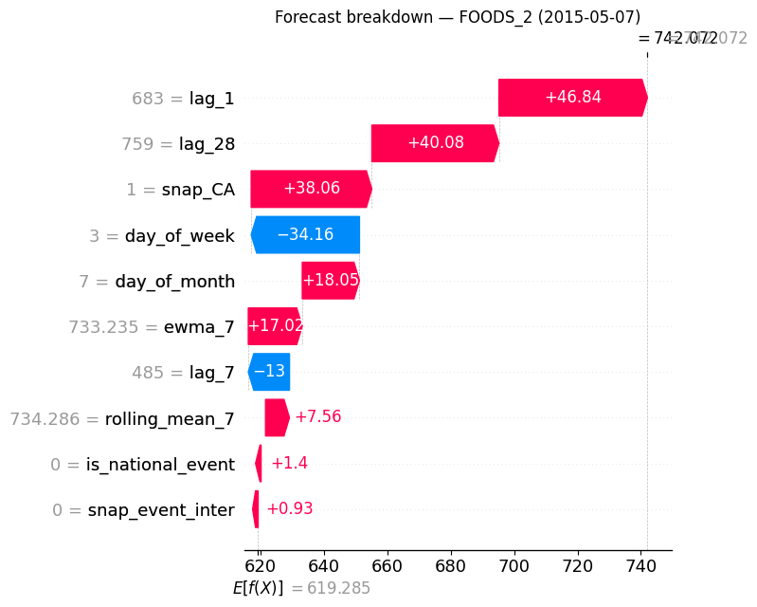
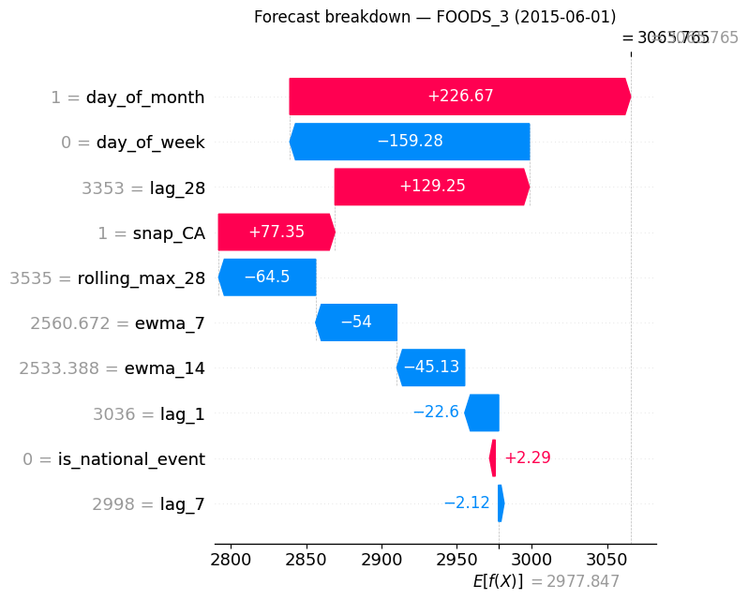
Explainability - SHAP Waterfall Plots (Median Test Observation)
Waterfall plots explain one specific prediction — how each feature pushed the forecast up (red) or down (blue) from the model baseline E[f(X)].
FOODS_1 (2015-06-16)
Actual=415, Forecast=447
+32 over-forecast
lag_1, rolling_mean_7, and day_of_week was the dominant drivers
FOODS_2 (2015-05-07)
Actual=658, Forecast=742
+84 over-forecast
lag_1(+46.84)+lag_28(+40.08)+snap_CA(+38.06) stacked positive while Thursday (−34.16) insufficient to offset
FOODS_3 (2015-06-01)
Actual=2,778, Forecast=3,066
+288 over-forecast
day_of_week dominant positive contributor followed by lag_28.
From History to Forecast | Julius Lauren Marasigan | April 2026
2-Direction Cost of Error
Both over AND under-forecasting cost money — waste from spoilage OR lost sales from empty shelves

Slide 13
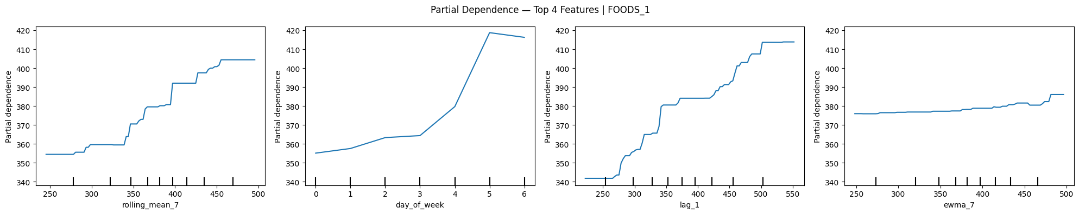
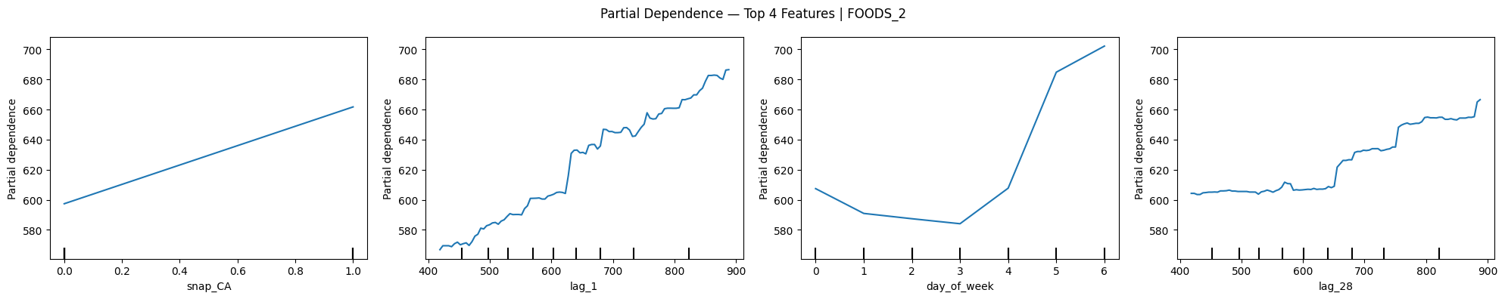
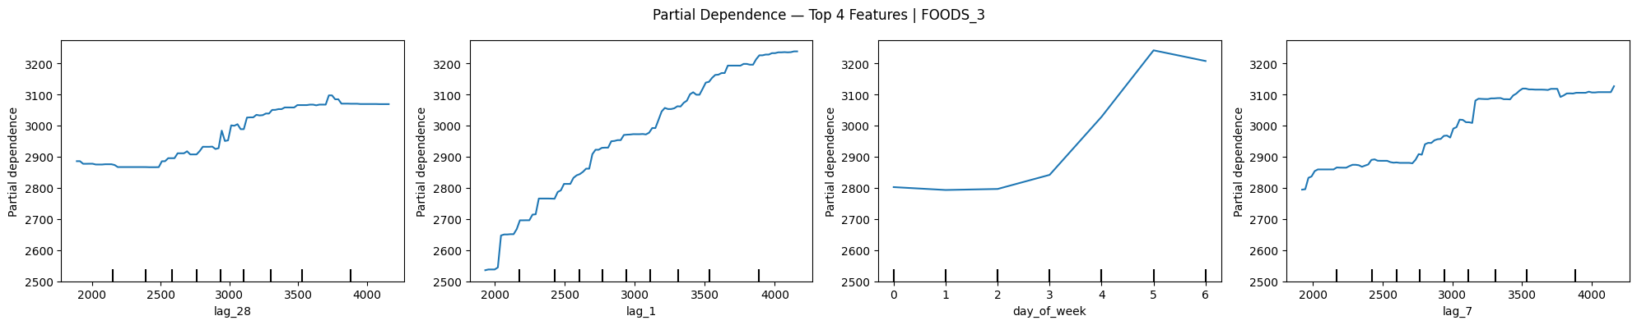
Explainability — Partial Dependence Plots (Top 4 Features per Dept)
PDP shows the average effect of one feature on the forecast while all other features are held constant. All upward slopes confirm correct directional learning — no inverted relationships found.
FOODS_1 — rolling_mean_7, day_of_week, lag_1, ewma_7
FOODS_2 — snap_CA, lag_1, day_of_week, lag_28
FOODS_3 — lag_28, lag_1, day_of_week, lag_7
snap_CA shows a clean binary step-up 0→1 for FOODS_2 (most operationally transparent PDP finding). lag_28 for FOODS_3 shows the steepest slope of any feature across all departments, consistent with its 0.41 importance score.
From History to Forecast | Julius Lauren Marasigan | April 2026
2-Direction Cost of Error
Both over AND under-forecasting cost money — waste from spoilage OR lost sales from empty shelves

Slide 14
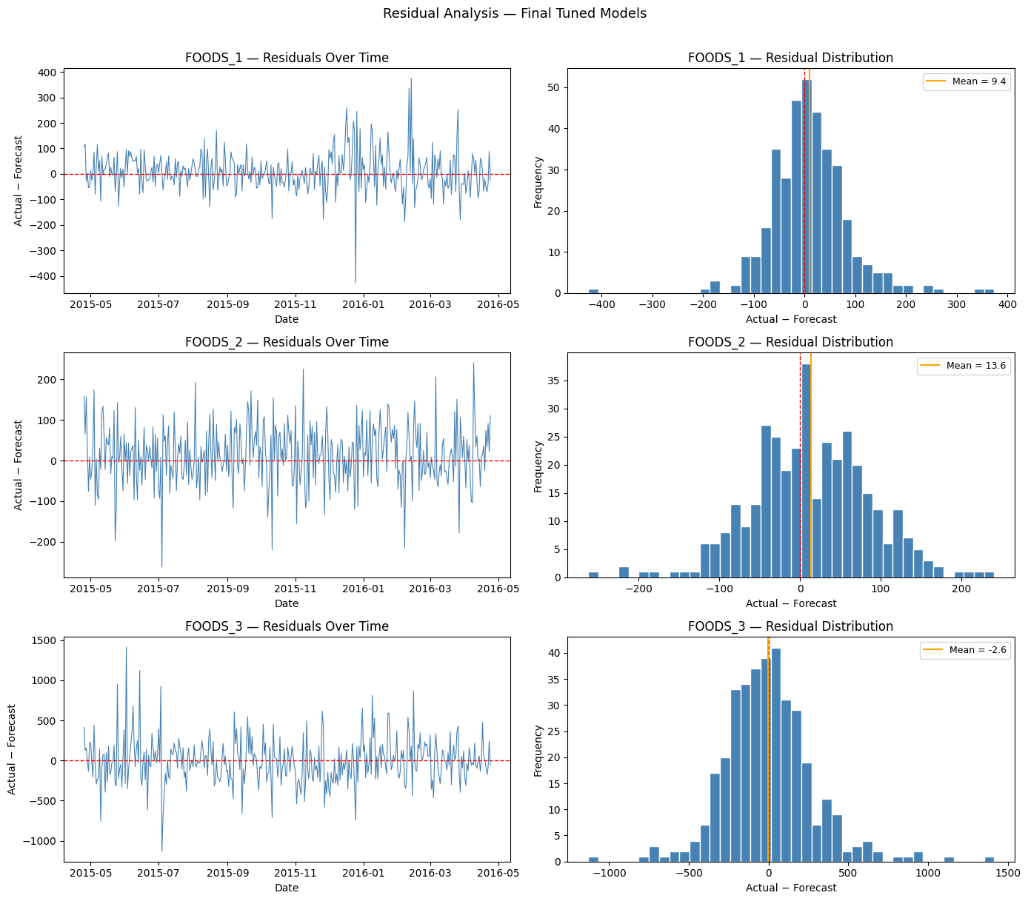
Results — Residual Analysis & Overfitting Check
Residual plots (Actual − Predicted) and Train vs Test MAPE comparison:
Mean Residual (Bias): FOODS_1 = +9.4 units/day (under-forecast) → apply +9 correction | FOODS_2 = +13.6 units/day → apply +14 correction | FOODS_3 = −2.6 units/day (negligible).
Overfitting Check — Train MAPE vs Test MAPE (gap assessment):
Department | Model | Train MAPE | Test MAPE | Gap (pp) | Overfitting Level
FOODS_1 | FINAL_XGB_GRID | 32.36% | 12.41% | −19.95 | Low — test < train
FOODS_2 | FINAL_XGB_GRID | 6.81% | 8.77% | 1.97 | Low — near zero gap
FOODS_3 | FINAL_XGB_GRID | 153.93% | 57.80% | −96.13 | Low — test << train
From History to Forecast | Julius Lauren Marasigan | April 2026
2-Direction Cost of Error
Both over AND under-forecasting cost money — waste from spoilage OR lost sales from empty shelves

Slide 15
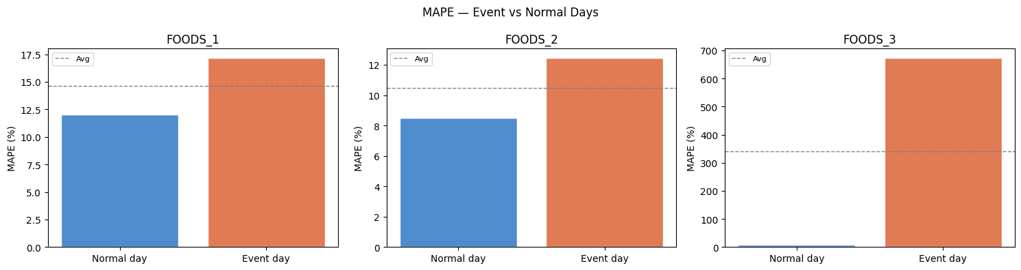
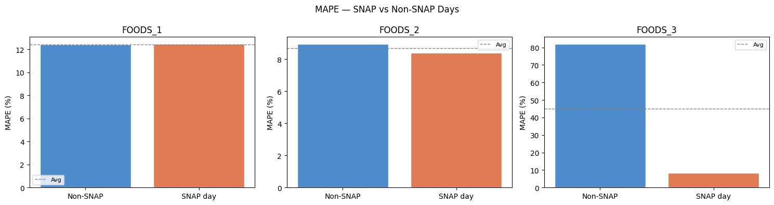
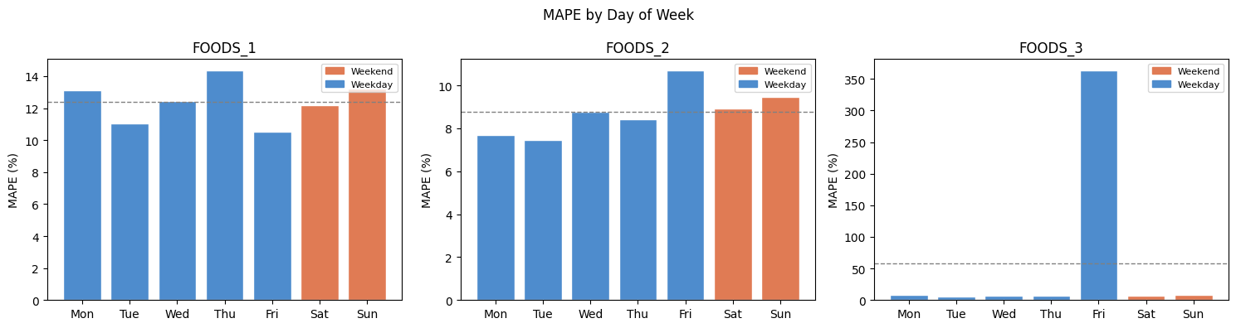
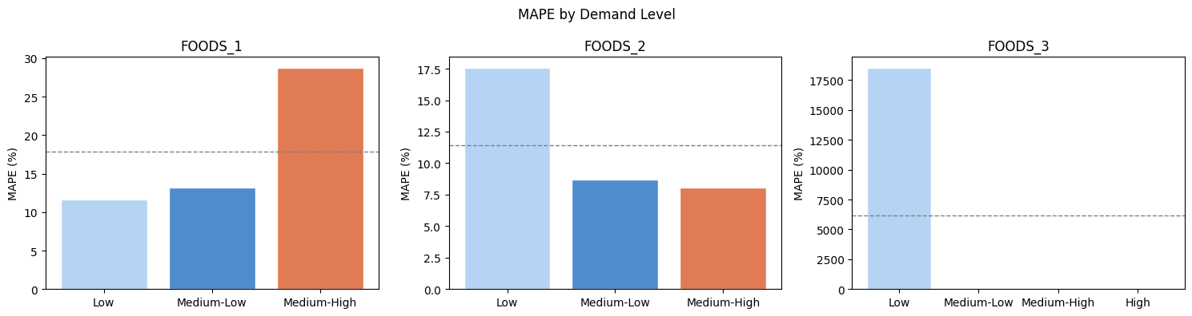
7. Critical Thinking – 4 Dimension Bias Audit Results
Bias check across 4 dimensions — any group exceeding 5pp MPE gap vs overall is flagged for planner intervention:
Section 3.1 — Event Day vs Normal Day
Section 3.2 — SNAP Day vs Non-SNAP Day
Section 3.3 — Day of Week Analysis
Section 3.4 — Demand Quartile Analysis
Critical findings: FOODS_3 event day MAPE=673% · FOODS_3 Friday MAPE=363% · FOODS_1 Saturday MPE=+8.13% · FOODS_2 SNAP days more accurate than non-SNAP — no equity concern confirmed.
From History to Forecast | Julius Lauren Marasigan | April 2026
2-Direction Cost of Error
Both over AND under-forecasting cost money — waste from spoilage OR lost sales from empty shelves

Slide 16
8. Limitations & Future Work
Known Limitations Error compounding - Recursive 28-day – Day1 forecast most reliable; each step add uncertainty.
Price/SNAP carry-forward – Future values assumed unchanged – manual overlay needed.
FOODS_3 MAPE 57.80% - Genuine demand volatility – all FOODS_3 needs planner review.
No future event knowledge – Confirmed events must be manually overlaid before release.
CA_3 FOODS scope only – Do not apply to other stores without full retraining.
Dept-level output only – SKU disaggregation required before order quantities.
PCA not applied – Deliberate – preserves interpretability for demand planning.
Future Work SKU Disaggregation Model – Top-down using 3-6 months rolling daily contribution % per item.
Weekly Modeling Refitting – Refit weekly with latest actuals to prevent error drift.
Event Override Rule Library – Pre-tuned uplift factors per confirmed event type.
LightGBM Stage 2 Comparison – Formal LGB vs XGB with wider hyperparameter grid.
SNAP Interaction Expansion – Test SNAP x day_of_week and SNAP x event day signals
Extend to all CA Stores – Cross-store training to leverage shared demand patterns.
Flask API Development – Serve .pkl models via REST for live operational forecasting.
From History to Forecast | Julius Lauren Marasigan | April 2026
2-Direction Cost of Error
Both over AND under-forecasting cost money — waste from spoilage OR lost sales from empty shelves

Slide 17
Key Takeaways
XGBoost won across all departments
Feature-rich ML consistently outperformed 14 other candidates including SARIMA, ARIMA, Random Forest, and LightGBM on all three departments.
CV-based feature selection is critical
TimeSeriesSplit 5-fold found optimal counts (10–15) that generalized better than using all 45+ non-zero importance features.
SHAP+ PDP make the model operationally auditable
Every prediction can be decomposed to individual feature contributions in units of sales qty — planners can verify model behavior.
4-dimension bias audit revealed critical gaps invisible to overall MAPE
FOODS_3 event day 673% and Friday 363% MAPE – these patterns would be completely hidden by looking at overall test MAPE.
From History to Forecast | Julius Lauren Marasigan | April 2026
2-Direction Cost of Error
Both over AND under-forecasting cost money — waste from spoilage OR lost sales from empty shelves

