Slide 1
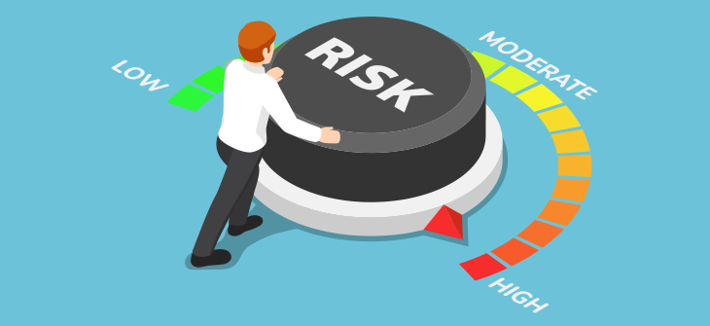
Credit Default Risk ASSESSMENT
JULJA eCO, NATE TALAMPAS

Slide 2
What is Credit default risk?
Credit default risk is the risk a lender takes that a borrower will not make the required payments on a debt obligation.
Earlier credit and risk management analysis would be conducted by analyzing the borrower's credentials and capabilities, which was more prone to error.
Machine learning algorithms are more efficient in performing credit risk assessments with better precision and at faster speeds.
Notes:
Credit default risk can lead to a possibility of loss for a lender.
ML algorithms can perform a credit risk assessment with better precision and much faster than any humans.

Slide 3
Research Questions
What variables are most significant in predicting credit default risk?
How do different machine learning algorithms perform in predicting credit risk?

Slide 4
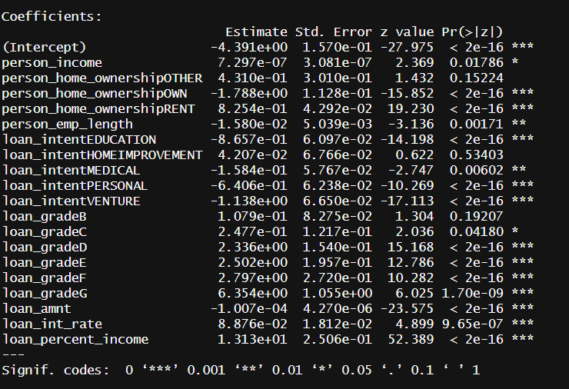
Determining significant Predictors
To determine which predictors are significant, we perform a logistic regression. All regression coefficients with a p-value less than 0.05 will be statistically significant.
Significant predictors include loan status, annual income, home ownership, employment length, loan intent, loan grade, loan amount, interest rate, and percent income.

Slide 5
SUMMARY OF THE DATA SET
The potential predictors to predict the outcome of whether a person will default include age, annual income, home ownership, employment length (in years), loan intent, loan grade, loan amount, interest rate, percent income, historical default, and credit history length.
The dataset contains 32,581 observations and 12 variables.
Notes:
Rows: 32581 Columns: 12

Slide 6
Summary Statistics of Dataset
loan_status person_income person_home_ownership person_emp_length loan_intent loan_grade Min. :0.0000 Min. : 4000 Length:28636 Min. : 0.00 Length:28636 Length:28636 1st Qu.:0.0000 1st Qu.: 39474 Class: character 1st Qu.: 2.00 Class :character Class :character Median: 0.0000 Median: 55910 Mode: character Median: 4.00 Mode: character Mode: character Mean: 0.2166 Mean: 66645 Mean: 4.78 3rd Qu.:0.0000 3rd Qu.: 80000 3rd Qu.: 7.00 Max. :1.0000 Max. :6000000 Max.: 41.00 loan_amnt loan_int_rate loan_percent_income Min.: 500 Min. : 5.42 Min. :0.0000 1st Qu.: 5000 1st Qu.: 7.90 1st Qu.:0.0900 Median: 8000 Median :10.99 Median :0.1500 Mean: 9655 Mean :11.04 Mean :0.1695 3rd Qu.:12500 3rd Qu.:13.48 3rd Qu.:0.2300 Max. :35000 Max. :23.22 Max. :0.8300

Slide 7
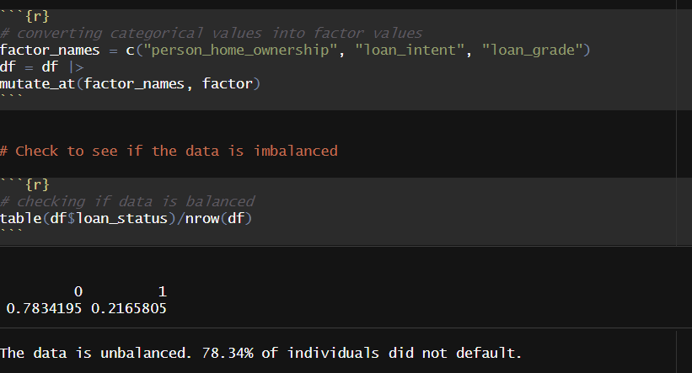
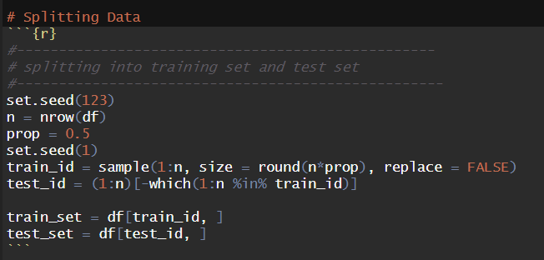
HOW WE BUILD MODELS
Determine if data is imbalanced
Convert character values into factor data type
Split data into training and test sets

Slide 8
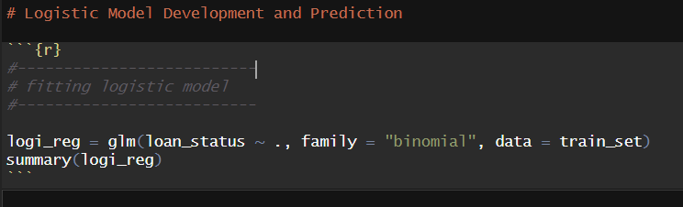
Logistic Regression
We fit a logistic regression.

Slide 9
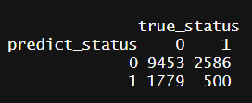
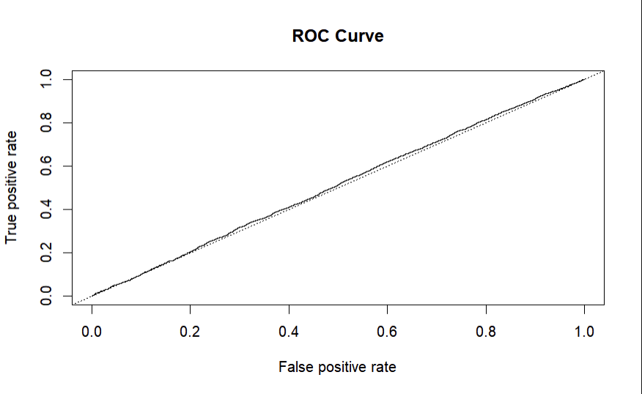
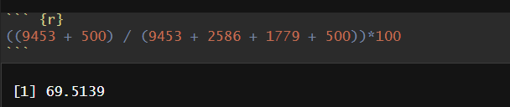
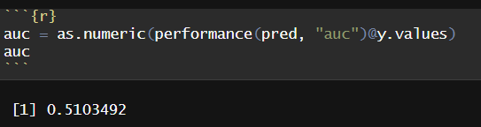
Logistic Regression
Accuracy is 0.6951
AUC value is 0.5103

Slide 10
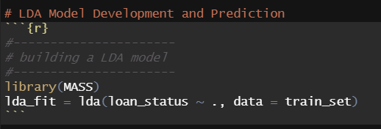

Linear Discriminant Analysis
We fit a LDA model using the training set.

Slide 11
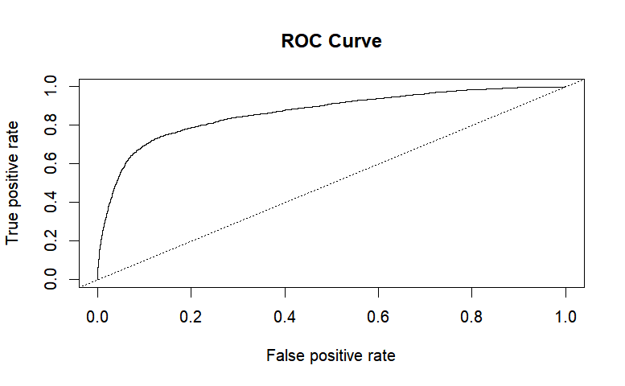
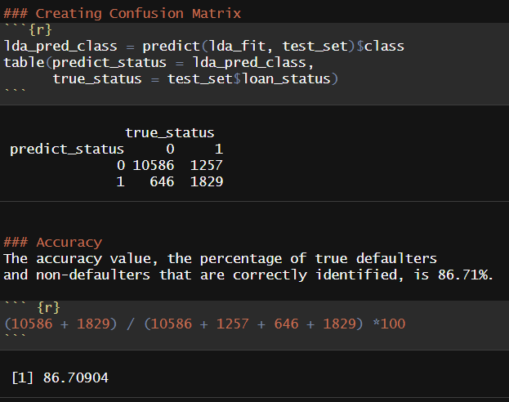
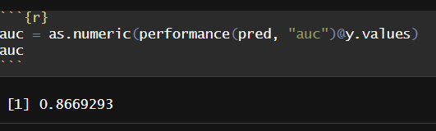
Linear discriminant analysis
Accuracy is 0.8671
AUC value is 0.8669

Slide 12
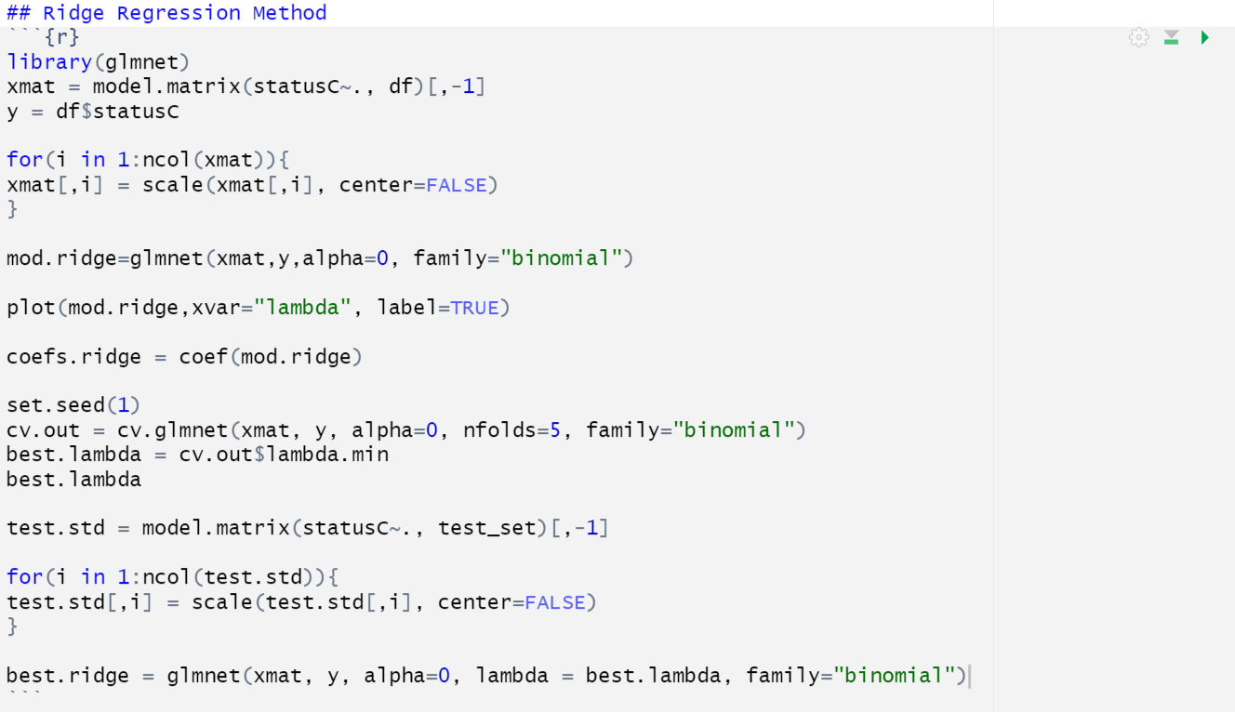
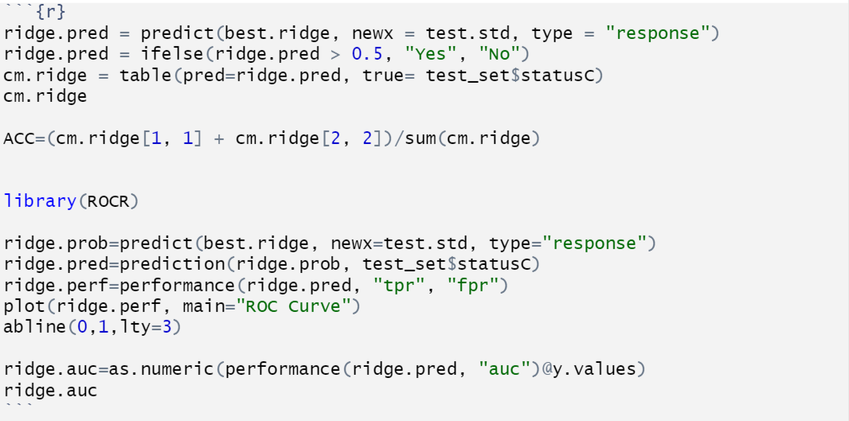
rIDGE REGRESSION

Slide 13
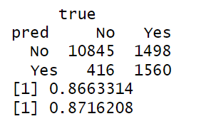
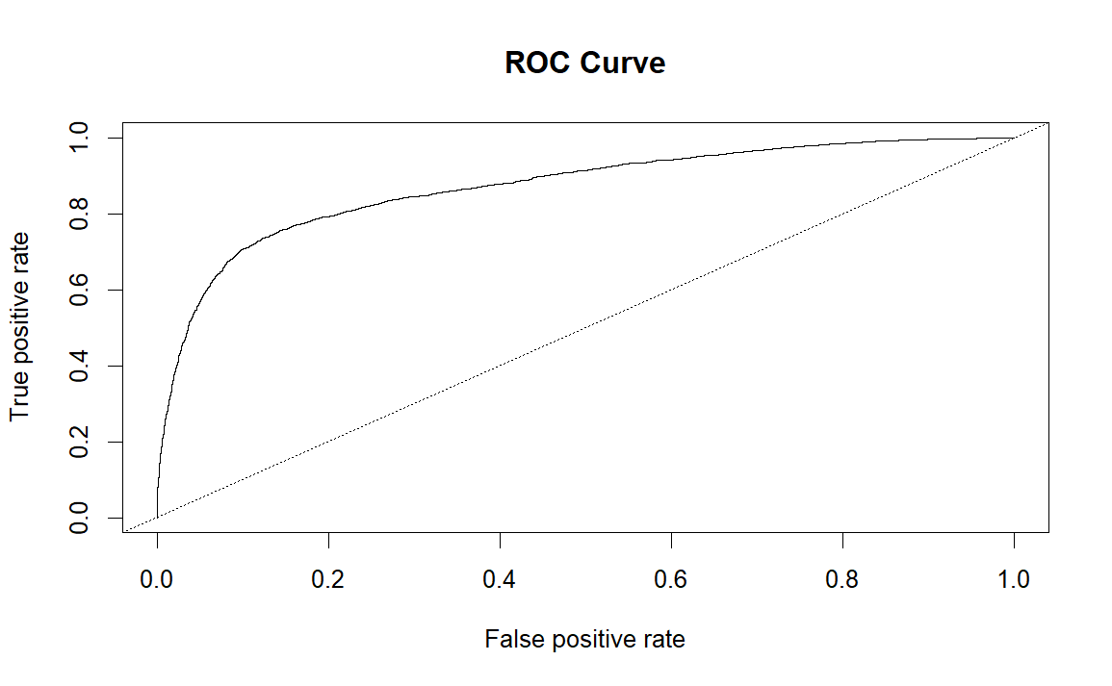
RIDGE REGRESSION
Accuracy is 0.8663
AUC value is 0.8716

Slide 14
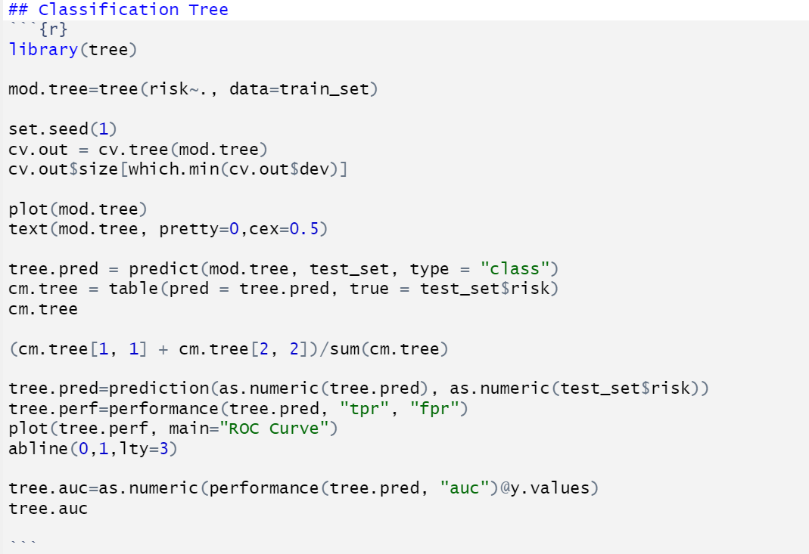
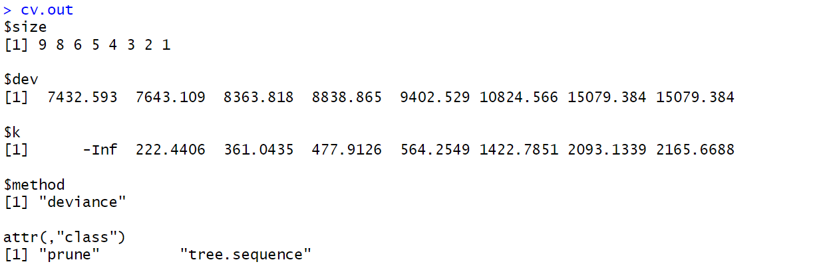

CLASSIFICATION TREE

Slide 15
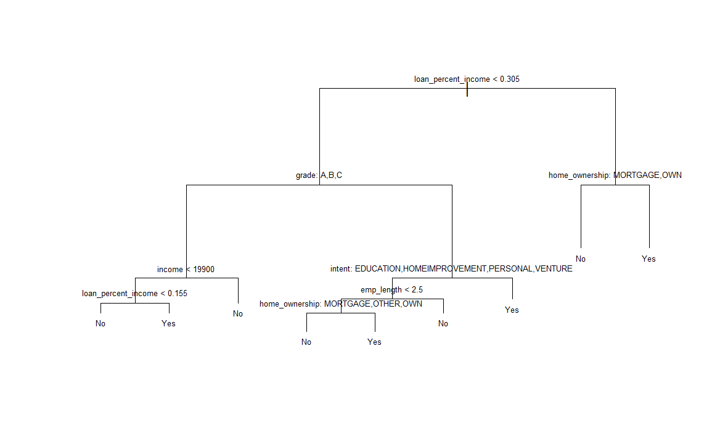
CLASSIFICATION TREE
You are considered not a risk if:
Your loan is more than 30.5% of your annual income, and you either mortgage or own a house
Your loan has a grade of A, B, or C, with the intent on the graph, and have been employed for more than 2.5 years
You are considered a risk if:
Your income is less than 19900 and your loan is more than 15.5% of your income
You have been employed for less than 2.5 years and you rent

Slide 16
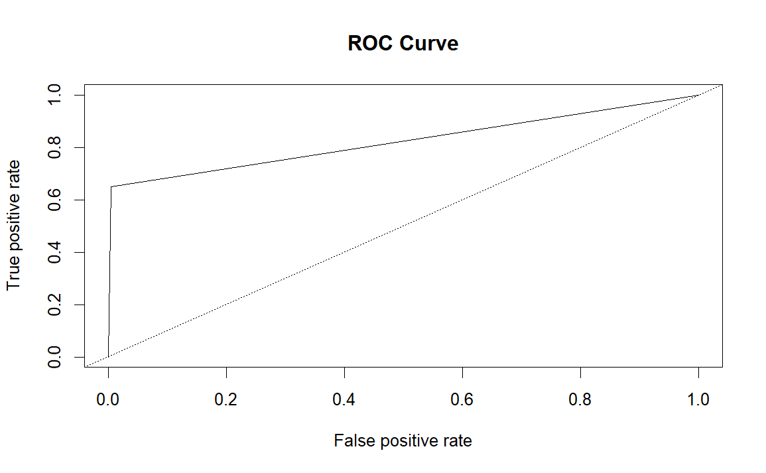
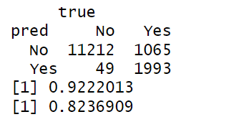
Classification tree
Accuracy is 0.9222
AUC value is 0.8237

Slide 17
SUMMARY OF MAIN RESULTS
 | Logistic Regression | Linear Discriminant Analysis | Ridge Regression | Classification Tree
Accuracy | 69.51% | 86.71% | 86.63% | 92.22%
ROC/AUC | 0.510 | 0.867 | 0.8716 | 0.8237
While Classification Tree has the best accuracy, the Ridge Regression has the highest AUC value. If the lender has low-risk clients or low loan amounts, use Classification Tree. If the lender has high-risk clients or high loan amounts, then use Ridge Regression.

Slide 18
CHALLENGES AND POSSIBLE FUTURE WORK
We could not fit a K-nearest-neighbor algorithm because there were too many ties.
For future work, we could use unsupervised learning methods like neural networks.

