Slide 1
CBM performance study 10 VIII 2021
@Julian Nowak julian.nowak.stud@pw.edu.pl

Slide 2
Motivation

Slide 3
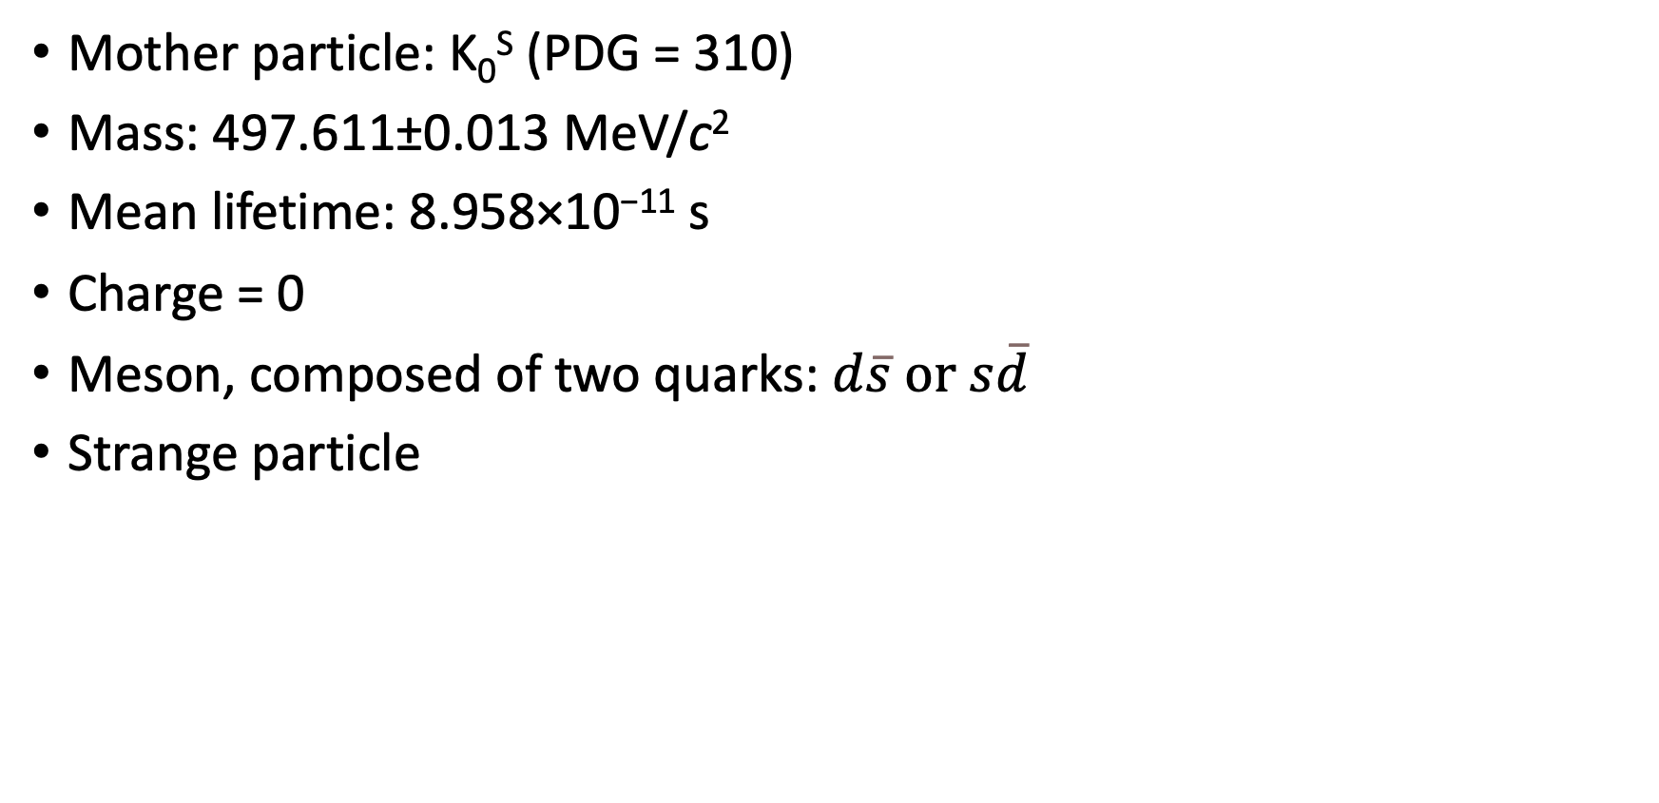
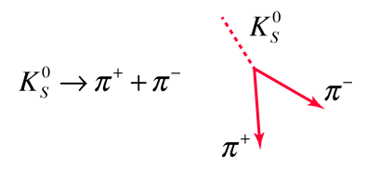
K-short (short lived Kaon) reconstruction
http://hyperphysics.phy-astr.gsu.edu/hbase/Particles/kaon.html

Slide 4
2. Data preparation

Slide 5
Correlations notebook
Generated PlainTrees for:
5k/20k events for background
20k/100k events for signal
Au-Au @12A GeV/c, DCMQGSM-SMM generator passed through CBM setup in GEANT4, without any cuts
My version of the correlations notebooks can be found here

Slide 6
Code (changes from last week)
The PlainTrees are imported using function from CBM_ML_Lambda_Library
The variables were implemented in almost every possible place (the notebook can be used with few changes for e.g., Ξ particles)
Deleted unnecessary imports, added text blocks and comments to the code
All graphs are stored as both pdf and png files in this folder

Slide 7
3. Data cleaning

Slide 8
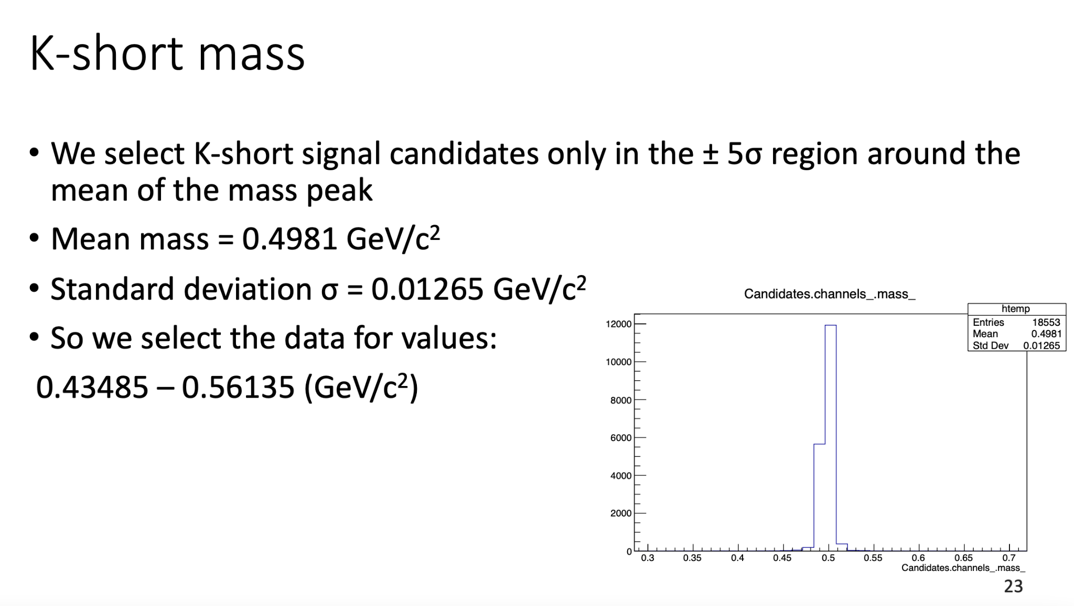
Data cleaning
PDF with all the histograms is available here
First, we apply mass cuts to select K-short signal and background candidates for experimental invariant mass value

Slide 9
Data cleaning
As the Machine Learning algorithms can’t differentiate between the values that have physical sense, and those that don’t, we have to apply some selection criteria
Code available here
Let’s see some examples of incorrect data (that wouldn’t be noticed by ML)

Slide 10
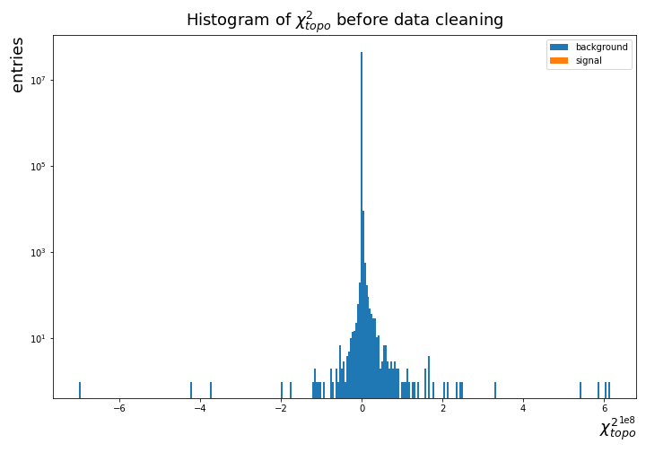
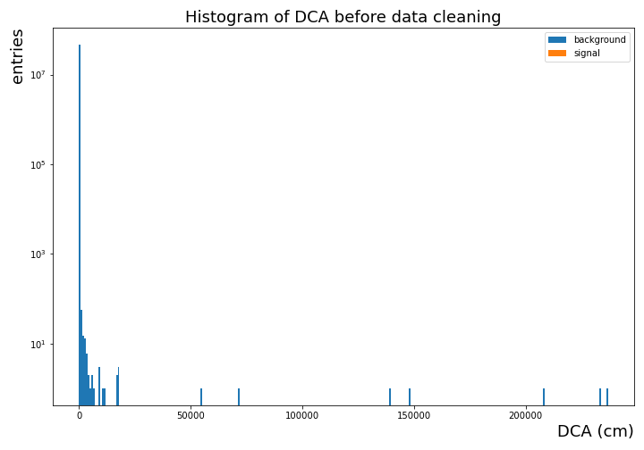
Histograms before data cleaning
χ² topo - dimensionless distance of closest approach between extrapolated kaon trajectory and primary vertex
DCA - distance of closest approach between pion tracks
χ² cannot be smaller than 0 (as it is a squared value of a real number)
Distance of closest approach cannot be bigger than some value (especially not 500 m !)
(y log scale)

Slide 11
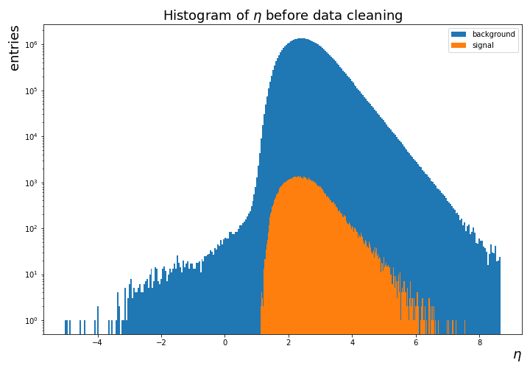
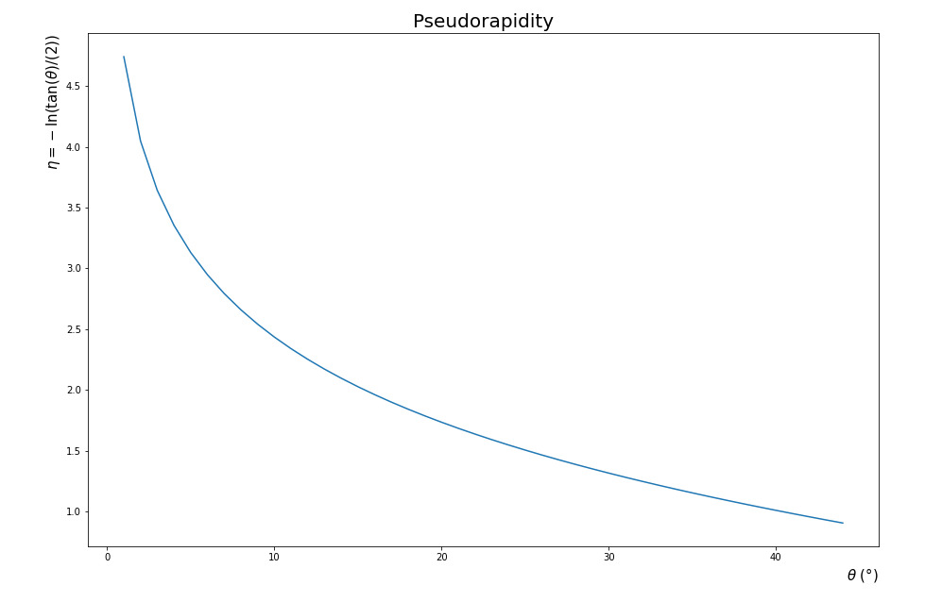
Histograms before data cleaning - pseudorapidity
(y log scale)
η =-ln(tan(θ)/(2)) cannot be smaller than 0 !

Slide 12
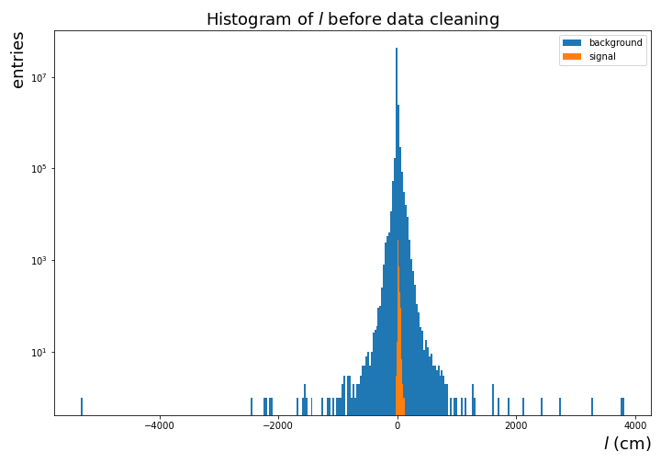
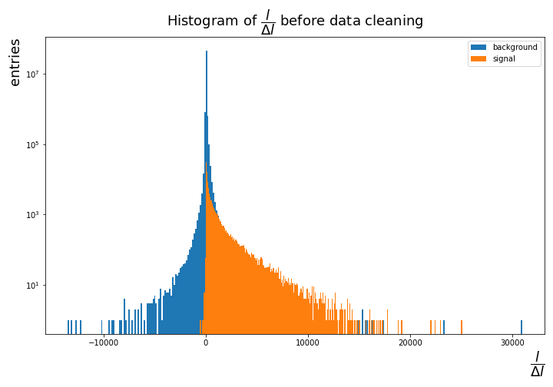
Histograms before data cleaning
L/ΔL - distance between primary and secondary vertex divided over its error
distance cannot be smaller than 0, nor bigger than 20m!
L/ΔL cannot be then smaller than 0

Slide 13
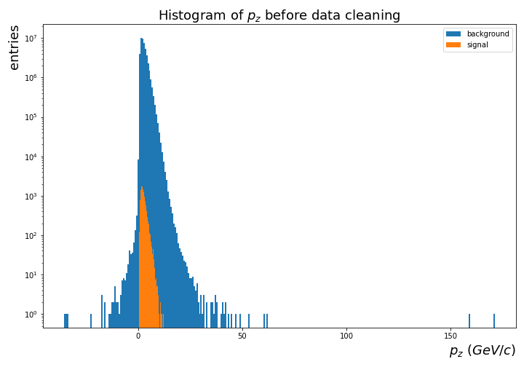
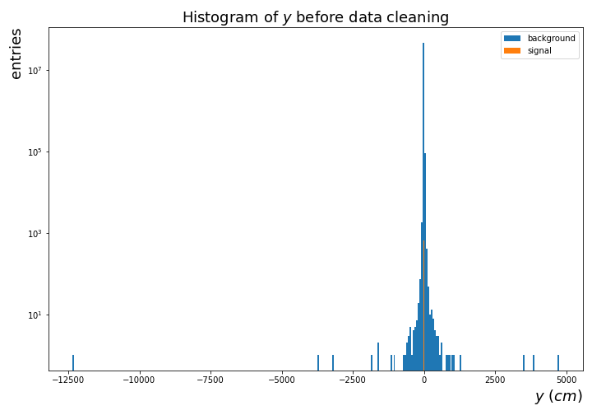
Histograms before data cleaning
The fixed target geometry of the detector requires that p_{z} > 0
|y| cannot be bigger than 50cm, due to the dimensions of the detector

Slide 14
Data cleaning
Selection criteria are described in this document on overleaf and in PDF version on github
0.279 GeV/c² < mass < 1.5 GeV/c² | 0 cm < DCA < 100 cm | 0 cm < l < 80 cm | |x|, |y| < 50 cm | |z|< 80 cm
l/∆l <5000 | p_{z} > 0 GeV/c | p_{z} < 20 GeV/c | p_{T} < 3 GeV/c | 1.5 < η < 3.82
0 < χ²_{geo} < 1000 | 0 < χ²_{topo} < 100000 | 0 < χ²_{geo} < 1000 | 0 < χ²_{first&second} < 3·10⁷ | 0.279 GeV/c² < mass < 1.5 GeV/c²
All the histograms available in PDF format here

Slide 15
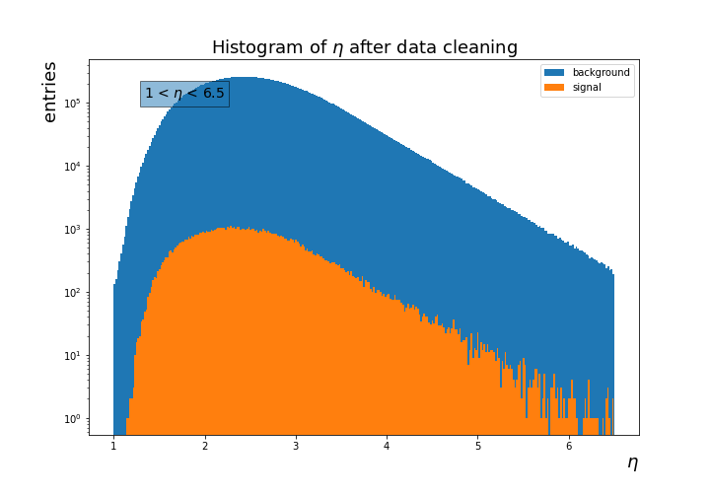
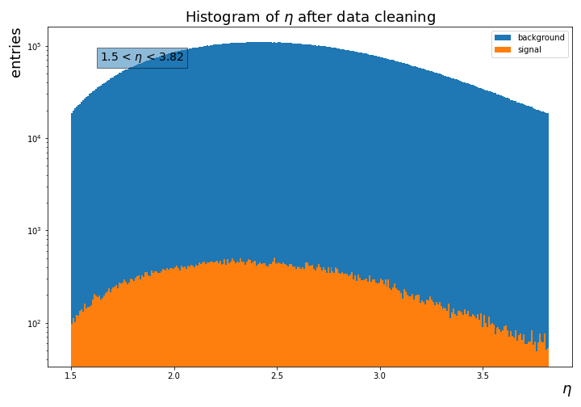
Histograms after data cleaning (examples)
With the eta cut, we loose about 5.66% of data for signal, and 6.75% of data for background
If we applied conditions 1 < η <6.5, we loose about 0.06% of data for signal, and 0.08% of data for background

Slide 16
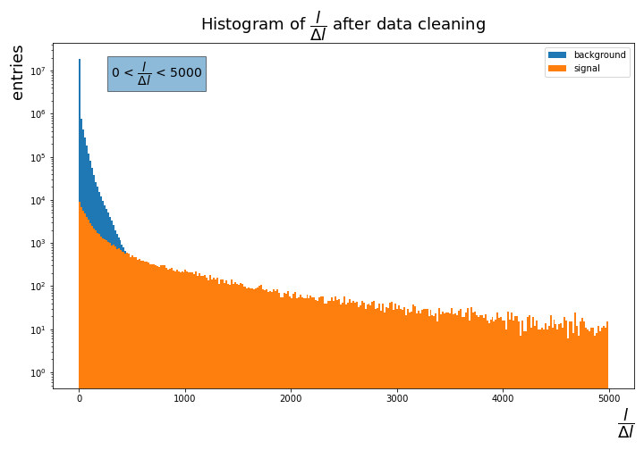
Histograms after data cleaning (examples)
With the l/dl cut, we loose about 2.45% of data for signal, and 45.78% of data for background

Slide 17
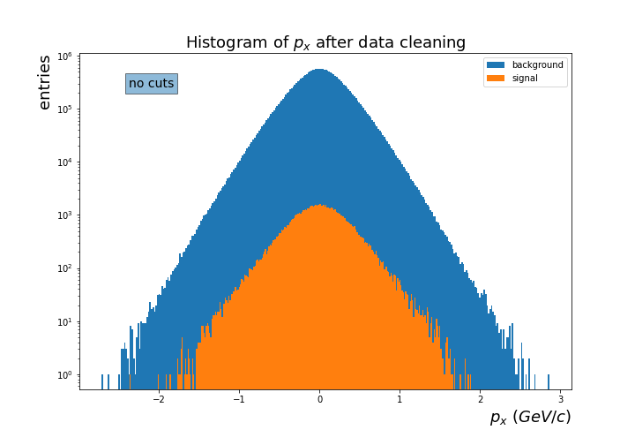
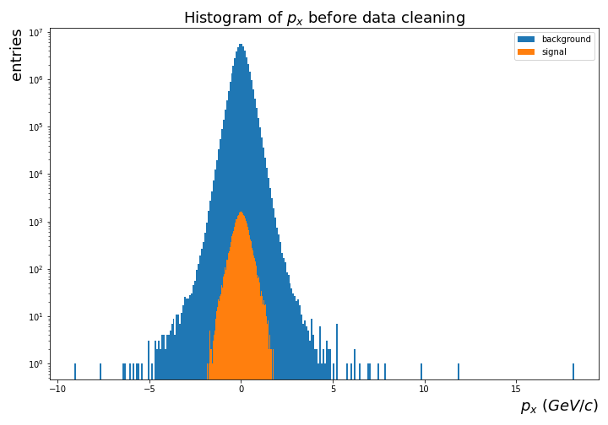
Histograms after data cleaning (examples)
Changes are visible even if we didn’t apply the cut on particular variable - correlations between the variables!

Slide 18
4. Selection of variables

Slide 19
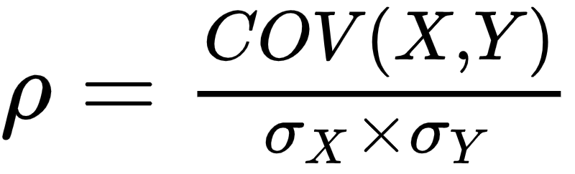
3. Correlations between the variables
We begin with showing the correlations between all the variables
That allows us to e.g., use only one variable, if we know that two of them are highly correlated
Also, we’ll eliminate the variables which are correlated with mass
Pearson correlation coefficient:
It only shows linear correlations between the variables
All the correlations graphs are available here

Slide 20
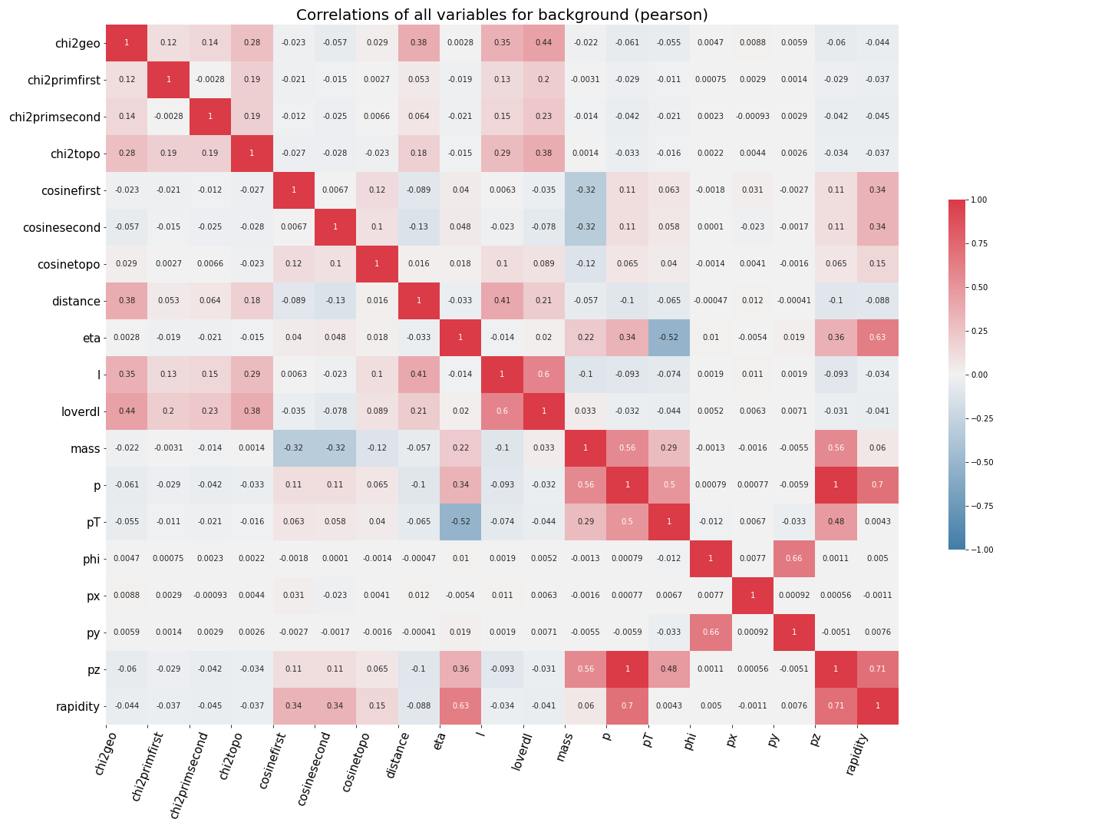
Correlation graph for background variables
(after data cleaning)

Slide 21
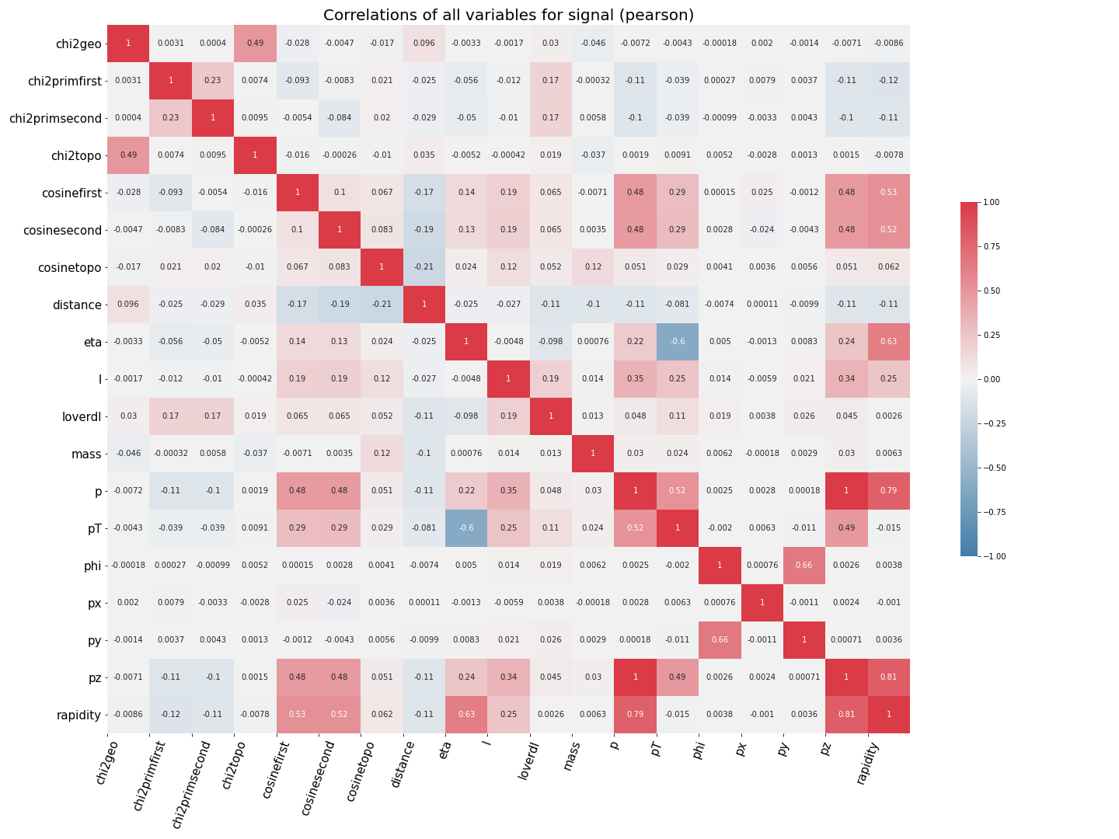
Correlation graph for signal
variables
(after data cleaning)

Slide 22
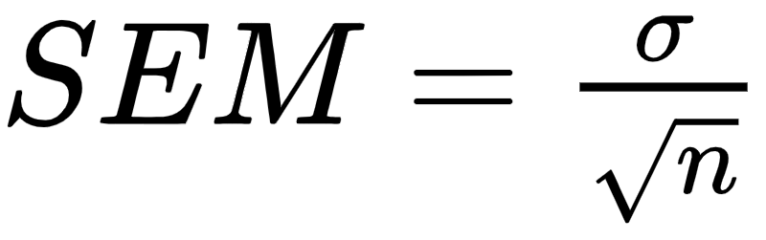
4. Correlations between variables and mass
What’s more interesting for our analysis, are the correlations between the variables and the invariant mass
We create a graph of correlations of each variable with the invariant mass, along with its standard error of the mean (SEM)
where σ - standard deviation

Slide 23
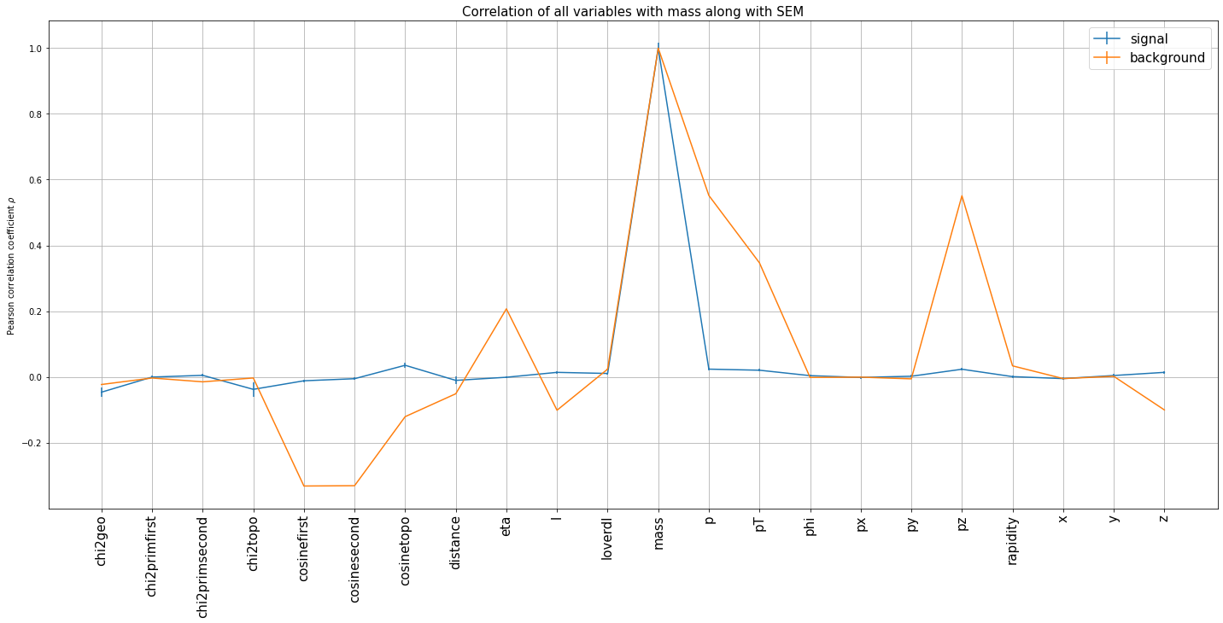
Correlations between variables and mass
We should take a closer look at the correlations between the mass and: pseudorapidity, cosinecut, p_{T}, p_{z} and p for background

Slide 24
Correlations between variables and mass
We make a function that plot the bin centers of the mass on the x-axis, and the mean values of the bins of another variable on the y-axis (along with its SEM)
We also plot 2D histograms of correlation between the variable and invariant mass
Code available here
Red line shows the position of the mean invariant mass of a K-short particle
We don’t delete background values in the 5σ signal region

Slide 25
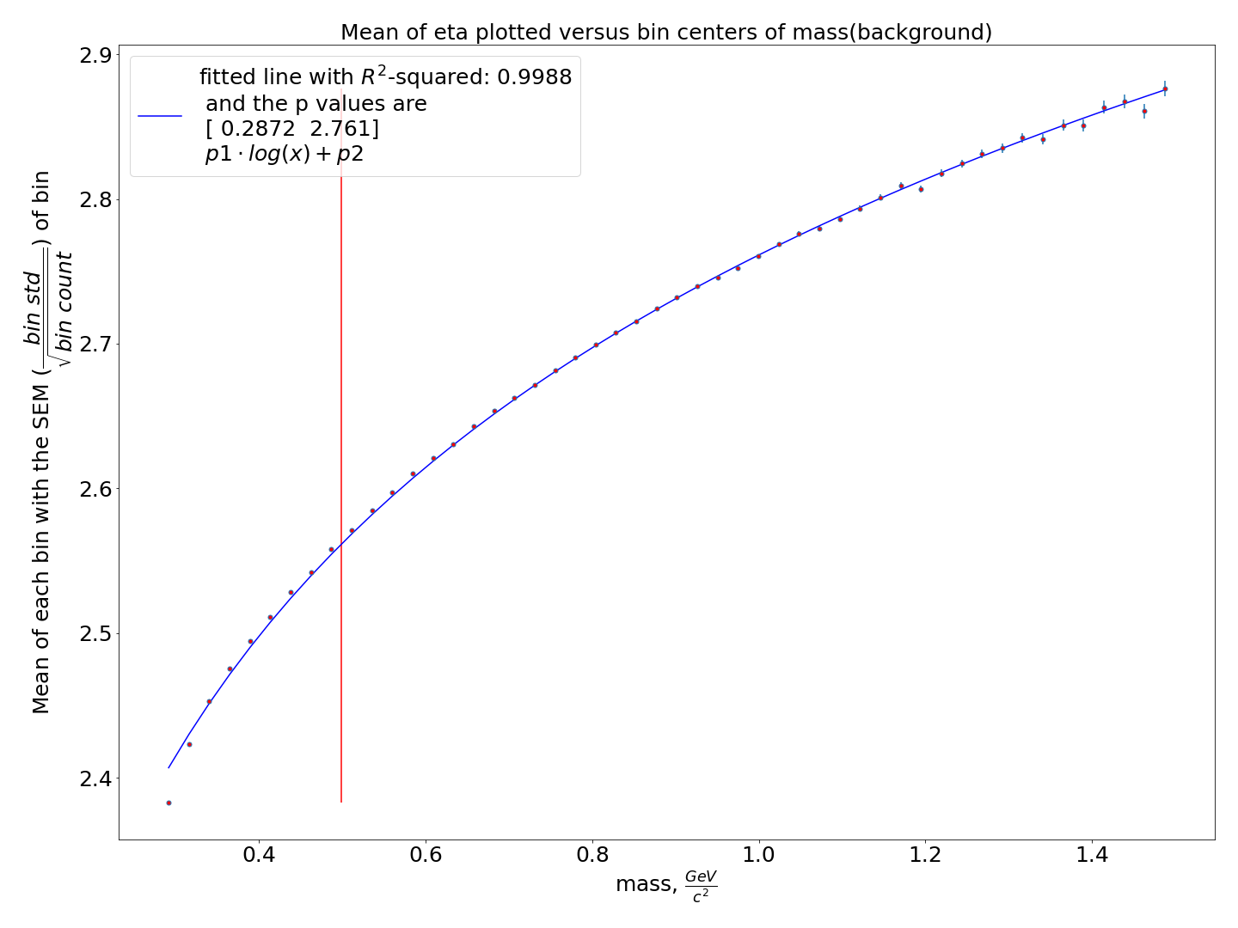
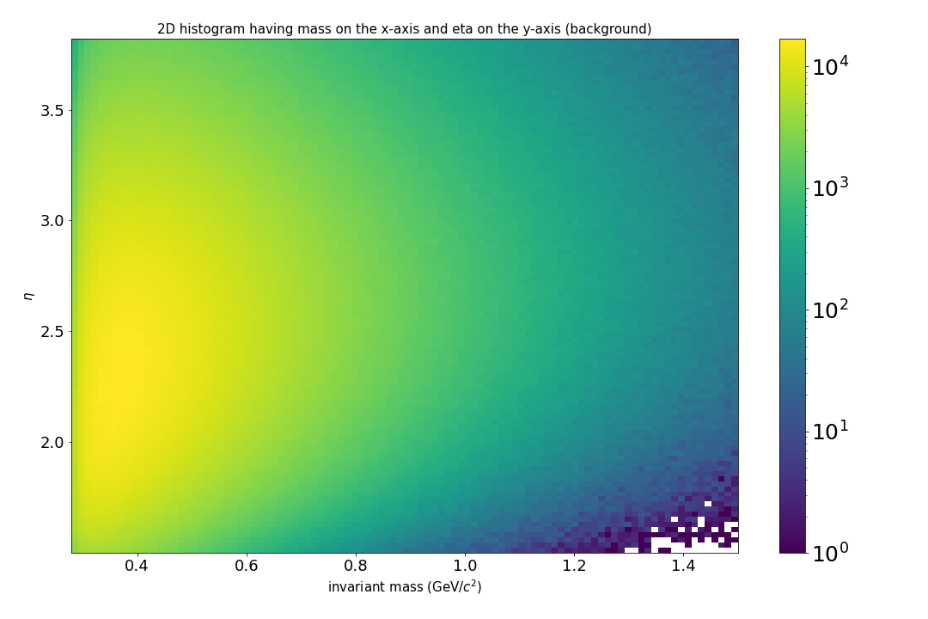
Correlation between η and mass
R² = 0.9988

Slide 26
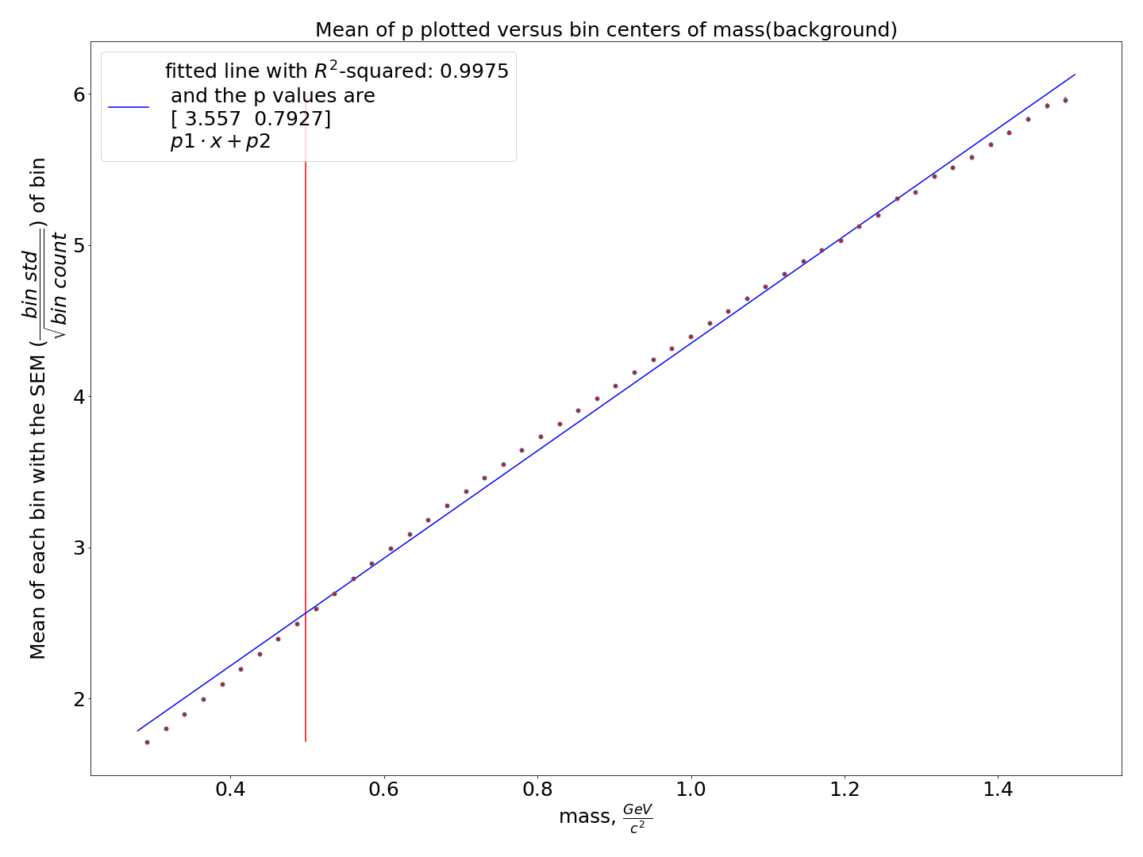
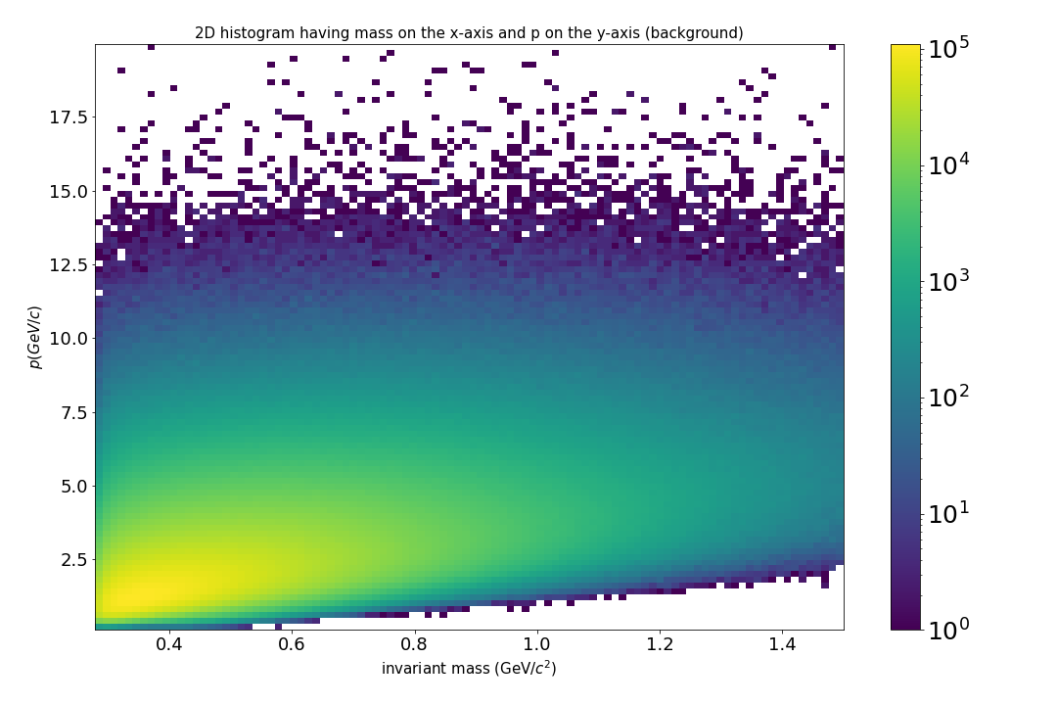
Correlation between p and mass
R² = 0.9975

Slide 27


Correlation between pz and mass
R² = 0.9976

Slide 28
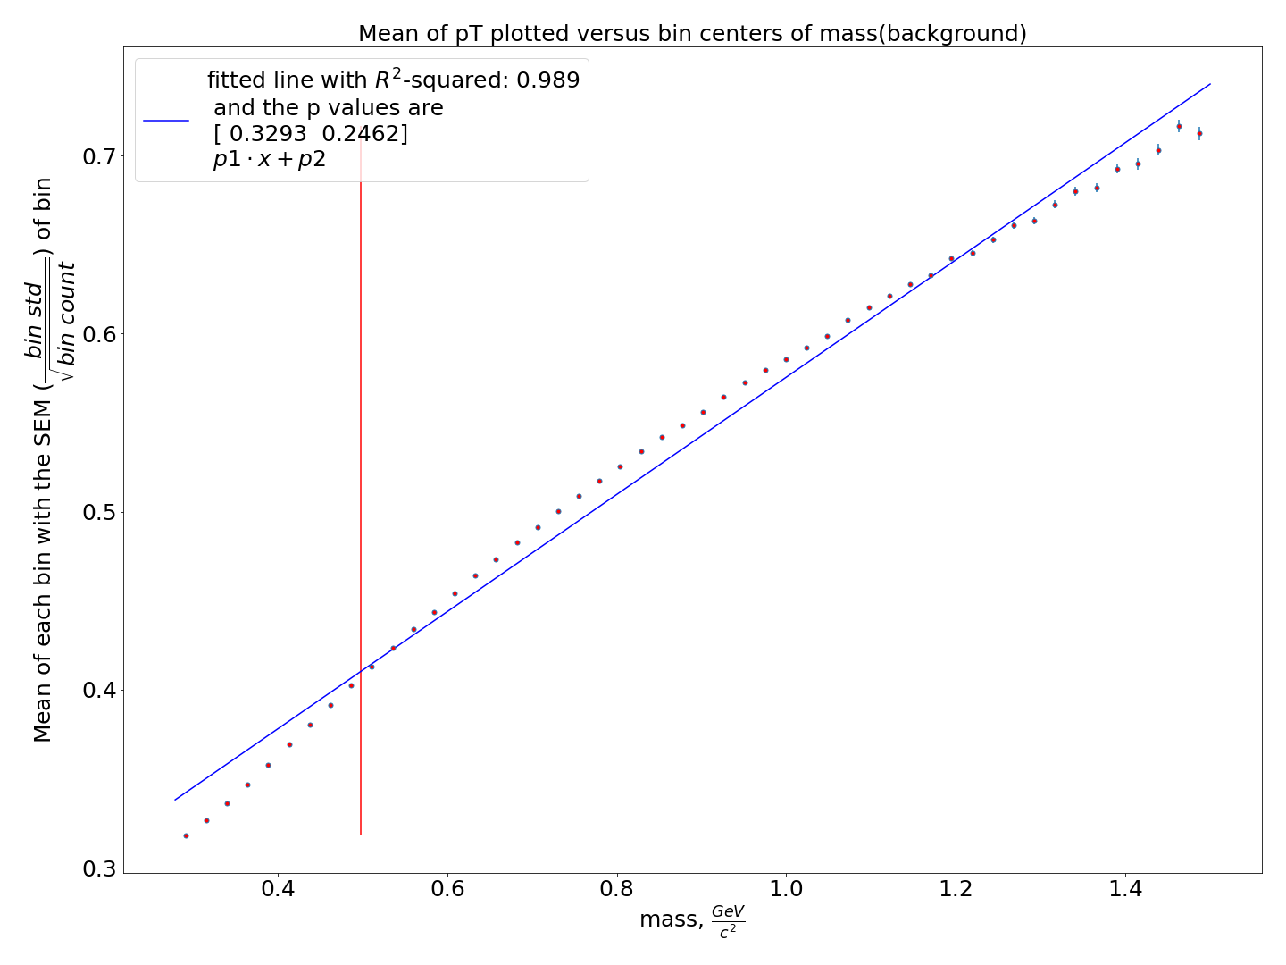
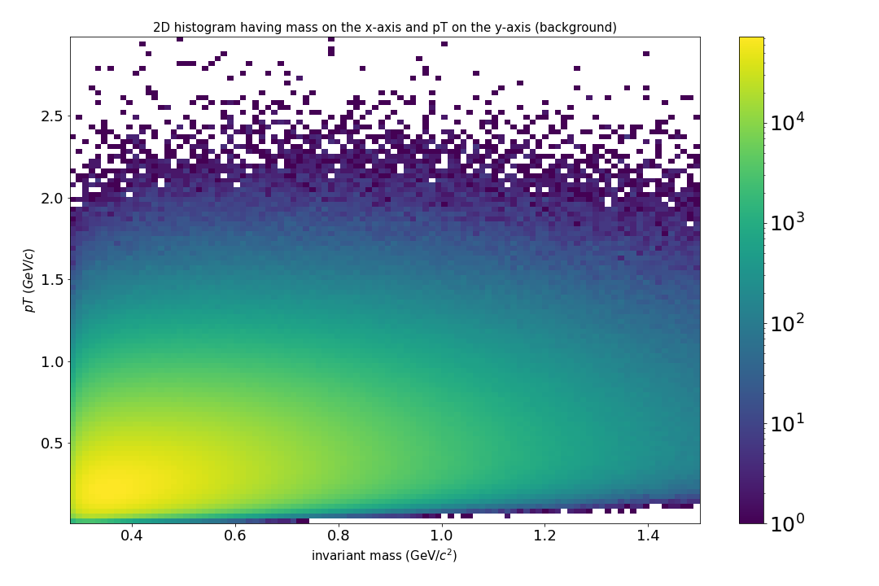
Correlation between pT and mass
R² = 0.989

Slide 29
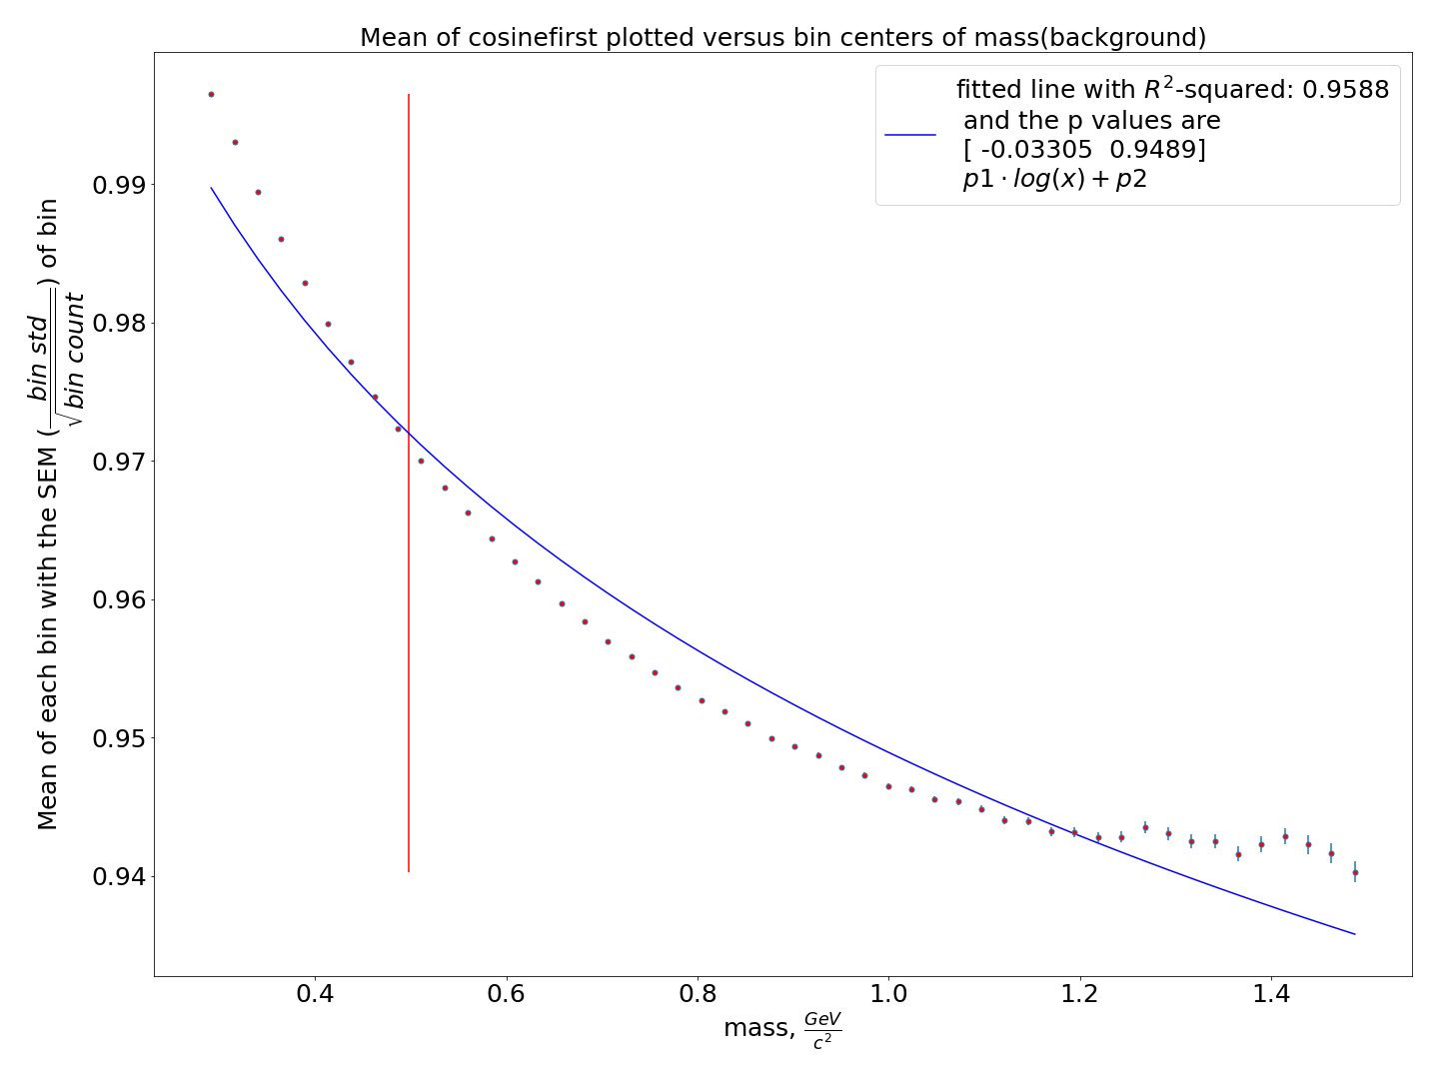
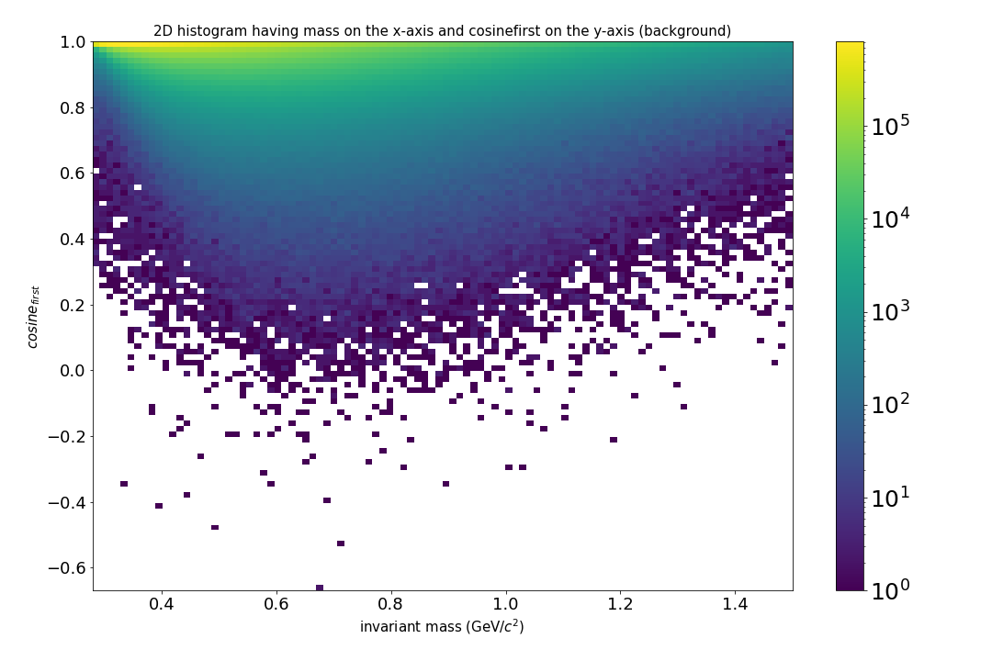
Correlation between cosine of angle between the pions momenta and mass
R² = 0.9588
The same histogram for cosinesecond (both pions have the same mass)

Slide 30
Correlation between variables - conclusion
Pseudorapidity, p, p_{z} and p_{T} are strongly correlated with the invariant mass
Therefore, they should be excluded from the training of the ML algorithm

Slide 31
5. Work in progress
Training of the machine learning algorithm for the values selected manually two weeks ago:
L/ΔL - distance between primary and secondary vertex divided over its error
DCA - distance of closest approach between pion tracks
χ2 geo - dimensionless distance of closest approach between pion tracks
χ2 topo - dimensionless distance of closest approach between extrapolated kaon trajectory and primary vertex
χ2 prim - dimensionless distance between extrapolated secondary track and primary vertex
Presentation with the selected values here

