Slide 2

SLC #1
SLC #2
SLC #1
SLC #2
?

Slide 4
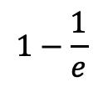



$$γ_{0}$$
Coherence
$$1−\frac{1}{e}$$
$$γ_{inf}$$
12-day coherence
Intf. 3
$$τ$$
Temporal baseline
Intf. 2
Coherence of interferogram 1

Slide 5
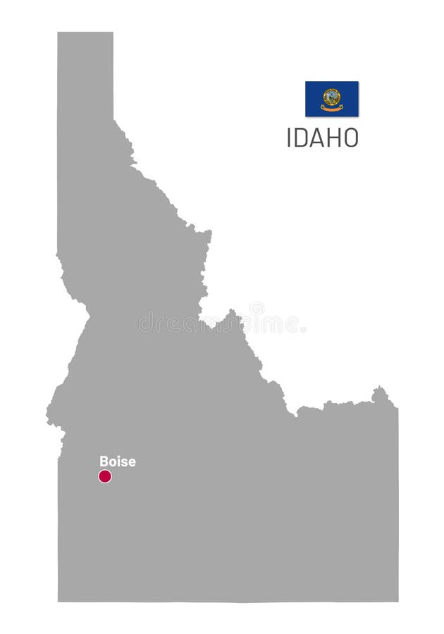
Boise

Slide 6
