Slide 2
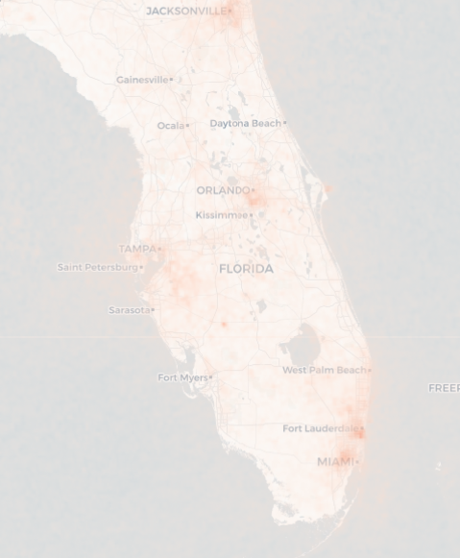
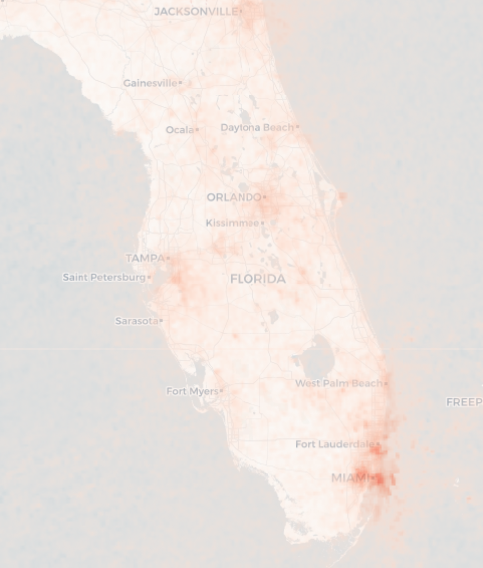
Before and after Florida forest fires
28-12-2020
04-01-2021
Notes:
https://maps.s5p-pal.com/no2/

