Slide 1
JASP
Absence of Evidence vs Evidence of Absence

Slide 2
Why Bother with Bayesian Stats?
Frequentist statistics are good at quantifying that there is an effect, but poor at quantifying evidence for the absence of an effect.
If I generate random numbers with m=0.5, and sd=1, and do a t-test against zero. Is H0:m=0 or H1:m≠0 true?
So as n increases, how should p behave?
If I generate random numbers with m=0, and sd=1, and do a t-test against zero. Is H0:m=0 or H1:m≠0 true?
So as n increases, how should p behave?

Slide 3
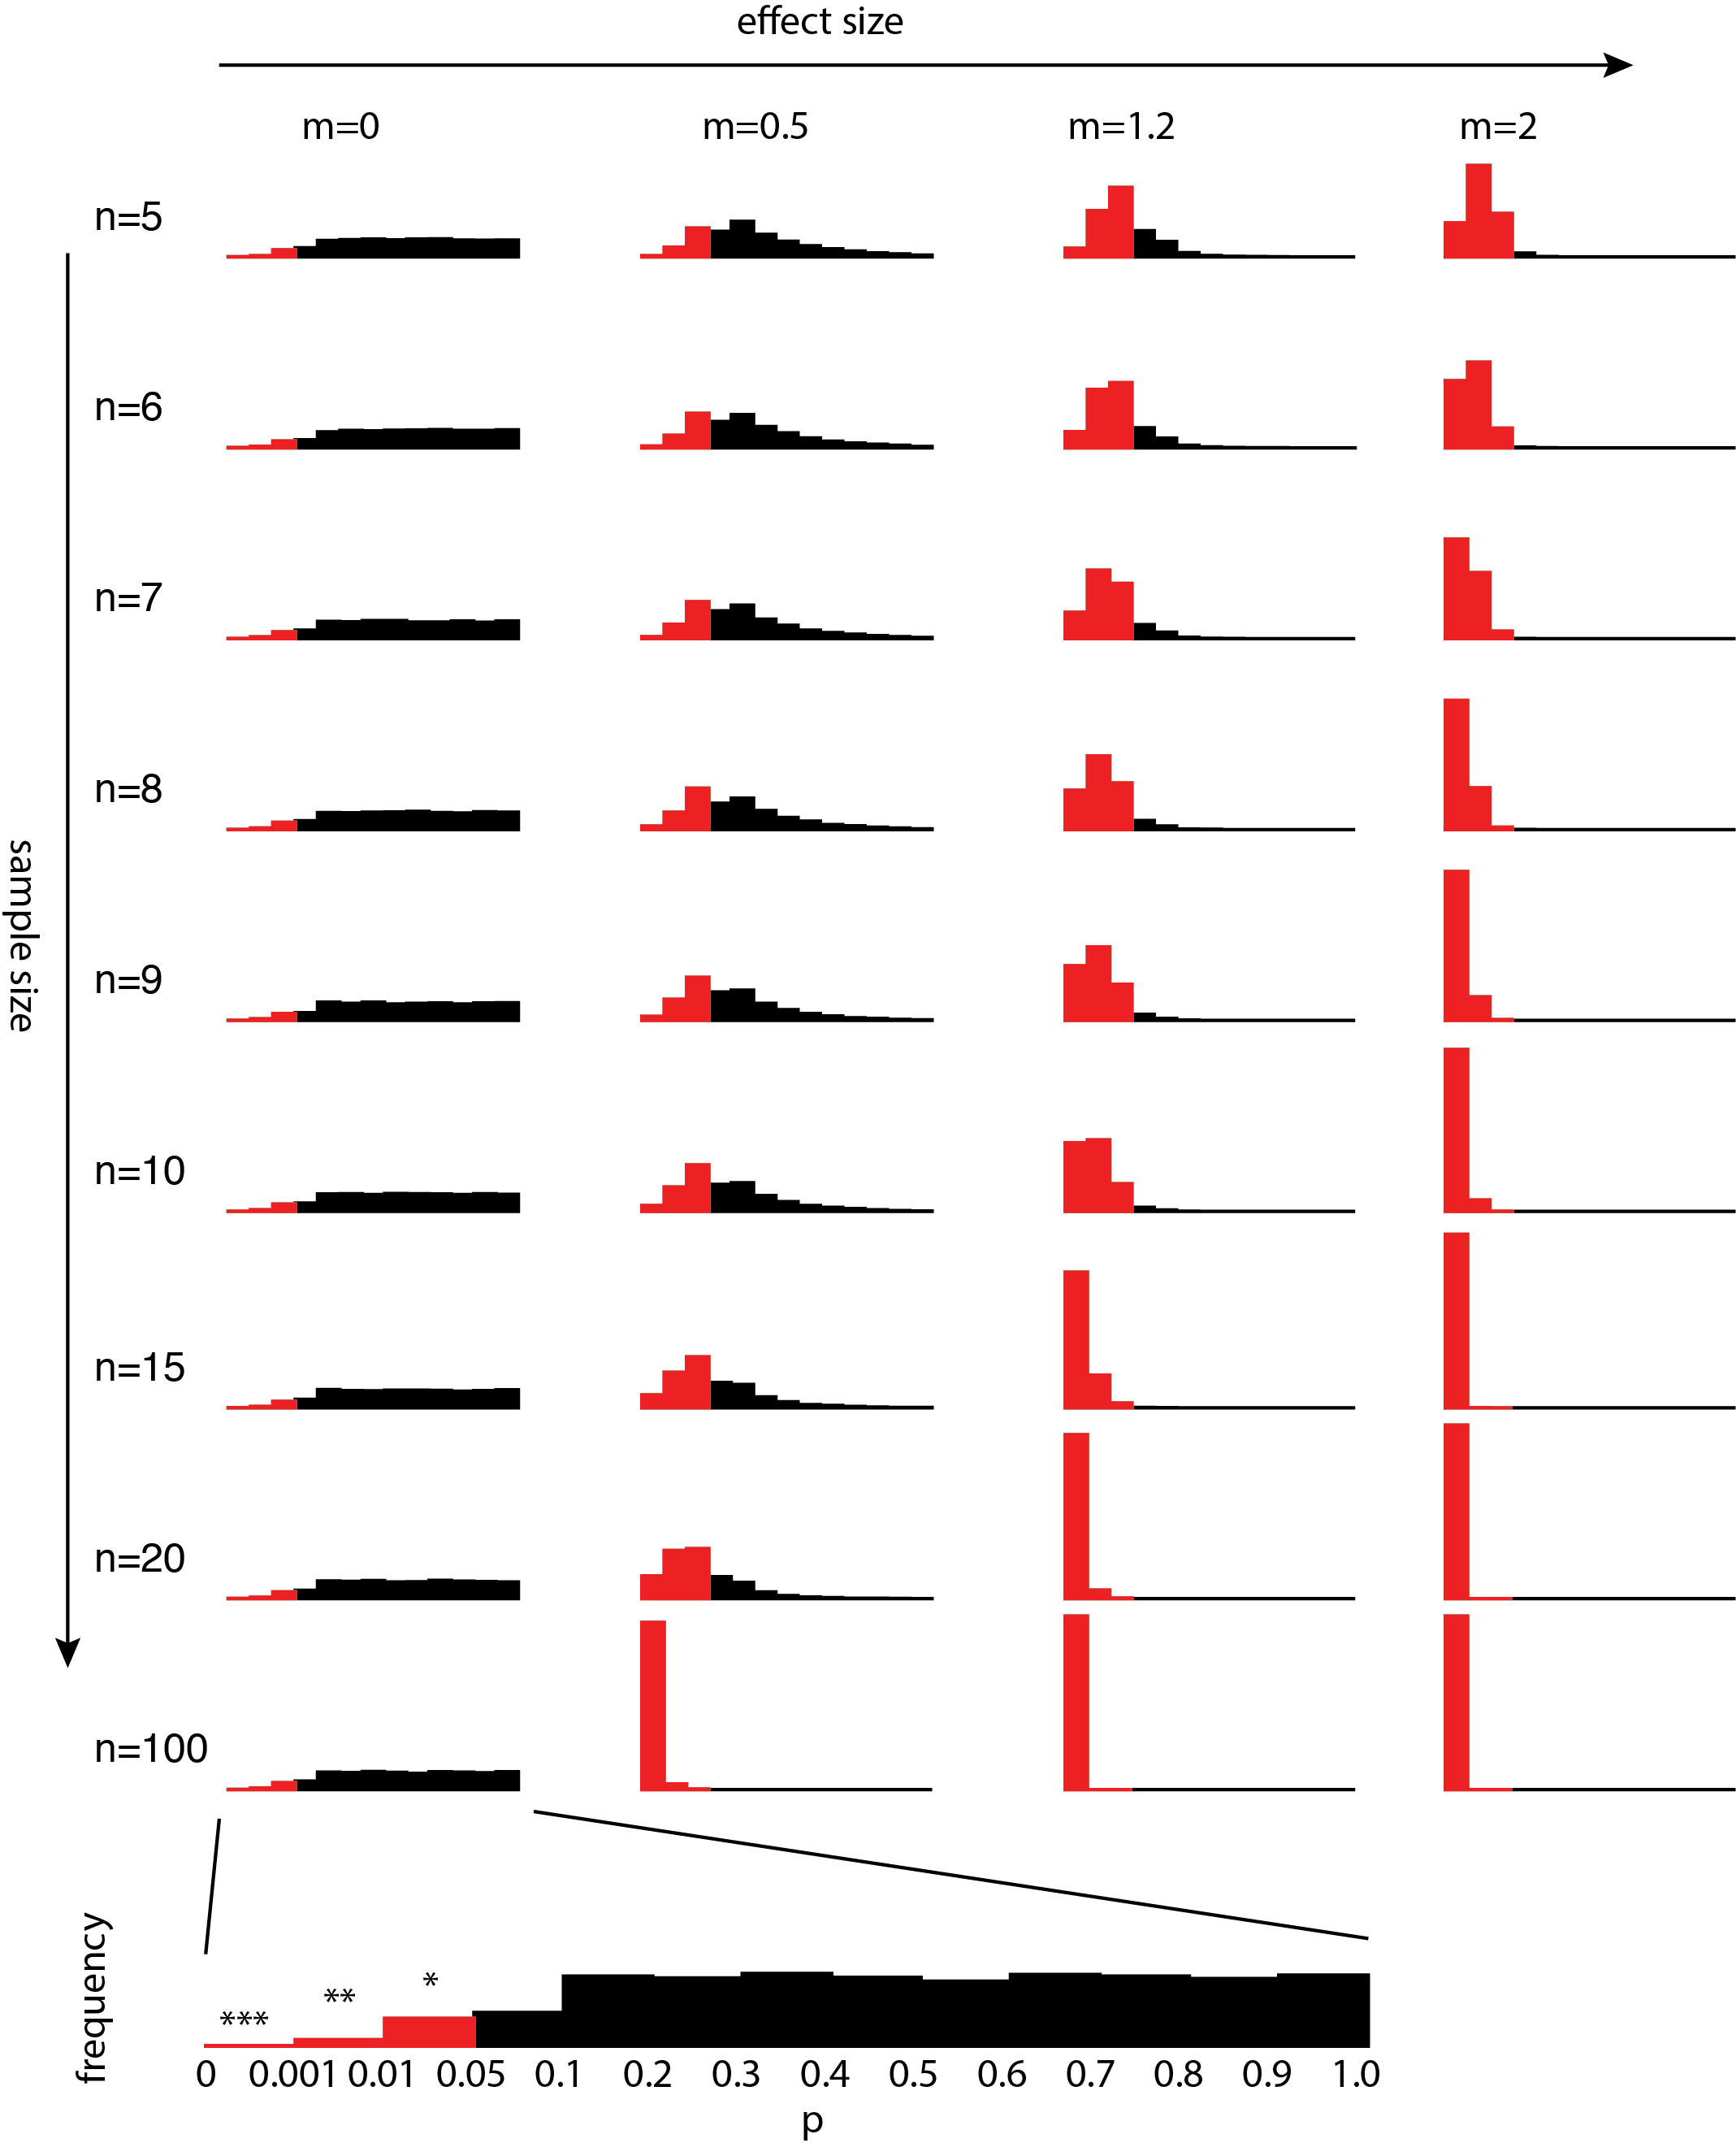

Slide 4
Evidence of Absence vs Absence of Evidence
Frequentist stats cannot easy tell you whether p>0.05 is absence of evidence or evidence of absence.
Often, however, we are interested in knowing the difference. Hypothetical scenario:
I want to know if region X is involved in a function. I interfere with X, and measure a behavior (performance or freezing). There should be three outcomes: (a) behavior is impaired, (b) behavior is not impaired, (c) sample size too small, I can’t tell yet… (a)=Evidence for H1, (b)=Evidence for H0 (evidence of absence), (c) no evidence (absence of evidence). Frequentist can provide (a), but not differentiate between (b) and (c)

Slide 5
Bayesian Approach
BF₁₀=p(data|H1)/p(data|H0). BF₀₁=p(data|H0)/p(data|H1)
BF relative plausibility
BF can go three ways: much higher than 1 -> Evidence for H1, much lower than 1-> Evidence for H0 (evidence of absence), around 1->Absence of Evidence.
Bounderies: 3, 1/3: moderate evidence; 10, 1/10: strong evidence. Otherwise no to anectotal.

Slide 6
 | m=0
 | strong | moderate | anecdotal | moderate | strong | very strong
n | 0-1/10 | 1/10-1/3 | 1/3-3/1 | "3-10 | "10-100 | 100+
5 | 0 | 0 | 9661 | 265 | 70 | 4
6 | 0 | 0 | 9668 | 261 | 70 | 1
7 | 0 | 0 | 9759 | 190 | 48 | 3
8 | 0 | 0 | 9733 | 216 | 48 | 3
9 | 0 | 2194 | 7541 | 199 | 63 | 3
10 | 0 | 3205 | 6535 | 200 | 55 | 5
11 | 0 | 3882 | 5898 | 179 | 41 | 0
12 | 0 | 4250 | 5522 | 186 | 37 | 5
13 | 0 | 4770 | 4986 | 175 | 63 | 6
14 | 0 | 5029 | 4778 | 142 | 46 | 5
15 | 0 | 5222 | 4563 | 161 | 54 | 0
20 | 0 | 6238 | 3558 | 148 | 52 | 4
100 | 0 | 8666 | 1248 | 65 | 21 | 0
500 | 7679 | 1836 | 443 | 29 | 13 | 0
1000 | 8505 | 1177 | 295 | 18 | 5 | 0
m=1.2
strong | moderate | anecdotal | moderate | strong | very strong
0-1/10 | 1/10-1/3 | 1/3-3/1 | "3-10 | "10-100 | 100+
0 | 0 | 5761 | 2931 | 1229 | 79
0 | 0 | 4651 | 3220 | 1940 | 189
0 | 0 | 3678 | 3268 | 2659 | 395
0 | 0 | 2851 | 3125 | 3344 | 680
0 | 2 | 2152 | 2933 | 3835 | 1078
0 | 2 | 1534 | 2566 | 4314 | 1584
0 | 2 | 1107 | 2139 | 4521 | 2231
0 | 1 | 902 | 1804 | 4418 | 2875
0 | 2 | 608 | 1515 | 4336 | 3539
0 | 0 | 414 | 1142 | 4125 | 4319
0 | 1 | 316 | 943 | 3614 | 5126
0 | 0 | 44 | 198 | 1725 | 8033
0 | 0 | 0 | 0 | 0 | 10000
0 | 0 | 0 | 0 | 0 | 10000
0 | 0 | 0 | 0 | 0 | 10000

Slide 7
Implementation
BayesFactor package in R
JASP
Remember: normally distributed residuals still apply
Multiple comparison can still be a problem (beyond today)

Slide 8
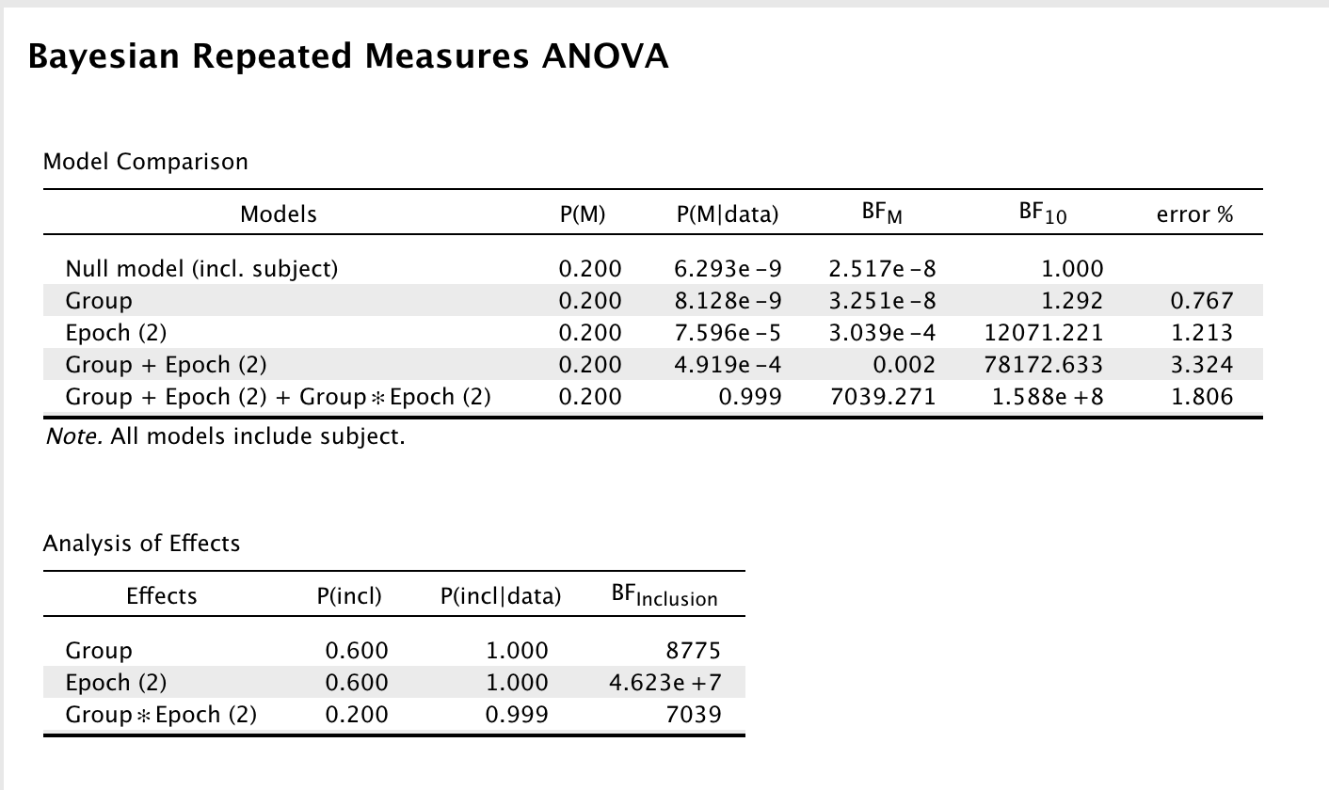
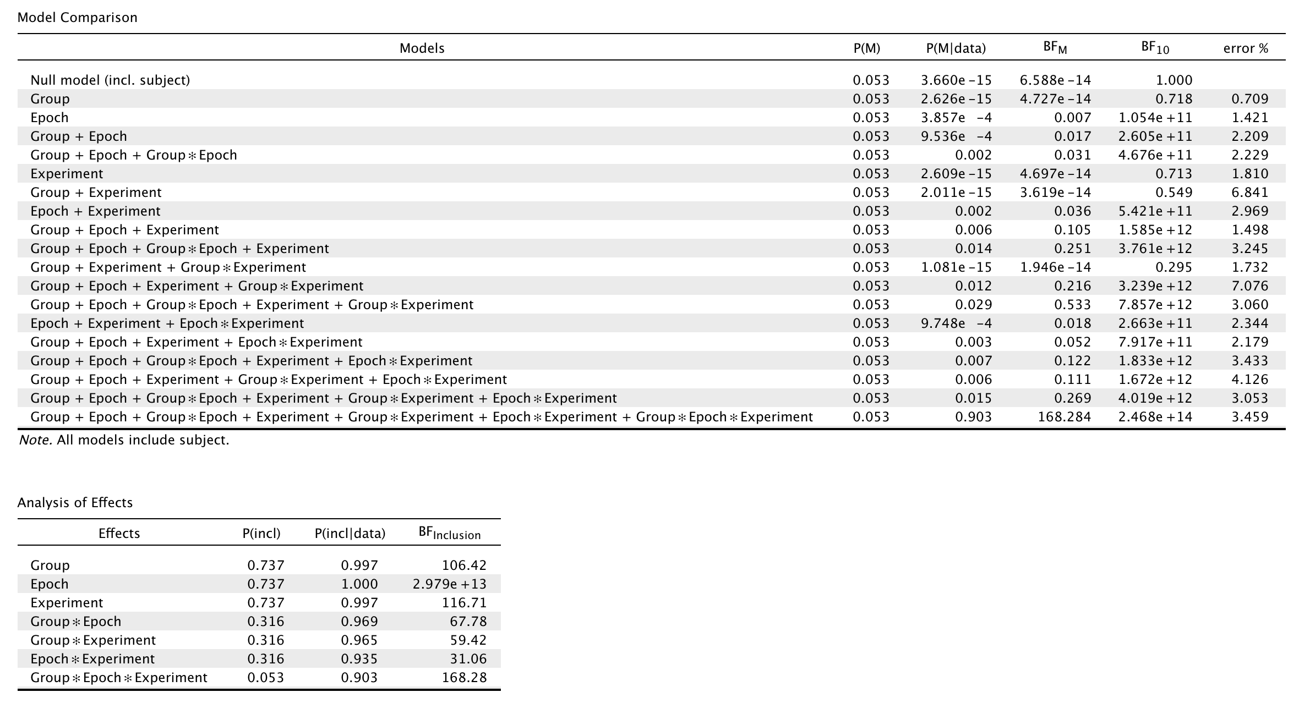
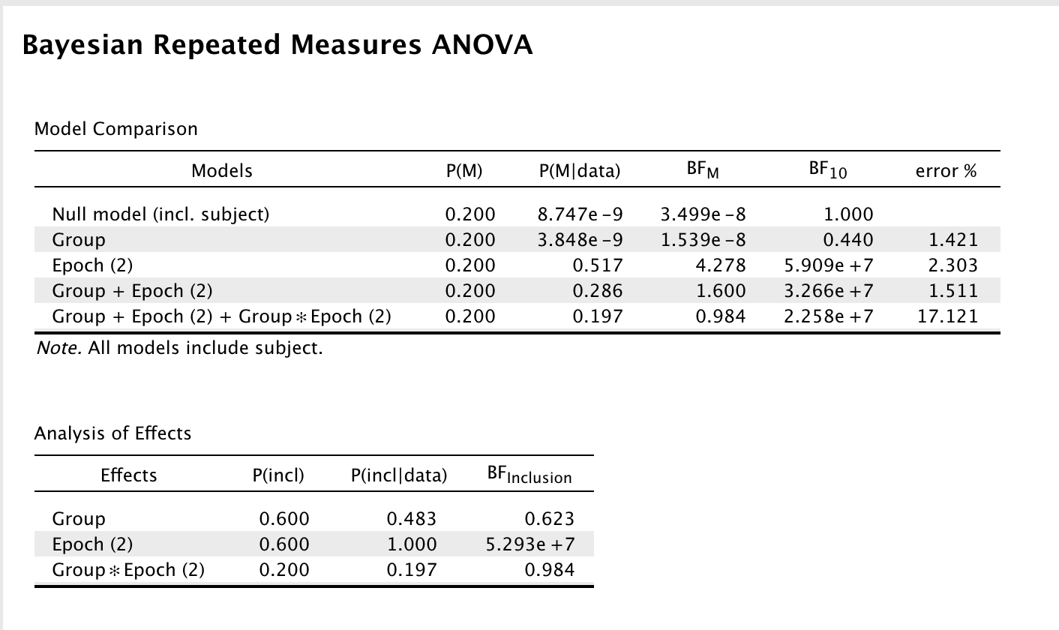
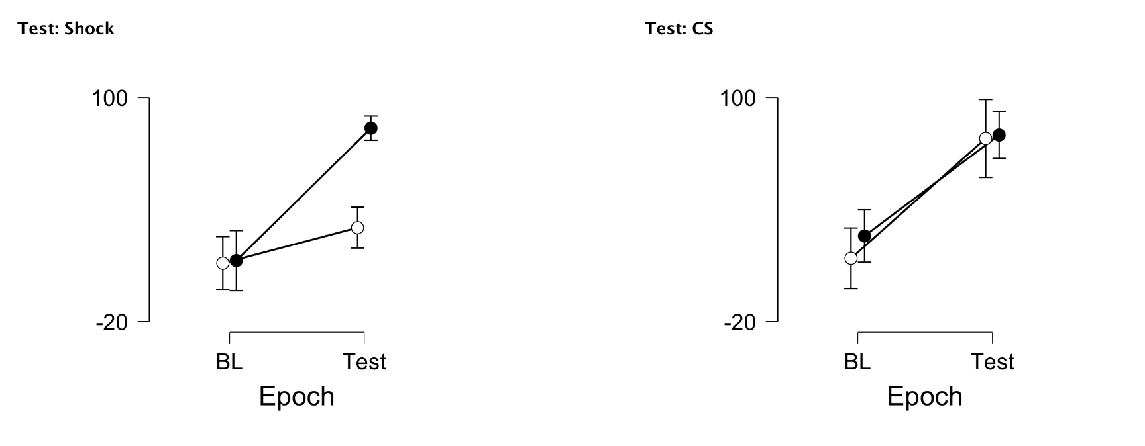
Example 1
Shock only
We inject muscimol in ACC vs. Saline
We measure freezing before (BL) and during shocks (Shocks)
We measure freezing before (BL) and during CS
Do we have an effect of Muscimol on Shock and/or CS triggered freezing
CS only
saline
musci

Slide 9
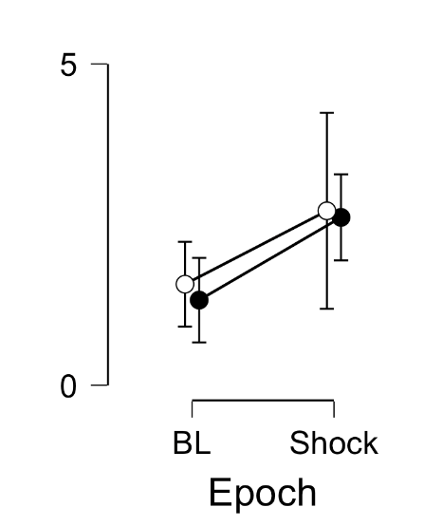
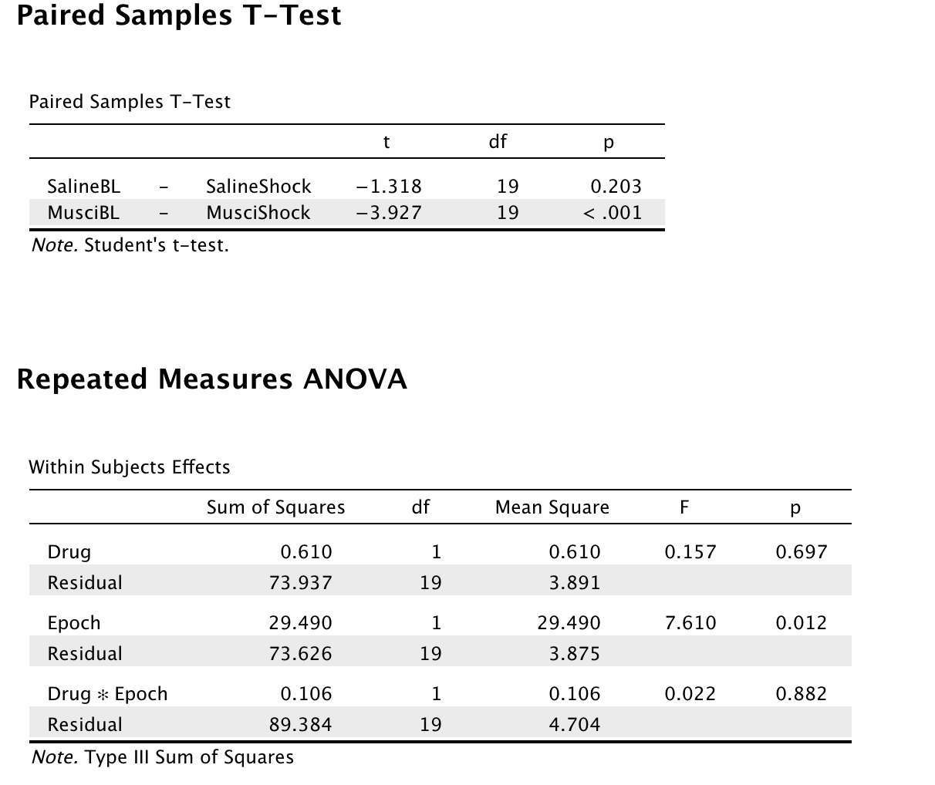
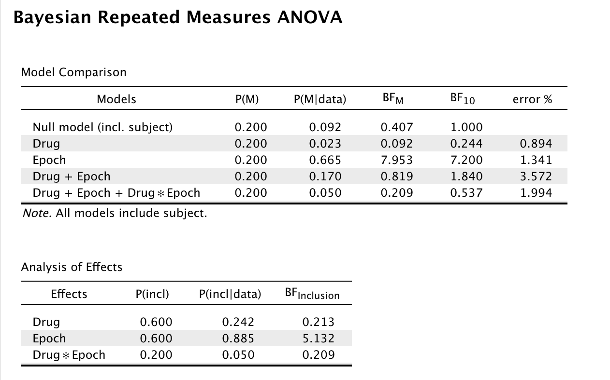
Example 2 – synthetic data
Difference between difference in significance vs. significant interaction
saline
musci

Slide 10
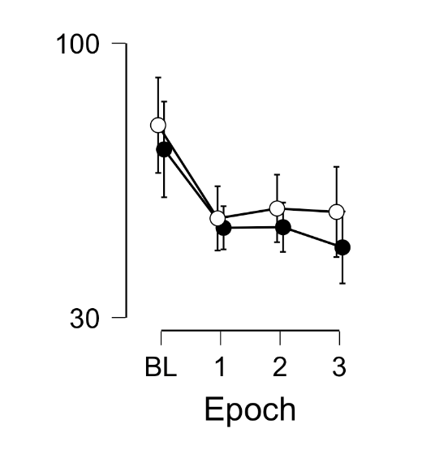
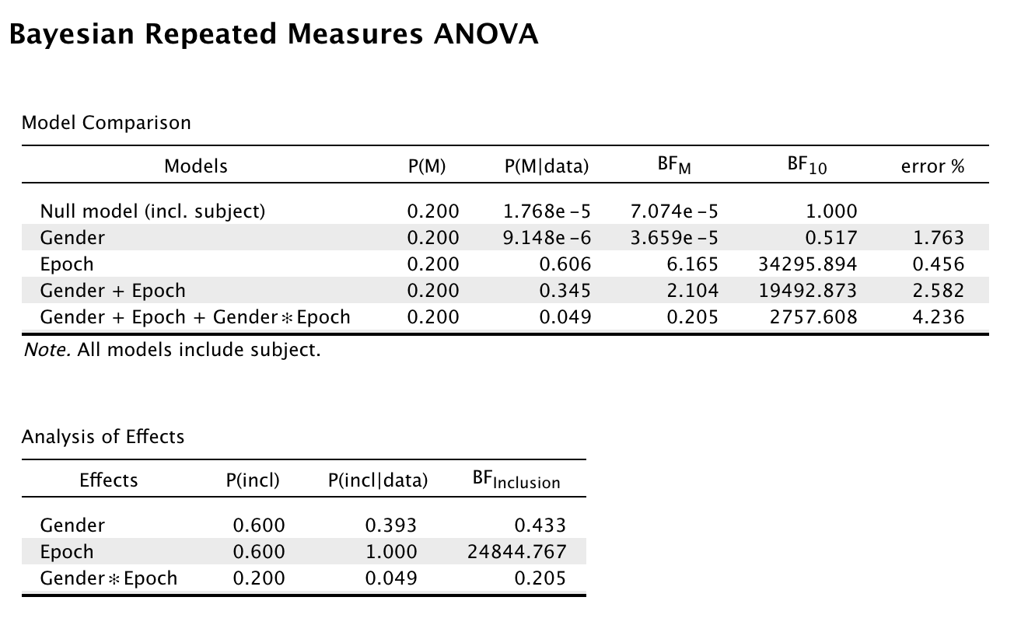
Example 3 – Julen, do males and femals switch similarly?
->overall preference appears to be gender independent, but this remains annecdotal
-> the effect of Gender on the change in pref is independent of gender

