Slide 1






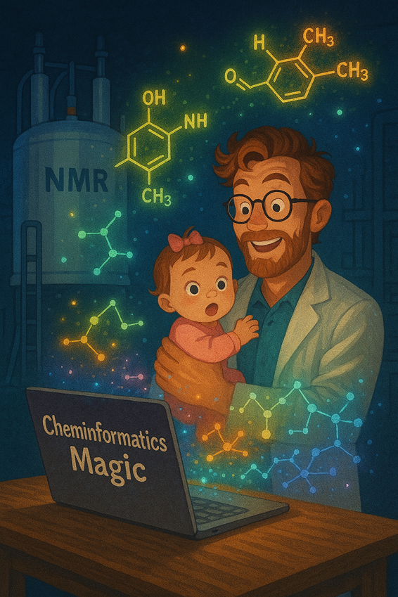
Ben Reiner
Education
BS Chemistry & Applied Maths, Boston College, 2013
PhD Organometallic Chemistry, Ohio State University, 2018
PostDoc Catalysis Informatics, University of Minnesota, 2019
Career @ Dow
Senior Research Specialist, Analytical Chemistry, Dow Core R&D, 2020 - 2024
Associate Research Scientist, Information Research, Dow Core R&D, 2024 – 2025
Research Scientist, MiLOS, Dow Core R&D, 2026 – present
Research: machine assisted synthesis, reaction modeling, material omics, spectroscopy & compressed sensing, predictive biodegradation, patent intelligence
Citizen Data Science and Digital Transformation
Digital Synthesis & Catalysis AI
Biomaterials Product Development

Slide 2
Agentic AI for Chemistry
The right tool for the right job
Ben Reiner, Dow · Presenter
With content contributions from James Wade
Created by humans for humans
Caltech AI-in-Chemistry Bootcamp · August 20, 2026

Slide 3
Key ideas for meaningful agents
1. Foundation
2. Right Choice
3. Optimizing
What is your training data, what assumptions are made, and how well is an underlying chemical space represented
When and where are agents critical as opposed to alternative mathematical approaches. Rubrics for evaluating data pipelines.
Details and interfaces matter. How we construct better prompts, more robust infrastructure, and self-improving pipelines.
Ground truth & data models
LLMs, statistics, quality metrics
Rationally engineered pipelines

Slide 4
PART 1
What can’t an agent know?
Data and knowledge foundations drive quality models
Notes:
5-second beat. Move quickly to content.

Slide 5
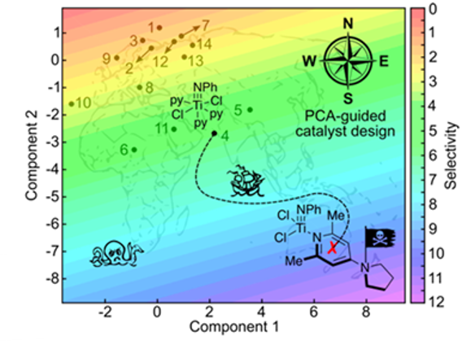
DEFINITION
Chemical Domains
A formulated abstraction of a physical space a mathematical operator uses for navigation and context, while pursuing or optimizing single or multiple objectives.
FOR EXAMPLE
In practice: the available synthetic space for a reaction of choice including conditions, reagents, catalysts, solvents, etc. represented as a matrix or tensor.

Slide 6
Training Set Bias
Ideal data
Real data
• Homogenous
covers a large, expansive chemical domain, with equal coverage across the space
• Dense
each part of the space is heavily covered by real experimental data points
• Interpolation
local models capture appropriate nuance and activity cliffs within your chemical space
• Extrapolation
new data is at least partially predicted by the existing corpus and can be easily ingested for augmentation
• Heterogenous
covers a small or spotty amount of chemistry with heavy density in only a handful of spaces
• Sparse
chemical space is undersampling and critical areas have little or no data
• Model instability
poor data quality ensures surrogate models do not capture local structures or clustering
• New Data Breaking
new data can’t be easily included in the old training or represents a whole new mechanism

Slide 7
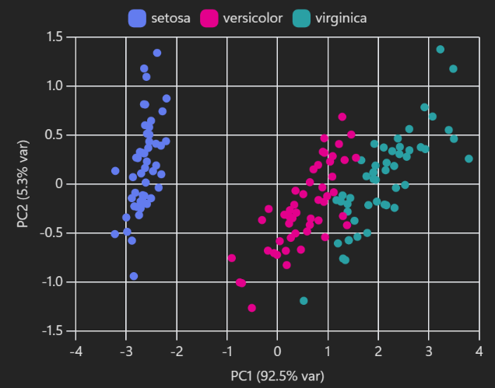
Data Visualization
Fluency in a few dimension reduction techniques will dramatically accelerate your ability to predict when an agent will behave…or not
PCA
principal component analysis
UMAP
uniform manifold approximation & projection
SOM
self-organizing maps
Graphs

Slide 8
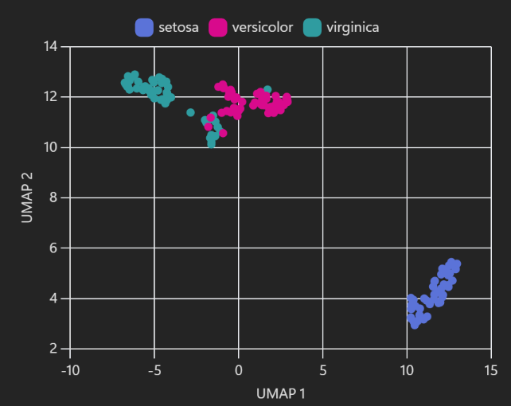
Data Visualization
Fluency in a few dimension reduction techniques will dramatically accelerate your ability to predict when an agent will behave…or not
PCA
principal component analysis
UMAP
uniform manifold approximation & projection
SOM
self-organizing maps
Graphs

Slide 9
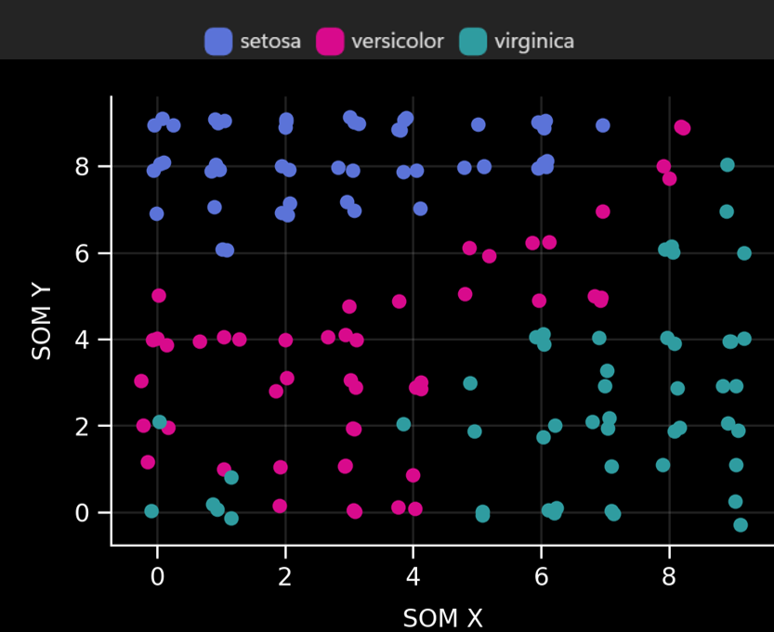
Data Visualization
Fluency in a few dimension reduction techniques will dramatically accelerate your ability to predict when an agent will behave…or not
PCA
principal component analysis
UMAP
uniform manifold approximation & projection
SOM
self-organizing maps
Graphs

Slide 10

What’s in a Name? Analytical characterization data
Your navigable chemical space is defined by your domain but your objective is defined by your characterization data. Unknown characterization issues will contaminate any mathematical treatment of your data.
Reaction
Characterize
Analyze
Plan
Bad calibration (SEC)
Unknown response factors (LC-MS)
Matrix effects (NMR, FTIR)
Data processing variance
Heteroskadicity

Slide 11
TAKE A MOMENT
Think about all the steps you need to reproduce your chemistry – can you translate that programmatically today?

Slide 12
Self-driving labs (SDLs) require autonomous agents to make decisions without humans
Reaction Robotics
Characterization
Decision-Maker
The physical machinery responsible for actually conducting the reactions including weighing reagents and solvents, heating or cooling, mixing, and purifying the crude material.
Sensors and instruments designed to measure expected and unexpected products and impurities. Ideal SDLs will have robots which can sample prep, load, and even optimize the characterization.
A mathematical operator, with or without human intervention, which can decide which next experiment(s) to pursue based on known objectives or criteria.
do the chemistry
see what you made
plan next best experiment

Slide 13
SDLs Safety Checks & Guardrails
✓ Good practices
✗ Bad practices
+
Physical stops
−
Programmatic stops
reactions have overheat protection, robotic arms can not physically swing out of a known space, etc.
csv files containing “bad” reagents, hard coded boiling points, instrument overrides, etc.
+
Human-in-the-loop
−
Zero human check or intervention
human check-in built at key decision points, parallel “race” against human operators to assay bias, etc.
long running SDLs, no protocols for refilling reagents, no manual audits of data or decisions
+
Auditable data & decision-making
−
Irreproducible pipelines
git and annotation for the code, management of change (MOC) documentation, etc.
worst extraction task; each one becomes an archaeology project

Slide 14
Knowledge check: Data Corruption
Where will an autonomous agent fail when analyzing the data represented in the table below?
reagent | CASRN | amount: mmol | phase | concentration: % | role
toluene | 108-88-3 | 20 | liquid | 100 | solvent
Pd(PPh3)4 | 108-88-3 | 0.05 | solid | 100 | catalyst
p-chlorotoluene | 106-43-4 | 0.6 | liquid | 50 | reagent
octylamine | 111-86-4 | 0.5 | liquid | 40 | reagent
Notes:
A, C, F

Slide 15
PART 2
A Calvacade of Choices
Guidelines for choosing a mathematical approach to chemistry problems

Slide 16

DEFINITION
What is an agent?
An agent is a large language model (LLM), in a harness (programmatic wrapping), that calls tools repeatedly in a loop, deciding each next step from the last result.
FOR EXAMPLE
User: Delete all the csv files in the current directory.
Claude: Run the ls() tool
ellmer: a.csv, b.csv, a.R, b.R, c.R
Claude: [Run rm("a.csv"), Run rm("b.csv")]
What is an agent? - by Hadley Wickham

Slide 17
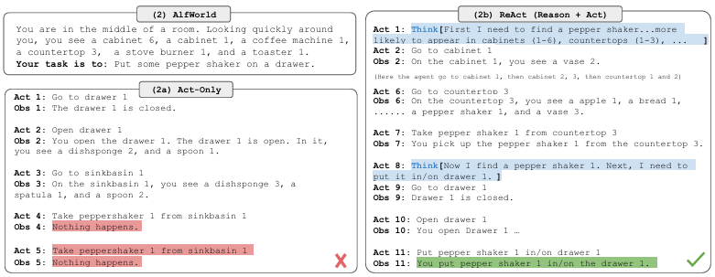
An agent using reasoning (“re”) and acting (“act”) framework to combine chain of thought reasoning with external tool use to complete complex tasks.
DEFINITION
ReAct Agent
REACT: Synergizing Reasoning and Acting in Language Models

Slide 18
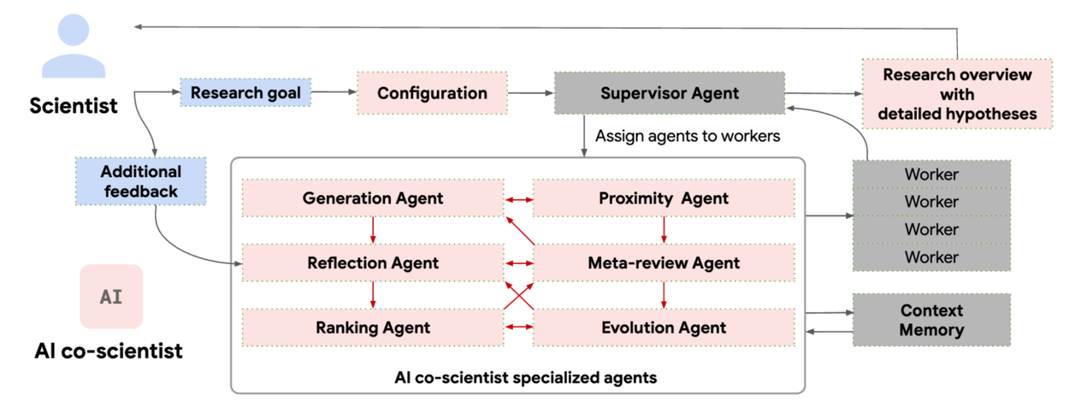
DEFINITION
Multi-agent system built on Gemini 2.0 as an AI collaborator designed to help scientists generate new hypotheses and accelerate discovery
Co-scientist
Accelerating scientific breakthroughs with an AI co-scientist

Slide 19
Taxonomy of Problems
Scientific problems exist on a spectrum ranging from inappropriate to perfectly poised for LLM-based agents
A/B Hypothesis Testing
Classification
do two catalyst have the statistically different turn over number? does one polymer have disproportionately higher shear strength?
classify reagents into good/medium/bad partners for Negishi couplings
Regression
Semantic Analysis
find the best polynomial fit between heterocycle pKa and reaction rate using a linear least squares regression
find all mentions of PFAS and their synonyms in the patent and open literature and analyze their occurrence per market segment

Slide 20
TAKE A MOMENT
What is a problem that does not require an LLM “brain”? What is a problem that critically requires one?

Slide 21
Rubric for Choosing the Right Tool
Thinking critically around the “job to be done” will help you build an ideal pipeline
Can I represent the problem mathematically?
matrices are easy to subject to canonical data science pipelines
Does a statistical test already exist?
problems that can be reframed into friendly statistical tests should not require an LLM
Is there an “off the shelf” trained ML model available for the task?
don’t rebuild the wheel especially for computationally expensive efforts
What have other researchers used in the past?
wisdom of the crowd is imperfect but a good canary for problem classification
Who is your solution audience?
does the answer need to make sense to a human, a digital agent, matrix algebra, or all 3?

Slide 22
Knowledge check: Choose Wisely
What is a representative data science tool you would use to approach the 3 problems below?
Problem #1
Problem #2
Problem #3
Optimize the reaction conditions of a Buchwald-Hartwig couplings using a set of 40 phosphine ligands
Determine the economic impact of patents across a corpus in a particular technology segment
What are the key factors driving selectivity in a Chan-Lam coupling with reagents above and below 10K g/mol
optimization
analysis
learning
Notes:
A, C, F

Slide 23
PART 3
Optimizing prompts & pipelines
How to build better, cheaper, modular tools a stranger can reuse and augment

Slide 24
Robust Pipelines: Industrial Perspective
✓ Good pipelines
✗ Bad pipelines
+
Env/dependency files
−
“Rotting” code
Virtual environments, dependency files, frozen models, served endpoints
workhorse packages and models regularly update and should not be pipeline breaking
+
Clear task delineation
−
Hyper-specific tooling/tasks
readme files and annotated code which details the purpose and output of each code chunk
limited tidy data flows or imperfect abstraction leads to a one tool – one solution problem
+
Efficient and low-cost
−
Irreproducible or stochastic
models are right-sized to purpose, leverage matched language and tool calls, optimized search algorithms
require a data owner for start-up and/or gives different answers every time

Slide 25
Thinking About Cost Models
Sometimes the most expensive part of doing science…is you
R&D
AI Agents
People
Not all problems require solutions and sometimes the cheapest answer is the one you already have.
Misused, misunderstood, or misappropriate AI pipelines can be worse than having no solution in hand at all.
Learning how to integrate human and machine intelligence will ultimately lead to faster discovery.
does a problem need solving?
do people need to solve this?
do I have the right people?
Notes:
A, C, F

Slide 26
Ideas for Cheaper Agents & Development
Cheaper can be defined by time, $$$, or people labor/stress
Copilot (via Google)
exceedlingly fast and cheap for quick code inserts or syntax checks
CLI proxies
add-ons like “rtk” reduce token consumption by compressing commands before reaching the LLM
Model matching
tasks that do not require high reasoning can use low level models such as Claude haiku
Claude skills & Copilot agents
building purpose-built skills can help give long prompts over complex tasks a second life
Designing code for re-use
the cheapest agents can interact with a broader ecosystem built from inception for modularity

Slide 27
DSPy: programs, not prompts
How to build language-model programs you can measure, optimize, and hand to someone else
SIGNATURES
OPTIMIZERS
dspy.Flex
Notes:
Framing: this is not a talk about what LLMs can do. It is a talk about how to build with them the way you build any other instrument method - with a written procedure, a calibration set, and a number that says whether it works.

Slide 28
Hand-tuned prompts are not reproducible, and nothing warns you when one stops working
Model drift
No transfer
No measure
Phrasing tuned for one model can stop working the week the provider ships an update. Nothing tells you it degraded.
What you work out by hand about one model's quirks does not carry over to the next model or the next task.
Without a metric and a held-out split, "this prompt is better" is an impression formed on three examples.
DSPy answer is to compile the prompt from a metric and a dataset instead of editing it by hand.
Notes:
Ask the room how they currently keep track of a prompt that worked. Answer is usually a chat message or a code comment. That is the problem.

Slide 29
DSPy splits an LM program into four parts you can version, test and optimize
SIGNATURE What goes in and what comes out, as a typed contract.
MODULE
How the work is done: Predict, ReAct, RLM, Flex.
METRIC
What counts as a good answer, defined in code.
OPTIMIZER
Searches for a better program under that metric.
You can change one part without rewriting the others. For example:
swap the module (how prediction is done) and keep the signature (inputs and outputs)
swap in a cheaper model and rerun the optimizer
tweak the metric and the entire program updates against it.
That is why a DSPy program survives a new model release without a rewrite.
Notes:
Signature = what. Module = how. Metric = what good means. Optimizer = the search. Everything else in DSPy sits on these four.

Slide 30
A signature is a typed contract for the task rather than a prompt for one model
InputField marks what the program is given. Every OutputField is a result that each competing implementation must return. The docstring is the task description, and an optimizer is allowed to rewrite it.
class ExtractBoilingPoint(dspy.Signature):
"""Extract the compound and normal boiling
point from the record. Convert to kelvin.
Return needs_review=True if the value is
missing, conflicting, or only a range."""
text: str = dspy.InputField()
compound_name: str = dspy.OutputField()
boiling_point_K: float | None = dspy.OutputField()
evidence: str = dspy.OutputField()
needs_review: bool = dspy.OutputField()
Notes:
Point out that the docstring is not decoration - it is the task description the optimizer is allowed to rewrite. The type annotations do the parsing work for you.

Slide 31
Written feedback beat reinforcement learning on six tasks, using far fewer runs
35×
+10%
~75×
fewer rollouts than GRPO reinforcement learning, across six tasks
over MIPROv2, the leading prompt optimizer, and +12% on AIME-2025
cheaper: Shopify moved a GPT-5 task onto a small Qwen model and optimized it
GEPA reads the trajectories of its own failures and writes the next candidate. That beat thousands of policy-gradient rollouts on the same six tasks.
Notes:
GEPA numbers are from the paper (arXiv:2507.19457, ICLR 2026 oral). The comparison is against GRPO, a reinforcement-learning method that needs thousands of rollouts. The Shopify and Dropbox figures are self-reported in the DSPy docs - present them as reported, not measured by us.

Slide 32
Run, score with feedback, reflect, propose, keep the winners: that is the whole loop
RUN
Program on training examples
SCORE
Metric returns a number and a reason
REFLECT
Model reads traces and failures
PROPOSE
New instructions, or new code
KEEP
Winners on the Pareto frontier
Two models with different jobs. The student model runs the program you are optimizing. A separate reflection model reads what went wrong and writes the next candidate; it is called only a handful of times, so it costs little. When you are optimizing a small model, reflect with a large one.
Notes:
The key mechanism: the metric returns a score AND a sentence. Pareto selection keeps candidates that win on some examples rather than only the single best average.

Slide 33
The metric is where your chemistry judgement enters, and it returns a reason as well as a score
score decides which candidate wins.
feedback is read by the reflection model. It is how you tell the optimizer what a chemist would object to.
A small per-call penalty makes the optimizer prefer the cheaper program only when accuracy holds.
def chemistry_metric(example, pred, ..., program_trace=None):
s = component_scores(example, pred)
calls = len(program_trace or [])
penalty = min(0.10, 0.02 * calls)
return dspy.Prediction(
score=max(0.0, s["scientific"] - penalty),
feedback="Numerical parsing and unit "
"conversion can be deterministic "
"when the text is explicit.",
)
Weight the parts a reviewer would defend: the value, the compound, the exact supporting substring, and the decision to abstain.
Notes:
This is the slide to dwell on. The metric is the only place your domain judgement enters the loop. If the metric is wrong, the optimizer will faithfully optimize the wrong thing.

Slide 34
dspy.Flex makes the program's source code the thing being optimized
It starts as a baseline
GEPA rewrites the source
It runs in a sandbox
A Flex is built from a signature and starts as a single dspy.Predict, or a dspy.RLM if you hand it tools.
Instead of only rewriting instructions, GEPA proposes a whole new module: split predictors, plain Python, helper functions.
Optimizer-written code never runs in your process. It executes in a Deno sandbox; only real model calls bridge back out.
What gets searched is the program itself, and your metric decides which version survives.
Notes:
Flex is where prompt optimization becomes program synthesis. Declare program_trace in the metric signature and GEPA passes the execution trace, letting you penalize model calls.

Slide 35
A worked example: does boiling-point extraction actually need a language model?
40 training, 15 validation and 20 held-out records of chemical-property statements: explicit kelvin, Celsius that needs converting, distractor numbers, ranges, conflicts and missing values. All three implementations get the same signature and the same metric. The dataset decides which one wins.
MANUAL PARSER
Regular expressions and arithmetic. Zero model calls, and brittle by construction.
DIRECT PREDICTOR
dspy.Predict sends the signature and the record to the student model. One call each.
FLEX + GEPA
Starts as a predictor; the optimizer may replace the whole module. Zero or more calls.
The metric charges 0.02 per predictor call, capped at 0.10, so a correct one-call answer still beats a wrong zero-call answer.
Notes:
The honest outcome matters more than the flashy one: if the optimizer discovers the task is deterministic and writes plain Python, that is a result worth having. Run the notebook live if there is time.

Slide 36
When the context is too big to read, dspy.RLM has the model explore it with code
PEEK
The model sees metadata and a preview, not the whole text.
EXPLORE
It writes Python in a sandbox to search and filter.
ASK
llm_query() runs a sub-model on the snippets it found.
SUBMIT
It returns typed fields your program can use.
Why this matters in a lab: supporting information runs to hundreds of pages, instrument logs to millions of lines, and a screening table will not fit in a context window. RLM keeps the data in a REPL and loads only the part the model asks for, and you can read the code it ran.
Notes:
Context rot: model quality degrades as context grows. RLM separates the variable space (data in the REPL) from the token space (what the model reads). Needs Deno for the sandbox.

Slide 37
What this buys you: reproducibility, a cheaper model, and an argument you can defend
It is version-controlled
Small models get good
You can defend it
The prompt stops being a paragraph in a group chat. Program, metric and splits live in git and rerun on demand.
An optimized small model often matches a hand-prompted frontier model, which matters when you pay per token out of a grant.
A metric, a held-out split and a printed program are things a supervisor or a reviewer can actually argue with.
When the next model lands, you rerun the optimizer against it instead of rewriting your prompts by hand.
Case studies reported in the DSPy documentation: Shopify (~75× cheaper, ~2× more reliable)
Notes:
Tie back to the group's own work: pick one curation or triage task someone in the room already does by hand.

Slide 38
References and further reading
• Google Research
Accelerating scientific breakthroughs with an AI co-scientist
• Wickam, H
What is an agent? - by Hadley Wickham
• Yao, S.
REACT: Synergizing Reasoning and Acting in Language Models
• rtk
GitHub - rtk-ai/rtk: CLI proxy that reduces LLM token consumption by 60-90% on common dev commands. Single Rust binary, zero dependencies · GitHub
• DSPy
Agrawal et al., GEPA, arXiv:2507.19457 (ICLR 2026) ; DSPy

