Slide 1
Design of Experiments
How to decide what data to collect to answer your research question
Alix Schmidt, Dow · Presenter
With content contributions from Matthew Malloure, Kaiwen Ma
Created using Claude Code
Caltech AI-in-Chemistry Bootcamp · August 18, 2026

Slide 2
Where you are in this workshop
• Yesterday afternoon
how to preserve data — data stewardship
• This morning
how to generate data on purpose — design of experiments
• Shared premise
your data is more valuable than you think; plan for it up front

Slide 3
Introduction to Statistical Thinking for Science
1. Statistical thinking
2. The DOE family
3. Analyzing your results
Signal, noise, factors, measurement. This is the language every DOE assumes you already speak. We'll build it up from EDA and the basic variance decomposition.
OFAT, factorial, fractional factorial, response surface, active learning. Different tools for different objectives — and what happens when you use the wrong one.
Fit the model, check whether the effect is real, interpret interactions, verify. The steps that turn a table of numbers into a defensible answer.
the foundation
the toolkit
closing the loop

Slide 4
PART 1
Statistical thinking — the foundation
Signal, noise, measurement, and what an experiment is trying to accomplish

Slide 5
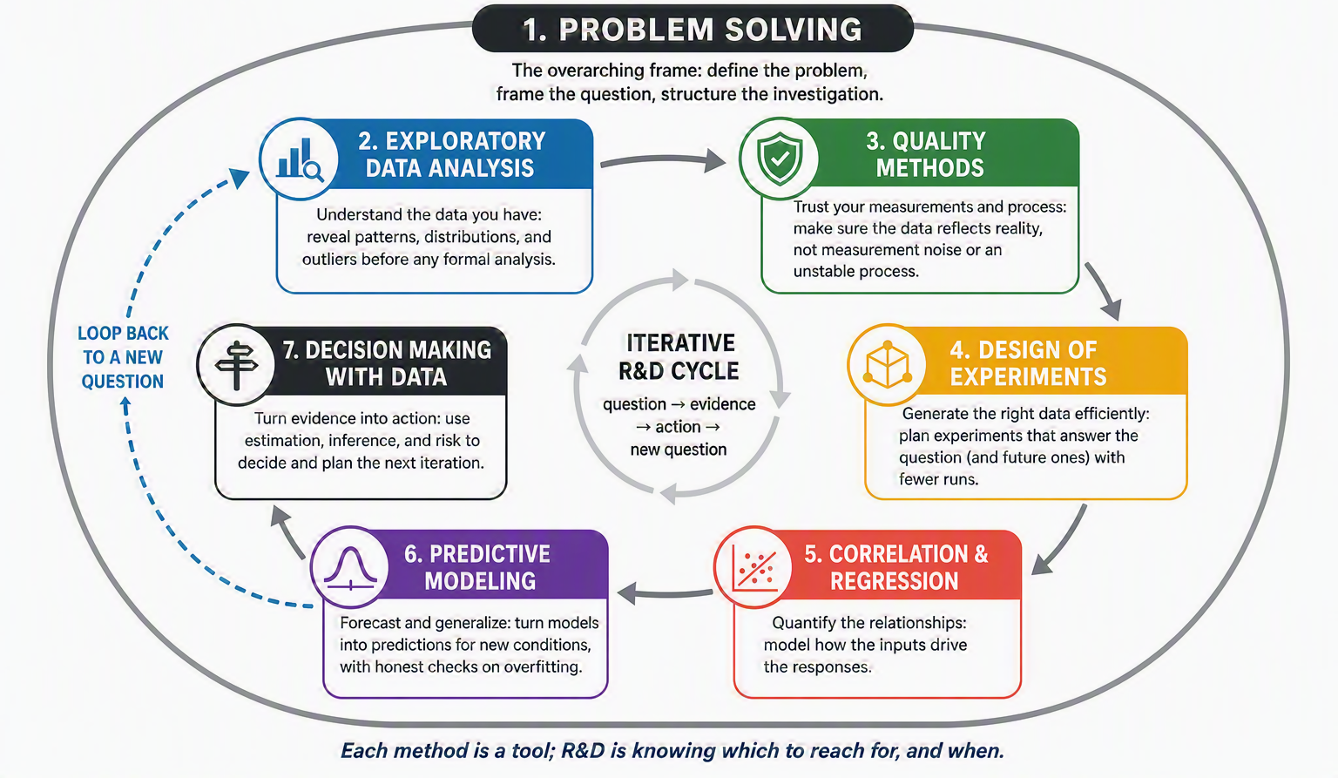
The R&D Problem Solving Toolkit
Frame the question
Generate trustworthy evidence
Model what matters
Decide what to do next

Slide 6
Foundation 1: Understanding data
HOW DATA IS BORN
Physical phenomenon
Structural noise
Random noise
The underlying data-generating system that exists in the world. It responds to external conditions based on physics. This is usually what we’re trying to study.
On top of the physical phenomenon, we have “other things that happened in the world that we aren’t strictly interested in.” Batches, operators, days, instruments, seasons.
Irreducible system, process, and measurement variability.

Slide 7
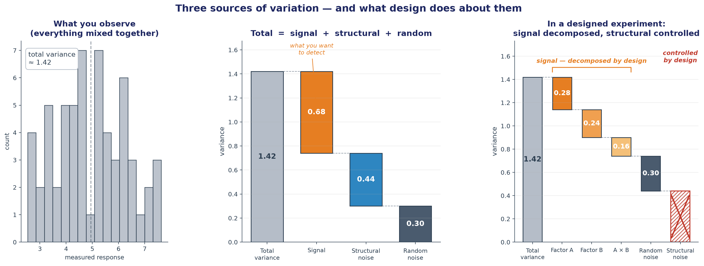
Data – measured observations – are a combination of all 3

Slide 8
Data – measured observations – are a combination of all 3
Total variance = signal + structural + random. Design is how we keep the signal from getting mixed up with the other two.

Slide 9
Data – measured observations – are a combination of all 3
Total variance = signal + structural + random. Design is how we keep the signal from getting mixed up with the other two.

Slide 10
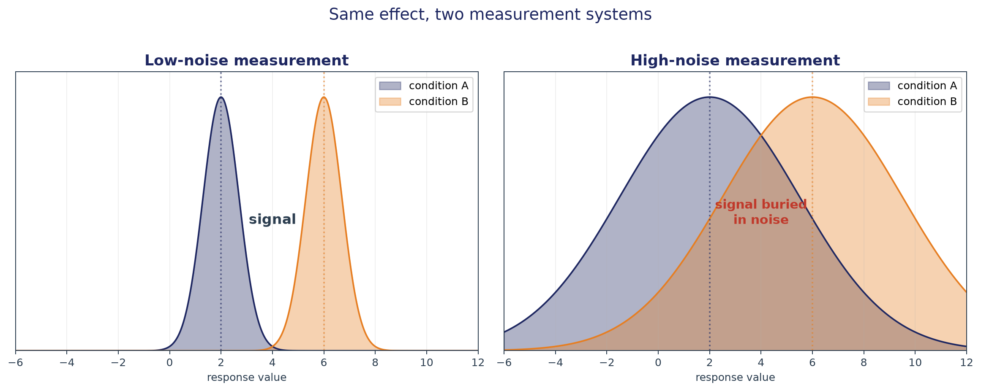
Foundation 2: Separating signal from noise is the goal
Same real effect, two experimental systems. On the left, the effect is clear and easy to see. On the right, the same effect is drowned in variability. This is the central problem statistical thinking is designed to address: how do we tell what our factors-of-interest did from what the day, the instrument, the operator, and the atmosphere did on top of it?

Slide 11
Measurement systems analysis – Know your ruler
TWO OPERATORS TITRATE THE SAME REACTION. WHICH ONE IS RIGHT?
Same reagent lot. Same protocol. Same reaction, sampled at the same time. Operator A calls the endpoint at 3.15 mL. Operator B calls it at 3.28 mL.
Neither is wrong. Both numbers are the reaction PLUS the operator's variability PLUS whatever else happened on that bench that day — a slight tilt in the burette, a difference in what two eyes see, a slightly different reference standard.
You cannot answer 'which is right?' until you've decomposed the variability into its sources. That is what a measurement systems analysis is for.

Slide 12
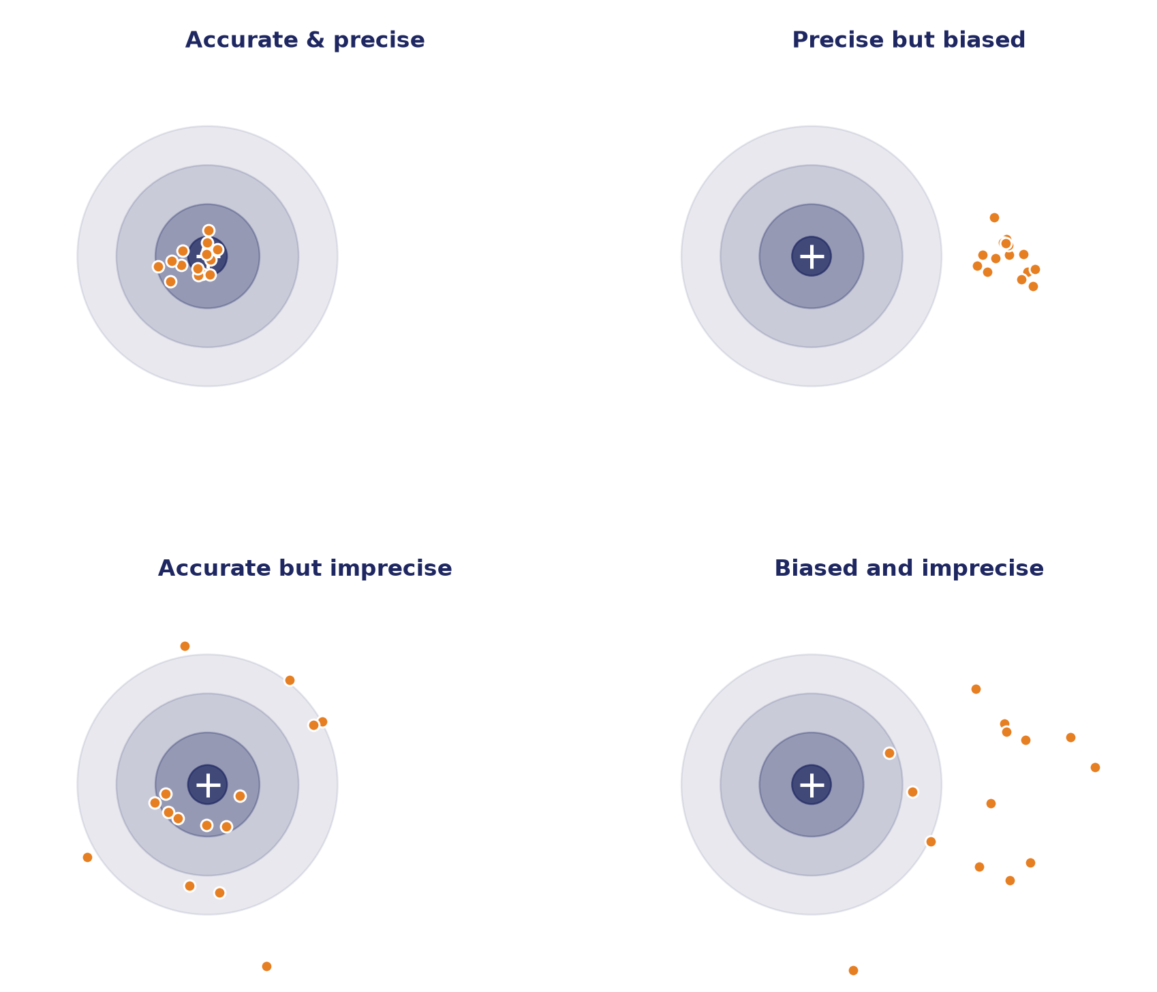
Precision vs accuracy
Precision is repeatability — the same person doing the same measurement gets a tight cluster around some value. Accuracy is whether that cluster is centered on the truth.
Imprecision can be addressed by replicates – the mean of 10 messy points is more accurate. You cannot replicate your way out of bias — biased means converge to the biased answer. Bias has to be detected and removed.

Slide 13
What MSA checks — four dimensions
Repeatability
Bias
Same operator, same sample, same day — do you get the same number? If not, the process is noisy at the operator level.
Is the average right, or shifted from the true value? Replication doesn't fix bias; a reference standard does.
Reproducibility
Linearity
Different operators, different days — is the number stable? This is where the two-operator titration story lives.
Does the measurement error stay the same across the range? Instruments that drift with magnitude create trends that look like real effects.

Slide 14
Foundation 3: Look at your data
The datasaurus dozen – 12 datasets with the same summary statistics

Slide 15
Exploratory Data Analysis (EDA) – a data scientist’s lab
LOOK AT THE DATA WITH EACH OF THESE LENSES
Histogram
Run chart
one variable at a time — is it symmetric, skewed, bimodal? Are there outliers?
the measurement in the order it was collected — time-drift, sudden jumps, seasonality.
Boxplot
Correlation heatmap
compare distributions across groups — spread, median, and outliers side by side.
many variables at once — quick screen for pairs that move together.
Scatterplot
Residuals vs fitted
two variables together — is there a relationship? Is it linear, curved, or absent?
after any model, plot what's left over against what you predicted. Patterns here mean the model is missing something.

Slide 16
DISTINCTION THAT MATTERS AT ANALYSIS TIME
Statistical vs practical significance
Statistical significance asks: is the effect big enough that noise could not plausibly have produced it by chance? Practical significance asks: is the effect big enough to matter for the decision I'm making?
FOR EXAMPLE
A 0.2% yield improvement, measured across 500 runs, can be statistically significant but practically useless. A 5% improvement measured on 6 runs can matter enormously even if the p-value is 0.09. Report both cases, put your findings in their statistical context, and move forward with your decisions.

Slide 17
PART 2
The DOE toolkit
Where designs fit in the scientific method, and how to choose one

Slide 18
DEFINITION
Design of Experiments (DOE)
A structured approach to planning experiments so the resulting data can answer specific questions about a system — while using the fewest runs and separating real effects from noise.
FOR EXAMPLE
'What are the main effects of temperature, catalyst loading, and residence time on yield, and do any of them interact?' — with an experimental plan that will actually answer that.

Slide 19
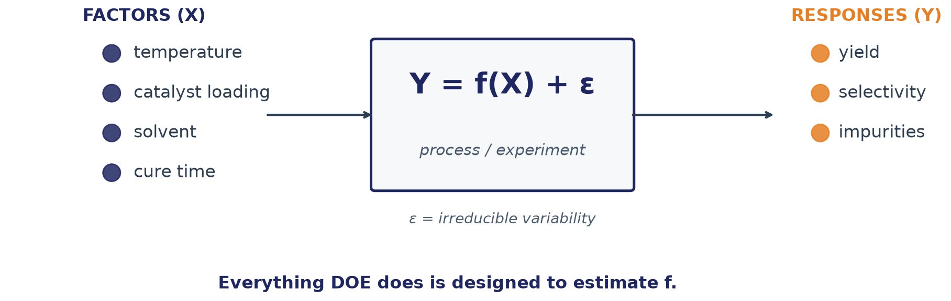
The language of DOE
Factors (X), a.k.a. independent variables, are things you change on purpose. Responses (Y) are things you measure. The function f is the underlying reality you're trying to learn. Every measurement you take is that reality plus a bit of noise.
Notes:
45 s.

Slide 20
The empirical model most DOE aims to fit
Y = β₀ + Σ βᵢ xᵢ + Σ βᵢⱼ xᵢxⱼ + Σ βᵢᵢ xᵢ² + ε
Y
response — the thing you measured (yield, viscosity, tensile)
xᵢ
factor i, coded to a common scale (usually [-1, +1])
β₀
intercept — the response at the design center
βᵢ
main effect of factor i — the slope in xᵢ direction
βᵢⱼ
two-way interaction between factors i and j
βᵢᵢ
curvature term — quadratic in factor i
ε
residual error — everything the model doesn't explain
Your scientific hypothesis is encoded into this functional form. Then, you use statistics to test if β ≠ 0

Slide 21
Your question → model choice → design
If you pick the wrong tool for the objective you have, running more experiments won't recover it.
What are you trying to learn?
Screening (which factors matter)? Optimization (where's the peak)? Mechanism (why)?
What model shape can answer that?
Linear main effects? Response-surface quadratic? Mechanistic differential equation?
What design supports that model?
Fractional factorial screens. CCD or Optimal for surfaces. Targeted kinetic runs for mechanism.

Slide 22
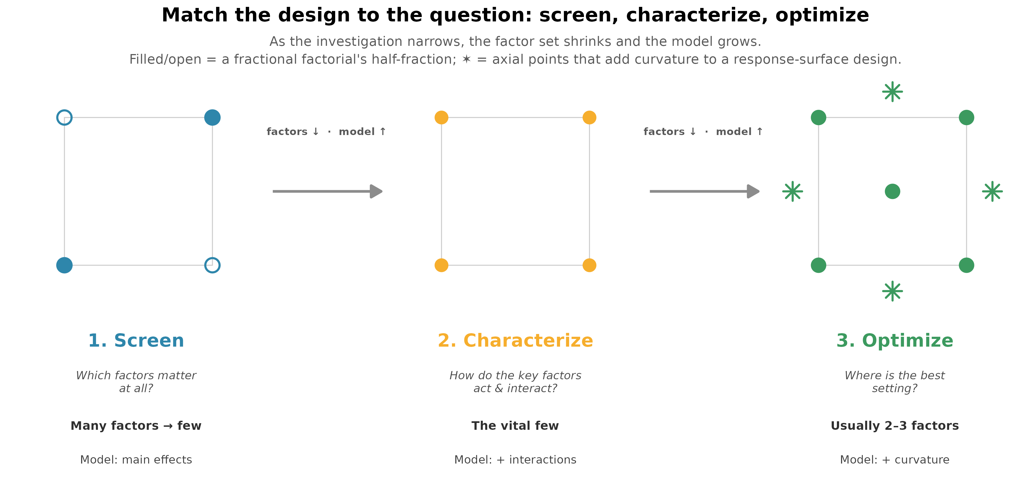
Your design determines what you can learn

Slide 23
Your design determines what you can learn
To see these, a DOE will…
✗ DOE Mistakes
+
a main effect
−
interaction with fixed factor
vary that factor across its range
One factor at a time freezes other factors — interactions invisible
+
an interaction
vary two factors JOINTLY, not one at a time
−
curvature at 2 levels
+
curvature, i.e. a quadratic effect
you fit a line through 2 points; curvature is undetectable
use ≥ 3 levels, or add center-point runs
−
no noise without replication
+
signal vs noise
one number per condition — can't separate signal from ε
replicate — rerun at the same conditions, not test the same sample twice
+
day/batch drift
−
drift without randomization
block on the drifting variable and randomize inside blocks
time trends read as fake main effects

Slide 24
Four ways people actually run experiments
Informed search
One factor at a time (OFAT)
Chemistry intuition guides the next runs. Fast when intuition is right; has blind spots and is hard to audit.
Vary one factor at a time, freezing everything else. What everyone does by default. Misses interactions completely.
DOE
Active Learning
Plan the whole set of runs up front. Every main effect and every interaction, quantified — the design decides which β terms are estimable.
An iterative strategy to choose the next most informative experiment, i.e. will most reduce uncertainty or best improve target

Slide 25
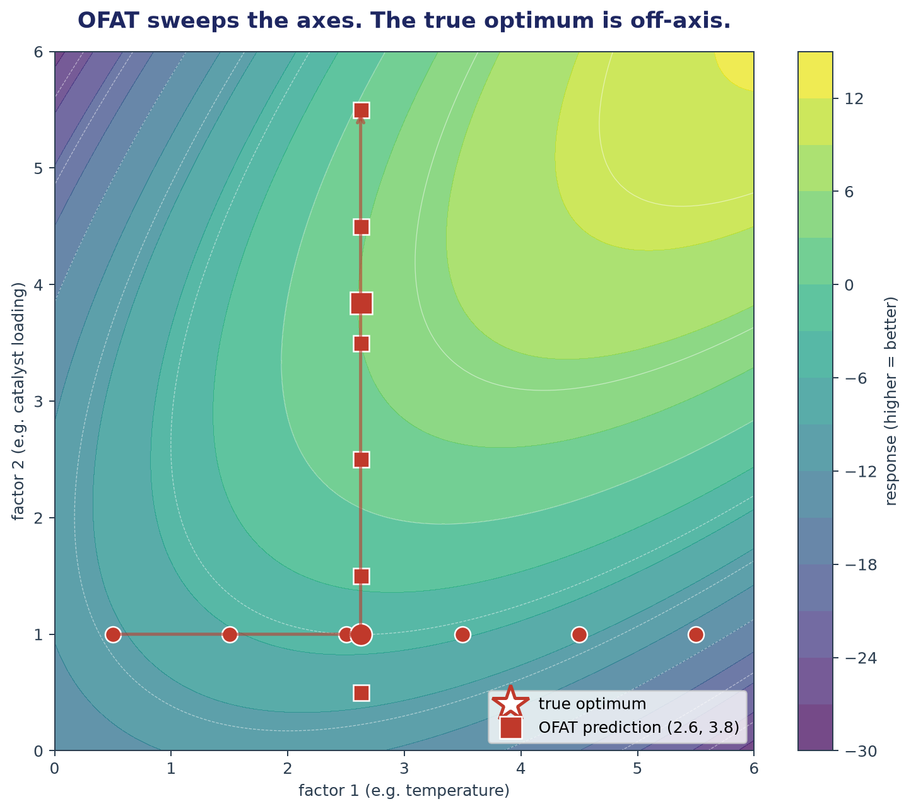
A visual explanation of one-factor-at-a-time
OFAT freezes each factor at its per-factor best and then moves to the next. If the factors interact, e.g. if the best temperature depends on which catalyst you're using, that per-factor series never explores the corner where the interaction lives. OFAT looks reasonable when factors are truly independent. In chemistry, factors are rarely independent.

Slide 26
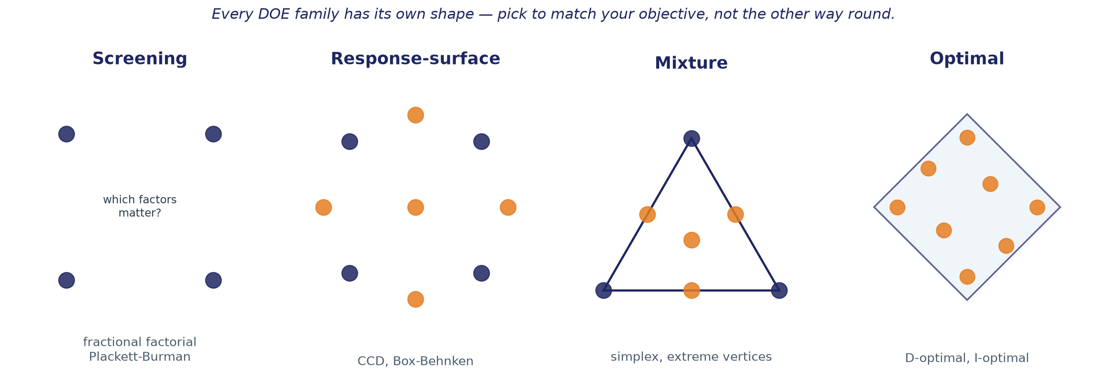
The DOE family (a survey, not a how-to)
Different designs answer different questions. The tutorial later will let you feel the difference between three of them.

Slide 27
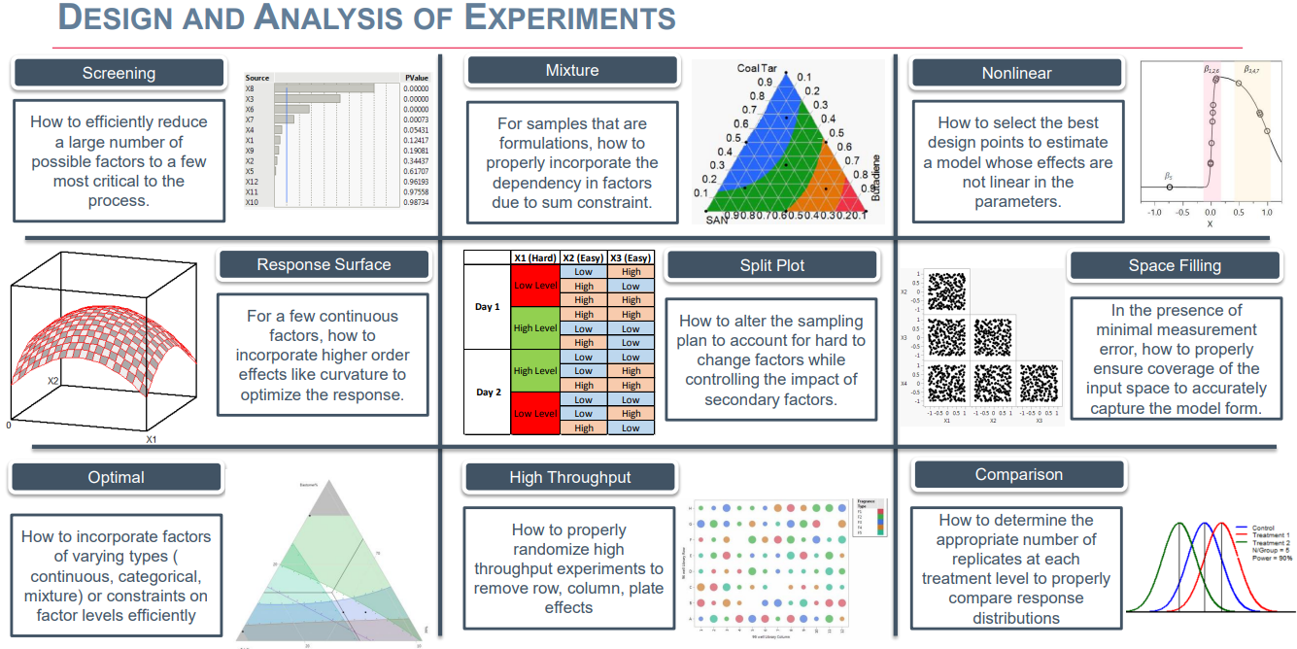
The DOE extended family

Slide 28
Choosing factor ranges
THE NUMBERS YOU PICK SCOPE WHAT YOU CAN LEARN
Wide enough that the effect is bigger than the noise
A 2 °C span probably won’t show a temperature effect. Use your domain knowledge combined with your goal.
Narrow enough to stay physically sensible
25 → 200 °C might cross a phase change, a decomposition, or a solubility limit you didn't plan for.
Bounded by what's actually operable
Reactor limits, safety, handling.
Bounded by chemistry reality
Consider range-finding experiments to identify boundaries of infeasible regions – design your corners just inside these boundaries. If you skip this step, run your DOE, and 50% of your runs don’t produce results, you will waste more time than the range-finding takes.

Slide 29
Constraints and forbidden regions
• Some combinations are mathematically impossible
e.g. 100% solvent A AND 100% solvent B cannot coexist
• Some are operationally forbidden
e.g. high temperature + high pressure past the reactor rating
• Some are chemically nonsensical
e.g. crosslinker = 0 with cure temp > 150 °C — nothing cures
What do we do with data points that produced no results because they were not testable?

Slide 30
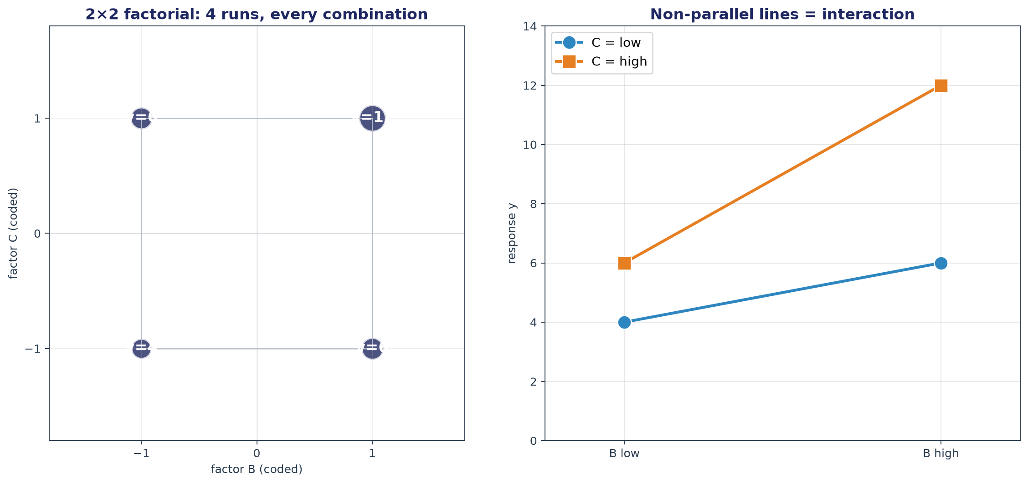
2^{K} full factorial – screening what matters
A full factorial design runs every combination of factor levels; when used for screening (2 levels) it tests every corner of your k-dimensional hypercube.
Screening seeks to answer the question: “which factors can I ignore because they don’t matter?” This design cleanly estimates every main effect and interaction with no aliasing, but the run count explodes as 2k, so once you're past ~5 factors it becomes impractical and fractional factorials or other screening designs (Plackett-Burman, definitive screening) are better.

Slide 31
Thinking about interactions
The results of the four corners of a 2×2 factorial, plotted as two lines — one line per level of one factor. If the lines are parallel, the factors don't interact. If they aren't, the gap between their slopes IS the interaction.

Slide 32
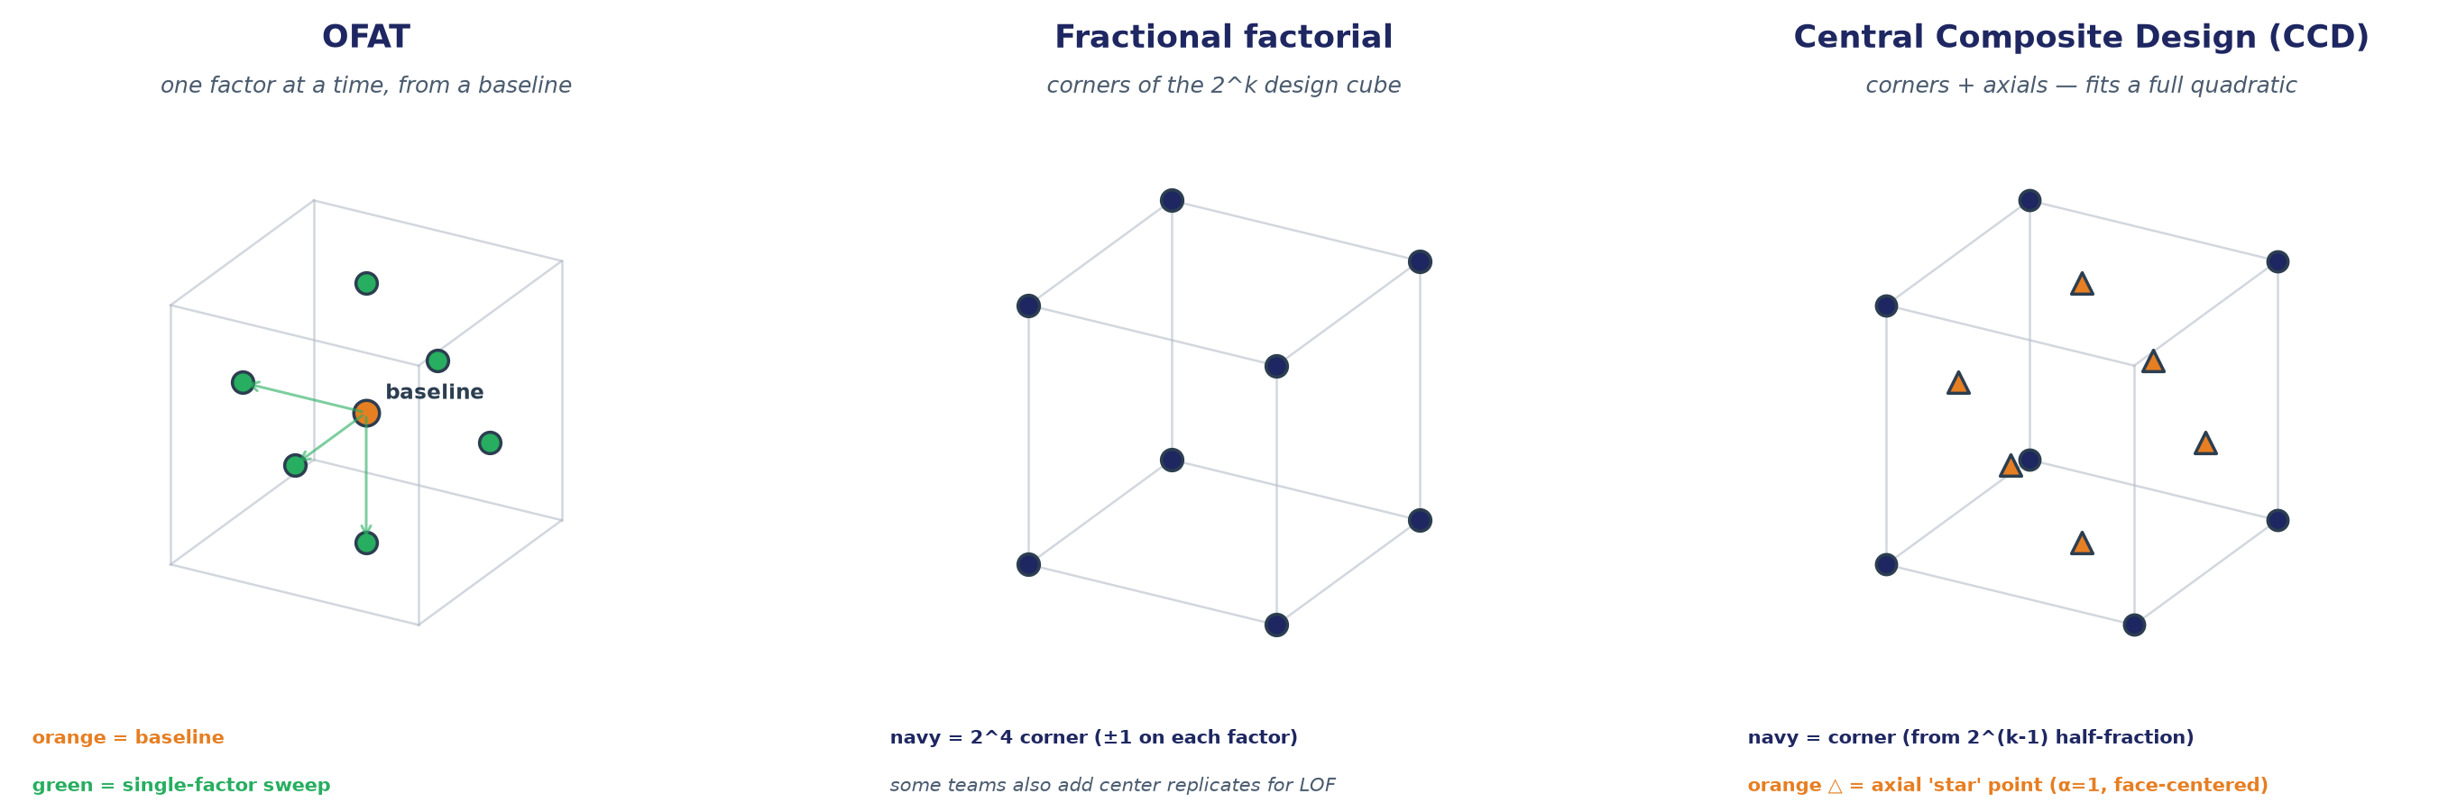
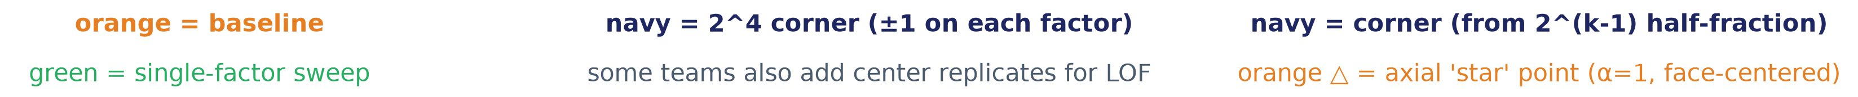
Tutorial preview: the three shapes teams will run
Two new bits of vocabulary: a CORNER is a run where every varied factor is at ±1; an AXIAL point is a run where one factor is at ±1 and the others are at their midpoints. Corners let you estimate interactions; axials let you estimate pure-quadratic curvature.

Slide 33
PART 3
Analyzing your results
From a table of runs to a defensible answer
Notes:
15 s section transition.

Slide 34
A DOE analysis workflow
1
2
3
4
5
6
Plot
Fit
Check
Reduce
Interpret
Verify
look at each response and each factor before any model
regress the response on the selected model
residuals, R², Lack of Fit — does the model actually match the data?
drop terms that don't matter; keep the model as small as it can be
main effects, interaction plots, prediction profiler
run a confirmation experiment at the predicted best condition

Slide 35
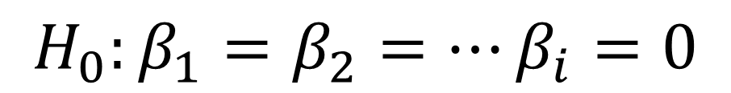
THE FIRST ANALYSIS QUESTION
Is the difference real?
Given that every measurement has noise, is the difference between conditions bigger than what noise alone would produce? That's what comparing groups statistically is designed to answer — with a t-test, ANOVA, or an F-test on regression coefficients.
$$H_{0}:β_{1}=β_{2}=…β_{i}=0$$
FOR EXAMPLE
Two catalysts, three runs each. Catalyst A yields 68, 71, 69 percent. Catalyst B yields 72, 74, 71 percent. Different means, but the spreads overlap. How confident can we be that the difference isn’t noise?

Slide 36
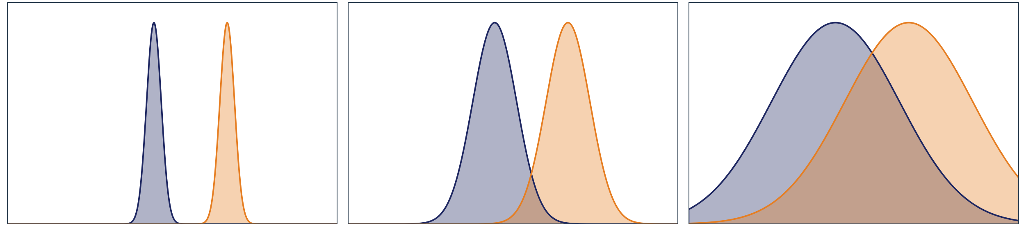
Comparing groups — signal vs within-group spread
The test that answers 'is the difference real' compares two variances: the variance BETWEEN group means and the variance WITHIN each group. If the between-group signal is much bigger than the within-group noise, the difference is real. If not, the noise could explain the pattern. This is the F-ratio at the heart of ANOVA. Every regression coefficient's p-value is a variation on the same idea: this coefficient's size vs the residual noise.

Slide 37
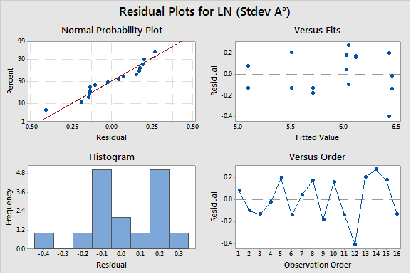
Analysis of DOE results uses the probabilistic linear regression toolkit you learned previously
Step 1: Analysis of Variance (ANOVA) is the workhorse
Additional Steps:
Visualize residuals and test for normality (you shouldn’t see any patterns)
Lack-of-fit test – are you missing curvature?
Trim insignificant variables (with hierarchy for interaction terms), re-fit model
Overall model F-test
Identify and check high-leverage points
NIST Engineering Statistics Handbook - 5.4: Analysis of DOE data
A DOE in a Manufacturing Environment (Part 2)

Slide 38
Statistical significance and practical significance are different questions
Statistical significance
Practical significance
• Question
could noise alone have produced this?
• Answer
a p-value, a confidence interval, a test statistic
• Depends on
the size of the effect AND the number of runs
• Failure mode
a tiny effect with a huge sample looks significant
• Question
is the effect big enough to change my decision?
• Answer
a judgment about what matters for the process
• Depends on
the cost of the change and the value of the improvement
• Failure mode
a huge naïve effect with too few runs or too large may not be statistically significant

Slide 39
Before you claim you're done — the verification experiment
Pick your predicted-best condition
the point on the fitted surface where your objective is optimized
Run 2-3 confirmation experiments at that condition
not one — you need to see the noise around the point too
Compute the mean and a confidence interval
against the model's prediction and its own confidence interval
If they agree — you can trust the research
the fitted model predicts observed reality at the predicted best
If they don't — something is off
extrapolation, missed factor, changed process, drift since the DOE. Investigate before you scale up.

Slide 40
AN ASIDE
Comparing Experimental Approaches
DOE vs. Active Learning
Notes:
15 s section transition.

Slide 41
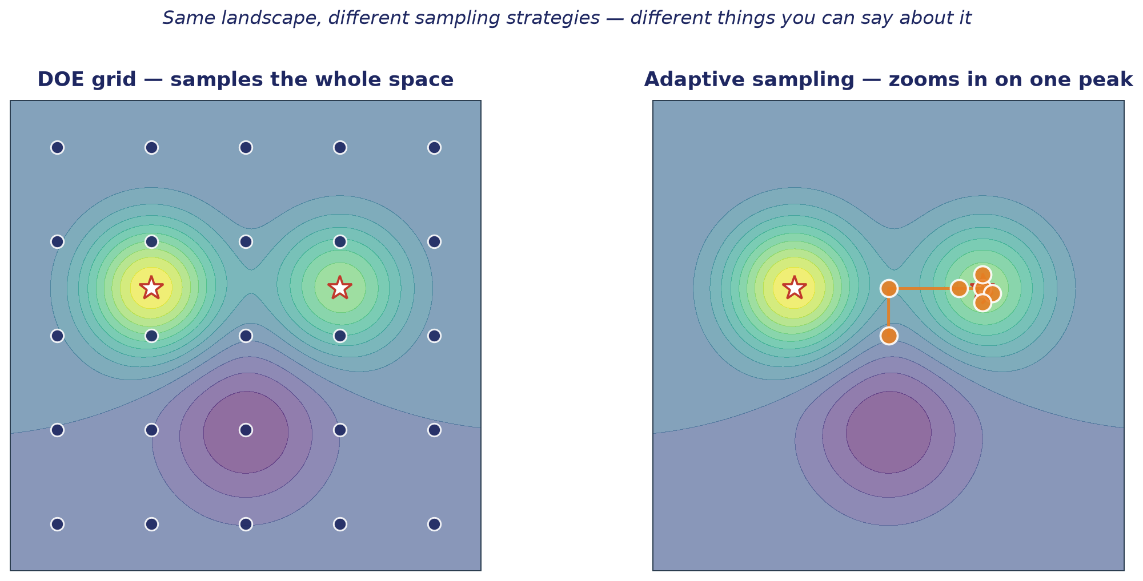
DOE vs. Adaptive Sampling

Slide 42

DoE vs. BO: “No free lunch”
Similarity: utilize simulation or experiment results, help to guide the next step experiment(s)
Differences:
DOE: Designed Experimentation
Build quality model to help screen or optimize
Explore the entire input space to build a good model, applicable for future studies
More explanation possible, but require more experimental budget
Provide a predictive model in the design space
BO: Bayesian Optimization
You want to optimize your reaction
Provide adaptive and autonomous balance between exploration and exploitation
Find best solutions faster, but sacrifice interpretation
Limited predictive power in a small subset of the design space
Exp. Budget
Explanation
Explanation
Exp. Budget

Slide 43



DOE and active learning: different tools for different questions
 | DOE asks | Active learning asks
Objective | “Tell me what drives what” | “Point me at the next experiment”
Coverage | Maps the whole response surface | Concentrates near the current best guess
Explanation | Explainable structure by definition | Predictive point, not necessarily interpretable
Uses prior data? | No – designs initialize dataset | Yes – Bayesian model uses priors and updates each round
Best for | Understanding, hypothesis testing | Hunting a single optimum on a tight budget
Downside | Can waste runs in uninteresting areas | No information on causality, can miss local optima
Objective: Where is the left eye in the picture?
Experimental budget: Pixels
Actual System
DoE
DFO/BO

Slide 44
When to reach for which
✓ Reach for DOE
✗ Reach for active learning
+
You need to understand a system
−
You have a clear numeric objective
why does it work; which factors matter
maximize yield; minimize cost
+
You'll explain results to stakeholders
−
You already have some data
grows structural knowledge
AL uses it as a prior; DOE ignores it
+
You'll reuse the data later
−
Budget is tight
map now, exploit later; the map compounds
you need the optimum, not the surface
+
Factors have physical meaning
−
You don't need to explain WHY
worth mapping the whole space you can defend
just WHERE — where's the best next run

Slide 45
Correlation is not causation — and DOE is what turns one into the other
You can find a strong correlation in almost any observational dataset. Sales of ice cream correlate with drowning deaths. Neither causes the other; hot weather causes both.
A designed experiment breaks the ambiguity. When you deliberately vary a factor and measure the response, and everything else is randomized or blocked, a correlation you observe is causal by construction — because you were the one who varied the factor.
This is the deep reason DOE matters: it’s the foundation of the scientific method

Slide 46
What to remember from today
Design first
Measure your ruler
The design step decides what you can learn. If you can't answer 'what model, what runs, what factors?' don't run yet.
MSA is not optional. If your ruler is worse than the effect, no design saves you. Bias is not fixable by replication.
Use structure
Close the loop
Using the right design for your question saves time over exploring the space ad-hoc and realizing you missed key relationships later.
Plot, fit, check, reduce, interpret, verify. The analysis is where a designed experiment becomes an answer you can defend.

Slide 47
TAKE A MOMENT
What would you change about the next experiment you plan?

Slide 48
Coming up next — the formulation game
1
2
3
4
Setup
Design + run
Analyze
Debrief
5 min · assign teams, hand out templates
30 min · plan and run 15 experiments — maximize tensile
15 min · fit your model, predict your best
15 min · reveal plots show who found the peak, and why

Slide 49
References and further reading
• Statistical Thinking for Industrial Problem Solving, presented by JMP | Coursera
• NIST Engineering Statistics Handbook: Section 5 - Process Improvement
• Montgomery, D. C.
Design and Analysis of Experiments (Wiley) — the canonical textbook
• Box, Hunter & Hunter
Statistics for Experimenters (Wiley) — chemistry-friendly classic
• Doyle group
"Bayesian reaction optimization as a tool for chemical synthesis." Shields et al., Nature 590, 89-96 (2021)
• pyDOE2, dexpy
Python packages for design generation
• statsmodels, scikit-learn
Python analysis — model fits, ANOVA, regression

