Slide 1


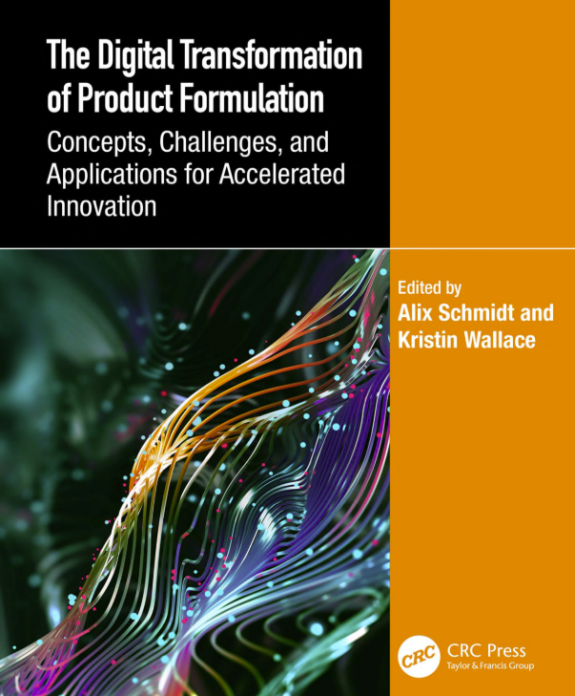
Alix Schmidt
Education
BS Chemical Engineering, University of Illinois at Urbana-Champaign, 2009
MS Predictive Analytics, Northwestern University, 2016
Career @ Dow
Product Development Intern, Copolymers group, Dow Corning, summer 2008
Process R&D Engineer, Copolymers group, Dow Corning, 2009 – 2012
High Throughput Research Engineer, Dow Corning/Dow, 2012 – 2017
Data Scientist, Manufacturing Chemometrics and AI, Dow, 2017 – 2021
Senior Data Scientist, Information Research, Dow, 2021 – present
Research: Formulation modeling and inverse design
The Digital Transformation of Product Formulation: Concepts, Challenge
Model Deployment and MLOps Strategy Development
Citizen Data Science and Digital Transformation
GenAI and agentic research

Slide 2
Data Stewardship
Preserving the data you generate so it keeps paying off after your project ends
Alix Schmidt, Dow · Presenter
With content contributions from Peter Margl, Matt Benedict
Created using Claude Code
Caltech AI-in-Chemistry Bootcamp · August 18, 2026

Slide 3
Key ideas for good data stewardship
1. Structure
2. Identity
3. Packaging
What separates data a computer can read from data that needs an afternoon of cleaning.
How a value in one row points at an entity outside the row, and how this forms the basis for advanced analysis.
What turns a folder of files into a thing a stranger can use: a dataset with a dictionary, provenance metadata, and the code that produced it.
Rectangular, tidy, typed
IDs, join keys, canonical forms
Data + code + docs = one asset

Slide 4
PART 1
Why do we care about re-usable data?
An industry perspective on what makes a dataset valuable
Notes:
5-second beat. Move quickly to content.

Slide 5
DEFINITION
Data stewardship
Decision
A skill set for creating, handling, and maintaining structured data so it can be used for transparent, collaborative research decisions based on rigorous analyses.
Analysis
Collection
FOR EXAMPLE
In practice: the discipline that turns 'the data I collected for my project' into 'the data the next three projects will build on.'

Slide 6
Why data stewardship matters
A PhD project
An industry R&D project
• Starts with you
you frame the question, you generate the data, you own the interpretation
• Ends with you
when the thesis ships, the dataset stops being touched, often within months
• Half-life is short
very few people ever revisit the raw numbers after the defense
• Reproducibility is a courtesy
not usually a requirement of anyone else's downstream work
• Joins the pile
every dataset compounds into institutional knowledge
• Outlives the project
the next project reads yours as its starting point, sometimes years later
• Half-life measured in years
long enough that people, tools, and file formats all turn over
• Reproducibility is a job
someone else will need to re-run your analysis and get the same number

Slide 7
TAKE A MOMENT
Have you ever inherited someone's data and been able to fully reproduce their analysis in under one hour?

Slide 8
Well-structured data supports four key principles of scientific research at once
Fidelity
Transparency
Reproducibility
Collaboration
Structured data supports data fidelity, which means it is easy to avoid or detect errors during the process of noting or storing data
Structured data fosters collaboration because it is easily understandable
Structured data makes it easy for your colleagues to understand and reproduce your results
Transparency and reproducibility along with good documentation make collaboration on project data easy

Slide 9
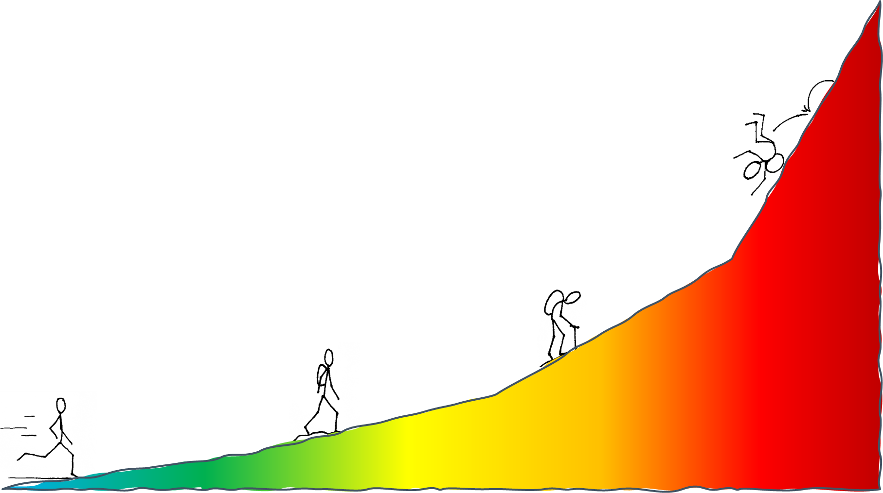
Structured-ness affects ease of use
For instance, let’s look at how easy it is to get data out of a structured data file vs an unstructured data file…
Structured data Unstructured data
EASY HARD FORGET IT!

Slide 10
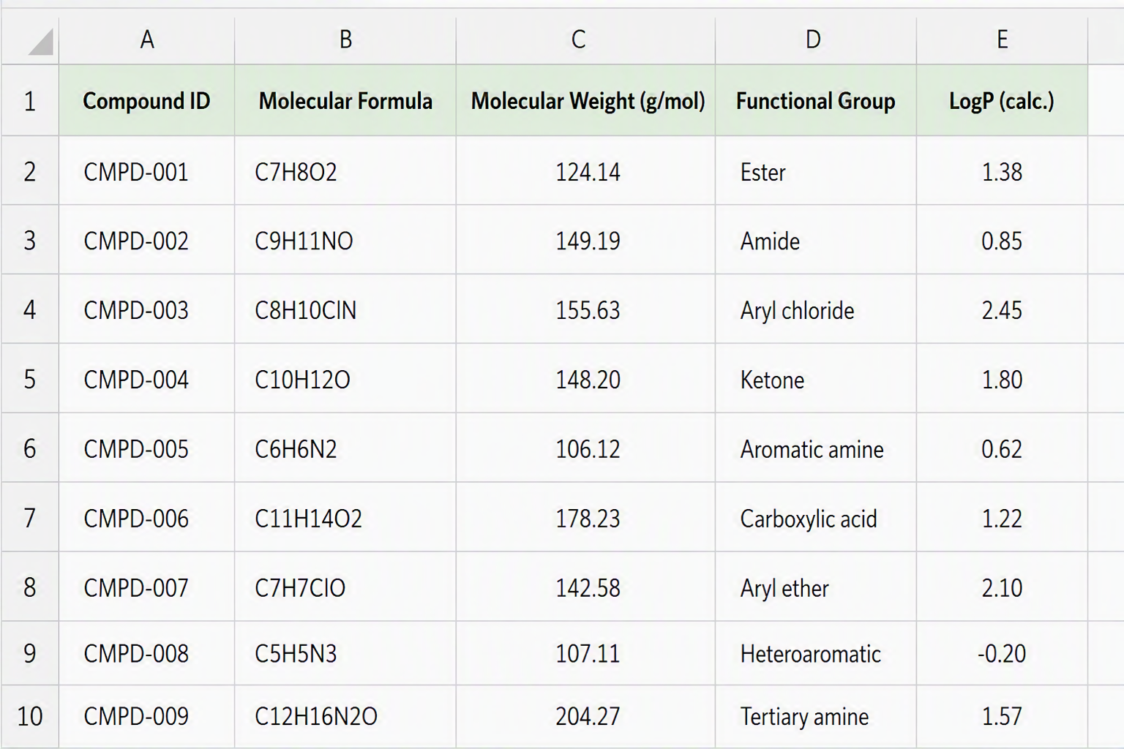
Structured-ness affects ease of use
Excel, structured-rectangular
EASY
HARD
FORGET IT

Slide 11
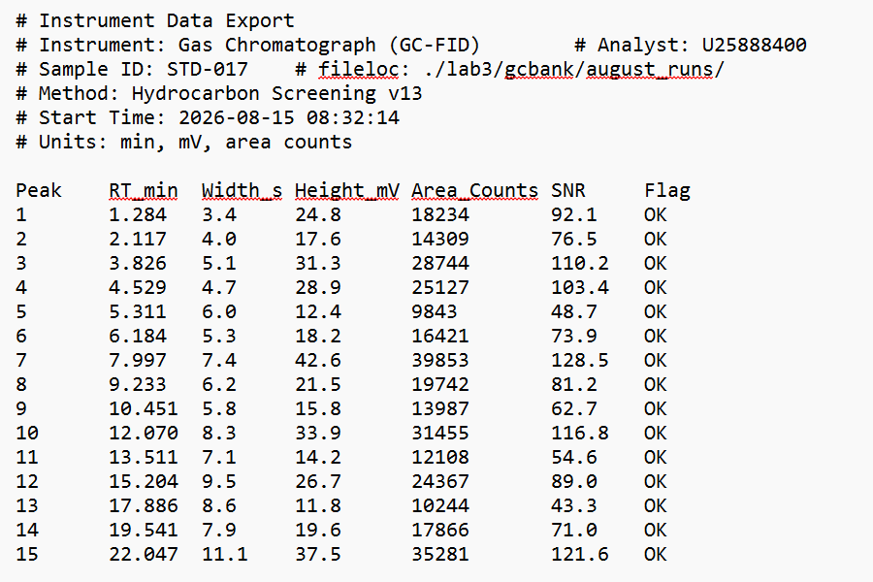
Structured-ness affects ease of use
Plain-text, semi-structured
Excel, structured-rectangular
EASY
HARD
FORGET IT

Slide 12
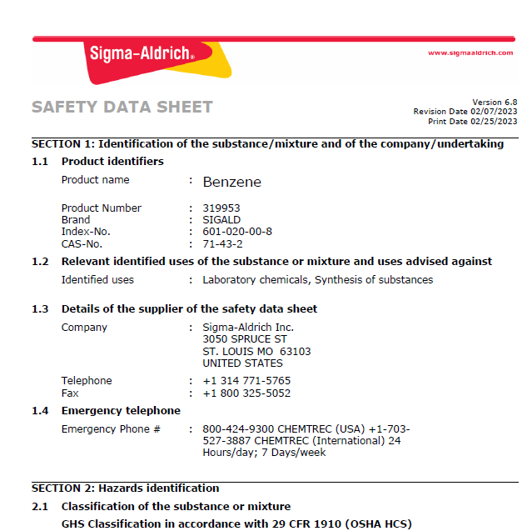
Structured-ness affects ease of use
Plain-text, semi-structured
PDF text
Excel, structured-rectangular
EASY
HARD
FORGET IT

Slide 13
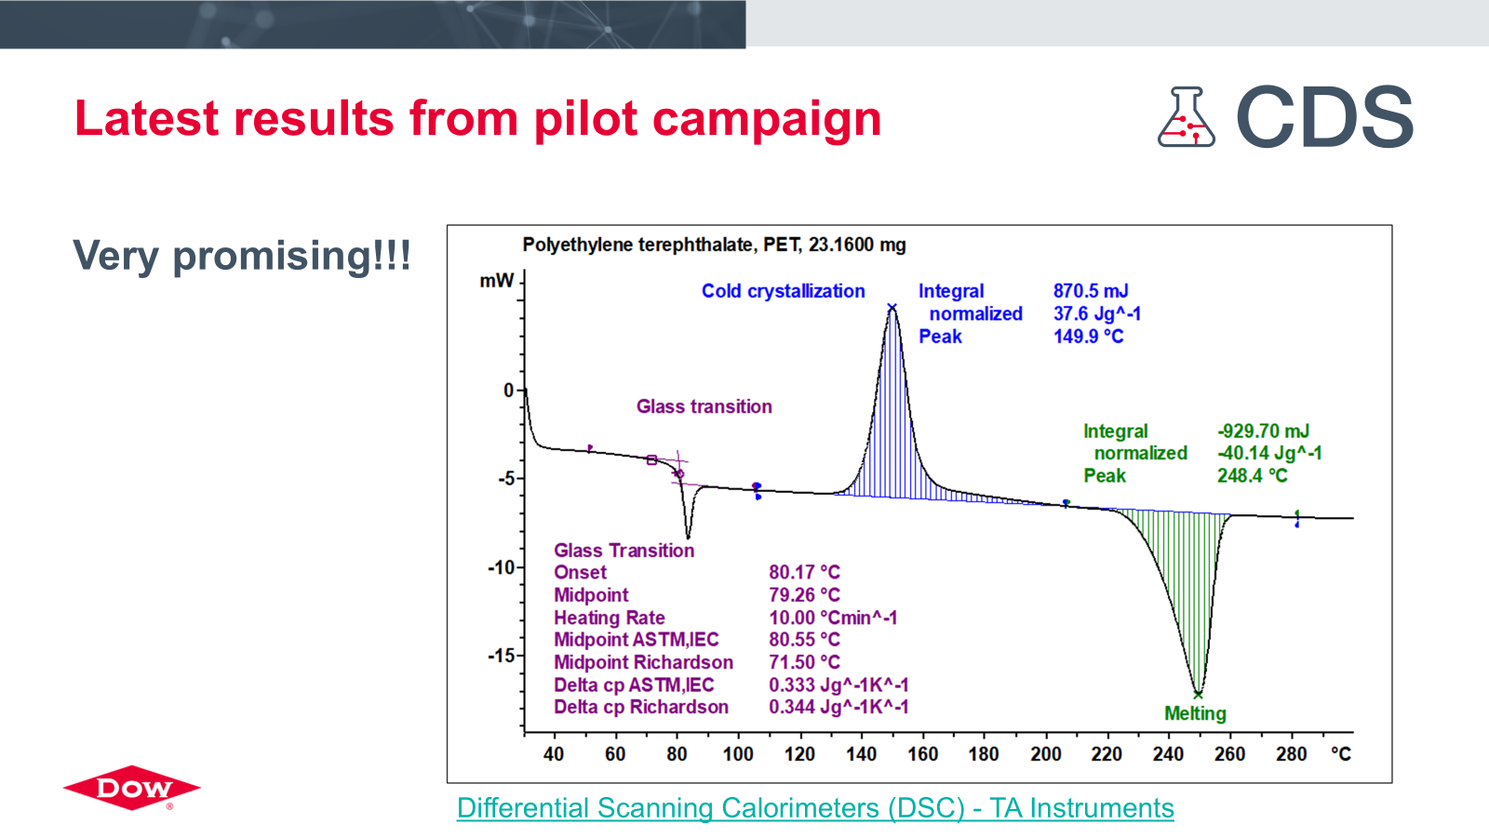
Structured-ness affects ease of use
mixed text & graphics, PowerPoint or Excel
Plain-text, semi-structured
PDF text
Excel, structured-rectangular
EASY
HARD
FORGET IT

Slide 14
PART 2
Guidelines for Tidy Data
Rules for rectangular shapes, cells, types, identifiers, relationships

Slide 15
THREE NAMES, ONE IDEA
Rectangular · tidy · normalized
Three vocabularies for the same underlying discipline: one variable per column, one observation per row, one table per kind of entity. Rectangular is the shape. Tidy is the semantics. Normalized is the database term for splitting data across tables so no fact gets duplicated.
FOR EXAMPLE
Reactions in one table, catalyst reference in another, solvent reference in a third. You link them by shared identifiers, not by copying the catalyst's properties down every row of the reactions log.

Slide 16
Meet the Engine Oil Dataset
sample_number | temperature: deg_c | viscosity: cp | material: sae_grade
SAM-AB1234 | 20.0 | 286 | 15W-40
SAM-AB1235 | 30.0 | 154 | 15W-40
SAM-AB1236 | 20.0 | 210 | 10W-40
SAM-AB1237 | 30.0 | 121 | 10W-40
SAM-AB1238 | 20.0 | 382 | 10W-60
SAM-AB1241 | 30.0 | 221 | 10W-60
SAM-AB1242 | 40.0 | 137 | 10W-60
SAM-AB1243 | 50.0 | 90 | 10W-60
SAM-AB1244 | 20.0 | 205 | 5W-40
SAM-AB1245 | 30.0 | 121 | 5W-40
SAM-AB1246 | 40.0 | 79 | 5W-40
SAM-AB1247 | 50.0 | 51 | 5W-40
An employee at a company that makes formulated engine oils in multiple grades measures the viscosity of various oil grades coming off the production lines at various temperatures and records the data in a table. Each sample has a unique “sample number”.

Slide 17
Tidy data: rectangular shape
sample_number | temperature: deg_c | viscosity: cp | material: sae_grade
SAM-AB1234 | 20.0 | 286 | 15W-40
SAM-AB1235 | 30.0 | 154 | 15W-40
SAM-AB1236 | 20.0 | 210 | 10W-40
SAM-AB1237 | 30.0 | 121 | 10W-40
SAM-AB1238 | 20.0 | 382 | 10W-60
SAM-AB1241 | 30.0 | 221 | 10W-60
Rectangular data can be easily understood by humans as well as computers.
Rectangular data is a prerequisite for processing and analysis of the data by computers

Slide 18
Tidy data: Cells
✓ Do
✗ Don't
+
one row per measurement
−
merged cells
no averages mixed in with individuals; no summary rows
each cell holds one value; a script reads cells, not layouts
+
empty cell for missing data
−
mixed data types
blank means missing
'80 °C' is a string; '80' with a unit column is a number
+
annotations get their own column
−
codes for missing values
observation_notes column, not a comment or coloring key
no 'n/a', 'N/A', '—', '999' — those are values, not blanks
sample_number | temperature: deg_c | viscosity: cp | material: sae_grade | observation_notes
SAM-AB1234 | 20.0 |  | 15W-40 | ~0.5 degC temperature drift
SAM-AB1235 | 30.0 | 154 | 15W-40 | none
SAM-AB1236 | 20.0 | 210 | 10W-40 | none
SAM-AB1237 | 30.0 |  | 10W-40 | not enough sample
SAM-AB1238 | 20.0 | 382 | 10W-60 | none

Slide 19
Tidy data: Identifiers
Row identifier
unique per row — sample_number, reaction_id, batch_id. This is what makes a row addressable.
One column can uniquely name a row, or point to a thing outside the row.
Entity identifier
points to a thing outside the table — catalyst_id, operator_id, material_grade. This is what makes tables joinable.
Canonical form, not free-typed
'PD_PPH3_4' spelled consistently, not 'Pd(PPh3)4' and 'pd(pph3)_4' and 'Pd(PPh₃)₄' all referring to the same catalyst.

Slide 20
Why are data Identifiers and data Relationships important?
Identifiers
Identifiers are values in a data set that uniquely identify a particular thing
+
Relationships
Relationships stitch different pieces of data together to allow greater insights

Slide 21
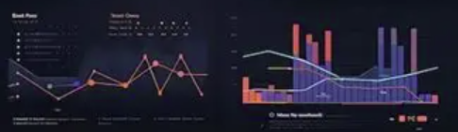
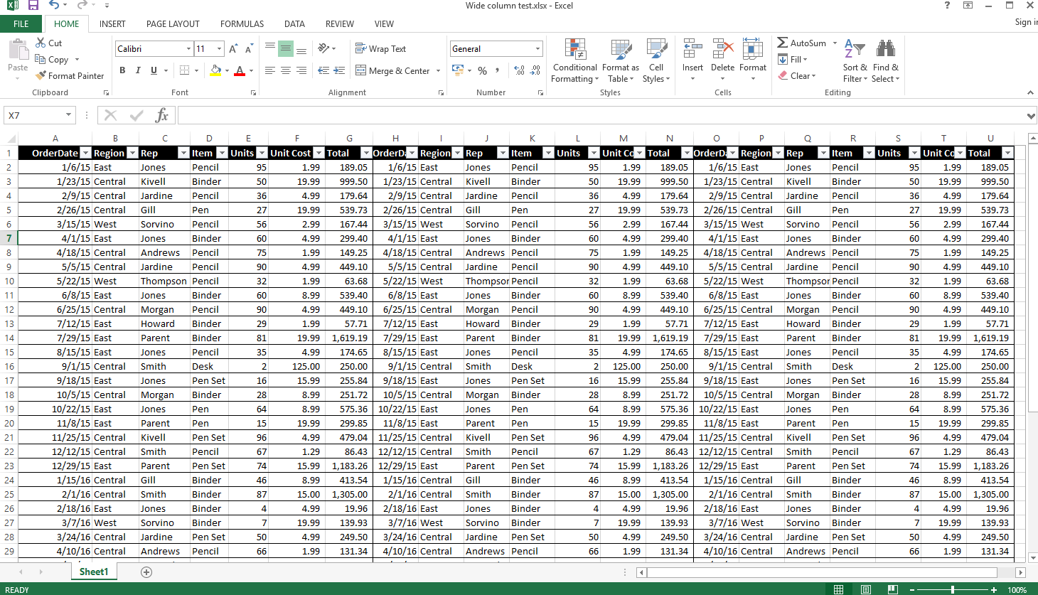
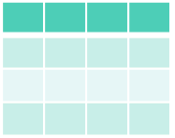
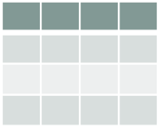
Why you care about this…

Slide 22
Data identifier examples
Identifiers are values in columns that uniquely identify a particular thing.
sample_number | temperature: deg_c | viscosity: cp | material: sae_grade
SAM-AB1234 | 20.0 | 286 | 15W-40
SAM-AB1235 | 30.0 | 154 | 15W-40
SAM-AB1236 | 20.0 | 210 | 10W-40
SAM-AB1237 | 30.0 | 121 | 10W-40
SAM-AB1238 | 20.0 | 382 | 10W-60
SAM-AB1241 | 30.0 | 221 | 10W-60
They can identify either a row in the table or a thing outside the table
Examples:
a material
a person
another piece of information
a row in a table

Slide 23
Knowledge check: Identifiers
Which of the columns in this table contain Identifiers?
A
B
C
D
E
F
sample_ id | polymer_loading: wt% | solvent | temperature: degC | absorption: % | experimenter: user_id
402212 | 5.0 | water | 22.1 | 83 | uc91123
402213 | 7.0 | water | 27.5 | 52 | uc91123
406935 | 5.1 | dmso | 21.9 | 1 | ub91244
406936 | 7.4 | dmso | 26.2 | 0 | ub91244
Notes:
A, C, F

Slide 24
What are data Relationships?
When an identifier points to another piece of information, a data relationship is created. The purpose of data relationships is to stitch different pieces together to allow greater insights. In the case below, the table on the right can be used to determine if a measurement in the left table was between the lower and upper limits for the grade in the left-hand side table because the material identifiers are shared.
sample_number | temperature: deg_c | viscosity: cp | material: sae_grade
SAM-AB1234 | 20.0 | 286 | 15W-40
SAM-AB1235 | 30.0 | 154 | 15W-40
SAM-AB1236 | 20.0 | 210 | 10W-40
SAM-AB1237 | 30.0 | 121 | 10W-40
SAM-AB1238 | 20.0 | 382 | 10W-60
SAM-AB1241 | 30.0 | 221 | 10W-60
… | … | … | …
material: sae_grade | temperature: deg_c | viscosity_upper_limit: cp | viscosity_lower_limit: cp
15W-40 | 20 | 290 | 285
10W-40 | 20 | 210 | 205
10W-60 | 20 | 377 | 382
… | … | … | …
Fictitious data

Slide 25
Relationships work if identifiers are shared
sample_number | temperature: deg_c | viscosity: cp | material: sae_grade
SAM-AB1234 | 20.0 | 286 | 15W-40
SAM-AB1235 | 30.0 | 154 | 15W-40
SAM-AB1236 | 20.0 | 210 | 10W-40
SAM-AB1237 | 30.0 | 121 | 10W-40
SAM-AB1238 | 20.0 | 382 | 10W-60
SAM-AB1241 | 30.0 | 221 | 10W-60
… | … | … | …
material: sae_grade | temperature: deg_c | viscosity_upper_limit: cp | viscosity_lower_limit: cp
15W-40 | 20 | 290 | 285
10W-40 | 20 | 210 | 205
10W-60 | 20 | 377 | 382
… | … | … | …
Fictitious data
Column names don’t need to match!
(but it’s very helpful if they do)

Slide 26
Relationships work if identifiers are shared
But the identifiers themselves must match
sample_number | temperature: deg_c | viscosity: cp | material: sae_grade
SAM-AB1234 | 20.0 | 286 | 15W40
SAM-AB1235 | 30.0 | 154 | 15W40
SAM-AB1236 | 20.0 | 210 | 10W-40
SAM-AB1237 | 30.0 | 121 | 10W-40
SAM-AB1238 | 20.0 | 382 | 10W-60
SAM-AB1241 | 30.0 | 221 | 10W-60
… | … | … | …
material: sae_grade | temperature: deg_c | viscosity_upper_limit: cp | viscosity_lower_limit: cp
15W-40 | 20 | 290 | 285
10W-40 | 20 | 210 | 205
10W-60 | 20 | 377 | 382
… | … | … | …
Fictitious data
Even small spelling differences will break the join

Slide 27
Knowledge check: Data relationships
Which of the following pairs of tables enables a data relationship?
sample_id | sample_weight: g | material: name
PMM373 | 312.1 | toluene
JDA783 | 531.5 | hexane
material: cas_number | molecular_weight: g/mol
108-88-3 | 92.14
110-54-3 | 86.18
A
sample_id | sample_weight: g | material: casno
PMM373 | 312.1 | 108-88-3
JDA783 | 531.5 | 110-54-3
material: cas_number | molecular_weight: g/mol
108-88-3 | 92.14
110-54-3 | 86.18
B
sample_id | sample_weight: g | material: name
PMM373 | 312.1 | Peter_sample_1
JDA783 | 531.5 | hexane
material: name | molecular_weight: g/mol
Peter_sample1 | 92.14
n-hexane | 86.18
C
Notes:
B

Slide 28
PART 3
Packaging: from files to data products
What turns a folder of files into something a stranger can pick up and use

Slide 29
A re-usable digital asset has three legs
Data
Code
Docs
The numbers and observations, arranged so someone else can load them into their tool of choice without hand-transcription. This is what most people mean when they say 'data’, but it's only one piece of complete data stewardship.
The transformations, models, plots, and joins that produced the outputs. A report of numbers with no script that made them is irreproducible; nobody can re-derive anything.
What, exactly, the columns mean, what units apply, who collected the data, what instrument was used, what method was followed.
csv · tidy xlsx · sql
code · git · requirements.txt
dictionary · README · provenance

Slide 30
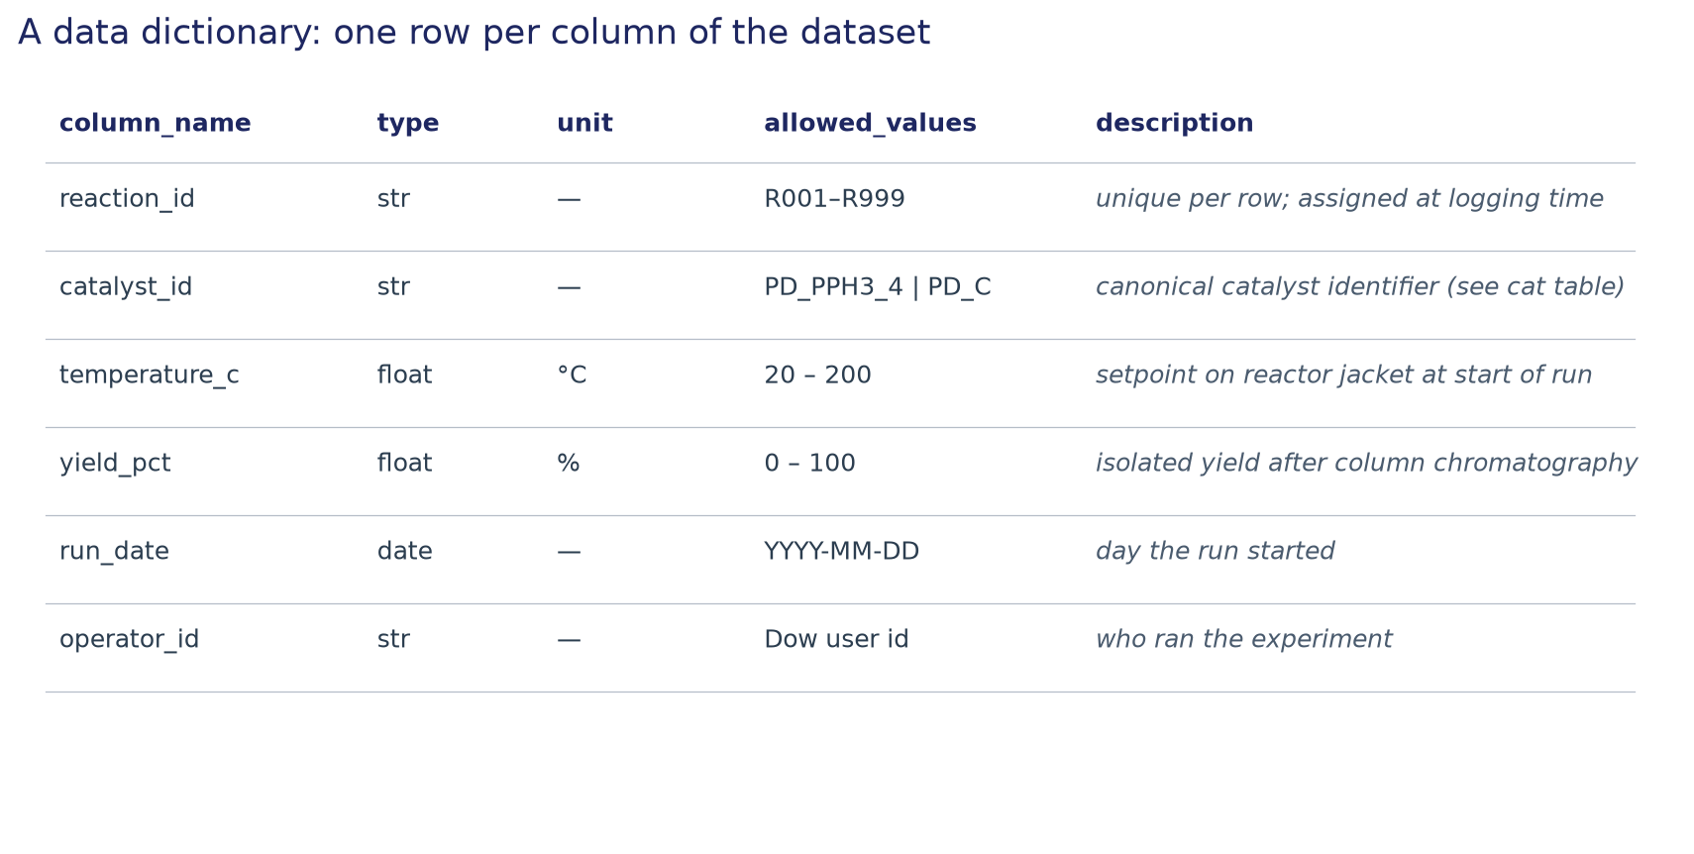
A data dictionary — one row per column of your dataset
Minimum-viable fields: column name, type, unit, allowed values, description

Slide 31
Easy steps to self-documenting data
Column headers are explicit and clearly define what was recorded
“Temperature setpoint”, not “Tsp”
Column headers contain units clearly separated from name
“Temperature setpoint : degC”, not “ToC”
Use an agreed-upon material ID instead of product names
“ELN10234” instead of “Dave’s polymer 3”
One row per measurement, keep all measurements
no averaged data or hand-picked data points
Use separate columns for intended vs actual and name them accordingly
reactor set-point temperature vs actual measured reactor temperature
Refer to measurement procedures, if possible by including them in the column name
“ASTM_d2983-09_viscosity”

Slide 32
Dataset-level metadata — the questions the columns don't answer
PROVIDING METADATA GIVES FUTURE RESEARCHERS THE CONTEXT NEEDED TO RE-USE YOUR DATA
Who collected it
user id or name — 'A. Schmidt, Materials Chemistry.' Not 'the lab.'
When it was collected
specific dates — '2026-03-14 through 2026-03-21.' Not 'last quarter.'
What instrument produced it
make, model, unit — 'Anton Paar MCR 302, s/n M172.' Calibration date if it matters.
What settings applied
'10 mL/min flow · 80 °C · 60 min residence.' Reactor set-point and measured, if different.
What method was used
reference the procedure by name — 'SOP-CAT-023 v2.1' — not by verbal description.

Slide 33
FAIR — a data interoperability framework
WILKINSON ET AL., SCIENTIFIC DATA 3, 160018 (2016)
The FAIR Guiding Principles for scientific data management and stewardship | Scientific Data
Findable
Interoperable
someone else can locate your dataset — persistent identifier, indexed in a catalog, not buried in your Google Drive.
the format and vocabulary can be read alongside other datasets — standard file formats, controlled vocabularies, machine-readable schemas.
Accessible
Reusable
once found, the data can actually be retrieved — with clear terms about who's allowed and how. 'Email me for a copy' is not accessible.
there's enough context — license, provenance, dictionary — for someone to use it responsibly in a new setting.

Slide 34
How to share data — and how not to
✓ Good ways
✗ Ineffective ways
+
Shared file location
−
Non-rectangular Excel
SharePoint, project file share, cloud bucket — everyone sees the same file
tables scattered around a sheet, multi-header rows, formatting-as-data
+
Project database
−
Tables inside PowerPoint
ELN, LIMS — schema enforced by the system, not by the user
numbers stuck to a slide — a screenshot of data, not data
+
Version-controlled repo
−
Email, chat, PDFs
git for the code and data-generation scripts; changes are auditable
worst extraction task; each one becomes an archaeology project

Slide 35
Code deserves the same discipline as data
A bare script is like an unlabeled spreadsheet
Version control is a lab notebook for code
A packaged script
A .py with no README, no requirements pin or venv, no example inputs. It ran on your machine last Tuesday; it does not run anywhere else.
code + requirements.txt (or pyproject.toml) + a short README describing inputs, outputs, and how to run it. Same three legs as a dataset: content + spec + docs.
git tracks what changed, when, and why. If your only backup is 'final_v3.py' next to 'final_v3_ACTUALLY_final.py' — you don't have version control, you have a warning sign.

Slide 36
What to remember
Structure beats free-form
Identifiers are load-bearing
Rectangular, tidy, neat cells.
Identifiers build data relationships to enrich your analysis. Choose meaningful identifiers with your team and type them carefully.
Document the dataset
Data + code + docs = one asset
Use a data dictionary and dataset metadata to remove ambiguity about what your data means for future users.
Clearly documented data and the code used for transformations and processing leave a clear audit trail of your analysis.

Slide 37
TAKE A MOMENT
What would you change about your current data workflow starting next week?

Slide 38
References and further reading
• Wickham, H.
"Tidy Data." Journal of Statistical Software 59(10), 2014
• Broman & Woo
"Data Organization in Spreadsheets." The American Statistician 72(1), 2018
• Wilkinson et al.
"The FAIR Guiding Principles for scientific data management and stewardship." Scientific Data 3, 160018 (2016)
• Data Carpentry
datacarpentry.org — open lessons, especially Data Organization in Spreadsheets

