Slide 1
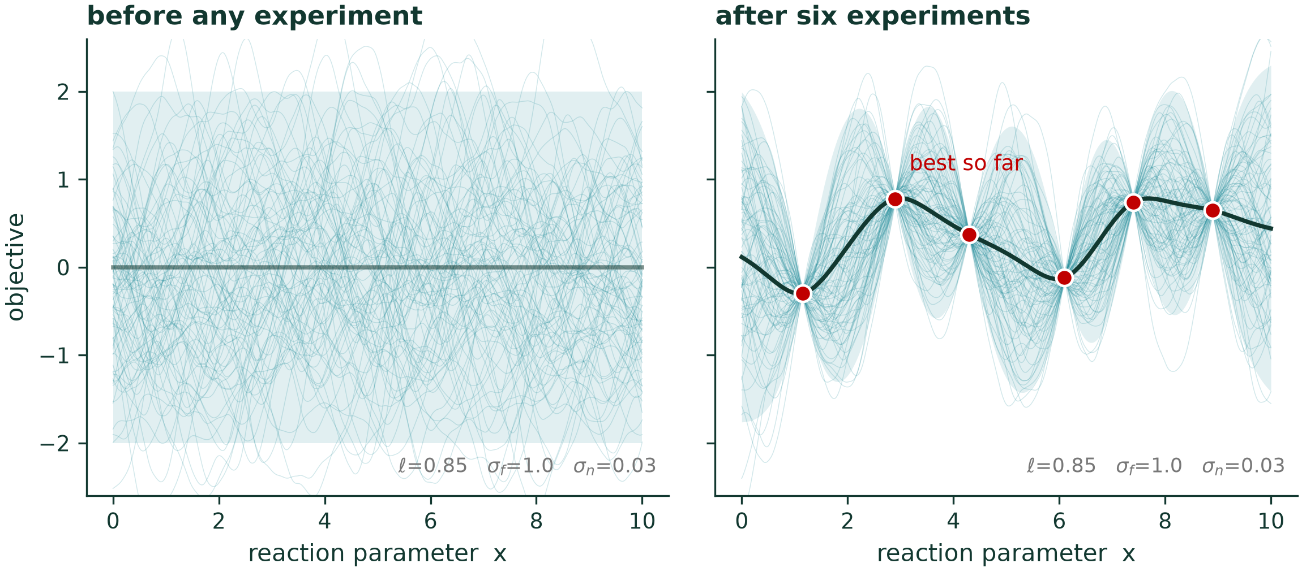

Bayesian Optimization
DATA ACQUISITION
J. Schleinitz · Tuesday, August 18, 2026 · RSC 275, Caltech
Claude Code was used for slides preparation
AI4ChemicalSciences BootCamp 2026
Notes:
Lecture 12 of 12. Ninety minutes.
Opening line: "This morning you designed experiments. This afternoon we let the
algorithm design the next one — and then the one after that, using what it just learned."
Set expectations: by 15:15 they run this themselves on real Suzuki data.

Slide 2
Outline
1 · Optimizing when data acquisition is expensive
2 · The Bayesian optimization loop
3 · Gaussian processes
4 · Categorical variables and noise
5 · Practical Scenarios: Multi-objective, batch
AI4ChemicalSciences BootCamp 2026
Notes:
Section marker. We are entering: 1 · Optimization when experiments are expensive

Slide 3
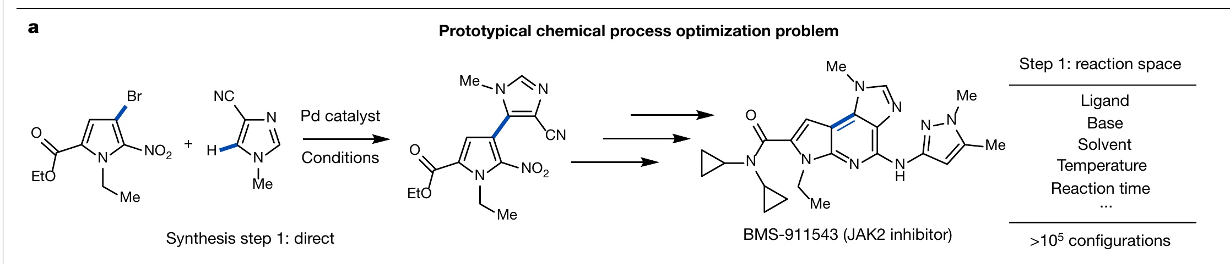
Reaction Optimization
Maximize the yield of a Suzuki coupling
temperature · residence time · catalyst loading · ligand · base · solvent
Shields, B. J.; Stevens, J.; Li, J.; Parasram, M.; Damani, F.; Martinez Alvarado, J. I.; Janey, J. M.; Adams, R. P.; Doyle, A. G. Nature 2021, 590 (7844), 89–96.
AI4ChemicalSciences BootCamp 2026
Notes:
Open with the problem, not the method. Put this brief up and ASK THE ROOM how they
would spend the 30 experiments. Take two or three answers out loud.
You will reliably get "vary one thing at a time" and "screen the ligands first".
Both are worth having said aloud — the rest of the lecture is a critique of the
first and an endorsement of the second.
Do not move on until someone has said OFAT. It makes the next slide land.

Slide 4
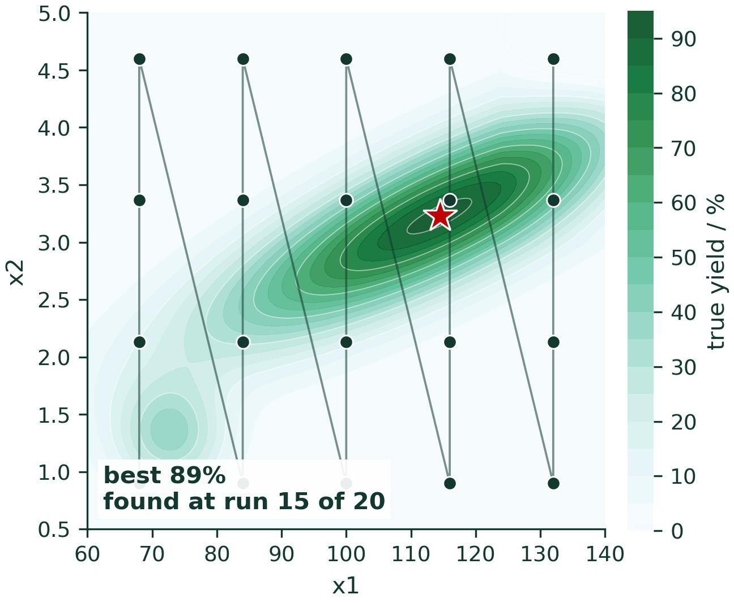
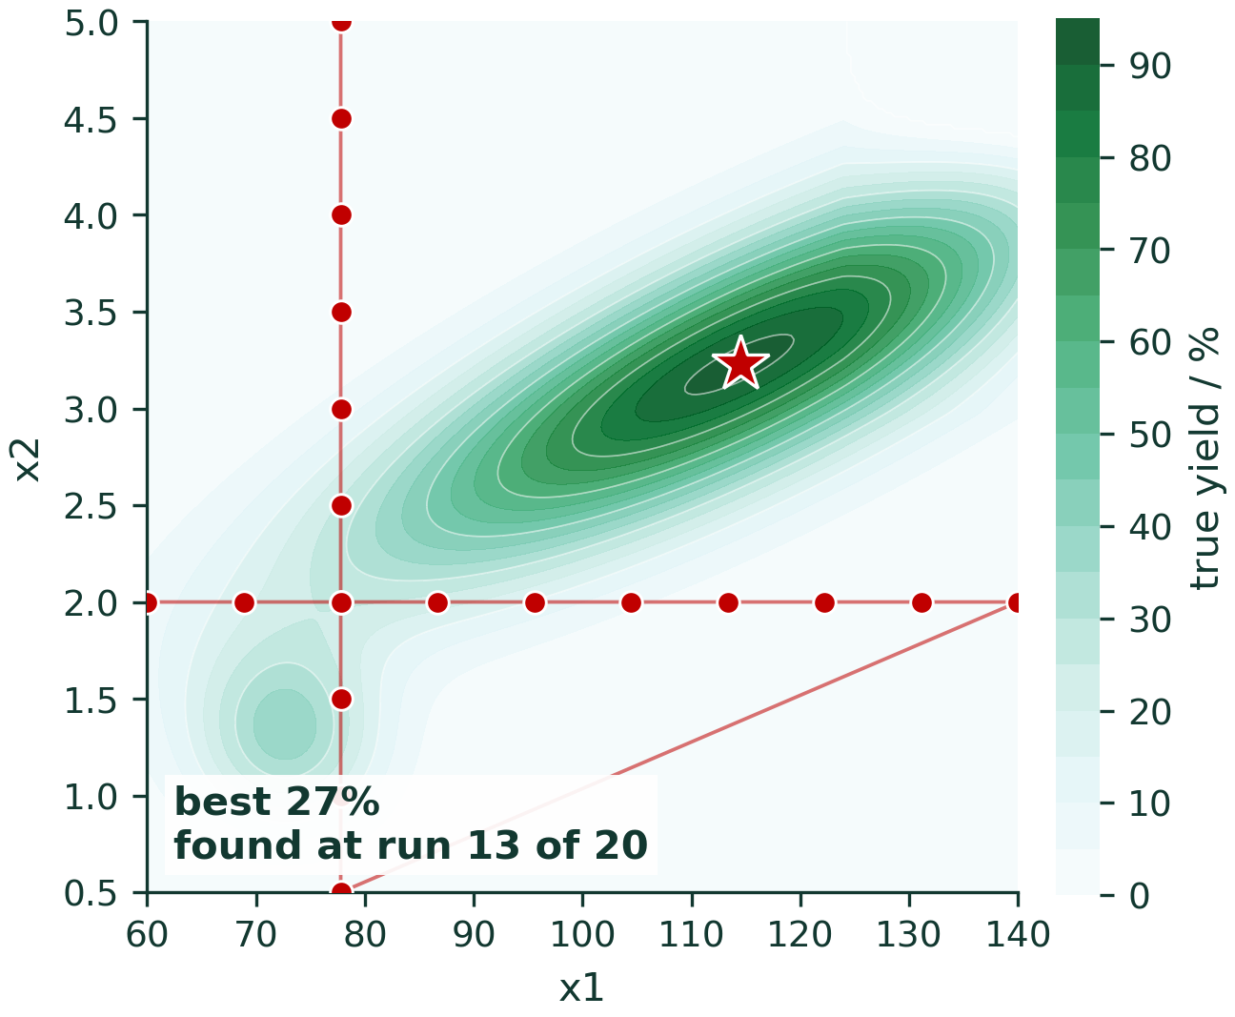
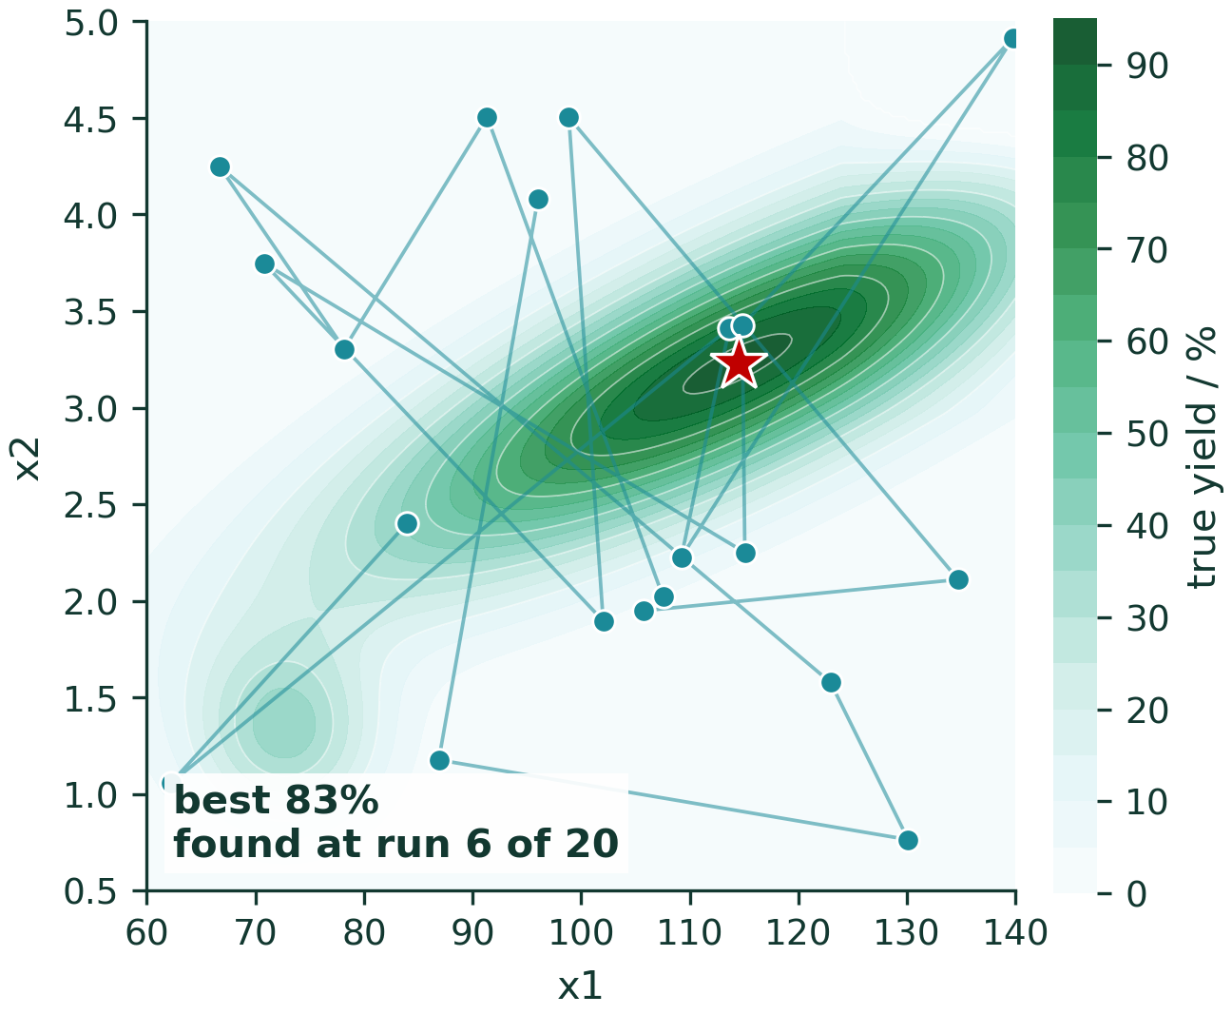
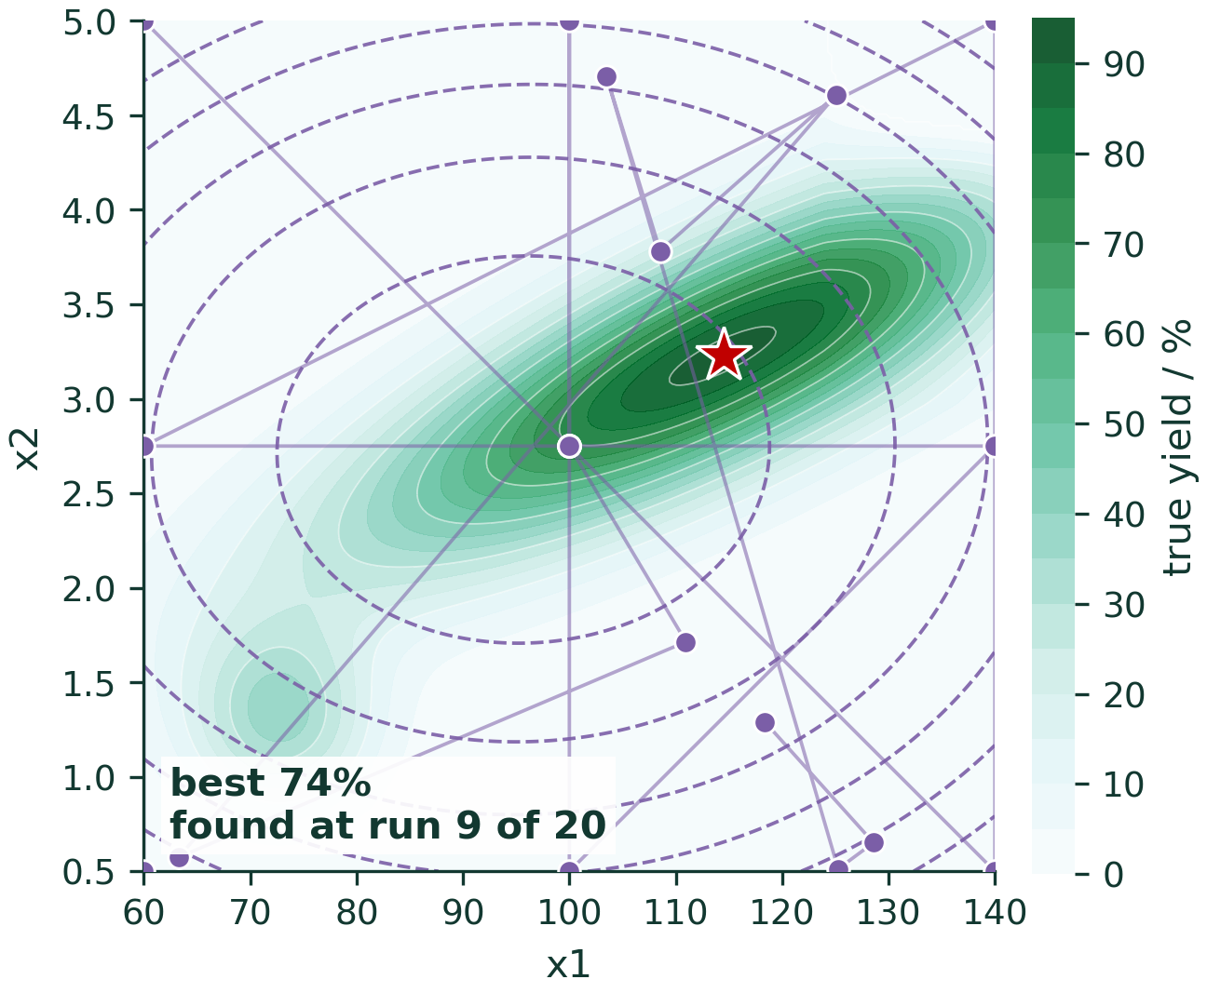
Baseline Approaches
Grid Search
OVAT
Random
DOE
AI4ChemicalSciences BootCamp 2026
Notes:
Four panels, one figure each, all on the SAME 2-D ridge landscape so they are
directly comparable. This is the landscape you reuse for the whole lecture.
OFAT is the slide the audience feels personally. Let it land — most of them have
run a campaign like this. Do not be smug about it.
RANDOM SEARCH: include it deliberately. It is the baseline every BO result must be
compared against, and saying so builds credibility for everything that follows.
Anyone who has read the hyperparameter-tuning literature will respect you for it.

Slide 5
Objective: argmax f(x)
x* = argmax f(x)
Black-box
Non-convex, interacting
Mixed-variable
Noisy
Expensive
AI4ChemicalSciences BootCamp 2026
Notes:
x* -> objective
Characterise f by what makes it HARD, not by what it is.
EXPENSIVE is the defining property — everything in BO is a consequence of it.
Say that explicitly; it is the thread through the whole lecture.
NOISY: flag it here, and promise you will come back to it. You will, twice
(the hyperparameter table, and the dedicated noise section). It is the failure
mode with the most published evidence behind it.
MIXED-VARIABLE: flag now, resolve in the categorical section. Do not let anyone
leave thinking BO only works on continuous boxes.

Slide 6
Outline
1 · Optimizing when data acquisition is expensive
2 · The Bayesian optimization loop
3 · Gaussian processes
4 · Categorical variables and noise
5 · Practical Scenarios: Multi-objective, batch
AI4ChemicalSciences BootCamp 2026
Notes:
Section marker. We are entering: 1 · Optimization when experiments are expensive

Slide 7
Bayesian Optimization
Definition:
A sequential model-based strategy for optimization of black-box objective functions whose evaluations are costly.
The method constructs a probabilistic model of the unknown function and uses the resulting predictive distribution to choose the next evaluation point. This choice is made by optimizing a sampling criterion, also called an acquisition function.
https://en.wikipedia.org/wiki/Bayesian_optimization
AI4ChemicalSciences BootCamp 2026
Notes:
Lecture 12 of 12. Ninety minutes.
Opening line: "This morning you designed experiments. This afternoon we let the
algorithm design the next one — and then the one after that, using what it just learned."
Set expectations: by 15:15 they run this themselves on real Suzuki data.

Slide 8
Bayesian Optimization Loop
0 INITIALIZATION
select few data points to label
1 SURROGATE MODEL
a cheap probabilistic model of f
mean + uncertainty
2 ACQUISITION FUNCTION
score every candidate,
using the posterior
repeat until
the budget is spent or objective is reached
4 UPDATE
recompute the posterior
3 RUN THE EXPERIMENT
$$$
AI4ChemicalSciences BootCamp 2026
Notes:
One slide, no equations. Chemists need the SHAPE of the thing before the machinery.
This is the slide people photograph.
Explain each node in one sentence, then stop. Do not unpack anything yet.
Mention the seed step: the loop needs an initial design (Latin hypercube or Sobol,
or a DOE screen). Note aloud that THIS IS WHERE DOE AND BO ALREADY TOUCH — your
initial design is a design of experiments. That is the first of several handshakes
with this morning's lecture.
State the scope: one objective, one experiment at a time, for the next hour.
We relax both assumptions at the end.

Slide 9
Bayes' law, stated over functions
p( f | D ) ⍺ p( D | f ) · p( f )
PRIOR p(f)
What functions are plausible before any data.
Not “yield is about 60%” but “yield varies smoothly with T, over tens of degrees”.
LIKELIHOOD p(D|f)
How strongly the measurements constrain f.
Contains the experimental noise model.
Noiseless likelihood ⇒ the surrogate is forced through every point, including your bad ones.
POSTERIOR p(f|D)
The updated belief.
Narrow where you have measured.
Wide where you have not.
AI4ChemicalSciences BootCamp 2026
Notes:
Note: p(f | D_n) ∝ p(y_n | f, x_n) · p(f | D_{n−1})
Merged deliberately with the surrogate section: the posterior over functions IS the
Bayes step. Presenting Bayes' law later, after acquisition functions, makes it read
as an appendix.
Interpret each term AS A STATEMENT ABOUT FUNCTIONS — that is the unfamiliar move for
this audience, and the whole reason to spend a slide on it.
PRIOR is worth dwelling on. Most chemists have strong beliefs about smoothness and
scale and never encode them. Ask: "over how many degrees does your yield change
appreciably?" — that number is a length-scale, and they already know it.
Let me verify references rather than cite from memory.The prior has three separable levers, and chemistry gives you reasons to move each one:
p(f) = mean function m(x) + kernel k(x,x′) + hyperpriors on ℓ, σ_f, σ_n
Here are the cases where a non-default choice is defensible, strongest evidence first.
1. Different encodings need different hyperpriors — and Shields et al. tuned them separately.
This is in the SI you sent me. They optimised GP priors per representation, and the recommended values differ substantially:
encoding
length-scale prior
mode
one-hot Gamma(3.0, 1.0) 2.0
Mordred descriptors Gamma(2.0, 0.1) 10.0
That's not cosmetic. One-hot lives on the corners of a hypercube where all distances are √2, so a short length-scale is appropriate; a continuous descriptor space is far more spread out and needs a length-scale five times longer. Using one set of priors for both encodings is a modelling error, and they measured it. Shields et al., Nature 2021, 590, 89–96, SI Tables S2–S3.
2. Molecules as inputs → Tanimoto kernel, not RBF on fingerprints.
A fingerprint is a sparse binary vector. An RBF kernel on it says similarity decays with squared Euclidean distance, which for sparse bit vectors is dominated by how many bits are set, not by which substructures are shared. Chemists have used Tanimoto for four decades for exactly this reason, and it can be used as a valid GP kernel. GAUCHE implements it, and reports that a differential reaction fingerprint with a Tanimoto kernel is the best-performing reaction representation they tested. Griffiths et al., "GAUCHE: A Library for Gaussian Processes in Chemistry," NeurIPS 2023; arXiv:2212.04450; code at github.com/leojklarner/gauche.
3. Categorical components → descriptor kernel, not one-hot. Already your §6. Shields found DFT descriptors gave the most consistent worst-case performance across reactions; Gryffin builds the descriptor idea into the prior explicitly. Shields et al. 2021 · Häse et al., Appl. Phys. Rev. 2021, 8, 031406, doi:10.1063/5.0048164.
4. Log-transform anything spanning orders of magnitude. Rate constants, IC50, solubility, conductivity, particle size.
A GP on the raw scale asserts that a change of ±X units is equally plausible everywhere. For a quantity ranging over 10⁻³ to 10³ that's simply false — the right invariance is ±X fold. Modelling on the log scale encodes it. Chemists already do this by reflex (pIC50, logS, logP) and think of it as data cleaning; it is in fact a statement about p(f), and it's usually the single highest-value prior change available.
5. Physics you already have → put it in the mean function.
m(x) = 0 asserts that, absent data, you expect the centred response to be average everywhere. If you have an Arrhenius relation, a kinetic model, or DFT estimates, set m(x) to that and let the GP model only the residual. The GP then has to learn where the physics is wrong, which is a much smaller and smoother function than the response itself — so it learns it from fewer experiments. Multi-fidelity BO is the systematic version, using cheap simulations as a prior for expensive experiments. Wu, Walsh & Ganose, "Race to the bottom: Bayesian optimisation for chemical problems," Digital Discovery 2024, 3, 1086–1100, doi:10.1039/D3DD00234A — a good general survey of these choices for a chemistry audience.
6. Bounded responses. Yield lives in [0, 100]. A Gaussian prior does not, so your posterior will happily predict 108% — and EI computed near the ceiling is then wrong in a way that matters, because optimization drives you toward that boundary. Fixes: logit-warp the response, or use a Beta likelihood (at the cost of the closed form). I'm flagging this as a modelling argument rather than a citation — I don't have a verified chemistry-specific reference to hand, and I'd rather say so than manufacture one.
7. Heteroscedastic noise as a prior choice. If you expect variance to grow with temperature or at low conversion, that belongs in the model, not in a shrug. Griffiths et al. show a heteroscedastic GP not only tolerates this but can be steered toward low-noise optima. Griffiths et al., Mach. Learn.: Sci. Technol. 2022, 3, 015004, doi:10.1088/2632-2153/ac298c.
A verification note, to be consistent with how I've handled citations in this project: items 1–5 and 7 are verified — 1 from the SI you gave me, 2 from a search this session, 3/5/7 against Crossref. One further idea I'd mention but have not verified: GPs with monotonicity constraints (conversion is monotone in time; yield is monotone in equivalents up to saturation). I believe the standard reference is Riihimäki & Vehtari, AISTATS 2010, but I haven't checked it in this session — treat it as a lead, not a citation.
If you want one line for the slide: the default prior — zero mean, RBF on raw numbers, generic hyperpriors — encodes "I know nothing about chemistry." Every item above is a place where you do know something, and the length-scale question you already ask on that slide is only the mildest of them.
TWO PRECISION POINTS, twenty seconds each, both pre-empt a sharp question:
1. The acquisition step is NOT Bayesian. Bayes gives the posterior; choosing where
to go next is decision theory bolted on top. Get there before they do.
2. "Bayesian" does not mean "Gaussian process". GP is one choice of prior over
functions. This sets up the last section for free.

Slide 10
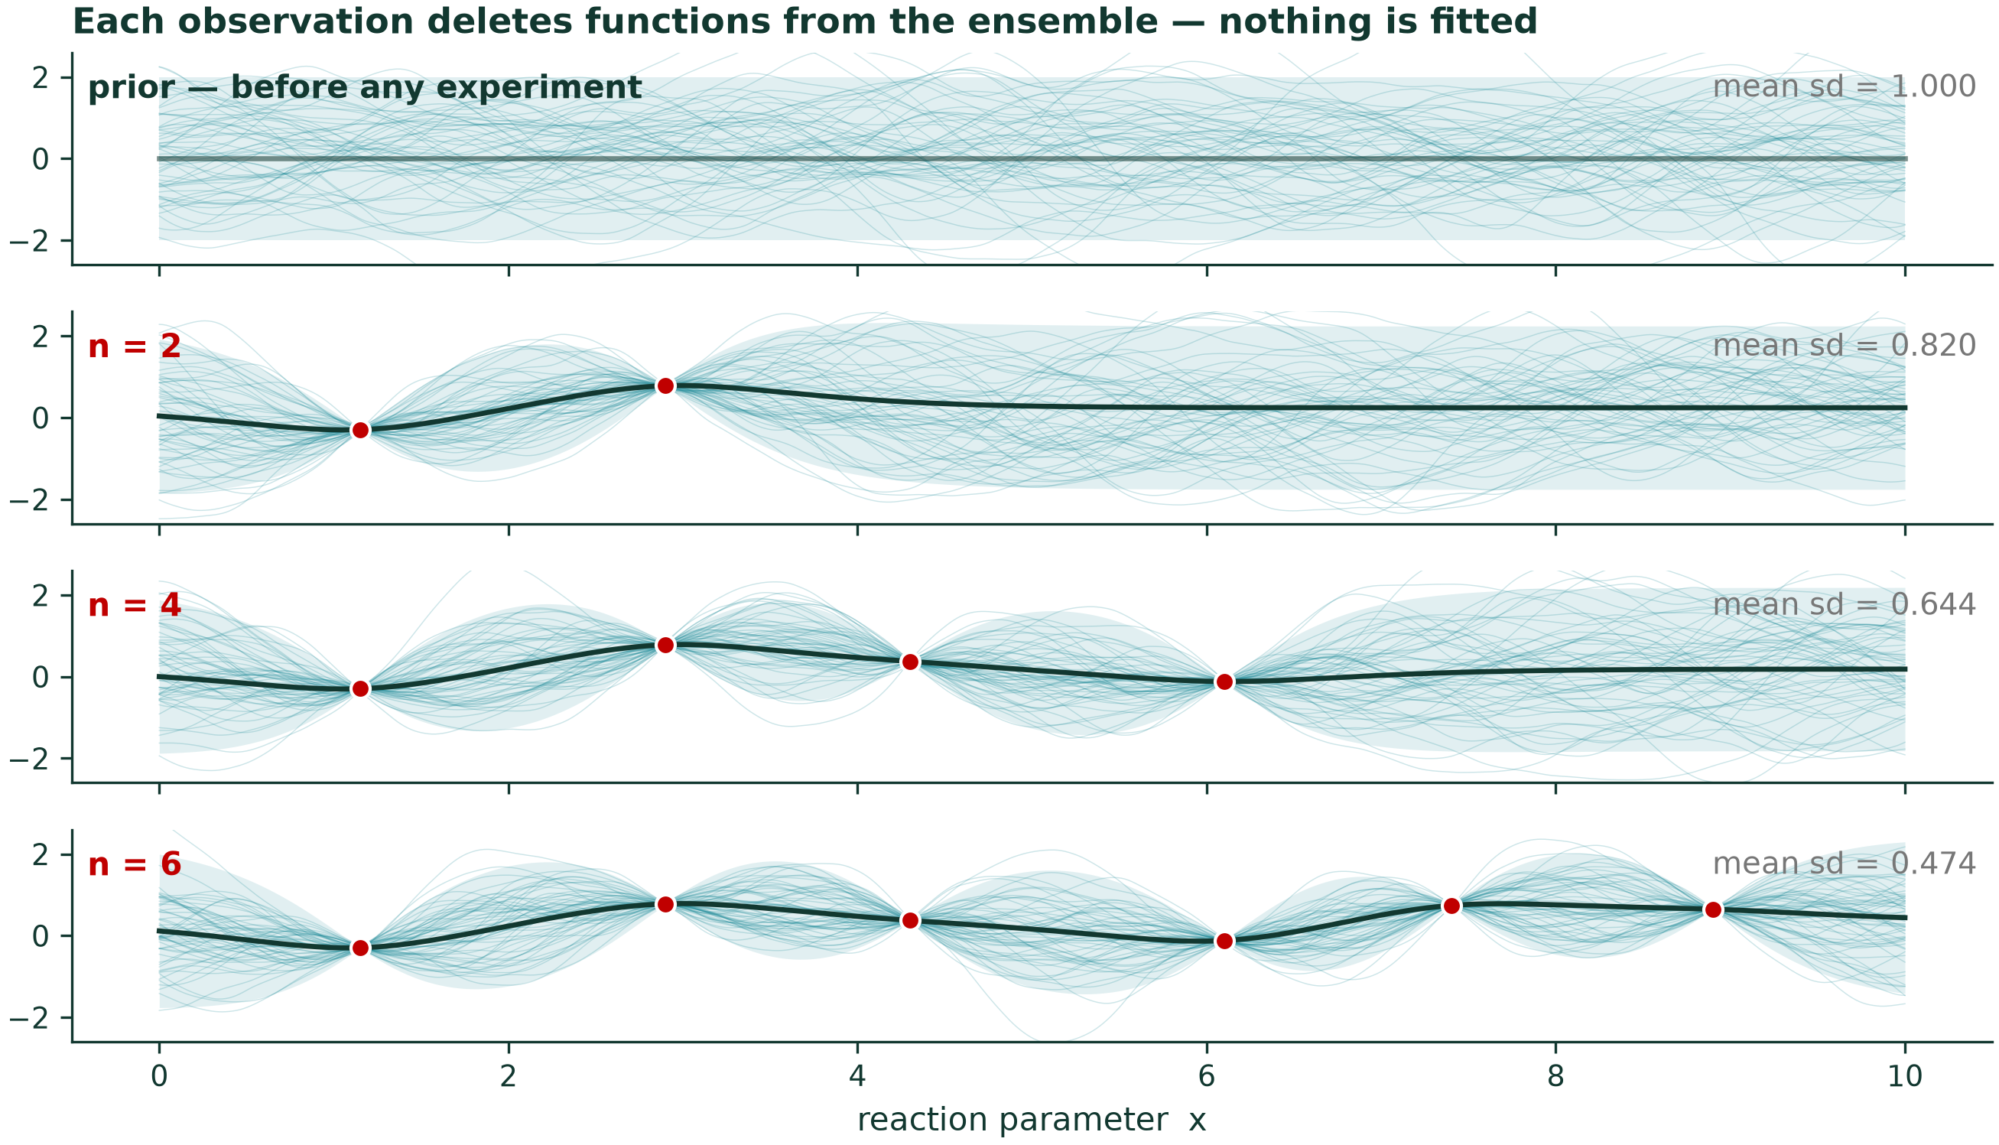
The posterior is not a fit it is what survives
p( f )
Data
acquisition
p( f | D )
fig_04_posterior_collapse.ipynb
AI4ChemicalSciences BootCamp 2026
Notes:
Talk over the figure, top panel to bottom:
"Top panel: before any experiment, these are all the functions I consider
plausible. Every panel below, I run one experiment. Notice what is happening —
I am not fitting a curve. I am DELETING the functions that are inconsistent
with what I measured. What is left is the posterior."
That reframe — deletion, not fitting — is the moment it clicks for most people.
SAY IT TWICE.
Point at the mean-uncertainty number falling down the panels. That number is what
the acquisition function will be built out of in ten minutes.
Note: a draft of this figure already exists (gaussian-processes_plate-I.pdf).
Decide whether to reuse it as-is or re-render in the deck palette.

Slide 11
Decision Making
p( f(x) | D ) = N( μ(x), σ²(x) )
Candidate A
predicted 62%
Candidate B
predicted 55%
σ = 1%
σ = 15%
Which do you run next?
Expected Mean Value + Model Uncertainty are needed for decision making
AI4ChemicalSciences BootCamp 2026
Notes:
Make an animation using the predicted only decision and adding the ”ignorance” P(f|D) = posterior
N = normal distribution
µ = mean value
σ = quantification of your ignorance of f – uncertainty on f
Start from what they already know: every model in this bootcamp so far returns a
number, y-hat = model(x). A surrogate returns a DISTRIBUTION. Two functions of x
now — a mean and an uncertainty — and everything downstream uses both.
Then run the A/B question. Ask for a show of hands. There is no universally right
answer, and that is exactly the point: it is what an acquisition function
formalises.
The punchline is the red line. A point-estimate model can only exploit. It would
never discover that B's region contains an 85% optimum.
Do not rush this slide. It is where "uncertainty" stops being decoration.

Slide 12
Closed Form
μ(x) = kₓᵀ K⁻¹ y σ²(x) = kₓₓ − kₓᵀ K⁻¹ kₓ
with K = K(X,X) + σₙ² I
σ² does not contain y.
Where you sampled sets the uncertainty — not what you measured.
If you only consider uncertainty, you can plan a campaign before running it. This is the seed of tomorrow's Active Learning lecture.
True only at fixed hyperparameters (θ). Once ℓ, σf, σₙ are fitted to the data, y re-enters through θ.
AI4ChemicalSciences BootCamp 2026
Notes:
State the equations; do NOT derive them. Flag that with a GP prior and Gaussian
noise the posterior is also Gaussian and available in closed form — no MCMC, no
sampling. That conjugacy is the single practical reason GPs dominate BO.
Then the surprise: sigma-squared has no y in it.
⚠️ SAY THE QUALIFIER OUT LOUD. It holds only at fixed hyperparameters. In the GP
section you will fit the length-scale, signal variance and noise by maximising the
marginal likelihood — which depends on y. So in any real run the variance does
acquire an indirect y-dependence through theta.
A sharp student will spot exactly this, and it is much better to have said it first.
The clean version to use:
"Given the kernel, geometry determines uncertainty. Learning the kernel is what
lets the data back in."

Slide 13
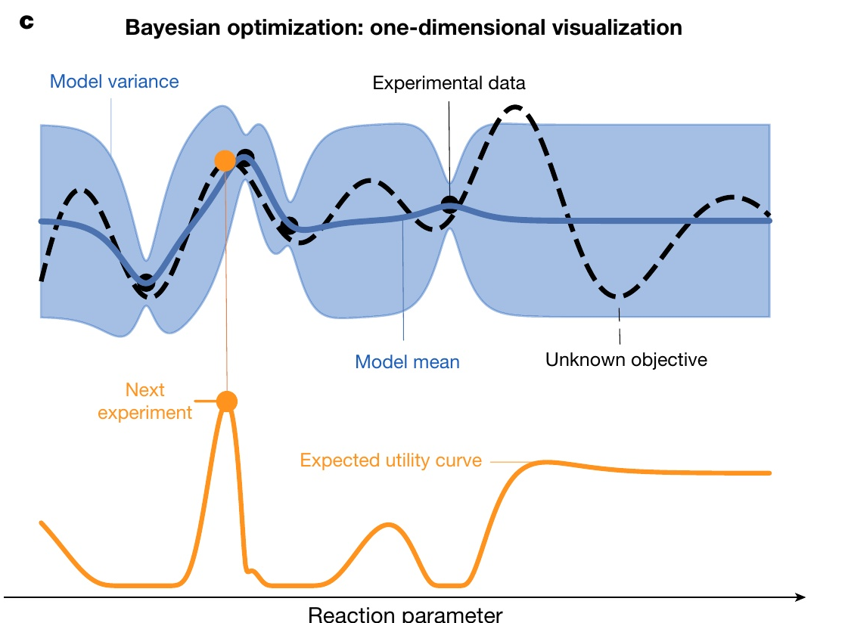
Reminder on the Objective
x* = argmax f(x)
We cannot optimize f , too expensive.
Instead optimize a score for how useful an experiment would be
Shields, B. J.; Stevens, J.; Li, J.; Parasram, M.; Damani, F.; Martinez Alvarado, J. I.; Janey, J. M.; Adams, R. P.; Doyle, A. G. Nature 2021, 590 (7844), 89–96.
AI4ChemicalSciences BootCamp 2026
Notes:
α is the acquisition function
The dashed line is the truth. You never see it.
Blue: the surrogate — mean and variance.
Orange: the acquisition function, computed from the posterior alone.
Its maximum is the next experiment — and note it is NOT where the mean is highest.
Maximising α is itself non-convex, but it costs milliseconds. So we can afford to be crude.
State the core trick plainly: we replaced one expensive optimization with
infinitely many cheap ones.
Then acknowledge the sleight of hand — maximising alpha is itself a non-convex
problem in d dimensions. But it costs milliseconds, not days, so multi-start
L-BFGS or brute-force sampling is fine. Chemists appreciate knowing where the
cheat is; hiding it costs you trust.

Slide 14
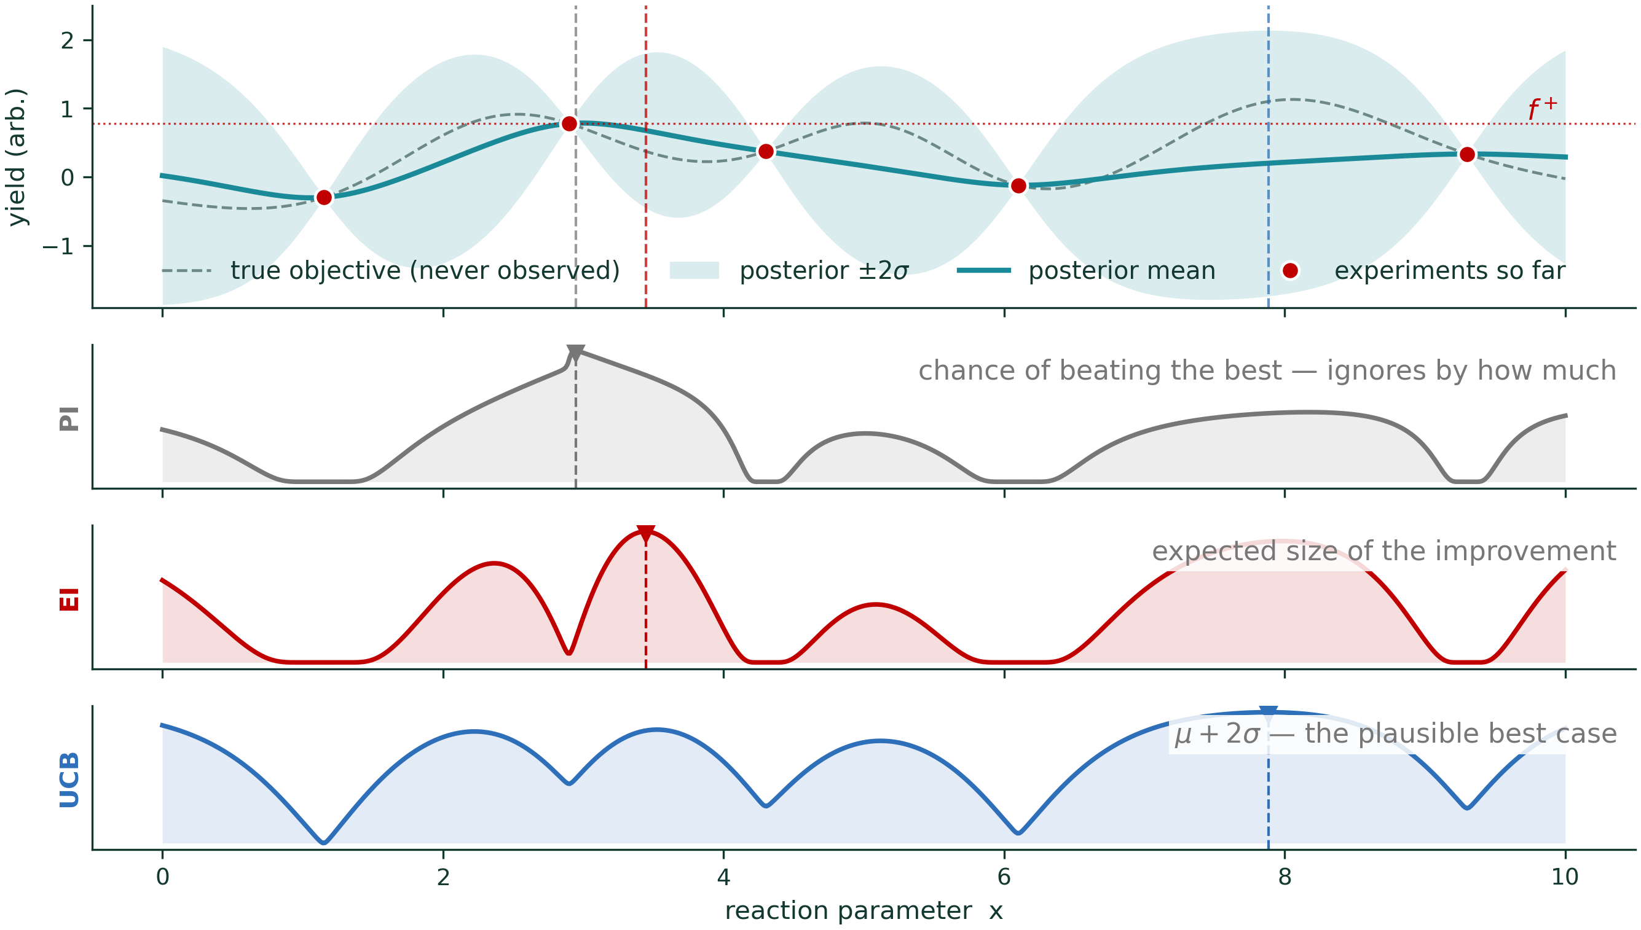
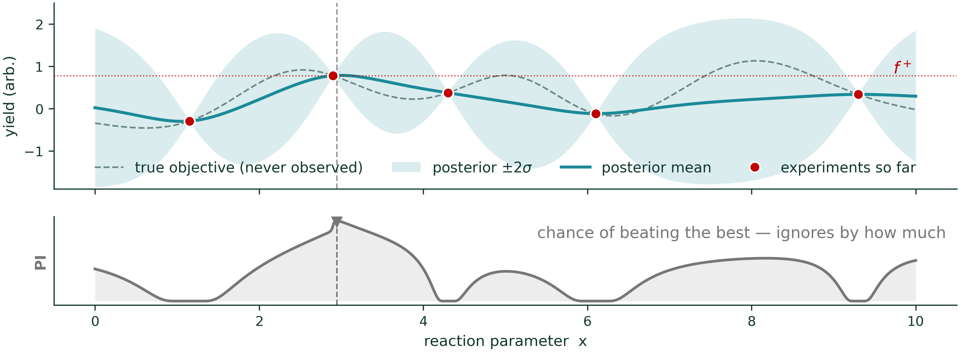
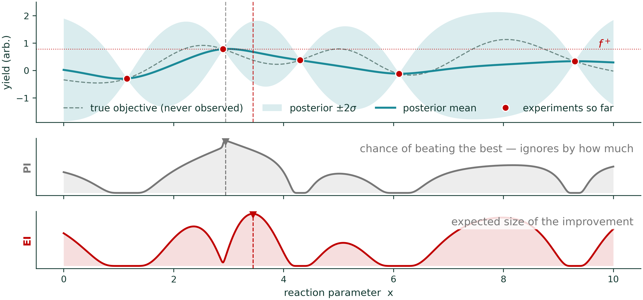
Decision Making/Acquisition Function using the Posterior
PI: Probability of Improvement
EI: Expected Improvement
UCB: Upper Confidence Bond
AI4ChemicalSciences BootCamp 2026
Notes:
THE ANCHOR SLIDE OF THE LECTURE. If you make only one figure, make this one.
Build it in three clicks so each criterion appears in turn under the same posterior.
Ask before revealing each argmax: "where will this one send us?" It turns a
passive slide into a prediction exercise, and the disagreements between the three
are the whole lesson.
PI is historical (Kushner 1964) and pathologically greedy at xi = 0: it will take a
51% chance of a 0.1% gain over a 40% chance of a huge one. It cares WHETHER you
improve, not BY HOW MUCH — which is exactly what EI fixes.
PI: Probability of Improvement
α_PI(x) = 𝔼[ 𝟙(f(x) > f⁺) ] = P( f(x) > f⁺ )
⏱ IF YOU ARE BEHIND: drop PI to one sentence and move on. It is the designated cut.

Slide 15
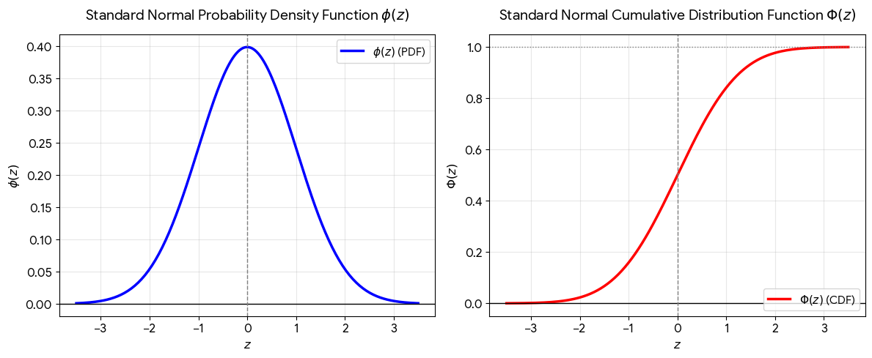
Expected Improvement (EI)
α_EI(x) = E[ max(0, f(x) − f⁺) ] = (μ − f⁺)Φ(z) + σφ(z)
z = (μ − f⁺) / σ
(μ − f⁺) Φ(z)
large where the mean is high → EXPLOITATION
σ φ(z)
grows with σ → EXPLORATION
Note: Φ(z) alone is Probability of Improvement (PI). The EGO paper comes out of the design-of-computer-experiments tradition — the same lineage as DOE.
Jones, D. R.; Schonlau, M.; Welch, W. J. J. Global Optim. 1998, 13 (4), 455–492.
AI4ChemicalSciences BootCamp 2026
Notes:
Both are the standard normal — mean 0, variance 1. That's why the formula needs z: you standardise, read off the universal bell curve, then rescale by σ.
φ(z) — lowercase phi — is the probability density function, the bell curve itself:
φ(z) = (1/√2π) · exp(−z²/2)
It's a height. Peaks at φ(0) = 0.399, decays symmetrically.
Φ(z) — uppercase Phi — is the cumulative distribution function, the area under that curve to the left of z:
Φ(z) = ∫₋∞^z φ(t) dt
It's a probability, running 0 → 1, with Φ(0) = 0.5. And Φ′ = φ — the CDF is the running integral of the PDF.
z is the standardised improvement, z = (μ − f⁺)/σ: how many standard deviations your predicted mean sits above the best result so far. Dimensionless, which is exactly what lets you use universal functions here.
z
Φ(z)
φ(z)
reading
−2 0.023 0.054 2σ below the incumbent — almost certainly no improvement
−1 0.159 0.242
0 0.500 0.399 predicted mean exactly at the incumbent — coin flip, and φ is at its maximum
+1 0.841 0.242
+2 0.977 0.054 2σ above — improvement near-certain, but φ has collapsed
What each term is doing.
Φ(z) is the probability that this experiment beats your current best. Literally: if f(x) ~ 𝒩(μ, σ²), then P(f(x) > f⁺) = Φ((μ−f⁺)/σ) = Φ(z). Which means Φ(z) is the probability-of-improvement acquisition function. So
α_EI = (μ − f⁺) · α_PI + σ · φ(z)
EI is PI, weighted by how big the win would be, plus a correction for spread. That's a nice way to introduce them in sequence rather than as two unrelated formulas.
σφ(z) is the uncertainty bonus, and note where it peaks — at z = 0. That's the subtlety worth saying out loud, because "σφ(z) = exploration" invites the wrong picture. It does not reward uncertainty everywhere. It rewards uncertainty right at the decision boundary, where your predicted mean sits level with the incumbent and extra spread could tip you either way. Far above f⁺ you'll win anyway; far below, no plausible amount of noise saves you. Both tails have φ → 0.
Three limits that make it feel inevitable:
σ → 0 and μ > f⁺: z → +∞, Φ → 1, φ → 0, so EI → μ − f⁺. A certain improvement, worth exactly its size.
σ → 0 and μ < f⁺: both terms → 0. EI = 0. Nothing to gain, no uncertainty to hope on.
μ = f⁺ exactly: EI = 0 + 0.399σ. A point no better than your incumbent still has positive EI, purely from uncertainty. That's exploration paid for in the arithmetic.
EI is ≥ 0 everywhere, because improvement is floored at zero by the max(0, ·).
A link to your code that's worth showing. Since scipy wasn't available, _shared/gp.py implements these from the error function: Φ(z) = ½(1 + erf(z/√2)), with φ written out directly. So norm_cdf and norm_pdf in that file are literally these two objects, six lines apart — a good thing to point at when someone asks where the Greek letters went.
One presentation warning. Φ and φ are the standard convention, but at projection size in a serif italic they look nearly identical. Label them the first time — "Φ, the CDF" and "φ, the density" — or colour them differently in the figure. Students who miss the distinction read the formula as the same thing added to itself.
Do not derive. Point at the two terms and read them aloud. That is the entire slide.
If asked, two precisions:
- the exploration term peaks where mu is close to f-plus, i.e. it rewards
uncertainty NEAR the current best, not uncertainty anywhere;
- EI is undefined at sigma = 0; every implementation handles that edge case.
- a margin xi can be subtracted from f-plus exactly as in PI to force more
exploration. Most packages expose it; most people leave it at zero.
The EGO citation is a nice thread back to Schmidt's morning lecture — same
statistical lineage, different goal.

Slide 16
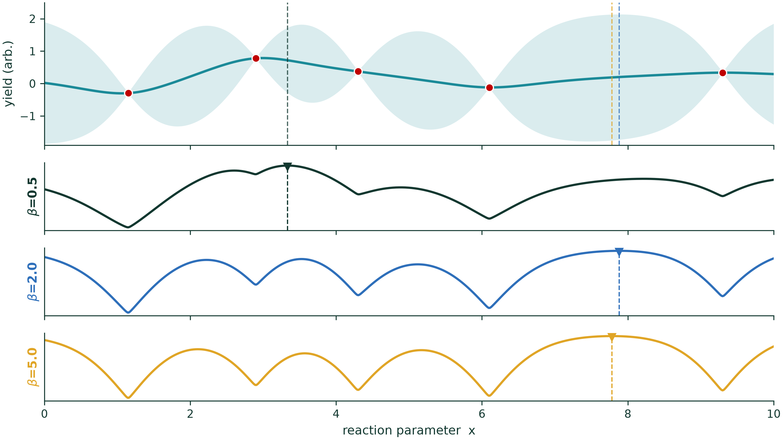
Upper Confidence Bound (UCB)
α_UCB(x) = μ(x) + β · σ(x)
β small → greedy
β large → explorer
β = 2 is the usual default
fig_06_ucb_beta_sweep.ipynb
Srinivas, N.; Krause, A.; Kakade, S. M.; Seeger, M. W. IEEE Trans. Inf. Theory 2012, 58 (5), 3250–3265.
AI4ChemicalSciences BootCamp 2026
Notes:
Two things to say, no more.
1. Chemists like UCB because beta is explicit. EI's balance is implicit; UCB's you
can write in a report and defend.
2. It has the cleanest theory — Srinivas et al. proved sublinear regret bounds.
BE PRECISE: those guarantees require beta to GROW with iteration (roughly
logarithmically), not the fixed beta = 2 people actually run. So the honest
sentence is:
"The schedule-based version of UCB has convergence guarantees; the fixed-beta
version we all actually use is a heuristic inspired by them."
Five seconds, and this audience will respect it.
Also do not call beta = 2 a 95% bound. It is one-sided ~98%. Someone will check.

Slide 17
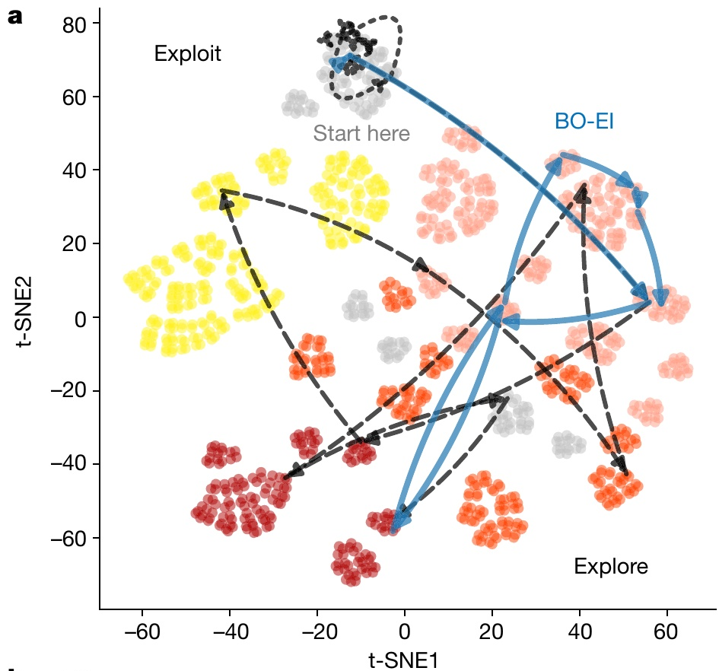
Exploration – Exploitation Trade-off
→ Pure EXPLOIT stays in the cluster it started in.
→ Pure EXPLORE tours the whole space
→ BO with EI visits three of the five clusters, then commits.
Fig. 3a.
Shields, B. J.; Stevens, J.; Li, J.; Parasram, M.; Damani, F.; Martinez Alvarado, J. I.; Janey, J. M.; Adams, R. P.; Doyle, A. G. Nature 2021, 590 (7844), 89–96.
AI4ChemicalSciences BootCamp 2026
Notes:
The published version of the honest close. Students over-index on acquisition
functions because they are the mathematically prettiest part of the subject —
here is the evidence that the choice is close to a wash.
Point at the two dashed grey curves (exploit, explore) that clearly lag, then at
the cluster of everything else. The lesson is not "acquisition functions do not
matter", it is "the balanced ones are all fine, and the unbalanced ones are not".
The red strip is the transition into the rest of the lecture: those three things are
sections 6, 5b and 10 respectively.
Tutorial hook: "This afternoon you will run EI against UCB and see this yourself."
————————————————————————————————————————————————
THE THREE KNOBS THAT SET THE BALANCE (one per acquisition function)
Everything on this slide is a point on one axis: how much does the method pay
for uncertainty? Each of the three balanced acquisition functions exposes that
as a single number.
beta in UCB alpha(x) = mu(x) + beta * sigma(x)
The most explicit of the three — beta is literally the price, in
units of standard deviation, that you are willing to pay for
uncertainty. beta = 0 is pure exploitation; beta -> infinity is pure
exploration. Default 2. Theory wants beta to GROW like sqrt(log t),
not sit at 2 (see the UCB slide).
xi in EI z = (mu(x) - f+ - xi) / sigma(x)
Often called the jitter or the improvement threshold. It raises the
bar: an experiment only counts as an improvement if it beats the
incumbent by at least xi. xi = 0 is the textbook definition and can
be too greedy in practice; xi ~ 0.01 x (range of y) is the usual
nudge towards exploration. NOTE the sign convention — larger xi means
MORE exploration, which is the opposite direction to what people
expect from the name "threshold".
eps in eps-greedy with probability 1 - eps take argmax mu(x);
with probability eps pick a candidate uniformly.
Not really a Bayesian acquisition function at all — it never uses
sigma. It is the bandit-literature baseline, and it is on the next
slide precisely because it does about as well as the principled ones.
DO NOT confuse these with the GP hyperparameters. ell, sigma_f and sigma_n
(sections coming up) live in the MODEL and are fitted from the data by
maximising the marginal likelihood. beta, xi and eps live in the DECISION RULE
and are chosen by you — no data will ever tell you what they should be. If one
student asks one question about this lecture, it will be this one.
THE GREEDY ACQUISITION FUNCTION
alpha_greedy(x) = mu(x)
Pick wherever the posterior mean is highest. No sigma term anywhere, so a
region that has never been sampled is worth exactly its prior mean and is
never revisited. This is the "pure EXPLOIT" trace on the figure — it stays in
the cluster it started in, because nothing in the score ever rewards leaving.
It is the beta = 0 corner of UCB, and the eps = 0 corner of eps-greedy.
Its mirror image, alpha(x) = sigma(x), is pure exploration: it tours the space
and never commits. Both are on the figure, both lose. The lesson is not that
acquisition functions do not matter — it is that the BALANCED ones are
interchangeable and the UNBALANCED ones are not.

Slide 18
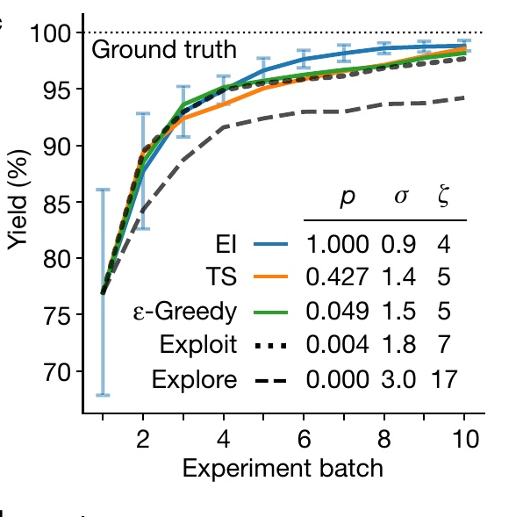
The Acquisition Function Matters Less Than You Think
EI, Thompson sampling and ε-greedy all converge together.
Pure exploit and pure explore are the only ones that lose.
Fig. 3c,f — average of 30 runs, error bars 0.5σ.
Shields, B. J.; Stevens, J.; Li, J.; Parasram, M.; Damani, F.; Martinez Alvarado, J. I.; Janey, J. M.; Adams, R. P.; Doyle, A. G. Nature 2021, 590 (7844), 89–96.
AI4ChemicalSciences BootCamp 2026
Notes:
The published version of the honest close. Students over-index on acquisition
functions because they are the mathematically prettiest part of the subject —
here is the evidence that the choice is close to a wash.
Point at the two dashed grey curves (exploit, explore) that clearly lag, then at
the cluster of everything else. The lesson is not "acquisition functions do not
matter", it is "the balanced ones are all fine, and the unbalanced ones are not".
The red strip is the transition into the rest of the lecture: those three things are
sections 6, 5b and 10 respectively.
Tutorial hook: "This afternoon you will run EI against UCB and see this yourself."

Slide 19
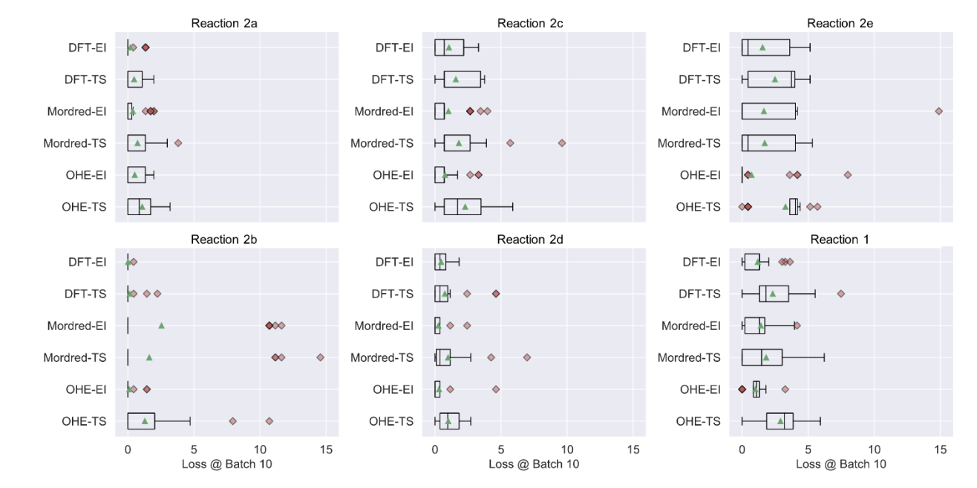
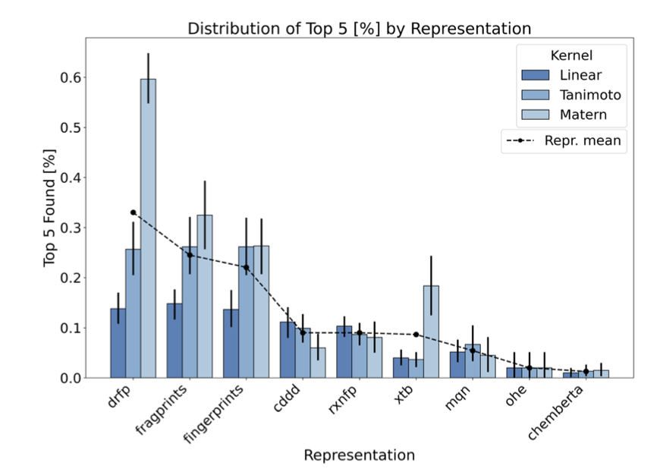
Role of the Representation and Kernel
Shields, B. J.; Stevens, J.; Li, J.; Parasram, M.; Damani, F.; Martinez Alvarado, J. I.; Janey, J. M.; Adams, R. P.; Doyle, A. G. Nature 2021, 590 (7844), 89–96.
Ranković, B.; Griffiths, R.-R.; Moss, H. B.; Schwaller, P. Digital Discovery 2024, 3 (4), 654–666.
AI4ChemicalSciences BootCamp 2026
Notes:
The published version of the honest close. Students over-index on acquisition
functions because they are the mathematically prettiest part of the subject —
here is the evidence that the choice is close to a wash.
Point at the two dashed grey curves (exploit, explore) that clearly lag, then at
the cluster of everything else. The lesson is not "acquisition functions do not
matter", it is "the balanced ones are all fine, and the unbalanced ones are not".
The red strip is the transition into the rest of the lecture: those three things are
sections 6, 5b and 10 respectively.
Tutorial hook: "This afternoon you will run EI against UCB and see this yourself."

Slide 20
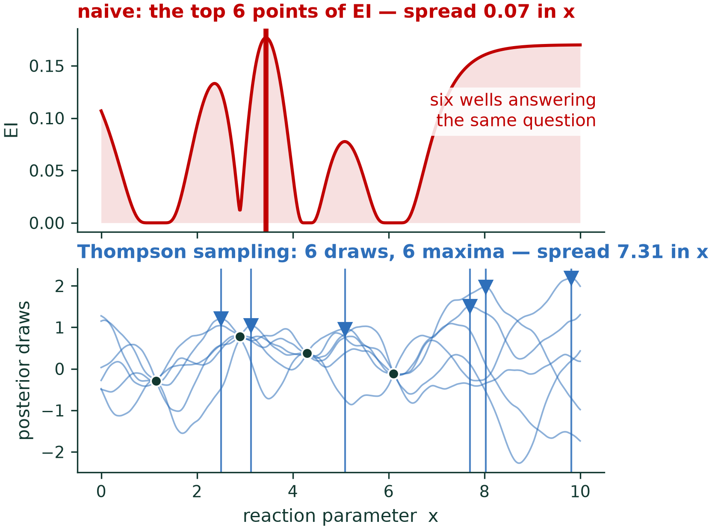
Thompson Sampling
Draw one function from the posterior. Select x that maximizes that draw as a next experiment
AI4ChemicalSciences BootCamp 2026
Notes:
Thompson sampling: almost trivially simple, and — the key point — NATURALLY PARALLEL.
Draw q functions, get q diverse experiments for free. Plant it here; you harvest it
in the batch section.
Then close the acquisition section with honesty. Students over-index on acquisition
functions because they are the mathematically prettiest part of the subject. Say so
out loud. The three things on the right are what the rest of the lecture is about,
and framing them as "what actually matters" buys you their attention for the
unglamorous sections.
Tutorial hook: "This afternoon you will run EI against UCB on real Suzuki data and
see exactly how small the difference is."

Slide 21
Plan
1 · Optimizing when data acquisition is expensive
2 · The Bayesian optimization loop
3 · Gaussian processes
4 · Categorical variables and noise
5 · Practical Scenarios: Multi-objective, batch
AI4ChemicalSciences BootCamp 2026
Notes:
Section marker. We are entering: 3 · Gaussian processes and their knobs

Slide 22
Kernel
If two conditions are similar, how similar should their outcomes be?
RBF
k(x,x′) = σ_{f}² exp( −‖x−x′‖² / 2ℓ² )
MATÉRN 5/2
same idea, rougher assumption about f
RBF implies f is infinitely differentiable — a strong claim about a surface with phase boundaries and catalyst death. Matérn 5/2 assumes only twice-differentiable.
AI4ChemicalSciences BootCamp 2026
Notes:
"The kernel answers one question: if two conditions are similar, how similar should
their outcomes be?" That is a chemical statement, not a statistical one, and it is
your bridge into the room.
⚠️ VERIFY BEFORE YOU SAY "MATERN IS THE DEFAULT".
BoTorch changed SingleTaskGP away from ARD Matern 5/2 to an RBF kernel with
dimension-scaled log-normal priors (v0.12, 2024). If the tutorial pins a current
BoTorch, students will see RBF on screen at 15:15.
Two framings — pick one once you have checked:
- IF CURRENT (RBF default): use it as the better lesson. The community moved back
to RBF not because the smoothness argument was wrong, but because THE PRIORS ON
THE HYPERPARAMETERS MATTERED MORE THAN THE CHOICE OF KERNEL. That sets up the
"with fewer than 10 points, priors do the work" warning perfectly.
- IF PINNED OLDER (Matern default): keep the smoothness framing, mention the change.
This is the one claim in the lecture the room can falsify live. Get it right.

Slide 23
Hyperparameters
RBF kernel
k(x,x′) = σ_{f}² exp( −‖x−x′‖² / 2ℓ² )
ℓ length-scale
“How far must I move in temperature before the yield changes?”
ℓ = 10 °C is a claim you can sanity-check.
Too small → reverts to the mean between points; BO degenerates to random search.
Too large → oversmooths, misses a narrow optimum.
σ_{f}² signal variance
“How much does yield vary across the whole space?”
Sets the vertical scale of the prior.
Too small → over-confident, under-explores.
σₙ² noise
Your experimental error. The replicate error of your assay.
Set to ~0 and the GP interpolates every point exactly — including one bad measurement — and BO chases a lucky outlier for the rest of the campaign.
The single most common practical error in chemistry BO.
AI4ChemicalSciences BootCamp 2026
Notes:
The part of the lecture with the highest practical return.
The noise column is the one to slow down on. It leads straight into the noise
section and it is the failure they will actually hit in the tutorial.
The next slide shows what the length-scale does to the posterior.

Slide 24
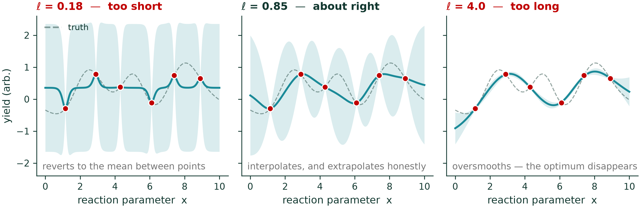
Length Scale
Too short and the posterior snaps back to the mean between points — BO degenerates towards random search. Too long and the optimum is smoothed away.
fig_08_hyperparameters.ipynb · same six observations, three length-scales
AI4ChemicalSciences BootCamp 2026
Notes:
The part of the lecture with the highest practical return. Ideally one figure per
parameter: same six data points, three settings, three posteriors.
The noise column is the one to slow down on. It leads directly into the noise
section, and it is the failure they will actually hit in the tutorial.
If the figure box at the bottom is too cramped once built, split this into two
slides — the table here, the three-panel length-scale figure on its own.

Slide 25
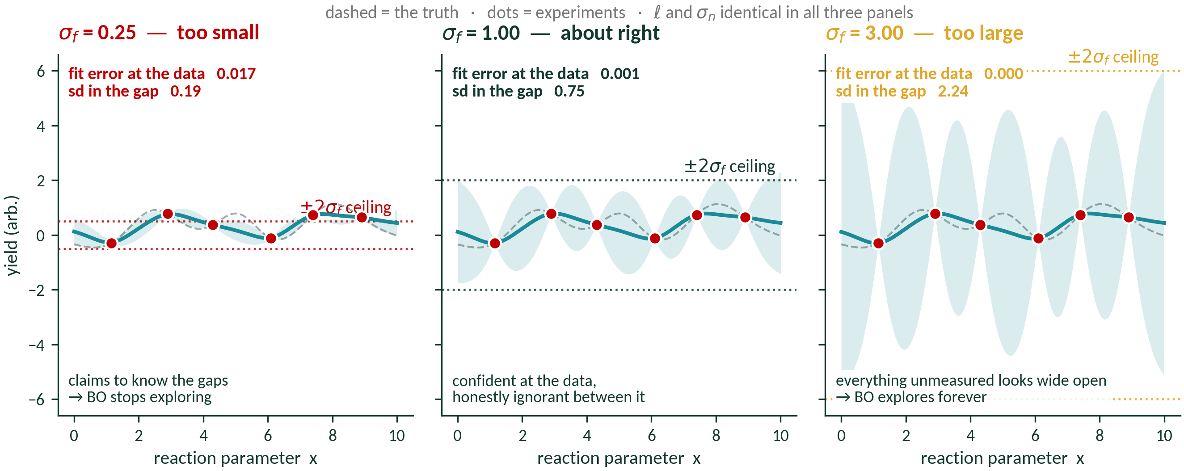
σ_{f} — Signal Variance
All three fit the data equally well. σ_f changes nothing at the observations — it sets the CEILING of the band in the gaps, and therefore how much BO wants to explore.
fig_18_sigma_f.ipynb · ℓ and σₙ identical in all three panels
AI4ChemicalSciences BootCamp 2026
Notes:
The number to point at is the pair in each top-left corner. Fit error at the data:
0.017, 0.001, 0.000 — indistinguishable. sd in the gap: 0.19, 0.75, 2.24 — a factor
of twelve.
So say it plainly: σ_f does almost nothing where you have measured, and everything
where you have not. Since the exploration term of EI is σφ(z), σ_f is effectively
the dial on how adventurous the campaign will be.
The dotted lines are ±2σ_f. Note the band never crosses them — σ(x) ≤ σ_f always,
because the posterior can never be more uncertain than the prior. Far from data,
kₓ → 0 and σ(x) → σ_f exactly.
⚠️ A student may object that the left panel "looks like a worse fit". It isn't —
check the printed fit error. What it is, is over-confident.

Slide 26
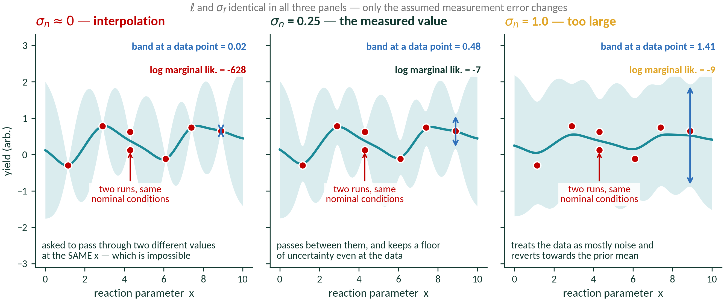
σₙ — Data Noise
fig_19_sigma_n.ipynb · ℓ and σ_f identical; one pair of runs is a replicate
AI4ChemicalSciences BootCamp 2026
Notes:
The part of the lecture with the highest practical return. Ideally one figure per
parameter: same six data points, three settings, three posteriors.
The noise column is the one to slow down on. It leads directly into the noise
section, and it is the failure they will actually hit in the tutorial.
If the figure box at the bottom is too cramped once built, split this into two
slides — the table here, the three-panel length-scale figure on its own.

Slide 27
Hyperparameter Fitting
log p(y | X, θ) = −½ yᵀK⁻¹y − ½ log|K| − (n/2) log 2π
−½ y^{T}K⁻¹y
data fit — rewards explaining the observations
−½ log|K|
complexity penalty — punishes over-flexible models
AI4ChemicalSciences BootCamp 2026
Notes:
Show the expression, interpret the two terms, do NOT derive. Thirty seconds on the
Occam framing — it lands well with this audience.
Then the warning that will actually save them in the tutorial: with fewer than about
ten points, marginal-likelihood optimization is unstable. Every good BO package
applies priors or bounds by default; they should know it is happening rather than
discover it when their length-scale comes back as 1e-4.
Also mention cost here: O(n^3) from the matrix inverse. Free at n = 50, impossible
at n = 1e5. Irrelevant for a reaction campaign, decisive for library screening —
which is exactly why the last section of this lecture exists.
Answer the "why GPs?" question head-on, honestly:
"Because at n = 20 a GP gives calibrated uncertainty essentially for free, in
closed form, with three interpretable parameters — and n = 20 is where a chemist
lives."
Then the caveat: GPs are natural for low-d, continuous, smooth, small-n. Outside
that regime NN ensembles match or beat them. "Most natural fit for YOUR problem" is
defensible; "most natural fit" alone is not.

Slide 28
Plan
1 · Optimizing when data acquisition is expensive
2 · The Bayesian optimization loop
3 · Gaussian processes
4 · Categorical variables and noise
5 · Practical Scenarios: Multi-objective, batch
AI4ChemicalSciences BootCamp 2026
Notes:
Section marker. We are entering: 4 · Real chemistry: categorical variables, noise, DOE

Slide 29
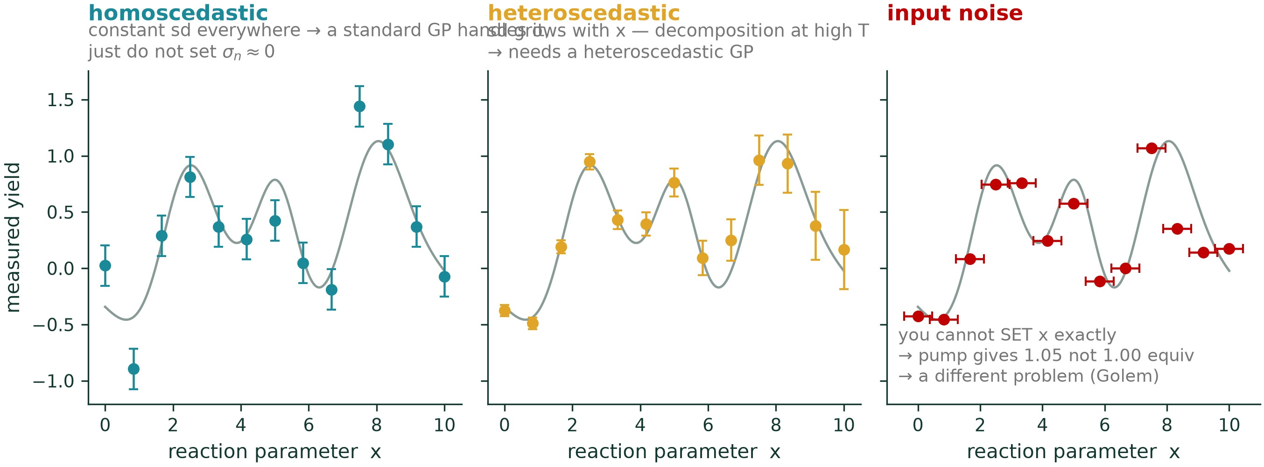
Three different things get called “noise”
HOMOSCEDASTIC
constant σₙ across the space
assay error roughly the same everywhere
→ standard GP — just don't set σₙ ≈ 0
HETEROSCEDASTIC
σₙ varies with x
variance blows up at high T where the catalyst dies; low-conversion regions are proportionally noisier
→ heteroscedastic GP
INPUT NOISE
you cannot SET x exactly
the pump delivers 1.05 not 1.00 equiv; the reactor overshoots by 3 °C
→ Golem — a different problem entirely
AI4ChemicalSciences BootCamp 2026
Notes:
Chemists conflate these three constantly. Separating them takes 45 seconds and
prevents a whole class of confusion.
Input noise is genuinely a different problem: it is not that your measurement is
noisy, it is that the condition you asked for is not the condition you got.

Slide 30
Why noise biases BO, rather than just slowing it down
EI is defined against f⁺, the best value observed so far — and treats it as truth.
Under noise, f⁺ is probably a lucky measurement.
If EI anchors to a number that is too high, it under explores, and spends the budget chasing an outlier.
Standard EI trusts your best data point. Noisy EI does not.
AI4ChemicalSciences BootCamp 2026
Notes:
The mechanism, in one sentence. This is the crux of the noise section.
Noisy EI fixes it by marginalising over the uncertainty in f-plus as well — it asks
"improvement over the best TRUE value", not "over my luckiest data point".
Lineage for the tutorial: Letham et al. 2019 introduced NEI, and it is the direct
ancestor of qNEI / qNEHVI in BoTorch — so at 15:15 they run its descendant.
The next slide is the evidence.

Slide 31
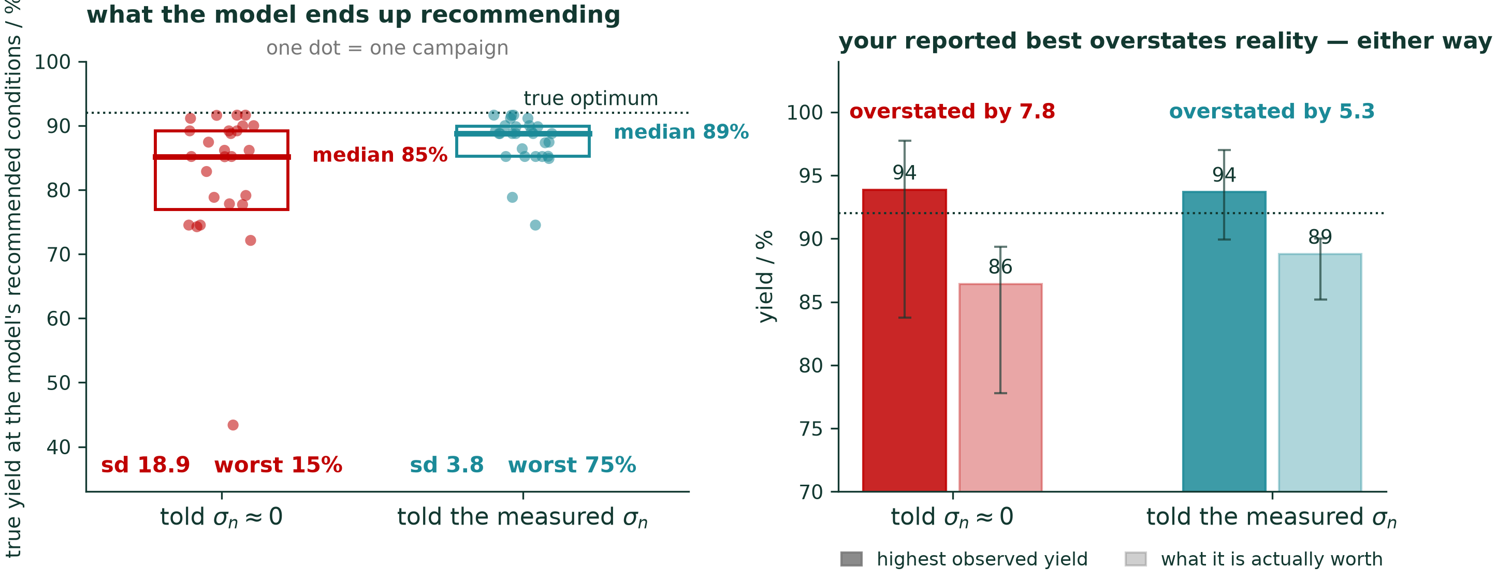
Same noise, two assumptions, 28 campaigns each
fig_11_noise_ablation.ipynb · true σₙ = 6 percentage points
Telling the GP σₙ ≈ 0 does not mainly cost you yield on average — it makes the outcome a lottery. Same lesson as the human benchmark.
AI4ChemicalSciences BootCamp 2026
Notes:
The mechanism, in one sentence. This is the crux of the noise section and the thing
they will remember.
Noisy EI (NEI) fixes it by marginalising over the uncertainty in f-plus as well — it
asks "improvement over the best TRUE value, given everything I have measured", not
"improvement over my luckiest data point".
Figure 11 is the highest teaching value per minute in the whole lecture. Two runs,
same landscape, only the assumed noise differs. Show the near-zero run locking on.
Lineage worth stating for the tutorial: Letham et al. 2019 introduced NEI, and it is
the direct ancestor of qNEI / qNEHVI in BoTorch — so at 15:15 they run the
descendant of that paper.
Figure 11 is not real data — it's a simulation on a synthetic 2-D reaction surface. Worth being explicit about, because it sits two slides away from the Shields panels which are real.
The surface (_shared/landscape.py, the "ridge" variant): temperature 60–140 °C × catalyst loading 0.5–5 mol%, built by hand out of three analytic terms —
a curved ridge whose optimal loading rises with temperature (this is what defeats a fitted quadratic in fig 15),
a deceptive secondary bump at low T / low loading,
a decomposition penalty that kicks in at high T and high loading.
Nothing is fitted to measurements. The same surface is reused by figures 2 and 15, which is what makes the grid/DOE/BO comparison a like-for-like one.
What's actually run (specs_b.py, FIG11): two BO campaigns, identical in every respect except one number.
true measurement noise added to every observation: sd = 6 percentage points
one campaign is told σ_n = 0.05 ("≈ 0"), the other is told σ_n = 6.0 (the truth)
6 seed experiments + 14 EI iterations = 20 runs, on a 36×36 candidate grid
28 random seeds each, paired seed-for-seed
fixed kernel: Matérn 5/2, ℓ = [20 °C, 1.2 mol%], σ_f = 28 — deliberately not refitted, so the only thing varying between the two arms is σ_n
Per campaign it records three things: the highest yield the chemist observed, what those exact conditions are actually worth on the noiseless surface, and what the model would recommend (argmax of the posterior mean). That third quantity is the left panel; the gap between the first two is the right panel.
Why synthetic here is the right choice. Both panels need the ground truth — "what your reported best is really worth" and "how good is the model's recommendation" are unanswerable without a noiseless oracle. You can't get that from an HTE dataset, where every entry is itself one noisy reading. The price is that the effect sizes (sd 18.9 vs 3.8) are properties of this surface and this noise level, not universal constants.
If you want the noise argument backed by real measurements too, the published route is the noisy-EI literature already in your reference list rather than a rerun of this figure. Want me to add a one-line "synthetic surface — ground truth known by construction" note to slide 33, so nobody in the room assumes it's Shields data?

Slide 32
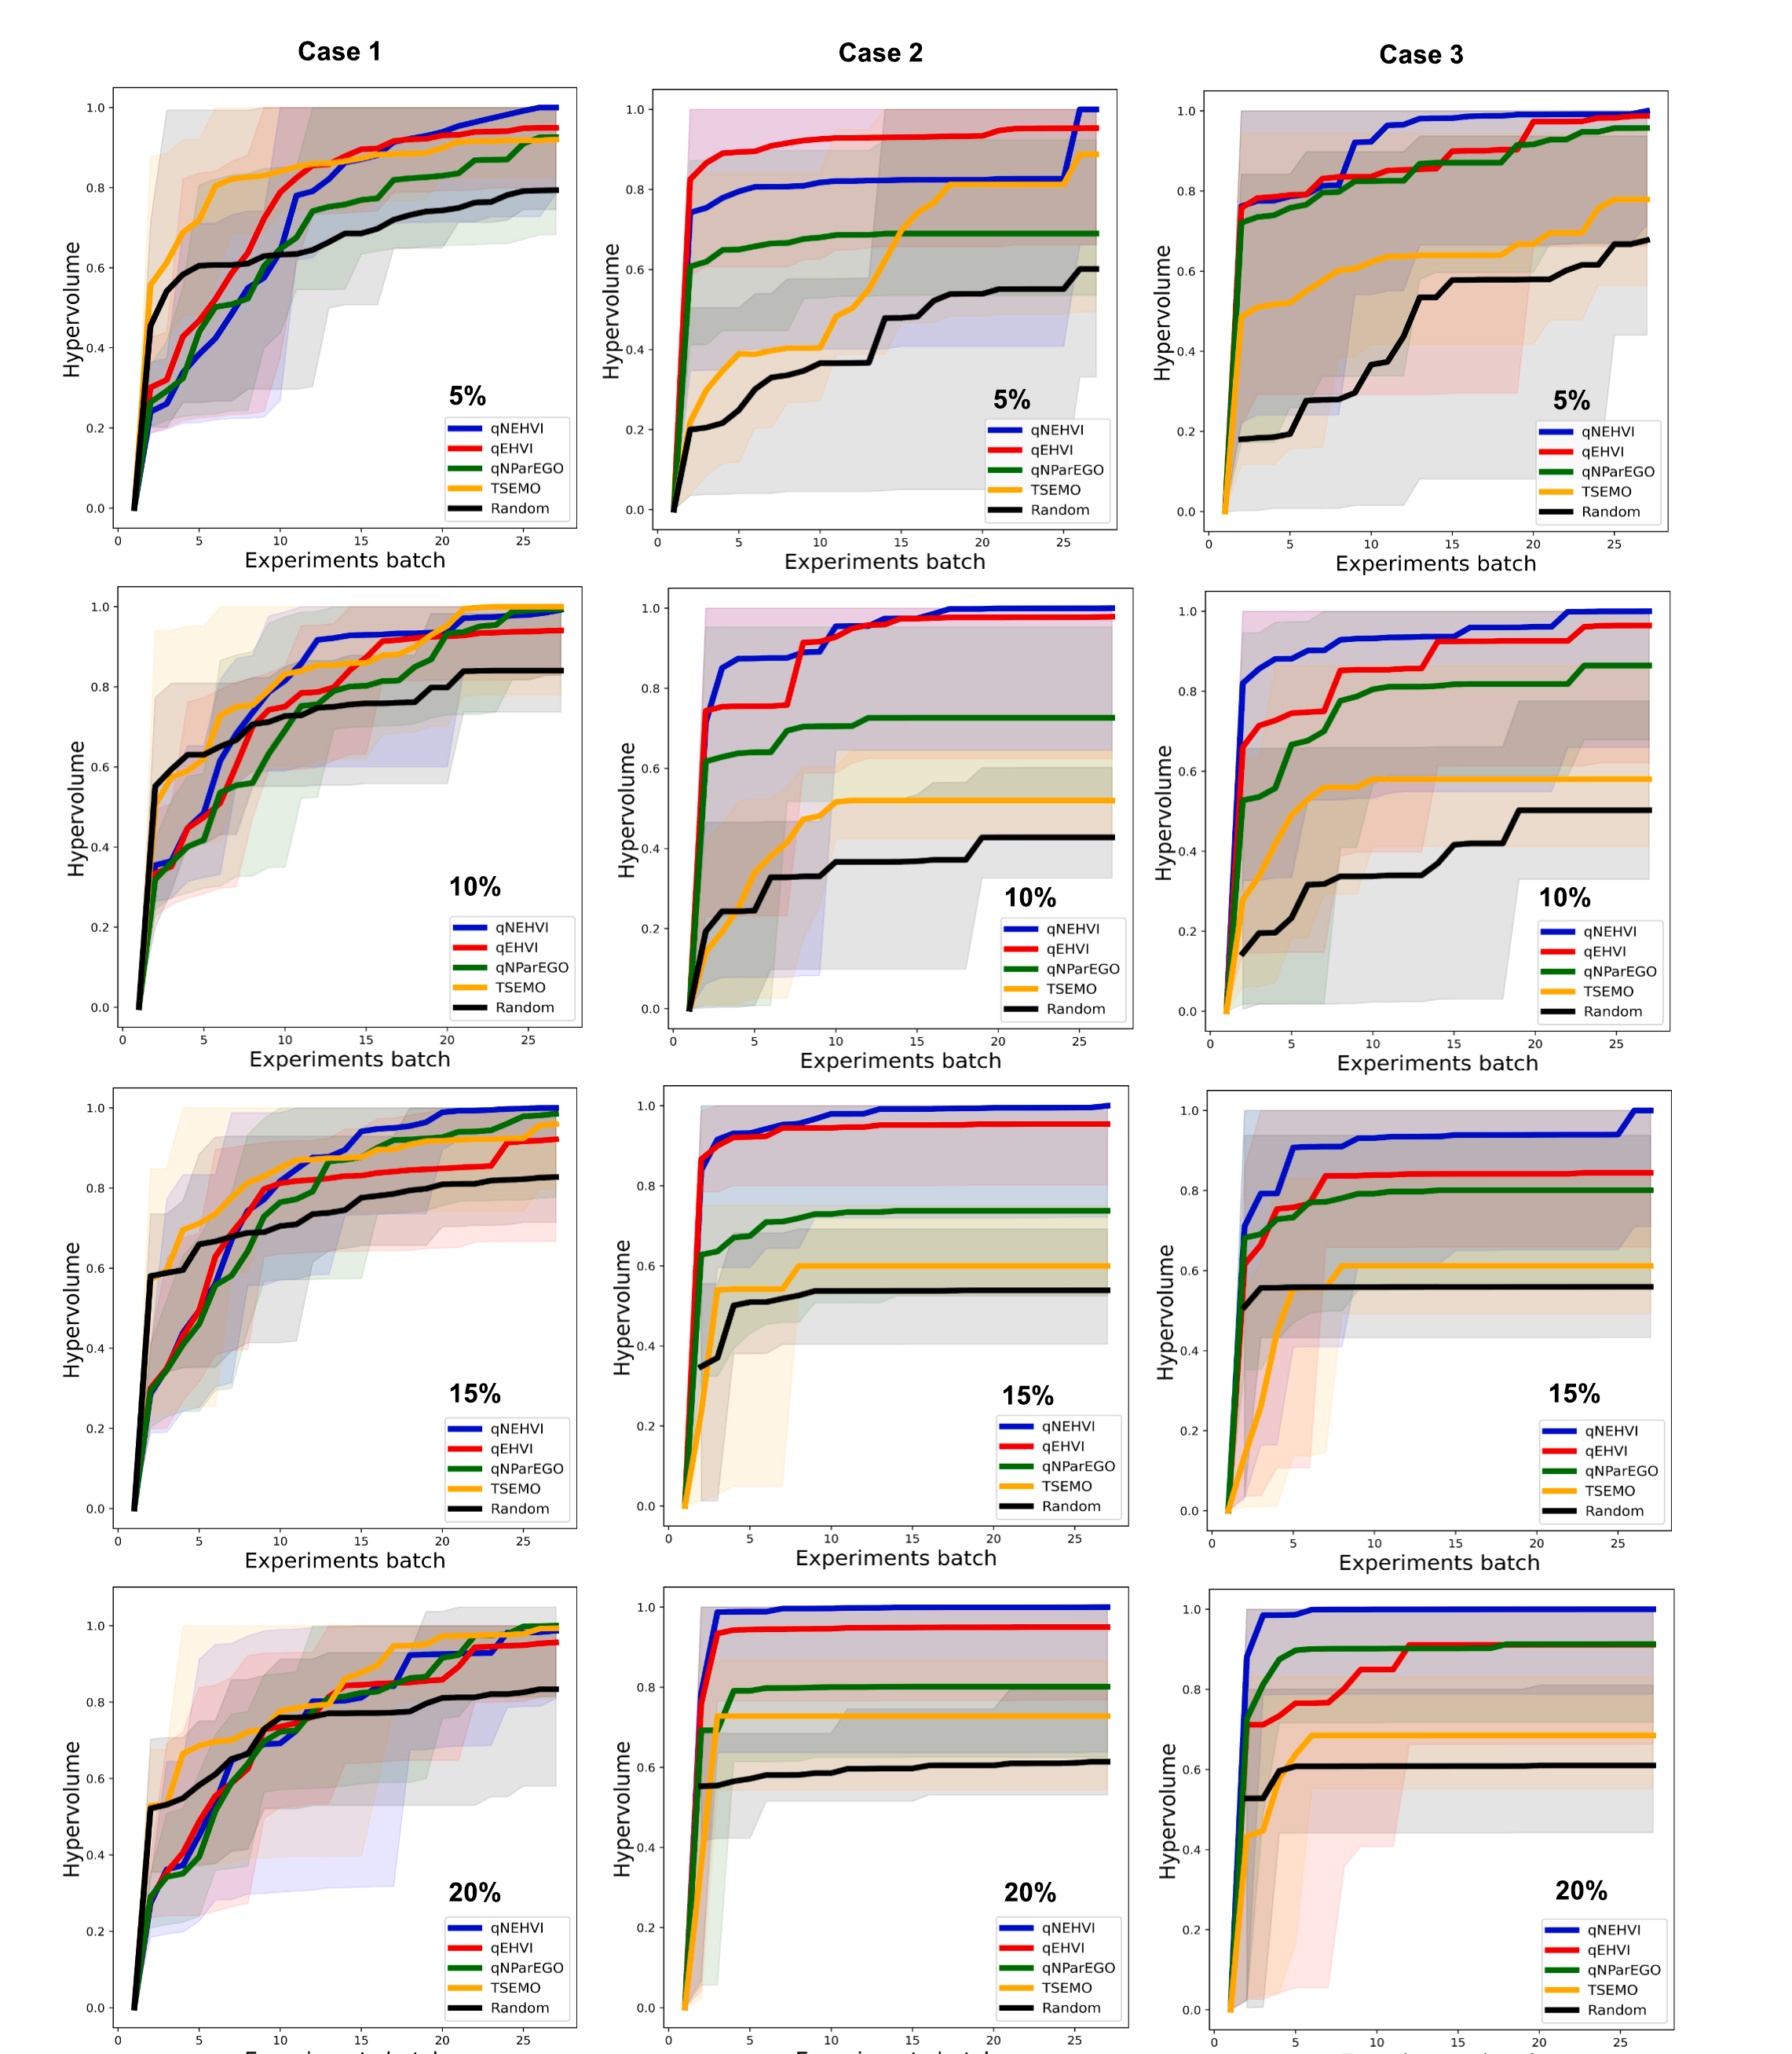
Published: which acquisition function survives the noise
qNEHVI — noisy expected hypervolume improvement
Integrates over the posterior at every point already run, so the current Pareto front is treated as uncertain rather than as fact. Top of all twelve panels.
qEHVI — expected hypervolume improvement
Same hypervolume reward, but conditions on the observed front as if it were exact. Level with qNEHVI at 5 % noise; falls behind as noise grows.
qNParEGO — random-weight scalarisation
Increasing noise level
Draws a fresh weight vector per batch point, collapses the objectives with an augmented Tchebycheff function, then runs noisy EI. Cheap.
TSEMO — Thompson sampling, multi-objective
NSGA-II over random Fourier feature draws of the GPs. Strong at 5 %, degrades most once noise reaches 10 %.
Random
The control. Note how close it gets in Case 1 — that panel is a wash.
Luo, G.; Yang, X.; Su, W.; Qi, T.; Xu, Q.; Su, A. Chem. Eng. Sci. 2024, 298, 120434.
AI4ChemicalSciences BootCamp 2026
Notes:
WHY THIS SLIDE EXISTS
The previous slide is my simulation. This one is the same claim, published,
with real kinetics and a controlled noise level — so nobody has to take my
synthetic surface on faith.
THE SETUP (Luo et al., Chem. Eng. Sci. 2024, 298, 120434)
Three reactions — amidation, acylation, SNAr — each with a previously
published kinetic model, so the ground truth is known and the noise can be
DIALLED: 5, 10, 15, 20 % relative. Two objectives per case. Batch of q = 2
per iteration, 25 iterations, 10 independent trials, shaded band = min-max
over trials. Vertical axis is hypervolume, normalised to 1 at the best found.
Everything else — surrogate (GP, Matern), initialisation, budget — is held
fixed. The ONLY thing that varies within a panel is the acquisition function.
THE FIVE ACQUISITION FUNCTIONS, IN WORDS
qEHVI Expected Hypervolume Improvement, batch version.
alpha(X) = E[ HVI(f(X)) ] where HVI(Y,P,r) = HV(P u Y, r) - HV(P, r).
"How much do I expect this batch to grow the volume dominated by
the Pareto front, measured against a reference point r?"
The catch: it conditions on P, the OBSERVED front, as if those
measurements were exact.
qNEHVI The noisy version. Instead of one front P, it draws posterior
samples of f at every point already run, builds a front from each
draw, and averages the hypervolume improvement over those:
alpha(X) ~ (1/N) sum_t HVI( f_t(X) | P_t ).
Same trick as noisy EI on the previous slides, lifted to many
objectives — the incumbent is a distribution, not a number.
Daulton, Balandat & Bakshy, NeurIPS 2021.
qNParEGO Scalarise, then optimise. Draw a random weight vector, collapse
the objectives with an augmented Tchebycheff function, run noisy EI
on the scalar. A new weight per batch member gives spread across the
front. Much cheaper than hypervolume; less directed.
Knowles 2006 (ParEGO); Daulton et al. 2021 for the noisy batch form.
TSEMO Thompson sampling for multi-objective problems. Draw one random
Fourier feature approximation per GP, hand the resulting cheap
surrogate to NSGA-II, take a subset of the evolved front. Randomised
by construction — which is exactly why it suffers when the draws are
being made from a posterior that has not modelled the noise.
Bradford, Schweidtmann & Lapkin, J. Glob. Optim. 2018.
Random Uniform sampling. The control.
WHAT TO SAY, AND WHAT NOT TO
SAY: at 5 % noise almost everything works; by 10-15 % the ordering is fixed
and qNEHVI is at or near the top of every panel; TSEMO is the biggest casualty.
The paper then runs qNEHVI in the wet lab on a two-step continuous-flow HFIP
synthesis and reaches E-factor 0.125 and 93.1 % yield in 29 runs.
DO NOT overclaim. Case 1 (left column) is close to a wash — Random is within
the bands at every noise level. Point at it yourself before someone else does.
The honest sentence is: "on the two cases where the acquisition function
matters at all, the noise-aware one wins, and the margin grows with the noise."
If asked why hypervolume and not yield: with two objectives there is no single
number to maximise, so the benchmark scores the whole front. That is slide 37.
Second paper, same message, if anyone wants it: Zhang, Semochkina, Sugisawa,
Woods & Lapkin, Comput. Chem. Eng. 2025, 194, 108983 — multi-objective
expected quantile improvement under heteroscedastic noise, benchmarked against
qNEHVI, qNParEGO and TSEMO. Their Figs 8 and 9 are the equivalent panels for
linear and log-linear noise structures.

Slide 33
Published evidence that getting the noise right changes the outcome
Picheny, V.; Wagner, T.; Ginsbourger, D. Struct. Multidiscip. Optim. 2013, 48 (3), 607–626.
Ten kriging infill criteria benchmarked with noise level, budget and sample size varied systematically. The RANKING of criteria changes with noise.
Letham, B.; Karrer, B.; Ottoni, G.; Bakshy, E. Bayesian Anal. 2019, 14 (2), 495–519.
Introduces Noisy EI. Standard methods degrade as noise rises; NEI does not. Ancestor of qNEI / qNEHVI in BoTorch.
Luo, G.; Yang, X.; Su, W.; Qi, T.; Xu, Q.; Su, A. Chem. Eng. Sci. 2024, 298, 120434.
THE CHEMISTRY ONE. qNEHVI / qEHVI / qNParEGO / TSEMO / random on simulated amidation, acylation, SNAr ACROSS NOISE LEVELS — noise-aware qNEHVI wins. Then real two-step flow synthesis of hexafluoroisopropanol: 93.1% yield, E-factor 0.125, 29 runs.
Zhang, J.; Semochkina, D.; Sugisawa, N.; Woods, D. C.; Lapkin, A. A. Comput. Chem. Eng. 2025, 194, 108983.
Heteroscedastic, multi-objective. Expected quantile improvement under linear and log-linear noise; esterification, space-time-yield vs E-factor.
AI4ChemicalSciences BootCamp 2026
Notes:
Do not read this slide out. Point at the third box and spend your time there — it is
the one that does the work, because it is the only one that is (a) chemistry and
(b) a controlled comparison at varying noise.
Framing for Luo et al.: "Same problem, noise handling varied, noise-aware wins,
then validated on real chemistry." That is exactly the experiment you would design
if you wanted to answer the question, and someone already ran it.
If short on time: show only Luo, mention the others exist, move on.
Griffiths et al. 2022 (Mach. Learn.: Sci. Technol. 3, 015004) is the fifth one and
adds a conceptual turn worth 20 seconds if you have it: their ANPEI acquisition does
not merely tolerate noise, it hunts for LOW-NOISE regions. That is the difference
between a paper result and a process.
Binois et al. 2019 (Technometrics 61, 7–23) formalises replicate-vs-explore — cite
when you tell them to replicate on the next slide.

Slide 34
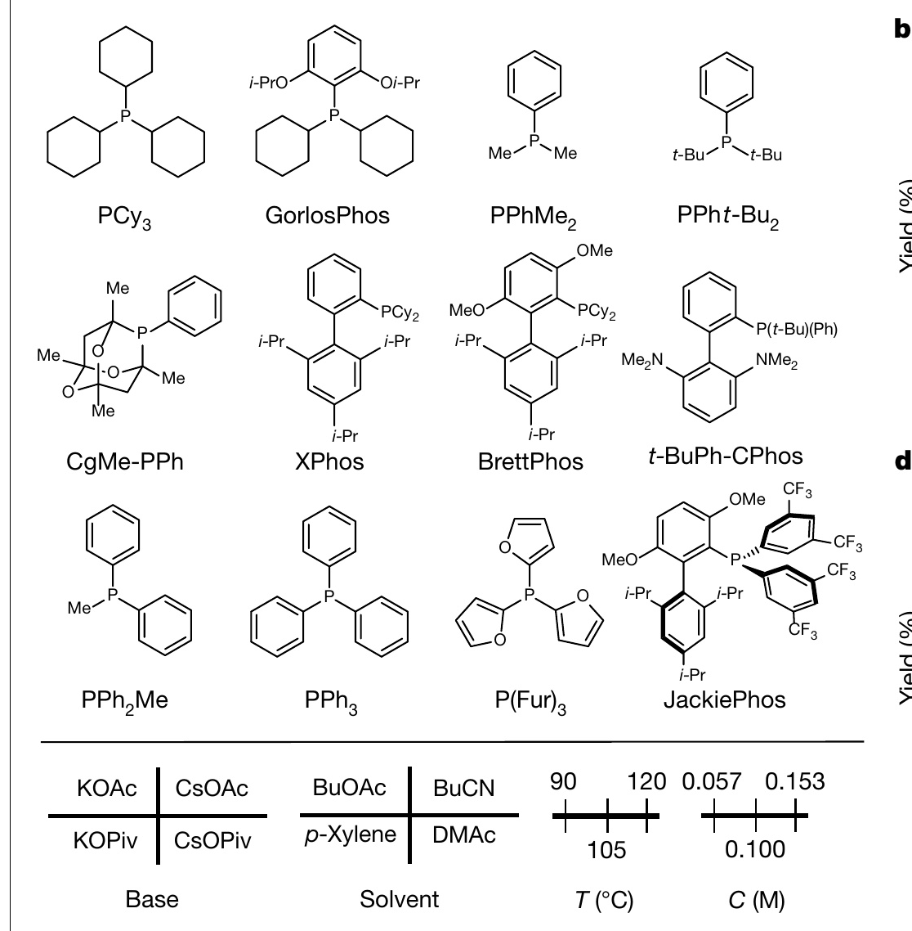
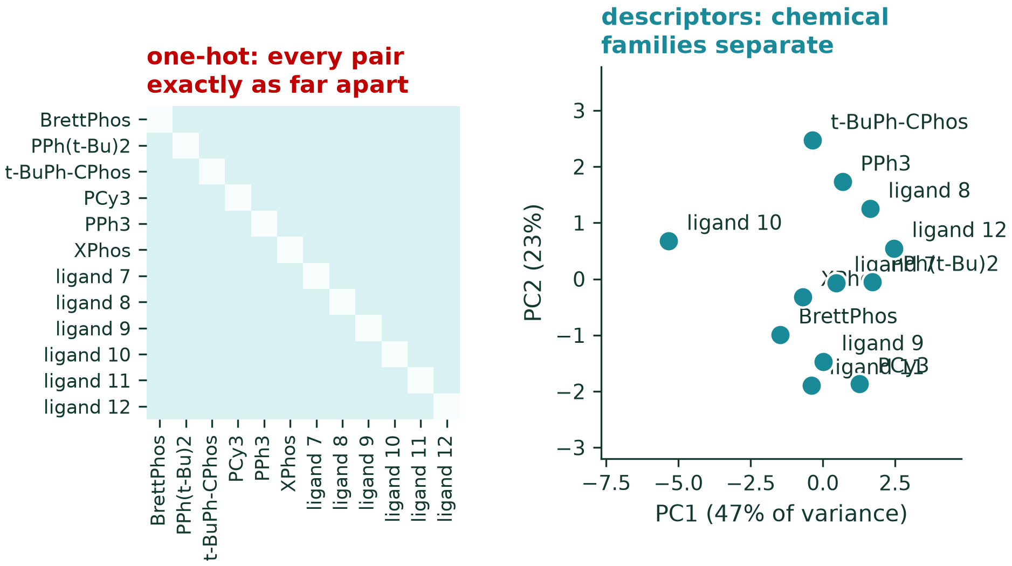
Your real variables are not numbers
What is the distance between PPh₃ and XPhos? Between DMF and toluene?
fig_12_categorical_encoding.ipynb · SMILES verbatim from EDBO
These are all phosphines. They are obviously related — and one-hot encoding throws every bit of that away.
12 ligands × 4 bases × 4 solvents × 3 T × 3 C = 1,728 experiments.
Fig. 4a.
Shields, B. J.; Stevens, J.; Li, J.; Parasram, M.; Damani, F.; Martinez Alvarado, J. I.; Janey, J. M.; Adams, R. P.; Doyle, A. G. Nature 2021, 590 (7844), 89–96.
AI4ChemicalSciences BootCamp 2026
Notes:
Placed right after the GP section deliberately — it is the first thing that breaks
when the machinery meets a real bench, and it lands hardest while the kernel is
still fresh.
The fix: encode each ligand by computed physicochemical properties — cone angle,
Tolman electronic parameter, buried volume, DFT-derived Sigman-type descriptors.
Now chemically similar ligands are numerically close, the RBF kernel works as
intended, and information transfers across the ligand set. This is exactly what
Shields et al. do in EDBO.
Name the alternatives at 10 seconds each: Gryffin (KDE over categories, accepts
expert descriptors), categorical/Hamming overlap kernels, Phoenics, and random
forests which handle categorical splits natively.

Slide 35
Role of the Representation and Kernel
Shields, B. J.; Stevens, J.; Li, J.; Parasram, M.; Damani, F.; Martinez Alvarado, J. I.; Janey, J. M.; Adams, R. P.; Doyle, A. G. Nature 2021, 590 (7844), 89–96.
Ranković, B.; Griffiths, R.-R.; Moss, H. B.; Schwaller, P. Digital Discovery 2024, 3 (4), 654–666.
AI4ChemicalSciences BootCamp 2026
Notes:
The published version of the honest close. Students over-index on acquisition
functions because they are the mathematically prettiest part of the subject —
here is the evidence that the choice is close to a wash.
Point at the two dashed grey curves (exploit, explore) that clearly lag, then at
the cluster of everything else. The lesson is not "acquisition functions do not
matter", it is "the balanced ones are all fine, and the unbalanced ones are not".
The red strip is the transition into the rest of the lecture: those three things are
sections 6, 5b and 10 respectively.
Tutorial hook: "This afternoon you will run EI against UCB and see this yourself."

Slide 36
DOE vs BO | When to choose which ?
DOE (factorial + RSM)
Bayesian optimization
Design
fixed, chosen up front, all at once
sequential, adapts after every result
Model
polynomial of fixed form
non-parametric; flexibility grows with data
Uncertainty
CIs on coefficients
full posterior at every point
Primary goal
UNDERSTAND — main effects, interactions
FIND THE ARGMAX
Categorical
levels; combinatorially expensive
descriptors let information transfer
Best when
few factors, cheapish runs, you want a model
expensive runs, nonlinear, you want the best point
Complementary: screening DOE to drop irrelevant factors, then BO on what is left.
AI4ChemicalSciences BootCamp 2026
Notes:
One table, then the generous close. The honest industrial workflow really is
screening DOE followed by BO on the reduced space — say so. It respects Schmidt's
morning and it is what people actually do.
Do not linger. Two minutes maximum on this slide; the triptych did the persuading.

Slide 37
The same loop, in four other places
MATERIALS
Self-driving lab: robotic platform autonomously optimising hole mobility in thin films for perovskite solar cells.
MacLeod, B. P.; Parlane, F. G. L.; Morrissey, T. D.; Häse, F.; Roch, L. M.; Dettelbach, K. E.; Moreira, R.; Yunker, L. P. E.; Rooney, M. B.; Deeth, J. R.; Lai, V.; Ng, G. J.; Situ, H.; Zhang, R. H.; Elliott, M. S.; Haley, T. H.; Dvorak, D. J.; Aspuru-Guzik, A.; Hein, J. E.; Berlinguette, C. P. Sci. Adv. 2020, 6 (20), eaaz8867.
ENERGY
Fast-charging protocols for Li-ion batteries. Each experiment takes MONTHS — the strongest possible case for expense-driven method choice.
Attia, P. M.; Grover, A.; Jin, N.; Severson, K. A.; Markov, T. M.; Liao, Y.-H.; Chen, M. H.; Cheong, B.; Perkins, N.; Yang, Z.; Herring, P. K.; Aykol, M.; Harris, S. J.; Braatz, R. D.; Ermon, S.; Chueh, W. C. Nature 2020, 578 (7795), 397–402.
DRUG DESIGN
Pool-based screening over 100M+ compounds. Surrogate is a NEURAL NETWORK ENSEMBLE, not a GP — n is far too large for O(n³).
Graff, D. E.; Shakhnovich, E. I.; Coley, C. W. Chem. Sci. 2021, 12 (22), 7866–7881.
PROCESS
Autonomous batch process optimization — categorical phosphine ligand choice dominated the outcome.
Christensen, M.; Yunker, L. P. E.; Adedeji, F.; Häse, F.; Roch, L. M.; Gensch, T.; dos Passos Gomes, G.; Zepel, T.; Sigman, M. S.; Aspuru-Guzik, A.; Hein, J. E. Commun. Chem. 2021, 4 (1), 112.
AI4ChemicalSciences BootCamp 2026
Notes:
About one minute each. Spend the extra breath on the drug-design box: the surrogate
there is a neural-network ensemble, not a GP, because n is 100 million. That makes
the "GPs are natural FOR YOUR REGIME" caveat concrete rather than abstract, and it
sets up the final section.
MacLeod is where you introduce the phrase "self-driving laboratory", which recurs in
Thursday's agentic AI lecture.
The PROCESS box is optional filler — drop it without hesitation if you are behind.

Slide 38
Plan
1 · Optimizing when data acquisition is expensive
2 · The Bayesian optimization loop
3 · Gaussian processes
4 · Categorical variables and noise
5 · Practical Scenarios: Multi-objective, batch
AI4ChemicalSciences BootCamp 2026
Notes:
Section marker. We are entering: 5 · Beyond the basics: multi-objective, batch, other models

Slide 39
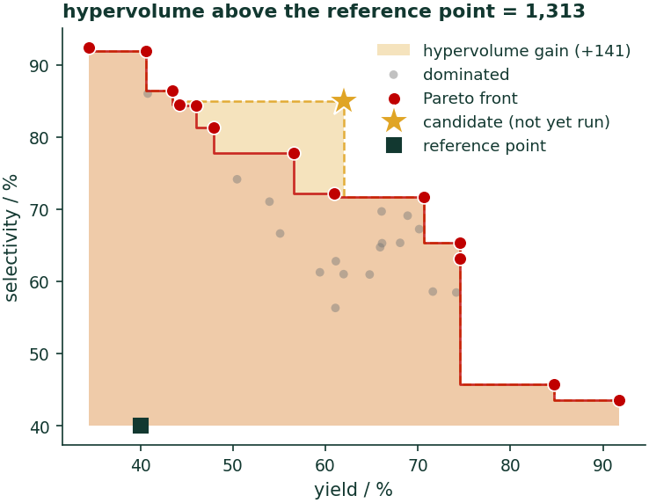
Multi-Objective
Process
yield AND selectivity AND cost AND catalyst loading
Medicinal
potency AND solubility AND metabolic stability AND low hERG
Materials
conductivity AND stability AND processability
EHVI : expected hypervolume improvement.
“How much do I expect this experiment to grow the frontier?”
fig_16_pareto_front.ipynb
AI4ChemicalSciences BootCamp 2026
Notes:
The Pareto figure does most of the work; the text on the right is a reading guide,
not a script.
Mention the reference point in one clause — hypervolume is only a single number
relative to a reference you pick, and that choice does affect the ranking.
The last line is the one to land. Attendees find it reassuring rather than
threatening: the algorithm hands you a menu, and choosing from it is your job.
⏱ DESIGNATED COMPRESSION POINT. If you are behind, narrate this slide in two minutes
from the Pareto figure alone and skip the right-hand column.

Slide 40
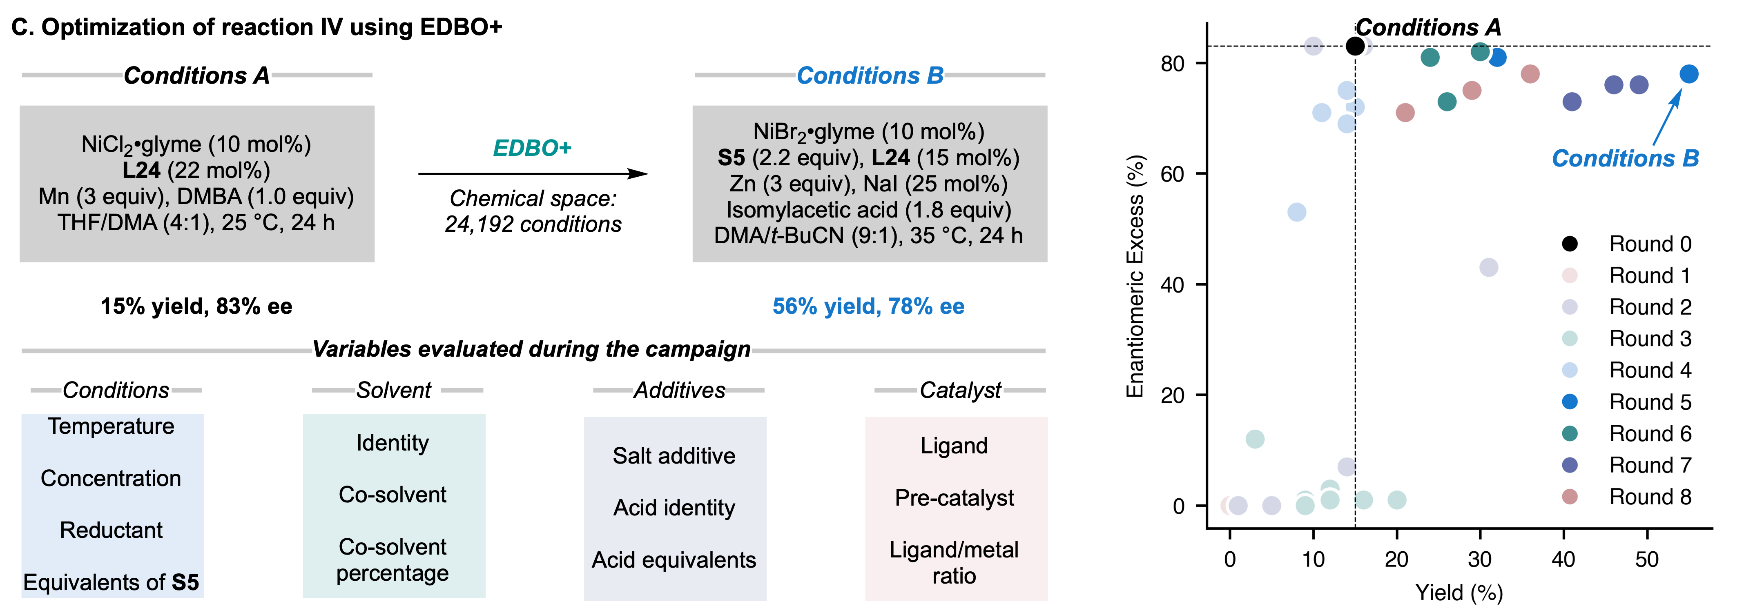
Practical take away: Tells you when you can/should stop
Condition space update after optimization plateau
Rounds 1 – 4:
Solvent
Additive
Reductant
Ligand
Precatalyst
L/M ratio
Concentration
Rounds 5 – 8:
Co-solvent
Co-solvent %
Concentration
Acid identity
Acid equivalent
S5 equivalents
Gutiérrez-Valencia, N. E.; Schleinitz, J.; Wild, T. H.; Williams, W. L.; Mantin, D.; Doyle, A. G.; Reisman, S. E.; Sigman, M. S. ACS Catal. 2026. https://doi.org/10.1021/acscatal.6c02585.
AI4ChemicalSciences BootCamp 2026
Data-science guided approaches informed by chemists’ decisions were instrumental for further optimization
Notes:
The most useful slide in the lecture for anyone who goes home and tries this.
Frame it exactly as the title says: "you will hit at least two of these."
BOUNDS is the one to dwell on — chemically the most common and most invisible
failure. The campaign converges beautifully, the diagnostics look healthy, and the
answer is wrong because the optimum was never inside the box.
Tell them to photograph this one too.

Slide 41
Batching
Take the top q points of α(x) and they cluster — eight wells answering the same question.
q-EI
joint expected improvement of a SET of q points. Principled, pricier, standard in BoTorch.
Thompson sampling
draw q posterior functions, maximise each. Diversity is automatic — you planted this earlier.
Greedy + fake data
constant liar inserts a FIXED constant; Kriging believer inserts the MODEL'S prediction. Not the same thing.
Local penalization
no fabricated data at all — multiply α by a penalty around each point already chosen.
With parallelism you stop minimizing the NUMBER of experiments and start minimizing wall-clock time or cost — and those give different designs.
fig_17_batch_selection.ipynb · q = 6
AI4ChemicalSciences BootCamp 2026
Notes:
Keep this to three minutes. The clustering figure makes the problem obvious in two
seconds; the four fixes are one line each.
⚠️ Be precise on the third bullet — these are three distinct methods that get merged
constantly:
- CONSTANT LIAR (Ginsbourger) inserts a FIXED CONSTANT — often min or mean of
observed y — precisely so it does not depend on the model's prediction;
- KRIGING BELIEVER inserts the MODEL'S OWN PREDICTION;
- LOCAL PENALIZATION (Gonzalez et al. 2016) fabricates nothing; it multiplies the
acquisition by a Lipschitz-derived penalty around already-selected points.
————————————————————————————————————————————————
THE MATHS, FOR THE THIRD AND FOURTH BULLETS
All the greedy batch methods share one skeleton. Build the batch one point at
a time, and before choosing point k, pretend the k-1 points already chosen
have come back with a result:
x_k = argmax_x alpha( x | D u { (x_j, y_hat_j) }_{j<k} ), k = 1..q
Nothing has actually been measured. The fake y_hat_j exists only to update the
posterior so that the next argmax lands somewhere new. The methods differ in
one place only — what you put in for y_hat_j:
CONSTANT LIAR (Ginsbourger, Le Riche & Carraro 2010)
y_hat_j = L for all j, where L is a FIXED CONSTANT chosen in advance and
deliberately independent of the model:
L = min(y) pessimistic — spreads the batch most aggressively
L = mean(y) the usual default
L = max(y) optimistic — keeps the batch clustered
The point of a constant is that it cannot inherit the model's own bias.
KRIGING BELIEVER (same paper)
y_hat_j = mu(x_j), the posterior mean at the point just chosen.
Subtle but important: inserting the mean leaves mu roughly unchanged at
x_j — what actually changes is sigma, which collapses to ~sigma_n there.
So the deterrent is entirely the loss of uncertainty. Failure mode: if
mu is confidently wrong in an unexplored region, the whole batch follows
it there.
LOCAL PENALIZATION (Gonzalez, Dai, Hennig & Lawrence, AISTATS 2016)
Fabricates nothing at all:
x_k = argmax_x alpha(x) * prod_{j<k} phi(x ; x_j)
phi is a soft exclusion bubble around each already-chosen point, and its
radius is derived from an estimate of the Lipschitz constant of f — i.e.
from how fast the response can physically change. Cleaner assumption,
and it degrades gracefully.
ONE-LINE SUMMARY TO SAY OUT LOUD
Constant liar inserts a NUMBER. Kriging believer inserts a PREDICTION. Local
penalization inserts NOTHING and multiplies the acquisition instead.
And the exact version — q-EI, which optimises the whole batch jointly instead
of one point at a time — is the next slide.

Slide 42
q-EI, formally
A batch is one decision about q points
α_qEI(X) = E[ maxᵢ max(0, f(xᵢ) − f⁺) ] X = {x_1, …, x_q}
Why not just take the top q of EI?
What it costs
Under noise: q-NEI
Sum of individual EIs is maximized by q copies of the same point. The inner max pays the batch ONCE however many of its members improve, so redundancy earns nothing and diversity is automatic.
You now optimize jointly over q·d dimensions, and each evaluation is an N-sample average.
This is why sequential-greedy approximations exist — and why BoTorch ships both.
f⁺ is replaced by the max of posterior samples at the points already run. Same fix as slide 30, now inside a batch. qNEI → qNEHVI is the multi-objective version on slide 32.
Ginsbourger, D.; Le Riche, R.; Carraro, L. In Computational Intelligence in Expensive Optimization Problems; Tenne, Y., Goh, C.-K., Eds.; Springer: Berlin, 2010; pp 131–162.
Wang, J.; Clark, S. C.; Liu, E.; Frazier, P. I. Oper. Res. 2020, 68 (6), 1850–1865.
Balandat, M.; Karrer, B.; Jiang, D. R.; Daulton, S.; Letham, B.; Wilson, A. G.; Bakshy, E. In Advances in Neural Information Processing Systems 33; Curran Associates: Red Hook, NY, 2020; pp 21524–21538.
AI4ChemicalSciences BootCamp 2026
Notes:
This slide is the formal version of the first bullet on the batching slide.
Two minutes. The equation is the point; the three columns are a reading guide.
READ THE EQUATION OUT LOUD, IN THIS ORDER
1. X = {x1, ..., xq} — a batch is ONE argument, a set, not q separate ones.
2. f+ — the incumbent, the best value so far. Same f+ as ordinary EI.
3. max over i — over the members of the batch.
4. max(0, .) — improvement is one-sided; a batch is never punished for a
member that turns out worse than f+.
5. E[.] — expectation over the GP posterior of f at all q points JOINTLY,
using the full q x q covariance. The joint covariance is what encodes
"these two wells are near each other".
WHY THE INNER MAX MATTERS — the sentence to land
If you instead summed the individual EIs, sum_i EI(x_i), the maximiser is q
copies of the single best point: each copy contributes full value. With the
max inside, the batch is rewarded once for its best member, so a second point
near the first adds almost nothing, and the optimiser is pushed to spread out.
Diversity is not bolted on. It falls out of the definition.
This is the same structure as EHVI on slide 37: reward the SET, not the members.
COMPUTATION
q = 1 recovers ordinary EI, closed form. q = 2 has a closed form
(Ginsbourger). Beyond that, Monte Carlo: draw f~t from the joint posterior,
evaluate the inner maxes, average. Use the reparameterisation trick
(f~ = mu + L z, z ~ N(0,I), L the Cholesky of the posterior covariance) so the
estimator is differentiable in X and you can run L-BFGS on it; use Sobol
sequences rather than plain random draws for lower variance. That is exactly
what BoTorch's qExpectedImprovement does, and it is why they call the family
"MC acquisition functions".
Cost: the search space is q*d dimensional, and every objective evaluation is
an N-sample average. For a 96-well plate this is why nobody optimises q = 96
jointly.
MATHS OF THE GREEDY ALTERNATIVES (the fallback when joint q-EI is too dear)
Build the batch one point at a time, each time pretending the previous picks
have already returned a result:
x_k = argmax_x alpha( x | D u { (x_j, y_hat_j) }_{j<k} ), k = 1..q
The three methods differ ONLY in what fake y_hat_j they insert:
CONSTANT LIAR y_hat_j = L, a fixed constant, chosen once and not
depending on the model. L = min(y) is pessimistic and
spreads the batch hardest; L = max(y) is optimistic;
L = mean(y) is the usual compromise. (Ginsbourger 2010)
KRIGING BELIEVER y_hat_j = mu(x_j), the model's own posterior mean.
Note this leaves mu unchanged at x_j but COLLAPSES
sigma there, which is what actually deters the next
pick. Risk: the model believes its own extrapolation
and the batch drifts.
LOCAL PENALIZATION fabricates nothing. Instead
x_k = argmax_x alpha(x) * prod_{j<k} phi(x; x_j)
with phi a soft exclusion zone whose radius comes from
an estimate of the Lipschitz constant of f.
(Gonzalez, Dai, Hennig & Lawrence, AISTATS 2016)
Say the one-liner: constant liar inserts a NUMBER, Kriging believer inserts a
PREDICTION, local penalization inserts NOTHING and multiplies instead.
Pure greedy, for completeness: alpha_greedy(x) = mu(x). No uncertainty term at
all. It is the beta = 0 corner of UCB and the reason the "exploit" trace on
slide 17 never leaves its cluster.

Slide 43
You will hit at least two of these
Too few seed points
BO with 3 initial points is not BO. ~5–10 per dimension, or a DOE screen.
Bounds set wrong
The optimum is at 150 °C; you bounded at 120. It converges beautifully to the wrong answer.
Noise ignored
σₙ ≈ 0 → interpolates a lucky replicate → 15 experiments revisiting it.
Dimension too high
Degrades toward random search without structure. Reduce the space first — that is what a screening DOE is for.
Deceptive landscapes
Phase changes, precipitation, catalyst death. The smoothness prior is simply wrong across the discontinuity.
Badly posed objective
Optimise yield alone → 99% yield at 200 equivalents and 72 hours. It optimises exactly what you asked.
Robustness
The sharp optimum may not survive process variation. A lower, broader one is often the better manufacturing answer.
Robustness (Golem). Aldeghi, M.; Häse, F.; Hickman, R. J.; Tamblyn, I.; Aspuru-Guzik, A. Chem. Sci. 2021, 12 (44), 14792–14807.
AI4ChemicalSciences BootCamp 2026
Notes:
The most useful slide in the lecture for anyone who goes home and tries this.
Frame it exactly as the title says: "you will hit at least two of these."
BOUNDS is the one to dwell on — chemically the most common and most invisible
failure. The campaign converges beautifully, the diagnostics look healthy, and the
answer is wrong because the optimum was never inside the box.
Tell them to photograph this one too.

Slide 44
The framework does not need a Gaussian process
SURROGATE
UNCERTAINTY FROM
GOOD WHEN
Gaussian process
closed-form posterior
n ≲ 10³, continuous, low-d
Random forest
variance across trees
categorical / conditional spaces; used in SMAC
NN ensembles, MC dropout
disagreement between members
n ≫ 10³, structured inputs — MolPAL
Stay with a GP until experiment number exceeds a few thousand, or your inputs stop being vectors.
AI4ChemicalSciences BootCamp 2026
Notes:
BO needs a model that returns a mean AND an uncertainty. It does not need a GP.
One slide, and the rule of thumb at the bottom is what they should remember.
This is also where the earlier honesty pays off — you told them at the GP section
that "most natural fit" only holds in the small-n, low-d, continuous regime, and
here is the other side of that.

Slide 45
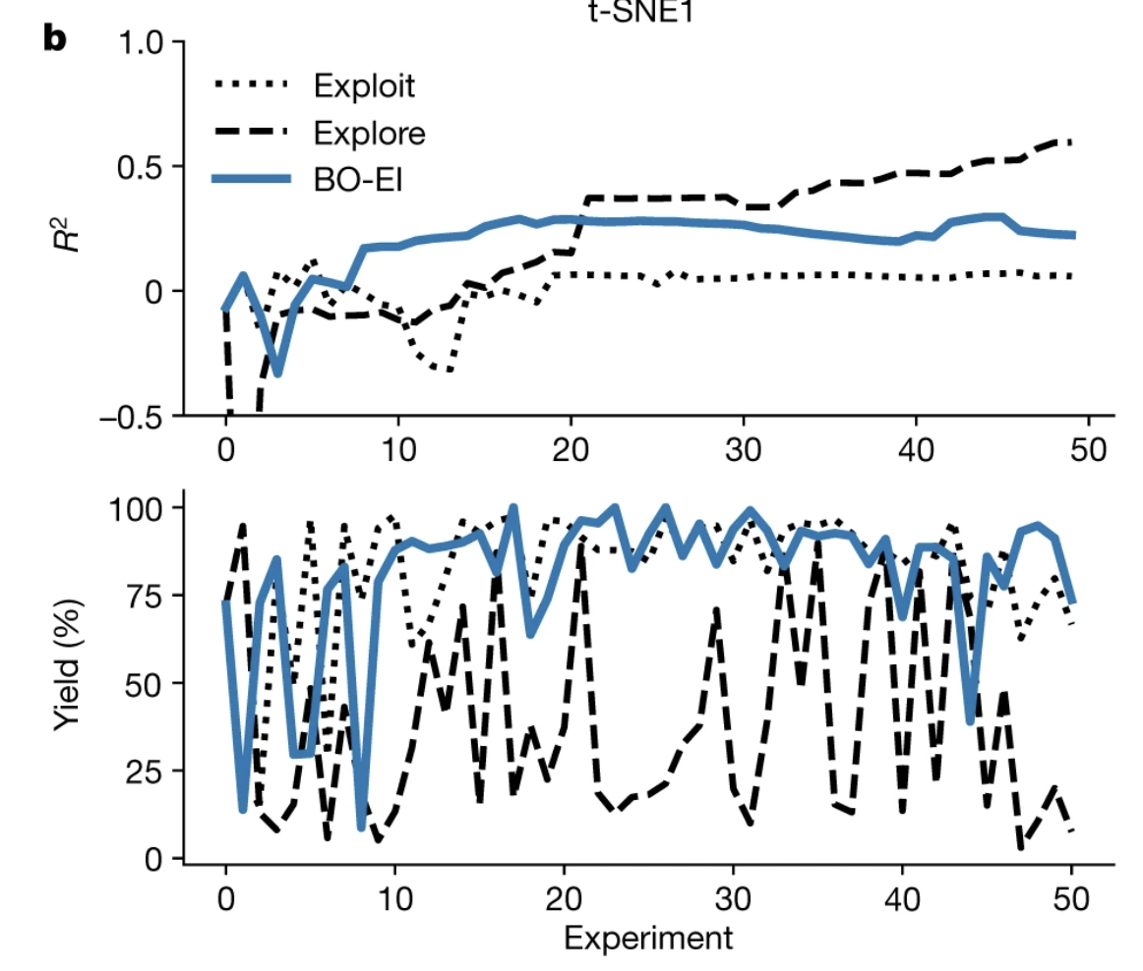
Where this goes next
Gutiérrez-Valencia, N. E.; Schleinitz, J.; Wild, T. H.; Williams, W. L.; Mantin, D.; Doyle, A. G.; Reisman, S. E.; Sigman, M. S. ACS Catal. 2026. https://doi.org/10.1021/acscatal.6c02585.
AI4ChemicalSciences BootCamp 2026
Notes:
Close by putting the BO/AL boundary back up. You showed it at the start as scope;
now it is the bridge.
Then recall the observation from the closed-form slide — that posterior variance
does not depend on the measured values (at fixed hyperparameters) — and note that
this is precisely what makes uncertainty-driven Active Learning possible. A clean,
honest cliffhanger.
If you do not draw this line explicitly, you will spend the first 15 minutes of
tomorrow's lecture undoing confusion.

Slide 46
References
METHOD
Jones, D. R.; Schonlau, M.; Welch, W. J. J. Global Optim. 1998, 13 (4), 455–492. (EGO / expected improvement)
Shahriari, B.; Swersky, K.; Wang, Z.; Adams, R. P.; de Freitas, N. Proc. IEEE 2016, 104 (1), 148–175. (review)
Srinivas, N.; Krause, A.; Kakade, S. M.; Seeger, M. W. IEEE Trans. Inf. Theory 2012, 58 (5), 3250–3265. (GP-UCB)
Rasmussen, C. E.; Williams, C. K. I. Gaussian Processes for Machine Learning; MIT Press: Cambridge, MA, 2006. (chapters 2 and 5)
CHEMISTRY AND BENCHMARKS
Shields, B. J.; Stevens, J.; Li, J.; Parasram, M.; Damani, F.; Martinez Alvarado, J. I.; Janey, J. M.; Adams, R. P.; Doyle, A. G. Nature 2021, 590 (7844), 89–96. (EDBO; the human benchmark)
Felton, K. C.; Rittig, J. G.; Lapkin, A. A. Chem. Methods 2021, 1 (2), 116–122. (Summit benchmarks)
MacLeod, B. P.; Parlane, F. G. L.; Morrissey, T. D.; Häse, F.; Roch, L. M.; Dettelbach, K. E.; Moreira, R.; Yunker, L. P. E.; Rooney, M. B.; Deeth, J. R.; Lai, V.; Ng, G. J.; Situ, H.; Zhang, R. H.; Elliott, M. S.; Haley, T. H.; Dvorak, D. J.; Aspuru-Guzik, A.; Hein, J. E.; Berlinguette, C. P. Sci. Adv. 2020, 6 (20), eaaz8867.
Attia, P. M.; Grover, A.; Jin, N.; Severson, K. A.; Markov, T. M.; Liao, Y.-H.; Chen, M. H.; Cheong, B.; Perkins, N.; Yang, Z.; Herring, P. K.; Aykol, M.; Harris, S. J.; Braatz, R. D.; Ermon, S.; Chueh, W. C. Nature 2020, 578 (7795), 397–402.
Graff, D. E.; Shakhnovich, E. I.; Coley, C. W. Chem. Sci. 2021, 12 (22), 7866–7881.
Christensen, M.; Yunker, L. P. E.; Adedeji, F.; Häse, F.; Roch, L. M.; Gensch, T.; dos Passos Gomes, G.; Zepel, T.; Sigman, M. S.; Aspuru-Guzik, A.; Hein, J. E. Commun. Chem. 2021, 4 (1), 112.
AI4ChemicalSciences BootCamp 2026
Notes:
Leave up during questions. Full annotated list with DOIs is in the lecture plan document.

Slide 47
References — categorical, multi-objective, noise
CATEGORICAL VARIABLES AND ENCODING
Häse, F.; Aldeghi, M.; Hickman, R. J.; Roch, L. M.; Aspuru-Guzik, A. Appl. Phys. Rev. 2021, 8 (3), 031406. (Gryffin)
Häse, F.; Roch, L. M.; Kreisbeck, C.; Aspuru-Guzik, A. ACS Cent. Sci. 2018, 4 (9), 1134–1145. (Phoenics)
Ranković, B.; Griffiths, R.-R.; Moss, H. B.; Schwaller, P. Digital Discovery 2024, 3 (4), 654–666. (representation beats acquisition)
MULTI-OBJECTIVE, BATCH AND ROBUSTNESS
Torres, J. A. G.; Lau, S. H.; Anchuri, P.; Stevens, J. M.; Tabora, J. E.; Li, J.; Borovika, A.; Adams, R. P.; Doyle, A. G. J. Am. Chem. Soc. 2022, 144 (43), 19999–20007. (multi-objective platform + web app)
Aldeghi, M.; Häse, F.; Hickman, R. J.; Tamblyn, I.; Aspuru-Guzik, A. Chem. Sci. 2021, 12 (44), 14792–14807. (Golem)
Ginsbourger, D.; Le Riche, R.; Carraro, L. In Computational Intelligence in Expensive Optimization Problems; Tenne, Y., Goh, C.-K., Eds.; Springer: Berlin, 2010; pp 131–162. (constant liar / Kriging believer)
González, J.; Dai, Z.; Hennig, P.; Lawrence, N. In Proceedings of the 19th International Conference on Artificial Intelligence and Statistics; PMLR, 2016; Vol. 51, pp 648–657. (local penalization)
NOISE
Picheny, V.; Wagner, T.; Ginsbourger, D. Struct. Multidiscip. Optim. 2013, 48 (3), 607–626.
Letham, B.; Karrer, B.; Ottoni, G.; Bakshy, E. Bayesian Anal. 2019, 14 (2), 495–519. (Noisy EI)
Griffiths, R.-R.; Aldrick, A. A.; Garcia-Ortegon, M.; Lalchand, V.; Lee, A. A. Mach. Learn.: Sci. Technol. 2022, 3 (1), 015004.
Binois, M.; Huang, J.; Gramacy, R. B.; Ludkovski, M. Technometrics 2019, 61 (1), 7–23. (replicate vs explore)
Luo, G.; Yang, X.; Su, W.; Qi, T.; Xu, Q.; Su, A. Chem. Eng. Sci. 2024, 298, 120434. (noise-resilient MOBO, chemistry)
Zhang, J.; Semochkina, D.; Sugisawa, N.; Woods, D. C.; Lapkin, A. A. Comput. Chem. Eng. 2025, 194, 108983.
AI4ChemicalSciences BootCamp 2026
Notes:
Full annotated list with verified DOIs is in lecture_12_bayesian-optimization_PLAN.md.

