Slide 1
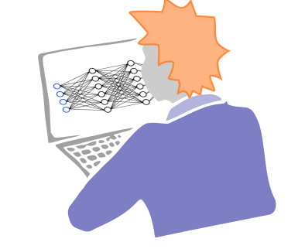
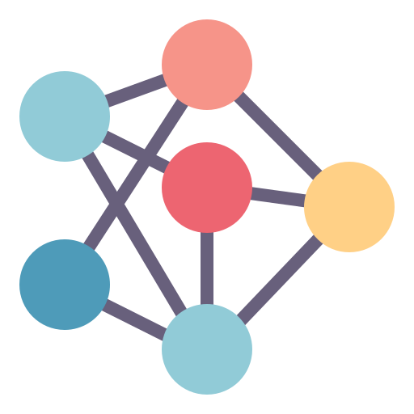


Active Learning
Train model
2
Design/Select
Experiments
Perform Experiment
J. Schleinitz
Some slides were created using Claude Code
AI4ChemicalSciences BootCamp 2026
Notes:
Lecture 13. Ninety minutes. Tutorial follows — DFT active learning, also yours.
Open with the sentence on the slide and nothing else. It is the whole lecture, and every
section is a consequence of it.
Structure of the hour, so they know where they are going: fifteen minutes of setup, half
an hour on one real campaign end to end, then the part that makes it honest.

Slide 2
Plan
1 · The BO/AL loop
2 · Objective = model improvement
3 · What changes in the acquisition function
4 · A worked example: regioselectivity
5 · Which uncertainty is worth buying?
6 · Practical issues
7 · Active learning in the wild — and what is not
8 · Conclusion
AI4ChemicalSciences BootCamp 2026
Notes:
Section marker. We are entering: 1 · The loop you saw yesterday

Slide 3
The loop
0 INITIALIZATION
select few data points to label
1 SURROGATE MODEL
a cheap probabilistic model of f
mean + uncertainty
2 ACQUISITION FUNCTION
score every candidate,
using the posterior
repeat until
the budget is spent or objective is reached
4 UPDATE
recompute the posterior
3 RUN THE EXPERIMENT
$$$
AI4ChemicalSciences BootCamp 2026
Notes:
IMPORTANT: copy these five shapes across from the L12 deck so they sit in exactly the same
positions with the same arrows. The recognition is the teaching — if it looks like a new
diagram you have lost the point.
Ninety seconds. Name the four boxes, point at the red one, move on. They know this.
The one word to change from yesterday: "score CANDIDATES" rather than "score the pool" —
because today the candidate set is sometimes a library and sometimes a design space.

Slide 4
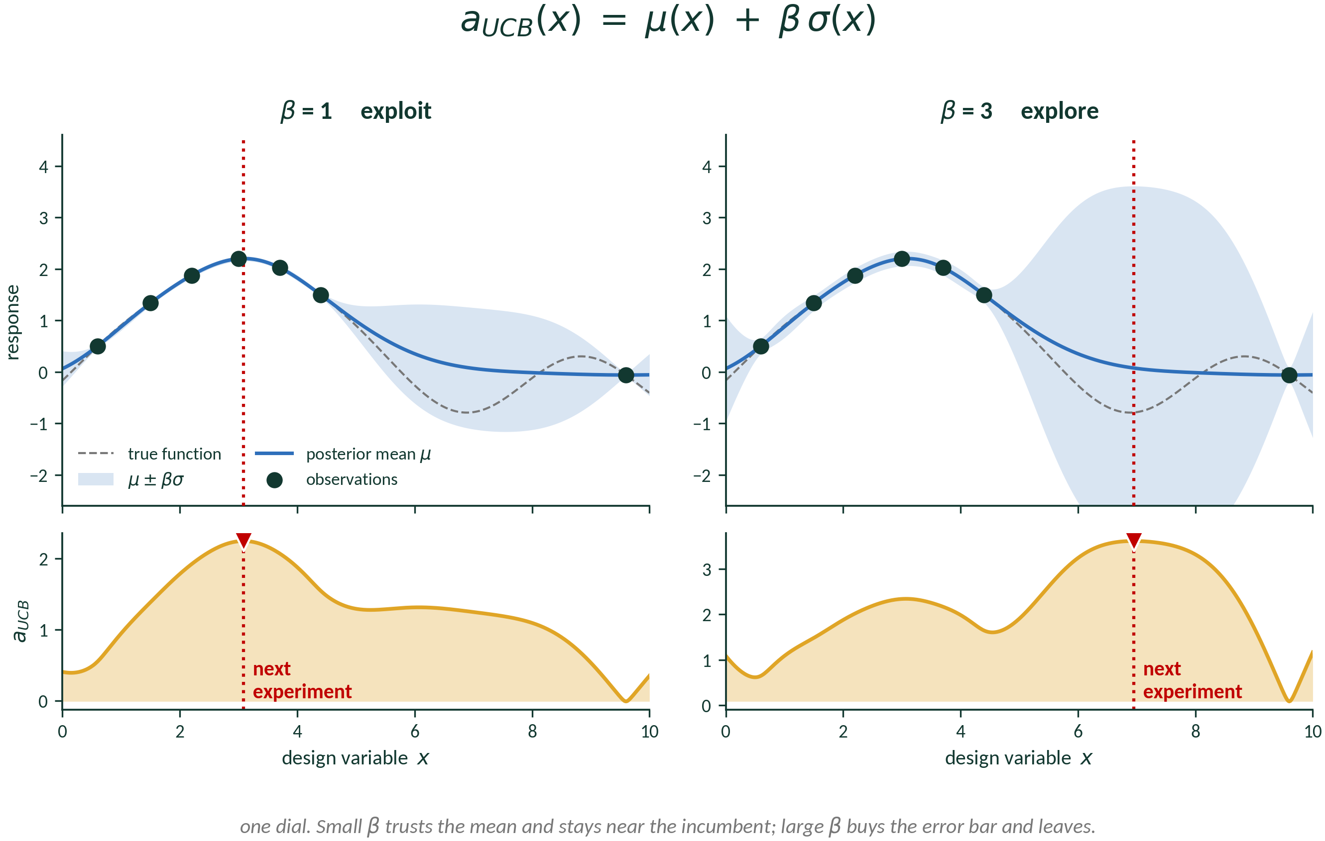
Bayesian Optimization Acquisition Function
β small → trust the mean, stay near the best point. β large → buy the error bar, go somewhere new.
AI4ChemicalSciences BootCamp 2026
Notes:
UCB because it is the one you can read off the page: predicted mean plus a bit of error
bar. No expectation, no integral.
MAKE THEM PREDICT. Show the top panels, cover the bottom, ask where the next experiment
goes for beta = 1 and for beta = 3. Then reveal.
Both panels use the same six observations. beta = 1 picks x = 3.1, right next to the
incumbent. beta = 3 picks x = 7.0, in the middle of the gap. One number, completely
different campaign.
The bridge to the next section, and say it in these words: BOTH of those are still trying
to find the maximum. The exploration term is instrumental — you explore because it helps
you optimise later. Today we stop pretending that is why we explore.

Slide 5
Plan
1 · The BO/AL loop
2 · Objective = model improvement
3 · What changes in the acquisition function
4 · A worked example: regioselectivity
5 · Which uncertainty is worth buying?
6 · Practical issues
7 · Active learning in the wild — and what is not
8 · Conclusion
AI4ChemicalSciences BootCamp 2026
Notes:
Section marker. We are entering: 2 · The model is the deliverable

Slide 6
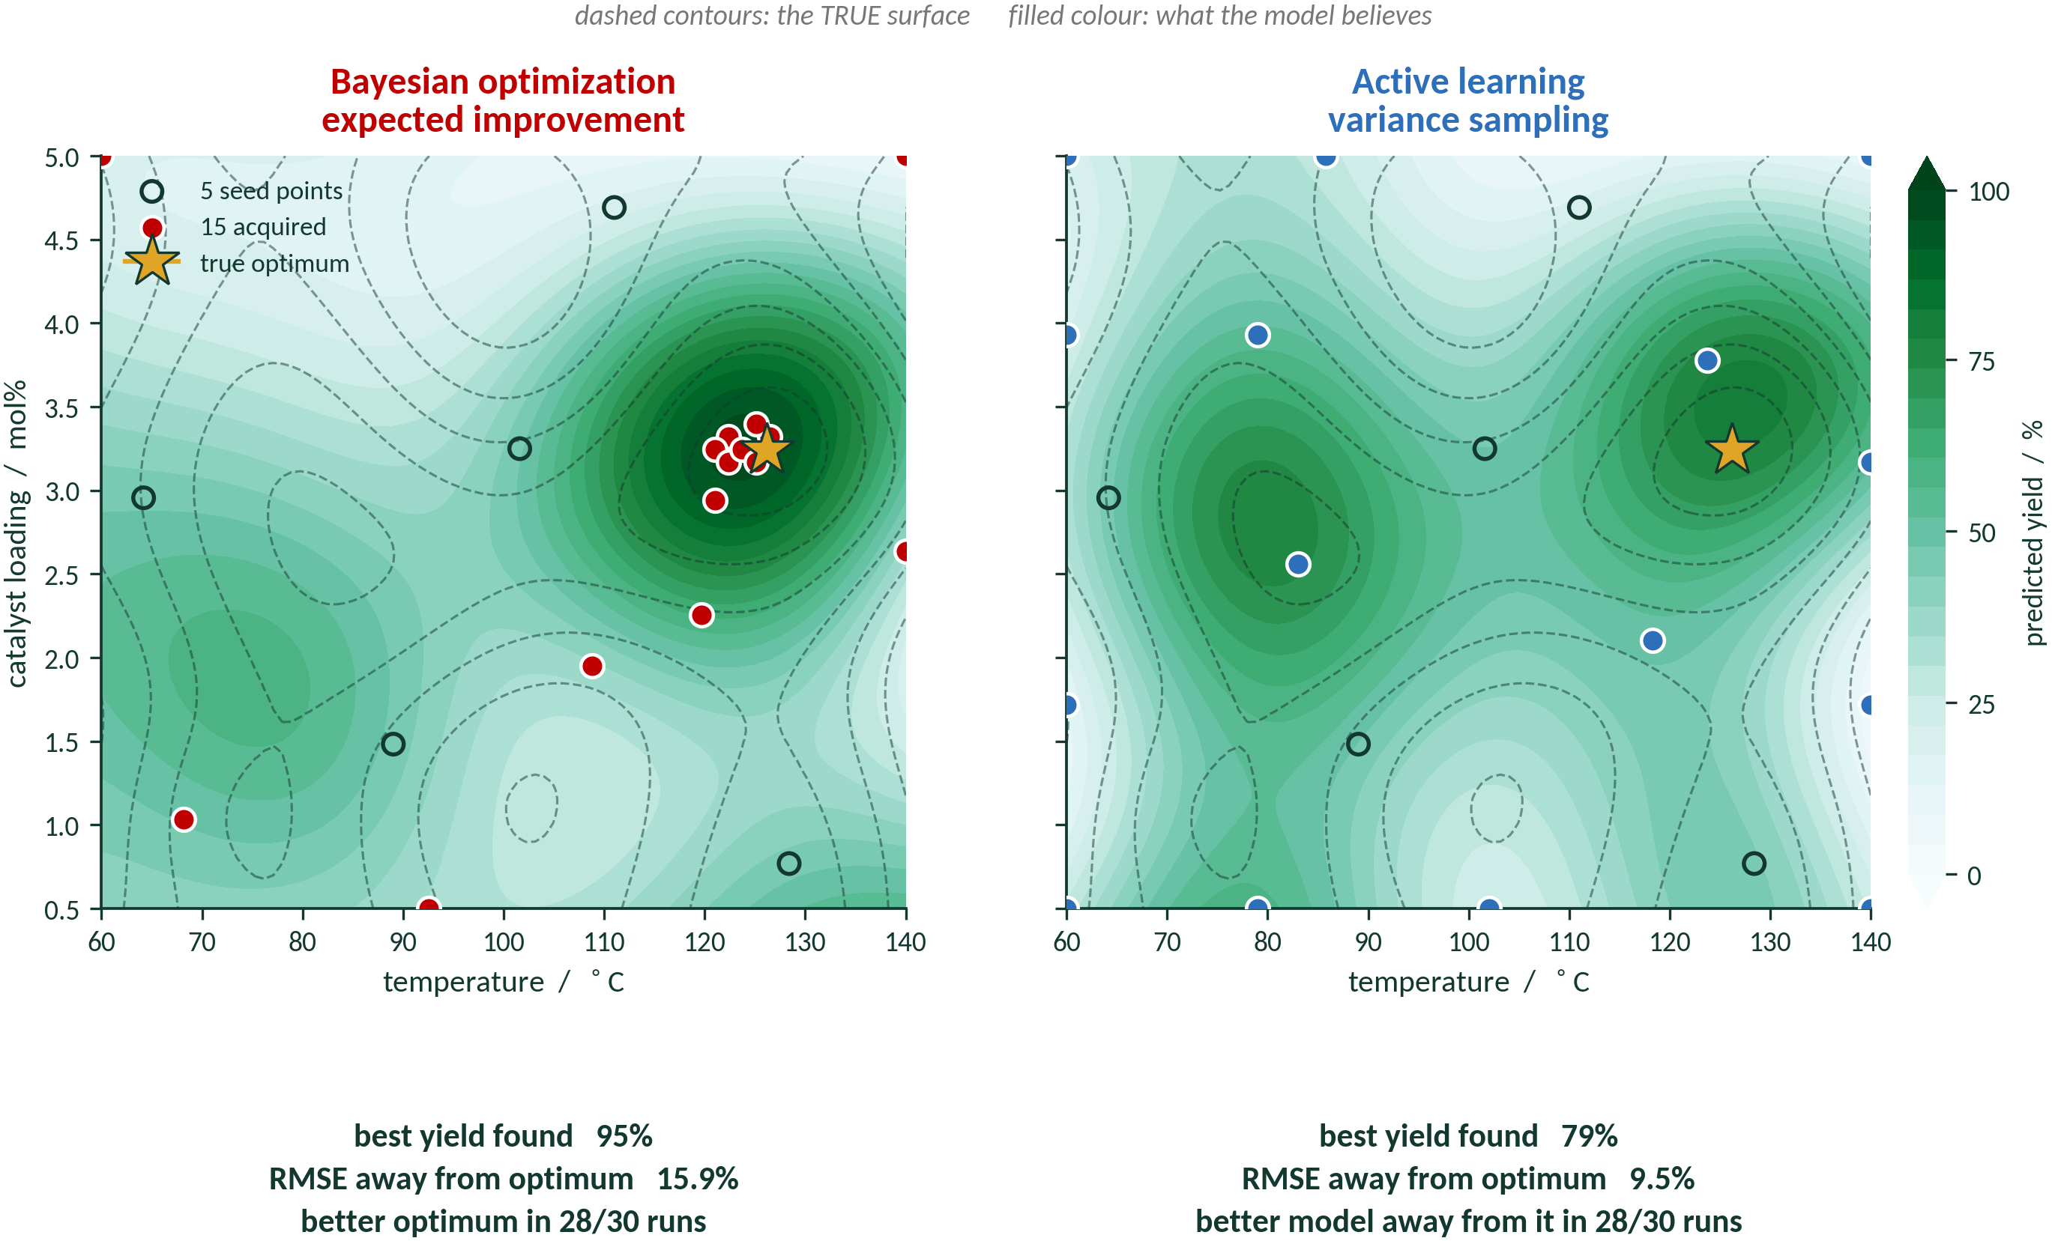
BO and AL: same loop but different question
AI4ChemicalSciences BootCamp 2026
Notes:
The money figure. Same landscape, same budget, same seed — say all three out loud or
somebody assumes you tuned it.
Point at the two numbers under each panel. BO finds the better optimum. AL gives the
better model away from the optimum. Neither is wrong; they answer different questions.
Over 30 seeds: AL wins on away-from-optimum RMSE in 28/30, BO wins on best-found in 28/30.
That is on the figure so you do not have to be believed on trust.
Note the AL panel's points at the edges — that is a real property of variance sampling and
you come back to it in section 3.

Slide 7
When the model is the deliverable
You are going to interpret the model.
Interpretability. If you will pull SHAP values or a rate law out of it, it has to be right in the whole region you will interpret.
You are going to run it a million times.
Deployment at scale. An interatomic potential, a regioselectivity model, a pKa predictor. Its value is accuracy across the whole domain, on inputs nobody has looked at.
AI4ChemicalSciences BootCamp 2026
Notes:
Ask the room first — "when do you actually want a good model rather than a good point?" —
and take two answers before revealing these.
The first two are the ones this audience will feel. INTERPRETABILITY: a model that is only
accurate near the optimum gives you a rate law that is only true near the optimum.
DEPLOYMENT: this is why the MLIP community was doing active learning before anyone called
it that — you ship the potential, and it meets configurations you never sampled.
The third is the honest one. You do not know what you will be asked next year, and a model
of the space survives a change of objective in a way that an optimum does not.
The footnote is a promise. Keep it in section 6.

Slide 8
Plan
1 · The BO/AL loop
2 · Objective = model improvement
3 · What changes in the acquisition function
4 · A worked example: regioselectivity
5 · Which uncertainty is worth buying?
6 · Practical issues
7 · Active learning in the wild — and what is not
8 · Conclusion
AI4ChemicalSciences BootCamp 2026
Notes:
Section marker. We are entering: 3 · What changes in the acquisition function

Slide 9
Acquisition Function depends on Model Objective
you are predicting
you are predicting
you are predicting
A value, across a library
A class
A ranking
→ uncertainty sampling
→ margin
→ margin, again
σ(x) — GP variance or ensemble spread
P(ŷ₁|x) − P(ŷ₂|x)
score(top site) − score(runner-up)
You want low error everywhere.
Sampling where the model knows least.
You want the decision right.
Sampling where the top two are closest to a tie.
Which C–H reacts?
An argmax over sites — so the same criterion applies.
AI4ChemicalSciences BootCamp 2026
Notes:
This slide is the map for the next fifteen minutes. Three regimes, one per card, and each
gets a worked failure or a worked example.
The bottom line is the unifying idea and it is worth pausing on: MARGIN NEEDS A RUNNER-UP.
Classification gives you one. Ranking gives you one. A scalar regression does not, which is
exactly why least-confident, margin and entropy all reduce to the same thing — the standard
deviation — the moment your output is continuous.
Do not do entropy here. It belongs with the epistemic/aleatoric material in section 5,
where the reason it fails is the point.

Slide 10
I. Optimizing Regressor Prediction across Chemical Space
Gaussian process
Any ensemble
x* = argmax σ²(x)
σ̂²(x) = (1/M) Σₘ ( fₘ(x) − f̄(x) )²
Closed form, no retraining, no label needed to evaluate it. Ideal for small data.
Model-agnostic — random forests, D-MPNN, neural-network potentials. Costs M× training.
AI4ChemicalSciences BootCamp 2026
Notes:
The GP formula is free — they derived it yesterday. Spend the time on the box.
The "no y values" observation surprises people every time. It is also the cleanest way to
see why uncertainty sampling alone is not enough: if the acquisition ignores the labels, it
is doing geometry, and geometry does not know which regions matter.
This is also a live callback to A. Schmidt's DOE lecture — a space-filling design is a
Latin hypercube, and if that is all you were going to get you did not need the GP.

Slide 11
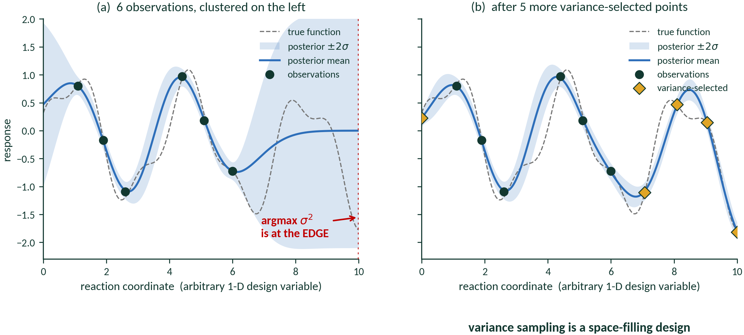
Uncertainty sampling reaches for outliers
AI4ChemicalSciences BootCamp 2026
Notes:
Let them predict where the next point goes before you reveal panel (a). They will say "in
the gap". They are right, and the edge is the surprise.
Panel (b) is the punchline: run it long enough and you have reinvented a space-filling
design. Which is fine! But say so, and do not pretend the GP earned it.
Then the transition: on a continuous design space, going to the corner is merely wasteful.
On an enumerated library it is worse, and that is the next slide.

Slide 12
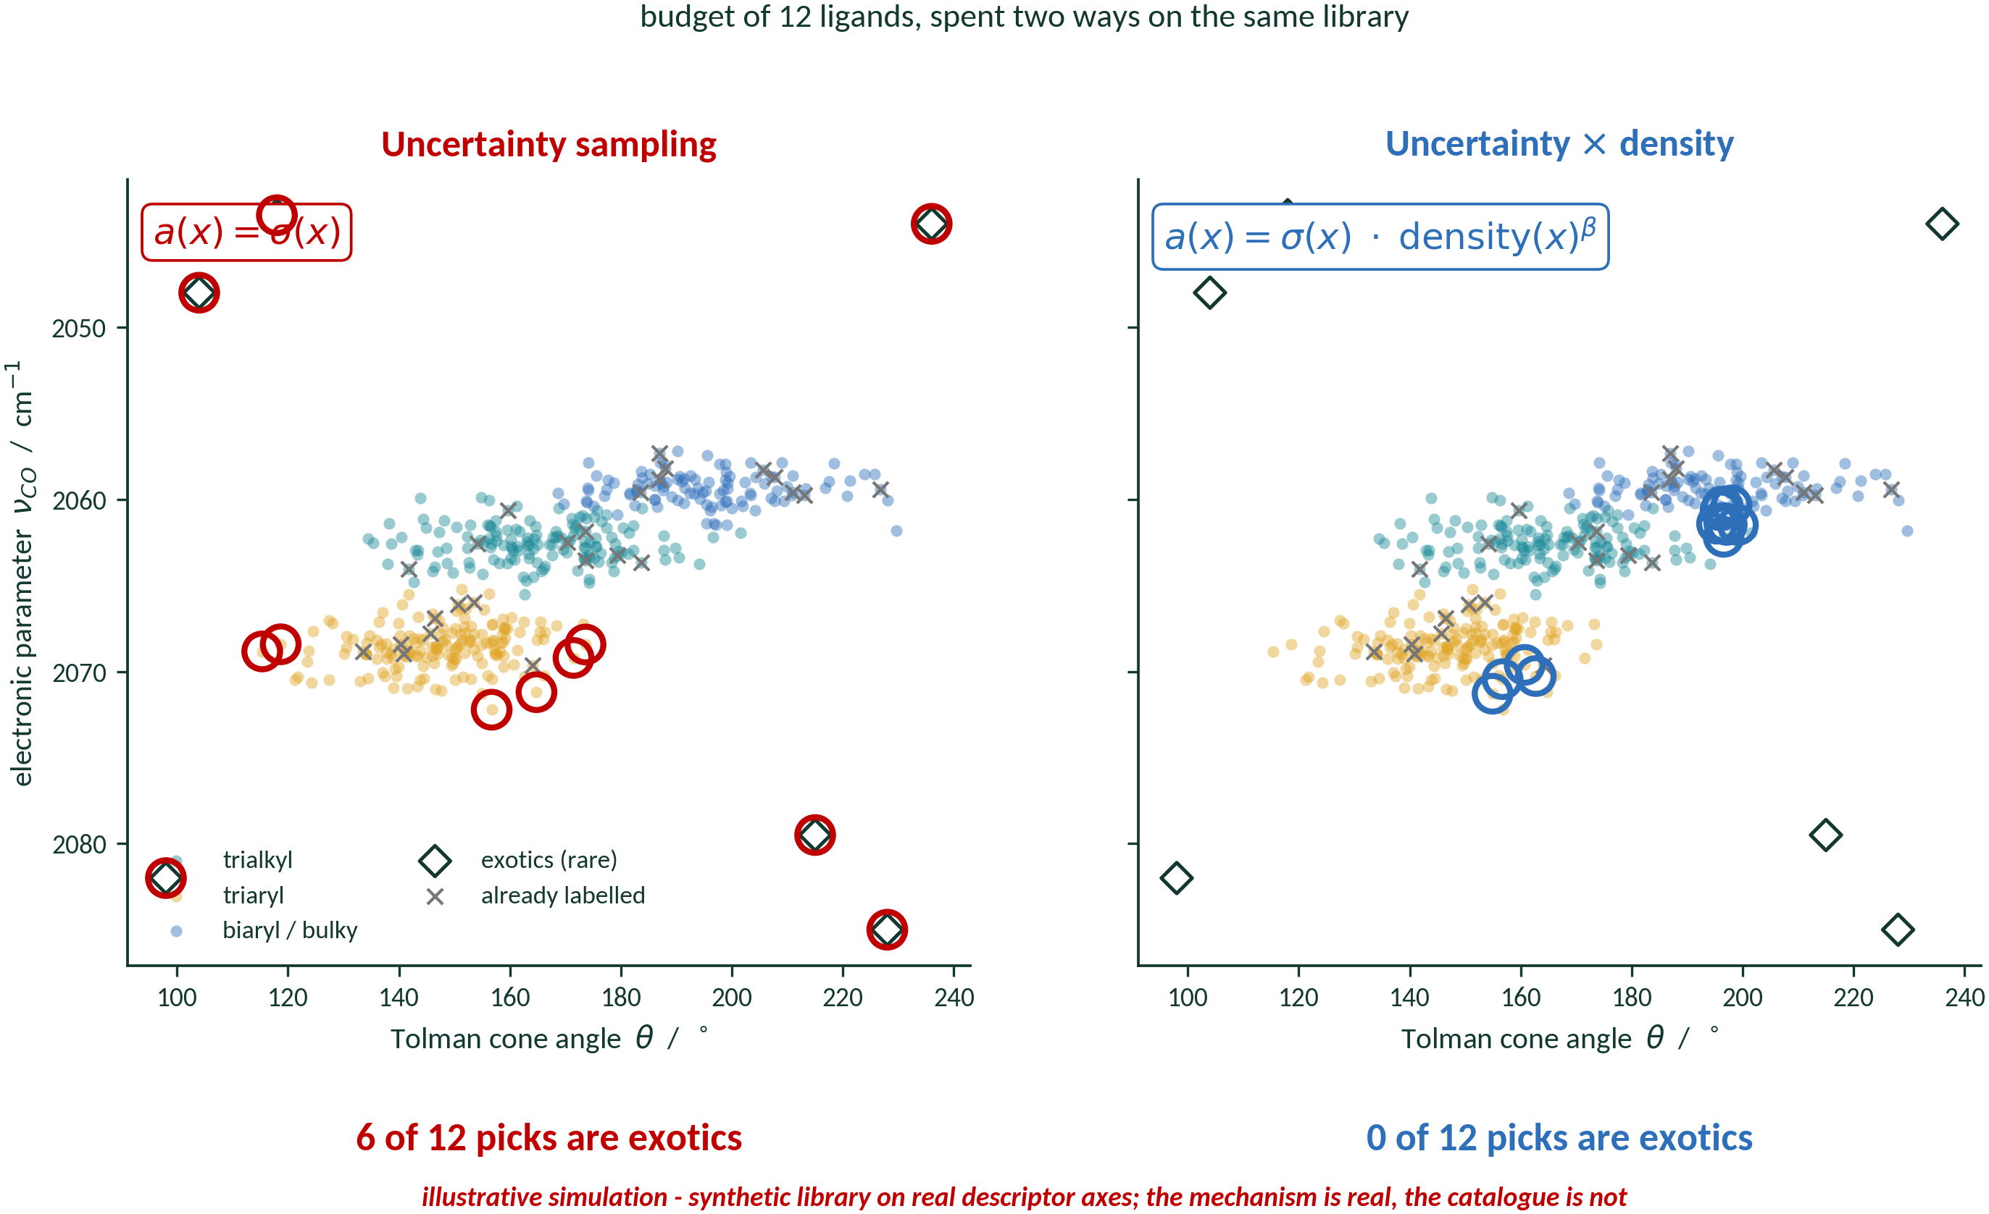
Uncertainty sampling reaches for outliers
After Settles, Active Learning Literature Survey, TR1648, 2009, Fig. 7 · information density: Settles & Craven, EMNLP 2008
AI4ChemicalSciences BootCamp 2026
Notes:
The concrete version of the trap. Budget of 12 ligands from an enumerated library, spent
two ways on identical data.
LEFT: plain uncertainty sampling. Six of the twelve picks are the exotics — every single
exotic in the library. They are maximally uncertain precisely because nothing resembles
them, and that is also why labelling them teaches you nothing transferable. You have spent
half your budget characterising the tail.
RIGHT: multiply the uncertainty by a density term. Zero exotics; the budget lands in the
three populated families where your future predictions will actually be made.
BE HONEST ABOUT THE FIGURE, it says so on its face: the descriptor axes are real (Tolman
cone angle, nu-CO) but the library is synthetic. The mechanism is real; this is not a
result on a real catalogue.
Ask the room whether they have had an uncertainty ranking hand them a compound that turned
out to be a bad SMILES or a charged organometallic in a set of neutrals. Hands go up.

Slide 13
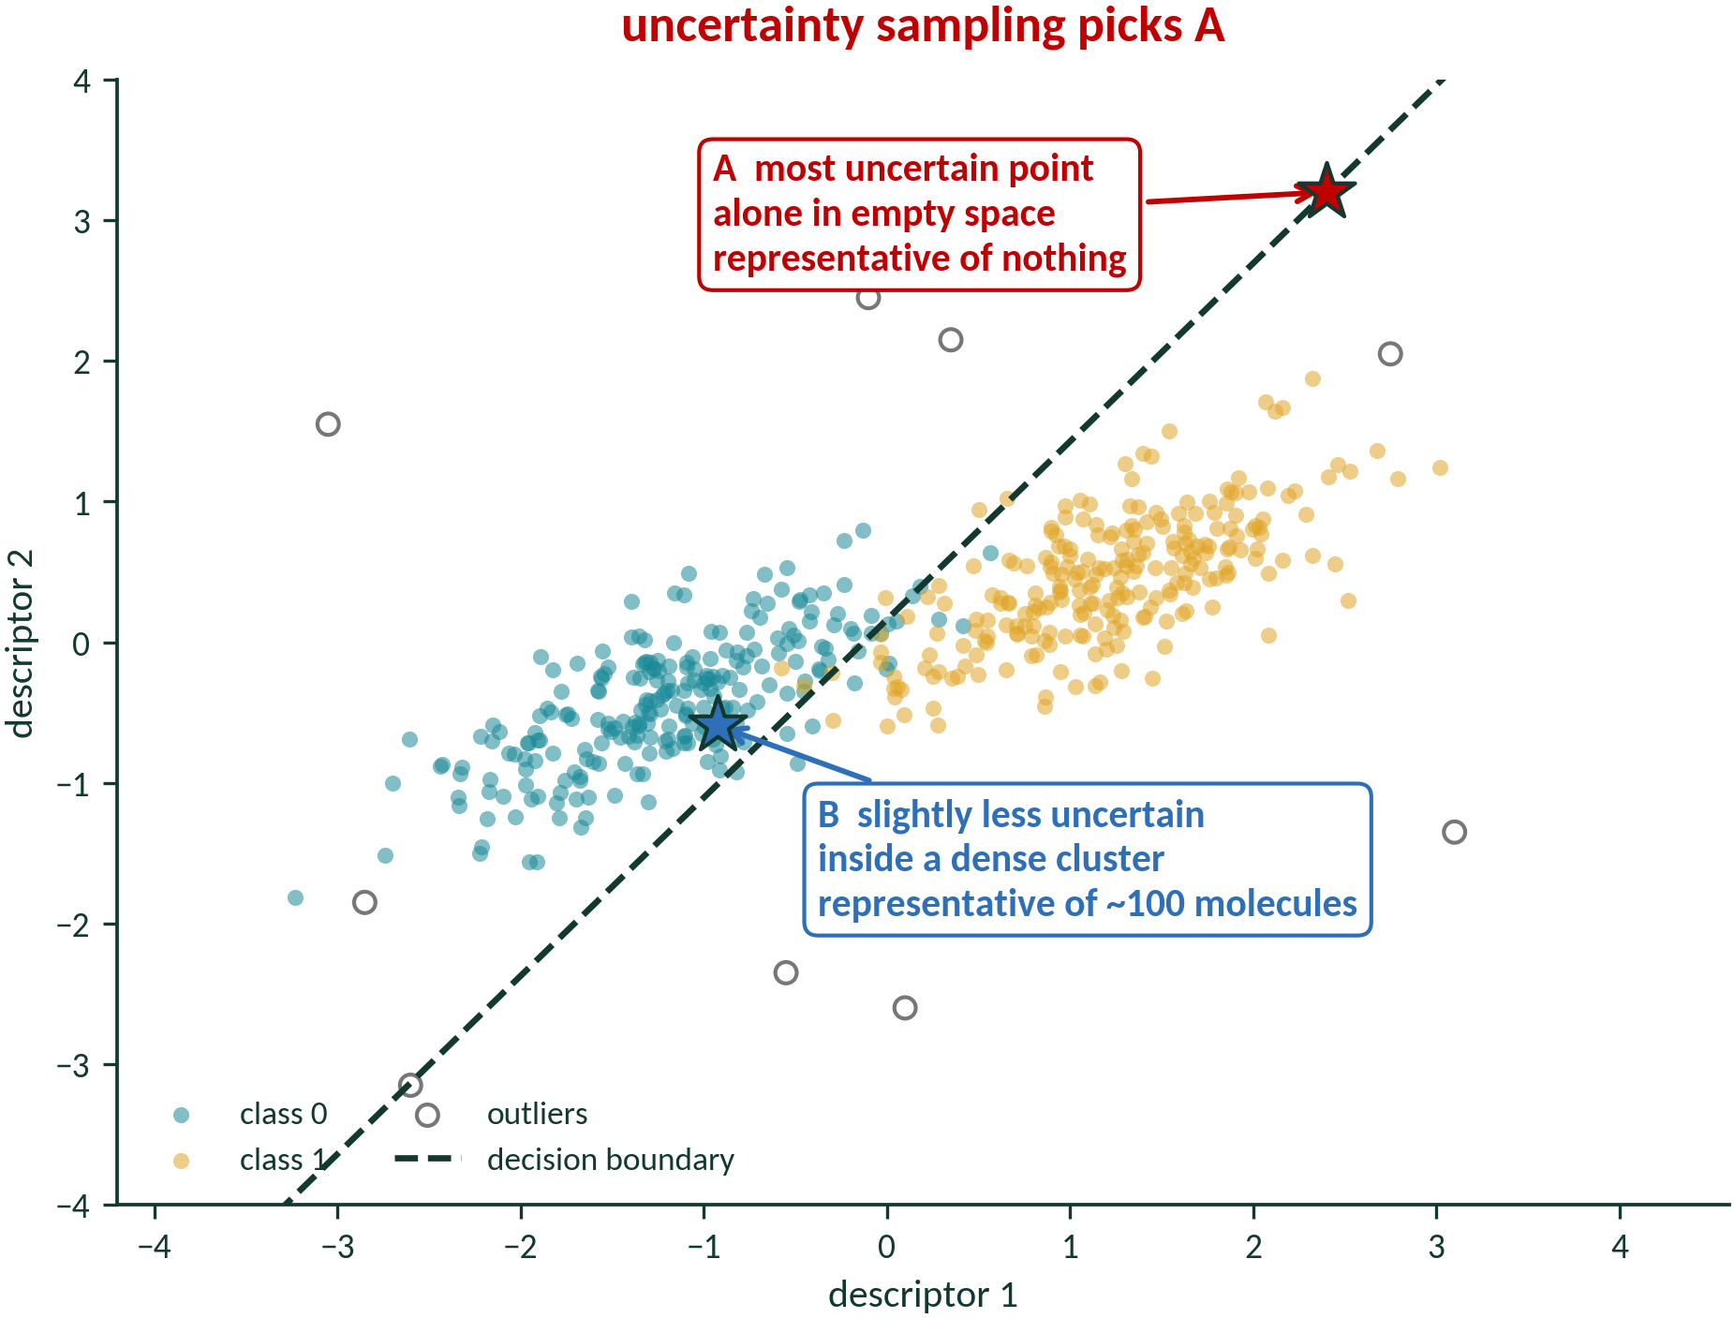
Bias towards Representativeness
a(x) = σ(x) · density(x)^{b}
After Settles, Active Learning Literature Survey, TR1648, 2009, Fig. 7 · information density: Settles & Craven, EMNLP 2008
AI4ChemicalSciences BootCamp 2026
Notes:
The general statement of what the ligand slide showed. Settles' figure 7 is the canonical
picture and it is worth the thirty seconds.
The formula is deliberately the simplest possible fix — multiply by how typical the point
is. beta is a free hyperparameter, which is its weakness; BADGE and core-set are the
principled versions and you are not covering them today.
The practical recommendation at the bottom is what most people in the room will actually
implement, and it is defensible: shortlist by uncertainty, then Tanimoto diversity-pick.
Do not spend more than a minute here. The next regime is more interesting.

Slide 14
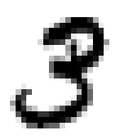
II. Classification task
Margin
x* = argmin [ P(ŷ₁ | x) − P(ŷ₂ | x) ]
3
8
8
x
P(3|x) ~ 1
P(3|x) ~ 0.5
P(8|x) ~ 0.5
P(8|x) ~ 1
AI4ChemicalSciences BootCamp 2026
Notes:
Build these as PowerPoint equation objects or clean text boxes — not rendered images — so
you can edit them live if someone asks.
Say the bottom line before anyone asks it. The three criteria only differ with three or
more classes.
Margin is highlighted because it is the one this lecture uses twice: here, and again for
ranking in two slides' time.

Slide 15
III: Ranking the two most reactive sites
Which C–H bond reacts? An argmax over the sites in one molecule.
margin = score( best site ) − score( runner-up )
AI4ChemicalSciences BootCamp 2026
Notes:
Short slide, and its only job is the handoff.
The conceptual point, worth stating cleanly because it is the one people get wrong: MARGIN
IS A PROPERTY OF THE DECISION, NOT OF THE MODEL. The underlying model here predicts a
per-site reactivity — a regression — but the decision is a choice among finitely many
sites, so margin is well defined and top-1 accuracy is the metric.
If someone asks about regression with a discrete decision more generally: yes, the same
thing happens whenever you are choosing among candidates. The quantity becomes the
probability that the top-ranked candidate really beats the runner-up, which is the
ranking-and-selection view and the bridge back to Thompson sampling from yesterday.
Put the target substrate up and go straight into section 4.

Slide 16
Plan
1 · The BO/AL loop
2 · Objective = model improvement
3 · What changes in the acquisition function
4 · A worked example: regioselectivity
5 · Which uncertainty is worth buying?
6 · Practical issues
7 · Active learning in the wild — and what is not
8 · Conclusion
AI4ChemicalSciences BootCamp 2026
Notes:
Section marker. We are entering: 4 · A worked example: regioselectivity

Slide 17
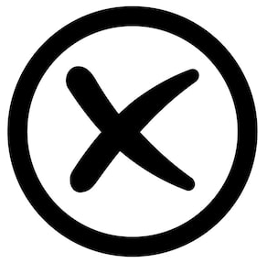
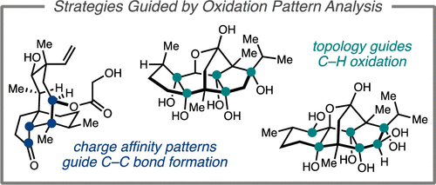

Csp³–H Late-stage functionalization (LSF)
T
LSF: introduction of functionality
site selectivity challenge
no interference of functional group
$
Dioxirane oxidations
$
$
AI4ChemicalSciences BootCamp 2026
Notes:
Stage: Master avec GN synthese et ccharacterrization de complexe de lanthanides divalents These AGPR sous la direction de LG et ML: Analyse Méca et ML: études de mécanismes et utilization de ML pour prediction de rendements Postdoc développement de méthodes de ML pour la synthèse organique. Collaboration CCAS: experts en ML et experts en synthèse organique. L’essential de mes travaux utilisent à la fois des études expérimentales et de la pour la comprehension de la réactivité en chimie organique

Slide 18
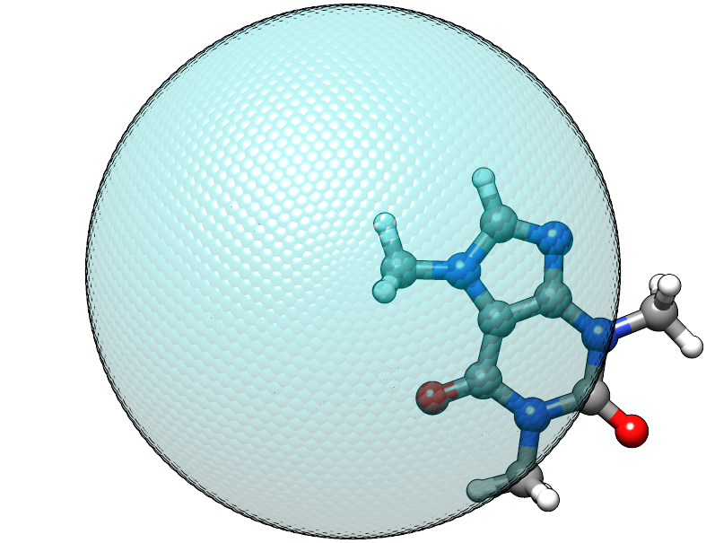
Predicting site-selectivity: previous work
Transformer
Neural Network
Decision Tree
Linear Regression
General reaction outcome prediction
Accuracy: ~83% for brominations
Decreasing model complexity
C2=CC=C(Br)C=C2
SMILES
Arene borylation
Accuracy:
~90% in sample
~70% out of sample
Graphs
Increasing representation complexity
EAS
Accuracy:
~93% in sample
~90% out of sample
xTB
Ir-cat. arene borylation
Accuracy: ~92%
Transition States
Ree, N. et al. Digital Discovery, 2022, 1, 108. Nippa, D. F. et al. Chemrxiv, 2023, Nippa, D. F. et al., Chemrxiv, 2022. Caldeweyher, E. et al., JACS, 2023, 145, 17367–17376. Schwaller P., et al., ACS Cent. Sci., 2019, 5, 1572.
AI4ChemicalSciences BootCamp 2026

Slide 19
Predicting site-selectivity on complex molecules
T
Complex molecules
Small molecules
Molecular Complexity
$
- difficult to access
- hard to characterize
- prediction: high value
- commercially available
- easy to characterize
- prediction: low value
$
$
How can we be sure that a model will predict well on a target of interest?
AI4ChemicalSciences BootCamp 2026

Slide 20
Perspective for de-risking synthetic planning
Predict selectivity/reactivity
Synthesis planning
T
Single step evaluation ?
Determine whether prediction is satisfactory
2
Yes
add to training set
$
or
No
Use acquisition function to select new molecules
Validate or discard synthetic plan
$
$
AI4ChemicalSciences BootCamp 2026

Slide 21
“Direct” prediction
Calculate transition states for all C–H bonds?
Failure to identify tertiary TSs.
Use general model?
struggles with regioselectivity (IBM-RXN 2020)
AI4ChemicalSciences BootCamp 2026

Slide 22

C–H bond oxidation database
Literature database - dioxirane oxidations
~130 small molecules
~50 complex molecules
Small molecules < 15 C
Complex molecules >= 15 C
AI4ChemicalSciences BootCamp 2026

Slide 23
Predicting site-selectivity validation?
Top-1 model performance
• Textbook baseline:
Benzylic > tertiary > secondary > primary
Validations:
• Leave one out (LOO) for 185 molecules.
• Complex-target validation:
Train on small molecules (135 molecules) and predict on complex molecules (50 molecules)
AI4ChemicalSciences BootCamp 2026

Slide 24
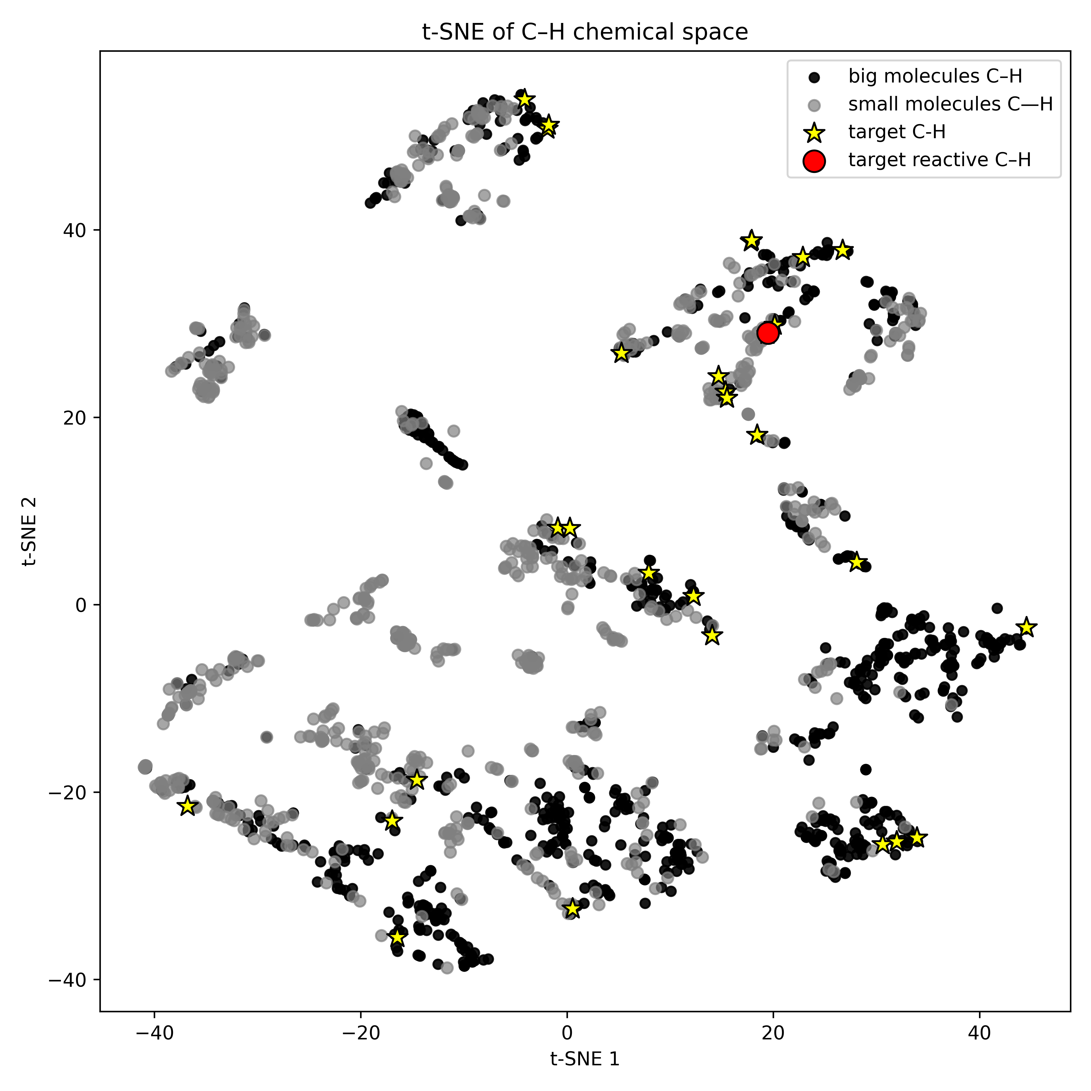
C–H chemical space
Stereo-electronic representation:
• BDE
• C-H charges
• %Vbur
Target molecule
AI4ChemicalSciences BootCamp 2026

Slide 25
Predicting site-selectivity on complex molecules
1. Large foundational model
- Data expensive
- Modeling Challenges
2. Target oriented dataset design:
- Small training set representative of the target reactivity
Acquisition function
Applicability domain
Applicability domain
Training data
Training data
Targets
Target
AI4ChemicalSciences BootCamp 2026

Slide 26
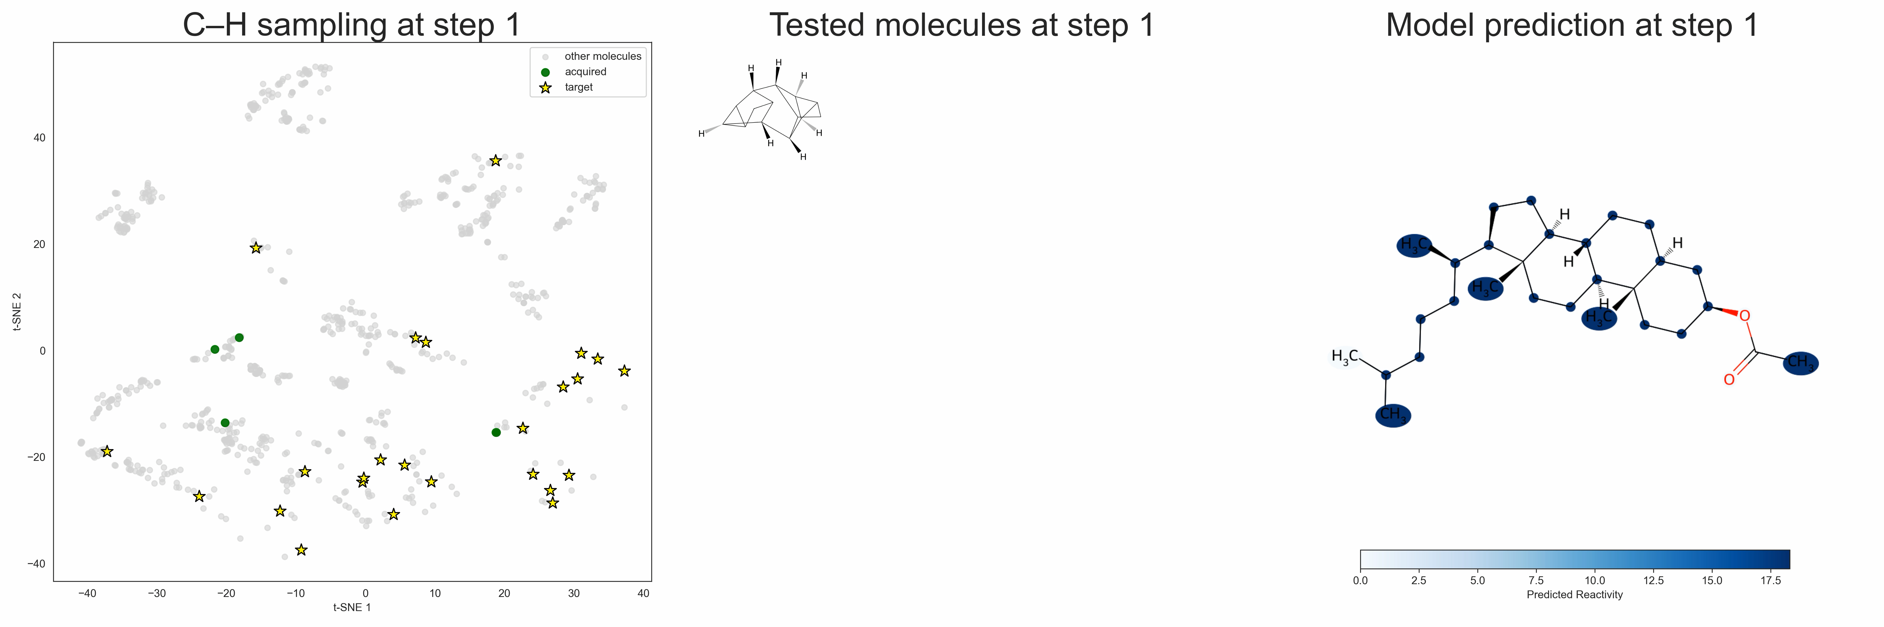
Active learning baselines: similarity
What makes a training molecule “good” for prediction on a target?
Scaffold similarity
C–H site similarity
AI4ChemicalSciences BootCamp 2026

Slide 27
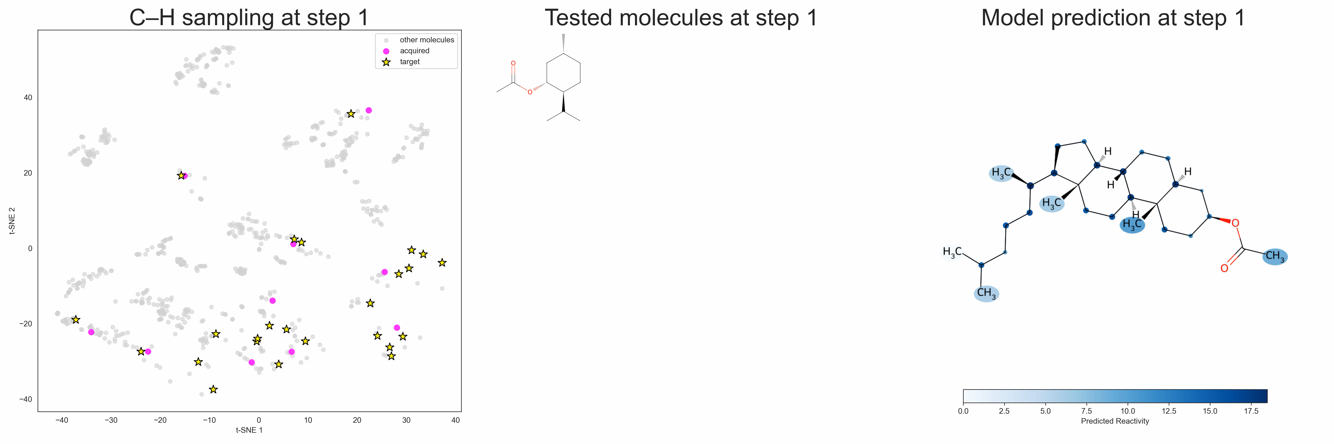
Active learning baselines: similarity
Scaffold similarity
C–H site similarity
AI4ChemicalSciences BootCamp 2026

Slide 28
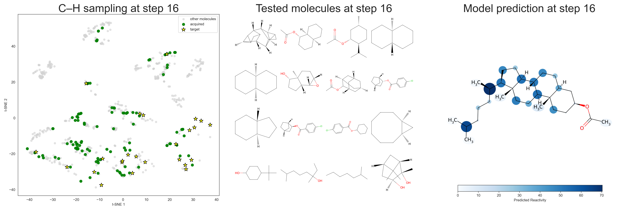
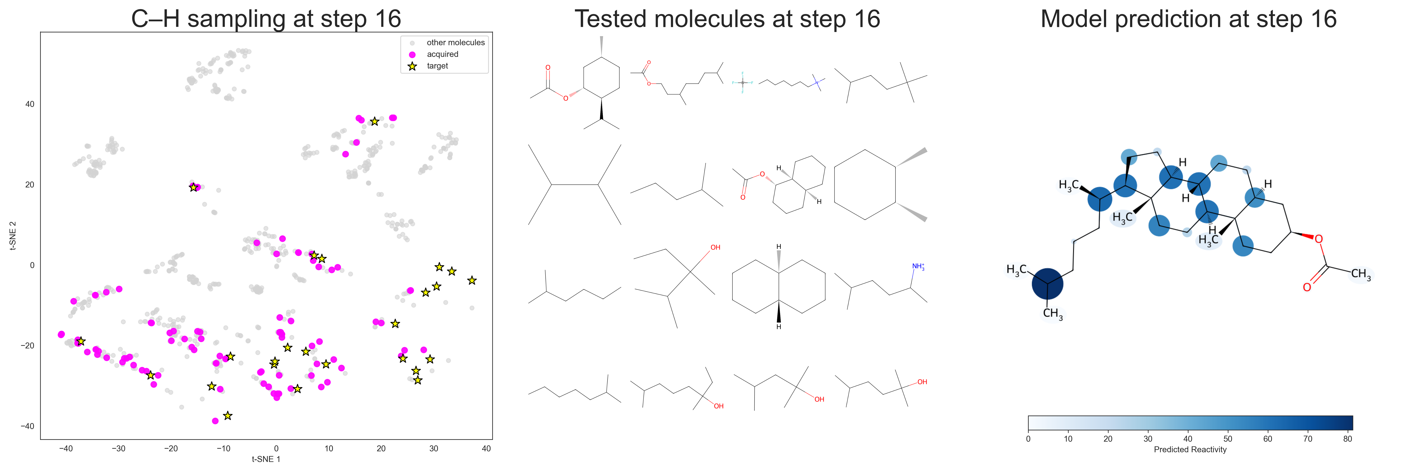
Active learning baselines: similarity
Scaffold similarity
C–H site similarity
Pro: Easy to implement, very intuitive
Cons: Redundancy of the information, not taking into of what the model learned previously
AI4ChemicalSciences BootCamp 2026

Slide 29
Active learning: leveraging uncertainty and predictions
What makes a training molecule “good” for prediction on a target?
Scaffold similarity
C–H site similarity
Active learning
Reactivity prediction
Model uncertainty
AI4ChemicalSciences BootCamp 2026

Slide 30

Active learning: leveraging uncertainty and predictions
Active learning
Reactivity prediction
Model uncertainty
AI4ChemicalSciences BootCamp 2026

Slide 31
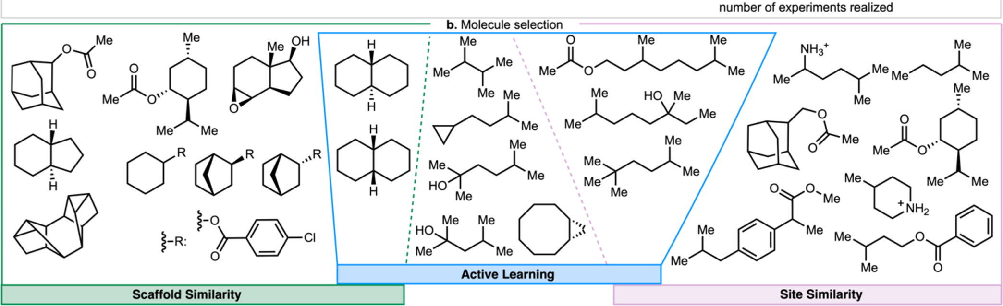
Analyzing Acquisition Function Selections
AI4ChemicalSciences BootCamp 2026
Notes:
This is the slide where the abstract argument becomes visible chemistry, and it is the best
one in the section because you did not go looking for it.
LEFT panel: AF_SC picks polycyclic cage after polycyclic cage. RIGHT panel: AF_CH picks
isopropyl after isopropyl. Both are buying the same information repeatedly.
MIDDLE: AF_AL draws from both families — the decalins that AF_SC likes and the isopropyls
that AF_CH likes.
AND THE NEGATIVE RESULT, which is what makes the rest credible: bolting CLUSTERING onto
AF_SC and AF_CH to force diversity DID NOT improve performance. The fix was not a diversity
filter applied afterwards; it was an acquisition function that is diverse by construction,
because weighting by reactivity times uncertainty automatically stops rewarding the tenth
analogue of something you have already learned.
This is also the batch-redundancy problem in miniature — you meet it properly in section 5.

Slide 32
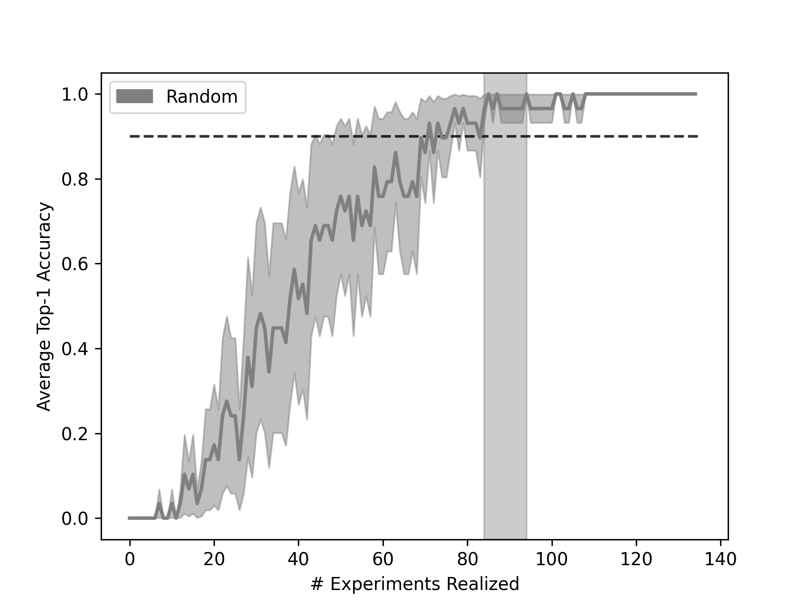
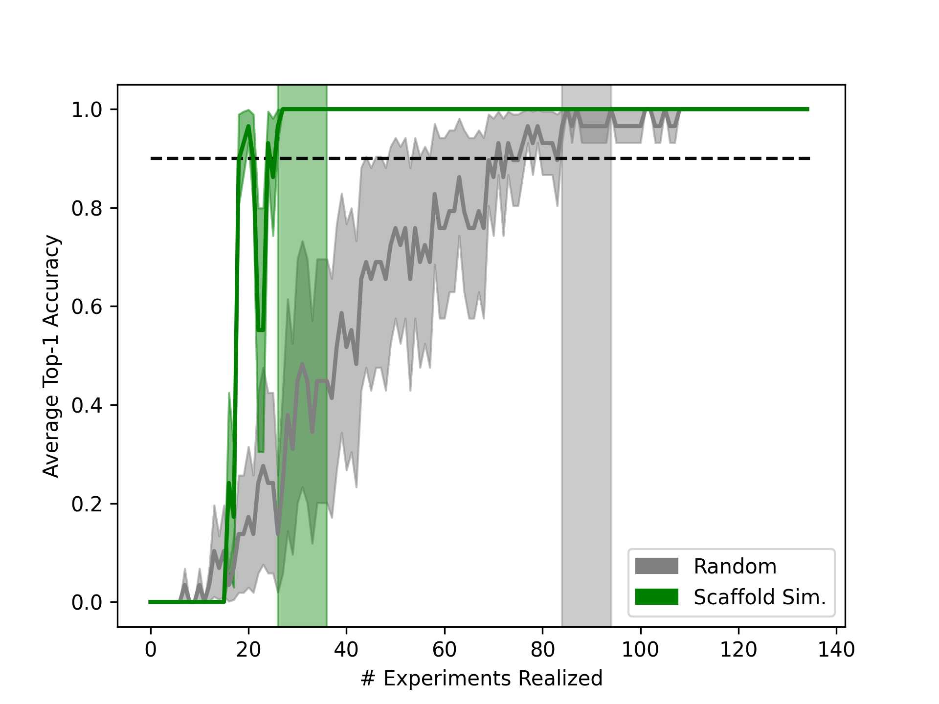
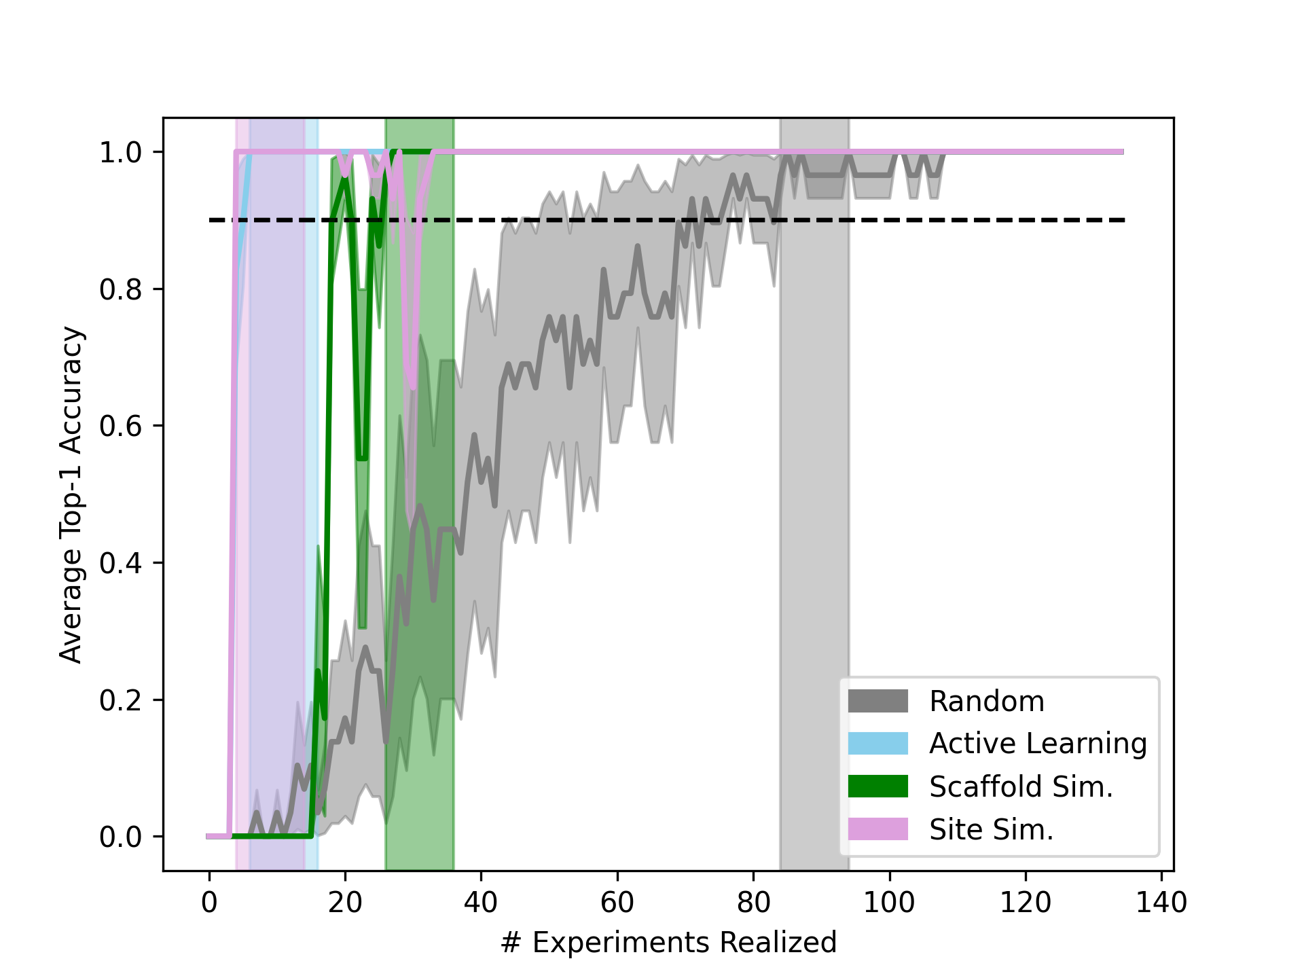
Designing target-specific datasets with acquisition functions
Learning curves:
-80
-78
-58
ground truth
AI4ChemicalSciences BootCamp 2026

Slide 33
Statistical significance
Dataset size difference between AFs and random
• Good performance on 5 complex molecules tested experimentally
• Good performance for predicting radical arene borylation using another literature dataset
AI4ChemicalSciences BootCamp 2026

Slide 34
Improvement of top-1 accuracy
Comparison of random and active learning AFs
More data is not always better: smaller datasets that cover only the relevant region of chemical space outperform larger datasets
AI4ChemicalSciences BootCamp 2026

Slide 35
Designing target-specific datasets with acquisition functions
• STATISTICALLY SIGNIFICANT:
- Active Learning reduces ~40 datapoints
- Active Learning design specific datasets successful where random can’t
• TRANSPOSABLE TO DIFFERENT C–H FUNCTIONALIZATION:
- C(sp³)–H Dioxirane oxidations
- C(sp²)–H borylations
• EXPERIMENTAL VALIDATION:
5 targets successfully predicted with this method
AI4ChemicalSciences BootCamp 2026

Slide 36
Future work: prospective use needs stopping criterion
ground truth
AI4ChemicalSciences BootCamp 2026

Slide 37
Perspective for de-risking synthetic planning
Predict selectivity/reactivity
Synthesis planning
T
Single step evaluation ?
Determine whether prediction is satisfactory
2
Yes
add to training set
$
or
No
Use acquisition function to select new molecules
Validate or discard synthetic plan
$
$
AI4ChemicalSciences BootCamp 2026

Slide 38
Plan
1 · The BO/AL loop
2 · Objective = model improvement
3 · What changes in the acquisition function
4 · A worked example: regioselectivity
5 · Which uncertainty is worth buying?
6 · Practical issues
7 · Active learning in the wild — and what is not
8 · Conclusion
AI4ChemicalSciences BootCamp 2026
Notes:
Section marker. We are entering: 5 · Which uncertainty is worth buying?

Slide 39
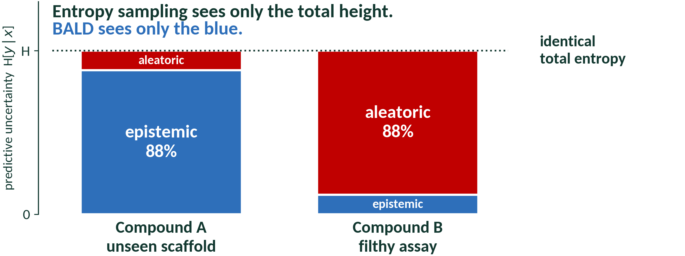
What are the sources of uncertainty?
Compound A
A scaffold the model has never seen. Wide error bars.
Compound B
A well-understood scaffold, but the assay is filthy. Replicates scatter by 30%.
AI4ChemicalSciences BootCamp 2026
Notes:
Build this slowly. It is the idea in the lecture most likely to change what someone does on
Monday, and it lands harder here — after section 4 — than it would have before, because
they have just watched an ensemble-uncertainty acquisition function work.
Do NOT show the equation yet. Get them to feel the difference first: ask which compound they
would run. Most say A, correctly. Then ask WHY, and the answer is the next slide.
No amount of data shrinks B's error bar. The uncertainty is in the assay, not the model.
The chemistry examples worth naming: A is a new heterocycle nobody has oxidised. B is a
compound whose assay has a 30% coefficient of variation, or a substrate with two genuinely
equireactive sites where the true answer IS a 50:50 mixture.

Slide 40
Not all uncertainty is worth sampling
H[ y | x, 𝒟 ] = 𝕀[ y ; ω | x, 𝒟 ] + 𝔼ω [ H[ y | x, ω ] ]
TOTAL
EPISTEMIC
ALEATORIC
“I don't know.”
“I don't know YET — an experiment fixes this.”
“Nobody knows. Running it again will not help.”
Sample x!
Don’t sample x!
Identity: Houlsby, Huszár, Ghahramani & Lengyel, arXiv:1112.5745, 2011 · vocabulary: Hüllermeier & Waegeman, Mach. Learn. 2021, 110, 457
AI4ChemicalSciences BootCamp 2026
Notes:
Read it in words, then in symbols, then in chemistry.
total = "I don't know."
epistemic = "I don't know YET, and an experiment would fix it."
aleatoric = "Nobody knows, and running it again will not help."
STRESS THAT IT IS EXACT. I(A;B) = H(A) - H(A|B) is the definition of mutual information.
The decomposition is free; there is nothing to approximate and nothing to assume.
GIVE THEM THE VARIANCE FORM — most chemists accept it on sight where the entropy version
makes them work: spread of the members' MEANS, plus the average of the members' NOISE.
HOW IT IS COMPUTED, in one line, because it explains why the noise cancels: entropy of the
average prediction, minus the average of the individual entropies. If a point is
irreducibly noisy, every member is broad, so both terms are large and they cancel. If it is
unexplored, each member is sharp but they disagree, so only the first term is large.
⚠ AND THE CAVEAT, which is the most useful thing on this slide and is almost never said:
if your likelihood has a single global sigma-squared — one fitted noise term for the whole
domain — then the aleatoric part is a CONSTANT in x. Subtracting a constant does not change
an argmax, so BALD and entropy rank identically and you have gained nothing. You need
heteroscedastic noise, sigma-squared as a function of x. Ask the room whether their model
has that. Most do not.
ATTRIBUTION: "epistemic" and "aleatoric" do not appear in Houlsby et al. Credit the
uncertainty-quantification literature for the vocabulary.

Slide 41
Bayesian Active Learning by Disagreement (BALD)
μ(x) σ²(x)
Average σ²(x) is high and Standard Deviation of μ(x) is low: aleatoric uncertainty
Average σ²(x) is low and Standard Deviation of μ(x) is high: epistemic uncertainty
μ(x) σ²(x)
μ(x) σ²(x)
μ(x) σ²(x)
AI4ChemicalSciences BootCamp 2026
Notes:
Having built the previous slide, BALD is now almost trivially motivated: it is the
acquisition function that buys the first term and refuses to buy the second.
I( y ; ω ) = H( y ) − Eω[ H( y | ω ) ]
Walk the three panels left to right, and SLOW DOWN ON THE MIDDLE ONE. Ask: "entropy
sampling puts this at the top of its list. Should we run it?"
THE READING THAT MAKES BALD CLICK, and say it twice: BALD is high only when the individual
models are each CONFIDENT and they confidently DISAGREE. Not "everybody is unsure" — that
is entropy, and it includes the noise. "Everybody is sure, and sure of different things."
That state only arises when several distinct hypotheses still fit your data, which is
exactly when an experiment is worth running.
The numbers are computed on the figure, so you can point at them: panel (b) has H = 1.00
bit and BALD = 0.00; panel (c) has H = 1.00 and BALD = 0.80.

Slide 42
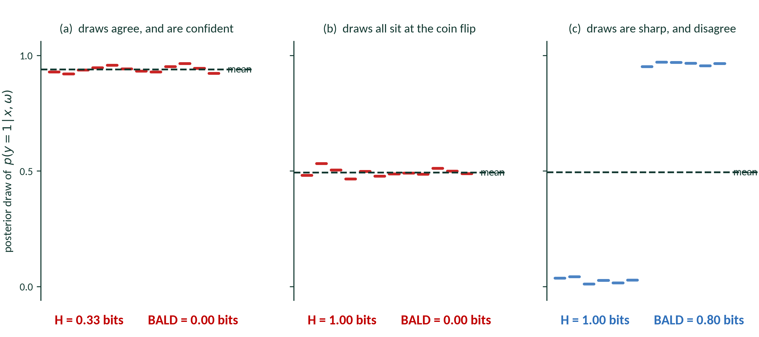
Example on classification
BALD — Houlsby et al., arXiv:1112.5745, 2011 · H and BALD computed on the figure
AI4ChemicalSciences BootCamp 2026
Notes:
Having built the previous slide, BALD is now almost trivially motivated: it is the
acquisition function that buys the first term and refuses to buy the second.
I( y ; ω ) = H( y ) − Eω[ H( y | ω ) ]
Walk the three panels left to right, and SLOW DOWN ON THE MIDDLE ONE. Ask: "entropy
sampling puts this at the top of its list. Should we run it?"
THE READING THAT MAKES BALD CLICK, and say it twice: BALD is high only when the individual
models are each CONFIDENT and they confidently DISAGREE. Not "everybody is unsure" — that
is entropy, and it includes the noise. "Everybody is sure, and sure of different things."
That state only arises when several distinct hypotheses still fit your data, which is
exactly when an experiment is worth running.
The numbers are computed on the figure, so you can point at them: panel (b) has H = 1.00
bit and BALD = 0.00; panel (c) has H = 1.00 and BALD = 0.80.

Slide 43
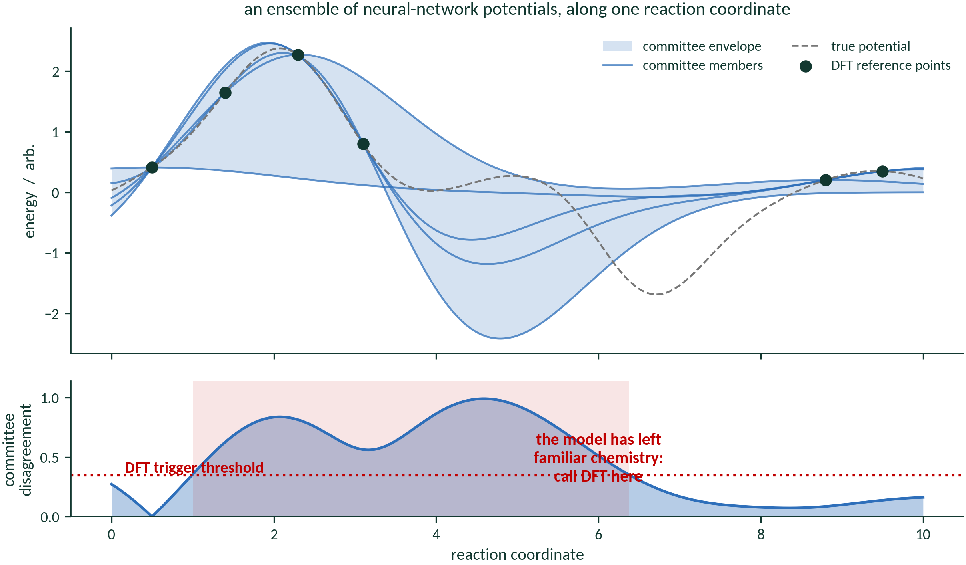
In practice: query by committee
AI4ChemicalSciences BootCamp 2026
Notes:
The bridge from the theory back to what people actually run — and back to section 4, where
the uncertainty was ensemble spread.
Land the point plainly: chemists have been doing BALD since 1992 without calling it that.
Seung, Opper and Sompolinsky, COLT '92.
The table is the practical menu. The line to emphasise is "deep ensemble — under-disperses":
members trained on the same data with the same architecture are correlated, so their spread
UNDER-estimates the epistemic term, and you drift back toward random sampling without
noticing. That is a real failure mode and it connects to section 6.
If asked about the difference between QBC and exact BALD: the committee is a crude,
finite, non-Bayesian sample of the posterior. It gets you the disagreement structure, which
is most of the value, and it costs you calibration.

Slide 44
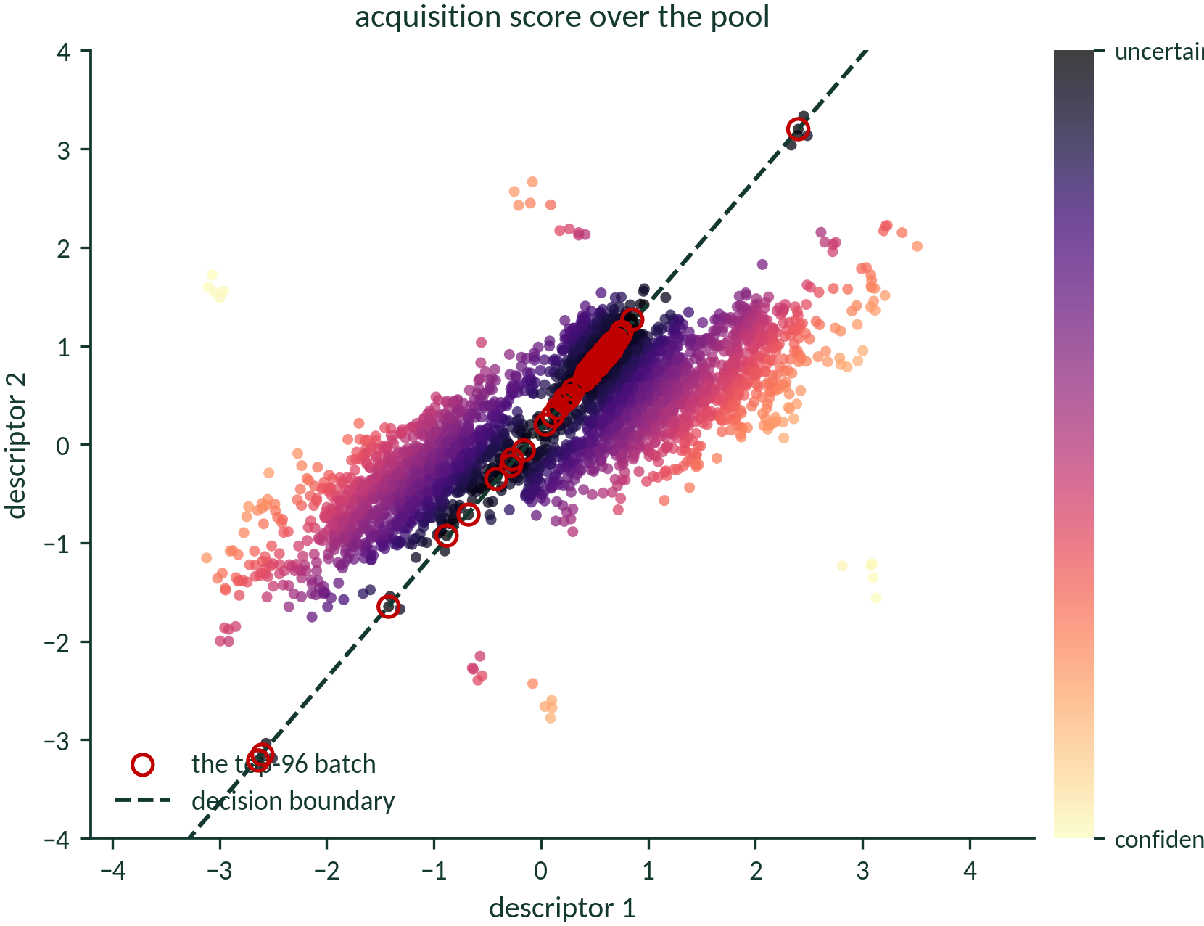
Batching
AI4ChemicalSciences BootCamp 2026
Notes:
Ninety seconds, and it is the compressible slide in this section — cut it to thirty if you
are behind.
Open with the failure, not the fix. Ask who has done this. Some will have.
The one-line diagnosis is what to remember: INDEPENDENCE IN THE SCORING MEANS REDUNDANCY IN
THE BATCH. Batch size 1 has no problem; batch size 96 has a severe one; and chemistry is
almost never batch size 1.
Name BatchBALD and core-set and move on — do not derive either. If someone wants the
information-theoretic version: BALD summed over a batch double-counts the overlap between
what the points would tell you, and BatchBALD scores the union instead. That is the whole
idea.
CALLBACK: they have already seen this in real data — AF_CH's nine isopropyls in Figure 3b.

Slide 45
Plan
1 · The BO/AL loop
2 · Objective = model improvement
3 · What changes in the acquisition function
4 · A worked example: regioselectivity
5 · Which uncertainty is worth buying?
6 · Practical issues
7 · Active learning in the wild — and what is not
8 · Conclusion
AI4ChemicalSciences BootCamp 2026
Notes:
Section marker. We are entering: 6 · Practical issues

Slide 46
1 · Unconstrained, it will buy the useless corner
Weight by density
σ(x) · density(x)ᵝ — reward points that are typical as well as uncertain
Constrain the pool
filter for synthesizability, cost, characterisability BEFORE scoring
Bias deliberately
AF_AL toward small molecules took 27 targets to 31
Constrain the pool, not just the score.
AI4ChemicalSciences BootCamp 2026
Notes:
The first practical lesson, and it is the one they will hit first.
Say that they have now met this failure three times in ninety minutes — the ligand
catalogue, Settles' isolated point A, and the GP walking to 200 degrees and 20 mol%. It is
not an edge case; it is the default behaviour of an unconstrained uncertainty criterion.
THE THIRD FIX IS THE ONE WITH EVIDENCE BEHIND IT and it is from your own paper: biasing
AF_AL toward small molecules raised the count from 27 to 31 targets. That is a
constraint on the POOL, motivated by characterisability, not a cleverer score. Constraining
the candidate set is usually easier and more effective than fixing the acquisition function.
Practical framing for the room: before you score anything, ask what you would refuse to make
even if the model begged for it. Then remove those first.

Slide 47
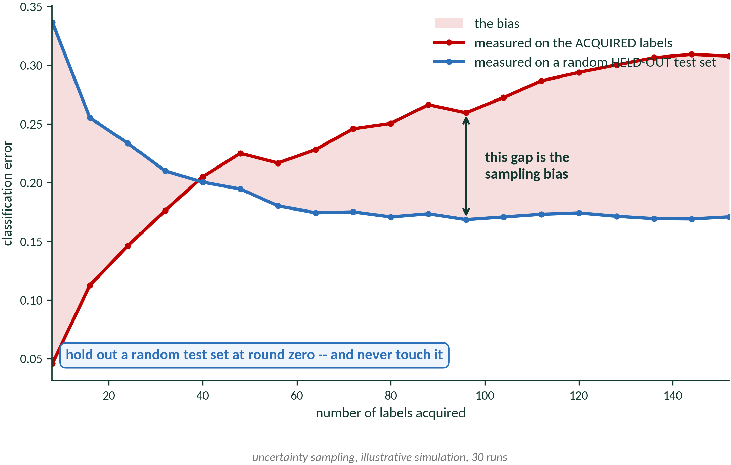
2 · Your data is now a biased sample
Error estimation assumes xᵢ ~ p(x), i.i.d. Under active learning xᵢ ~ qᵢ(x) — an adaptive, model-dependent proposal. Your training set over-samples hard points, so it over-states difficulty.
Hold out a random test set at round zero.
Never touch it. Never evaluate on the actively-acquired pool.
The successor-model problem.
Data selected by model A can be WORSE than random for model B. If you will ever swap your surrogate — and in molecular ML you always do — an AL-curated data set is a liability.
The bias is not always bad.
For overparameterised models it acts like hard-example mining. De-bias your EVALUATION always; de-bias your TRAINING only sometimes.
Lowell, Lipton & Wallace, EMNLP-IJCNLP 2019 · Farquhar, Gal & Rainforth, ICLR 2021, arXiv:2101.11665
AI4ChemicalSciences BootCamp 2026
Notes:
The successor-model problem is the most under-appreciated point in the lecture and the one
with the biggest practical consequence for this audience.
People curate a data set with an AL loop, publish it as a resource, and then somebody trains
a different architecture on it and does WORSE than they would have with a random sample of
the same size. If you are building a data set others will reuse with unknown models, that is
an argument for random or diversity sampling, not AL.
The figure: the gap between the two curves is the sampling bias, and it GROWS over the
campaign. Uncertainty sampling deliberately buys hard points, so the error measured on its
own acquisitions over-states the difficulty of the problem.
The rule is one line: hold out a random test set at round zero and never touch it. It costs
you a few labels at the start of a campaign and it is the only thing standing between you
and a number that means nothing.
CALLBACK: this also invalidates the learning-curve-plateau stopping rule on the next slide.

Slide 48
3 · When do you stop?
Criterion
The rule
Where it breaks
Budget / economic
stop when the money or the plates run out
honest, and what actually happens — but it is not a criterion
Max uncertainty
stop when max a(x) over the pool falls below ε
overconfident models trip it far too early
Learning-curve plateau
stop when the validation metric flattens
INVALID if the validation set was actively acquired — see the last slide
Residual fail rate
stop when < 5% of the remaining pool still fails your error tolerance
needs a tolerance in physical units, fixed in advance
Smith et al. used the last one, and it worked — because they wrote down 0.04 kcal/mol before they started.
So the question to take away: what is your 0.04 kcal/mol?
AI4ChemicalSciences BootCamp 2026
Notes:
This answers the problem you deliberately left open at the end of section 4.
Walk the table quickly. The first row is the honest one and Settles says so: "the real
stopping criterion for practical applications is based on economic or other external
factors". Most campaigns stop when the money runs out.
But the last row is a genuine, published, WORKING intrinsic criterion, and it is worth the
time because it tells you the condition under which stopping rules work at all. Smith et
al.'s ANI loop stops when fewer than 5% of the not-yet-added data are still fail cases,
where a fail case is |E_ANI - E_DFT|/sqrt(N) > 0.04 kcal/mol.
WHY IT WORKS: they fixed an error tolerance IN PHYSICAL UNITS before starting. Not "when
the curve flattens", not "when I feel confident" — a number, in kcal/mol, decided in
advance and defensible on chemical grounds.
END ON THE QUESTION. Ask the room what their 0.04 kcal/mol is. Most people have never
written it down, and that — not the lack of a clever criterion — is why stopping feels
impossible.

Slide 49
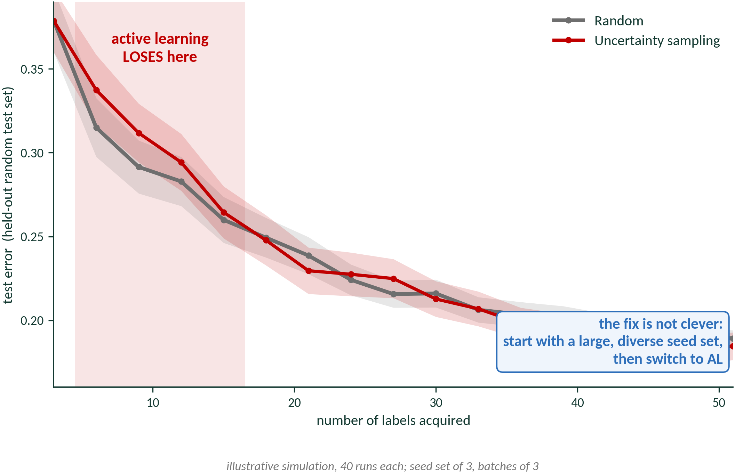
4 · And random is a much better baseline than you expect
A model trained on almost nothing produces biased queries.
It does not yet know enough to know what it does not know.
Always plot the random baseline on the same axes.
In batch mode, Sener & Savarese found that oracle-quality uncertainty still lost to random.
A large fraction of published active-learning gains disappear the moment you draw that line.
Worse than random at n = 6, 9, 12, 15. Crosses over at 18.
AI4ChemicalSciences BootCamp 2026
Notes:
Do not cut this slide. It is what separates a lecture from a sales pitch, and everyone here
is going to go and run these methods.
Warn them explicitly that they will see the cold start in the tutorial this morning and that
it is NOT a bug in their code. Uncertainty sampling is worse than random for the first four
rounds of this simulation, over 40 runs, and crosses over at 18 labels.
The mechanism is worth one sentence: a model trained on almost nothing produces biased,
outlier-seeking queries. It cannot yet tell the difference between "I have not looked there"
and "there is nothing there".
The seed-set advice is the single most actionable thing in this section. Diversity-pick your
first batch. Do not let the model choose it.
And the boxed rule: always plot random on the same axes. You are not arguing that AL does
not work — section 4 was your own paper — you are arguing that the baseline is not optional.

Slide 50
Plan
1 · The loop you saw yesterday
2 · The model is the deliverable
3 · What changes in the acquisition function
4 · A worked example: regioselectivity
5 · Which uncertainty is worth buying?
6 · Practical issues
7 · Active learning in the wild — and what is not
8 · Conclusion
AI4ChemicalSciences BootCamp 2026
Notes:
Section marker. We are entering: 7 · Active learning in the wild — and what is not

Slide 51
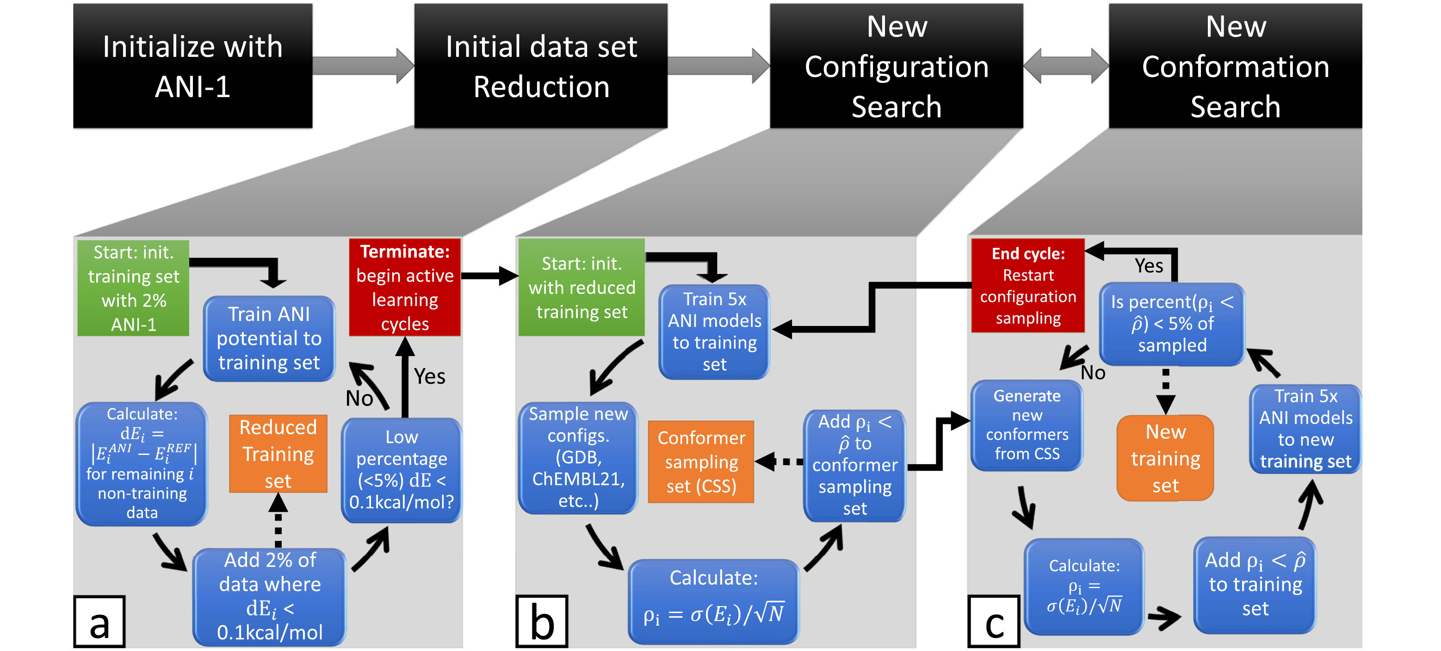
“Less is more” — active learning for a universal potential
ρᵢ = σ(Eᵢ) / √N add if ρᵢ > ρ̂
ρ̂ = 0.23 kcal/mol — 98% of errors above 1.5 kcal/mol
beats random-sampled ANI-1 with
and vastly beats it at
stops below
10%
25%
5%
of the data
fail cases remaining
Smith, Nebgen, Lubbers, Isayev & Roitberg, J. Chem. Phys. 2018, 148, 241733 · DOI 10.1063/1.5023802 · Fig. 2, reproduced for non-commercial teaching use
AI4ChemicalSciences BootCamp 2026
Notes:
The canonical active-learning paper in chemistry, and the title is this lecture's thesis in
three words. Two minutes.
Their Figure 2 contains the loop, the acquisition criterion AND the stopping rule in one
picture, which is why it is worth showing rather than describing.
The criterion is the deployment argument from section 2 made concrete: rho = sigma(E)/sqrt(N)
— ensemble spread, normalised by atom count so ONE threshold works across molecules of
different size. Without the square root, big molecules always look uncertain, which is a
representation problem rather than an information problem, and they fixed it in the metric.
⚠ THE PUBLISHED FIGURE HAS THE INEQUALITY BACKWARDS, in three places: "Add rho_i < rho-hat".
The body text is unambiguous and physically correct — include when rho_i is GREATER than
rho-hat, because rho is an uncertainty. It is a typo in the figure. If a student points at
it, agree with them, say Eq. 1 and the text are authoritative, and move on. Do NOT read the
sign off the figure and do not try to rationalise it from the podium.
The quotable line from the abstract: active learning improves the potential "by mitigating
human biases in deciding what new training data to use."

Slide 52
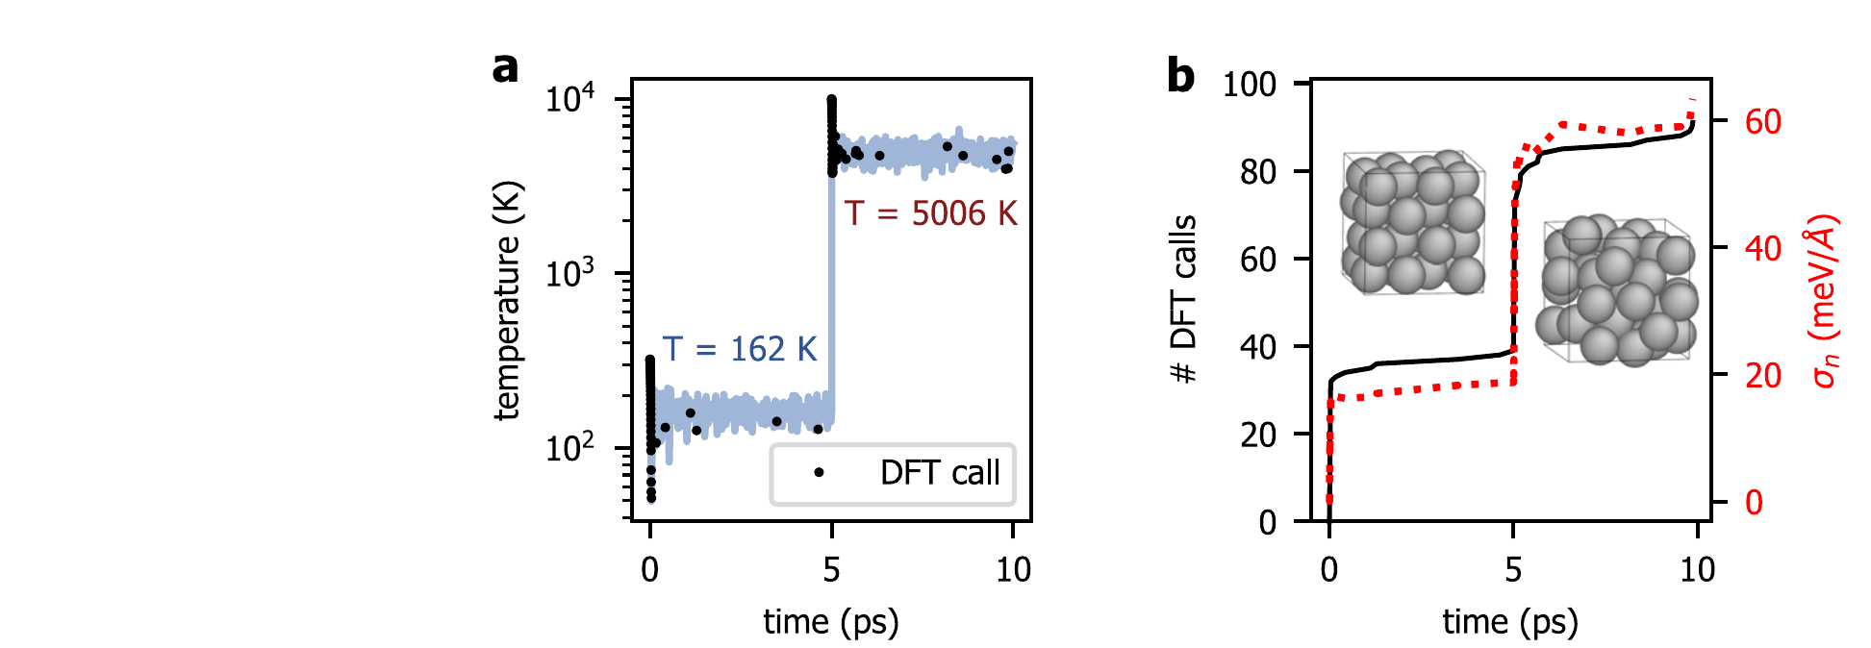
On the fly: the model asks for DFT when it gets lost
Candidates
the configurations the MD is visiting right now — they arrive, they are not enumerated
Oracle
DFT
Trigger
sparse-GP epistemic variance on the forces exceeds the model's own noise level
Bought
no further DFT after ~400 ps of vacancy diffusion; >300× faster than AIMD
Aluminium, 10 ps. It melts at t = 5 ps — and the DFT calls and the fitted noise both jump at exactly that moment.
Vandermause et al., npj Comput. Mater. 2020, 6, 20 · DOI 10.1038/s41524-020-0283-z · Fig. 3a,b, CC BY 4.0
AI4ChemicalSciences BootCamp 2026
Notes:
Do not explain this figure — point at it and let them watch. Ninety seconds.
Panel a: the trajectory starts in the FCC crystal at 162 K. At t = 5 ps it melts and hits
5006 K. Black dots are DFT calls.
Panel b: cumulative DFT calls and the fitted noise. Both flat, then both step, at exactly
the melting transition.
The audience SEES the model leave the chemistry it knows and ask for help. Nobody told it
melting was coming.
Worth noting because it differs from everything else today: there is no pool here. The MD
generates the candidates as it goes, and the decision to keep or discard is made once, in
real time. That is a genuinely different setting from section 4's enumerated library.
The honest caveat, fifteen seconds: the trigger is a threshold on the GP's own uncertainty,
so it inherits whatever the kernel believes. If the kernel cannot represent the new physics,
the uncertainty may not rise at all — the bias term again.

Slide 53
Most of what is called active learning is optimization
Three famous, excellent papers. All three use the machinery from this lecture. None of them wants a globally good model.
Molecular pool-based AL
Autonomous synthesis
Pareto active learning
MolPAL
A-Lab
PAL
100 M docking candidates, D-MPNN surrogate, UCB or greedy. Recovers 94.8% of the top-50,000 after docking 2.4% of the library.
Recipes proposed from the literature, robotic synthesis, automated XRD, recipes updated after failures. 41 compounds from 58 targets in 17 days.
Uses the Pareto-dominance relation directly, so no scalarisation and no imposed weighting. Recovers the front with >98% fewer evaluations than random.
It wants the TOP OF THE RANKING. Error in the boring 97% is irrelevant.
It wants NEW COMPOUNDS. A model of everything it did not make is worthless to it.
Its own first sentence: “the holy grail of material science is to find the OPTIMAL material.”
Graff, Shakhnovich & Coley, Chem. Sci. 2021, 12, 7866
Szymanski et al., Nature 2023, 624, 86 · see Author Correction, Nature 2026, 650, E1
Jablonka et al., Nat. Commun. 2021, 12, 2312
AI4ChemicalSciences BootCamp 2026
Notes:
This slide closes the loop on section 2, and it is the most useful piece of literature
advice in the lecture.
Work across the three and say, for each, WHAT IT WANTS:
- MolPAL wants the top of a ranking. Explicitly BO-flavoured; the authors are not hiding
it. Fine — just do not copy it expecting a calibrated model.
- A-Lab wants novel compounds. Active learning appears as recipe repair after a failed
synthesis; it is not the core claim.
- PAL wants the Pareto front. Read its first line out loud and the point makes itself.
THE PRACTICAL RULE: when you read a chemistry paper with "active learning" in the title,
find the OBJECTIVE before you find the method. If it reports "best found", it is optimizing.
If it reports test error across a domain, it is doing what we did today.
WHERE AL GENUINELY DOMINATES IN CHEMISTRY, and be honest that the list is short: building
interatomic potentials and building data sets. Both are cases where the model IS the
deliverable. That is not a coincidence — it is section 2 showing up in the shape of the
literature.
If you are behind, this whole slide is 60 seconds from the three red boxes.
On A-Lab, get the numbers right: a 2026 Author Correction re-analysed the diffraction by
hand and found the platform correct in 36 of 40 reported successes, 4 inconclusive and now
removed. "Novel" meant new to the prediction platform, not new to science. Do not say "most
were not really made" — that is not what the record shows.

Slide 54
Plan
1 · The BO/AL loop
2 · Objective = model improvement
3 · What changes in the acquisition function
4 · A worked example: regioselectivity
5 · Which uncertainty is worth buying?
6 · Practical issues
7 · Active learning in the wild — and what is not
8 · Conclusion
AI4ChemicalSciences BootCamp 2026
Notes:
Section marker. We are entering: 8 · Conclusion

Slide 55
What to take away
The objective decides the acquisition function.
A value across a library → uncertainty, weighted by representativeness. A class or a ranking → margin. Ask what you are scoring before you ask which formula.
Not all uncertainty is worth sampling.
Epistemic shrinks when you spend money. Aleatoric does not. If your noise model does not depend on x, you cannot tell them apart.
Measure yourself honestly.
A random test set held out at round zero, a random baseline on the same axes, and an error tolerance written down before you start.
AI4ChemicalSciences BootCamp 2026
Notes:
Three sentences, then stop. Do not summarise the summary.
If they remember one line, make it the second one: NOT ALL UNCERTAINTY IS WORTH BUYING.
Then send them to the tutorial with the warning about the cold start, so they do not spend
twenty minutes debugging correct behaviour.

Slide 56
References — theory and method
★ Smith, J. S.; Nebgen, B.; Lubbers, N.; Isayev, O.; Roitberg, A. E. Less is more: sampling chemical space with active learning. J. Chem. Phys. 2018, 148, 241733. DOI 10.1063/1.5023802
★ Schleinitz, J.; Carretero-Cerdán, A.; Gurajapu, A.; et al. Designing Target-specific Data Sets for Regioselectivity Predictions on Complex Substrates. J. Am. Chem. Soc. 2025, 147, 7476–7484. DOI 10.1021/jacs.4c15902
Settles, B. Active Learning Literature Survey. Comp. Sci. Tech. Report 1648, Univ. Wisconsin–Madison, 2009. minds.wisconsin.edu/handle/1793/60660
Houlsby, N.; Huszár, F.; Ghahramani, Z.; Lengyel, M. Bayesian Active Learning for Classification and Preference Learning. arXiv:1112.5745, 2011.
Hüllermeier, E.; Waegeman, W. Aleatoric and epistemic uncertainty in machine learning. Mach. Learn. 2021, 110, 457–506. DOI 10.1007/s10994-021-05946-3
Seung, H. S.; Opper, M.; Sompolinsky, H. Query by committee. COLT '92, 287–294. DOI 10.1145/130385.130417
Kirsch, A.; van Amersfoort, J.; Gal, Y. BatchBALD. NeurIPS 32, 2019. arXiv:1906.08158
Sener, O.; Savarese, S. Active Learning for CNNs: A Core-Set Approach. ICLR 2018. arXiv:1708.00489
Settles, B.; Craven, M. An analysis of active learning strategies for sequence labeling tasks. EMNLP 2008, 1070–1079. aclanthology.org/D08-1112
Baum, E. B.; Lang, K. J. Query learning can work poorly when a human oracle is used. IJCNN 1992, Beijing. (no DOI)
AI4ChemicalSciences BootCamp 2026
Notes:
Leave up during questions. Several of these have no DOI — arXiv IDs and anthology links are given instead; do not invent DOI strings for them. Full figure provenance and licences: lecture_13_CREDITS.md

Slide 57
References — chemistry
Vandermause, J.; et al. On-the-fly active learning of interpretable Bayesian force fields for atomistic rare events. npj Comput. Mater. 2020, 6, 20. DOI 10.1038/s41524-020-0283-z
Nippa, D. F.; Atz, K.; Hohler, R.; et al. Enabling late-stage drug diversification by high-throughput experimentation with geometric deep learning. Nat. Chem. 2024, 16, 239–248. DOI 10.1038/s41557-023-01360-5
Graff, D. E.; Shakhnovich, E. I.; Coley, C. W. Accelerating high-throughput virtual screening through molecular pool-based active learning. Chem. Sci. 2021, 12, 7866. DOI 10.1039/D0SC06805E — optimization, not model-building (slide 43)
Jablonka, K. M.; et al. Bias free multiobjective active learning for materials design and discovery. Nat. Commun. 2021, 12, 2312. DOI 10.1038/s41467-021-22437-0 — Pareto-front optimization (slide 43)
Szymanski, N. J.; et al. An autonomous laboratory for the accelerated synthesis of inorganic materials. Nature 2023, 624, 86–91. DOI 10.1038/s41586-023-06734-w — see Author Correction: Nature 2026, 650, E1. DOI 10.1038/s41586-025-09992-y
Reker, D.; Schneider, G. Active-learning strategies in computer-assisted drug discovery. Drug Discov. Today 2015, 20, 458–465. DOI 10.1016/j.drudis.2014.12.004
Podryabinkin, E. V.; Shapeev, A. V. Active learning of linearly parametrized interatomic potentials. Comput. Mater. Sci. 2017, 140, 171–180. DOI 10.1016/j.commatsci.2017.08.031
Lowell, D.; Lipton, Z. C.; Wallace, B. C. Practical Obstacles to Deploying Active Learning. EMNLP-IJCNLP 2019, 21–30. aclanthology.org/D19-1003
Farquhar, S.; Gal, Y.; Rainforth, T. On Statistical Bias In Active Learning: How and When To Fix It. ICLR 2021. arXiv:2101.11665
Gorantla, R.; et al. Benchmarking Active Learning Protocols for Ligand-Binding Affinity Prediction. J. Chem. Inf. Model. 2024, 64, 1955–1965. DOI 10.1021/acs.jcim.4c00220
AI4ChemicalSciences BootCamp 2026
Notes:
Leave up during questions. Several of these have no DOI — arXiv IDs and anthology links are given instead; do not invent DOI strings for them. Full figure provenance and licences: lecture_13_CREDITS.md

