Slide 1
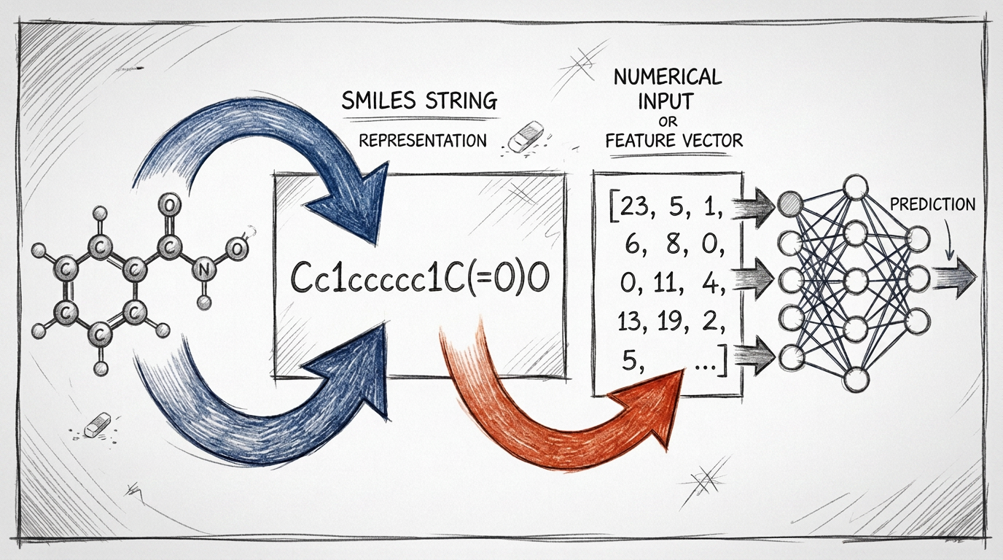

Chemical Representations for Machine Learning
J. Schleinitz · Monday, August 10, 2026 · RSC 275, Caltech
AI4ChemicalSciences BootCamp 2026

Slide 2
Plan
• Evolution of “data-driven” chemistry
• Overview of existing representations
• Importance of the choice of the representation
• Data preprocessing: practical considerations
• Data visualization
AI4ChemicalSciences BootCamp 2026

Slide 3
Ideas of what needs to be treated here
Standardization?
AI4ChemicalSciences BootCamp 2026

Slide 4
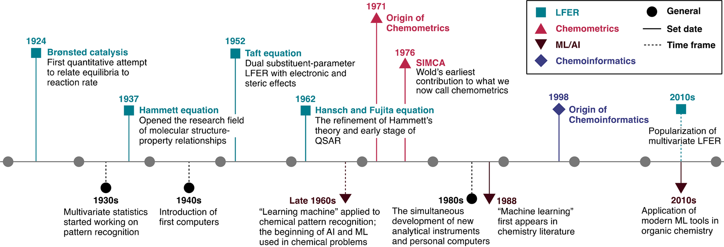
Evolution of Data-Driven Chemistry
Variational Auto Encoders
2016
(8/12)
Hammett
1937
SMILES
1988
Extended Connectivity Fingerprints
2010
Graph Neural Networks
2015
(8/12)
Transformers
2019
(8/18)
Figure adapted from Williams, W. L.; Zeng, L.; Gensch, T.; Sigman, M. S.; Doyle, A. G.; Anslyn, E. V. ACS Cent. Sci. 2021, 7 (10), 1622–1637
AI4ChemicalSciences BootCamp 2026

Slide 5
History of open-source datasets availability
PDB
Protein Structures
250 k
CSD
ICSD
Crystal Structures
1.7 m
USPTO reaction
dataset (Lowe)
Open Reaction
Database (ORD)
Reactions (open)
2.0 m
CAS Registry
computerized
SciFinder
Reaxys platform
Reactions (proprietary)
150 m
SDBS
Pistachio
(NextMove)
Spectroscopy
10k - 1m
NIST/Wiley
2008
ChEMBL
ZINC22
Bioactivity
2.9 m
OQMD
PubChem
2004
Materials
50 k
Materials Project
OMol25
Computed / simulated
140 m
QM9
ANI-1
OC20
1970
1980
1990
2000
2010
2020
Open / free access
Proprietary / restricted access
AI4ChemicalSciences BootCamp 2026

Slide 6
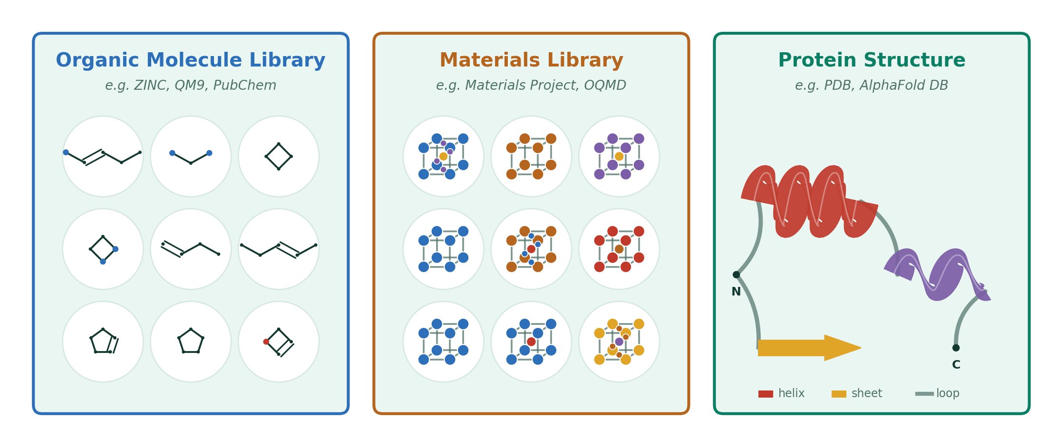
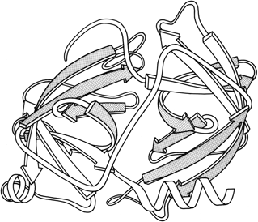
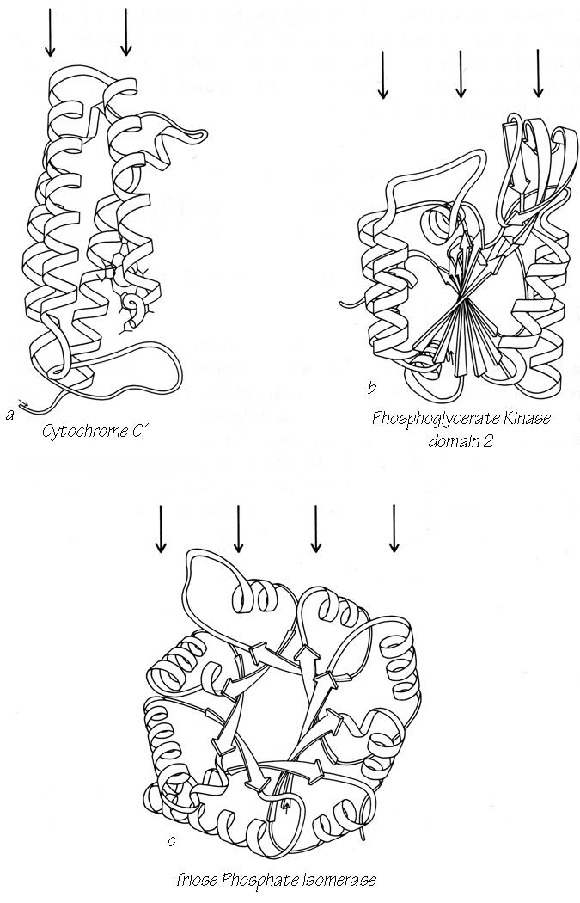
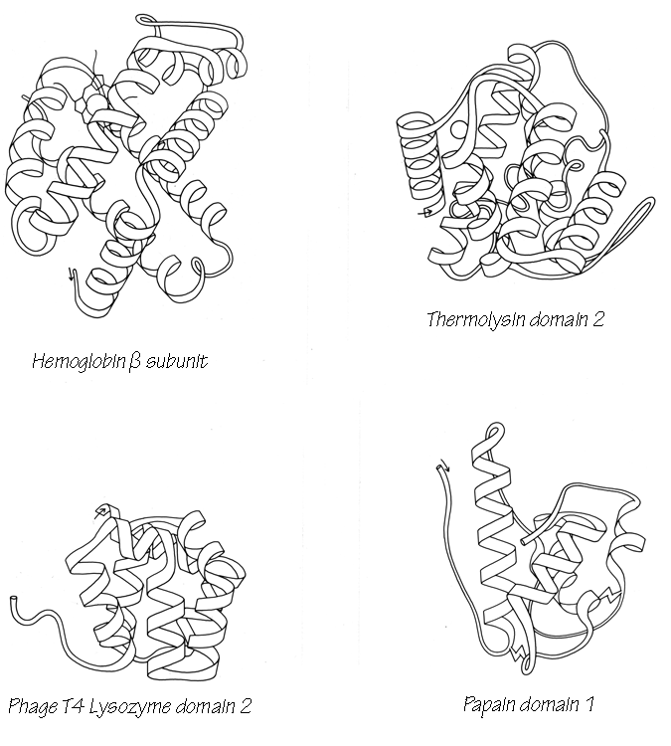
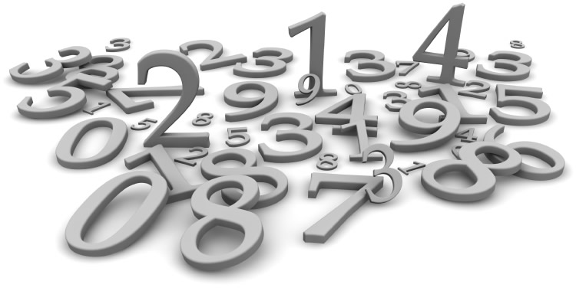
The need for molecular representations
Optimize
Function/Property
Representation
information the model has on top of the data – choices to make – never neutral!
Understand
Structure Activity Relationship
AI4ChemicalSciences BootCamp 2026

Slide 7
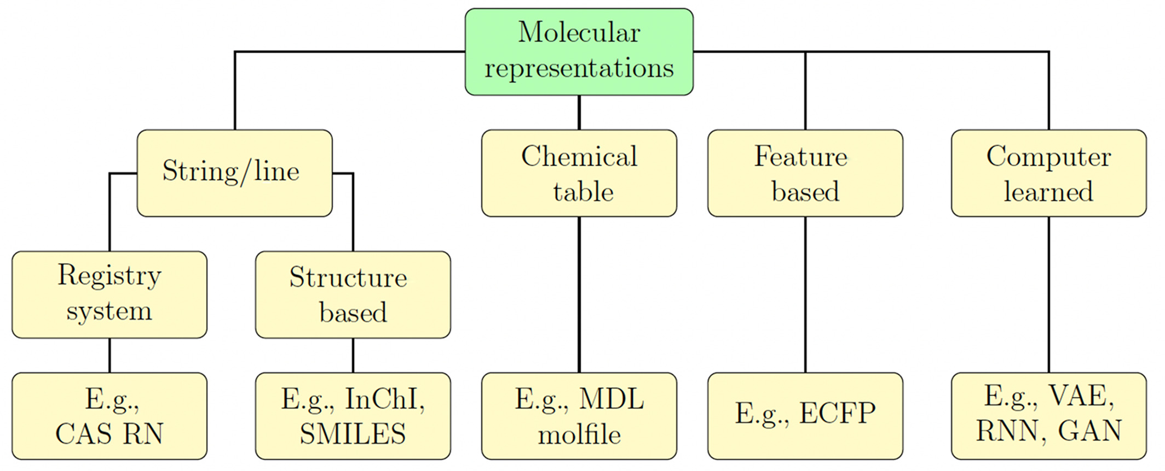
Type of molecular representations
Text-based
Numerical
Numerical representations are often called “descriptors” or “features”
Wigh, D. S.; Goodman, J. M.; Lapkin, A. A. WIREs Comput Mol Sci 2022, 12 (5).
AI4ChemicalSciences BootCamp 2026

Slide 8
History of open-source datasets availability
PDB
Protein Structures
250 k
CSD
ICSD
Crystal Structures
1.7 m
USPTO reaction
dataset (Lowe)
Open Reaction
Database (ORD)
Reactions (open)
2.0 m
CAS Registry
computerized
SciFinder
Reaxys platform
Reactions (proprietary)
VAEs
2016
150 m
SDBS
Pistachio
(NextMove)
Spectroscopy
10k - 1m
NIST/Wiley
2008
ChEMBL
ZINC22
Hammett
1937
GNNs
2015
Bioactivity
SMILES
1988
2.9 m
OQMD
PubChem
2004
Materials
Transformers
2019
50 k
Materials Project
OMol25
Computed / simulated
Fingerprints
2010
140 m
QM9
ANI-1
OC20
1970
1980
1990
2000
2010
2020
Open / free access
Proprietary / restricted access
AI4ChemicalSciences BootCamp 2026

Slide 9
The Evolution of Data-driven Chemistry
Variational Auto Encoders
2016
(8/12)
Hammett
1937
SMILES
1988
Extended Connectivity Fingerprints
2010
Graph Neural Networks
2015
(8/12)
Transformers
2019
(8/18)
Figure adapted from Williams, W. L.; Zeng, L.; Gensch, T.; Sigman, M. S.; Doyle, A. G.; Anslyn, E. V. ACS Cent. Sci. 2021, 7 (10), 1622–1637
AI4ChemicalSciences BootCamp 2026

Slide 10
Plan
• Evolution of “data-driven” chemistry
• Overview of existing representations
• Importance of the choice of the representation
• Data preprocessing: practical considerations
• Data visualization
AI4ChemicalSciences BootCamp 2026

Slide 11
String based representations are usually the starting point
Small size
Easy to use
Potential missing Information
Wigh, D. S.; Goodman, J. M.; Lapkin, A. A. WIREs Comput Mol Sci 2022, 12 (5).
AI4ChemicalSciences BootCamp 2026

Slide 12
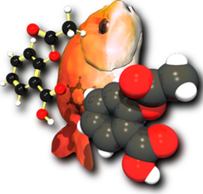

String line representations for small molecules: SMILES
SMILES — Simplified Molecular-Input Line-Entry System
SMILES Manipulation
OpenBabel
CCC(=O)O
OC(=O)CC
RDKit
1
COc1ccccc1
C1=C[CH]C=C1.C1=C[CH]C=C1.[Fe]
1
https://openbabel.org/index.html
https://www.rdkit.org/
Weininger, D. J. Chem. Inf. Comput. Sci. 1988, 28 (1), 31–36
AI4ChemicalSciences BootCamp 2026

Slide 13
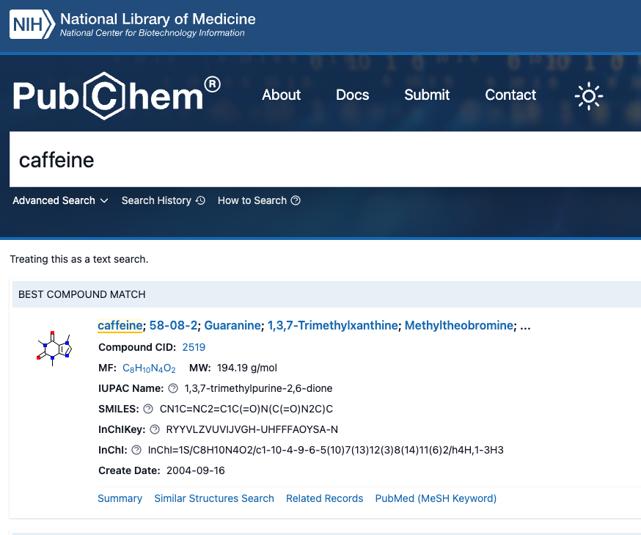
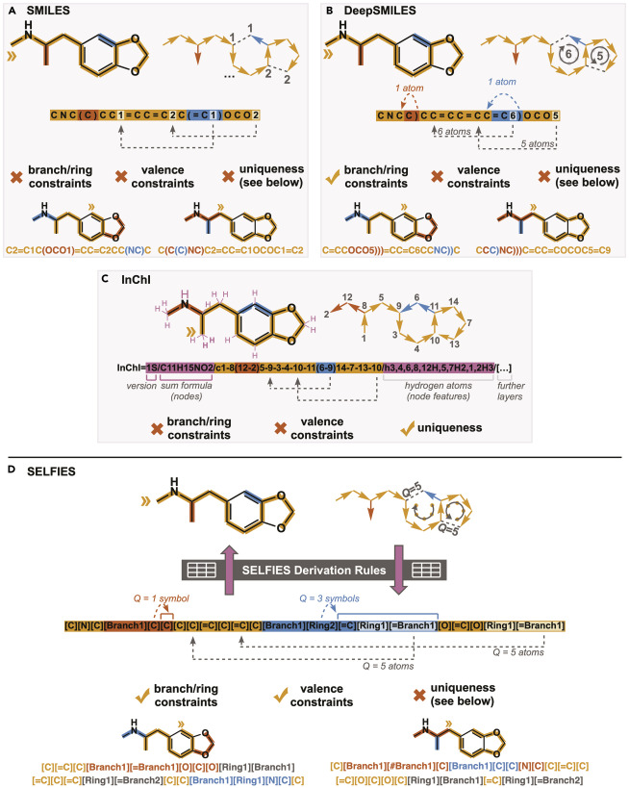
String base representations for small molecules: beyond SMILES
Krenn, M.; Häse, F.; Nigam, A.; Friederich, P.; Aspuru-Guzik, A. Mach. Learn.: Sci. Technol. 2020, 1 (4), 045024.
https://pubchem.ncbi.nlm.nih.gov/
AI4ChemicalSciences BootCamp 2026

Slide 14
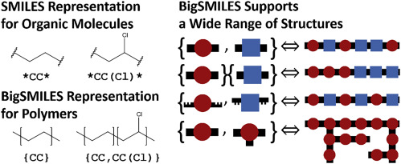
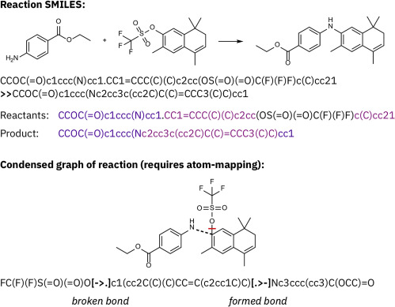
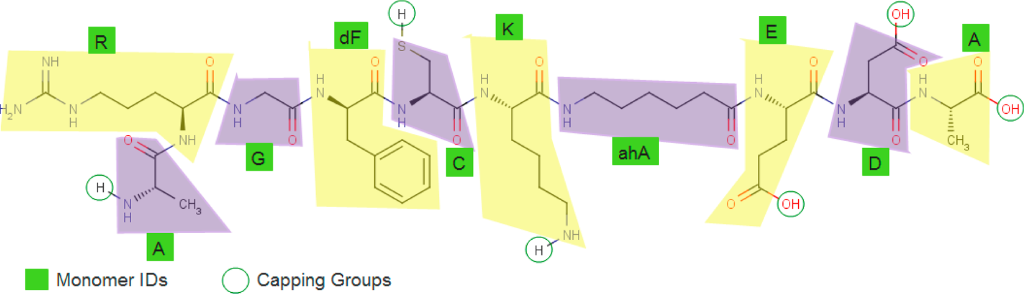
String base representations beyond small molecules
Polymers (BigSMILES)
Materials
SLICES (Simplified Line-Input Crystal-Encoding System)
Wyckoff-position strings
Reactions
Proteins (HELM)
A.R.G.[dF].C.K.[ahA].E.D.A
Krenn, M. et al. Patterns 2022, 3 (10), 100588.
AI4ChemicalSciences BootCamp 2026

Slide 15
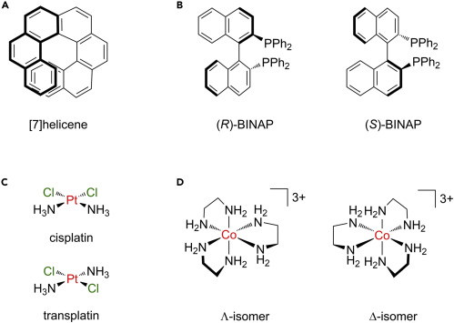
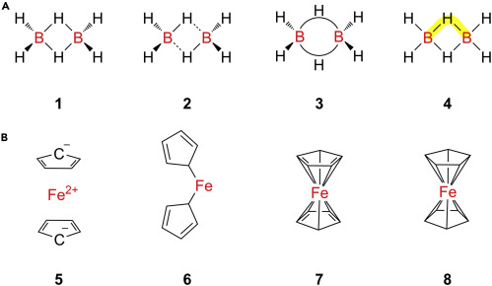
Ongoing issues with string based representations
Stereoisomers
Hapticity
Be aware of representation limitations!
Which information is/is not captured in my representation?
Krenn, M. et al. Patterns 2022, 3 (10), 100588.
AI4ChemicalSciences BootCamp 2026

Slide 16
From String Based Representation to Numeric Representations
Numerisation/Vectorization of the Information
In the literature descriptors or features are both used for “numerical representations”
Wigh, D. S.; Goodman, J. M.; Lapkin, A. A. WIREs Comput Mol Sci 2022, 12 (5).
AI4ChemicalSciences BootCamp 2026

Slide 17
Descriptors Survey
Small Molecule Descriptors
Lipinski
Fingerprints
Experimentally Derived Descriptors
Computed Descriptors
Predicted Descriptors
Reaction Descriptors
Fingerprints
Energy Surfaces
Concatenation of Molecular Descriptors
AI4ChemicalSciences BootCamp 2026

Slide 18
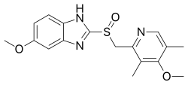
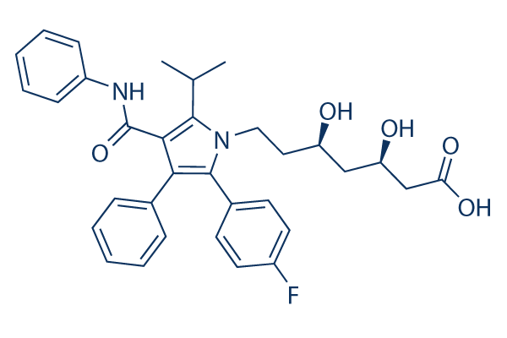
Numeric representations: Small Molecules
Lipinski’s rule of 5 for drug likeness:
• No more than 5 hydrogen bond donors
• No more than 10 hydrogen bonds acceptors
• Molecular mass less than 500 daltons
• Partition coefficient water-octanol (ClogP) < 5
• 1
• 5
• 345 g/mol
• 2.3 – 2.6
Omeprazole
Atorvastatin
• 4
• 56
• 559 g/mol
• 2.2 – 2.56
AI4ChemicalSciences BootCamp 2026

Slide 19
Descriptors Survey
Small Molecule Descriptors
Lipinski
Fingerprints
Experimentally Derived Descriptors
Computed Descriptors
Predicted Descriptors
Reaction Descriptors
Fingerprints
Energy Surfaces
Concatenation of Molecular Descriptors
AI4ChemicalSciences BootCamp 2026

Slide 20


Numeric representations: Small Molecules
Molecular Fingerprints Developed for Quantitative Structure Activity Relationships (QSAR):
CN1C=NC2=C1C(=O)N(C(=O)N2C)C
Advantages:
Very fast to compute
Tanimoto/Jaccard similarity
Information encoded:
2D structure/connectivity
Stereochemistry
No 3D information
No conformers
AI4ChemicalSciences BootCamp 2026

Slide 21
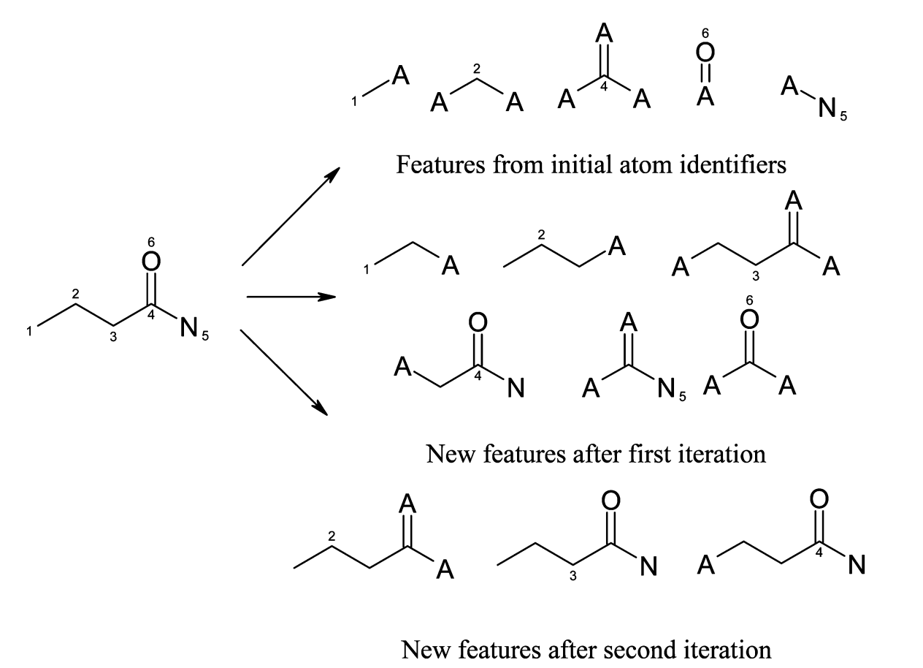
Numeric representations: Small Molecules
Extended Connectivity Fingerprints (ECFPs):
Radius 0
Radius 1
Radius 2
Rogers, D.; Hahn, M. J. Chem. Inf. Model. 2010, 50 (5), 742–754
More on FPs generation: https://greglandrum.github.io/rdkit-blog/posts/2023-01-18-fingerprint-generator-tutorial.html
AI4ChemicalSciences BootCamp 2026

Slide 22
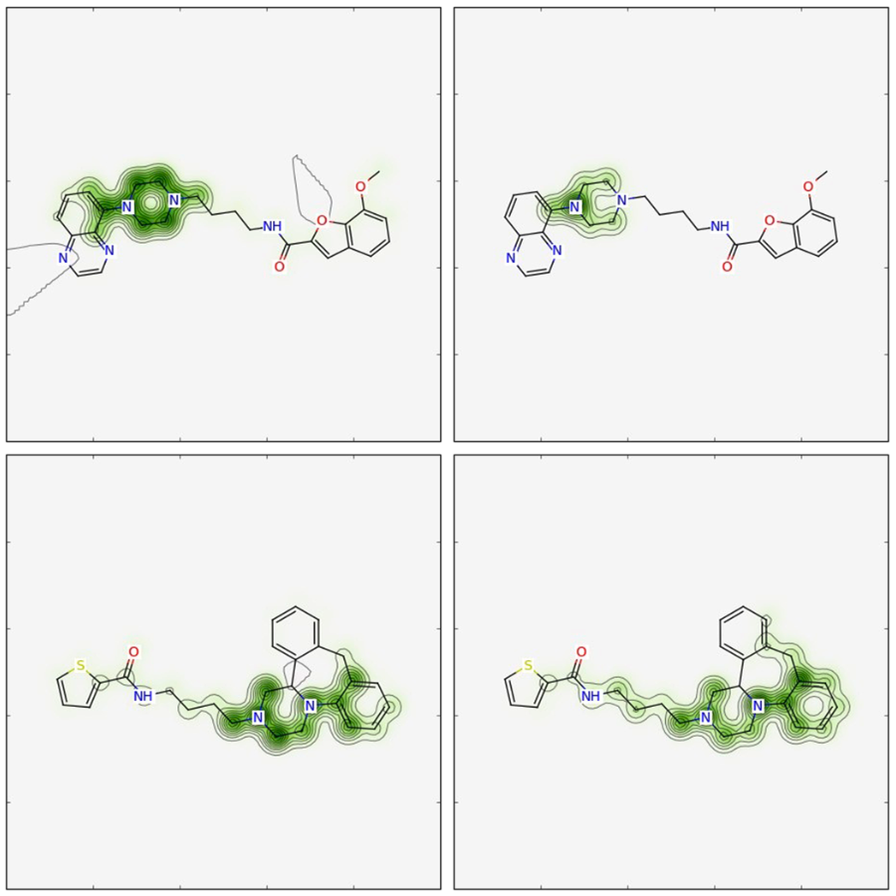
Application ECFPs for QSAR
Δpred visualization
mol1
FP
bioactivity
(predicted)
virtual
atom ablation
Δpred
new FP
new bioactivity
(predicted)
mol2
FP A
FP B
Riniker, S.; Landrum, G. A. J Cheminform 2013, 5 (1).
AI4ChemicalSciences BootCamp 2026

Slide 23
Recap on Molecular Fingerprints
When to use:
Good for a fast baseline small molecules activity
Efficient with relatively small datasets (100 – 10k molecules)
When not to use:
Properties/Activities depend on 3-D shape or conformers
Very small datasets
Non-organic molecules/other chemical systems
AI4ChemicalSciences BootCamp 2026

Slide 24
From String Based Representation to Numeric Representations
Numerisation/Vectorization of the Information
Wigh, D. S.; Goodman, J. M.; Lapkin, A. A. WIREs Comput Mol Sci 2022, 12 (5).
AI4ChemicalSciences BootCamp 2026

Slide 25
Descriptors Survey
Small Molecule Descriptors
Lipinski
Fingerprints
Experimentally Derived Descriptors
Computed Descriptors
Predicted Descriptors
Reaction Descriptors
Fingerprints
Energy Surfaces
Concatenation of Molecular Descriptors
AI4ChemicalSciences BootCamp 2026

Slide 26
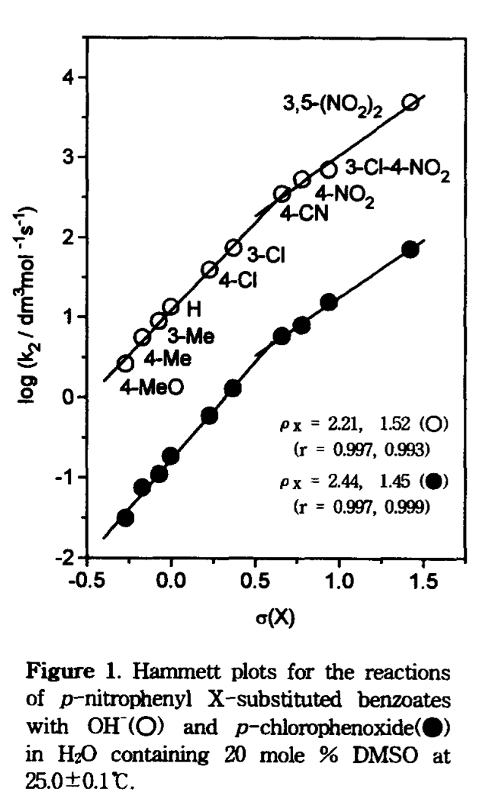
Feature Based Representations: Experimental Descriptors
Hammett descriptors:
Advantages:
Mechanism interpretability
Condensed information
Small dataset interpretability
Limitations:
Specific electronic effects
Availability
Um, I.-H.; Chung, E.-K.; Kwon, D.-S. Tetrahedron Letters 1997, 38 (27), 4787–4790.
AI4ChemicalSciences BootCamp 2026

Slide 27
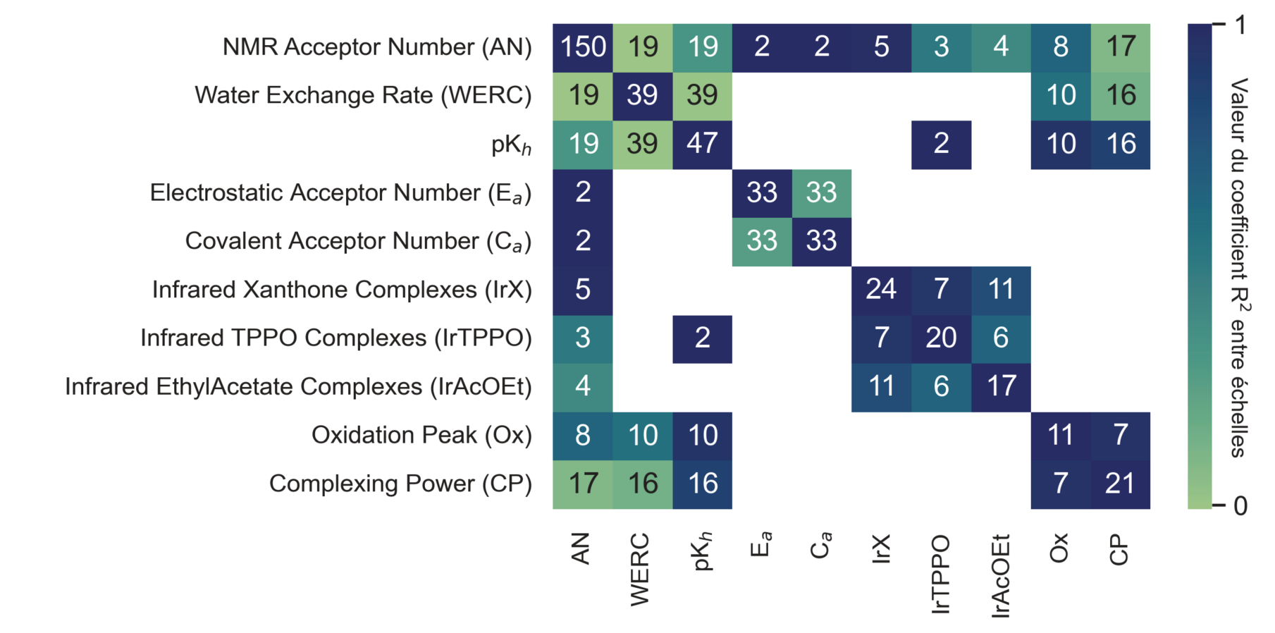
Feature Based Representations: Experimental Descriptors
Predicting Lewis Acid Base Affinity with Experimental Descriptors
Advantages:
Mechanism interpretability
Condensed information
Small dataset interpretability
Limitations:
Specific electronic effects
Availability of experimental descriptors
Today:
Computed descriptors
J. Schleinitz, https://theses.hal.science/tel-05018662
AI4ChemicalSciences BootCamp 2026

Slide 28
Descriptors Survey
Small Molecule Descriptors
Lipinski
Fingerprints
Experimentally Derived Descriptors
Computed Descriptors
Predicted Descriptors
Reaction Descriptors
Fingerprints
Energy Surfaces
Concatenation of Molecular Descriptors
AI4ChemicalSciences BootCamp 2026

Slide 29
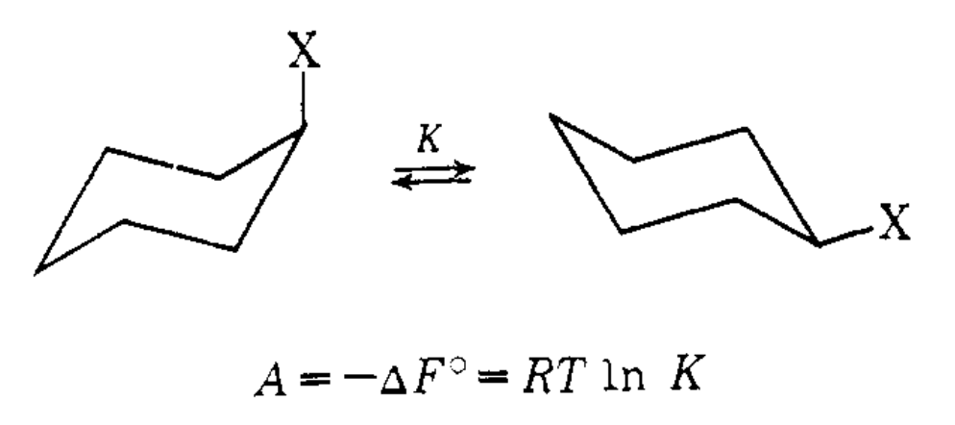
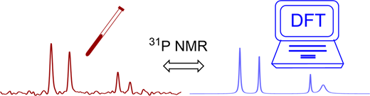
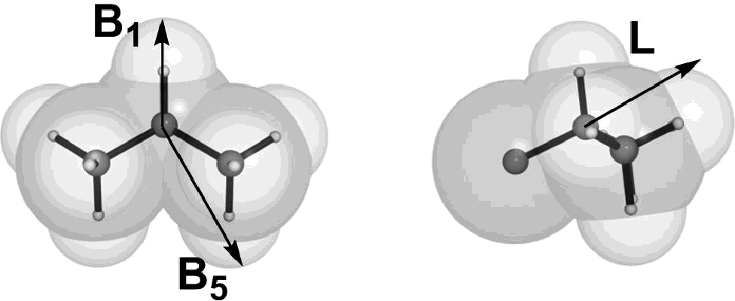
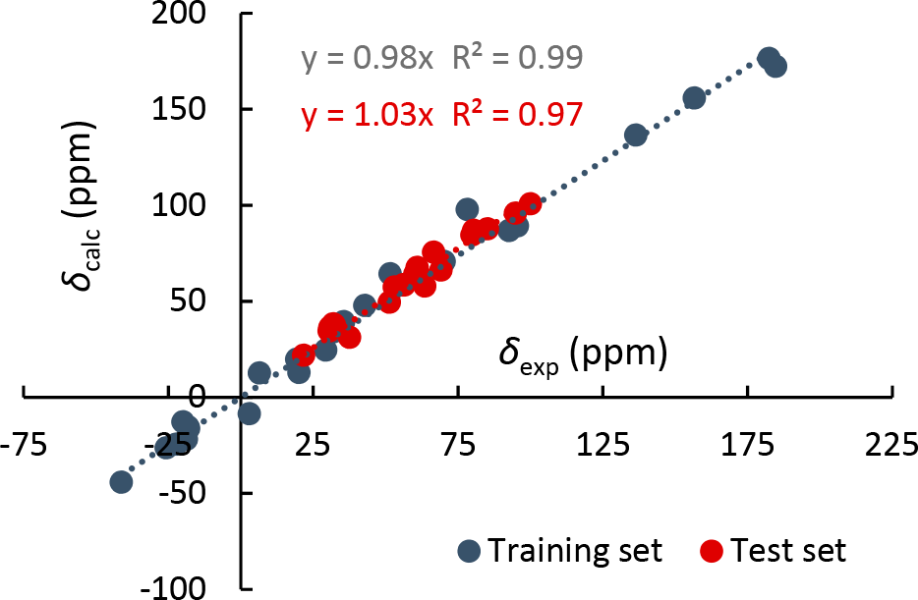
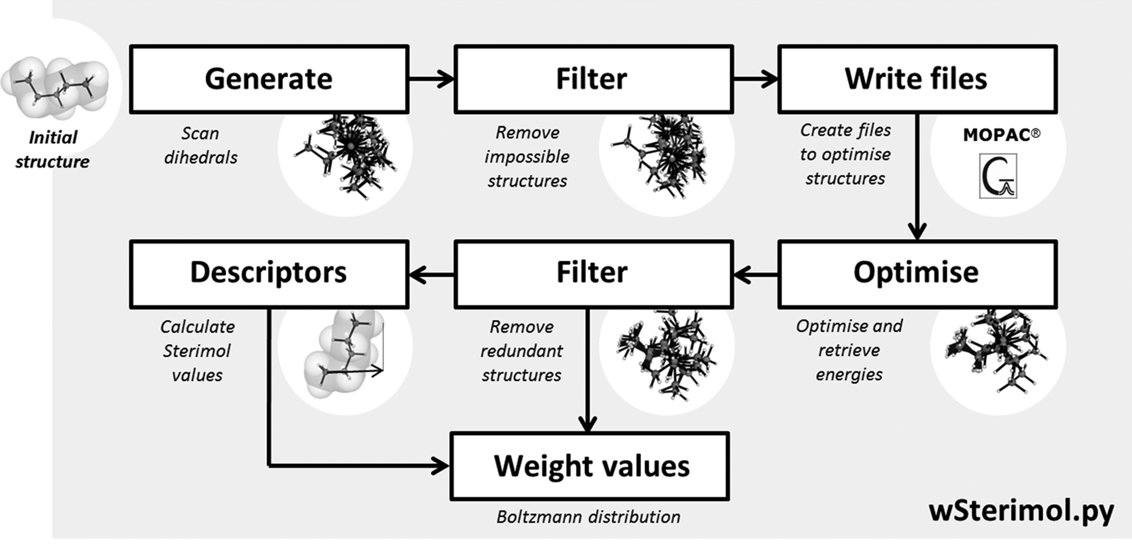
Feature Based Representations: Computed Descriptors
Phosphine Featurization by DFT:
Steric Effects:
Sterimol Descriptors:
Geometries optimized at the B3LYP/BS1 level of theory. ³¹P NMR shielding constants were evaluated with the GIAO method at the B3LYP/BS2 level of theory.
Payard, P.-A.; Perego, L. A.; Grimaud, L.; Ciofini, I. Organometallics 2020, 39 (17), 3121–3130.
Jensen, F. R.; Bushweller, C. H.; Beck, B. H. J. Am. Chem. Soc. 1969, 91(2), 344–351
Brethomé, A. V.; Fletcher, S. P.; Paton, R. S. ACS Catal. 2019, 9 (3), 2313–2323.
AI4ChemicalSciences BootCamp 2026

Slide 30
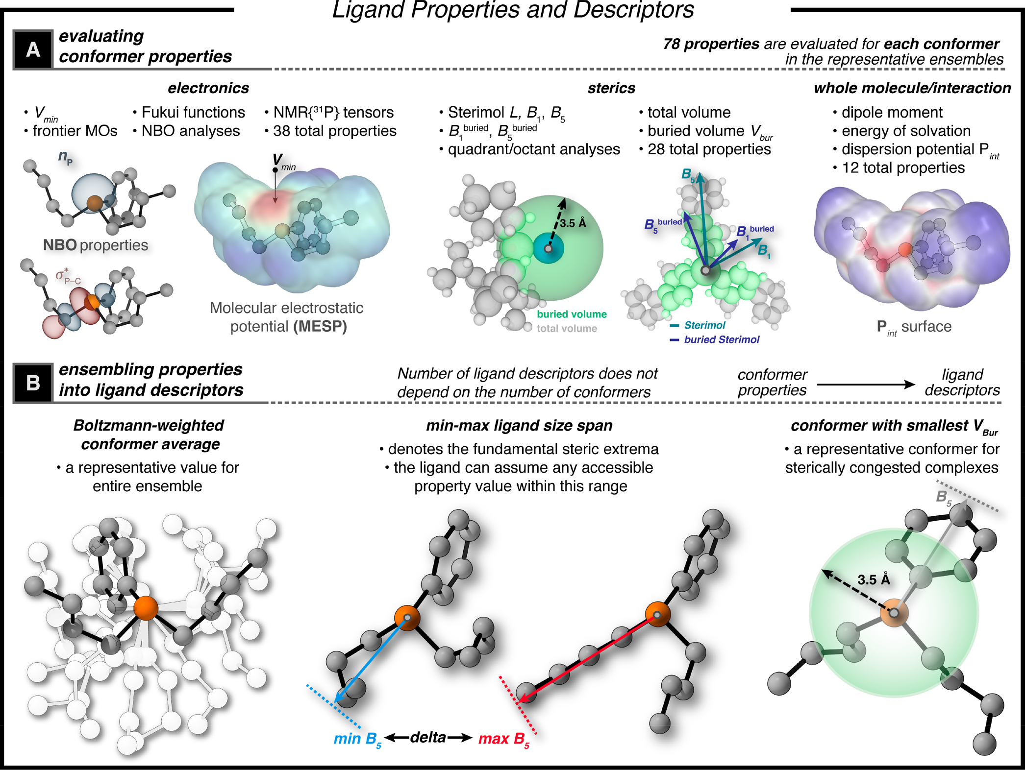
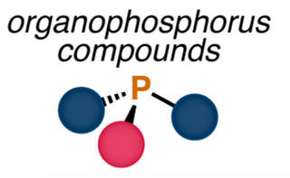
Feature Based Representations: Descriptors Libraries
1
2
1,558 ligands
Conformer ensemble
generation
Descriptor
Database
Gensch, T.; […] Sigman, M. S.; Aspuru-Guzik, A. J. Am. Chem. Soc. 2022, 144 (3), 1205–1217.
https://descriptor-libraries.molssi.org/
AI4ChemicalSciences BootCamp 2026

Slide 31
Feature Based Representations: Towards Predicted Descriptors
Cost/Practicality
Experimental
Computed
Accuracy
Customizability
Force
Field
ML
surrogate
UTOPIA
xTB
Cost
Pareto front
DFT
CCSD(T)
AI4ChemicalSciences BootCamp 2026

Slide 32
Descriptors Survey
Small Molecule Descriptors
Lipinski
Fingerprints
Experimentally Derived Descriptors
Computed Descriptors
Predicted Descriptors
Reaction Descriptors
Fingerprints
Energy Surfaces
Concatenation of Molecular Descriptors
AI4ChemicalSciences BootCamp 2026

Slide 33
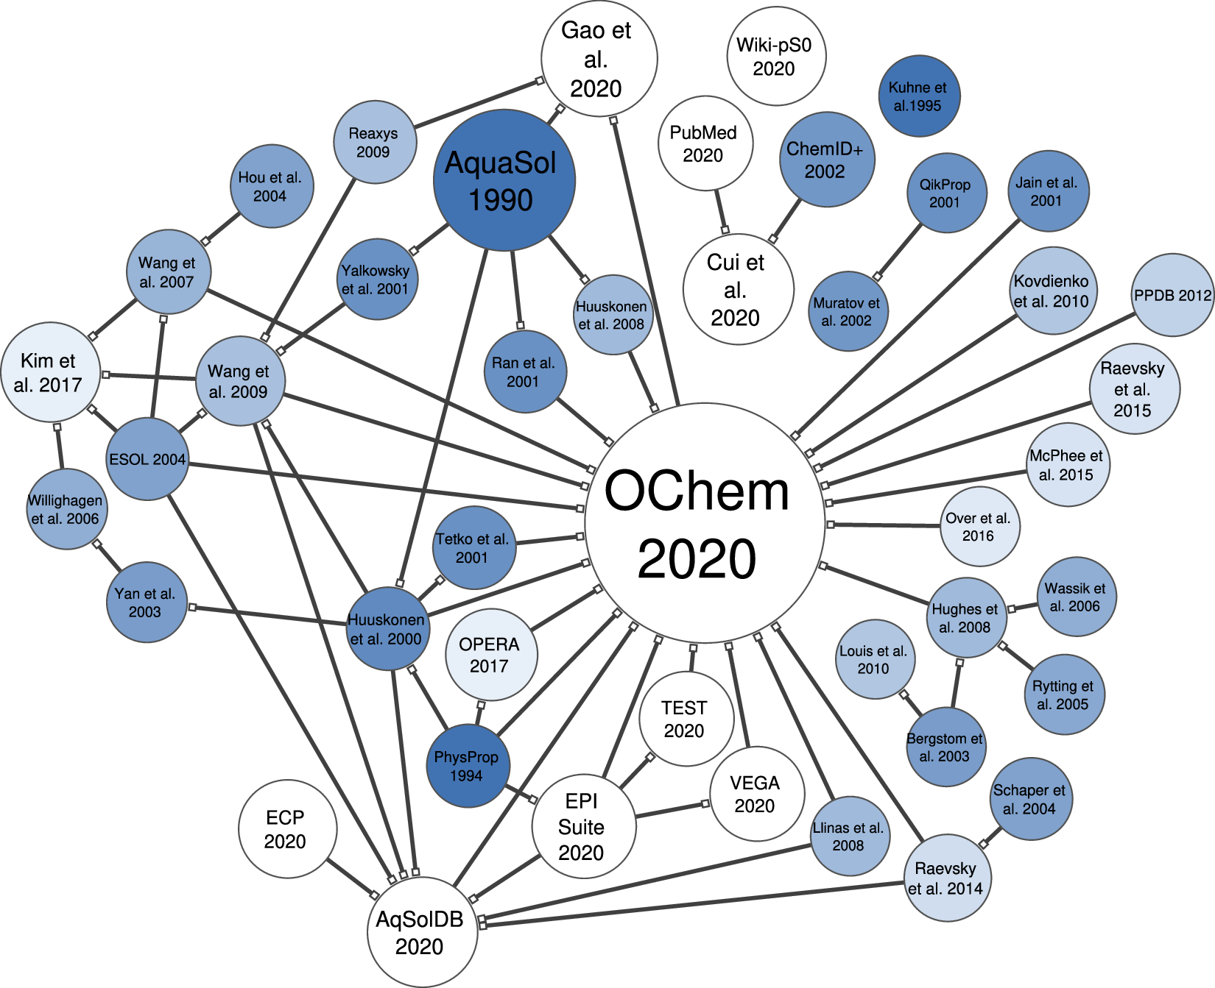
Examples of ML-Surrogates For Descriptor Generation
MLIPs for Geometry Optimization (Wednesday!)
BDE predictions:
• BondNET charged species
• Alfabet (homolytic neutral molecules)
• UMA
• MACE
• AIMNET
Solubility:
pKa predictions:
MolGpKa (https://xundrug.cn/molgpka)
Llompart, P.; Minoletti, C.; Baybekov, S.; Horvath, D.; Marcou, G.; Varnek, A. Sci Data 2024, 11 (1)
AI4ChemicalSciences BootCamp 2026

Slide 34
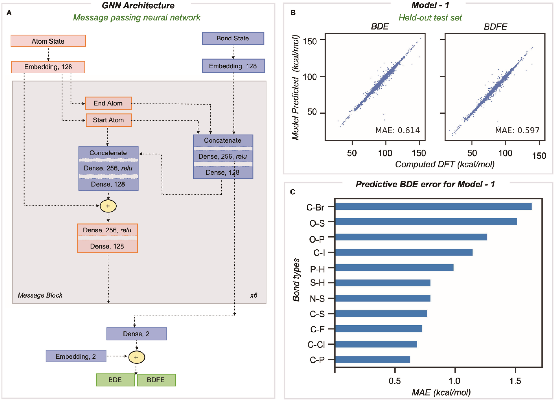
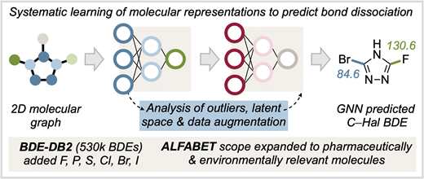
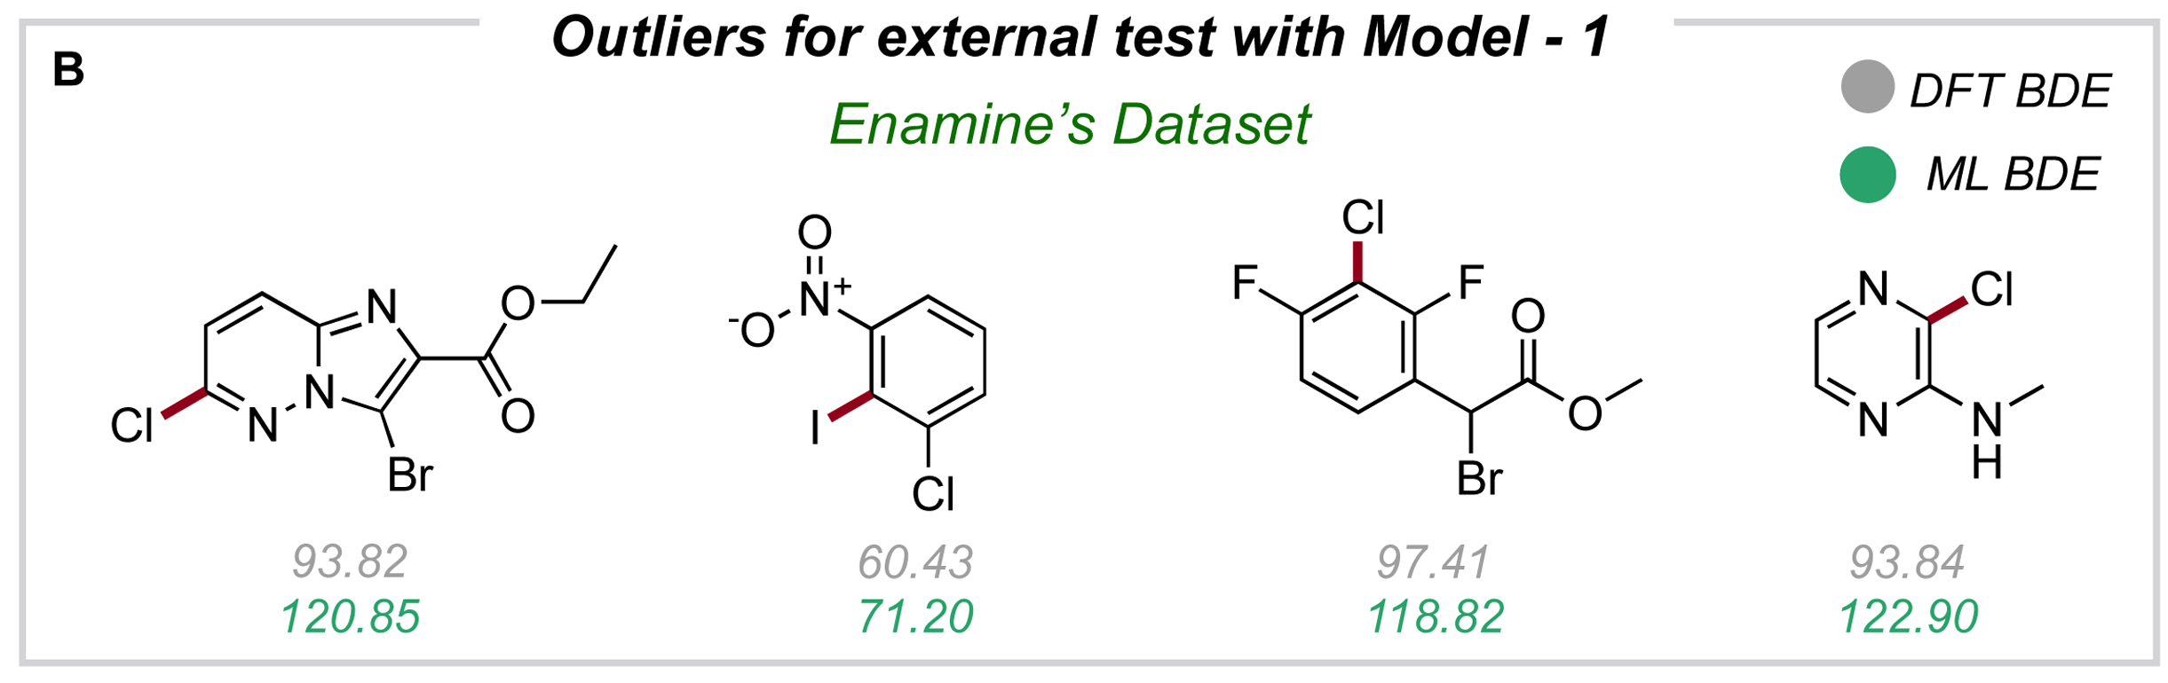
Expert Crafted Descriptors: Using ML models
Validation and Domain of Applicability
Prediction of BDEs using ML:
ML pipeline:
Always evaluate validity
Recompute some data points with the high accuracy method for important points!
S. V., S. S.; Kim, Y.; Kim, S.; St. John, P. C.; Paton, R. S. Digital Discovery 2023, 2 (6), 1900–1910.
AI4ChemicalSciences BootCamp 2026
ML pipeline:

Slide 35
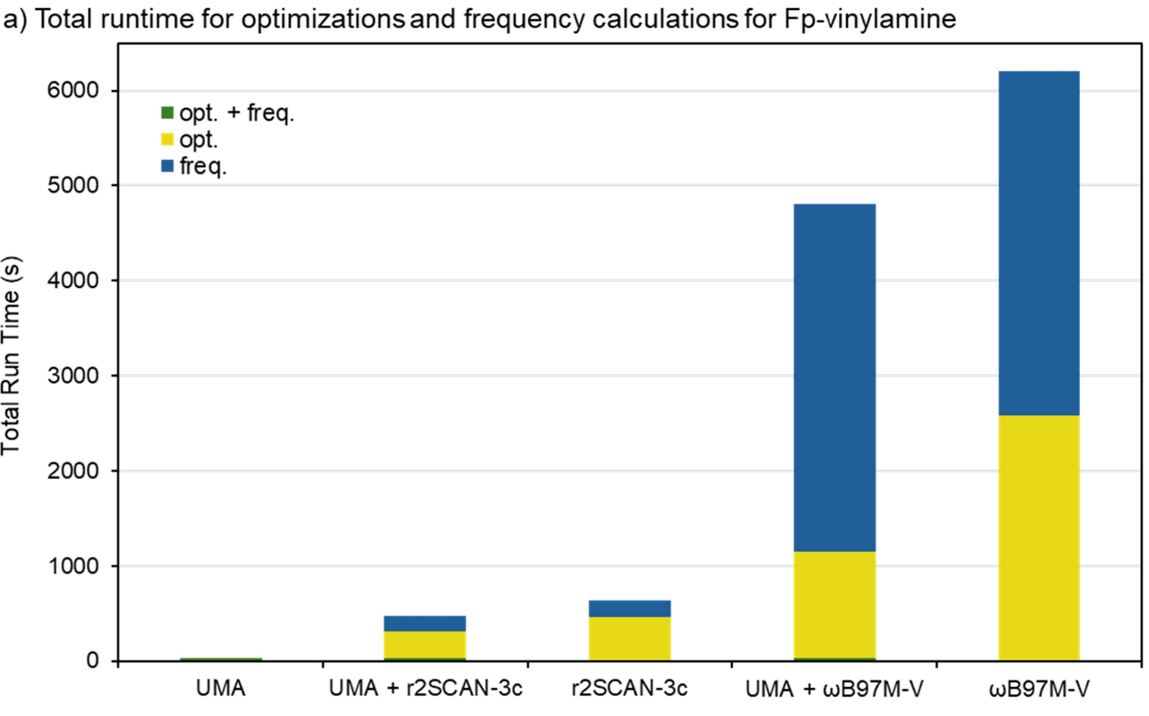
Expert Crafted Descriptors: Using ML models
Machine Learning Interatomic Potentials as DFT surrogate (Structure Optimization/Energy Calculation):
Closed shell
Open shell
>99% reduction compute
Quirion, K. P.; Kong, W.-Y.; Stanley, B.; Joy, J.; Ess, D. H. ACS Catal. 2026. 16 (9): 8053–8066.
AI4ChemicalSciences BootCamp 2026

Slide 36
Expert Crafted Descriptors: Using ML models
Computed
Accuracy
Force
Field
ML
surrogate
UTOPIA
Ab-initio or semi-empirical computational tools have identifiable flaws/literature experience.
ML surrogates are less predictable: Good usage practice:
Benchmark few points vs DFT/reference method
Understand/evaluate domain of applicability
xTB
Cost
Pareto front
DFT
CCSD(T)
AI4ChemicalSciences BootCamp 2026

Slide 37
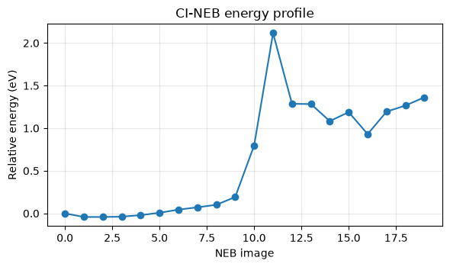
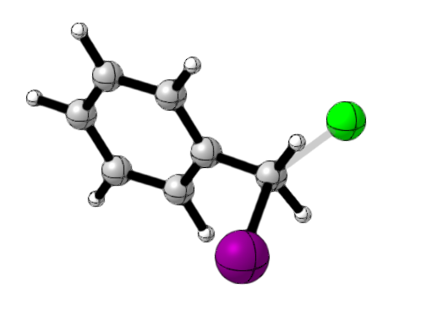
Expert-Crafter Descriptors: Precision/Generalizability Trade-off
Transition states
Descriptors for modeling rates of SN₂ ?
Graph
k_{Nu, LG}
Generalizability
Cost
molecular descriptors
atomic descriptors
Data efficiency – expert bias
AI4ChemicalSciences BootCamp 2026

Slide 38
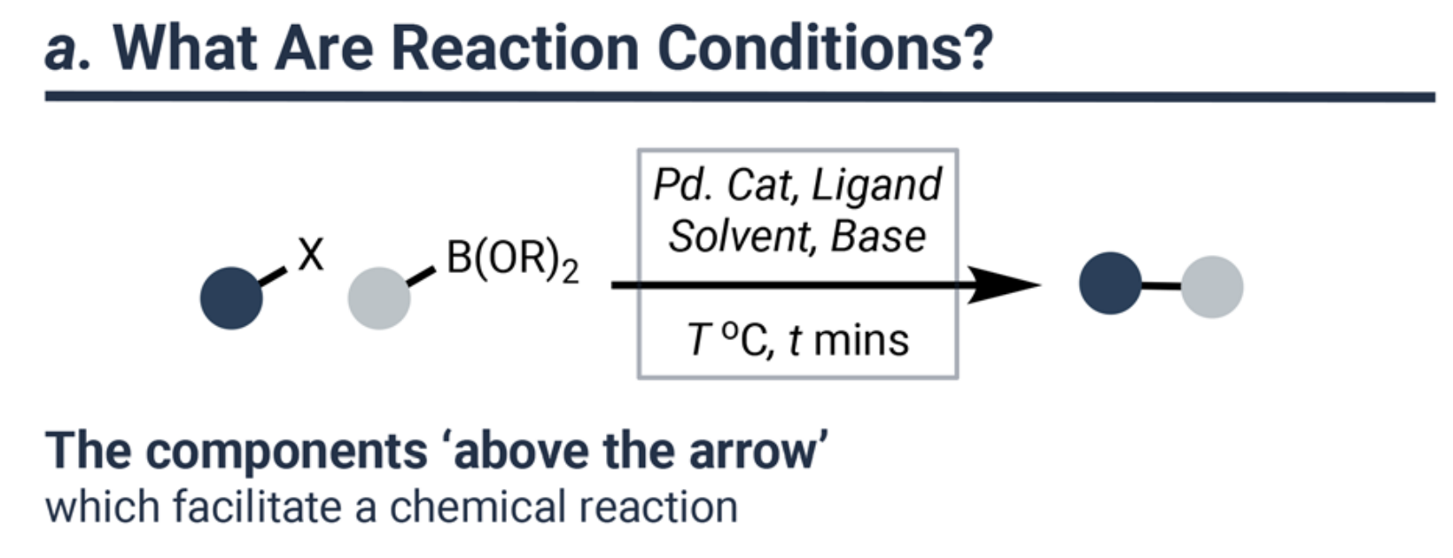
Multi-parameter/Combinatorial Chemical Systems
Example of Organic Reaction Conditions
Concatenate descriptors of reactant, conditions and product
Encode the reaction as a whole
Ball, M.; Horvath, D.; Kogej, T.; Kabeshov, M.; Varnek, A. Predicting Reaction Conditions: A Data-Driven Perspective. Chem. Sci. 2025, 16 (38), 17523–17541.
AI4ChemicalSciences BootCamp 2026

Slide 39
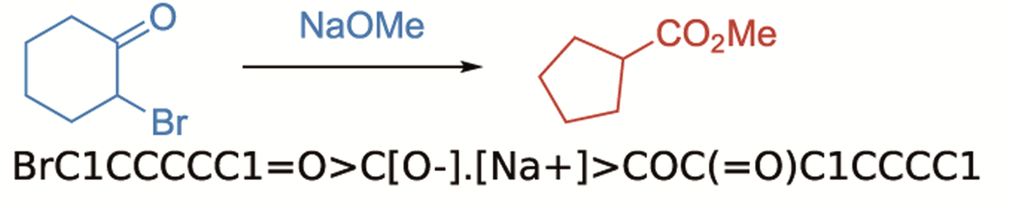
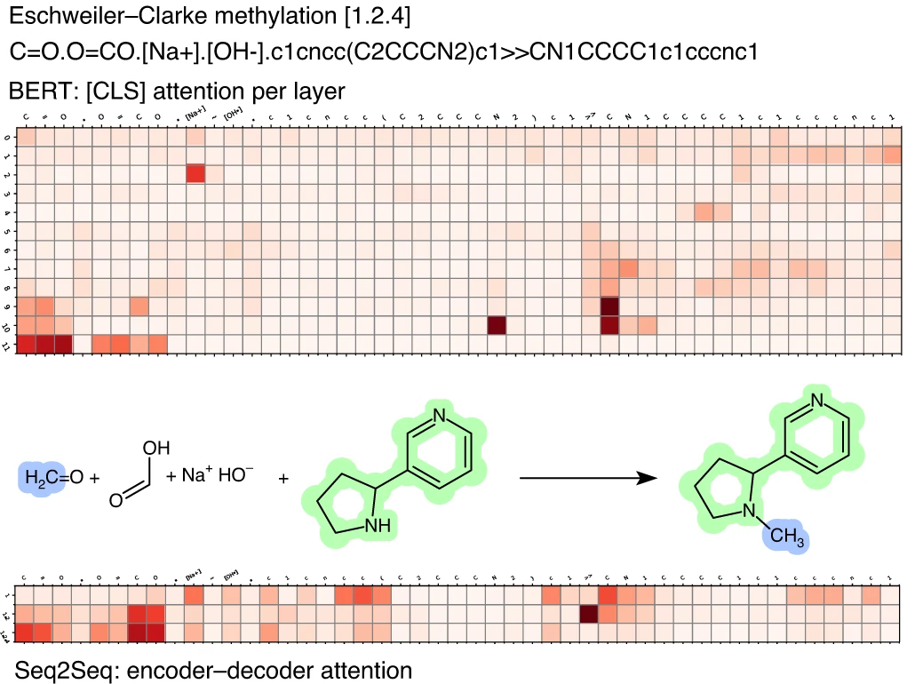
Multi-parameter/Combinatorial Chemical Systems: Organic Reactions
Encode the reaction as a whole:
Reaction SMILES:
Differential Reaction Fingerprints
Advantages:
• Universal
• Interpretable (DRFP)
Disadvantages:
• Coarse grained information
• Requires large datasets
Learned Encoding (Transformers)
Schneider, N.; Lowe, D. M.; Sayle, R. A.; Landrum, G. A. J. Chem. Inf. Model. 2015, 55 (1), 39–53. / Probst, D.; Schwaller, P.; Reymond, J.-L. Digital Discovery 2022, 1 (2), 91–97.
Schwaller, P.; Laino, T.; Gaudin, T.; Bolgar, P.; Hunter, C. A.; Bekas, C.; Lee, A. A. ACS Cent. Sci. 2019, 5 (9), 1572–1583. /
AI4ChemicalSciences BootCamp 2026

Slide 40
Multi-parameter/Combinatorial Chemical Systems: Organic Reactions
Encode the reaction as a whole:
Reaction SMILES:
Differential Reaction Fingerprints
Advantages:
• Universal
• Interpretable (DRFP)
Disadvantages:
• Coarse grained information
• Requires large datasets
Learned Encoding (Transformers)
Schneider, N.; Lowe, D. M.; Sayle, R. A.; Landrum, G. A. J. Chem. Inf. Model. 2015, 55 (1), 39–53. / Probst, D.; Schwaller, P.; Reymond, J.-L. Digital Discovery 2022, 1 (2), 91–97.
Schwaller, P.; Laino, T.; Gaudin, T.; Bolgar, P.; Hunter, C. A.; Bekas, C.; Lee, A. A. ACS Cent. Sci. 2019, 5 (9), 1572–1583. /
AI4ChemicalSciences BootCamp 2026

Slide 41
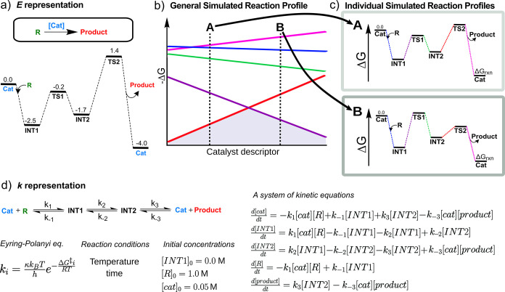
Multi-parameter/Combinatorial Chemical Systems: Organic Reactions
Encode the reaction as a whole:
Advantages:
• Captures subtle reactivity trends
• Transferable between catalysts
Disadvantages:
• Mechanism must be known/constant
• Computationally costly
• Only encodes catalyst
Worakul, T.; Laplaza, R.; Das, S.; Wodrich, M. D.; Corminboeuf, C. ACS Catal. 2024, 14 (13), 9829–9839.
AI4ChemicalSciences BootCamp 2026

Slide 42
Multi-parameter/Combinatorial Chemical Systems
Example of Organic Reaction Conditions
Concatenate descriptors of reactant, conditions and product
Encode the reaction as a whole
Ball, M.; Horvath, D.; Kogej, T.; Kabeshov, M.; Varnek, A. Predicting Reaction Conditions: A Data-Driven Perspective. Chem. Sci. 2025, 16 (38), 17523–17541.
AI4ChemicalSciences BootCamp 2026

Slide 43
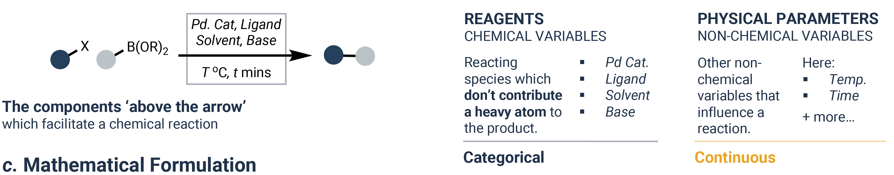
Multi-parameter/Combinatorial Chemical Systems: Organic Reactions
Integrating multiple variables?
solvent
base
additive
Concatenation of features:
Choice of features: choosing the right amount of expert bias to use?
Ball, M.; Horvath, D.; Kogej, T.; Kabeshov, M.; Varnek, A. Predicting Reaction Conditions: A Data-Driven Perspective. Chem. Sci. 2025, 16 (38), 17523–17541.
AI4ChemicalSciences BootCamp 2026

Slide 44
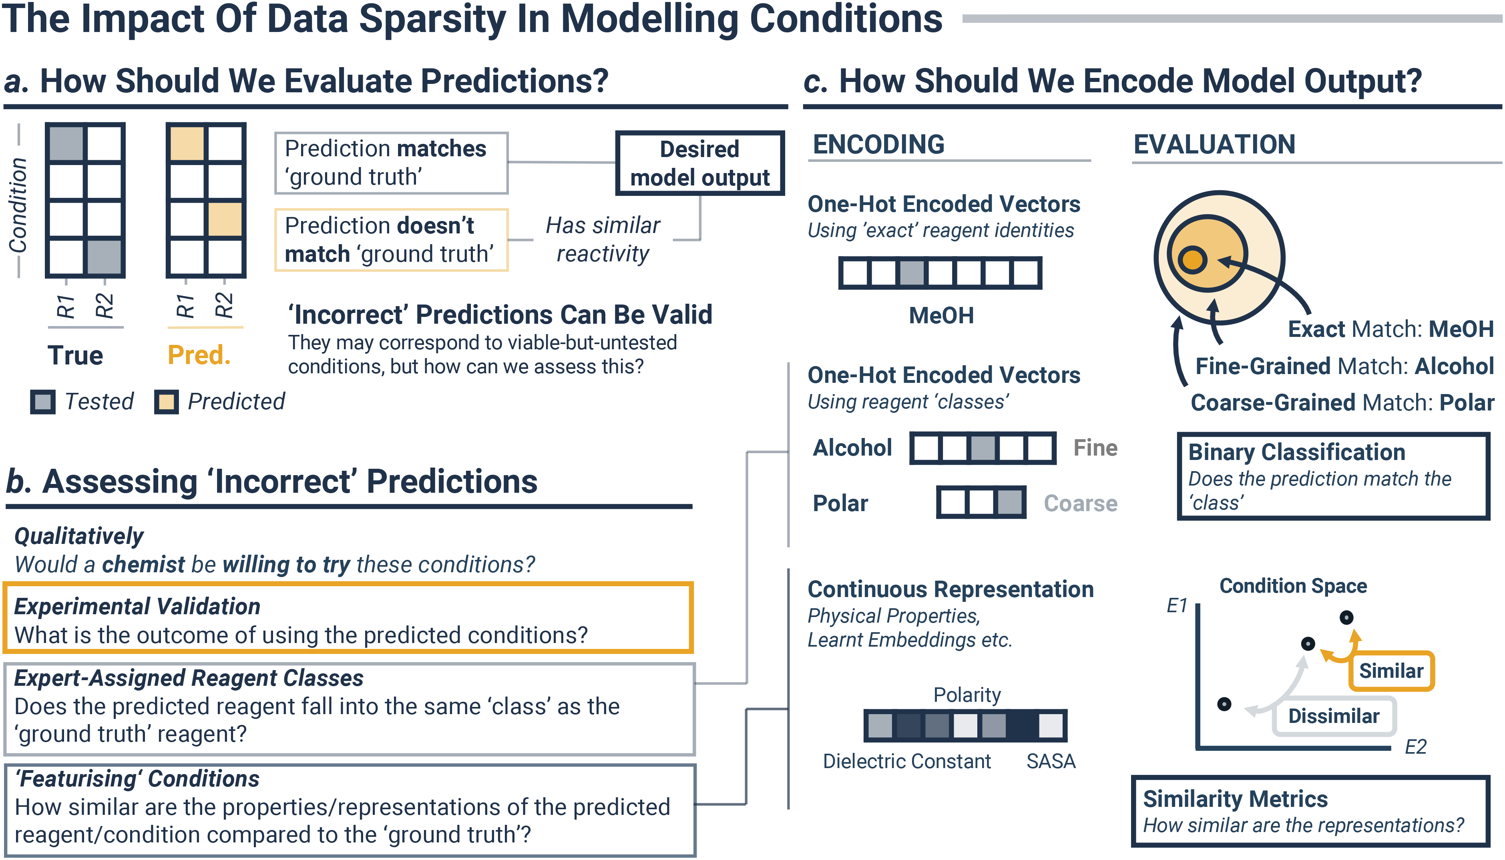
Bias into Engineered descriptors?
Example of solvent encoding
Expert bias / data efficiency (if feature related to property)
Ball, M.; Horvath, D.; Kogej, T.; Kabeshov, M.; Varnek, A. Predicting Reaction Conditions: A Data-Driven Perspective. Chem. Sci. 2025, 16 (38), 17523–17541.
AI4ChemicalSciences BootCamp 2026

Slide 45
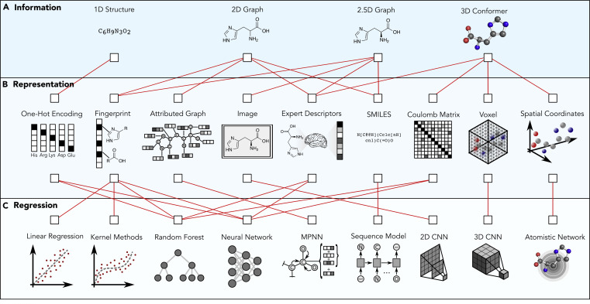
Molecular Representations: Outlook
Pattanaik, L.; Coley, C. W. Chem 2020, 6 (6), 1204–1207.
AI4ChemicalSciences BootCamp 2026

Slide 46
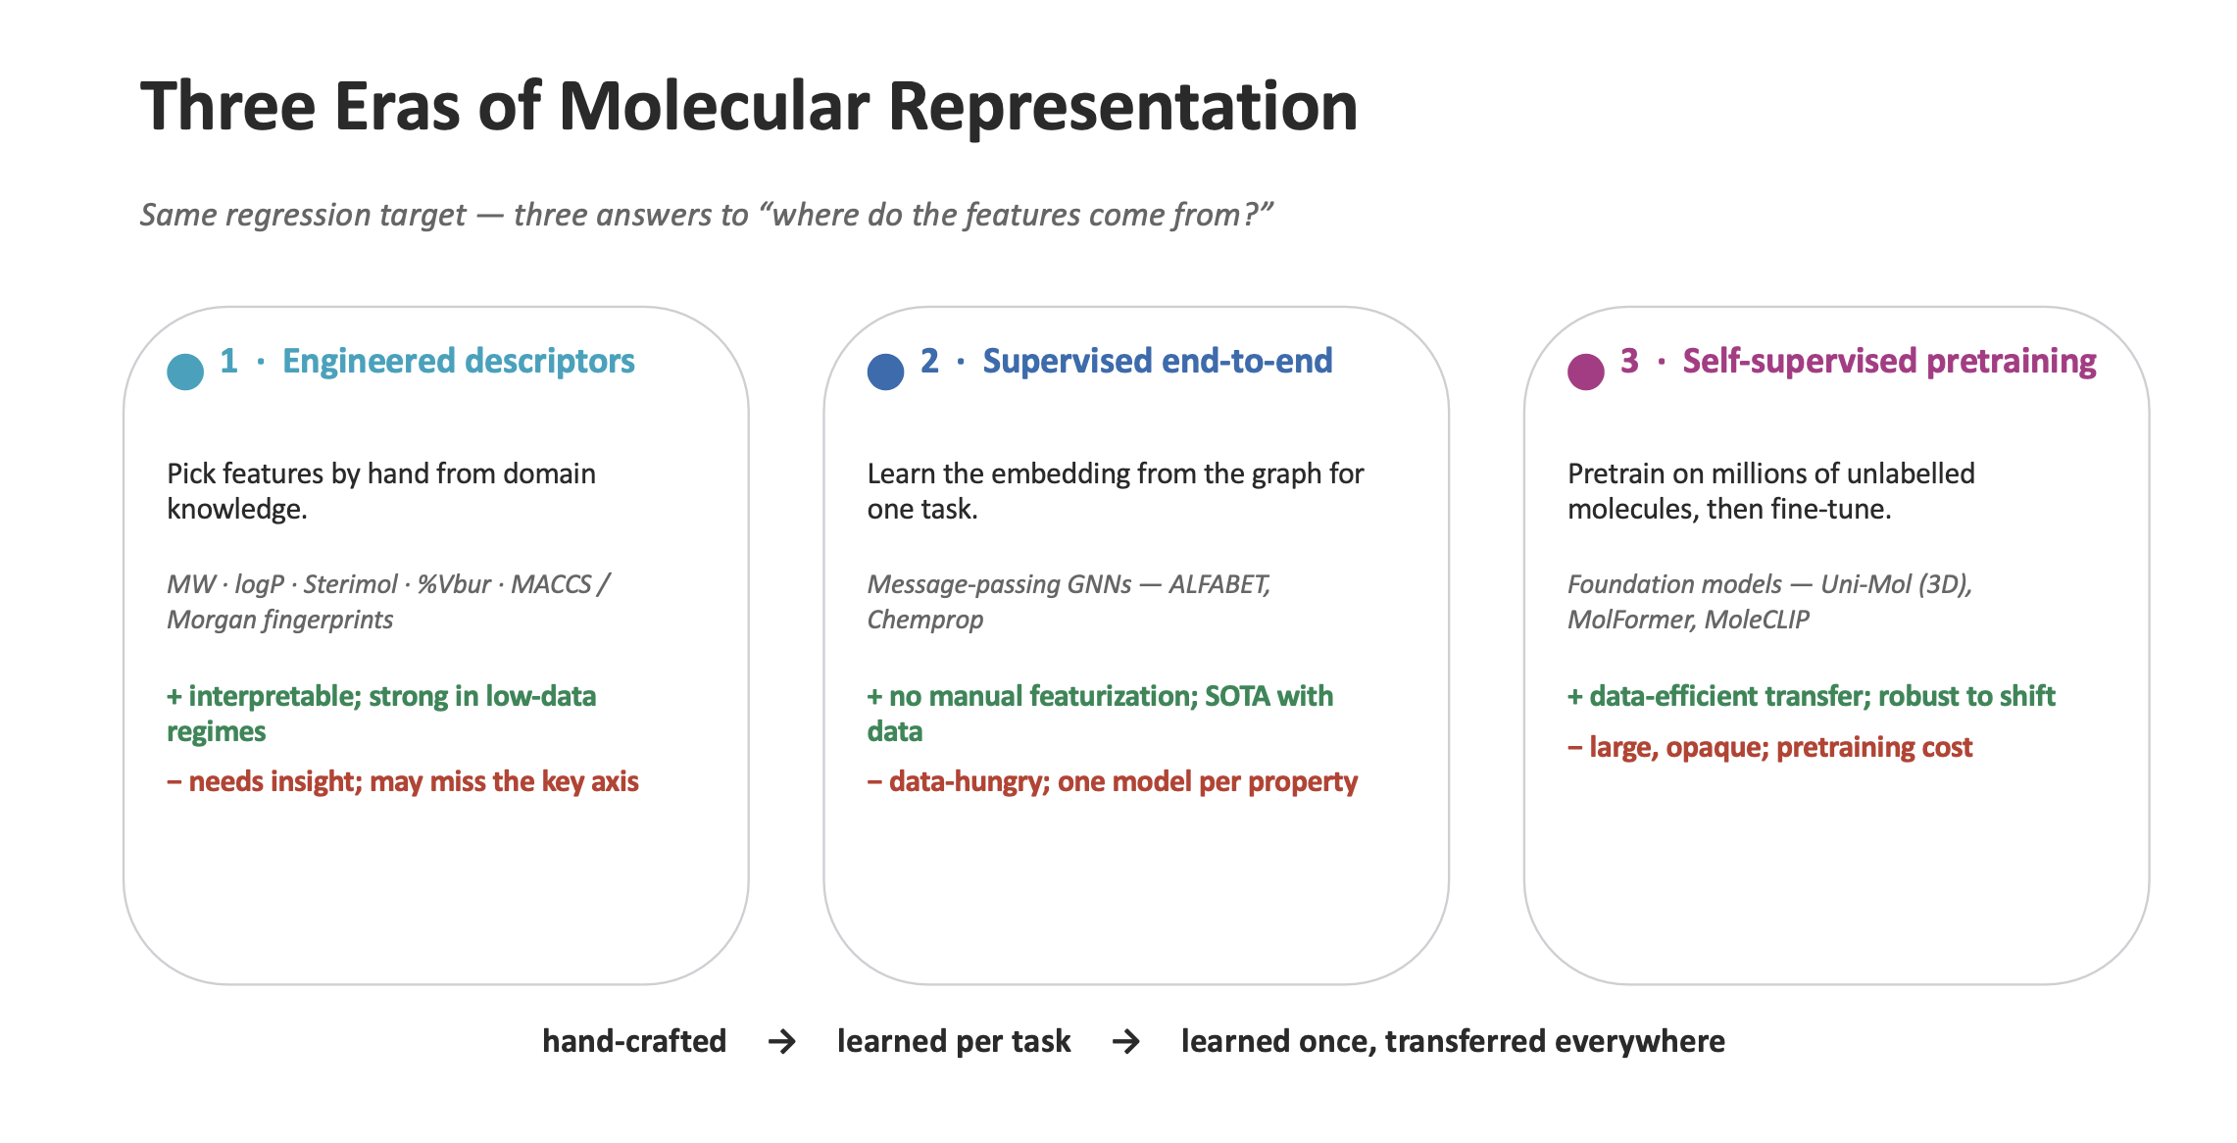
Molecular Representations: Outlook
https://github.com/camlcworkshop/camlcworkshop.github.io/blob/master/Sessions/Paton/Paton_2D_3D_Featurization.pdf
AI4ChemicalSciences BootCamp 2026

Slide 47
Plan
• Evolution of “data-driven” chemistry
• Overview of existing representations
• Importance of the choice of the representation
• Data preprocessing: practical considerations
• Data visualization
AI4ChemicalSciences BootCamp 2026

Slide 48
Expert-Crafter Descriptors: Precision/Generalizability Trade-off
Transition states
Graph
Generalizability
Cost
molecular descriptors
atomic descriptors
Data efficiency – expert bias
AI4ChemicalSciences BootCamp 2026

Slide 49
Plan
• Evolution of “data-driven” chemistry
• Overview of existing representations
• Importance of the choice of the representation
• Data preprocessing: practical considerations
• Data visualization
AI4ChemicalSciences BootCamp 2026

Slide 50
Multiple feature preprocessing
• Standardization
• Removing zero-variance features
• Removing correlated features
• Data visualization: understanding local and global data structure/potentially removing outliers
AI4ChemicalSciences BootCamp 2026

Slide 51
Plan
• Evolution of “data-driven” chemistry
• Overview of existing representations
• Importance of the choice of the representation
• Data preprocessing: practical considerations
• Data visualization
AI4ChemicalSciences BootCamp 2026

Slide 52
Principal Component Analysis (PCA)
Figure from: https://github.com/BingqingCheng/ML-in-chemistry-101/blob/master/slides/l5.pdf
AI4ChemicalSciences BootCamp 2026

Slide 53
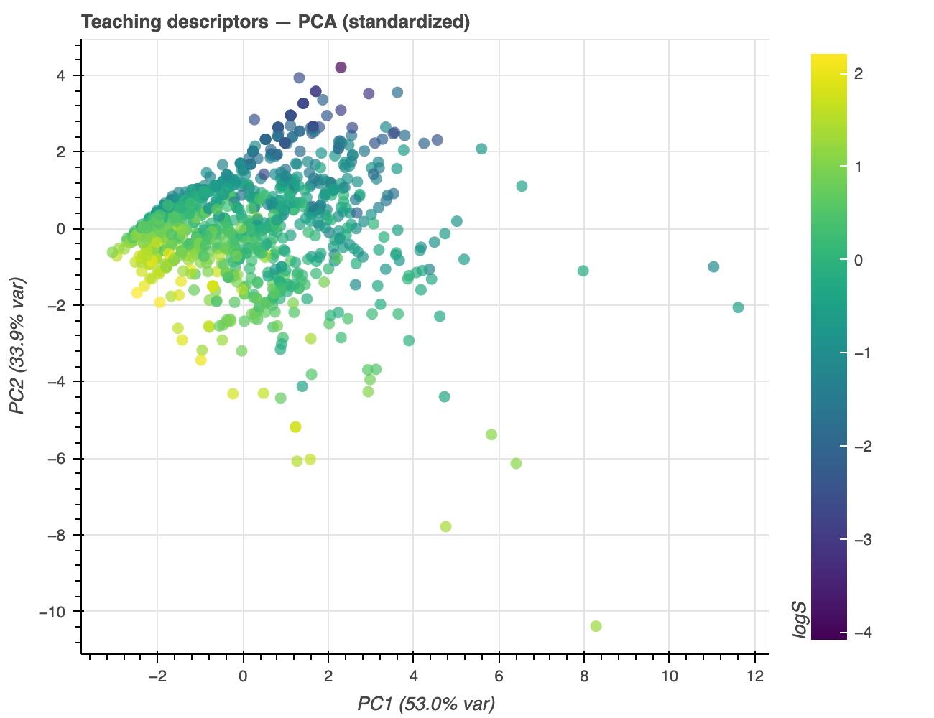
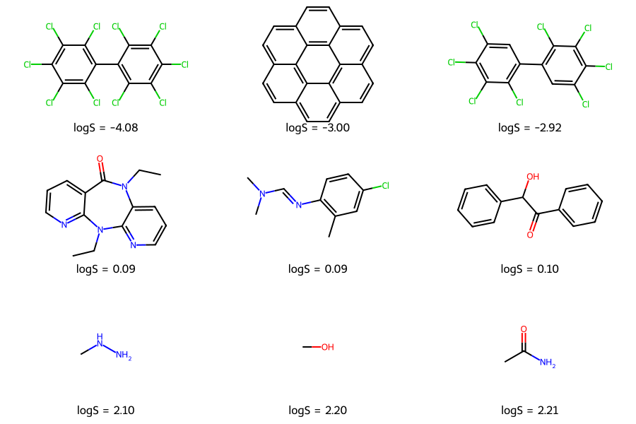
PCA: an example
Example molecules
PCA projection (PC1 and PC2)
Molecular descriptors used:
MolWt, TPSA, #HeavyAtoms, #Ring, MolLopP, #HDonors
Total variance explained = 86.9%
Delaney, J. S. J. Chem. Inf. Comput. Sci. 2004, 44 (3), 1000–1005.
AI4ChemicalSciences BootCamp 2026

Slide 54
PCA limitations
Figure from: https://github.com/BingqingCheng/ML-in-chemistry-101/blob/master/slides/l5.pdf
AI4ChemicalSciences BootCamp 2026

Slide 55
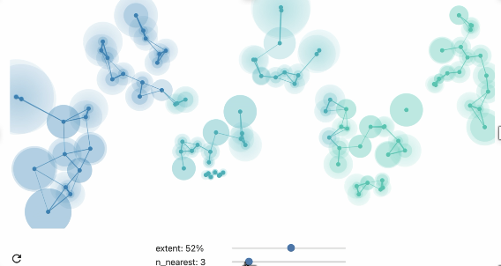
Beyond PCA for Dimensionality Reduction
https://pair-code.github.io/understanding-umap/
AI4ChemicalSciences BootCamp 2026

Slide 56
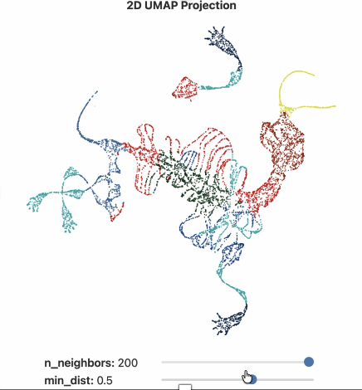
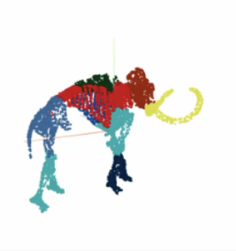
Beyond PCA for Dimensionality Reduction
Hyperparameters really matter.
Cluster sizes in a UMAP plot mean nothing.
Distances between clusters might not mean anything.
Random noise doesn’t always look random.
You may need more than one plot
Conclusion: Do not overinterpret!!!
How to preserve local and global structure while reducing dimension?
https://pair-code.github.io/understanding-umap/
AI4ChemicalSciences BootCamp 2026

Slide 57
Future Lectures
• Graphs Neural Networks
• Variational Auto-Encoders
• Transformers
Wigh, D. S.; Goodman, J. M.; Lapkin, A. A. WIREs Comput Mol Sci 2022, 12 (5).
AI4ChemicalSciences BootCamp 2026

Slide 58
Questions?
AI4ChemicalSciences BootCamp 2026

